Slide 1
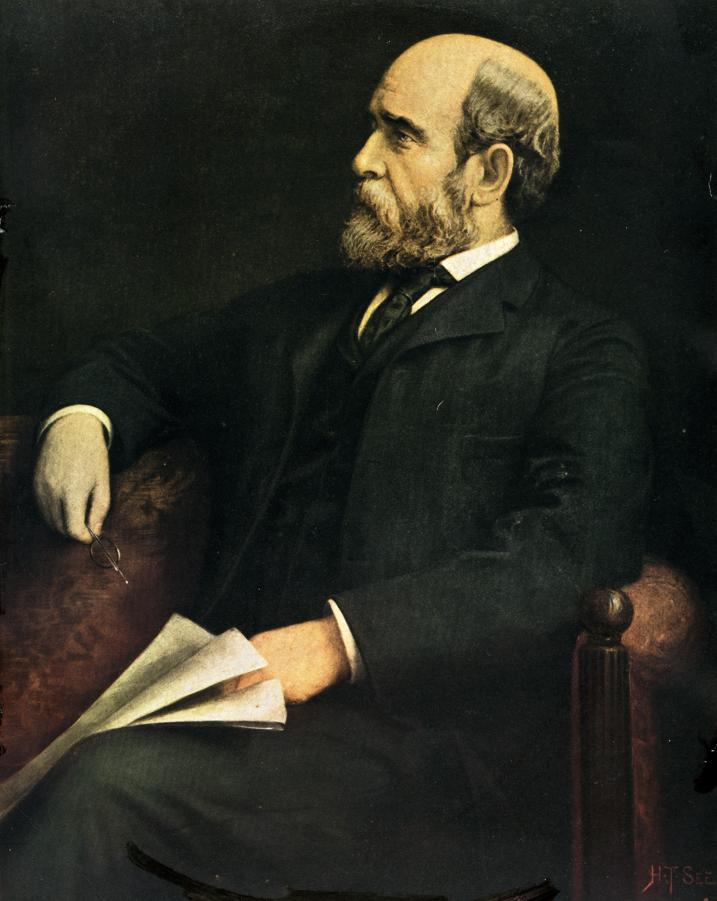
1

Slide 2
Lesson 3
The Effects of
Material Progress
upon the production & distribution of wealth

Slide 3
“The primary distribution of wealth is dual, not tripartite
Capital is but a form of labor . . . like skilled and unskilled”
Henry George
65

Slide 4
Rent:
the greater result that comes from superior land.
(natural opportunity)
Rent measures that which results from an advantage.

Slide 5
The Law of Rent
The rent of land is determined by the excess of its produce over that which the same application [of labor & capital] can secure from the least productive land in use.
David Ricardo 1809

Slide 6
The Law of Rent
The rent of land is determined by the excess of its produce over that which the same application [of labor & capital] can secure from the most productive land that is free.
Henry George 1879

Slide 7
The rent of land is determined by the excess of its produce over that which the same application [of labor & capital] can secure from the most productive land that is free.
Henry George 1879

Slide 8
The Potential Rent of land:
What could have been produced by virtue of superior land.

Slide 9
The Potential Rent of land:
What could have been produced by virtue of superior land.

Slide 10
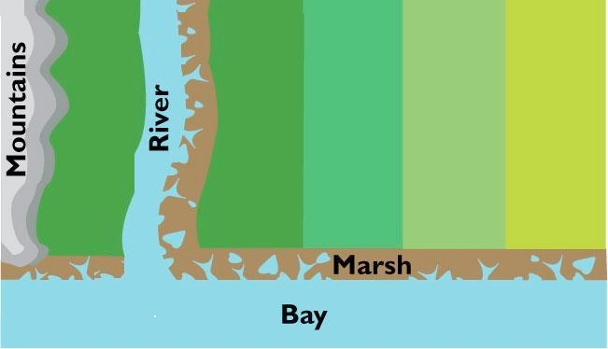
9
8
7
6
5
Average
Owned Land
Free Land
3rd
Settler
Settler
Free
Land
Settler
Settler
2nd
Settler
Settler
Free
Land
Settler
Settler
1st
Settler
Free
Land
Free
Land
Settler
Settler
Free
Land
Free
Land
Settler
Settler
Settler
67
67

Slide 11
Wealth Produced, minus what labor & capital get = Rent.
M
Owned Land
Free Land
Wealth Produced | 9 | 8 | 7 | 6 | 5 | 4 | 3 | 2
Wages & Int. | 6 | 6 | 6 | 6
Land Rent | 3 | 2 | 1 | 0
M
68

Slide 12
More people requires more land. Margin is pushed out.
M
Owned Land
Free Land
Wealth Produced | 9 | 8 | 7 | 6 | 5 | 4 | 3 | 2
M
69

Slide 13
Wages & Interest fall to 5
Owned Land
M
Free Land
Wealth Produced | 9 | 8 | 7 | 6 | 5 | 4 | 3 | 2
 | 6 | 6 | 6 | 6
Wages & Int. Interest | 5 | 5 | 5 | 5 | 5
M
70

Slide 14
Land Rent gains the difference.
Owned Land
M
Free Land
Wealth Produced | 9 | 8 | 7 | 6 | 5 | 4 | 3 | 2
 | 6 | 6 | 6 | 6
Wages & Int. &&Interest | 5 | 5 | 5 | 5 | 5
 | 3 | 2 | 1 | 0
Land Rent | 4 | 3 | 2 | 1 | 0
M
71

Slide 15
More people enables specialization & exchange.
Production doubles
M
Owned Land
Free Land
 | 9 | 8 | 7 | 6 | 5 | 4 | 3 | 2
Wealth Produced | 18 | 16 | 14 | 12 | 10 | 8 | 6 | 4
M
72

Slide 16
Productivity increases. Wages & Interest go up.
Owned Land
M
Free Land
 | 9 | 8 | 7 | 6 | 5 | 4 | 3 | 2
Wealth Produced | 18 | 16 | 14 | 12 | 10 | 8 | 6 | 4
 | 6 | 6 | 6 | 6
Wages & Int. Interest | 10 | 10 | 10 | 10 | 10
M
Wages & Interest = what can be produced on free land
73

Slide 17
Land Rent goes up as well.
Owned Land
M
Free Land
 | 9 | 8 | 7 | 6 | 5 | 4 | 3 | 2
Wealth Produced | 18 | 16 | 14 | 12 | 10 | 8 | 6 | 4
 | 6 | 6 | 6 | 6
Wages & Int. Interest | 10 | 10 | 10 | 10 | 10
 | 3 | 2 | 1 | 0
Land Rent | 8 | 6 | 4 | 2 | 0
M
74

Slide 18
18
16
14
12
10
Average
Owned Land
3rd
Settler
Settler
Settler
Settler
Settler
2nd
Settler
Settler
Settler
Settler
Settler
Free
Land
1st
Settler
Settler
Settler
Settler
4th
Settler
Settler
Settler
Settler
67

Slide 19
36
32
28
24
20
Avg.
Owned Land
Vet
Settler
Settler
Settler
Settler
Black
Smith
River
Settler
Settler
Settler
Settler
] Bridge [ Road
Free
Land
General
Store
Settler
Settler
Settler
Post
Office
Settler
Settler
Settler
75

Slide 20
Inventions & Infrastructure increase productivity.
M
Owned Land
Free Land
 | 18 | 16 | 14 | 12 | 10 | 8 | 6 | 4
Wealth Produced | 36 | 32 | 28 | 24 | 20 | 16 | 12 | 8
M
76
Engines, computers, Roads, Bridges, electric, police, etc.

Slide 21
Greater productivity demands more land.
M
Owned Land
Free Land
 | 18 | 16 | 14 | 12 | 10 | 8 | 6 | 4
Wealth Produced | 36 | 32 | 28 | 24 | 20 | 16 | 12 | 8
M
77
The margin extends to less potentially productive land.

Slide 22
Wages and Interest higher than before.
M
Owned Land
Free Land
 | 18 | 16 | 14 | 12 | 10 | 8 | 6 | 4
Wealth Produced | 36 | 32 | 28 | 24 | 20 | 16 | 12 | 8
 | 10 | 10 | 10 | 10 | 10
Wages & Int. | 16 | 16 | 16 | 16 | 16 | 16
M
78
Inferior land off set by greater productivity.

Slide 23
Land rent goes up disproportionately more.
M
Owned Land
Free Land
 | 18 | 16 | 14 | 12 | 10 | 8 | 6 | 4
Wealth Produced | 36 | 32 | 28 | 24 | 20 | 16 | 12 | 8
 | 10 | 10 | 10 | 10 | 10
Wages & Int. | 16 | 16 | 16 | 16 | 16 | 16
 | 8 | 6 | 4 | 2 | 0
Land Rent | 20 | 16 | 12 | 8 | 4 | 0
M
79
The advantage increases with material progress.

Slide 24
Wealth Produced, minus what labor & capital get = Rent.
M
Owned Land
Free Land
Wealth Produced | 9 | 8 | 7 | 6 | 5 | 4 | 3 | 2
Wages & Int. | 6 | 6 | 6 | 6
Land Rent | 3 | 2 | 1 | 0
M
68

Slide 25
Land Rent goes up as well.
Owned Land
M
Free Land
 | 9 | 8 | 7 | 6 | 5 | 4 | 3 | 2
Wealth Produced | 18 | 16 | 14 | 12 | 10 | 8 | 6 | 4
 | 6 | 6 | 6 | 6
Wages & Int. Interest | 10 | 10 | 10 | 10 | 10
 | 3 | 2 | 1 | 0
Land Rent | 8 | 6 | 4 | 2 | 0
M
74

Slide 26
Land rent goes up disproportionately more.
M
Owned Land
Free Land
 | 9 | 8 | 7 | 6 | 5 | 4 | 3 | 2
Wealth Produced | 18 | 16 | 14 | 12 | 10 | 8 | 6 | 4
 | 36 | 32 | 28 | 24 | 20 | 16 | 12 | 8
 | 6 | 6 | 6 | 6
Wages & Int. | 10 | 10 | 10 | 10 | 10
 | 16 | 16 | 16 | 16 | 16 | 16
 | 3 | 2 | 1 | 0
Land Rent | 8 | 6 | 4 | 2 | 0
 | 20 | 16 | 12 | 8 | 4 | 0
M
80
The advantage increases with material progress.

Slide 27
What actually creates the value of land?
Does the infrastructure enable a denser population?
Notes:
Public services like police & fire

Slide 28
What actually creates the value of land?
Do tall buildings enable a denser population?

Slide 29
Land rent goes up disproportionately more.
M
Owned Land
Free Land
 | 9 | 8 | 7 | 6 | 5 | 4 | 3 | 2
Wealth Produced | 18 | 16 | 14 | 12 | 10 | 8 | 6 | 4
 | 36 | 32 | 28 | 24 | 20 | 16 | 12 | 8
 | 6 | 6 | 6 | 6
Wages & Int. | 10 | 10 | 10 | 10 | 10
 | 16 | 16 | 16 | 16 | 16 | 16
 | 3 | 2 | 1 | 0
Land Rent | 8 | 6 | 4 | 2 | 0
 | 20 | 16 | 12 | 8 | 4 | 0
M
80
The advantage increases with material progress.

Slide 30
9
8
7
6
5
Average
Owned Land
Free Land
3rd
Settler
Free
Land
Settler
Settler
Settler
Free
Land
2nd
Settler
Settler
Settler
Settler
1st
Settler
Free
Land
Free
Land
Settler
Settler
Free
Land
Free
Land
Settler
Settler
Settler
67
67

Slide 31
Suppose 1 out of every 4 parcels were held for speculation
Settler
Settler
Settler
Settler
Settler
Spec.
Settler
Spec.
Settler
Settler
Settler
Spec.
Settler
Settler
Spec.
Settler
Settler
Spec.
Settler
Settler
85

Slide 32
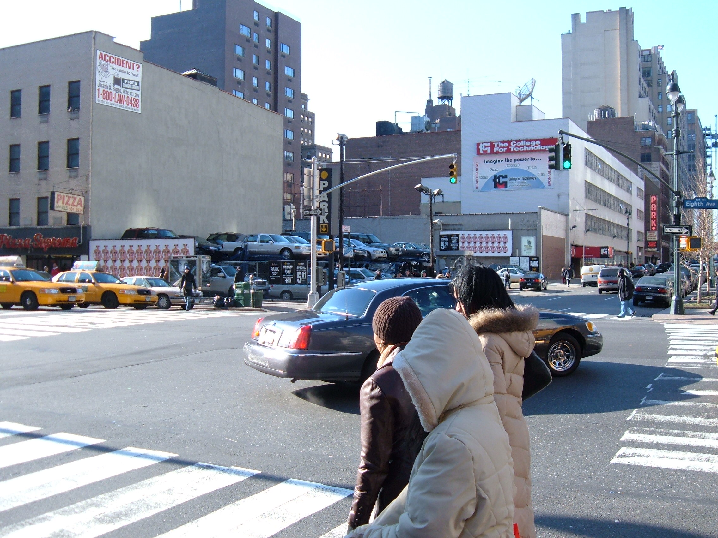
About ¼ acre
Sold $134 Million
New York City’s parking lots are really land speculation
86

Slide 33
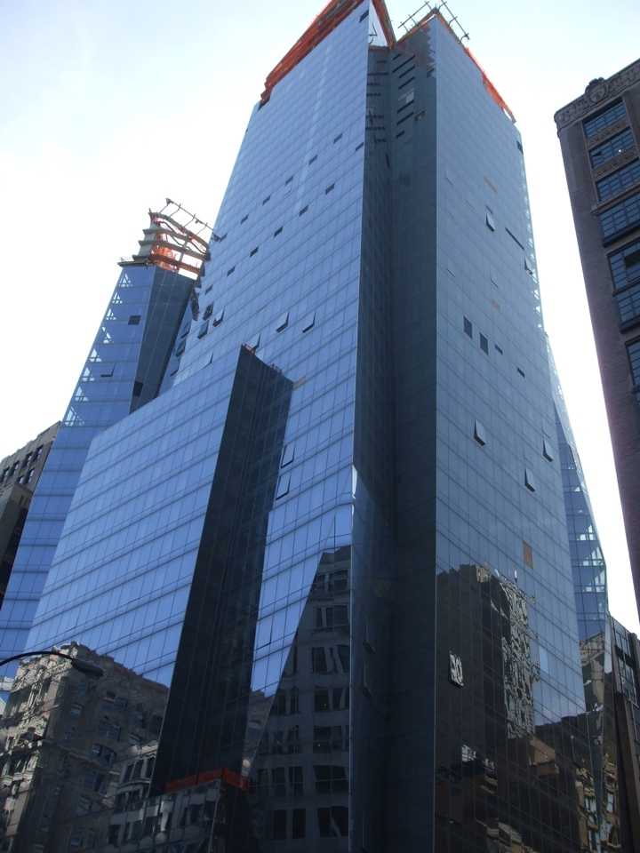
The land parked cars for over 50 years

Slide 34
The land parked cars for over 50 years

Slide 35
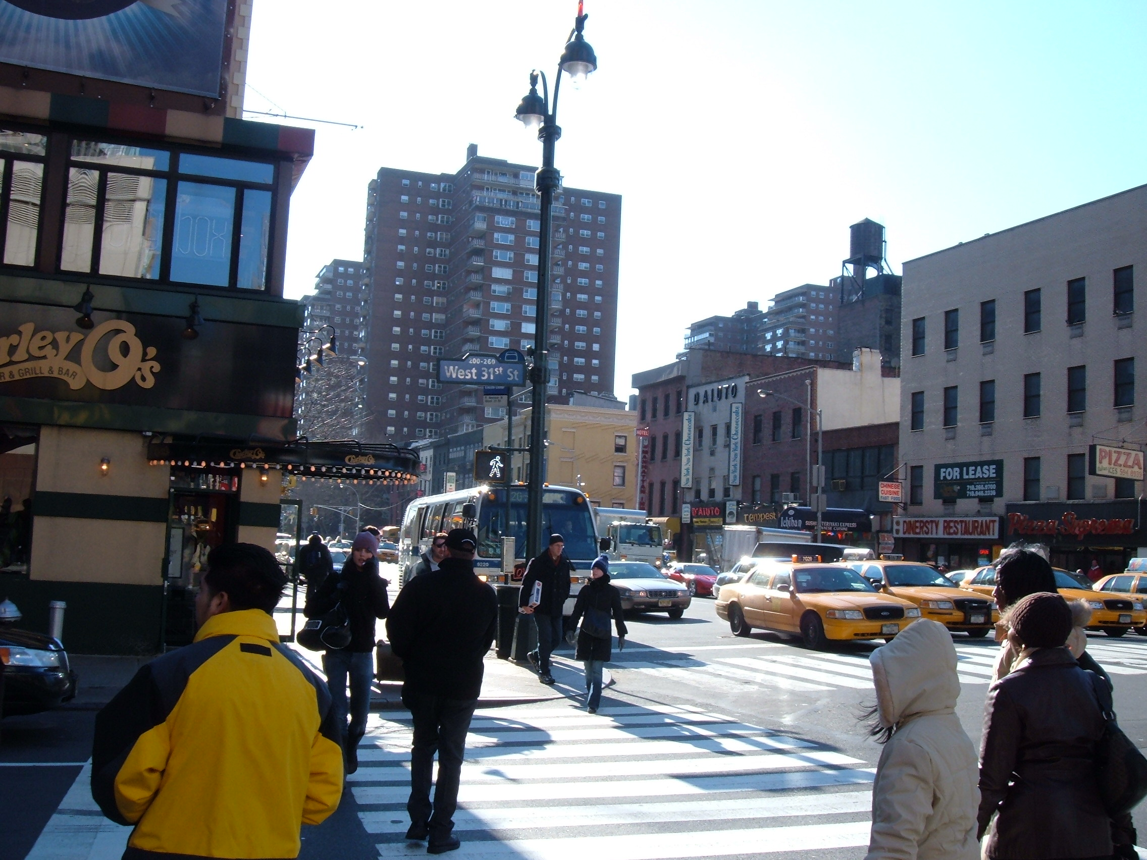
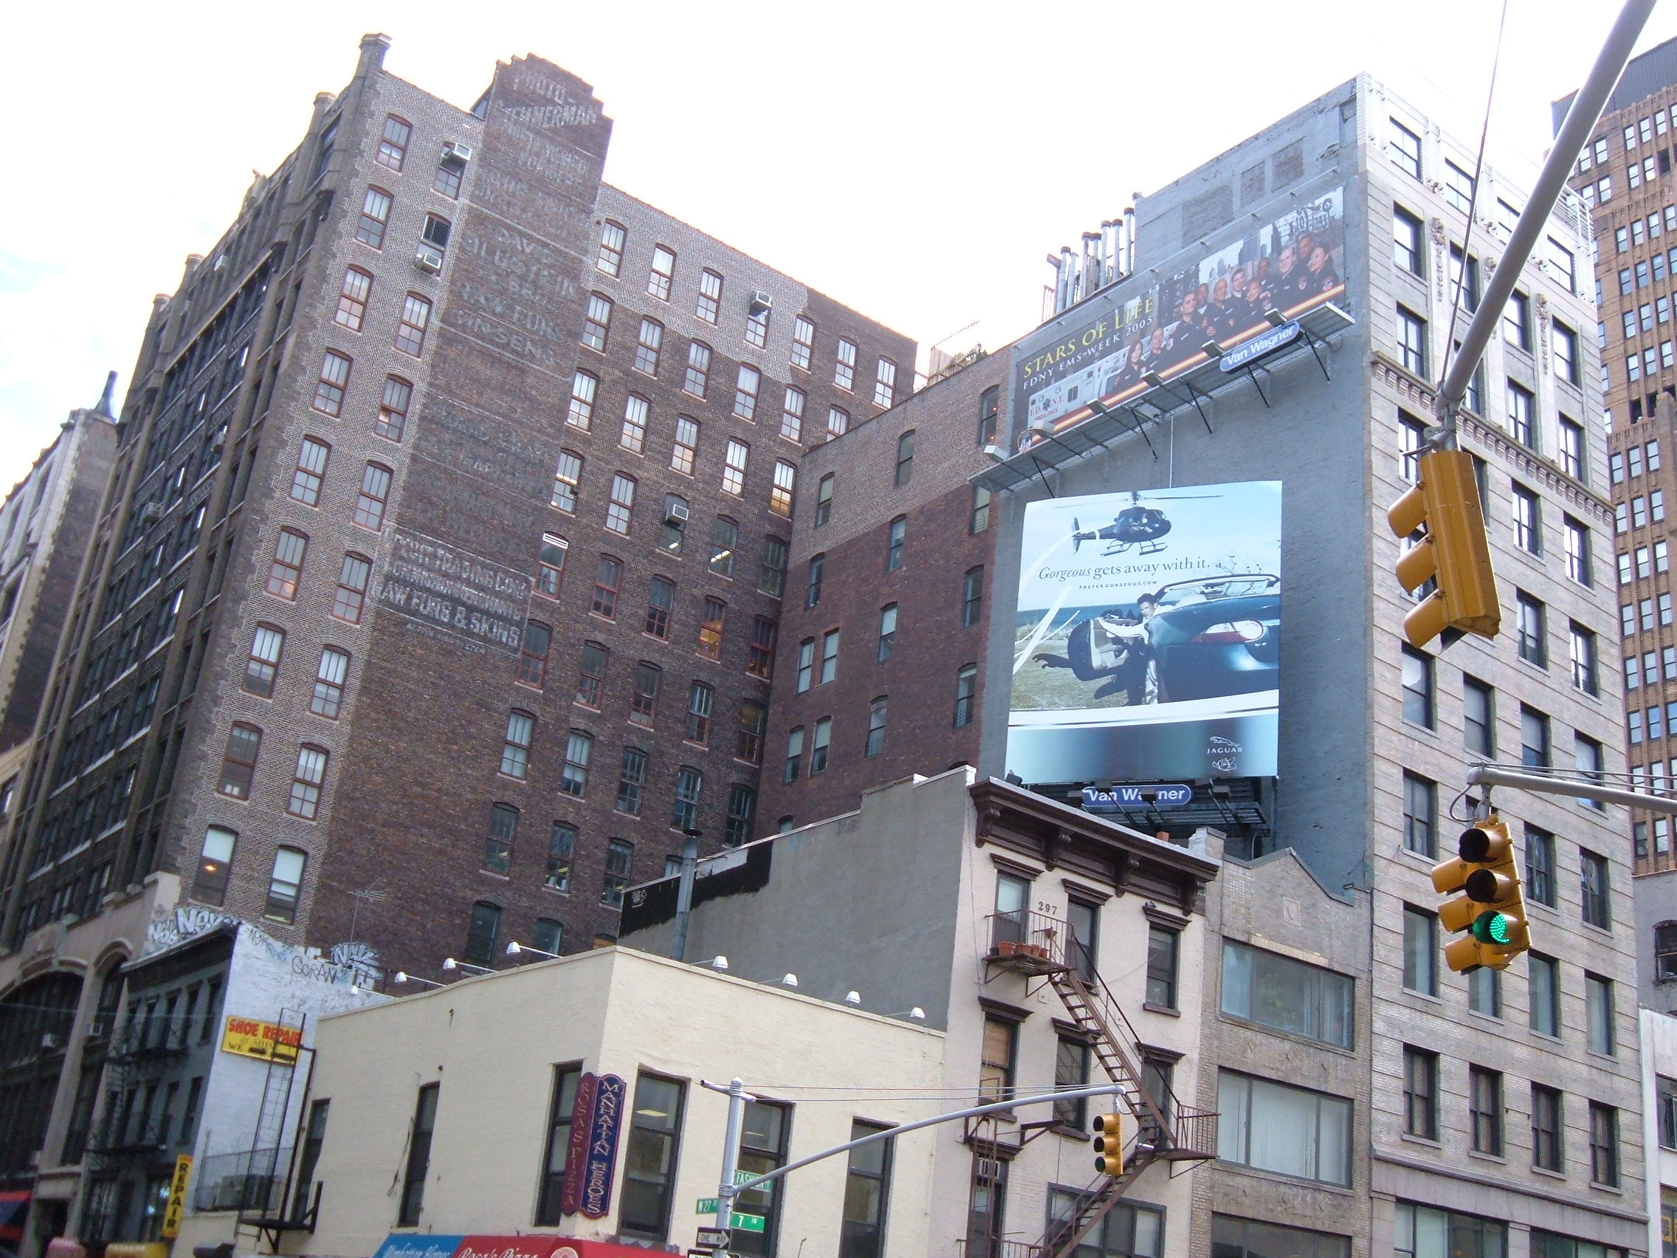
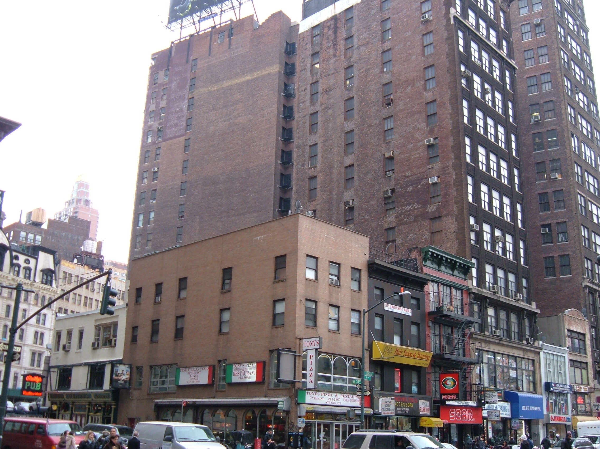
These 2 & 3 story buildings are really land speculation
87
These 2 & 3 story buildings are really land speculation

Slide 36
The margin is prematurely extended 2 grades.
M
Owned Land
Free
Land
Wealth Produced | 36 | 32 | 28 | 24 | 20 | 16 | 12 | 8
M
88
Just ¼ of each grade is withheld for speculation.

Slide 37
Wages & Interest fall with the margin.
M
Owned Land
Free
Land
Wealth Produced | 36 | 32 | 28 | 24 | 20 | 16 | 12 | 8
 | 16 | 16 | 16 | 16 | 16 | 16
Wages & Int. | 8 | 8 | 8 | 8 | 8 | 8 | 8 | 8
M
89
Land speculation off sets the gains of material progress.

Slide 38
As wages & Interest go down, rent goes up.
M
Owned Land
Free
Land
Wealth Produced | 36 | 32 | 28 | 24 | 20 | 16 | 12 | 8
 | 16 | 16 | 16 | 16 | 16 | 16
Wages & Int. | 8 | 8 | 8 | 8 | 8 | 8 | 8 | 8
 | 20 | 16 | 12 | 8 | 4 | 0
Land Rent | 28 | 24 | 20 | 16 | 12 | 8 | 4 | 0
M
90
Not shown: land speculation’s impediment to cooperation.

Slide 39
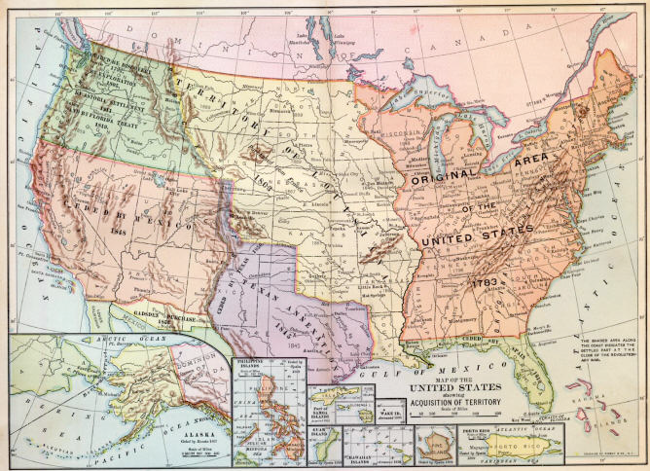
1853
North West
1846
Oregon
1848
California
Nevada
Arizona
New Mexico
Colorado
Utah
1803
Louisiana
828,000 S.M.
Thirteen
Colonies
270,000 S.M.
525,000 S.M.
1845
Annexation
1836
Independence
1821
1867
Alaska
Florida
Florida, Texas, Oregon, Washington, & Alaska Total 1 Million S.M. Add Hawaii and the other islands and you get a total of nearly 4 million Sq. Miles. 700,000 are arable and livable

Slide 40
1853
North West
1846
Oregon
1848
California
Nevada
Arizona
New Mexico
Colorado
Utah
1803
Louisiana
828,000 S.M.
Thirteen
Colonies
270,000 S.M.
525,000 S.M.
1845
Annexation
1836
Independence
1821
1867
Alaska
Florida
Florida, Texas, Oregon, Washington, & Alaska Total 1 Million S.M. Add Hawaii and the other islands and you get a total of nearly 4 million Sq. Miles. 700,000 are arable and livable

Slide 41
1853
North West
1846
Oregon
1848
California
Nevada
Arizona
New Mexico
Colorado
Utah
1803
Louisiana
828,000 S.M.
Thirteen
Colonies
270,000 S.M.
525,000 S.M.
1845
Annexation
1836
Independence
1821
1867
Alaska
Florida
Florida, Texas, Oregon, Washington, & Alaska Total 1 Million S.M. Add Hawaii and the other islands and you get a total of nearly 4 million Sq. Miles. 700,000 are arable and livable

Slide 42
1 out of every 4 parcels were held for speculation
N
O
F
r
e
e
L
a
n
d
Settler
Settler
Settler
Settler
Settler
Spec.
Settler
Spec.
Settler
Settler
Settler
Spec.
Settler
Settler
Spec.
Settler
Settler
Spec.
Settler
Settler
91

Slide 43
Without free land, what happens to wages & interest?
Wealth Produced | 36 | 32 | 28 | 24 | 20 | 16 | 12 | 8
NO
FREE
LAND
92
.

Slide 44
9
8
7
6
5
Average
Owned Land
Free Land
Settler
Settler
Settler
Settler
Settler
Settler
Sheep
Settler
Settler
Settler
Sheep
Settler
Settler
Settler
93

Slide 45
No Free Land
N
O
F
r
e
e
L
a
n
d
Settler
Settler
Settler
Settler
Settler
Spec.
Settler
Spec.
Settler
Settler
Settler
Spec.
Settler
Settler
Spec.
Settler
Settler
Spec.
Settler
Settler
94

Slide 46
This is the free market, without Minimum Wage laws, etc.
The chart represents all levels of skill & knowledge.
All Land is owned
Wealth Produced | 36 | 32 | 28 | 24 | 20 | 16 | 12 | 8
NO
FREE
LAND
Wages & Interest fall to an amount below which productivity would fall . If that were “3”
95
.

Slide 47
Land rent & other monopolies swallow progress
All Land is owned
NO
FREE
LAND
Wealth Produced | 36 | 32 | 28 | 24 | 20 | 16 | 12 | 8
Land Rent | 33 | 29 | 25 | 21 | 17 | 13 | 9 | 5
Wages & Interest fall to an amount below which productivity would fall . If that were “3”
96
.
Notes:
Put 100 people on an island and whether you make one the owner of the 100 or the island

Slide 48
More land held for speculation — more unemployment
N
O
F
r
e
e
L
a
n
d
Settler
Settler
Settler
Settler
Settler
Spec.
Settler
Spec.
Settler
Settler
Settler
Spec.
Settler
Settler
Spec.
Spec.
Settler
Spec.
Settler
Settler
97

Slide 49
As population increases and inventions replace workers, more land is needed.
N
O
F
r
e
e
L
a
n
d
Settler
Settler
Spec.
Settler
Spec.
Spec.
Settler
Spec.
Settler
Settler
Settler
Spec.
Settler
Settler
Spec.
Spec.
Settler
Spec.
Settler
Settler
98

Slide 50
Henry George

Slide 51
The Rate of Interest,
Capital investment,
job creation.

Slide 52
Land rent goes up disproportionately more.
M
Owned Land
Free Land
 | 9 | 8 | 7 | 6 | 5 | 4 | 3 | 2
Wealth Produced | 18 | 16 | 14 | 12 | 10 | 8 | 6 | 4
 | 36 | 32 | 28 | 24 | 20 | 16 | 12 | 8
 | 6 | 6 | 6 | 6
Wages & Int. | 10 | 10 | 10 | 10 | 10
 | 16 | 16 | 16 | 16 | 16 | 16
 | 3 | 2 | 1 | 0
Land Rent | 8 | 6 | 4 | 2 | 0
 | 20 | 16 | 12 | 8 | 4 | 0
M
80
The advantage increases with material progress.

Slide 53
Land rent goes up disproportionately more.
M
Owned Land
Free Land
 | 9 | 8 | 7 | 6 | 5 | 4 | 3 | 2
Wealth Produced | 18 | 16 | 14 | 12 | 10 | 8 | 6 | 4
 | 36 | 32 | 28 | 24 | 20 | 16 | 12 | 8
 | 6 | 6 | 6 | 6
Wages & Int. | 10 | 10 | 10 | 10 | 10
 | 16 | 16 | 16 | 16 | 16 | 16
 | 3 | 2 | 1 | 0
Land Rent | 8 | 6 | 4 | 2 | 0
 | 20 | 16 | 12 | 8 | 4 | 0
M
80
The advantage increases with material progress.

Slide 54
Land rent goes up disproportionately more.
M
Owned Land
Free Land
 | 9 | 8 | 7 | 6 | 5 | 4 | 3 | 2
Wealth Produced | 18 | 16 | 14 | 12 | 10 | 8 | 6 | 4
 | 36 | 32 | 28 | 24 | 20 | 16 | 12 | 8
 | 6 | 6 | 6 | 6
Wages & Int. | 10 | 10 | 10 | 10 | 10
 | 16 | 16 | 16 | 16 | 16 | 16
 | 3 | 2 | 1 | 0
Land Rent | 8 | 6 | 4 | 2 | 0
 | 20 | 16 | 12 | 8 | 4 | 0
M
80
The advantage increases with material progress.

Slide 55
Land rent goes up disproportionately more.
M
Owned Land
Free Land
 | 9 | 8 | 7 | 6 | 5 | 4 | 3 | 2
Wealth Produced | 18 | 16 | 14 | 12 | 10 | 8 | 6 | 4
 | 36 | 32 | 28 | 24 | 20 | 16 | 12 | 8
 | 6 | 6 | 6 | 6
Wages & Int. | 10 | 10 | 10 | 10 | 10
 | 16 | 16 | 16 | 16 | 16 | 16
 | 3 | 2 | 1 | 0
Land Rent | 8 | 6 | 4 | 2 | 0
 | 20 | 16 | 12 | 8 | 4 | 0
M
80
The advantage increases with material progress.

Slide 56
Land rent & other monopolies swallow progress
All Land is owned
NO
FREE
LAND
Wealth Produced | 36 | 32 | 28 | 24 | 20 | 16 | 12 | 8
Land Rent | 33 | 29 | 25 | 21 | 17 | 13 | 9 | 5
Wages & Interest fall to an amount below which productivity would fall . If that were “3”
96
.

Slide 57
Land rent & other monopolies swallow progress
All Land is owned
NO
FREE
LAND
Wealth Produced | 36 | 32 | 28 | 24 | 20 | 16 | 12 | 8
Land Rent | 33 | 29 | 25 | 21 | 17 | 13 | 9 | 5
Wages & Interest fall to an amount below which productivity would fall . If that were “3”
96
.

Slide 58
Land rent & other monopolies swallow progress
All Land is owned
NO
FREE
LAND
Wealth Produced | 36 | 32 | 28 | 24 | 20 | 16 | 12 | 8
Land Rent | 33 | 29 | 25 | 21 | 17 | 13 | 9 | 5
Wages & Interest fall to an amount below which productivity would fall . If that were “3”
96
.

Slide 59
Production
— Wages
— Interest
Land Rent

Slide 60
Production
— Wages
— Interest
Land Rent

Slide 61
Production
— Wages
— Interest
Land Rent

Slide 62
Production
— Wages
— Interest
Land Rent

Slide 63
2008
Building & machines | $100
x Interest 7% | $7
— Inflation 3.8% | $3.80
Real rate of Int. | $3.20

Slide 64
2008
Building & machines | $100
x Interest 7% | $7
— Inflation 3.8% | $3.80
Real rate of Int. | $3.20

Slide 65
2008
Building & machines | $100
x Interest 7% | $7
— Inflation 3.8% | $3.80
Real rate of Int. | $3.20

Slide 66
2009
Building & machines | $100
x Interest 3.25% | $3.25
+ Deflation .04% | $0.04
Real rate of Int. | $3.29

Slide 67
2013
Building & machines | $100
x Interest 3.25% | $3.25
— Inflation 1.5% | $1.50
Real rate of Int. | $1.75

Slide 68
2013
Building & machines | $100
x Interest 3.25% | $3.25
— Inflation 1.5% | $1.50
Real rate of Int. | $1.75

Slide 69
2013
Building & machines | $100
x Interest 3.25% | $3.25
— Inflation 1.5% | $1.50
Real rate of Int. | $1.75

Slide 70
2013
Building & machines | $100
x Interest 3.25% | $3.25
— Inflation 1.5% | $1.50
Real rate of Int. | $1.75

Slide 71
Population
& Subsistence

Slide 72
World population - over 7 billion.
101

Slide 73
World population - over 7 billion. U.N. estimates the world could feed 33 billion people
102

Slide 74
World population - over 7 billion.
U.N. estimates the world could feed 33 billion people with modern farming methods.
103

Slide 75
World population - over 7 billion.
U.N. estimates the world could feed 33 billion people with modern farming methods.
U.N. estimates world population at 10 billion by middle of century.
104

Slide 76
The U.S. would still be less dense than France is today
105

Slide 77
842 million people are hungry.
Many more in poverty.
Is it because of over population?
106

Slide 78
If too many people caused hunger,
108

Slide 79
If too many people caused hunger, most hunger would be in densely populated countries
109

Slide 80
If too many people caused hunger, most hunger would be in densely populated countries
(People per acre of arable land)
110

Slide 81
Africa
has 14% of world’s population,
and 12% of its arable land,
Yet,
Africa has the most hunger and poverty
107

Slide 82
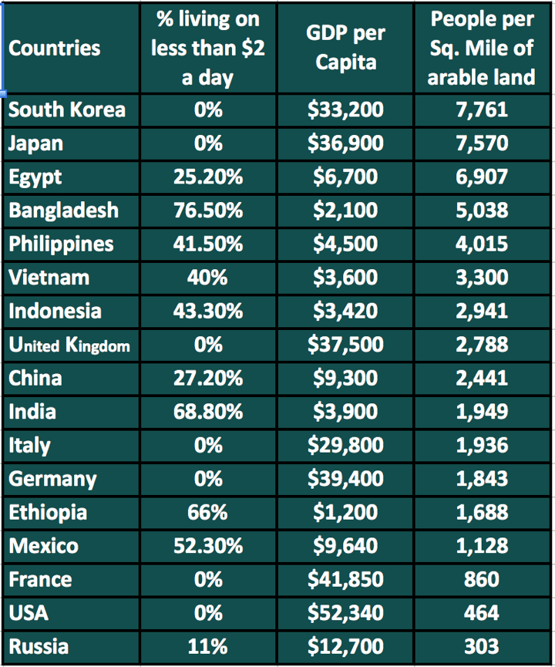
World population as of 2013
Sources: World Fact Book 2013, The World Bank

Slide 83
No correlation between density of population & the level of poverty
113

Slide 84
In impoverished countries, have the natural resources been largely exhausted?
113

Slide 85
In impoverished countries, does all the wealth go to the people who produce it?
113

Slide 86
Where do we find the greatest evidences of wealth --- in densely or sparsely populated communities?
113

Slide 87
The End

Slide 89
Out Takes

Slide 90
The
Problem
of Poverty

Slide 91
Capital, Wages, and employment

Slide 92
Capital, Wages, and employment

Slide 93
Capital, Wages, and employment

Slide 94
Capital, Wages, and employment

Slide 95
Capital, Wages, and employment

Slide 97
Low wages & unemployment are some-times attributed to the lack of capital
Does labor precede the payment of wages?
Does the employer get the results of labor before wages are paid?
Therefore, do wages come from the product of labor?

Slide 98
10,000 S.F.
Land

Slide 99
10,000 S.F.
10,000 S.F.
Land

Slide 100
10,000 S.F.
10,000 S.F.
10,000 S.F.
Land

Slide 101
10,000 S.F.
10,000 S.F.
10,000 S.F.
Land

Slide 102
We live on current production

Slide 103
Does the lack of capital explain the poverty in poor countries?

Slide 104
Could the lack of capital explain the poverty in rich countries

Slide 105
The End

Slide 106
The Wage Fund Theory
Wages 5 per day Int. 24%
Wages 2 per day Int 10%

Slide 107
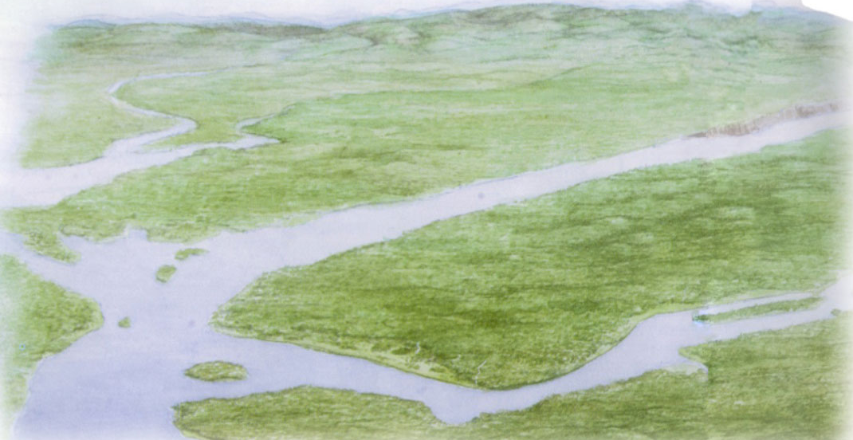
120

Slide 108
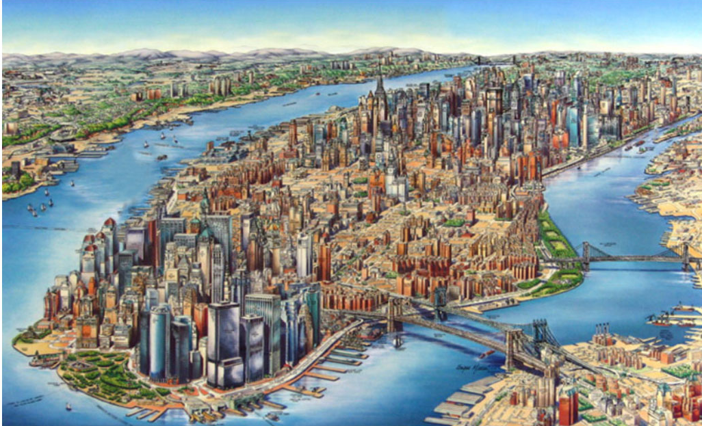
121

