Slide 1
OCCUPYING THE NEED ACT
BY NICK EGNATZ

Slide 2
I
Who creates and benefits from our money?

Slide 3
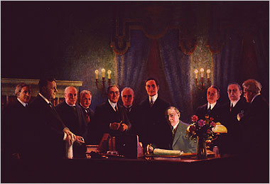
Who creates and benefits from our money?
“In 1913, the Federal Reserve Act ceded the power to create the nation’s
money supply to the private Federal Reserve System and its
private member banks.”
President Wilson signing
the Federal Reserve Act in 1913.

Slide 4
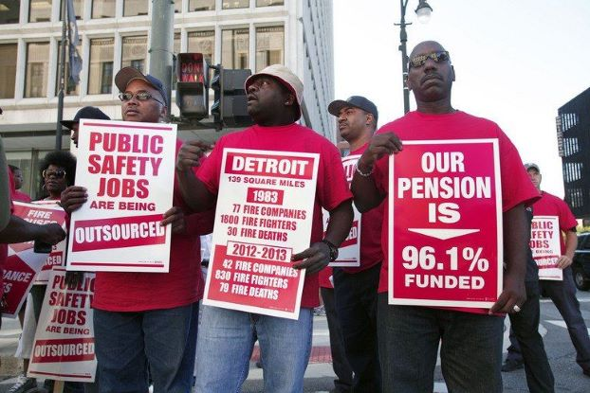
Who creates and benefits from our money?
“Arrayed against this plenary power of private banks to create our money supply are you, I, your friends, families, neighbors, mine and everyone else who either works for a living or has a need to do so – the working class.”
Misled by economists, educators, and media,
citizens cannot identify the private money system
as the core generator of inequality and poverty.

Slide 5
2
NATURE OF MONEY

Slide 6
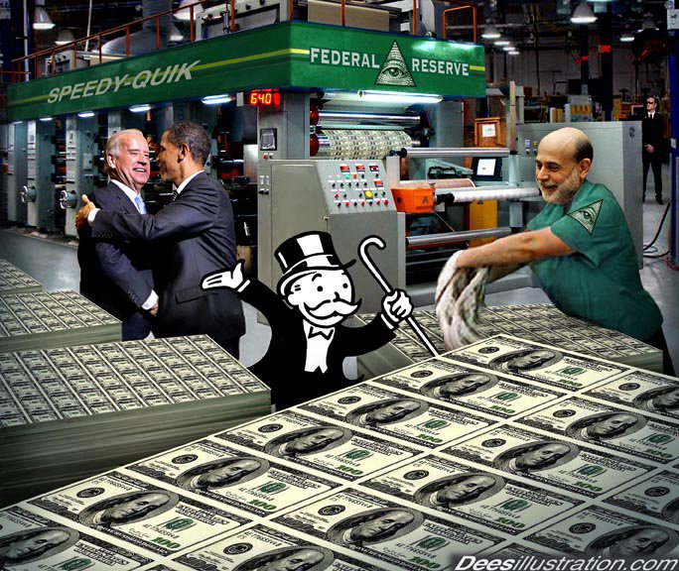
NATURE OF MONEY
“The confusion the banking class has spread throughout our country’s
history has been successful in keeping the people and our elected
representatives ignorant of the nature of money.”
Citizens believe money is created by government
and conceive money as cash (coins and currency).
BUT this is not the way the world works.
Our money is bank credit found in our checking accounts –
created out of thin air by private banks’ making loans –
all with interest to them!

Slide 7
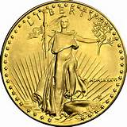
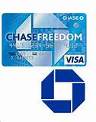
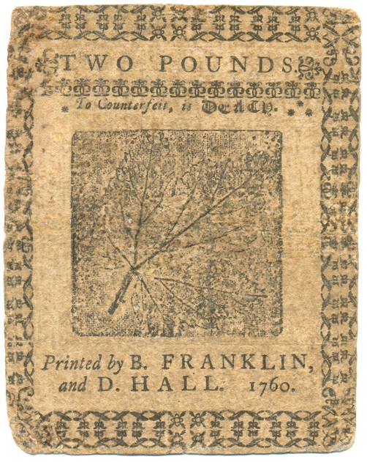
NATURE OF MONEY
There are basically three types of money:
1. Money as a commodity GOLD, SILVER
2. Private money: debt money
created by banks BANK CREDIT
3. Public money: debt-free money
created by government in law U.S. MONEY
PENNSYLVANIA
COLONY’S
PUBLIC MONEY –
“BILL OF CREDIT”
PRIVATE BANK
CREDIT CARD
GOLD U.S. COIN

Slide 8
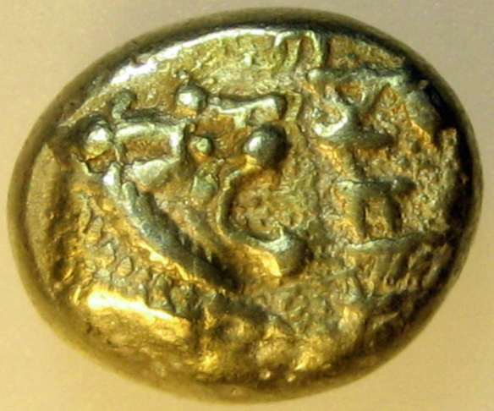
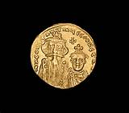
NATURE OF MONEY
Money as a commodity: Gold and silver coins and paper money backed by 100% gold and silver reserves in the vault.
FIRST GREEK COIN, 650-620 BCE
GOLD U.S. COIN, 1934
BYZANTINE GOLD COIN, 1100

Slide 9
NATURE OF MONEY
2. Debt money created by banks:
This is the system we have now and is the cause of our present problems.
Bills and coins make up only about 2½ % of our total money supply.
The rest of our money supply is conjured up out of thin air by private banks
when they make loans, with a private tax (interest) added on top.
PRIVATE BANK
CREDIT CARD

Slide 10

NATURE OF MONEY
3. Public money by law:
Aristotle defined money as an abstract legal creation of the state…
money is an instrument of the law for the benefit of all…
always public, never private.
PENNSYLVANIA
COLONY’S
PUBLIC MONEY –
“BILL OF CREDIT”

Slide 11
3
PUBLIC MONEY BY LAW

Slide 12
3A
ROME AND SPARTA: MONEY BY LAW

Slide 13
NATURE OF MONEY: MONEY BY LAW IN SPARTA
Usury on coined metal money had made Sparta a land ruled by a few wealthy people.
LYCURGUS’ REFORM
  Removed gold coins
  Money was iron disks
  treated to be valueless
  Fiat money: state law regulated
  volume and thus value
  Lasted for 3 ½ centuries!
GREEK MONEY REFORMS
Sparta, Greece
Lycurgus
700 BC
FIRST LEGAL FIAT MONEY

Slide 14
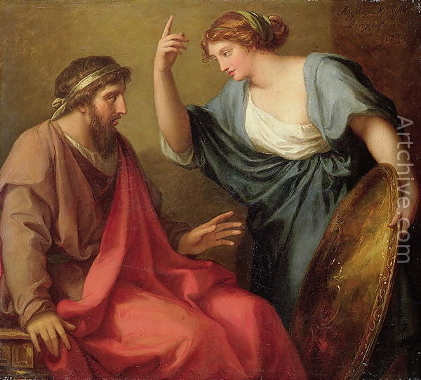
KING NUMA’S (reigned 715–673 BC)
Monetary Decision!
Monetize Bronze – NOT Gold or Silver
NATURE OF MONEY: MONEY BY LAW IN ROME

Slide 15
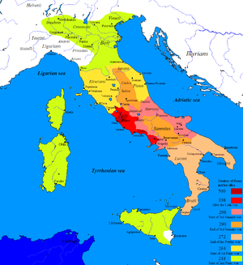
NATURE OF MONEY: MONEY BY LAW IN ROME
The Roman Republic (begun 509 BC) banned gold or silver money
for use at Rome. The money was bronze money by law,
which spread to the other parts of the peninsula under Roman rule.

Slide 16
3B
U.S. HISTORY: MONEY BY LAW

Slide 17
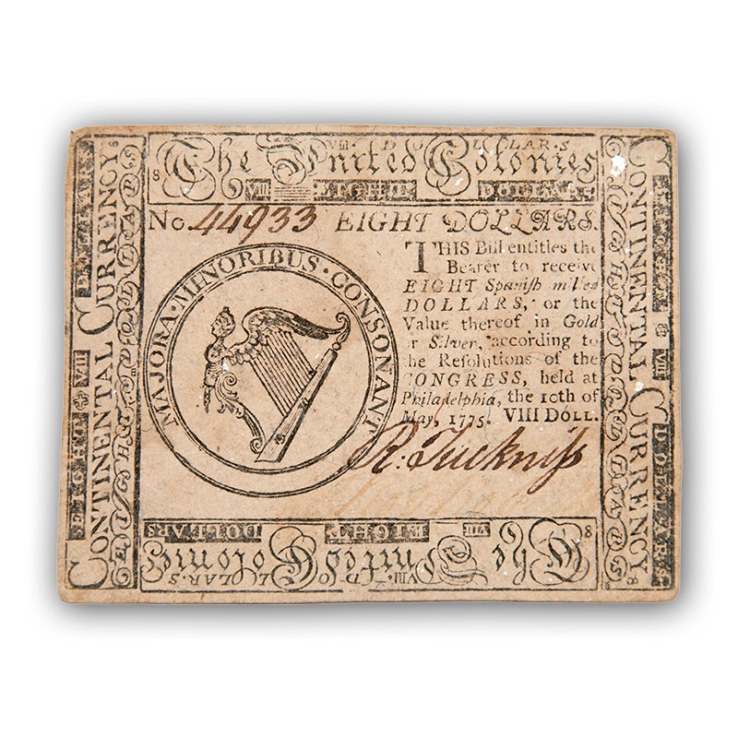
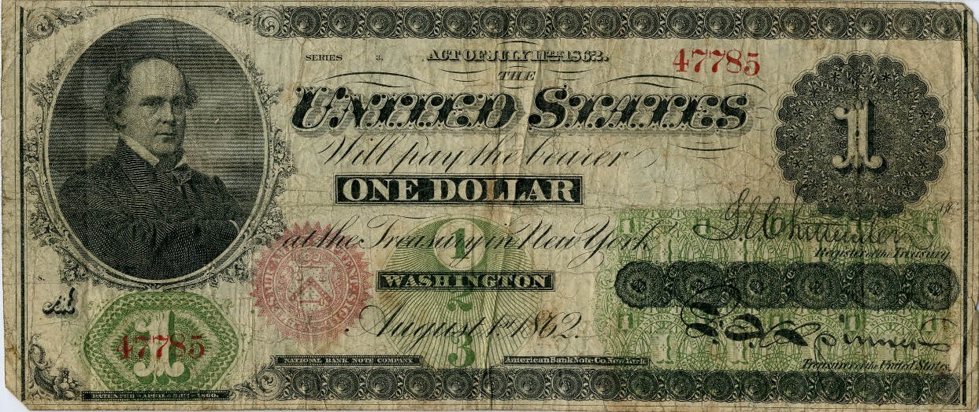
NATURE OF MONEY: MONEY BY LAW IN U.S. HISTORY
U.S. GREENBACK CURRENCY,
issued by Civil War Congress
in Washington, D.C.
PENNSYLVANIA COLONY’S
PUBLIC MONEY –
“BILL OF CREDIT (SCRIPT)”
REVOLUTIONARY WAR
U.S. CONTINENTAL,
Issued by Continental Congress

Slide 18
4
PRIVATE U.S. BANKING MONEY

Slide 19
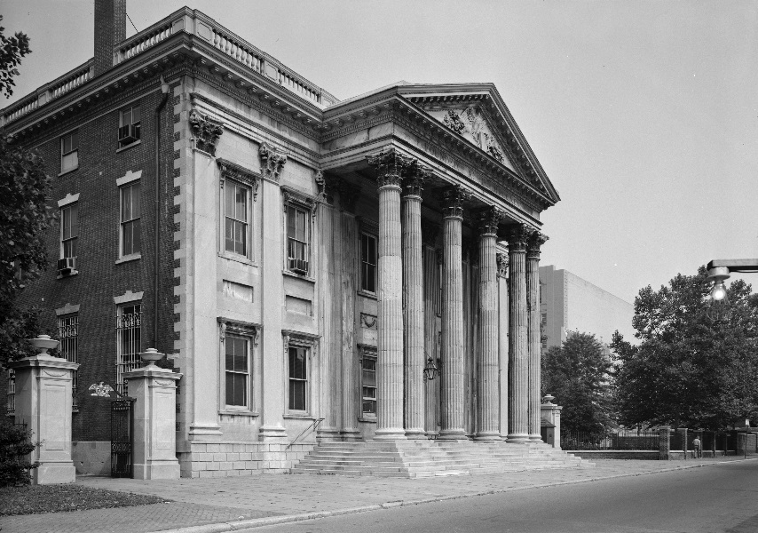
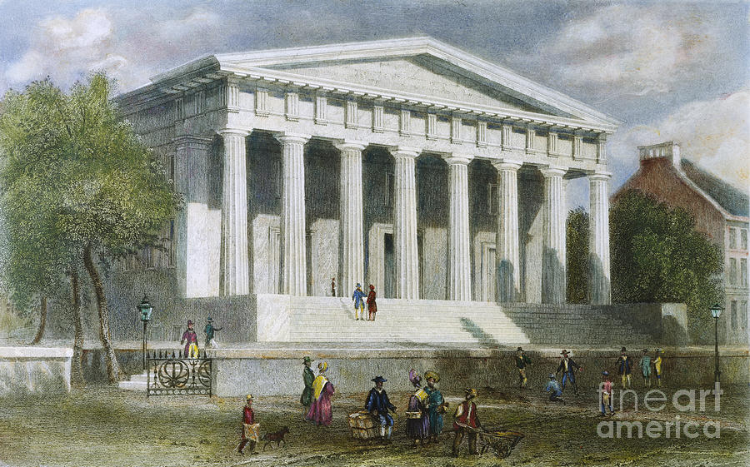
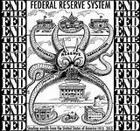
NATURE OF MONEY: PRIVATE U.S. BANKING MONEY
There have been 3 fights against private banking systems
issuing the nation’s money.
FIRST BANK OF U.S.
1791-1811
SECOND BANK OF U.S.
1816-1836
FEDERAL RESERVE SYSTEM
1913 to current

Slide 20
NATURE OF MONEY: PRIVATE U.S. BANKING MONEY
“The justification for giving the money power to these private banking systems was always
that they were issuing money as a commodity backed by gold and silver in their vaults.
But the reality was that these private banks … have always created our money supply out
of thin air by issuing debt money created by banks.”
FIRST BANK OF U.S.
1791-1811
SECOND BANK OF U.S.
1816-1836
FEDERAL RESERVE SYSTEM
1913 to current

Slide 21
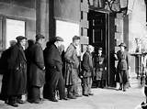
NATURE OF MONEY: PRIVATE U.S. BANKING MONEY
WHAT HAS “DEBT MONEY CREATED BY BANKS” GIVEN US?
Panic of 1785–1788
Panic of 1792
Panic of 1819–1822
Panic of 1837–1843
Panic of 1857–1861
Great Depression or Panic of 1873–1878
Panic of 1893–1897
Panic of 1907
Great Depression 1929–1941
Recession of the mid 1970s
Depression 2008-?

Slide 22

NATURE OF MONEY: PRIVATE U.S. BANKING MONEY
WHAT HAS “DEBT MONEY CREATED BY BANKS” GIVEN US?
INCREASING INEQUALITY
OCCUPY BRINGS INEQUALITY TO MAINSTREAM
THE CURRENT SYSTEM IS THE PROBLEM –
DEBT MONEY CREATED BY BANKS

Slide 23
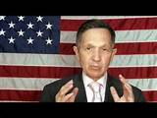
THE SOLUTION: PUBLIC U.S. MONEY
AMERICA NEEDS THE NEED ACT
GOVERNMENT BUYS SHARES OF FEDERAL RESERVE BANKS &
MAKES THEM PART OF TREASURY DEPARTMENT
ACCOUNTING RULE CHANGE PROHIBIT PRIVATE BANKS
FROM CREATING MONEY OUT OF THIN AIR
CONGRESS ORIGINATES (CREATES) NEW MONEY FOR REPAIRING
INFRASTRUCTURE, EDUCATION, HEALTH CARE, CITIZEN’S DIVIDENT,
GRANTS TO STATES, LOW-INTEREST LOANS TO MUNICIPALTIES, ETC.

