Slide 1
HERMAN DALY
ECOLOGICAL ECONOMIST
NATIONALIZE MONEY, NOT BANKS

Slide 2
1

Slide 3
1 THE PRIMARY PROBLEM
OF OUR SOCIETY

Slide 4


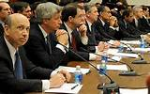

NATIONALIZE MONEY, NOT BANKS
Why should the public pay interest to the private banking sector
to provide a medium of exchange that the government can provide at little or no cost?

Slide 5
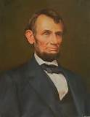

NATIONALIZE MONEY, NOT BANKS
Why should the profit on creating money go to the private sector rather than entirely to the government (the commonwealth)?

Slide 6
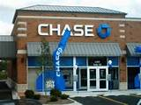

NATIONALIZE MONEY, NOT BANKS
CHANGE THE LAW FROM:
TO:
LOAN AND CREATE MONEY
LOAN EXISTING DEPOSITS ONLY
A DOLLAR LOANED WOULD BE A DOLLAR SAVED PREVIOUSLY BY A DEPOSITOR.

Slide 7
NATIONALIZE MONEY, NOT BANKS
LOAN EXISTING DEPOSITS ONLY
A DOLLAR LOANED WOULD BE A DOLLAR SAVED PREVIOUSLY BY A DEPOSITOR.
CREDIT LIMITED BY SAVING MEANS LESS LENDING AND BORROWING
AND DONE MORE CAREFULLY.

Slide 8
2

Slide 9
2 SOLUTION

Slide 10
NATIONALIZE MONEY, NOT BANKS
OUR GOVERNMENT ISSUES NON-INTEREST-BEARING FIAT MONEY,
TARGETING A STABLE PRICE LEVEL
WITH THE MANAGING OF THE MONEY SUPPLY.

Slide 11
3

Slide 12
3
HOW THIS REFORM
WILL SAVE
THE ENVIRONMENT

Slide 13
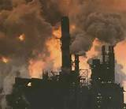
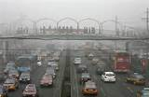
NATIONALIZE MONEY, NOT BANKS
THE ENVIRONMENT HAS BEEN DEGRADED
BY ECONOMIC GROWTH.

Slide 14

NATIONALIZE MONEY, NOT BANKS
THE NEW MONETARY SYSTEM WILL CONSTRAIN GROWTH
AND SERVE A STEADY-STATE ECONOMY.

Slide 15


#1
Restricting borrowing for new investment to existing savings ……….
reduces speculation.
NO HOUSING BUBBLES – down payments on houses would be higher
NO STOCK BUBBLES – borrowing to buy stocks would decrease

Slide 16

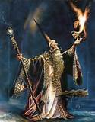
#2
More loans are not needed to have people pay back principal plus interest -- ‘money’ does not disappear when a loan is repaid.
MONEY CIRCULATES – DEPOSITED, LOANED, REPAID, SPENT, ETC.
MONEY DOES NOT DISAPPEAR ….
LIKE THE MAGIC OF BANKER’S ‘CREDIT’

Slide 17




#3
The financial sector will not capture 40% of nation’s profits.
SMART PEOPLE ARE FREED FOR MORE PRODUCTIVE,
LESS PARASITIC ACTIVITY

Slide 18


#4
The money supply would no longer expand during a boom
(when banks loan lots of money)
and contract during a recession
(when banks collect outstanding debts).

Slide 19
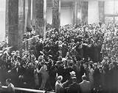


#5
NO DANGER OF RUN ON BANK…..
ABOLISH FDIC AND ITS MORAL HAZARD

Slide 20
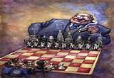
#6
NO DANGER OF A SYSTEM COLLAPSE DUE TO
TOO BIG TO FAIL BANKS…..

Slide 21
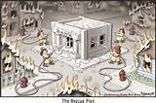
#7
NO MORE BAILOUTS NECESSARY FROM CONGRESS….

Slide 22




#8
POLICY OF STABLE PRICE INDEX REDUCES FEARS OF INFLATION
AND RESULTING QUEST TO ACCUMULATE MORE….

Slide 23
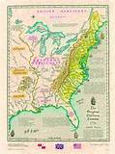
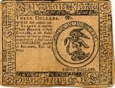
A CHANGE TO BENEFIT MANKIND
NATIONALIZE MONEY –
WHICH IS A NATURAL PUBLIC UTILITY IN THE FIRST PLACE

