Slide 1
TOPICS
I WHAT IS MONEY?
Notes:
We need to define our terms so we all know what we are talking about. People have a lot of different ideas of what money is. This is the way we will define it.

Slide 2




MONEY IS UNIQUE –
It has the power of life and death over each and every person
ESSENTIAL FOR SOCIETY TO EXIST AND FUNCTION
A HUMAN INVENTION
EXISTS IN LAW

Slide 3





MONEY CAN BE DEFINED BY ITS FUNCTIONS
#1 Means of exchange – a ticket. Not wealth.
#2 Unit of value –
RULE: QUANTITY MUST BE CONTROLLED.
#3 Store of value –
denominated by law & stamped by sovereign authority
#4 A means of payment –
legal power to pay debts -- public and private

Slide 4

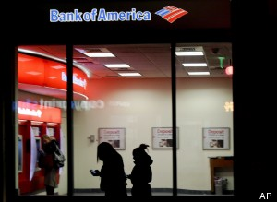
WHAT MONEY IS NOT
MONEY IS NOT WEALTH -- NOT A COMMODITY.
MONEY IS NOT BANK CREDIT:
WE PAY OUR DEBTS WITH MONEY.
DEBT IS NOT MONEY.
DEBT IS DESTRUCTIBLE; MONEY IS NOT.

Slide 5
A SOCIETY DEFINES ITS MONEY IN THE LAW
Edward Kellogg, 1861, A New Monetary System:
“The most important fundamental law in any nation is that which institutes money; for money governs the distribution of property, and thus affects in a thousand ways the relations of man to man.”

Slide 6
TOPICS
WHAT DO WE USE FOR MONEY?

Slide 7
WE HAVE
PRIVATELY ISSUED BANK CREDIT

Slide 8

PRIVATE commercial banks
create bank credit…..
which functions as money
but is DEBT.

Slide 9


PRIVATE COMMERCIAL BANKS –
Do not lend your deposits to borrowers
NO
DEPOSITS
LOANS

Slide 10
IT IS THE EXACT OPPOSITE !!!

Slide 11
A borrower signs a loan contract,
and the BANK CREATES A DEPOSIT
in the borrower’s account
LOANS
CREATE
DEPOSITS

Slide 12

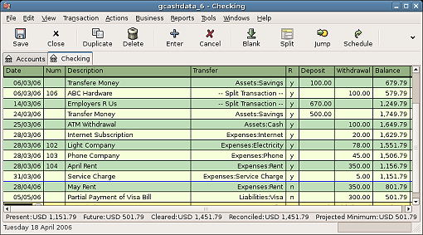
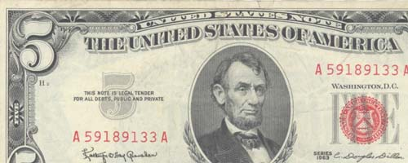
OUR MONEY SUPPLY
3% COIN AND BILLS
97% CHECKING DEPOSITS -- BOOKKEEPING ENTRIES ONLY
CREATED WHEN A PRIVATE BANK MAKES A LOAN TO A BORROWER
REPAID WITH INTEREST
DISAPPEARS WHEN THE LOAN IS REPAID; THE INTEREST REMAINS WITH THE PRIVATE BANK
MINTED BY GOVERNMENT
SPENT BY GOVERNMENT
PRINTED BY GOVERNMENT
NOT SPENT BY GOVERNMENT
ISSUED BY PRIVATE FEDERAL RESERVE BANKS to member banks

Slide 13
THIS BANK CREDIT (DEBT-MONEY) SYSTEM
WAS IMPLMENTED BY THE 1913 FEDERAL RESERVE LAW
NEW YORK FEDERAL RESERVE BANK:
OWNED BY ITS MEMBER BANKS
COMMERCIAL BANKS:
OWNERS OF NY FED BANK
NEW YORK FEDERAL RESERVE BANK
GOLDMAN SACHS
BANK OF
AMERICA
CITIGROUP
J.P.MORGAN
CHASE
DEUTSCHE BANK
HSBC
UBS
ETC.

Slide 14
TOPICS
Q & A

