Slide 1
CHAPTER 1
THE ORIGINS OF MONEY SYSTEMS
Part 2

Slide 2
GOLD

Slide 3
1 GOLD BECOMES MONEY

Slide 4
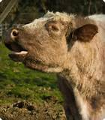
NEOLITHIC MONEY
COW STANDARD
The most widely used standard of value was the COW.
It was the measuring unit and means of exchange
for large transactions.

Slide 5
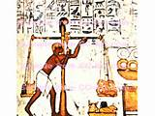
1500 to 1000 BC
COW STANDARD SHIFTS TO GOLD BY WEIGHT STANDARD
(COMMODITY)
1 COW
130 grains troy GOLD BY WEIGHT

Slide 6
1500 to 1000 BC
HOW DID THIS HAPPEN?
1 COW
130 grains troy GOLD BY WEIGHT

Slide 7
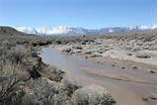
HOW DID GOLD BECOME MONEY?
Gold was the easiest metal for primitive man to obtain
Pure gold can be found in river beds throughout the ancient world
Gold does not decompose or oxidize
1 COW
130 grains troy GOLD BY WEIGHT

Slide 8
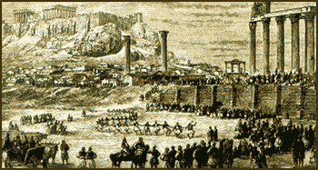
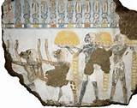
HOW DID GOLD BECOME MONEY?
We can surmise …. At a very early date ….
gold (used as jewelry) was accepted as donations or fees
by the temples, along with agricultural and animal produce.
1 COW
130 grains troy GOLD BY WEIGHT

Slide 9
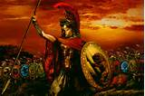
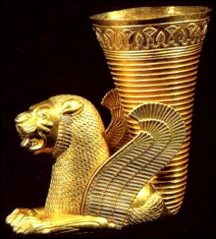
HOW DID GOLD BECOME MONEY?
Gold would accumulate in the temples … unlike the organic donations.
… all this is supported by the vast amounts of gold and silver that
Alexander the Great seized in 330 BC from the eastern temples at
Susa, Ecbatana, and Persepolis:
740,000 talents gold
180,000 talents silver
1 COW
130 grains troy GOLD BY WEIGHT

Slide 10
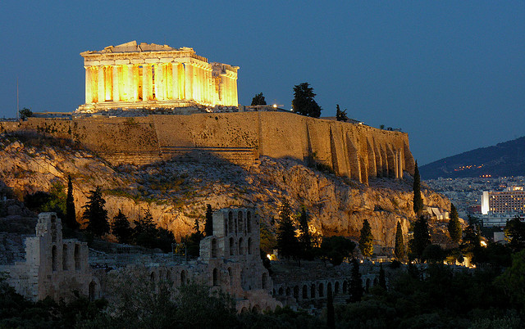
HOW DID GOLD BECOME MONEY?
TEMPLE WOULD HOLD GOLD IN STORAGE, SO PRICE WOULD BE STABLE.
LONG-STANDING TRADITION - - consecrate building by putting gold in its foundation or walls.
1 COW
130 grains troy GOLD BY WEIGHT

Slide 11
HOW DID GOLD BECOME MONEY?
THE TEMPLES WOULD CONTROL THE GOLD
They created a demand for it by accepting it for their ‘services’.
They controlled the supply, by accumulation and building consecration.
1 COW
130 grains troy GOLD BY WEIGHT

Slide 12
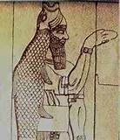
HOW DID GOLD BECOME MONEY?
WHO DECIDED WHAT THIS RATIO WOULD BE?
THE PRIESTHOODS OF THE TEMPLE CULTS.
THIS WOULD HAVE BEEN AN INSTITUTIONAL DECISION – MAKING GOLD A “FIAT” MONEY.
1 COW
130 grains troy GOLD BY WEIGHT

Slide 13
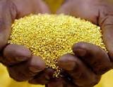
HOW DID GOLD BECOME MONEY?
OVER TIME, WITH THE POWERFUL SPONSORSHIP OF THE EASTERN TEMPLES,
GOLD WOULD SUPPLANT CATTLE, AND COME TO BE VALUED AS MONEY.
130 grains troy GOLD BY WEIGHT

Slide 14
HOW DID GOLD BECOME MONEY?
MONETARY CONTROL WOULD GO FROM ‘EAST’ TO ‘WEST’ ---
A THEME THROUGHOUT WESTERN HISTORY
130 grains troy GOLD BY WEIGHT

Slide 15
COINAGE

Slide 16
2 COINAGE – science of money advances

Slide 17
TIMELINE DESCRIPTION
Each Greek city state has it own gold coins
COINAGE:
Gold coins (later silver)
with stamped value
and mark of state authority
PRO’S:
state issued
legally valued
quantity controlled
CON’S:
gold/silver vulnerable to manipulation
of its volume (and therefore value)
Usury: severe problems with interest

Slide 18
TIMELINE DESCRIPTION
Usury on coined metal money had made Sparta a land ruled by a few wealthy people.
LYCURGUS’ REFORM
Removed gold coins
Money was iron disks
treated to be valueless
Fiat money: state law regulated
volume and thus value
Lasted for 3 ½ centuries!
GREEK MONEY REFORMS
Sparta, Greece
Lycurgus
700 BC
FIRST LEGAL FIAT MONEY

Slide 19
TIMELINE DESCRIPTION
GREEK MONEY REFORMS
Athens, Greece
Solon
600 BC
Laws studied by Rome in 454 BC
Usury on coined gold and silver money had corrupted Athens. Small farmers were foreclosed on and sold into slavery because of debt, and land concentrated in the hands of the few large landowners!
SOLON’S REFORMS:
no more debt slavery – enslaved farmers freed
land given back
floor prices for farm products set (‘monetized’)
laws against importing female luxuries
increased volume of silver coins, from local
sources

Slide 20
DEFINITION OF MONEY

Slide 21
3 ARISTOTLE – true nature of money

Slide 22
TIMELINE DESCRIPTION
Athens, Greece
ARISTOTLE
384-322 BC
Aristotle explained the nature of money, based on Greek money experimentation:
MONEY: exists not by nature ( not commodities)
but by law (fiat, issued by state authority)
….it is demand, which holds all things together
(a means of exchange to meet needs)
USURY: money is sterile and not capable of
breeding interest

