Slide 1
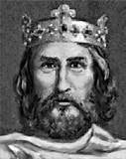
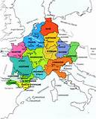
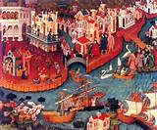
The Lost Science of Money
CHAPTER 4:
RE-INSTITUTING MONEY IN THE WEST
CHARLEMAGNE’S REVIVAL
RISE OF VENICE

Slide 2
THEMES OF LOST SCIENCE OF MONEY BOOK
Primary importance of the money power
Nature of money purposely kept secret and confused
How a society defines money determines who controls the society
Battle over control of money has raged for millennia: public vs private

Slide 3
PARTS OF PRESENTTION
Timeline
The Feudal Empire: Role of Church
The Frankish Kings -- Clovis & Charlemagne:
Money, Pope, Basileus
Venice:
Crusades, Ratio, Money
5. The Science of Money

Slide 4
PART 1
Timeline of Roman Empire

Slide 5
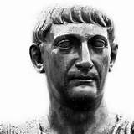
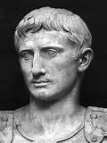
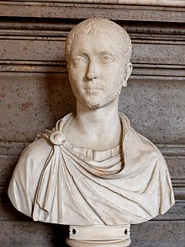
GOVERNMENT OF EMPIRE
  PRINCIPATE (sole ruler)
  (First 3 centuries)
  |--------------|--|---|-----------------------|-----------------------------------------------------------|
  46 27 0 14 235 284
235 – 284 AD
CRISIS OF 3RD CENTURY
Roman Empire nearly
collapsed with invasion,
civil war, plague, and
economic depression.
JULIUS CAESAR
PONTIFEX-
MAXIMUS
AUGUSTUS
Severus Alexander
Empire reached
greatest expansion
First emperor and
High priest

Slide 6
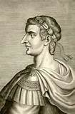
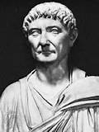
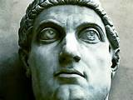
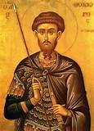
GOVERNMENT OF EMPIRE
  DOMINATE (co-rulers)
  (4th century)
  |-------------------------------------------------------------------------------------------------------|
  284 – 305 306 - 337 361-363 379 - 395
➔ EMPERORS DID NOT DIVIDE OFFICE OF PONTIFEX MAXIMUS ➔
Reign of
Diocletian
Reign of
Constantine
Reign of
Julian
Reign of Theodosius
Established Nicene Christianity
as the state religion
Sons proclaimed Emperors
in separate Eastern and
Western Empires.
Co-rulers
Worship of
emperor as
God weakened
Adopted Christianity
Moved capital to
Constantinople
Council of Nicaea: Nicene Creed
Restored pagan religion

Slide 7
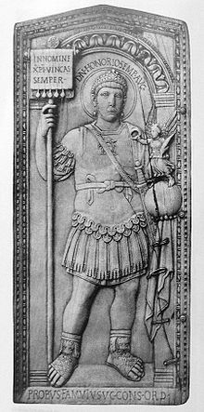
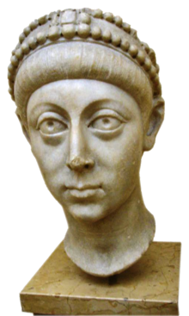
GOVERNMENT OF EMPIRE
SEPARATE EMPIRES:
“COLLAPSE” OF WESTERN ROMAN EMPIRE
(5th century)
  |-----------------|
  395 480
  |-------------------------------------|----------------------------------------------------------------|
  395 610 1204
WEST
480 AD - End of Western Roman Empire:
first non-Roman emperor recognizes Byzantine Emperor
as sole emperor of unitary empire.
EAST
➔ EMPERORS DID NOT DIVIDE OFFICE OF PONTIFEX MAXIMUS – WENT TO CONSTANTINOPLE ➔
SACRED EMPIRE: BYZANTINE ROMAN EMPIRE
Maintained claim to western empire
multiple claims to the imperial title meant civil war
Constantinople sacked
By 4th Crusade

Slide 8
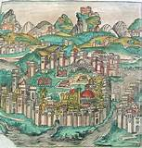


PONTIFEX MAXIMUS ENDOWED WITH SACRED PREROGATIVES
Regulate calendar
Grant highest titles of nobility
Issue
gold coins
Regulate ratio of value between gold & silver
12:1

Slide 9
PART 2
The Feudal Empire: Role of Church

Slide 10
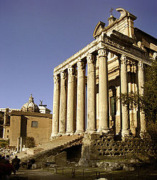
PAGAN WEALTH BECAME CHRISTIAN WEALTH
“…. the pagan church had acquired, through testamentary gifts, etc., a large proportion of all the private estates embraced in the empire.
Theodosius (380 AD) granted the ecclesiastical estates and living of the church to incumbents of the true faith. Such of the bishops and priests as had not embraced Christianity (for many of the latter had done so already) were expelled from their offices and replaced by others.”
424 pagan edifices became 365 Christian churches
Pagan ceremonies used by Christian church
Alexander Del Mar, THE MIDDLE AGES REVISITED, p 110.

Slide 11
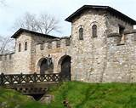
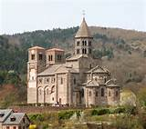
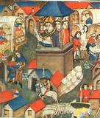
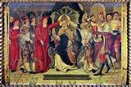
FEUDALISM
Roman origin of feudalism: feudal relations grew out of Caesar as God; Pontifex maximus created numerous social ranks and castes (ecclesiastical aristocracy):
“The imperial government was no longer capable of reaching the people;
there were too many vested interests, too many officials and too many
nobles and ecclesiastics between them.” Del Mar, THE MIDDLE AGES REVISITED, p 124
Roman origin of feudalism: services from inferiors, obligations from superiors
Roman castles became feudal castles
Church christianized empire: Roman Pope sent missions to convert barbarians
Church held inalienable landed estates and benefices

Slide 12
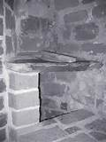
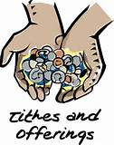
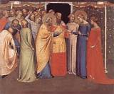
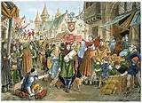
MEDIEVAL CATHOLIC CHURCH
Pope wanted everything, including imperial powers
Possessed most lucrative offices and functions:
laid sewers
swept streets
removed garbage
Benefices
Fiefs
Lands
Slaves
tithes
Revenues:
birth
baptism
marriage
deaths
buriels
Filled municipal offices
Profited from fairs

Slide 13
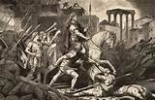


BARBARIANS
Except for Attila the Hun, there were no barbarian destroyers: barbarians conserved institutions, government, laws, temples, arts, titles, ceremonies of Roman lands
Risings of Goths and northern barbarians due to Roman conscription of its youth
4th & 5th centuries - Church Christianized barbarians who ended up as viceroys of Rome
5th & 6th centuries – men gave possessions to church to avoid fighting; everywhere men crowded into the Church

Slide 14
PART 3
The Frankish Kings -- Clovis & Charlemagne:
Money, Pope, Basileus

Slide 15
Merovingian Frankish Dynasty
SILVER DRAINS TO EAST➔
SILVER DRAINS TO EAST➔
|---------------|-------------|----------|-------------|---------|-------------------|----------|
457 481 486 496 511 654 726 751
Childeric I - -Clovis - - - - - - - - - - - - - - - - -
|-----------|----------------------------------------------------------------------------|----------|
300 452 697 700
496 - Clovis is
baptized
Catholic
654 – Roman Bishop
in chains to Byzantine
Emperor – sentenced
to death, reprieved,
banished
726 – Sacred
Emperor Leo
orders all images
removed from
Western & Eastern
churches
Fought along with
Roman generals
against Visigoths
First king of united
Frankish tribes
486 – defeated
Gallo-Roman ruler,
in Battle of Soissons,
considered end of
Western Roman rule
outside of Italy
751 - end of
Merovingian
dynasty
VENICE
630➔ RISE OF MOSLEMS
Attila the Hun
kills all but
100-200 families
Trade with
Alexandrian
Moslems
Roman
province
Venetian
Republic

Slide 16
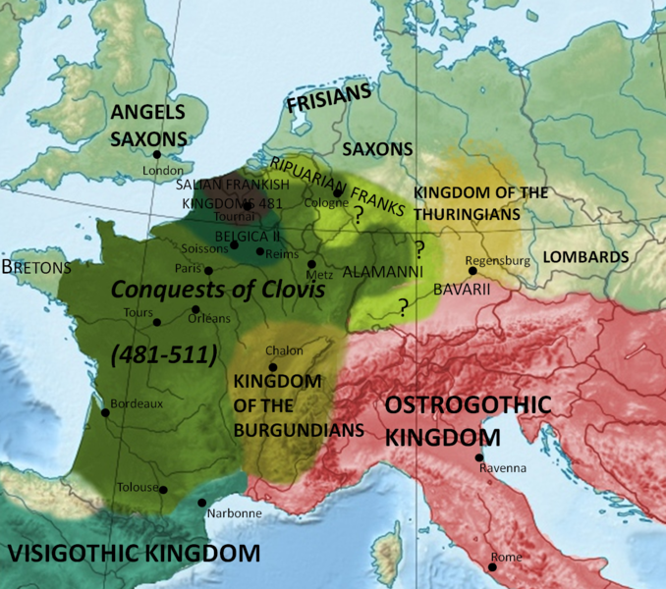
CLOVIS
The king's Catholic baptism 496 AD was of
immense importance in the subsequent history
of Western and Central Europe in general,
for Clovis expanded his dominion over almost all of Gaul.

Slide 17
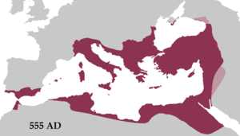
Justinian I, Byzantine Emperor (527 – 565), sought to revive the Empire's greatness
and reconquer the lost western half of the historical Roman Empire.
He reconquered many former territories of the Western Roman Empire,
including Italy, Dalmatia, Africa, and southern Hispania.

Slide 18
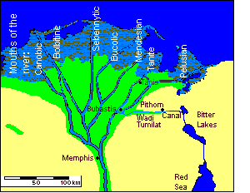
The Romans used both the overland
trade route to India as well as the
water route from Mediterranean
to Red Sea.
The Arsinoe Canal in Egypt had filled up
and the Moslems in Alexandria controlled
trade with India.
639 AD the Moslem ruler began clearing
the canal.

Slide 19
Carolingian Frankish Monarchy
SILVER DRAINS TO EAST➔
SILVER DRAINS TO EAST➔
|-------------------|-----------------------|----------------|-------------|------------------|
751 755 768 774 800 803
Pepin the Short - - - -Charlemagne - - - - - - - - - - - - - - - - - - -
|------------------------------------------------------------------------------------------------|
700 800
755 - Pepin conquers
Lombard German lands
In Italy and gives to
Catholic See in Rome
Bishop of Rome temporal
ruler; freedom from Sacred
Empire as vassal of Frankish
King
751 - Kings of
Franks, coronated
by Catholic Pope
Pepin suppresses his
gold coins
768 –
Charlemagne
King of Franks
774 –
Bishop of Rome
swears
allegiance to
Charlemagne
800 –
Charlemagne
crowned Emperor;
calls himself
Augustus Caesar
803 – Treaty of
Seltz with
Sacred Empire
VENICE
630➔ RISE OF MOSLEMS
SILVER DRAINS TO EAST➔
Venice ignores prohibition of Byzantium
and begins trading with the Moslems
Venice taps into East’s 7:1 silver/gold ratio
through Alexandria Moslems

Slide 20
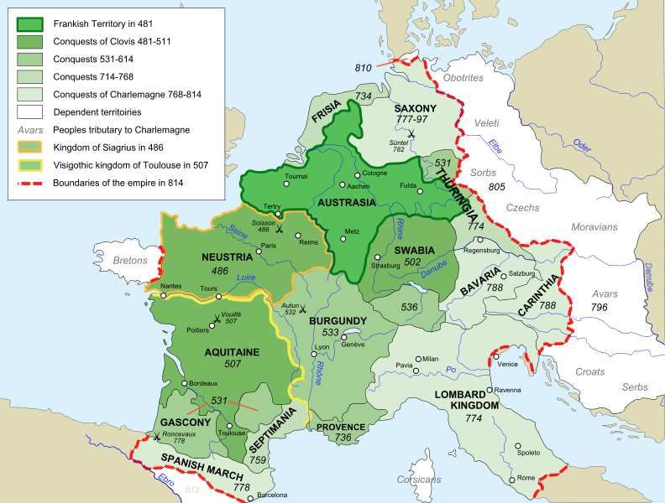

Slide 21
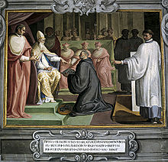
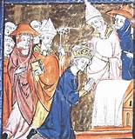
Pope Stephen anointing Pepin
Charlemagne Crowned by Pope Leo

Slide 22
LOST TREAT OF SELTZ, 803 AD
Alexander Del Mar, Chapter 10: THE LOST TREATY OF SELTZ, p. 193
“Many miracles are recorded in the books of this period, but the greatest miracle of all is not recorded in any of them. It is the corruption, mutilation, or destruction of every literary evidence concerning the origin, history, and legal relations of the Latin pontificate; and the survival of the fables invented to supply their place.”
The Treaty had to contain the following:
Charlemagne conceded superior rank to Basileus:
Sacred Emperor retained spiritual dominion over all Christendom, including West
2. Basileus retained highest prerogatives: granting titles, changing calendar, gold coinage, gold/silver ratio
Basileus conceded to Charlemange subsuzerainty of West, including Roman See, who was vassal of Frankish King
Because of this treaty, it was necessary for Roman See to issue forged Decretals of Isador after death
of Charlemagne. These purported to be a donation of both spiritual and temporal dominion
of the western world from Constantine I to Bishop of Rome.

Slide 23
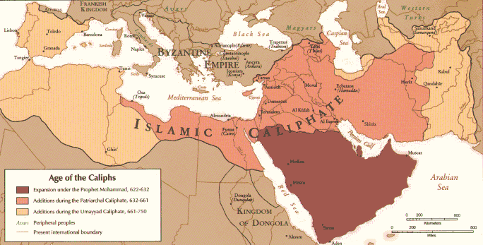

Slide 24
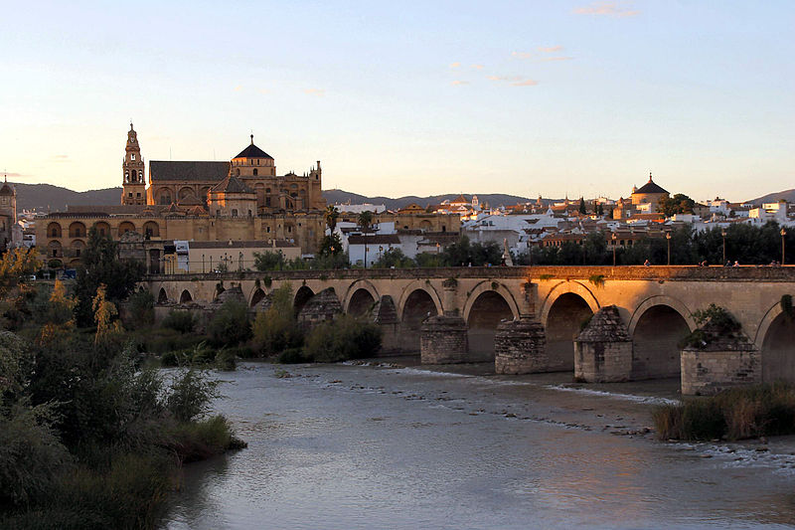
9th century Cordoba, Spain: The city was the capital of the Islamic Caliphate of Cordoba,
including most of the Iberian Peninsula. It had been the capital of Hispania Ulterior
during the Roman Republic and Capital of Hispania Baetica during the Roman Empire.
It has been estimated that in the 10th century Córdoba was the most populous city in the world,
and had become a center for education under its Islamic rulers. Universities contributed towards
mathematics and astronomy. During these centuries Córdoba had become the intellectual
center of Europe and was also noted for its predominantly Muslim society that was tolerant
toward its Christian and Jewish minorities.

Slide 25
PART 4
Venice:
Crusades, Ratio, Money

Slide 26
THE CRUSADES
SILVER DRAINS TO EAST➔
SILVER DRAINS TO EAST➔
|----------------|-------------------------------|---------------|------------------------------|
814 962 1084-85 1095 1204
Death of
Charlemagne
Western pope
elected by
independent
Sacred College
as pontifex
Maximus of West
|-----------------------------------------------|------------------|--------------------------|
814 1084-85 1095 1204
962 – Otto I is first German
Emperor of Italy
Bishop of Rome is vassal;
crowns Otto I as emperor
of West; pope compelled
due to Treaty of Seltz
1084-85 – Basileus
invokes assistance
of Venice
4th Crusade
SACK OF
CONSTANTINOPLE
by Pope & Venice
1st Crusade:
opens overland trade
route to India
Overland route cannot
be kept open in 12th
Century ========➔
Bishop of Rome
now appoints
Bishop of
Constantinople
VENICE
630➔ RISE OF MOSLEMS
SILVER DRAINS TO EAST➔
Venice shares
Basileus’ Orient
Trade thru Arabia
Venice joins 1st Crusade
late: gives up Alexandria
trade for overland route
Venice attacks
Constantinople

Slide 27
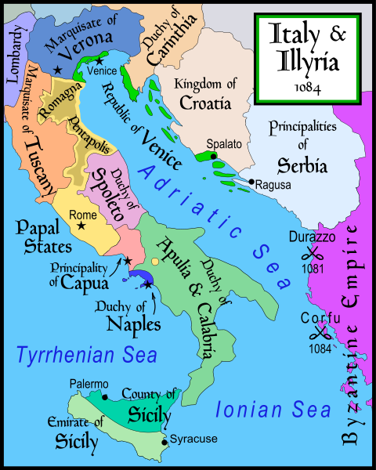
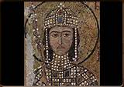
Robert Guiscard (c. 1015 – 1085) was a Norman
adventurer conspicuous in conquest of southern Italy
And Sicily. Became Duke of Apulia and Calabria.

Slide 28
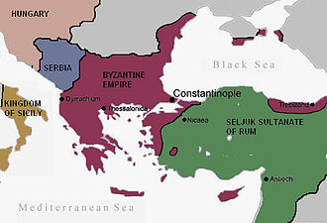
The Byzantine Empire and the Sultanate of Rûm before the First Crusade

Slide 29
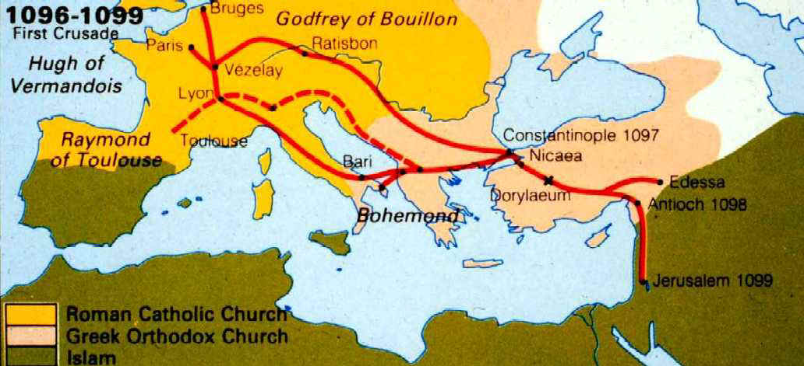

Slide 30
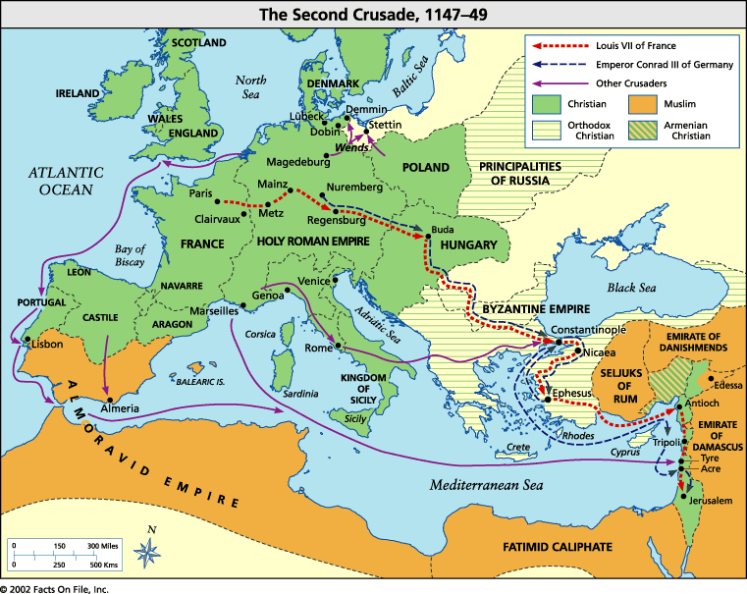

Slide 31
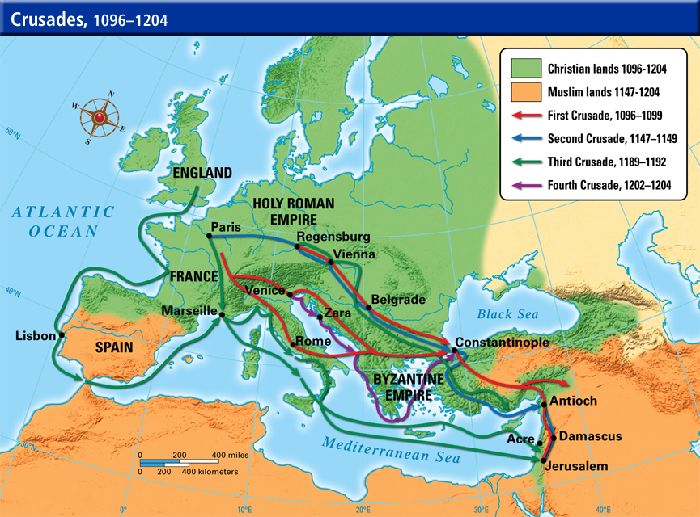

Slide 32
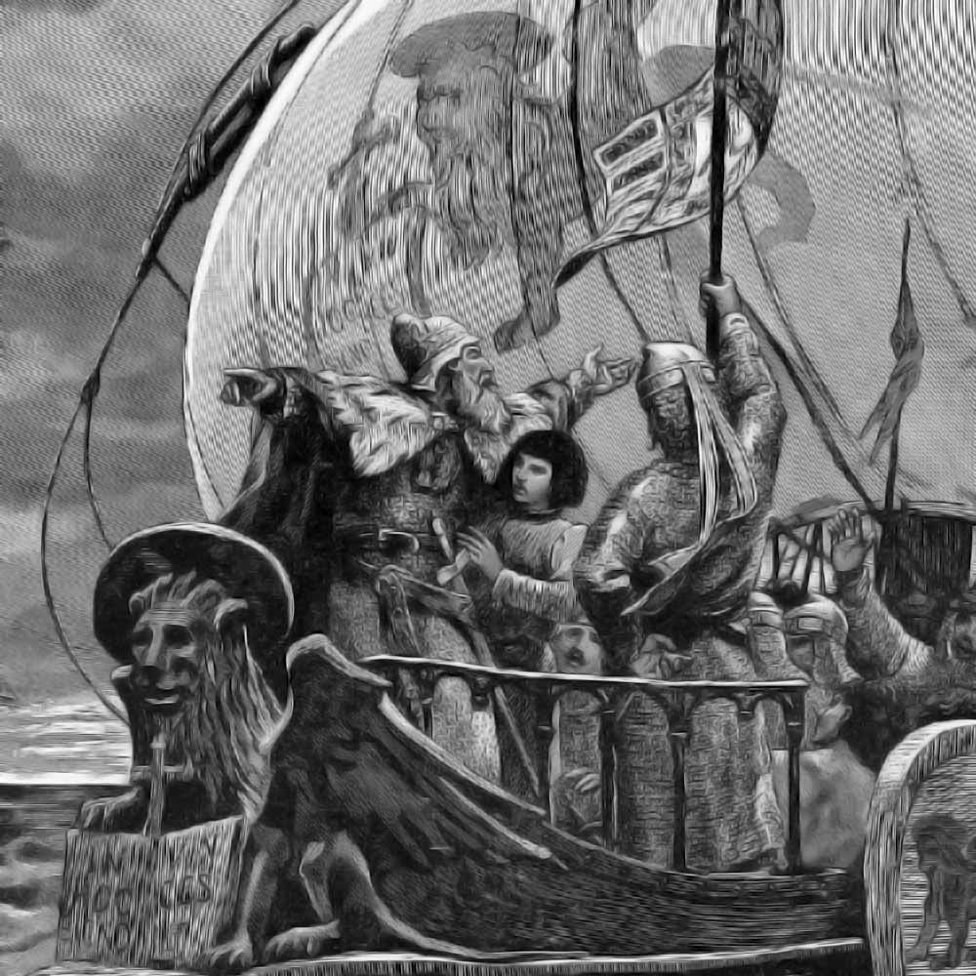
Doge Enrico Dandolo leading the 4th Crusade

Slide 33
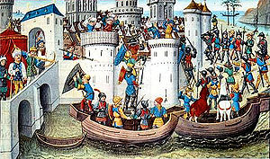
Conquest of Constantinople by the Crusaders in 1204.

Slide 34
VENICE
WESTERN GOLD/SILVER RATIO FLUCTUATES
|-------------------|--------------|-----------------|------------------------|
1204 1250 1284 1307 1345
|-------|-----------------------|---------------|------------------|--------------------------|
1345 1348-50 BLACK DEATH 1457-64 1472-73 1492 1503
TURNING POINT IN
MONETARY HISTORY
Venice
coins
silver
GROSSO
Frederick II
‘Sacred Emperor’
issues gold coin
Pope calls him
The Antichrist.
Venice mints
first gold coin,
Ducat, meant
to continue
Bezant
Knights Templars
Suppressed
Levant trade to
India lost
INDIA TRADE REOPENED:
Venice applies to Egyptian
government for reduction
in tariff on silver imported
by Venice into Alexandria
from 10% to 2%
Venice taps into Eastern ratio:
gold floods Europe
VENICE
SILVER DRAINS TO EAST➔
Venice & Naples
mint copper coins
Portugal sails around
African Cape
Venice knocked out of
India trade
For first time, gold in
quantity appears in
Europe
Silver crisis:
mints closed
Beginning of rape
of America
for gold and silver

Slide 35
PART 5
The Science of Money

Slide 36
THE SCIENCE OF MONEY:
Principles and Laws
Aristotle – money has value due to law, and not to nature.
Money is distinguished by its Mark of Authority - by law.
The volume determines the value of each piece.
Today the law omits a limit on money’s volume. Money as a measure of value is thus impaired.
When Aristotle wrote, the volume of money was limited by law in several of the Greek States.
In each was a definite and precise measure of value.

Slide 37
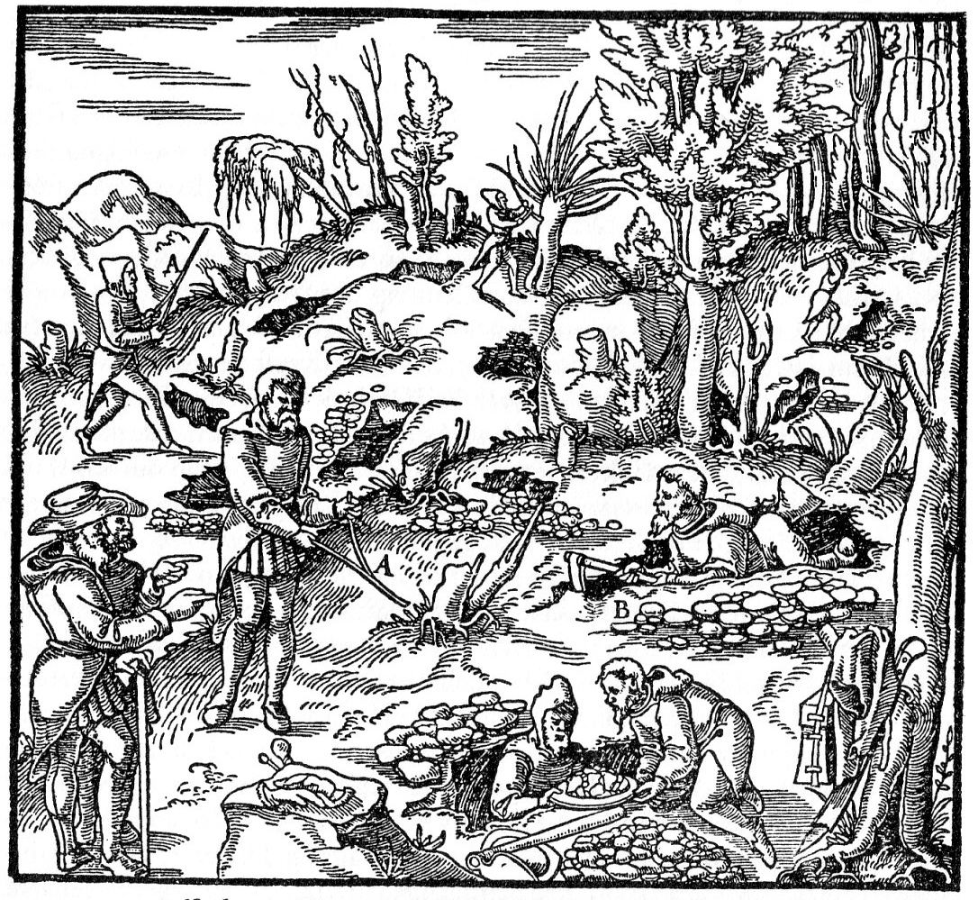
Charlemagne’s Silver Coins
Waged war.
Plundered.
Used slave labor to mine silver and issue coins.

Slide 38

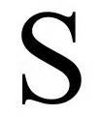

Charlemagne’s ‘Monies of Account’ system:
POUND SHILLING PENCE
LIVRES SOLS DENIERS
Gold Silver Bronze
Used from time of later Roman Empire: when treasury of empire in trouble,
could use ‘money of account’ to regulate the value of each coin
By edict, the government could value any coin at any value
Followed the establishment of Christianity in the barbarian provinces
Aided feudalism by allowing the diversity of coins
Established wherever Roman government prevailed

Slide 39
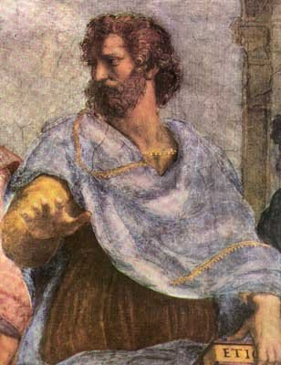
USURY
Venetian traders took risks. For this they made profit.
The Venetians anticipated the Christian Scholastic scholars:
The lender could earn interest if actually taking some risk,
without a guaranteed gain. Partnerships could be formed
if profitable investment opportunities existed.
One partner could supply labor and the other money.
Aristotle – “money was intended to be used in exchange,
but not to increase at interest….”

Slide 40
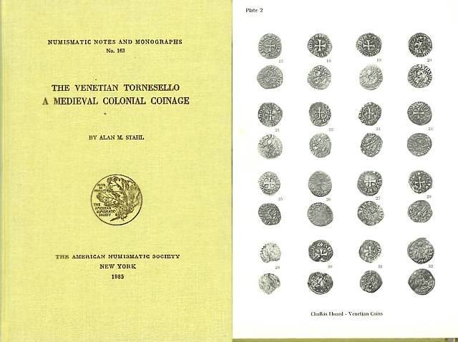

VENICE AND NOMISMA
The tornesello was minted in Venice
but was specifically designated for use
by the administrators of its colonies.
A mixed copper silver coin, valued at
twice its silver content by law - fiat.
The coin’s value was maintained
as long as the volume of issuance
matched the need. However,
after 1390 the quantities minted were
too great and a discount was applied.

Slide 41
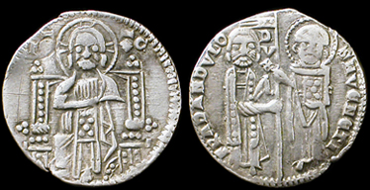
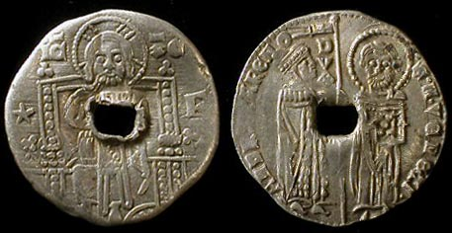
VENICE AND NOMISMA
1379:
Venice minted an ‘overvalued’ GROSSO coin.
Nearly identical to original GROSSO but with ‘star’.
Legally valued twice the old GROSSO.
Minted in large quantities for decades

Slide 42
VENICE AND BANKING
The Basileus suppressed banking, but after the fall of Constantinople,
banking rose in Spain and Genoa.
After the 3rd Crusade, Venice’s treasury was empty. The government created
the forced loan called the ‘Imprestidi’.
    In place of taxation: each citizen paid based on wealth; received interest
    Book entry only
    Merchants used as means of payment, therefore, increased money supply
    (not legal tender)
    No checks used or deposits kept
1587 converted into State Deposit (‘Giro’) Bank – bank has only deposits, no loans … but ...
Venice’s giro bank went bankrupt by 1600!

Slide 43
SUMMARY

Slide 44
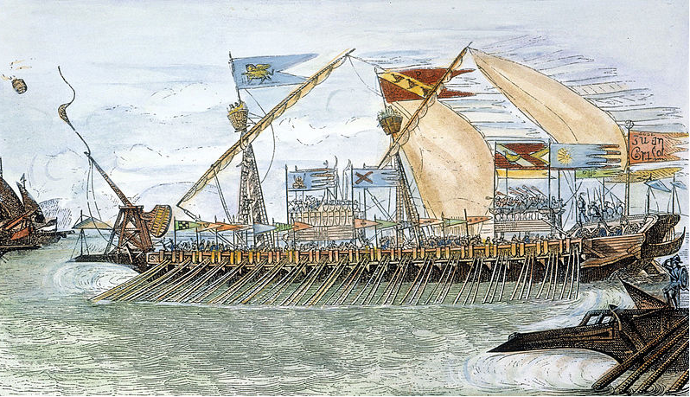
VENICE
Did not fully develop fiat money
Her trading profits raised the level of civilization

Slide 45
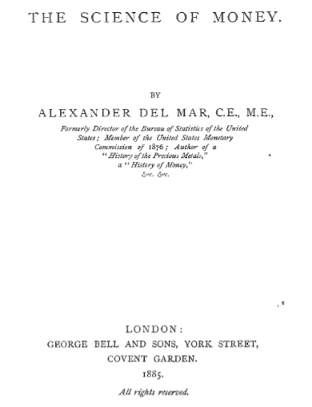
WHEN MONEY DISAPPEARS …..
DISINTEGRATION
OF SOCIETY
Alexander Del Mar
The Science of Money, 1885

Slide 46
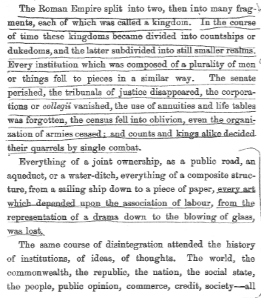

DISINTEGRATION
OF SOCIETY –
“DARK AGES”
Alexander Del Mar
1

Slide 47
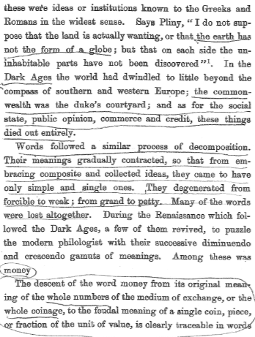
DISINTEGRATION
OF SOCIETY –
“DARK AGES”
Alexander Del Mar
2

Slide 48
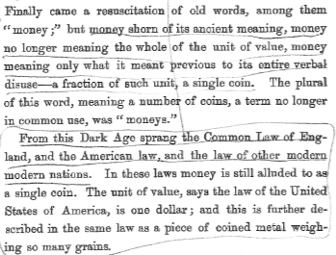
DISINTEGRATION
OF SOCIETY –
“DARK AGES”
Alexander Del Mar
3

Slide 49
Q & A

