Slide 1
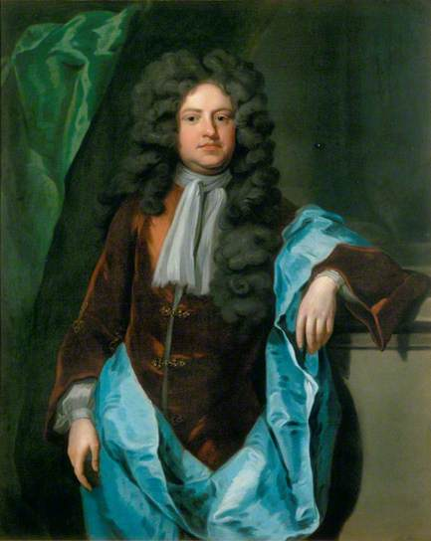
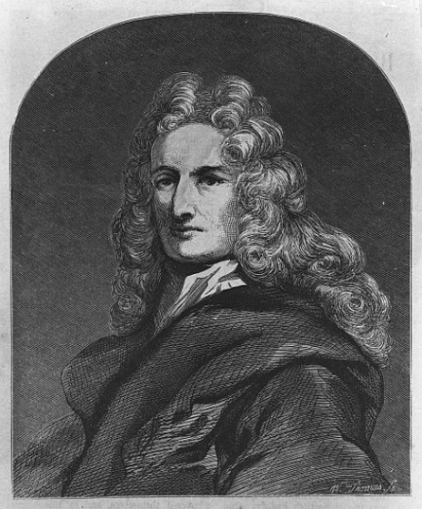

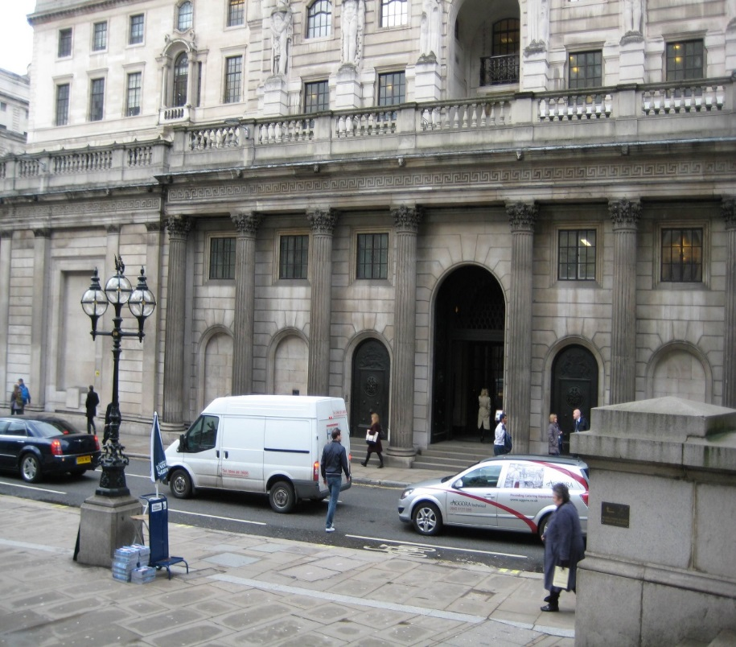
The Lost Science of Money
CHAPTER 11 Part 1
HATCHING THE BANK OF ENGLAND
Charles Montagu
1st Earl of Halifax
Sir William Patterson
MICHAEL GODFREY
BANK OF ENGLAND

Slide 2
THEMES OF LOST SCIENCE OF MONEY BOOK
Primary importance of the money power
Nature of money purposely kept secret and confused
How a society defines money determines who controls the society
Battle over control of money has raged for millennia: public vs private
The misuse of the monetary system causes tremendous misery and suffering for the ordinary working people. Will Decker & Martin Dunn, February 2014

Slide 3
PARTS OF PRESENTATION
William III and the Control of Money
Science of Money Is Recovered – But Privately
The Real Need for a Bank
Numerous Proposals for a Bank
Paterson’s Proposal, Montagu’s Bank
Bank of England Founded in Stealth
Opposition to the Bank
First Failure of the Bank of England
Gradual Development of the Bank

Slide 4
PART 1
William III and the Control of Money

Slide 5
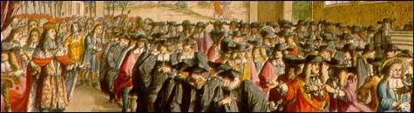
William III and the Control of Money
ENGLISH BILL OF RIGHTS
William could not cancel the charter of the Bank and issue his
own paper money because of the 1689 English Bill of Rights,
which describes the limits on the powers of the crown
and sets out the rights of Parliament
King William Addressing
the Convention Parliament
1689
“That the pretended power of suspending the laws or the execution of laws by regal authority without consent of Parliament is illegal;”
“That the pretended power of dispensing with laws or the execution of laws by regal authority, as it hath been assumed and exercised of late, is illegal;”
“That levying money for or to the use of the Crown by pretence of prerogative, without grant of Parliament, for longer time, or in other manner than the same is or shall be granted, is illegal;”

Slide 6
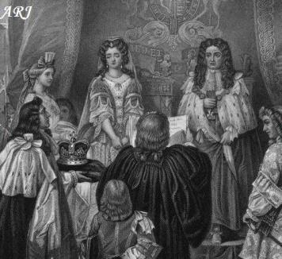
William III and the Control of Money
ENGLISH BILL OF RIGHTS
(DECLARATION OF RIGHTS)
This bill was passed to protect the liberties of Englishmen against
such tyrants as James II.
At the coronation, William and Mary heard the Declaration of Rights read to them and were asked to accept the Crown. William replied "We thankfully accept what you have offered us and promise to rule according to law and be guided by Parliament".
Coronation of William and Mary
“As if the maddest of believers in the divine right of kings had ever fashioned in imagination a tyranny one-hundredth part as strong as that which was clamped upon us by the Revolution of 1688!”
Christopher Hollis, THE TWO NATIONS, p. 34

Slide 7
PART 2
Science of Money Is Recovered – But Privately

Slide 8
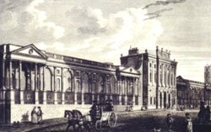
Science of Money Is Recovered – But Privately
The bank created fiat money, but for private power and profit of small group.
This is usury – a calculated misuse of the money system for private gain.

Slide 9
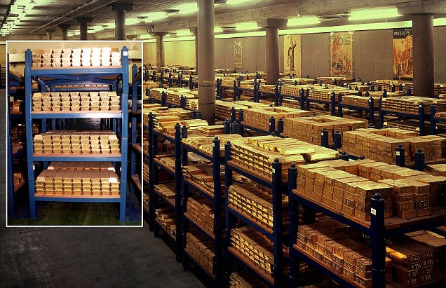
Science of Money Is Recovered – But Privately
The bank owners obscured the true nature of money –
while creating abstract money, they put forward a backward commodity
concept of money as gold and silver

Slide 10
PART 3
The Real Need for a Bank

Slide 11
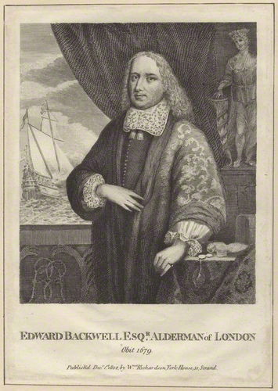
The Real Need for a Bank
The money market was chaotic with varying rates of exchange, as it had been in Amsterdam prior to the founding of the Bank there.
London goldsmith Edward Blackwell.
With the Stop of the Exchequer in 1672, a half dozen goldsmith-bankers
who lent large sums to Charles II were forced to suspend payments.
Edward Backwell was one of these ruined bankers. Many goldsmith-bankers,
however, were not major lenders to the Crown and did carry on. Five years after the Stop,
44 goldsmith-bankers were listed as keeping running cashes.
Despite the plague in 1665, the Great Fire in 1666, the Stop of the
Exchequer in 1672, a panic in 1682, and the Glorious Revolution of 1688,
the system of goldsmith-bankers continued functioning through
the foundation of the Bank of England in 1694 and the turn of the 18th century

Slide 12
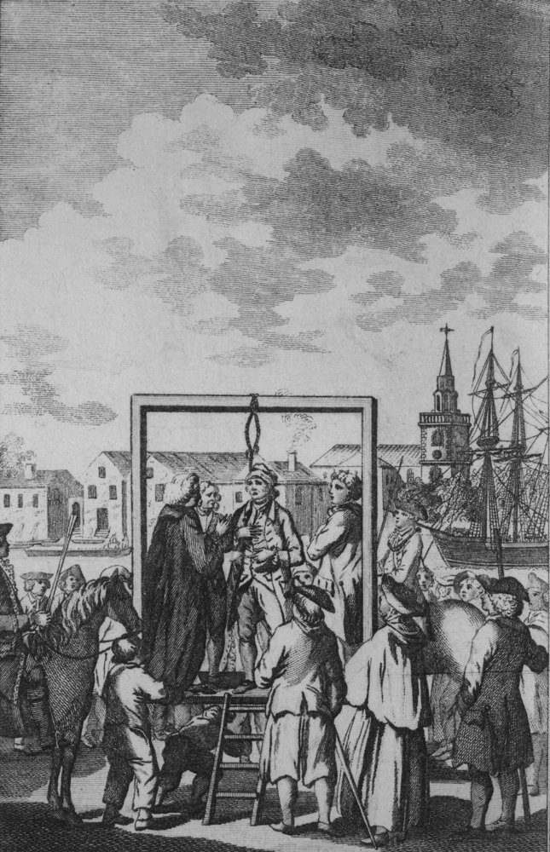
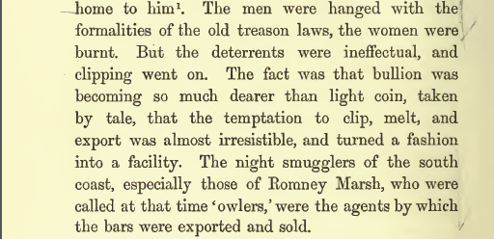
The Real Need for a Bank
Amsterdam’s bank protected her coinage from the clipper, but in England the illicit activities of the goldsmith/bankers continued.
THOROLD ROGERS,
THE FIRST NINE YEARS OF THE BANK OF ENGLAND

Slide 13
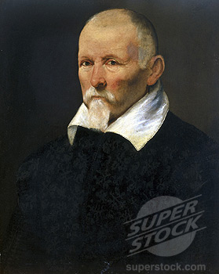
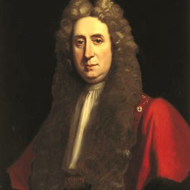
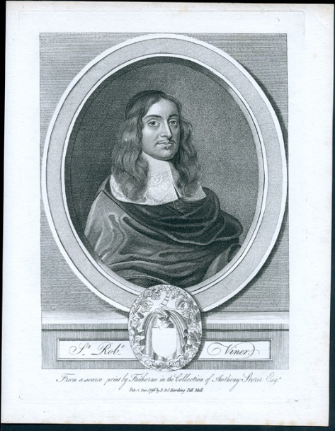
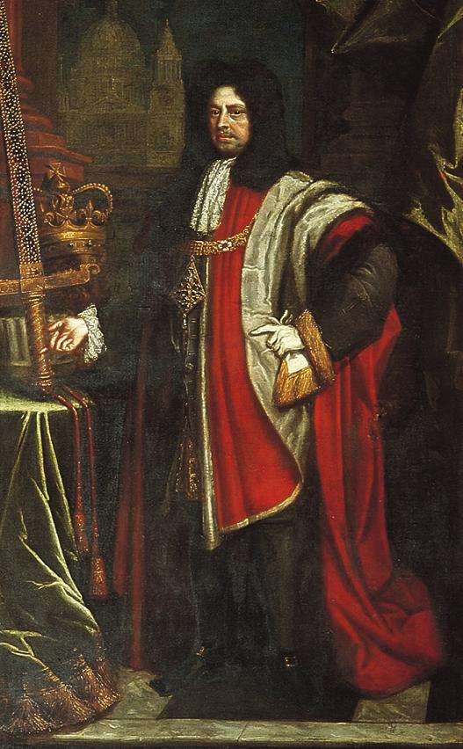
The Real Need for a Bank
The goldsmiths lent money at exorbitant rates - charging 30 to 80% yearly on small loans. The public had lost millions through the bankruptcies of the goldsmiths and the disappearance of their clerks. The public saw them as more interested in profits than in the safety of their investments.
Sir Richard Hoare
Sir Robert Viner
By the Restoration of Charles II in 1660, London’s goldsmiths had emerged as a network of bankers. The number of goldsmith-bankers has been estimated at 32 in 1670, 44 in 1677, and 42 in 1700. Some were little more than pawn-brokers while others were full service bankers. Goldsmiths offered financial services as fractional reserve, note issuing bankers.
Sir Hugh Myddelton, Welsh
Goldsmith and engineer, c 1600s
Sir Francis Child

Slide 14
PART 4
Numerous Proposals for a Bank

Slide 15
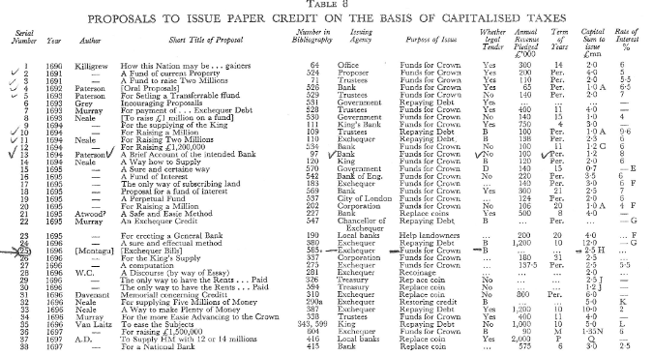
Numerous Proposals for a Bank
38 PROPOSALS FOR THE CREATION OF A PAPER CIRCULATION FOUNDED IN THE GOVERNMENT CREDIT –
EITHER A PERPETUAL FUND PAYING INTEREST-ONLY OR A FUND TO PAY PRINCIPAL AND INTEREST

Slide 16
Numerous Proposals for a Bank
WAR WAS A CONSTANT STIMULUS TO THESE PROPOSALS
AND TO THE CREATION OF A PERMANENT PUBLIC DEBT
Second Anglo-Dutch War (1665-1667)
Third Anglo-Dutch War (1672-1674)
Franco-Dutch War (1672-1678)
Nine Years’ War (1688-1697)
(England/Scotland, Germany, Netherlands, Savoy, Spain, and Sweden v France)
Williamite War In Ireland (1688–91)
War of the Spanish Succession (1701-1714)
(Great Britain (from 1707), Germany, Dutch Republic, Portugal, and Savoy v France, Spain, Mantua, and the electorates of Bavaria and Cologne)

Slide 17
Numerous Proposals for a Bank
IN THE LAST HALF OF THE SEVENTEETH CENTURY, THERE WERE 60 PROPOSALS (SCHEMES)
TO INCREASE PURCHASING POWER. They were of four kinds:
Credit creation based on goods (pawnbrokers)
Credit creation (paper bills) based on government revenues (Bank of England, etc.)
Credit creation based on commercial obligations (commercial banks)
Credit creation (paper bills) based on land (land banks)
'Dr. Hugh Chamberlen's Proposal to make England Rich and Happy.' … the bank was to advance money on the security of landed property by issuing large quantities of notes on the fallacy that a lease of land for a term of years might be worth many times the fee simple.

Slide 18
PART 5
Paterson’s Proposal, Montagu’s Bank

Slide 19
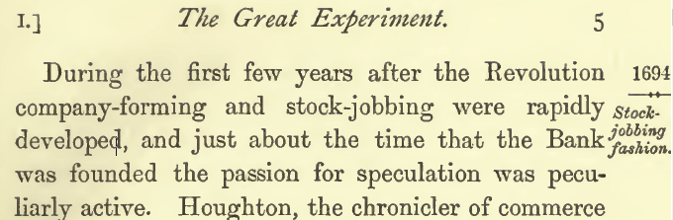
Paterson’s Proposal, Montagu’s Bank
THOROLD ROGERS, THE FIRST NINE YEARS OF THE BANK OF ENGLAND

Slide 20
Paterson’s Proposal, Montagu’s Bank
CHARLES MONTAGU, ONE OF THE FOUNDERS OF BANK OF ENGLAND
Born with excellent connections, but with insufficient leverage to attain any great position. After Westminster and Trinity College Cambridge – where he became the lifelong friend of Sir Isaac Newton – he was destined for a career in the Church.
Politics supervened, however, and in the year after signing the declaration to the Prince of Orange in 1688, Montagu entered Parliament as member. He soon gained the favour of King William and was appointed a Lord of the Treasury in 1689. In this office he soon showed a flair for financial planning, and for bold strokes of innovation.
In December 1689, he devised a scheme – the origin of the National Debt – to raise one million pounds by taxation of wines and spirits, on the credit of which he sold life annuities which reverted at death to the government.
After the House of Commons, he rose quickly, becoming one of the Commissioners of the Treasury and a member of the Privy Council.
Two years later he engineered the Tonnage Bill, intended to meet the costs of the French War. In order to raise the required £1,200,000 he organised the subscribers into a corporation, known as the Governor and Company of the Bank of England. In 1694 he became Chancellor of the Exchequer, in reward for having devised the establishment of the Bank of England.

Slide 21
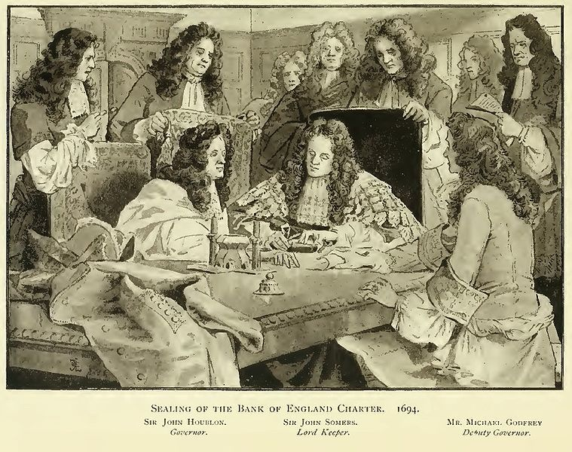
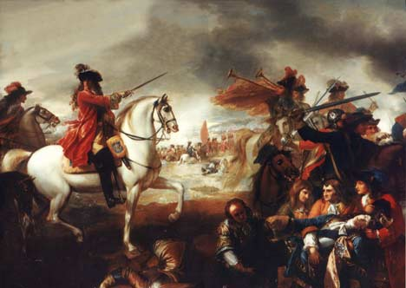
Paterson’s Proposal, Montagu’s Bank
What was Montagu’s motivation in inviting a Dutch Prince to take England’s throne,
creating the bank that would finance his wars, and allow foreign money lenders
to dominate England’s money system?

Slide 22
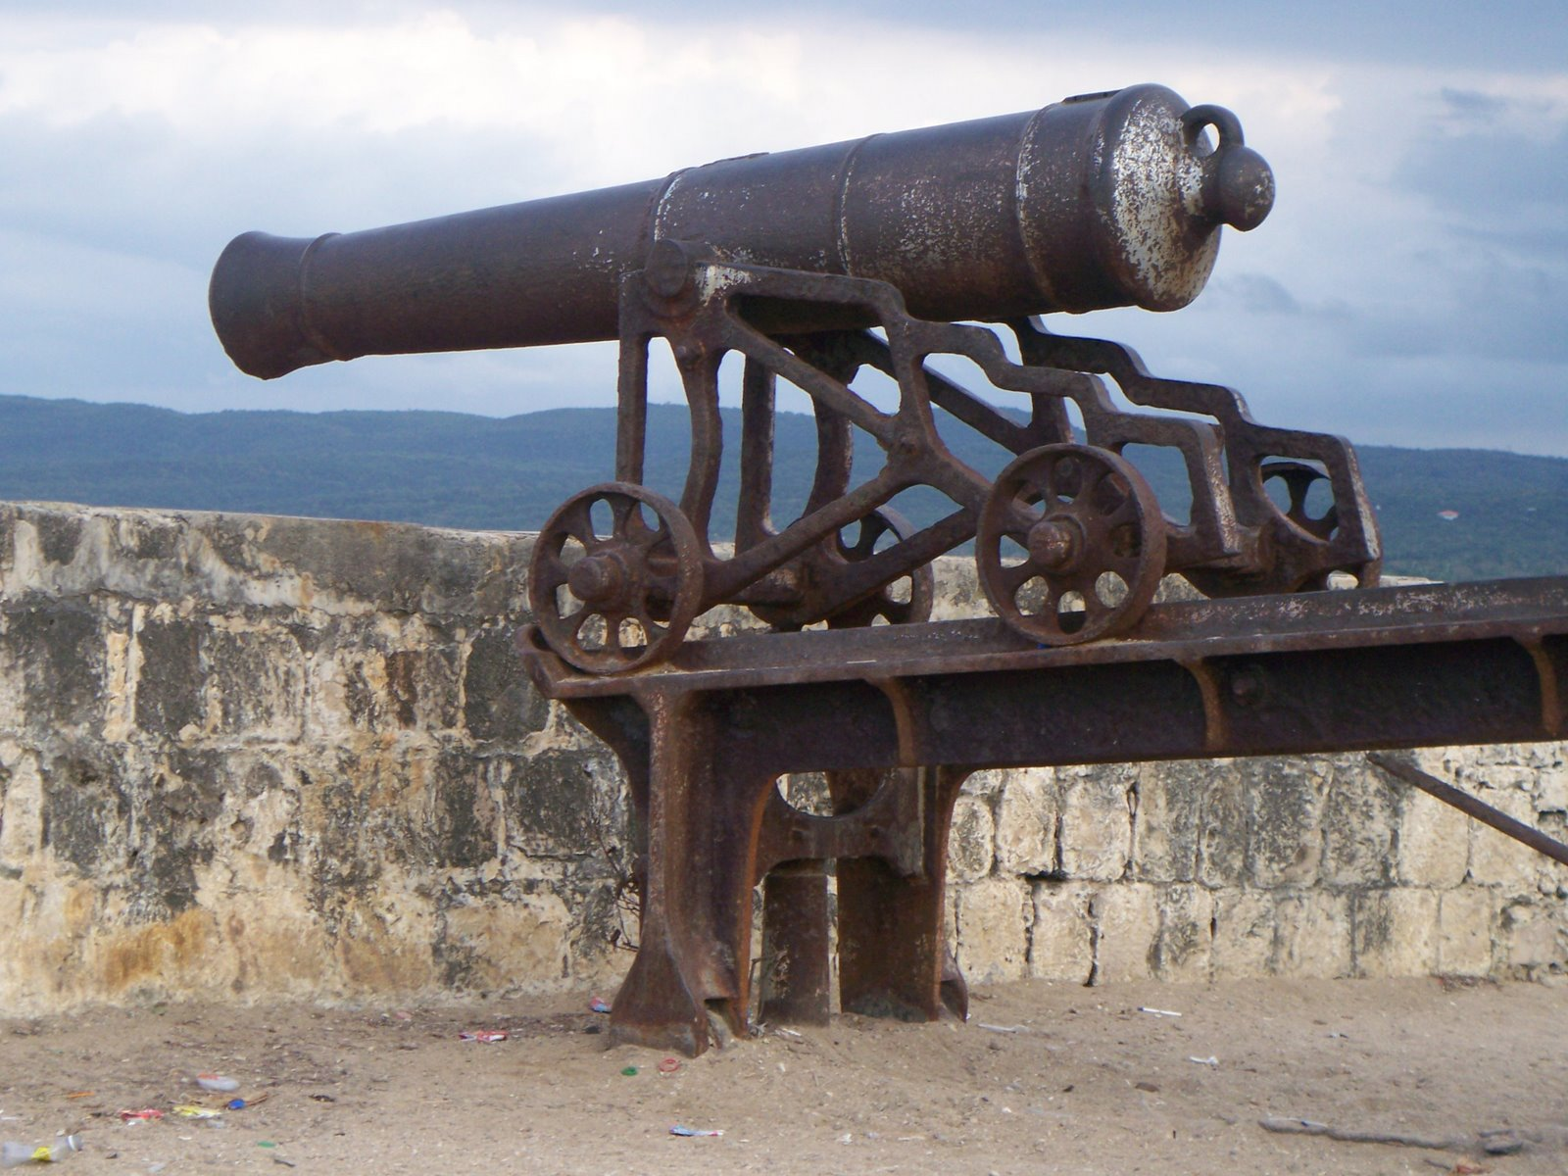
Paterson’s Proposal, Montagu’s Bank
MICHAEL GODFREY, ONE OF THE FOUNDERS OF BANK OF ENGLAND
The younger Godfrey and his brother Peter were merchants, and their father predicted that their speculations would speedily ‘bring into hotchpott’ the whole of their ample fortunes.
Godfrey supported William Paterson in the establishment of the Bank of England in 1694. He supported its acceptance among the city merchant. He was rewarded by being elected the first deputy-governor of the bank. Soon afterwards he published an able pamphlet entitled, ‘A Short Account of the Bank of England,’…
At a general court held on 16 May 1695… the bank resolved to establish a branch at Antwerp, in order to coin money to pay the troops in Flanders. Deputy-governors Sir James Houblon, Sir William Scawen, and Michael Godfrey were therefore appointed to go thither ‘to methodise the same, his majesty and the elector of Bavaria having agreed theretoo’. On their arrival at Namur, then besieged by William, the king invited them to dinner in his tent. They went out of curiosity into the trenches, where a cannon-ball from the works of the besieged killed Godfrey as he stood near the king, 17 July 1695.

Slide 23

Paterson’s Proposal, Montagu’s Bank
“The bank hath benefit of the interest on all moneys which it creates out of nothing.”
The Scotsman William Paterson, a relative of John Law,
was born in 1658 to moderately well off parents.
Though brilliant, he received little education.
In 1685, in Amsterdam, he became involved in William III’s
1688 revolution. Returning to London with William’s army,
He became rich and influential organizing the North London
Water Company, with the help of Montagu.
The plans for the Bank were Paterson’s, but “That Paterson’s
Plan was even adopted can be explained only by its….
being sponsored by two men of unusual influence and
determination – Charles Montagu and Michael Godfrey…”
Montagu put the plan through Parliament and Godfrey got
it past London’s merchants.

Slide 24
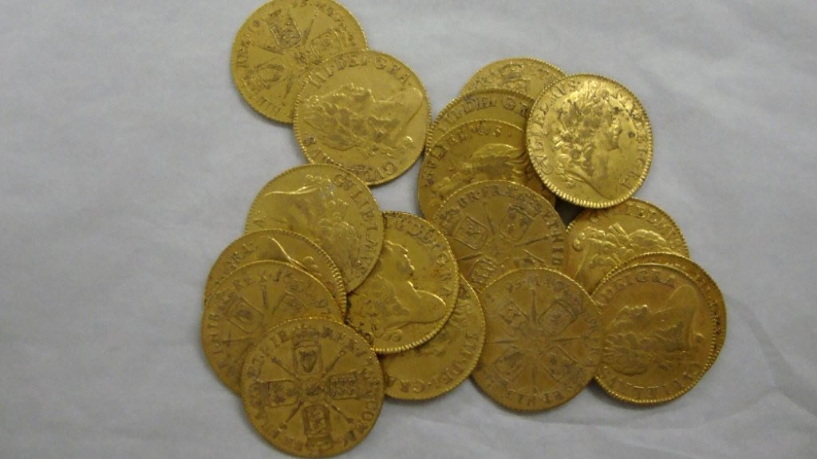
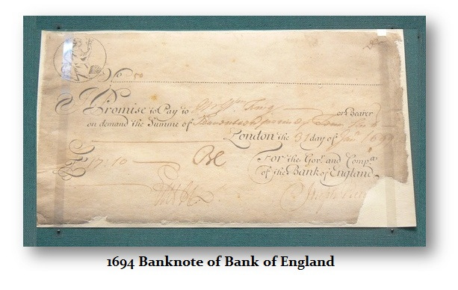
Paterson’s Proposal, Montagu’s Bank
THE PROPOSAL
The £ 1, 200,000 capital raised was to be lent wholly to the Government at 8%,
the interest to be financed by levying a duty "upon the Tunnage of ships
and vessels“ (interest yearly = £ 100,000) .
In return for the loan, the Bank was to be granted a charter and the right to issue
£ 1,200,000 of banknotes, secured only on that loan. The bank notes would circulate
as money, redeemable in gold.
The bank notes were not legal tender, but were
to be acceptable and payable by the Crown for
all things.

Slide 25
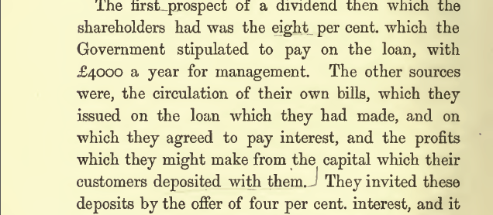
Paterson’s Proposal, Montagu’s Bank
SOURCE OF PROFITS TO THE BANK
THOROLD ROGERS, THE FIRST NINE YEARS OF THE BANK OF ENGLAND

Slide 26
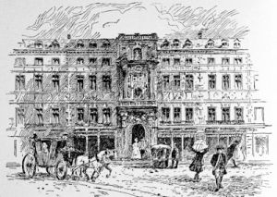
Paterson’s Proposal, Montagu’s Bank
The Chancellor of the Exchequer, fearful of failure, provided for a further £300,000 to be raised in the form of annuities, which is why the Act refers to £ 1,500,000. He need not have worried. The subscription for the Bank taken at the Mercers' Chapel, filled in 12 days. It had opened on June 21 1694, the Queen applying for £10,000.
DAY 1 - Thursday, June 21 £ 600,000 subscribed
By Tuesday, June 26 £ 900,000 subscribed
Noon, Monday, July 2 £ 1,200,000 subscribed (all)
MERCER’S HALL, LONDON

Slide 27
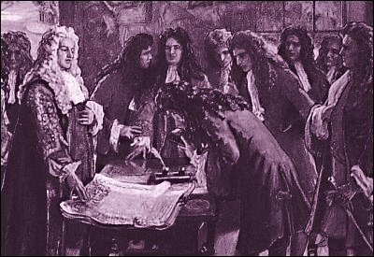
Out of 1,267 individual original shareholders of the Bank of England, there were 11 contributors of the permitted maximum amount of 10,000 pounds:
Paterson’s Proposal, Montagu’s Bank
King and Queen followed by:
1 the Earl of Portland (William Bentinck)
…. 6 individuals described only as Esquires
2 James de la Brettoniere of London
3 William Brownlowe of Woodcott, Surrey
Thomas Howard
Thomas Mulsoe of the Middle Temple (barrister?)
6 Anthony Humberstone (London)
7 Anthony Parsons (London).
The remaining 4 subscribers of the maximum amount allowed were elected members of the first court of directors:
8 Sir John Houblon (son of London merchant, 1689 London Sheriff, London alderman 1689-1712, member of grocer’s guild, Mayor 1695, director East India Co. 1700-1701) (twenty members of his family were also early stockholders)
9 brother Abraham Houblon
10 Theodore Janssen (financier and MP, ruined as Director of South Sea Company)
11 Sir William Scawen (British MP, some years in business, also governor of East India Co. 1710-1712)
Signing of the charter
of the Bank.

Slide 28
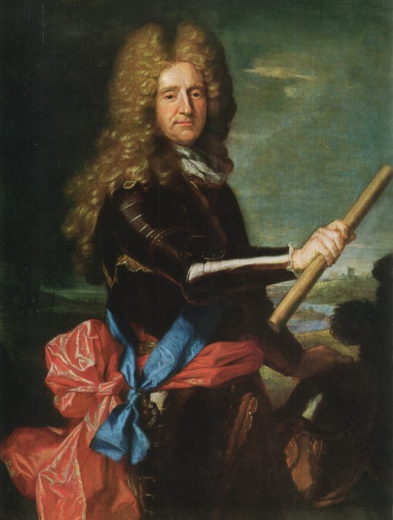
Paterson’s Proposal, Montagu’s Bank
AN ORIGINAL SUBSCRIBER OF 10,000 POUNDS TO THE BANK
The Earl of Portland, William Bentinck
A Dutch and English nobleman who became in an early stage the favourite of William, Prince of Orange, Stadtholder, in the Netherlands, and future King of England.
Bentinck superintended the arrangements for the invasion, including raising money, hiring an enormous transport fleet, organising a propaganda offensive, and preparing the possible landing sites, and also sailed to England with Prince William.
He had also been, since 1687, a medium of communication between his master and his English friends.

Slide 29
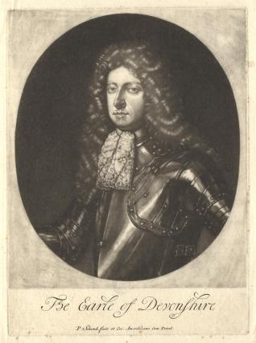
More Contributors
Paterson’s Proposal, Montagu’s Bank
King and Queen of England
Marlborough ~ invested large sums in the East India Co. in 1697; became Governor of the Hudson Bay Company
Lord Shrewsbury
Godolphin - invested 7000 pounds ~ predicted that the Bank of England would not only finance trade, but would carry the burden of her wars
Duke of Devonshire (William Cavendish) - also had signed the invitation to William to assume the throne of England
Duke of Leeds, Sir Thomas Osborne, who also signed the invitation to William
Earl of Pembroke, (Thomas Herbert), who became the first lord of the admiralty, and later lord privy seal
Earl of Carnarvon
Lord Edward Russell - joined the service of William in 1683, was appointed treasurer of the Navy 1689, first lord of admiralty 1696-17, and lord justice 1697-1714
Dr. Hugh Chamberlen
William Cavendish,
Duke of Devonshire
John Asgill, an eccentric writer and pamphleteer
Dr. Nicholas Barbon, son of Praisegod Barebones, who started the first insurance company in Great Britain
John Holland, a reputed Englishman who also started the Bank of Scotland in 1695
Salomon de Medina - wealthy Holland Jew who went with William to England as an army contractor. First Jew to be knighted.
Sir Gilbert Heathcote, director of Bank of England 1699-1701, and from 1723-25; he was Sheriff and later Lord Mayor of London, founded the New East India Co. in 1693
Marquess Normandy, John Sheffield, also held the title of Duke of Buckingham ~ he is buried in Westminster Abbey
philosopher, John Locke

Slide 30
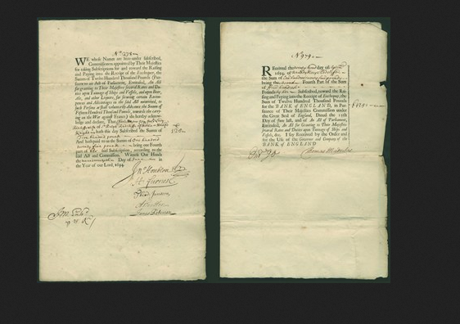
Paterson’s Proposal, Montagu’s Bank
These are for the subscription of £500 made by Sir Ralph Radcliffe (1633-1720) for his wife. The first is dated June 1694 when the Government were raising funds to create the bank, and the second is dated September 1694, just after the Bank had been formed, for the second payment of £125.

Slide 31
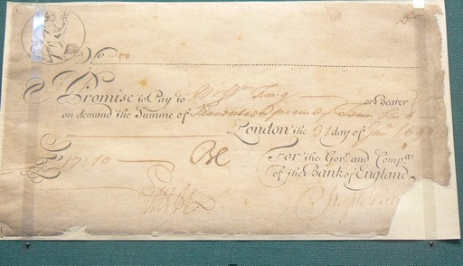
Christopher Hollis, The Two Nations, p. 33
Paterson’s Proposal, Montagu’s Bank
“Now, if a corporation lends money at interest and without risk, then re-lends the repaid loan and so on, never distributing more than a trifle of its profits either as wages or dividends, then, however small its original capital, however moderate its rate of interest, it is but a simple proposition in mathematics that in course of time it must necessarily become the possessor of the entire wealth of the country.”

Slide 32
PART 6
Bank of England Founded in Stealth

Slide 33
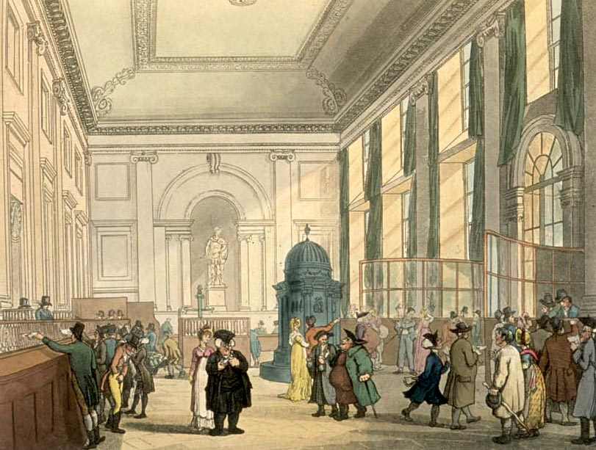
Bank of England Founded in Stealth
An interesting technique is revealed by the Charter of the Bank of England: it was slipped through as part of a tonnage bill, which was later to become a recognized parliamentary technique.
The Charter provides that "rates and duties upon tonnage of ships are made security to such persons as shall voluntarily advance the sum of 1,500,000 pounds towards carrying on the war against France."
The Great Hall, Bank of England

Slide 34
Bank of England Founded in Stealth
FROM THE WRITINGS OF WILLIAM PATERSON
“All this while, the very name of a bank or corporation was avoided, though the notion of both was intended, the proposers thinking it prudent that a design of this nature should have as easy and insensible a beginning as possible, to prevent, or at least gradually to soften and remove, the prejudices and bad impression commonly conceived in the minds of men against things of this kind before they are understood… “

Slide 35
Bank of England Founded in Stealth
STEPHEN ZARLENGA, LOST SCIENCE OF MONEY
The promoters of the Bank argued that the Bank would be founded upon a reserve that cannot fail but with the Nation – it was using government debt as collateral.
What they did not point out was that although the Bank would be paid interest on this created loan, the Bank was completely unnecessary in this money creation process. The Government could have created its own paper notes based on the same security and not paid any interest on it to anyone!
And unlike the Bank of Amsterdam, which was owned by the Government, the Bank of England was owned and controlled by private individuals.

Slide 36
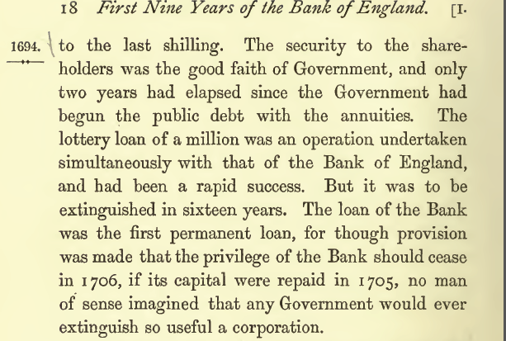
Bank of England Founded in Stealth
THOROLD ROGERS, THE FIRST NINE YEARS OF THE BANK OF ENGLAND

Slide 37
Bank of England Founded in Stealth
CREDIT BASED ECONOMY
WHY IS GOVERNMENT CREDIT UNDER A PRIVATE BANK
DIFFERENT FROM GOVERNMENT CREDIT WITH PUBLIC MONEY?
The Bank’s great strength was that, in response to the previously existing fear
of Royal default on the Crown’s obligations, it served as a “commitment device”
making the government’s promise to pay its debts trustworthy.

Slide 38
Bank of England Founded in Stealth
THE BANK BLACKMAILED THE CROWN
From the £ 1,200,000 subscribed, the bank gave the government:
£ 720 cash
£ 480 Bank notes
The Bank retained:
£ 480 cash
£ 720 Bank notes
The government spent the notes into circulation for war.
The Bank spent the notes into circulation to buy up William’s tally stick
I.O.U.s at 7% discount.
The Bank’s notes became a part of the money supply.
If William wished to change this, he would either have to repudiate the debt
(which might bring James II back) or repay the loan (which needed the
Parliament to vote extra taxation but Parliament was under the influence
of the Bank).

Slide 39
Bank of England Founded in Stealth
FROM ITS INCEPTION, THE BANK LENT FREELY.
PRICES ROSE FROM 100 TO 137 BETWEEN JUNE 1694 AND AUGUST 1695.
“It is then obvious why it was that the Bank inflated in 1695… the incidental consequence of inflation was a rise in prices, its essential consequence was so to increase the proportion of the Bank’s money in circulation to King’s money as to make the Bank’s money an essential part of the nation’s economy.” Christopher Hollis, The Two Nations, p. 33
“The Government, quite mistaking the disease, thought that the rise in prices was due to the clipped money, although English money had been clipped since the beginning of time and prices had remained perfectly stable since Cromwell’s death. Christopher Hollis, The Two Nations, p. 31

Slide 40
PART 7
Opposition to the Bank

Slide 41
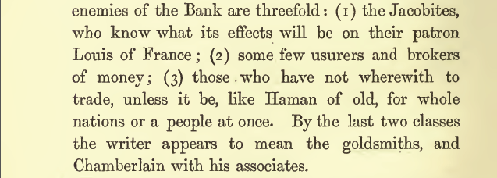
Opposition to the Bank
PATERSON POINTS OUT ENEMIES OF THE BANK
JACOBITES
GOLDSMITHS
MISTRUSTING
LANDHOLDERS
THOROLD ROGERS, THE FIRST NINE YEARS OF THE BANK OF ENGLAND

Slide 42
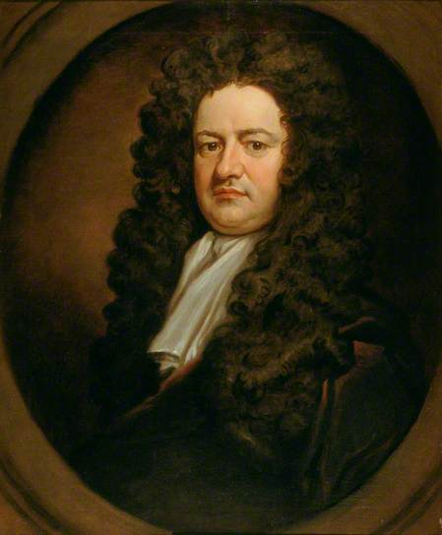
Opposition to the Bank
SOME OPPOSED IT ON ECONOMIC AND MORAL GROUNDS
“… WHO CAN THINK THAT POSTERITY WILL BE WILLING TO
PAY A TAX OF £ 110,000 PER ANNUM (ON THE ORIGINAL
LOAN) NOT FOR THE SUPPORT OF THEIR OWN
GOVERNMENT, FOR THE TIME BEING, BUT TO GO INTO THE
POCKETS OF PRIVATE MEN, STRANGERS AS WELL AS
NATIVES… “
WILLIAM LOWNDES

Slide 43
Opposition to the Bank
TORIES FORMED COMPETING LAND BANK – APRIL 1696
'Dr. Hugh Chamberlen's Proposal to make England Rich and Happy.‘
The bank was to advance money on the security of landed property by issuing large quantities of notes.
Land was the reserve asset. The fallacy with a land bank: as new money is created on land security,
the value of property is inflated, so even more money is created. Eventually this bubble bursts.
Within five months of its creation, only a few thousand pounds were subscribed. The landowners
had tried to establish the bank in the middle of a general re-coinage, when coin was scarce.
THIS HISTORICAL CASE WAS AN IMPORTANT INDICATOR
OF THE EVENTUAL DOMINANCE OF THE LANDED INTEREST BY THE MONEY POWER:
The landowners wanted the land bank to get money, not to invest money in land.
While they were land rich, they were cash poor and generally wanted to borrow
Money.
The Bank soon created a "new class" of moneyed interests in the City, as opposed
to the power of the old barons, whose fortunes derived from their landholdings.

Slide 44
PART 8
First Failure of the Bank of England

Slide 45
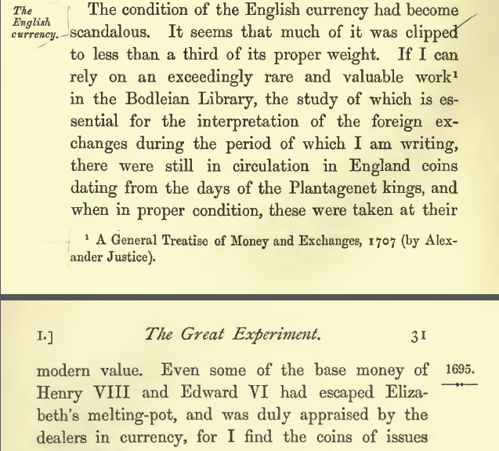
First Failure of the Bank of England
First Failure of the Bank of England
COINAGE CLIPPED
TO LESS THAN THIRD OF ITS WEIGHT
THOROLD ROGERS,
THE FIRST NINE YEARS OF THE BANK OF ENGLAND

Slide 46
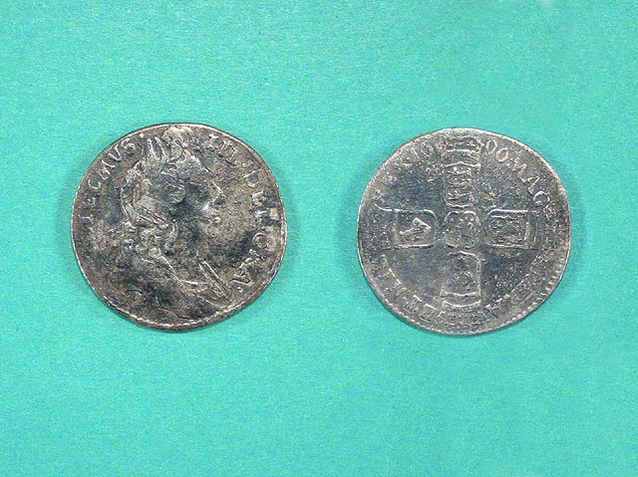
First Failure of the Bank of England
THE GOVERNMENT UNDERTOOK A RECOINAGE – REDUCING THE MONEY SUPPLY
In concert with John Lord Somers, Matthew Locke and Sir Isaac Newton,
Montagu devised the milled coinage that made this abuse impossible,
and paid for this reissue of the coinage by the invention of the window tax.
William III silver sixpence minted in 1696. This is one of the earliest milled edge coins. It remained in circulation throughout much of the 18th century

Slide 47
First Failure of the Bank of England
AFFECTED BY THE RE-COINAGE, THE BANK FAILED FOR THE FIRST TIME IN 1696:
IT COULD NO LONGER REDEEM ITS PAPER NOTES IN COINAGE
William Patterson pointed out the manipulation of the money power by the Bank for benefit of its own members, not society.
“Would they be indulged at the price of the Nation’s suffering?.... I am sure they deserve no indulgence at all… It is not impossible that they may return to their senses and act as becomes men… therefore as we usually bid beggars work, so must I bid those men pay… They are opulent and can do it… they ought upon the first sense of distress to have called in the forty percent from each of their members… instead of calling for it… they have borrowed 20% of their members as a favor.”
DOES THIS REMIND YOU OF THE ‘TOO BIG TO FAIL’ BANKS IN THE CRISIS OF 2008?

Slide 48
PART 9
Gradual Development of the Bank

Slide 49
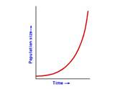
Gradual Development of the Bank
THE BANK FIT THE GOVERNMENT’S NEED FOR WAR FINANCE
The national debt increased steadily during the eighteenth century:
from £ 12,000,000 in 1700
to £ 850,000,000 by the end of the Napoleonic wars.
£ 850
THIS WAS A 700% RISE IN THE NATIONAL DEBT.
DEBT
IN MILLIONS
£ 12
1700
1815

Slide 50
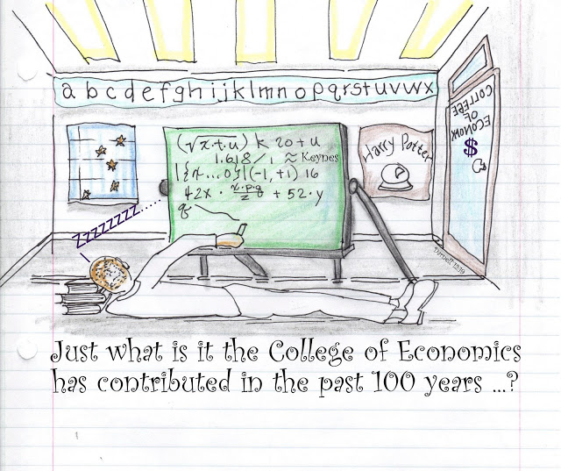
Gradual Development of the Bank
THE BANK ACCUMULATED POWER OVER THE PEOPLE
THE BANK’S MAIN PROTECTION:
ITS COMPLEXITY KEPT PEOPLE FROM UNDERSTANDING THE TRUE SOURCE OF ITS POWER –
THE MONEY CREATION PROCESS

Slide 51
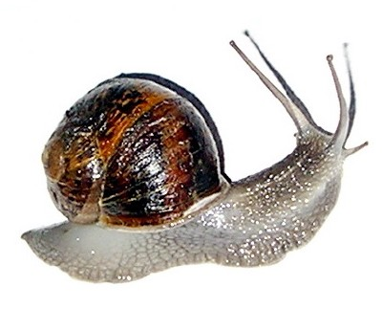
Gradual Development of the Bank
THE BANK ACCUMULATED POWER SLOWLY
For many years, its notes circulated only in London.
1698 – clause enacted permitting Treasury to accept Bank’s notes for taxes
1709 – charter renewed with right to double capital and note issue
1844 – monopoly of note issue
BANK

Slide 52
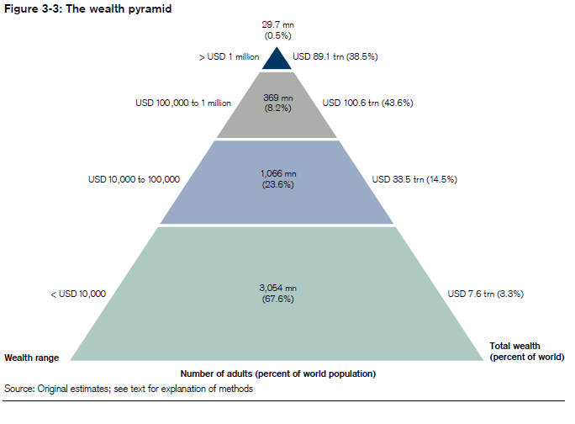
Gradual Development of the Bank
THE BANK’S SLOW GROWTH IN PRIVILEGES
INDICATES ITS POWER WAS KEPT WITHIN A SMALL CIRCLE
J. Keith Horsefield, BRITISH MONETARY EXPERIMENTS 1650-1710, 1960
“A favorite accusation was that the Bank had fallen into the hands of a close ring of related families which put their interests above those of the commercial world generally.”
THE WEALTH PYRAMID

Slide 53
Q & A
WILL DECKER’S CONCLUSION:
THE CONTROL OF MONEY -- WITHOUT CONTROL FROM THE PUBLIC -- LEADS TO
CORRUPTION … USURPATION … SLAVERY.

