Slide 1
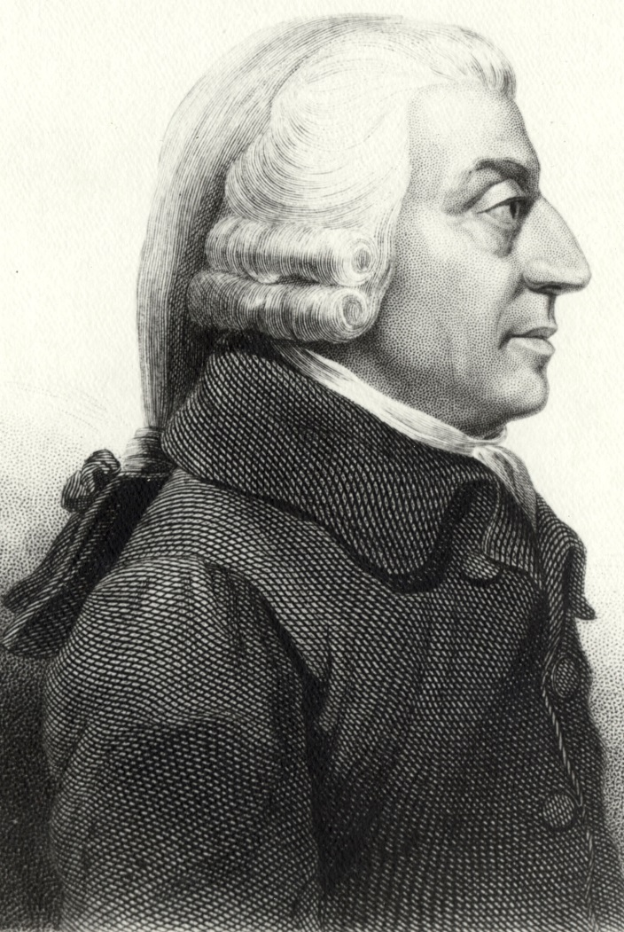
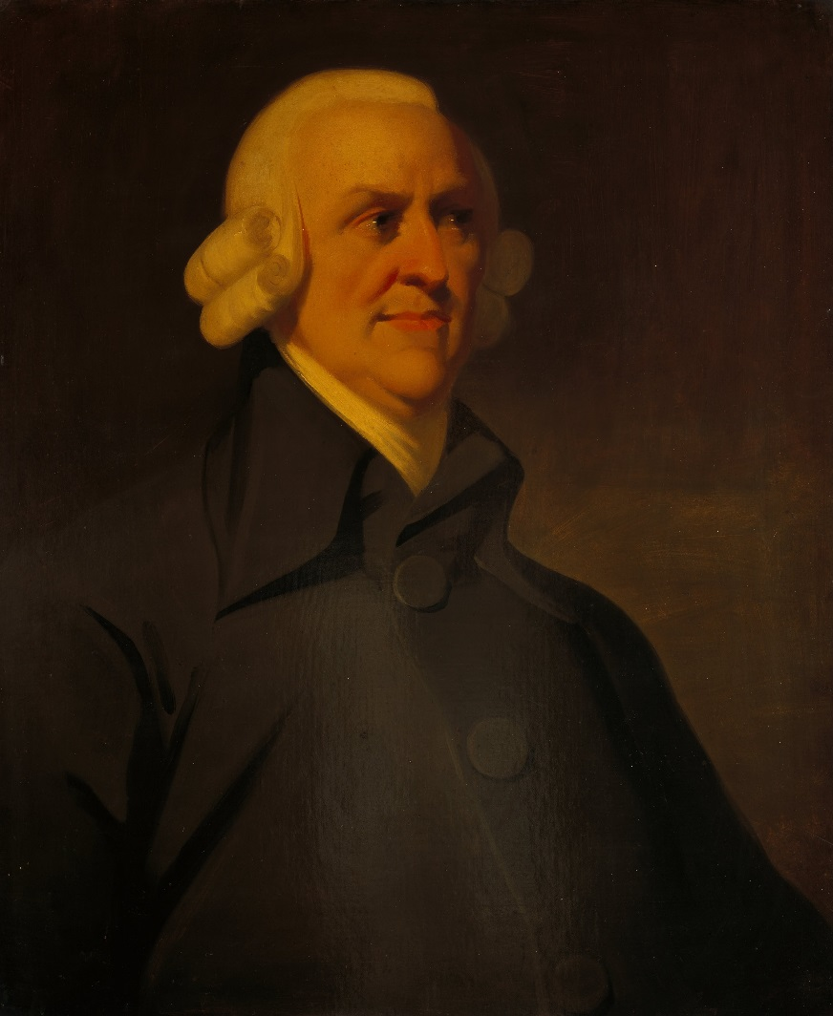
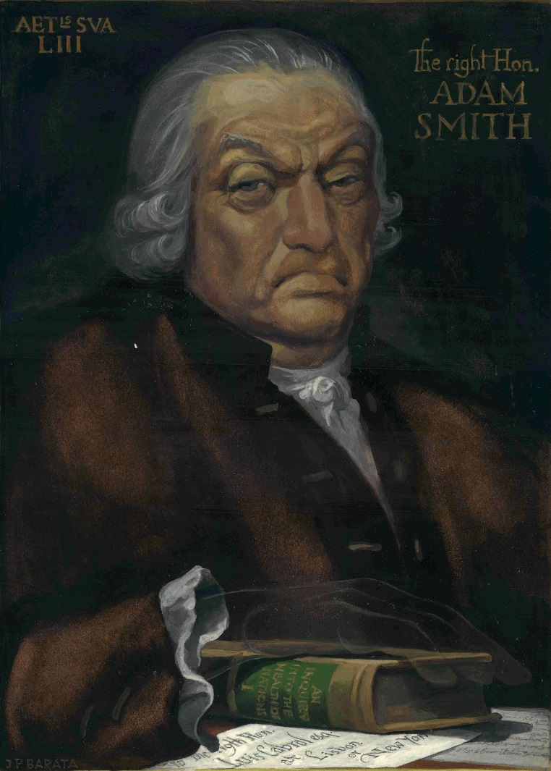
The Lost Science of Money
CHAPTER 12 – PART 1
POLITICAL ECONOMISTS: PRIESTHOOD OF THE BANKER THEOLOGY
ADAM SMITH
ADAM SMITH
ADAM SMITH

Slide 2
THEMES OF LOST SCIENCE OF MONEY BOOK
Primary importance of the money power
Nature of money purposely kept secret and confused
How a society defines money determines who controls the society
Battle over control of money has raged for millennia: public vs private
The misuse of the monetary system causes tremendous misery and suffering for the ordinary working people. Will Decker & Martin Dunn, February 2014

Slide 3
PARTS OF PRESENTATION
INTRODUCTION (SUMMARY)
IDEAS RULE: ECONOMISTS AS PROPAGANDISTS
ECONOMICS DEGENERATES FROM THE SCHOLASTICS
FOSTERING A DISDAIN FOR THE LESSONS OF HISTORY
NICOLA ORESME’S MEDIEVAL MENDACITY
WALPOLE’S DISDAIN & TOWNSHEND’S PROGRESSIVE THEORY OF HISTORY
ADAM SMITH: THE MYTH
  Falsifies the government’s monetary role as minor
  Obscures and degrades the concept of money
  Regresses to gold and silver by weight
  Avoids the quantity of money
  Poor definitions

Slide 4
PART 1
INTRODUCTION (SUMMARY)

Slide 5
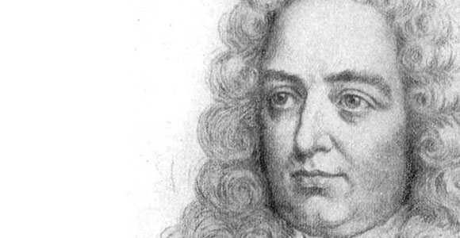
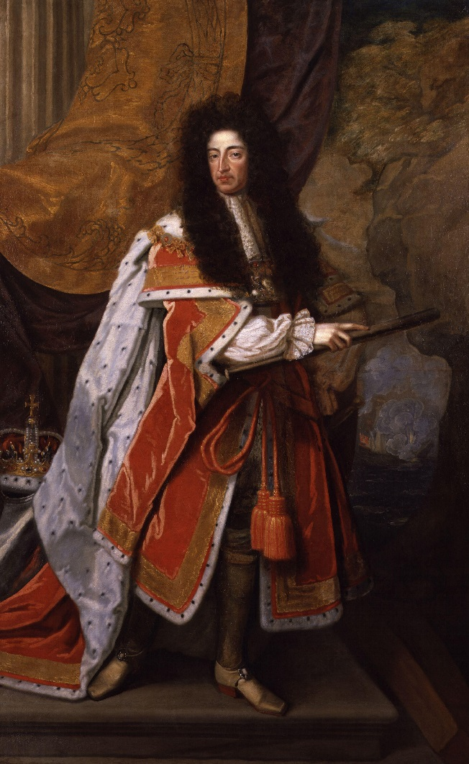
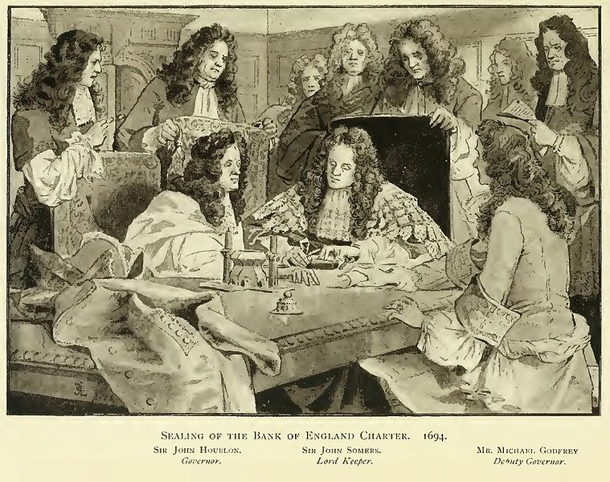
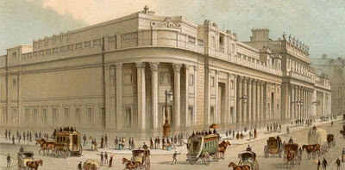
INTRODUCTION (SUMMARY)
Dr. Jonathan Swift, quoted by Cantillon on The Bank:
“… there has been brought in such a complication of Knavery and Cozenage, such a mystery of iniquity, and such a jargon of unintelligible terms to involve it in, as were never known in any age or country of the World …”
WILLIAM III
JONATHAN SWIFT, 1667-1745

Slide 6
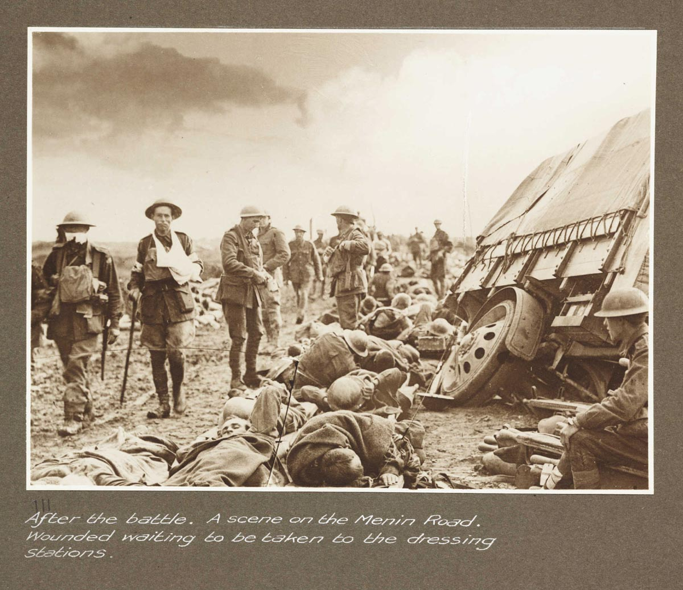


INTRODUCTION (SUMMARY)
Stephen Zarlenga, LSM, p. 305
“The magnitude of the evil that was finally institutionalized in the Bank of England by the Dutch, Jewish and English moneylenders and the House of Orange has not been fully recognized in terms of the long range problems and disharmonies it set in motion against humanity and now even the planet.”

Slide 7
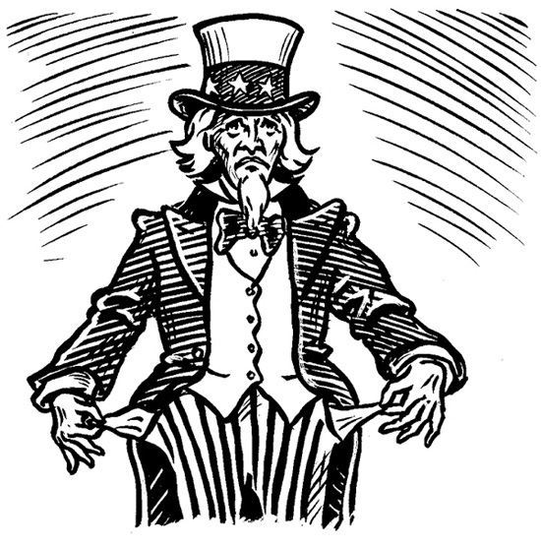


INTRODUCTION (SUMMARY)
Stephen Zarlenga, LSM, p 306
“… private money systems like the Bank of England’s unjustly concentrated the resources of society into a few private hands, crippling the possibility for government to function properly. This would lead to a growing contempt of government.”
Today people say, “We can’t trust the government.” When they should be saying, “We must take back our government.”

Slide 8
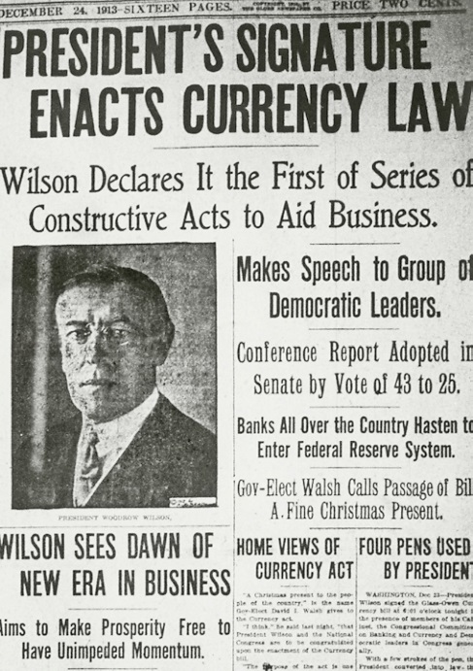
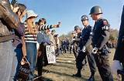

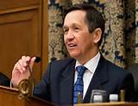
INTRODUCTION (SUMMARY)
The private monetary domination of society has stood on three (four) crucial legs:
Control of the creation and regulation of money (money power)
Using warfare to build up an immense national debt (demoralizing people, crippling government)
Harsh taxation on the populace
Absence of countervailing moral force to identify injustice and call for action against the corrupted monetary regime

Slide 9
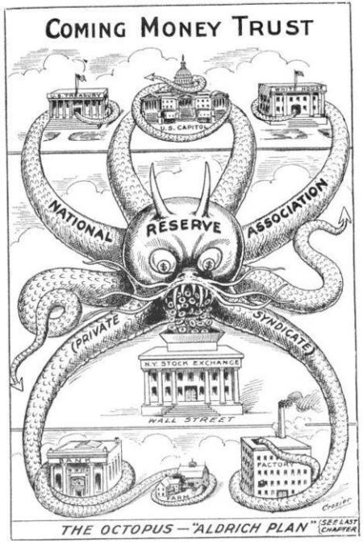


INTRODUCTION (SUMMARY)
The underlying primary source of the power, the well pumping money night and day, was USURY – THE STRUCTURAL MISUSE OF SOCIETY’S MONEY MECHANISM. It is the privilege to create and direct the flow of new credit money and to charge interest on loans of private “money” created out of thin air.

Slide 10
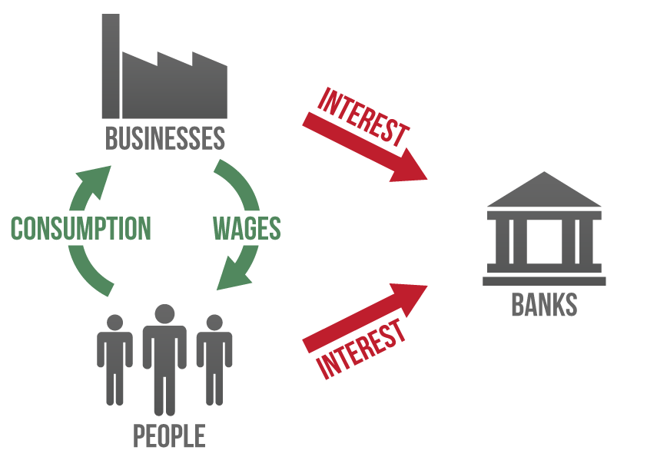

INTRODUCTION (SUMMARY)
It transferred power from Society to the Money Power 24 hours a day, seven days a week whether business was good or bad; whether crops were abundant or there was drought; whether the country was healthy or beset by plague. It transferred this wealth even though its beneficiaries normally did little or nothing useful for their fellow man; but systematically harmed the society to derive greater payments from it, and to render it less capable of protecting itself from their parasitical activities.

Slide 11
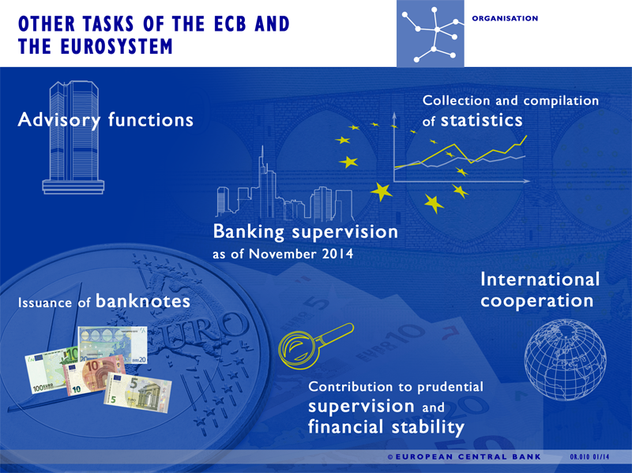
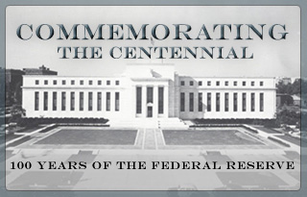
INTRODUCTION (SUMMARY)
They received the wealth of nations through conquest of their money systems. Few shots were fired and no formal surrender occurred to announce to the people that they and their posterity were to be subject to this power.

Slide 12
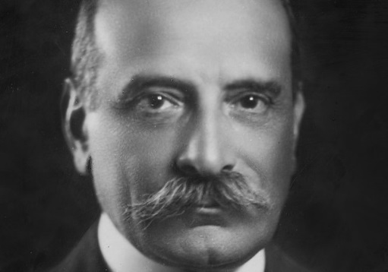
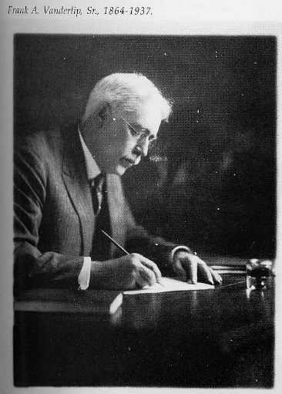
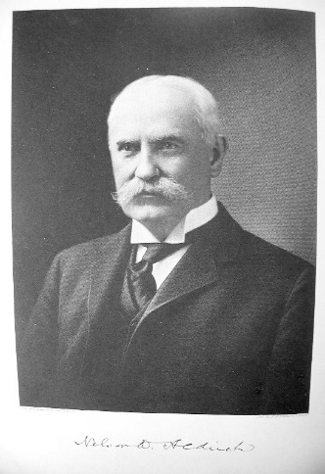
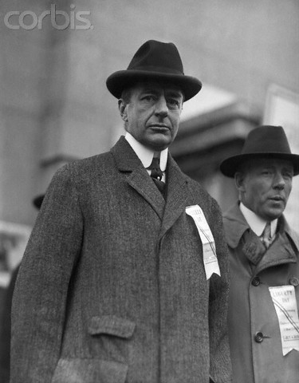
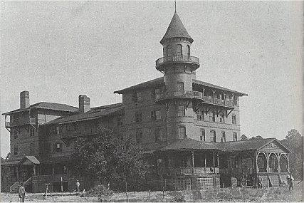
INTRODUCTION (SUMMARY)
Awareness was limited to very few people.
Forbes magazine founder Bertie Charles Forbes wrote several years later:
Picture a party of the nation’s greatest bankers stealing out of New York on a private railroad car under cover
of darkness, stealthily riding hundreds of miles South, embarking on a mysterious launch, sneaking onto an
island deserted by all but a few servants, living there a full week under such rigid secrecy that the names of
not one of them was once mentioned, lest the servants learn the identity and disclose to the world this strangest,
most secret expedition in the history of American finance. I am not romancing; I am giving to the world, for the
first time, the real story of how the famous Aldrich currency report, the foundation of our new currency system,
was written... The utmost secrecy was enjoined upon all. The public must not glean a hint of what was to be done.
NOVEMBER 1910
JEKYLL ISLAND ‘HUNT CLUB’
PAUL WARBURG
GERMAN WARBURG BANK
KUHN, LOEB, & CO, NYC
FRANK VANDERLIP
CITIBANK
(ROCKEFELLER)
NELSON
ALDRICH
(SENATOR,
ROCKEFELLER)
BENJAMIN STRONG
(MORGAN)

Slide 13
PART 2
IDEAS RULE: ECONOMISTS AS PROPAGANDISTS

Slide 14
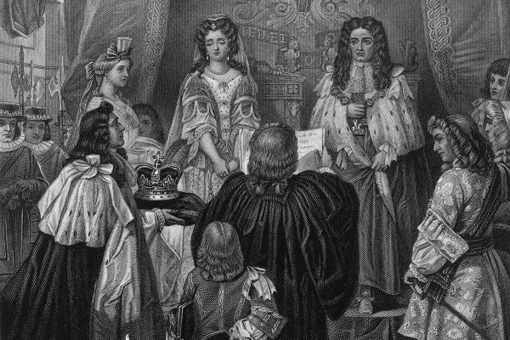
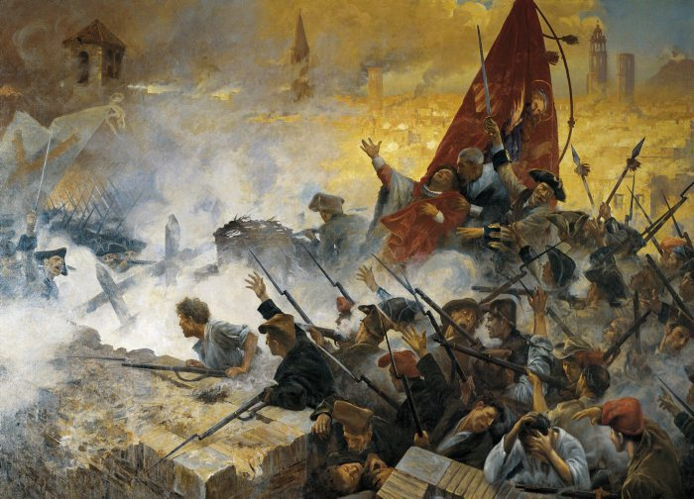
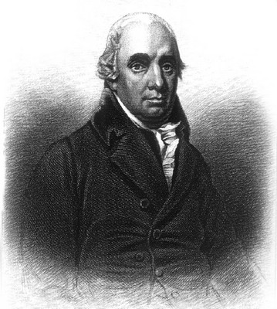
IDEAS RULE: ECONOMISTS AS PROPAGANDISTS
Over time, society is ruled by ideas.
This new private monetary rule over mankind required a new theology that justified and sanctified the new world order.
In the United States, political economy first was taught at the College of William and Mary, where in 1784, Smith's The Wealth of Nations was a required textbook.
1688 WILLIAM III & WIFE MARY
WILLIAM’S WARS
ADAM SMITH (1723-1790)

Slide 15
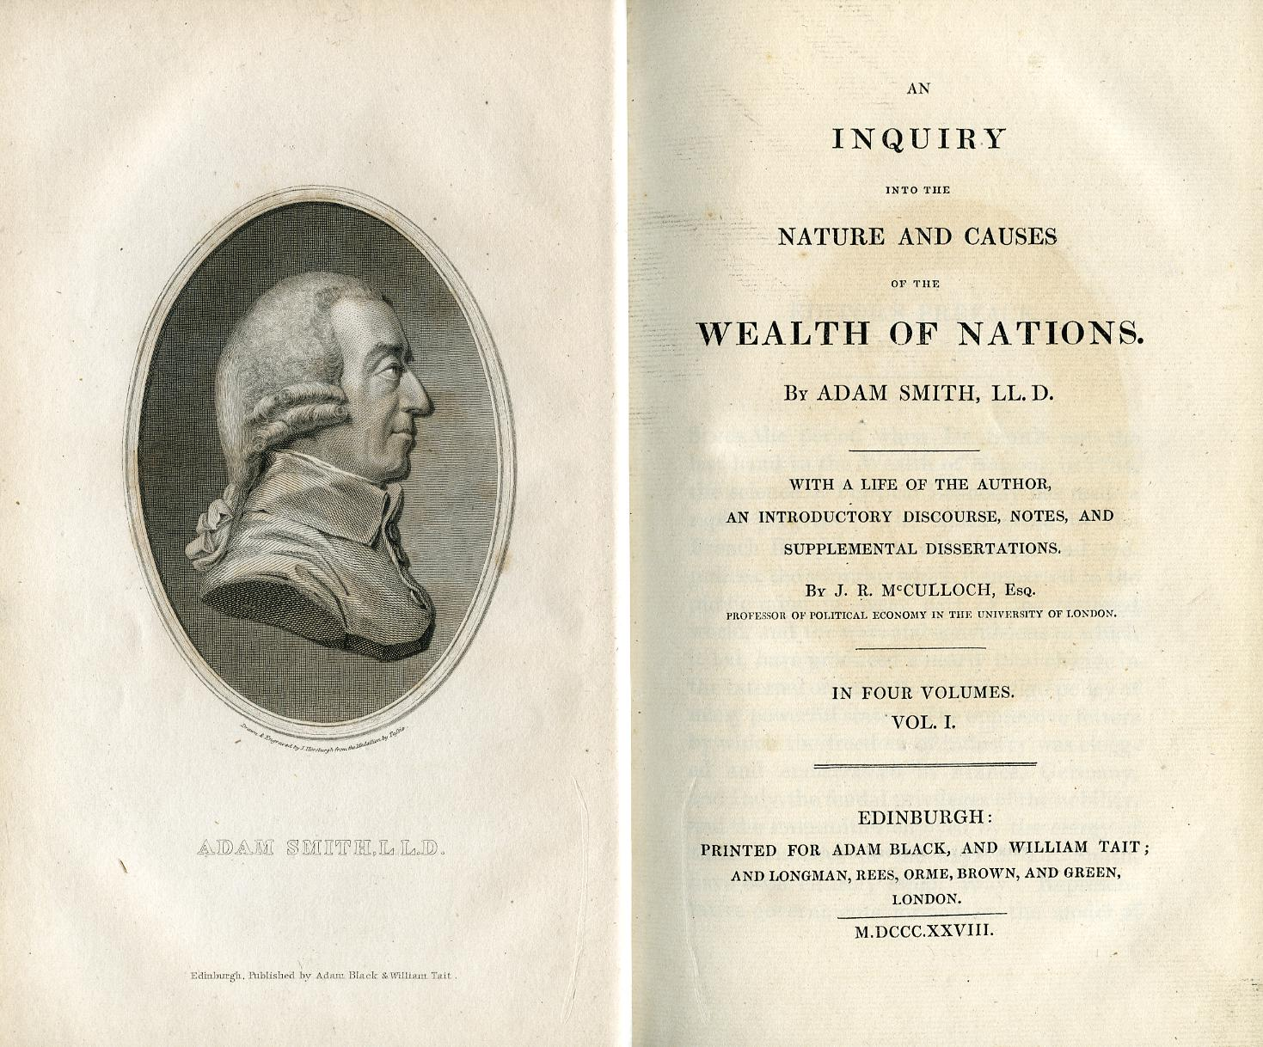
IDEAS RULE: ECONOMISTS AS PROPAGANDISTS
This new theology justifying the private money power would shroud its essentials in MYSTERY. The “Political Economists” served as a propaganda apparatus to whitewash the monetary power structure.
They put forward false ideas and smoke screens on the nature of money, that helped entrench the bankers.
“By the money price of goods it is to be observed, I understand always, the quantity of pure gold or silver for which they are sold, without any regard to denomination of the coin.” Adam Smith, Wealth of Nations

Slide 16
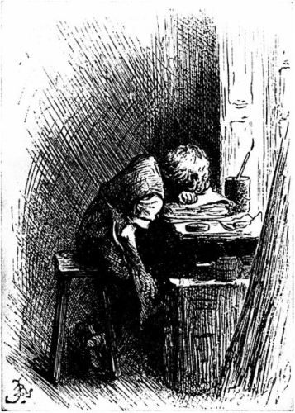
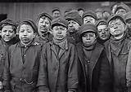
IDEAS RULE: ECONOMISTS AS PROPAGANDISTS
Few economists have included a deep concern for economic justice in their work.
Illustration by Fred Bernard of
Dickens at work in a shoe-blacking
factory after his father had been
sent to debtor’s prison, published
in the 1892 edition of Forster's
Life of Dickens

Slide 17
PART 3
ECONOMICS DEGENERATES FROM THE SCHOLASTICS

Slide 18
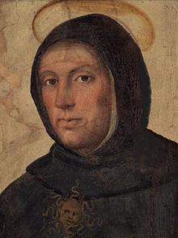
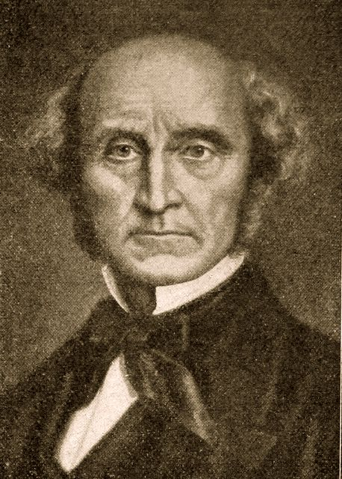
ECONOMICS DEGENERATES FROM THE SCHOLASTICS
Catholic Scholastics (1100-1500 AD)
Church scholars – first moral economists
Political Economists (1700+ AD)
examine the nature of wealth and the laws, both natural and man made, governing its production and distribution.
THOMAS AQUINAS
1225 - 1274
“Money is medium in exchange, and not terminus.” Money is not an end in itself.
A loan has no risk to the lender; therefore usury is unearned income.
JOHN STUART MILL
1806-1873
The Scholastics concentrated on the morality of economic activity, drawing conclusions from certain principles they held to be true.
Political economists also stressed the theoretical approach, but did away with any morality of economic activities.

Slide 19
PART 4
FOSTERING A DISDAIN FOR THE LESSONS OF HISTORY

Slide 20
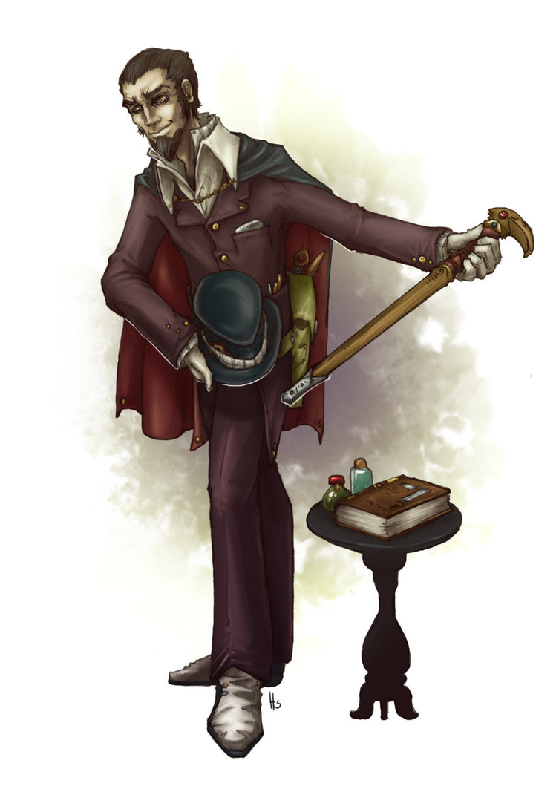
FOSTERING A DISDAIN FOR THE LESSONS OF HISTORY
H.S. Foxwell, 1908, preface to Andreades, History of the Bank of England, p xii:
“It was not the absence of official records that left so many other chapters of English economic history to be first dealt with by foreigners. The main cause is to be found in the anti-historical bias of the dominant school of English official economists, most of them avowed disciples of … David Ricardo. Their doctrinaire habits of thought, and their belief that they were in possession of a set of ‘principles’ of universal application, led them to frown on historical research as at best mere waste of time.
… historical differences had no interest, and he relegated history to the antiquary. This, as we now see, is really the attitude of the quack.”

Slide 21
PART 5
NICOLA ORESME’S MEDIEVAL MENDACITY

Slide 22
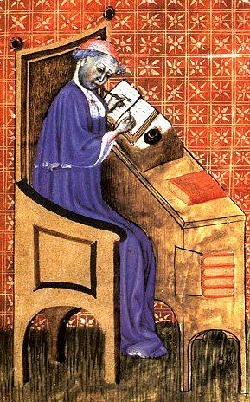
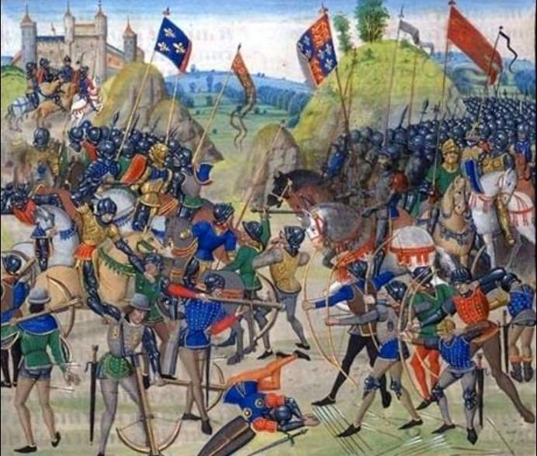
NICOLA ORESME’S MEDIEVAL MENDACITY
Oresme, counselor of King Charles V of France, supported the aristocracy
in its reactions to the Crown’s debasement of the currency. Here was a
Catholic precedent to the monetary trickery of the Political Economists.
When Oresme wrote, the first phase of the Hundred Years War between the
Plantagenets and the Valois had been going on for twenty years. The French
kings, in desperation, had resorted to an almost continuous series of
debasements of their coinage in order to provide money to meet a succession
of expensive emergencies.
The results for landowners were catastrophic.
NICOLA ORESME
1323 - 1382
Battle of Crecy, France
26 August 1346

Slide 23
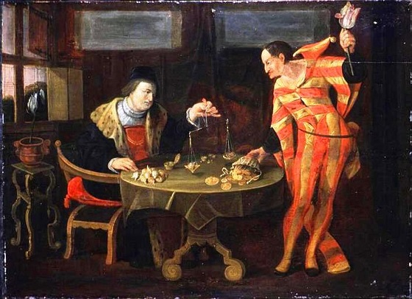
NICOLA ORESME’S MEDIEVAL MENDACITY
As early as the 14th century, some men, such as the Treasurer General of the town of Navarre, understood who gained or who lost by certain monetary policies:
“Everywhere there are four sorts of men.
The first … are those who have rents … they want money of strong alloy.
The second … are those who engage in commerce … trade is always poor except when money is in a middle state.
The third sort of men are those who live from the work of their bodies. These would wish to have weak money …
The fourth sort of money is desired by lords when they are at war (and want to pay troops in feeble coin).”

Slide 24
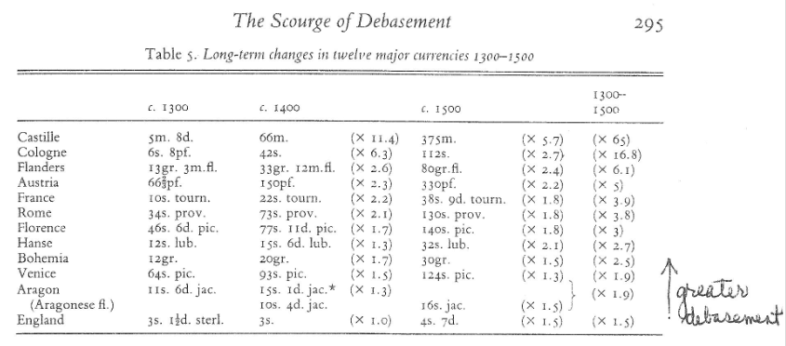
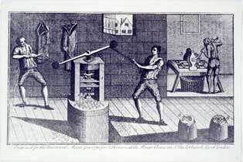
NICOLA ORESME’S MEDIEVAL MENDACITY
The royal theory was that any king or prince, may, of his own authority, by right or prerogative,
freely alter the money current in his realm, regulate it at his will, and take whatever gain or
profit may result.
The cornerstone of Oresme’s theory was that coinage belongs to the ‘community’, i.e., noble landlords, not to the prince. Therefore, the ‘community’, not the prince, might alter the coinage in emergencies. His views became a new orthodoxy in France and Europe for the next two centuries.
The English Royal Mint

Slide 25
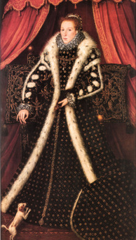
NICOLA ORESME’S MEDIEVAL MENDACITY
Oresme’s argument is purely one-sided; for him the only sort of good money was strong money:
“… because of these alternations, … money-rents, yearly pensions, leases, cesses (censure) and the like, cannot be well and justly assessed, or valued, as is well known.” Oresme
“A closer look at Oresme’s argument shows that as far as trade was concerned he was only interested in the import-trade, that is in the supply of luxury goods to be landowning classes. Even his arguments about trade are tinged with party interest.” Spuffold, Money and Its Use in Medieval Europe, p. 306.
LUXURY GOODS OF THE LANDOWNING CLASS

Slide 26
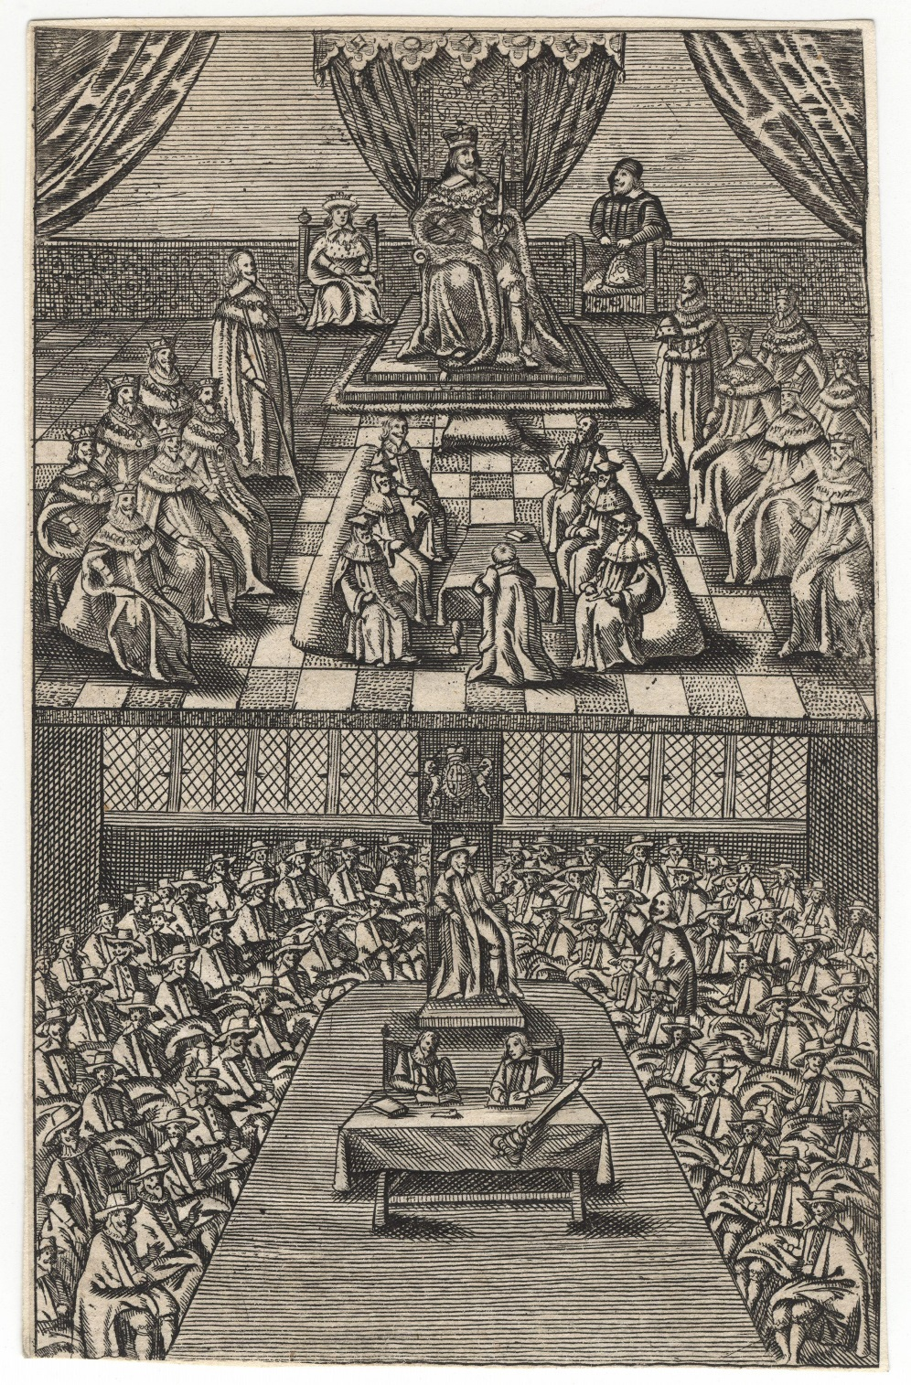
NICOLA ORESME’S MEDIEVAL MENDACITY
The Kings of England, who had a tradition of relatively frequent, direct taxation by parliamentary grant, and of a continued revenue from the customs, particularly the wool-customs, were in a favoured position compared with their French enemies.
The English kings could mobilize a much greater proportion of the wealth of their smaller kingdom without recourse to debasements. It was the early growth of an efficient system of lay subsidies that saved the English nobility from the scourge of debasement.
In France, the Netherlands and Castille, the overwhelming expenses of war provoked the rulers to violent debasements … the economic effects were in general favourable for the payers of fixed dues … bad for the consuming classes in general.
House of Lords and House of Commons during King Charles I’s reign, c. 1640-42

Slide 27
PART 6
WALPOLE’S DISDAIN & TOWNSHEND’S PROGRESSIVE THEORY OF HISTORY

Slide 28
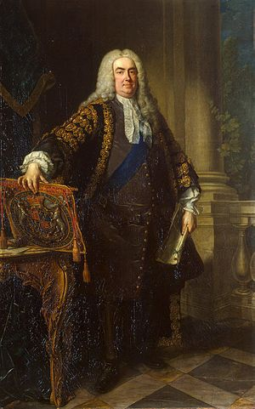
WALPOLE’S DISDAIN & TOWNSHEND’S PROGRESSIVE THEORY OF HISTORY
ROGER WALPOLE, PRIME MINISTER - 1721-1742
“Walpole ruled England for more than twenty years. The method by which
he ruled was the method of frank bribery and blackmail.”
“At least he spent the money that he made – on building a house, on
entertainment, on the pleasures of the country. He did not merely lend out
again at usury the profits of usury in a lunatic’s lust for accumulation.
Whatever he was, he was at least a man and not a bank.”
“ ’The bank hath benefit of the interest of all the moneys which it creates out
of nothing’, explained Paterson – which again was fair enough and frank enough,
but would not perhaps a little something about ‘service to the community’ have
been a trifle more discreet? … If the poor heard too much talk like that the whole
regime must collapse.”
Christopher Hollis, The Two Nations, pp. 35-36

Slide 29
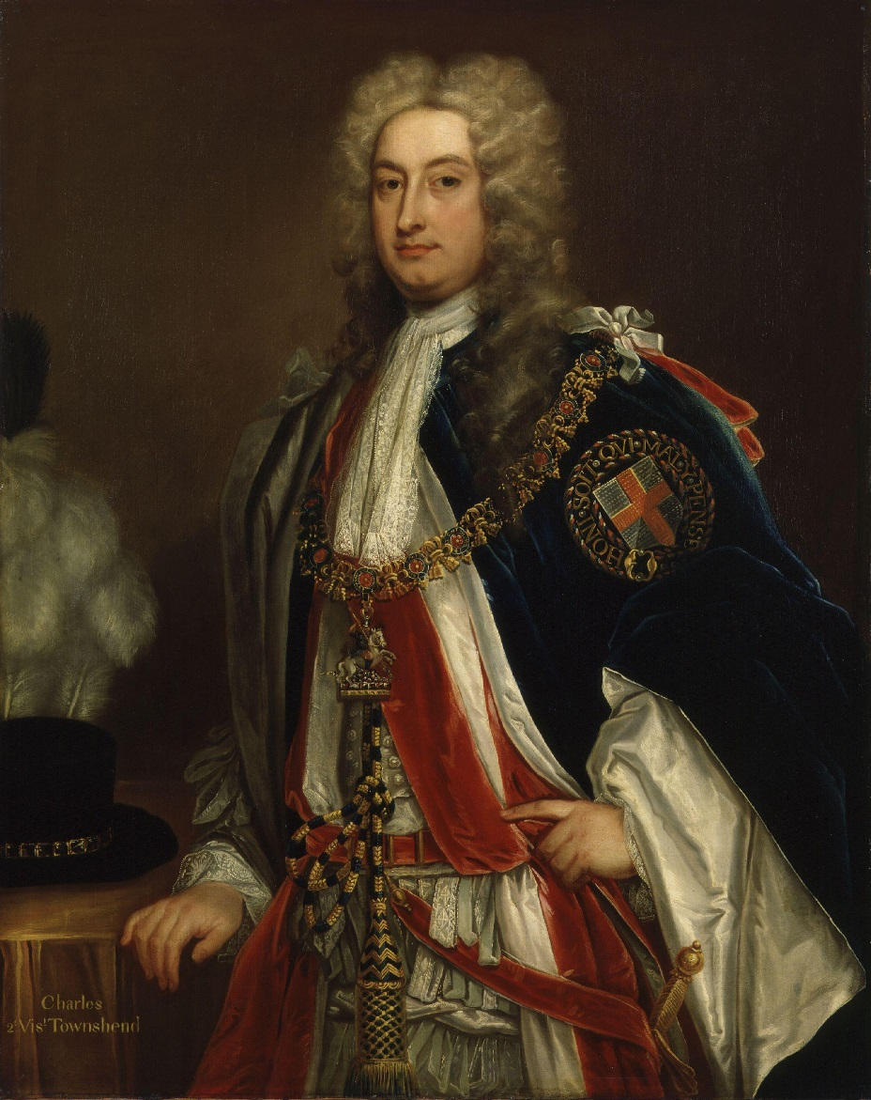
WALPOLE’S DISDAIN & TOWNSHEND’S PROGRESSIVE THEORY OF HISTORY
CHARLES TOWNSHEND, WALPOLE’S BROTHER-IN-LAW - 1674-1738
“It was Townshend … who grasped perhaps more clearly than any of the other Whigs of the early eighteenth century that an aristocracy, if it is to retain its privileges, must make some pretence of earning them by some service to its country.” Hollis, p. 37
“It was not convenient, as Townshend and his colleagues saw, that the methods by which the gentlemen of England had become so should be widely known. Therefore attention must be diverted from the details of that rise, and an official version must be put out to occupy the minds of those whose interest in history it was not possible wholly to suppress.”
Hollis, p 37

Slide 30
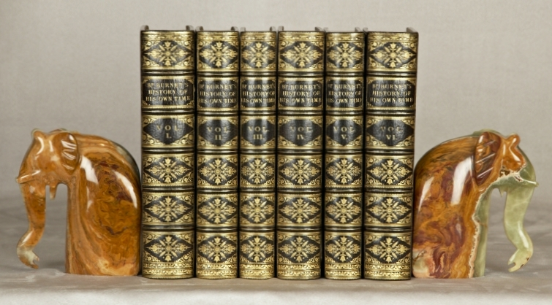
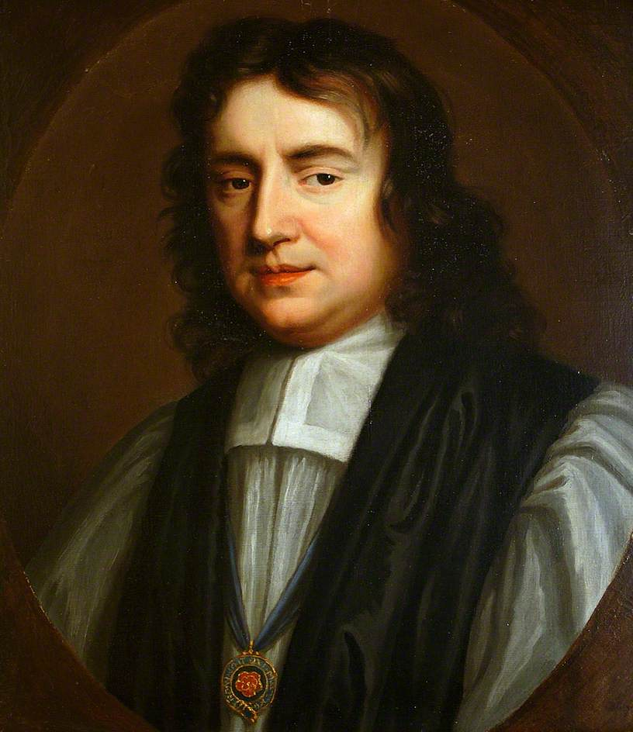
WALPOLE’S DISDAIN & TOWNSHEND’S PROGRESSIVE THEORY OF HISTORY
Gilbert Burnet, English bishop and historian -- 1643-1715
“Burnet now travelled … finally settling in Holland, at the Hague, where he won from the princess of Orange a confidence which proved enduring. He rendered a signal service to William by inducing the princess to offer to leave the whole political power in her husband's hands in the event of their succession to the English crown … in Holland he married a Dutch heiress … He returned to England with William and Mary, and drew up the English text of their declaration.” http://www.ourcivilisation.com
“… as the war dragged on, Burnet grew to be seriously alarmed at the unpopularity of the debt-system among the gentry who had to pay the taxes to meet its charges … a Whig History must be written … to show ‘what are the methods bad princes have taken to enslave us and by what conduct we have been preserved.” Hollis p 37
Bishop Burnet's History of His Own Time,
6 volumes

Slide 31
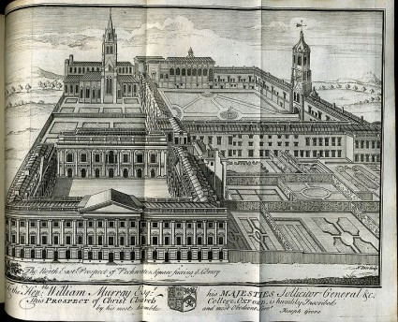
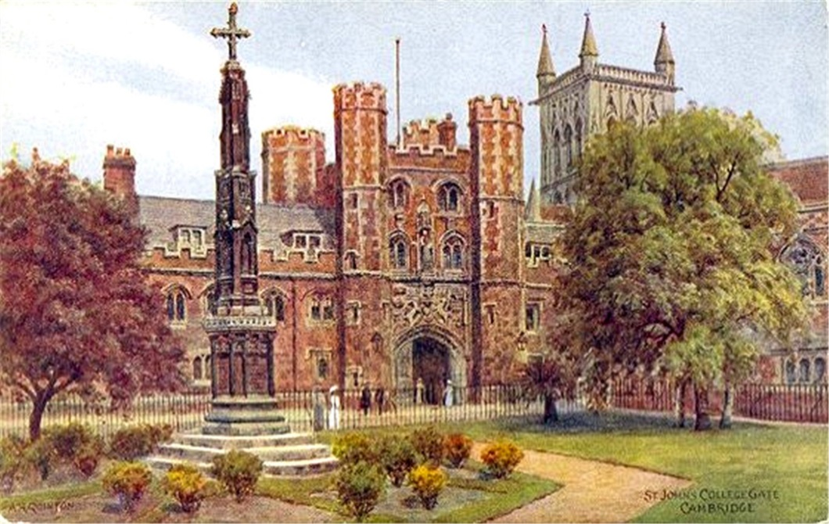
WALPOLE’S DISDAIN & TOWNSHEND’S PROGRESSIVE THEORY OF HISTORY
“SO THE WHIG HISTORY WAS WRITTEN …
THE IMPORTANT TASK WAS TO CAPTURE THE EDUCATIONAL MACHINE …” Hollis, p 38
“ … in 1724, Townshend and Gibson, Bishop of London, arranged for ‘24 persons, who are Fellows of Colleges in the two Universities, 12 from Oxford and 12 from Cambridge” to preach a sermon each at Whitehall .. to receive the considerable emolument of £30 … and none ‘must hope for a share of this bounty but they who are staunch Whigs and openly declare themselves to be so’. ”
“ But … there was needed, thought Townshend, ‘some further encouragement’. “
OXFORD
UNIVERSITY
(Tory)
CAMBRIDGE
UNIVERSITY
(Tory)

Slide 32
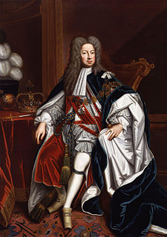
WALPOLE’S DISDAIN & TOWNSHEND’S PROGRESSIVE THEORY OF HISTORY
Townshend wrote to George I: “ ‘As Your Majesty knows I have always had the gaining them (university tutors)
over to Your Majesty … some things proper to this end … the foundation of a new professorship to teach the
modern tongues and modern history …’ “ Hollis p. 38
KING GEORGE I OF HANOVER &
GREAT BRITAIN
Therefore, the crown appointed and funded two new Regius (“Royal”) Professorships. “The duties of the Professor were to deliver one lecture a term and to keep an eye on ‘twenty scholars nominated by the King to be taught gratis’ and every year to send ‘an attested account of the progress made by each scholar … to our principal Secretary of State’. “ Hollis p. 39
CAMBRIDGE U. - Regius Professor of Modern History, 1724
OXFORD U. - The Regius Professor of History, 1724

Slide 33
WALPOLE’S DISDAIN & TOWNSHEND’S PROGRESSIVE THEORY OF HISTORY
WHAT WAS THE HISTORY
WHICH THESE ENDOWED TEACHERS TAUGHT?
“It was the progressive theory of history – a theory hitherto unknown, a theory, soon, as a result of their activities, accepted uncritically, a theory created in the first place quite cynically and clear-headedly in order to cover up the traces of truth ... It was the purpose of that history to create among the public the ambient feeling that, bad as things might be at the moment of writing, yet the lesson of history was a lesson of steady improvement.” Hollis p. 40

Slide 34
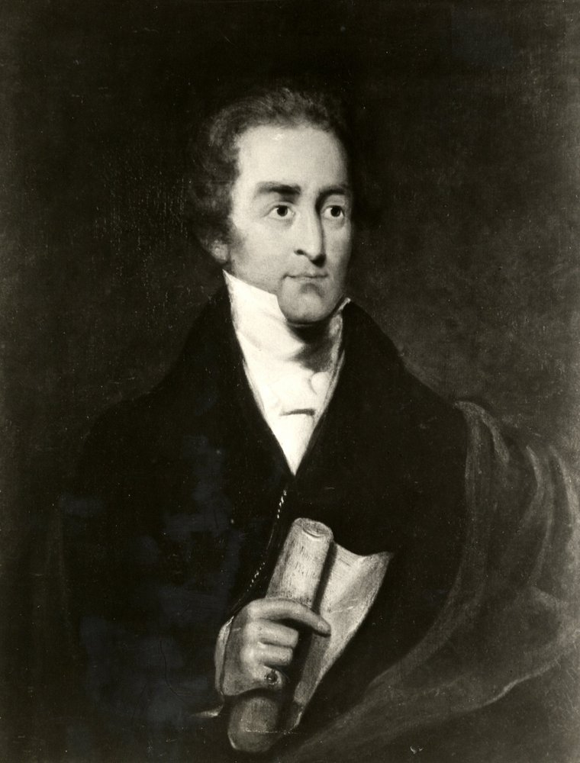
WALPOLE’S DISDAIN & TOWNSHEND’S PROGRESSIVE THEORY OF HISTORY
“So by the end of the eighteenth century the progressive theory of history had received general acceptance among those who claimed for themselves the prestige of educated people.” Hollis p 40
“As a consequence … all the ablest youths … should never come in contact within any problem that had been a reality since the foundation of Christianity. And yet in this world of unreality they acquired qualifications which they imagined to entitle them to positions of command in the real world.
Thus Sir Robert Peel … was allowed without question to take a leading part in his country’s government, and neither he nor anyone else ever suspected for a moment his total misunderstanding of the forces that had gone to shape that country.” Hollis p 41
Sir Robert Peel, 1788 - 1850

Slide 35
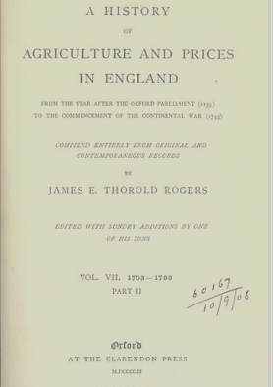
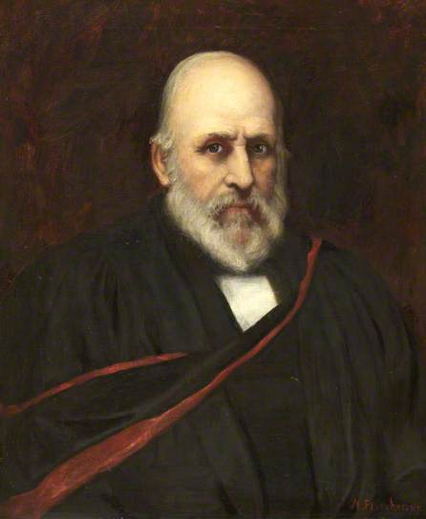
WALPOLE’S DISDAIN & TOWNSHEND’S PROGRESSIVE THEORY OF HISTORY
WHAT WAS THE TRUTH?
A HISTORY OF AGRICULTURE AND PRICES IN ENGLAND (1259 – 1793)
by Thorold Rogers
“A clergyman Thorold Rogers lived in Oxford (c. 1850) and made a living coaching in the
classics and philosophy. In 1860, however, he began serious research into the wages and
prices ruling at the various dates in English history, and on the strength of this research
in 1862 he was elected Drummond Professor of Political Economy … The statistics which he
collected alone fill a thick volume, and there is no reason to suspect that the conclusions
at which he arrives are generalizations from insufficient data.” Hollis pp 43-43
TRUTH: “Between Henry VII’s time and 1850 the population
of England multiplied by about five … the productivity of the
country had multiplied by about four by 1800 … and multiplied
by another four and a half between 1800 and 1850, making a
total of 18. As a result the poor ought to have been between
three or four times better-off. They were, however, considerably
worse off. The gentlemen of England, so far from being those
leaders of the nation towards a finer and a wider freedom which
the progressive history had represented them to be, were
revealed as in the heyday of their power the trickiest and most
rapacious class ever known among men.” Hollid p. 46

Slide 36
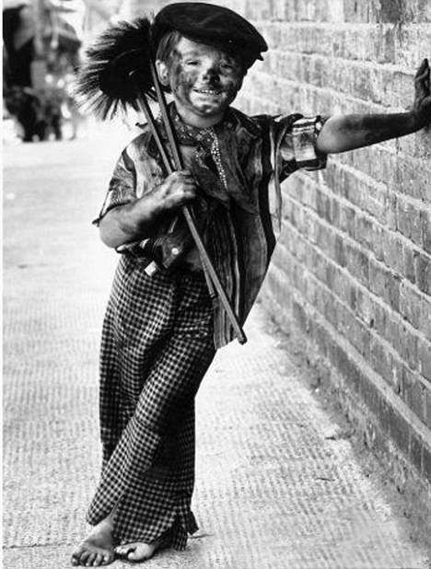
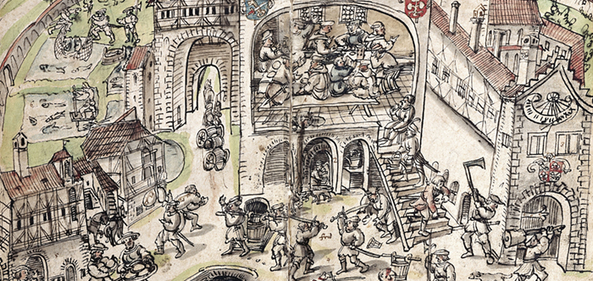
WALPOLE’S DISDAIN & TOWNSHEND’S PROGRESSIVE THEORY OF HISTORY
“There is hardly a scholar in all Europe to-day (1935) who would not acclaim Rogers’ greatness. But has anyone who has only studied history in the text-books that they dole out in the public schools ever heard either his name or his thesis? Has such a one to-day any notion that solid scholarship has seriously challenged, let alone refuted, the progressive theory of history?” Hollis p 48
“The poor in Townshend’s day were illiterate. Therefore … there was no necessity to educate them wrong. As a result there remained among them a strange and clouded memory that there had been good times in the past before the dissolution of the monasteries … it came from the fact that it was the coining of the monastic plate that started the rise in prices.” Hollis p 48
PLUNDER OF
MONASTERIES
1536-1541

Slide 37
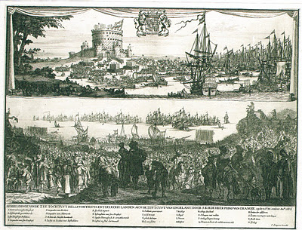

WALPOLE’S DISDAIN & TOWNSHEND’S PROGRESSIVE THEORY OF HISTORY
“Now how was it that this perversion of history played into the hands of the masters of the credit-system? That was not its original purpose, the purpose for which Townshend and his friends invented it … As has been argued, the Revolution of 1688 was essentially the work of gentlemen; the bankers were their very subordinate allies ...
Yet the most important result of that Revolution was the concession to the Bank of England of the extraordinary privilege of inventing money – a privilege which, as Swift demonstrated, by an inevitable mathematical necessity has caused the possessors of it to acquire a lien on the entire wealth of the nation to the loss of the gentlemen and everybody else.” Hollis p 49
WILLIAM III’S
GLORIOUS REVOLUTION
CHARTER OF
BANK OF ENGLAND

Slide 38




WALPOLE’S DISDAIN & TOWNSHEND’S PROGRESSIVE THEORY OF HISTORY
“Nothing would have been easier than for a system of education to explain to its pupils the nature of this privilege of the bankers … But Townshend’s education did not dare … tell the story of the founding of the Bank of England … unless you also told the true story of the Revolution of 1688. The two were inextricably intertwined.”
Thus, secure against all dangers of publicity, the power of usury was able to extend its control over the state … Under the system the gradual extrusion of the landed classes by the monied classes was mathematically inevitable. It happened.” Hollis p. 50
Landed gentry is a British social class of land owners who could live entirely off rental income.
In 1688 … the income of a merchant prince was half of
a baronet, little more than an eighth that of a nobleman,
and little more than a third that of a bishop.
In 1750 … the City of London had a larger commercial
income than the rents of the whole House of Lords and
the episcopal bench.
It was the Napoleonic wars which brought the final and
complete triumph of the money-lenders.

Slide 39


WALPOLE’S DISDAIN & TOWNSHEND’S PROGRESSIVE THEORY OF HISTORY
1818 made Deputy Governor of the Bank of England
- 1820 became Governor of the Bank of England (to 1822)
The people who stepped into power always called themselves gentlemen.
The big landowners, to save themselves,
make use of their voices to get, through place,
pension or sinecure, something back from the
taxers.
Sir Charles Pole –
Deputy Governor of Bank 1818-1820
Governor of Bank 1820-1822
Montagu Norman - 1871–1950 was an English banker,
best known for his role as the Governor of the Bank of
England from 1920 to 1944.

Slide 40

PART 7
ADAM SMITH: THE MYTH
1723-1790
“ … Adam Smith who introduced a spirit of sophistry, confusion and hypocrisy into political economy … even burned his papers on his deathbed for fear lest they should betray his true opinions.” List
Free Trade and Laissez Faire … destruction of the national organization – the only power capable of withstanding the offensive of the money system.

Slide 41
PART 7 - 1
ADAM SMITH: THE MYTH
1. Falsifies the government’s monetary role as minor

Slide 42


PART 7 - Falsifies the government’s monetary role as minor
… public offices called mints; institutions exactly of the same nature with those of aulnagers (wool inspectors) and stamp-masters of woolen and linen cloth … to ascertain the quantity and uniform goodness of those different commodities … THE WEALTH OF NATIONS, p. 11
… Smith would have been intimately familiar with the celebrated 1601 Mixt Monies Case, which alone disproves his mint statement.
* * * * * * * * *
… For in every country of the world, I believe the avarice and injustice of princes and sovereign states abusing the confidence of their subjects have by degrees diminished the real quantity of metal, which had been originally contained in their coins.”
… Smith contradicts himself – showing the great importance he now places on the institution of the mint. He exaggerated the kingly abuse of it and essentially condemned all past government control over money.

Slide 43
PART 7 - Falsifies the government’s monetary role as minor
… Such operations, (reduction of metal content of coins) … have always proved favourable to the debtor and ruinous to the creditor …
… He admits above the great importance of the mint.
… He slips in the false notion that Sovereign states can ‘feel’ avarice. This is an essential part of the attack on society.
* * * * * * * * *

Slide 44
PART 7 - 2
ADAM SMITH: THE MYTH
2. Obscures and degrades the concept of money

Slide 45
PART 7 - Obscures and degrades the concept of money
… some obscurity may still appear to remain upon a subject in its own nature extremely abstracted.
… Smith shifts responsibility for his obfuscation on to the subject matter.
* * * * * * * * *
… By the money price of goods it is to be observed, I understand always, the quantity of pure gold or silver for which they are sold, without any regard to denomination of the coin.”
… Smith does not refute or acknowledge the existence of more advanced concepts of money.

Slide 46
PART 7 - 3
ADAM SMITH: THE MYTH
3. Regression to gold and silver by weight

Slide 47
PART 7 - Regression to gold and silver by weight
… Adam Smith retrogressed the concept of money backwards to “Ponderata”, pure metal by weight. He ignored an advanced numerary based on law and the “Moneta” level of unlimited coinage.
… He had no answer to the great thinkers who showed that money was not merely a commodity.
* * * * * * * * *
… The Bank of England had advanced to abstract paper money 80 years earlier; not in theory, but in practice. Adam Smith regressed to commodity money, not in practice, but in theory.
… His theory applied to their practice would cause confusion and create mystery.

Slide 48
PART 7 - 4
ADAM SMITH: THE MYTH
4. Studied avoidance of the quantity of money

Slide 49
PART 7 - Studied avoidance of the quantity of money
… Equal quantities of labour at all times and places, may be said to be of equal value to the Laborer … Labour alone therefore never varying in its own value, is alone the ultimate and real standard by which the value of all commodities can at all times and places be estimated and compared. It is their real price. Money is their nominal price only.
… Having mis-defined money as a commodity, he had to explain how gold and silver get their value. He said the value of gold and silver as commodities, and as money, is determined by the labor involved in producing them – the cost of production … But we know it’s not up to a laborer how much he will be paid. He is not free to withhold his labor and to starve with his family.
* * * * * * * * *
… Labour … It is their real price. Money is their nominal price only.
… the only price that buyers and sellers are ever concerned with is expressed in terms of money … the metals were taken from American Indian societies at gunpoint, and then mined with slave labor … Did the Indians place equal value on their “labour at all times and places”? Did it make any difference what the Indians thought or valued?

Slide 50
PART 7 - Studied avoidance of the quantity of money
… Even following Adam Smith’s line of reasoning, how would the cost of production affect prices unless it first affected supply (quantity)?
… Smith’s avoidance of quantity protected the Bank of England because their additions to the supply of money were causing a drop in the value of money.
… Smith confused the nature of money with the value of labor.
* * * * * * * * *

Slide 51
PART 7 - 5
ADAM SMITH: THE MYTH
5. Notoriously poor definitions

Slide 52

PART 7 - Notoriously poor definitions
… Thomas Malthus complained about Smith’s obscure concept of labor and value … “in no works of political economy is it considered the measure of value”.
… “It is quite astonishing that Political Economists of reputation should be include to resort to any kind of illustration however clumsy and inapplicable, rather than refer to money.” Thomas Malthus
* * * * * * * * *
… However, when Malthus presented 60 “better” definitions of Political Economy terms, a definition of money is conspicuously absent … Malthus swallowed Smith’s definition of money as gold and silver metal.
… If economics is ever to become a science its terminology must be cleanly defined … that’s why my work concentrates on the definition and correct identification of the nature of money – AS THE KEY BUILDING UNIT OF ECONOMIC THOUGHT.

Slide 53
Q & A
WILL DECKER’S CONCLUSION:
THE CONTROL OF MONEY -- WITHOUT CONTROL FROM THE PUBLIC -- LEADS TO
CORRUPTION … USURPATION … SLAVERY.

Slide 54
POSTSCRIPT
Economics education, for 200 years, removed the creation of new money as a factor in economics.
They call it "demand for money", implying that money supply is related somehow to our demand for it.
They also call it "liquidity" or "savings", implying that it is already created money we are borrowing.
They are bald faced liars! And, finally that is being ferreted out. So, it is no surprise that these PHDs have no vocabulary about the function of the money system.
They want us to think that destruction comes from deep within us, instead of from these mechanistic institutions and their effects on us.
B.B., NEW YORK 2014

