Slide 1
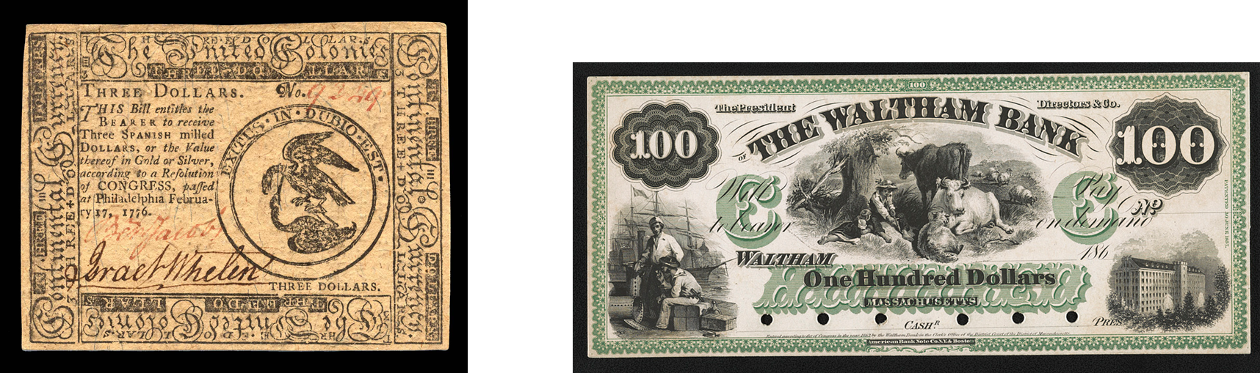
The Lost Science of Money
CHAPTER 16 – Part 2
U.S. GOVERNMENT ISSUED MONEY COMPARED TO PRIVATELY ISSUED MONEY
CONTINENTAL CURRENCY
PRIVATE BANK NOTE

Slide 2
THEMES OF LOST SCIENCE OF MONEY BOOK
Primary importance of the money power (power to create money and regulate it)
Nature of money purposely kept secret and confused
How a society defines money determines who controls the society
Battle over control of money has raged for millennia: public vs private
The misuse of the monetary system causes tremendous misery and suffering for the ordinary working people. Will Decker & Martin Dunn, February 2014
Whenever the public has owned a significant fraction of the money power, great public benefit has ensued: Sparta, the Roman Republic, the American Colonies in the 18th century, GREENBACKS after the Civil War, Canada after the Great Depression, British experience after World War II. Martin Dunn, July 2014.

Slide 3
PARTS OF PRESENTATION
BOSTON’S “SUFFOLK SYSTEM” (1825-1866)
NEW YORK’S SAFETY FUND SYSTEM (1829 – 1866)
COMMENTS ON STATE BANK NOTES – BY BRAY HAMMOND
THE STATE “FREE BANKING” LAWS FROM 1836
THE “FREE BANKING” IDEOLOGUES – A MODERN LESSON IN MISINTERPRETING MONETARY HISTORY
  Problem #1
  Problem #2
  Problem #3
  Problem #4
  Problem #5
THE REIGNING ERROR ON GOVERNMENT MONEY
WHITE’S PURPOSE: TO ATTACK THE GREENBACK
THE JUDGMENT OF THE PEOPLE

Slide 4
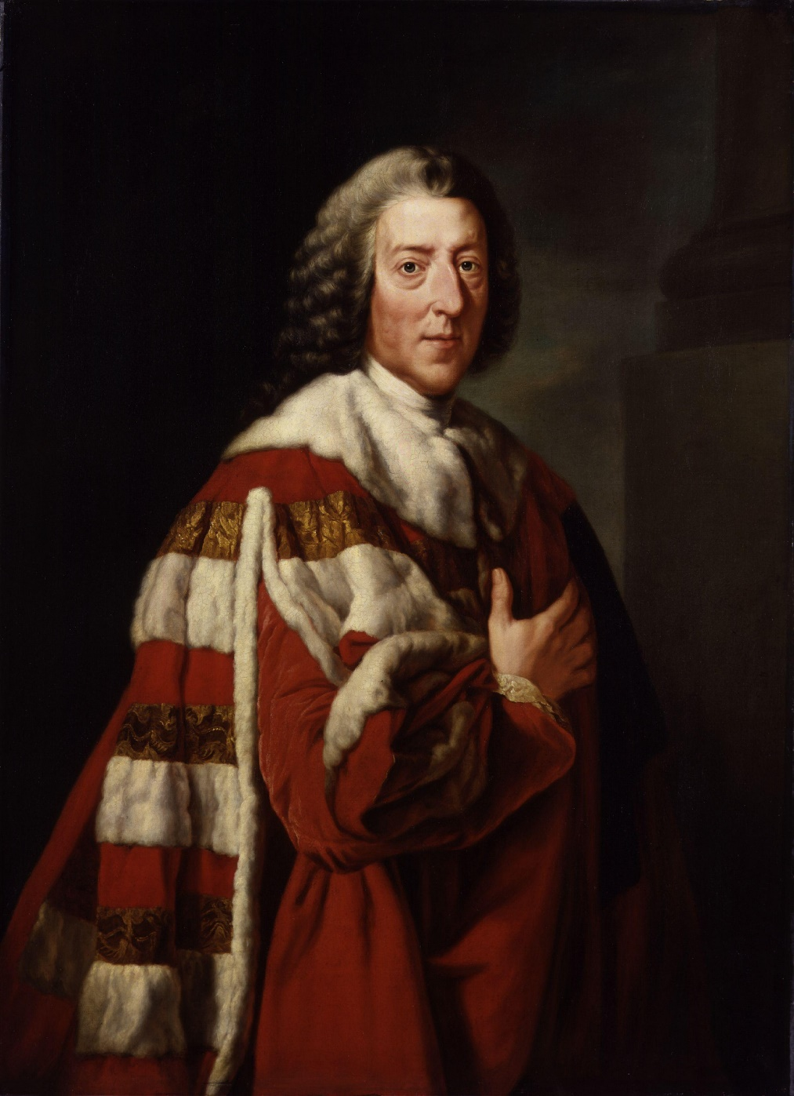
THE MONEY POWER VS THE U.S. CONSTITUTION
WILLIAM PITT, FIRST EARL OF CHATHAM
“Let the Americans adopt their funding
system, and go into their Banking institutions,
and their boasted independence will be
a mere phantom.”

Slide 5
PART 1
BOSTON’S “SUFFOLK SYSTEM”
(1825-1866)

Slide 6
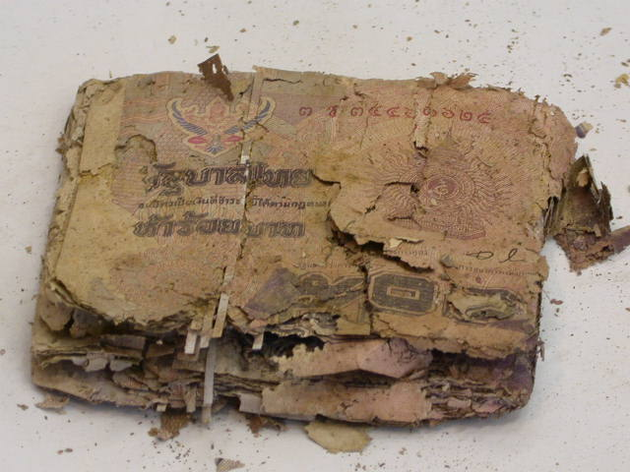
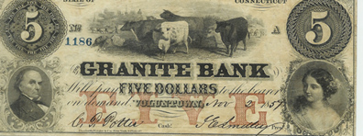
BOSTON’S “SUFFOLK SYSTEM” (1825-1866)
1818 - Suffolk Bank chartered in Boston
as 7th Boston Bank
With the ballooning creation of private state-chartered banks, many were speculative enterprises. Capital was paid in very little specie and mostly in stockholder notes. Even the gold and silver were borrowed from other banks.
Many banks placed themselves long distances from the centers of business to avoid redemption of their notes.
The flood of these ‘country’ bank notes circulated in the country at a discount to local bank notes.
The Granite Bank of Voluntown was a fraud. The notes of this “bank”
were issued from a saloon in New York City as change for bills.

Slide 7
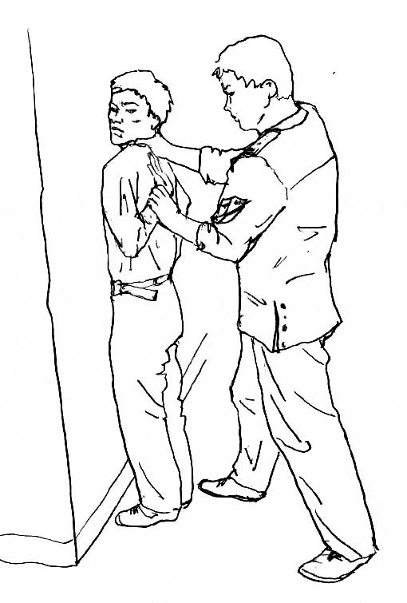
BOSTON’S “SUFFOLK SYSTEM” (1825-1866)
1818 - Suffolk Bank chartered in Boston
as 7th Boston Bank
Since country bank notes could only be redeemed for gold and silver by traveling out of town, the country bank notes circulated at a discount in Boston. This drove local bank notes out of circulation, since local bank notes could easily be redeemed at par for gold and silver.
The Suffolk Bank came up with a profit-making idea. The cost of redeeming the country bank notes should be born by the country banks, and in the process the circulation of local bank notes would increase.
Suffolk Bank offered the country banks the following arm-twisting deal:
  Suffolk Bank will redeem the country bank’s notes at par, as long as the country bank keeps a permanent deposit of $5,000 in Suffolk (with interest going to Suffolk) and further deposits a certain amount to cover the redemption of their notes in Boston (redemption fund)
                ELSE
  Suffolk Bank will collect their notes and send them home for redemption in specie
COUNTRY
BANKS
SUFFOLK
BANK

Slide 8
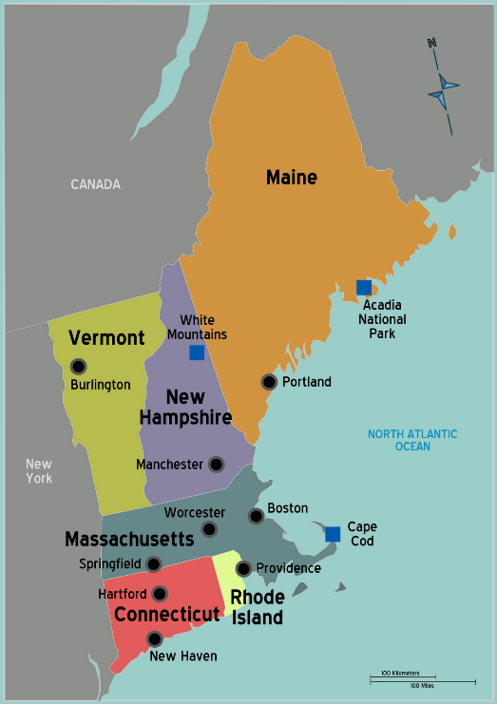
BOSTON’S “SUFFOLK SYSTEM” (1825-1866)
1818 - Suffolk Bank chartered in Boston
as 7th Boston Bank
The First Region-wide
Note-Clearing System in the U.S.
The country banks of New England acquiesced.
The Suffolk Bank was supported by large redemption funds from the six other Boston banks, to pay Suffolk to redeem their out-of-town bank notes.
Thus, Suffolk Bank became the clearing house for New England bank notes, balancing them against each other every day.
This system worked well from 1825 and 1858. The Suffolk Bank was very profitable – for its monopoly on New England note clearing and for offering overdraft loans to members of the system. It consistently paid dividends at a rate 2 percentage points higher than other large Boston banks or Massachusetts banks in general.*
* “Lessons from a Laissez-Faire Payments
System: The Suffolk Banking System (1825-58)”,
Rolnick, Smith, and Weber, 1998, Federal Reserve Bank of St. Louis

Slide 9
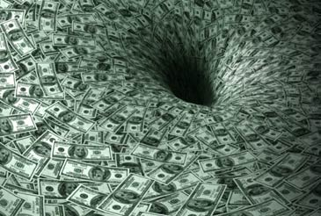
BOSTON’S “SUFFOLK SYSTEM” (1825-1866)
1818 - Suffolk Bank chartered in Boston
7th Boston Bank
By 1836, close to 300 banks, the vast majority of banks in New England, were correspondent bank members.
By 1850, 500 sound banks were in the system.
In 1845 the state of Massachusetts supported the Suffolk System by passing a law saying no bank should pay out any notes but its own. This compelled the banks to send other country notes to Suffolk for redemption.
New England bank notes gained extensive circulation in the entire country and Canada.
In 1855, the entire New England bank circulation was $40,000,000, and Suffolk was clearing $400,000,000. The notes were thus circulating ten times within the year.
The First Region-wide
Note-Clearing System in the U.S.

Slide 10
Part 2
NEW YORK’S SAFETY FUND SYSTEM
(1829 – 1866)

Slide 11
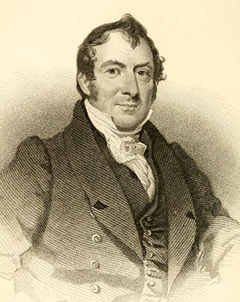
NEW YORK’S SAFETY FUND SYSTEM (1829 – 1866)
Joshua Forman was a lawyer, advocate of building the Erie Canal, and land speculator (founder of Syracuse N.Y.) and author of the Safety Fund Bank Insurance System.
Forman said, “They [the banks] enjoy in common the exclusive right to making a paper currency for the people… “
Forman's idea required all banks in New York to put three percent of their capital into a state fund to be used by the state to pay the debts of any insolvent bank that participated in the system.
It thus prevented note holders from the potential devastating losses of worthless notes.
The Forman plan also included the establishment of a banking commission comprised of three commissioners who were charged with the examination and the hearing of grievances related to banking affairs.
Joshua Forman (1777–1848)

Slide 12
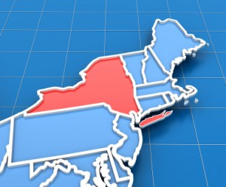
NEW YORK’S SAFETY FUND SYSTEM (1829 – 1866)
From 1800 to 1840, banks were the spoils of politics – legislative bank charters were given out with bribery, monopoly, political gain. The banks were notoriously corrupt.
In 1829, New York State government moved to improve local banking practices by creating the Safety Fund System.
The 1829 bill said:
the fund would pay for deposits and notes for failed banks
each member bank would pay in ½ % of its capital for 6 years
The 1829 bill had some weaknesses:
failed to require that notes be countersigned by a central agency
failed to limit the number of chartered banks
relieved stockholders, other than directors, from personal liability for bank’s debts
However, the Safety Fund was a constructive effort to strengthen New York’s banking system.

Slide 13
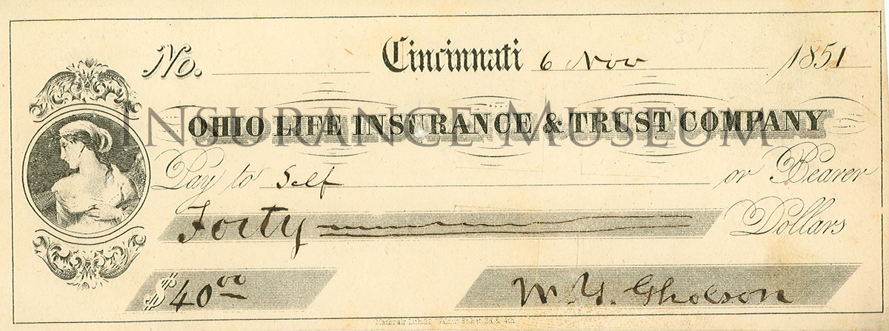
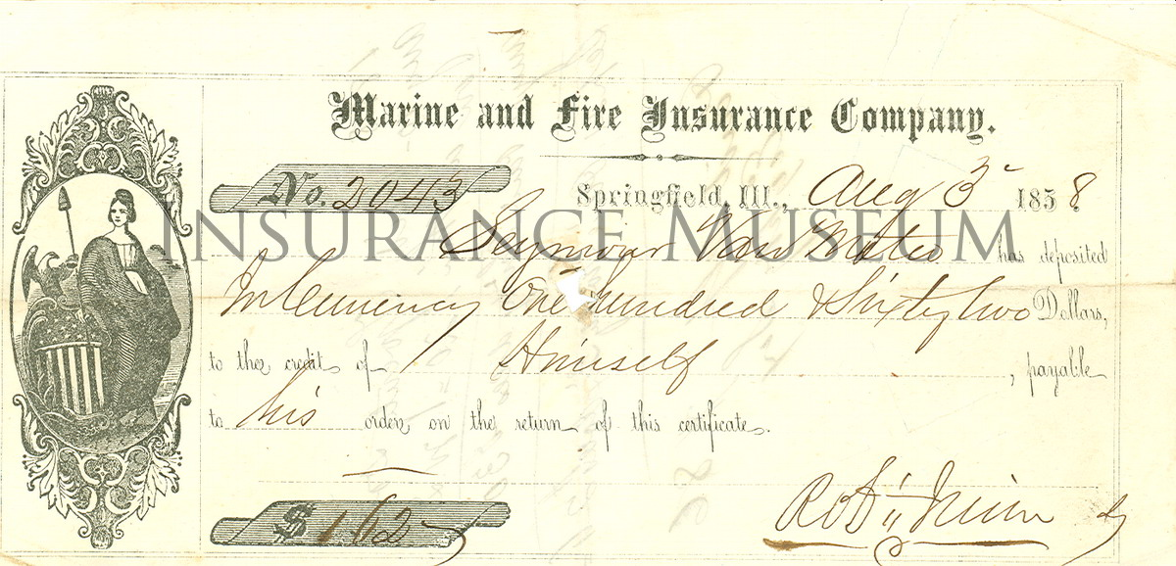
NEW YORK’S SAFETY FUND SYSTEM (1829 – 1866)
The Panic of 1837 was the first use of the fund, with 5 bank failures.
In 1840-1842, there were an additional 11 bank losses.
“The astonishing discovery that deposits were debts of banks as much as circulating notes caused dismay… “
The commissioners said, “This peculiar feature of the law does not seem until recently to have been generally understood either by the public at large or even by those engaged in the business of banking.”
“But it was obvious to those banks which had smaller circulation than deposits or no circulation at all”, such as the city banks.
Banks and Politics in America from the Revolution to the Civil War, Bray Hammond, 1957

Slide 14
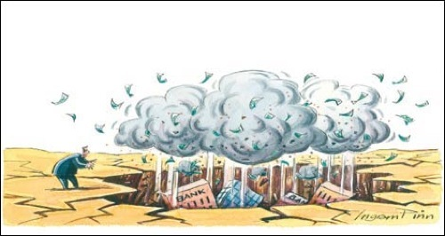
NEW YORK’S SAFETY FUND SYSTEM (1829 – 1866)
Changes to the Safety Funding System came too late
In 1842, a law was passed that, after the existing claims were paid, the fund should be applied only to the redemption of the circulating notes of failed banks. This was to protect the poorer people who used notes, not deposits.
In 1846, a new NY State constitution prohibited the granting or extension of any special charters for banks.
“These changes came too late to be of service; for the claims on the fund
were larger than be met … for several years.”
Money and Banking, Horace White, 1902

Slide 15
Part 3
COMMENTS ON STATE BANK NOTES
BY BRAY HAMMOND

Slide 16
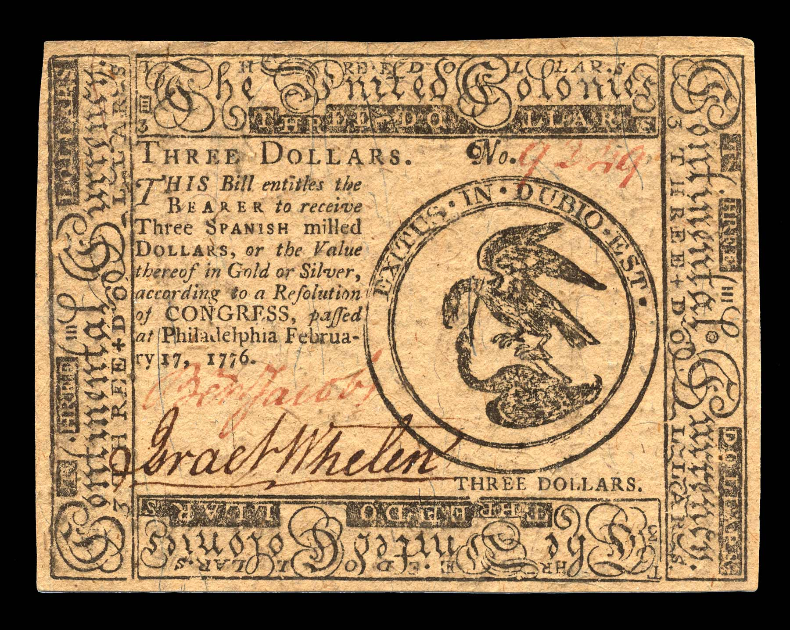
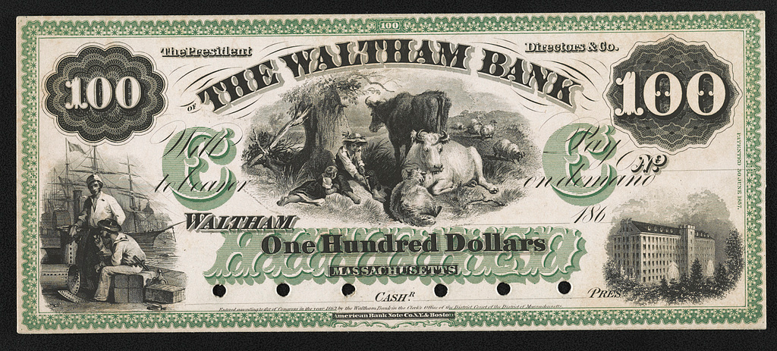
COMMENTS ON STATE BANK NOTES -- BY BRAY HAMMOND
The Suffolk System and the NY Safety Fund could not prevent suspension of specie payment
but they did tend to strengthen the system of state-chartered private banks.
“When the Constitution was fresh … people were familiar with bills of credit and with bank notes as quite distinct things… But twenty or more years later … as … circulating [bank] notes came to provide a volume of currency which before could not have been imagined, the fact that the notes were money became obvious, and its unexpected implications began to emerge.”

Slide 17
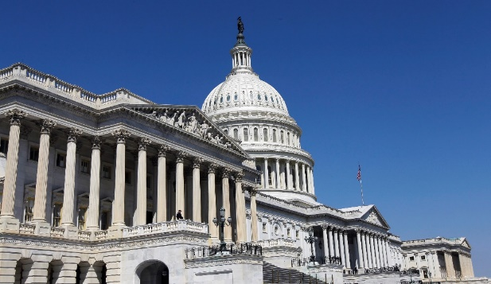
COMMENTS ON STATE BANK NOTES -- BY BRAY HAMMOND
1816 JOHN CALHOUN
“John C. Calhoun of South Carolina argued in February 1816 that the federal convention of 1787 had intended to give Congress exclusive control of the monetary system; that subsequently there had sprung up great numbers of state banks; that as a result there had been ‘an extraordinary revolution in the currency of the country’; that ‘by a sort of undercurrent the power of Congress to regulate the money of the country had caved in’; that the state banks had usurped it, ‘for gold and silver are not the only money,’ since whatever is ‘the medium of purchase and sale’ was the money of the country; and that the state banks should be caused ‘to give up their usurped power.’ “ Hammond, p. 565
“They were not then caused to give it up; in fact Congress in April 1816 specifically authorized the Treasury’s acceptance … of the notes of specie-paying state banks.” Hammond, p. 565

Slide 18
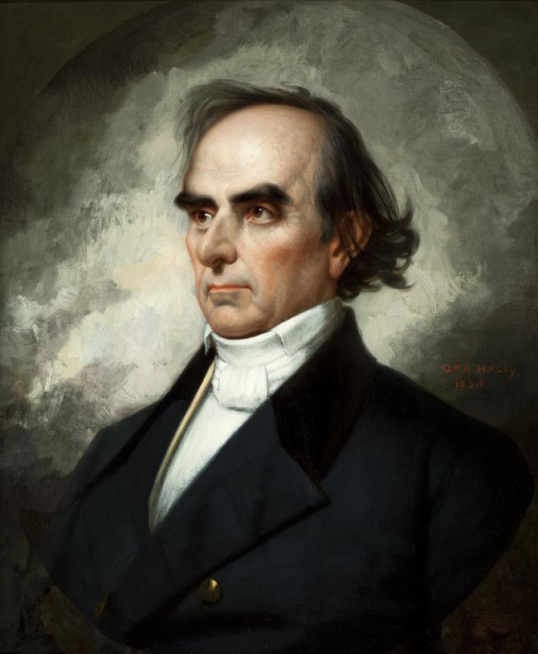
COMMENTS ON STATE BANK NOTES -- BY BRAY HAMMOND
1832 DANIEL WEBSTER
“ ‘ … intended by the Constitution to submit the whole subject of the currency of the country … to the control and legislation of Congress … how far any substitute should interfere with it and what that substitute should be … for the states seem first to have taken possession of the power and then to have delegated it’ to the state banks… “ Hammond, p. 565
WEBSTER SUPPORTED THE SECOND BANK
OF THE UNITED STATES AND WAS IN ITS PAY.
DANIEL WEBSTER (1782 – 1852)

Slide 19
Part 4
THE STATE “FREE BANKING” LAWS FROM 1836

Slide 20
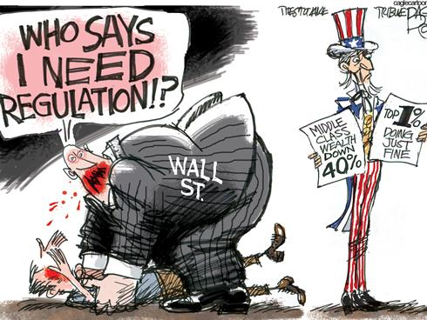

THE STATE “FREE BANKING” LAWS FROM 1836
THE MOVE FOR REFORMING THE BANKING SYSTEM WAS UNSTOPPABLE:
        THERE WAS OVERWHELMING CORRUPTION AND NOTORIETY IN CHARTERED BANKING
        WILLIAM GOUGE’S EXPOSE ON BANKING WAS INFLUENTIAL
The ‘free banking’ reform did away with legislatively chartered banks; anyone who met the requirements of the state could petition the state to open a bank.
However, the ‘free banking’ reform did not do away with government regulation. Just the opposite! There was more government regulation.

Slide 21
THE STATE “FREE BANKING” LAWS FROM 1836
The general banking law of New York, 1838, had the following
REGULATIONS:
NYS Comptroller to have engraved and printed, countersigned, numbered, registered circulating bank notes
Comptroller shall give bank notes to ‘any association of persons for the purpose of banking’ in return for bonds of US, NY, or certain approved states
Bank to execute, sign, and circulate notes
Bank must redeem the notes with lawful money of the US
Banks get interest on bonds deposited with Comptroller
No banks may be formed under it with a capital of less than $100,000
Each bank shall make semi-annual reports to Comptroller
No note for less than $1,000 shall be issued by any bank organized under this law, payable at any other place than its banking house
Have on hand at their place of business at least 12 ½ % in specie on the amount of bills or notes in circulation (8% fractional reserve)
A History of Banking in All the Leading Nations, Vol. 1, William Graham Sumner, 1896,
pp. 311-313

Slide 22
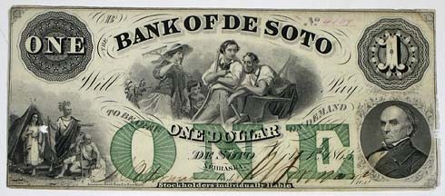
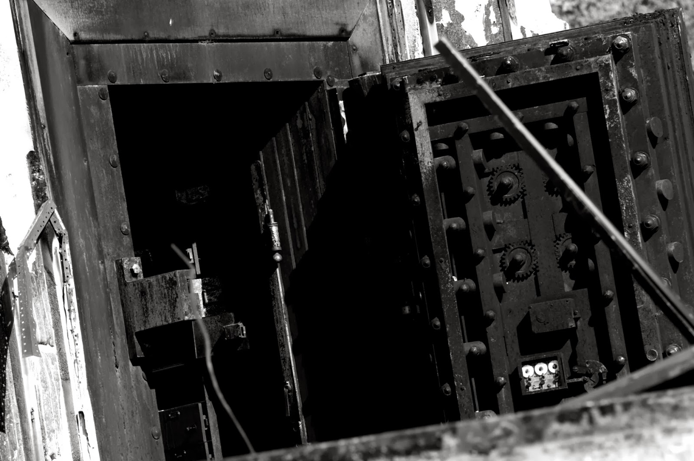
THE STATE “FREE BANKING” LAWS FROM 1836
“The results of private banking under these stricter state regulations were not without major problems, but were still widely recognized as far better than the mostly unregulated period before 1836.” Stephen Zarlenga, Lost Science of Money, P. 442
16 states adopted “free banking”. There was a wide range of effectiveness.
For example, in Illinois, in 1851, some banks had no counter for redemption but merely hired a remote room. In many cases, bonds had been borrowed and notes handed over to the lenders. Many of the bonds were those of Southern states which depreciated during the Civil War.
In New York, the system was strong. Securities used as bank’s capital were strong. Redemption of the notes at central cities was required.
BANK VAULT

Slide 23
PART 5
THE “FREE BANKING” IDEOLOGUES –
A MODERN LESSON IN MISINTERPRETING MONETARY HISTORY

Slide 24
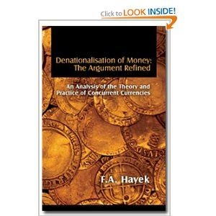
THE “FREE BANKING” IDEOLOGUES
THE “FREE BANKING” MOVEMENT
DENATIONALISATION OF MONEY, by F.A. Hayek, 1976
The current “free banking” movement is a political movement in economic garb. The movement arose from Frederich Hayek’s essay Denationalisation of Money.
The modern “free banking” economists are trying to make the historical case that “free banking” worked well in the past and therefore should be adopted today – that bankers should be essentially unregulated.
From Wikipedia:
“Free banking refers to a monetary arrangement in which banks are subject to no special regulations beyond those applicable to most enterprises, and in which they also are free to issue their own paper currency (banknotes).“

Slide 25
THE “FREE BANKING” IDEOLOGUES
HAYEK’S ESSAY IS A DIATRIBE OF ENDLESS, UNSUBSTANTIATED GENERALIZATIONS --
MOSTLY AGAINST GOVERNMENT
“But from Roman times to the 17th century, when paper money in various forms begins to be significant, the history of coinage [by the monarchy] is an almost uninterrupted story of debasements or the continuous reduction of the metallic content of the coins and a corresponding increase in all commodity prices.” p. 33
“I do not think it an exaggeration to say that history is largely a history of inflation, and usually of inflations engineered by governments and for the gain of governments…” p. 34
“Moreover, though there is every reason to mistrust government if not tied to the gold standard or the like, there is no reason to doubt that private enterprise whose business depended on succeeding in the attempt could
keep stable the value of a money it issued.” p. 36
DENATIONALISATION OF MONEY, by F.A. Hayek, 1976

Slide 26
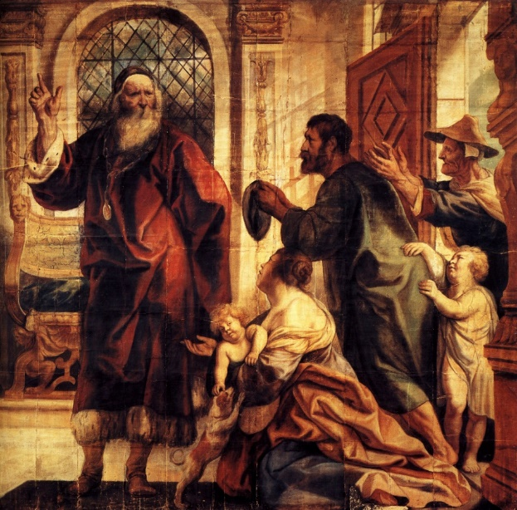
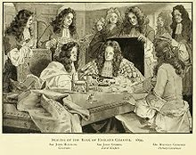

THE “FREE BANKING” IDEOLOGUES
THE “FREE BANKING” MOVEMENT
Stephen Zarlenga, LSM, p. 443:
“… these fellows are to be commended for their interest in monetary and banking history and their realization of the great relevance of historical example and experience to the monetary field... Unfortunately they have made several serious methodological errors…”
USURY
DIRECTORS OF BANK OF ENGLAND

Slide 27



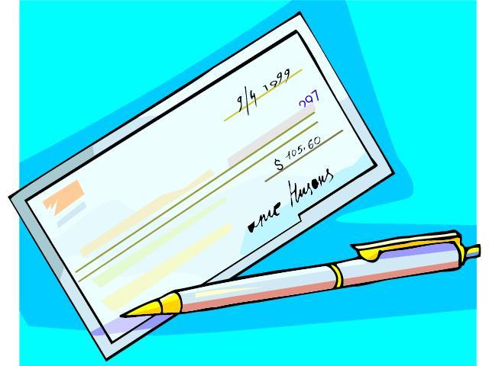
THE “FREE BANKING” IDEOLOGUES: Problem #1
#1
They have not accurately and uniformly defined money.
Their definition of “free banking” is not uniform, but varies greatly from writer to writer.
“MONEY IS … “
“Free banking is …. “

Slide 28
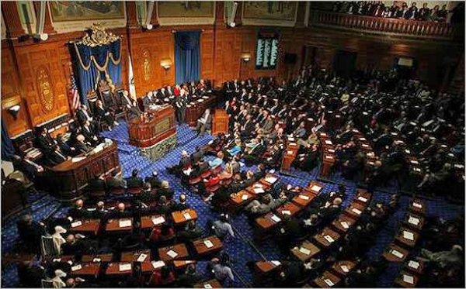
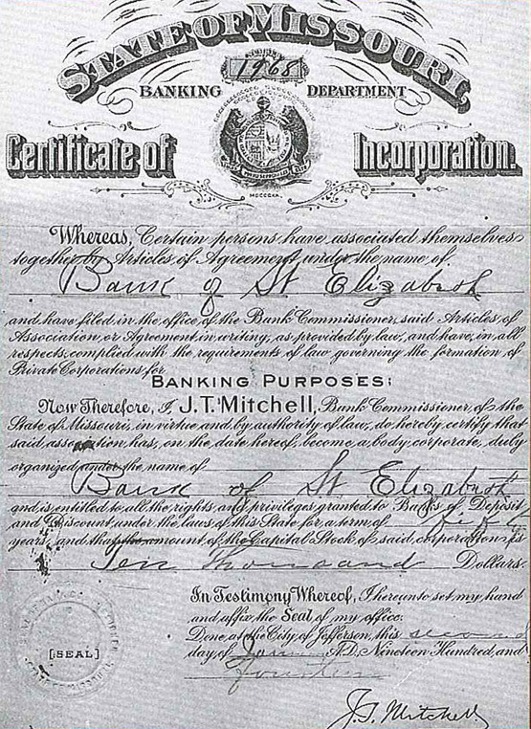


THE “FREE BANKING” IDEOLOGUES: Problem #2
#2
They have misclassified the period from 1836 to 1862 as the free banking period.
        Pre-1836 is the correct free banking period.
        Post-1836 is a period of increased government regulation.
STATE LEGISLATURE
ISSUED BANK CHARTERS
(1784-1836)
Original bank charter from
the state’s Division of Finance

Slide 29
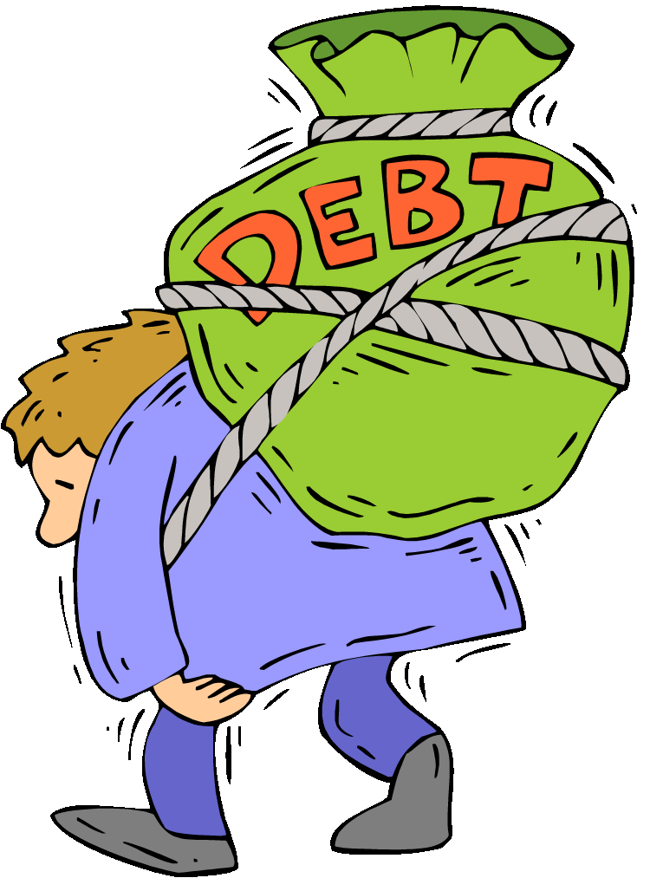
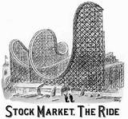
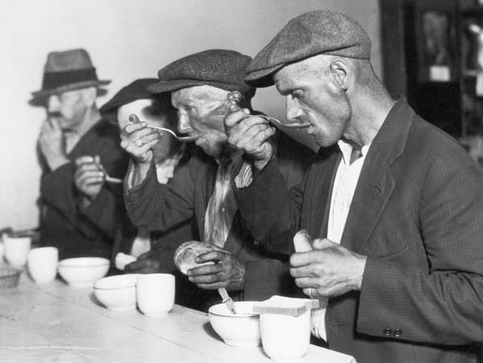
THE “FREE BANKING” IDEOLOGUES: Problem #3
#3
Free banking advocates focus on certain measures that cannot
convey a full and accurate picture of banking.
FOCUS ON BANK DEPOSITS
… NOT …
BANK DEBT-MONEY ISSUE
WHAT ABOUT BANK STOCK FRAUD?
HOW DOES BANKING AFFECT THE COMMUNITY?

Slide 30
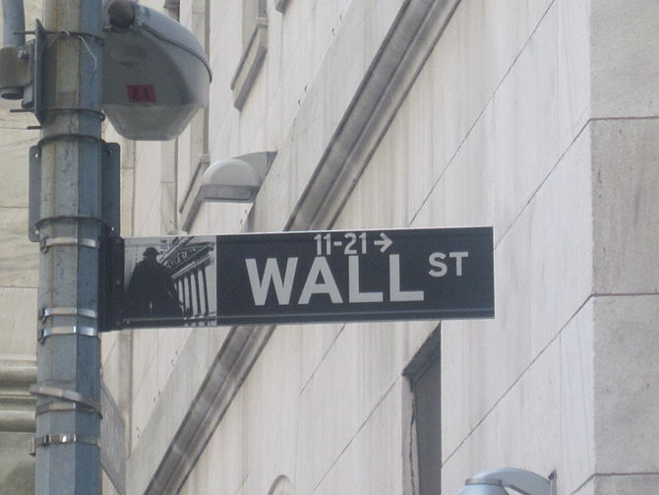


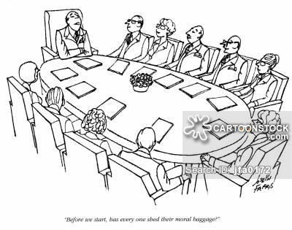

THE “FREE BANKING” IDEOLOGUES: Problem #4
#4
They think they have proven that bankers can be trusted to act honestly,
because it will build bankers’ reputations and therefore be profitable.
BEFORE WE START, HAS EVERYONE
SHED HIS MORAL BAGGAGE?

Slide 31

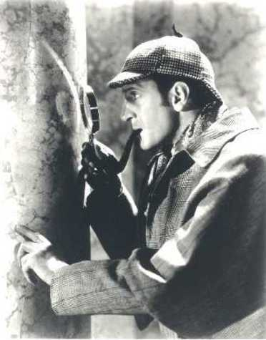
THE “FREE BANKING” IDEOLOGUES: Problem #5
#5
Starting with their theory, they look through history for empirical support.
  It does not work to briefly look through history for empirical support for your theory…
  It is not acceptable to filter history – retaining agreeable facts and ignoring disagreeable facts.

Slide 32
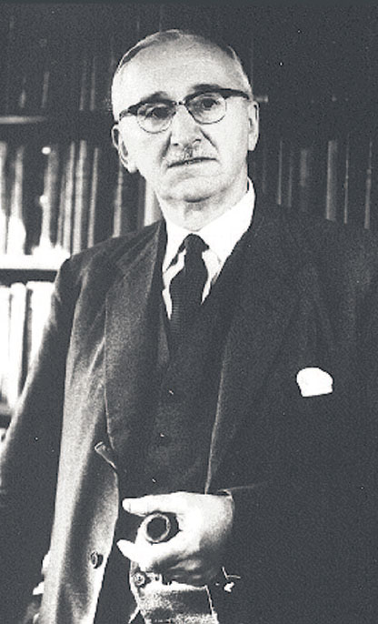
THE “FREE BANKING” IDEOLOGUES
HAYEK SAW HIS FUNCTION MORE AS A PROPAGANDIST
“I ought, perhaps, also to add, what I have often had occasion
to explain but may never have stated in writing, that I strongly
feel that the chief task of the economic theorist or political
philosopher should be to operate on public opinion to make
politically possible what today may be politically impossible,
and that in consequence the objection that my proposals are
at present impracticable does not in the least deter me from
developing them.” (emphasis added in LSM)
p. 17, Denationalisation of Money
F.A. Hayek
(1899-1992)

Slide 33
Part 6
THE REIGNING ERROR ON GOVERNMENT MONEY

Slide 34
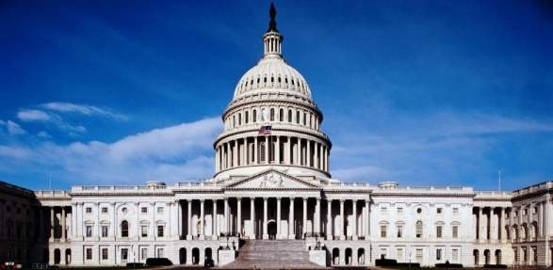
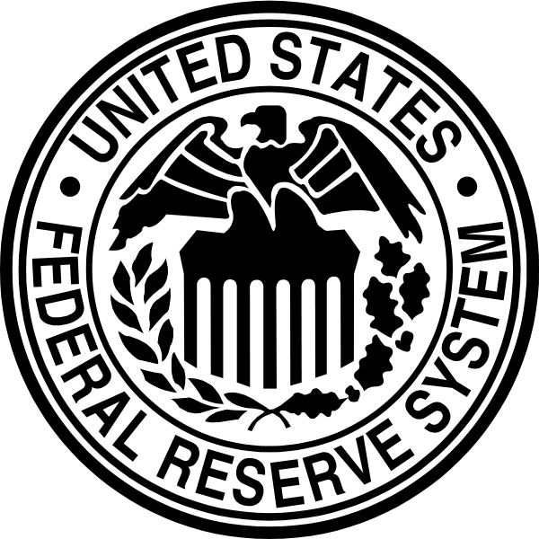

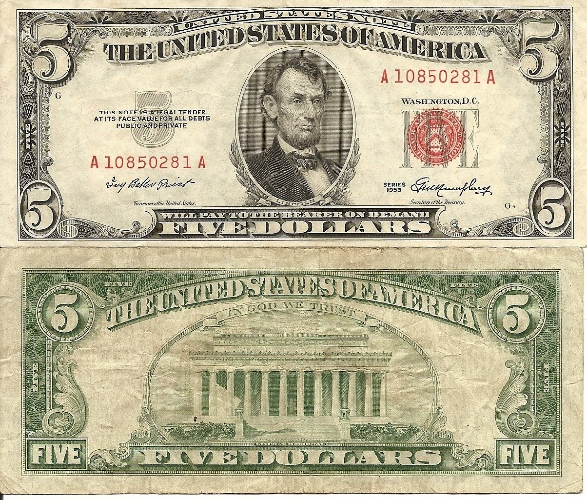
THE REIGNING ERROR ON GOVERNMENT MONEY
THE ERROR:
… the assumption that government-controlled money systems (based on fiat of the law) are …
    less just
        more destructive
            more dangerously inflationary
than are money systems privately controlled by bankers.

Slide 35
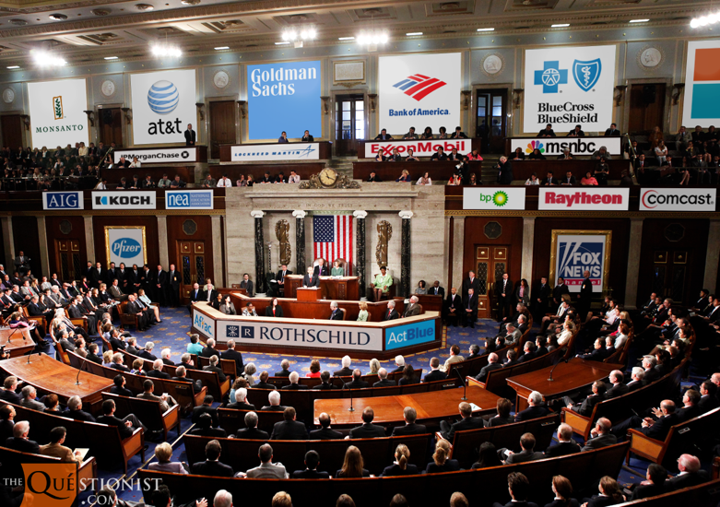
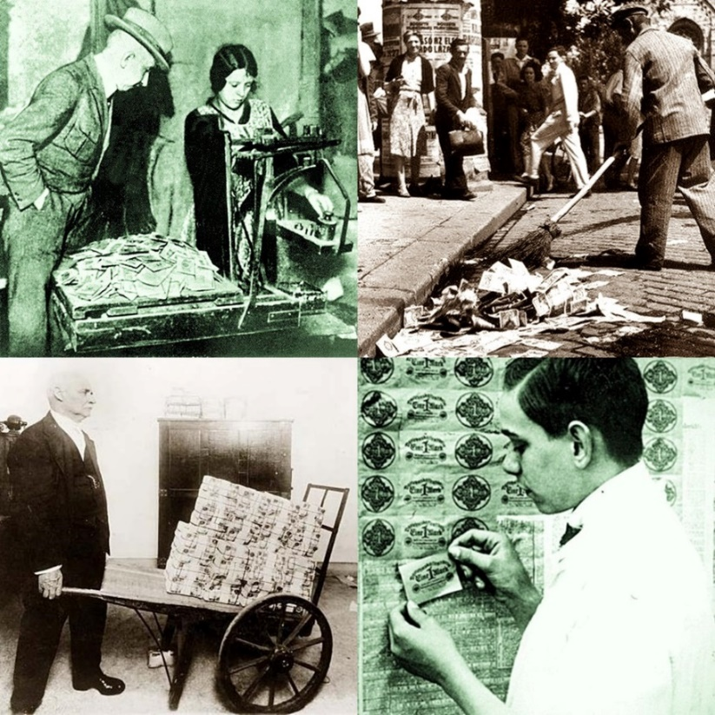
THE REIGNING ERROR ON GOVERNMENT MONEY
This anti-government, actually anti-social, anti-community viewpoint depends on TWO FALSEHOODS:
the assumption that poorly-run money systems of the past were under government control
the anthropomorphizing of government –
pretending government has motivations of greed, lust for power and gain –
which are characteristics only of living, individual men
1923 GERMAN
HYPERINFLATION
THE GREED OF MEN --
NOT THE GREED OF GOVERNMENT

Slide 36
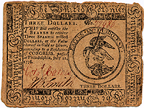
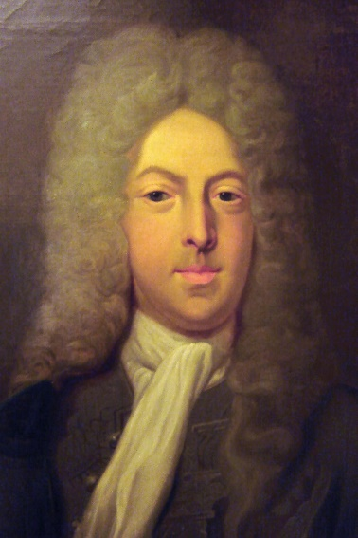
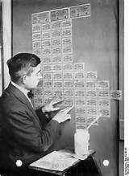
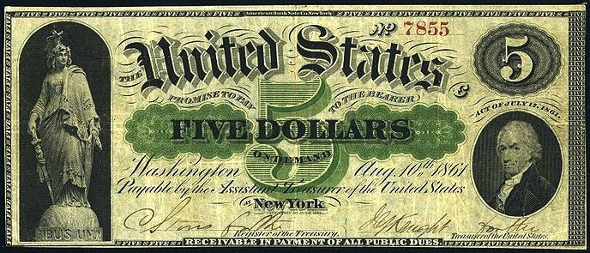
THE REIGNING ERROR ON GOVERNMENT MONEY
The argument for inflation of government money: made by distinguished conservative journalist Henry Hazlitt, in his introduction (1959) to Andrew Dickson White’s essay, Fiat Money Inflation in France, 1876.
“(The) world has failed to learn the lesson of the assignats [that governments inflate fiat money if they control its issuance]. Perhaps the study of the other great inflations – of John Law’s experiments with credit in France between 1716 and 1720; of the history of our own Continental currency between 1775 and 1780; of the Greenbacks of our Civil War; of the great German inflation that culminated in 1923 – would help to underscore and impress that lesson. Must we, from this appalling and repeated record, draw once more the despairing conclusion that the only thing man learns from history is that man learns nothing from history?”
CONTINENTAL
JOHN LAW (1671-1729)
GREENBACK
1923 GERMAN
CURRENCY USED
AS WALLPAPER

Slide 37
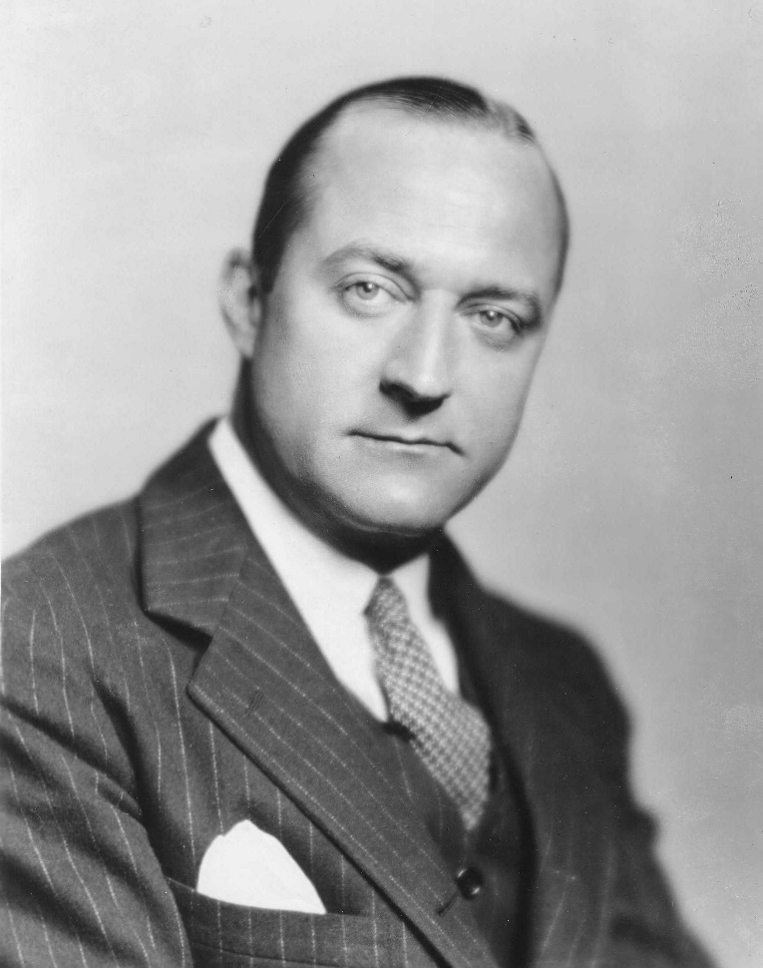
THE REIGNING ERROR ON GOVERNMENT MONEY
Like Hazlitt, those arguing against government exercising its proper control over the nation’s money system actually think they have history on their side … No doubt Hazlitt believed that the narratives he relied on, of those past inflations, were accurate and objective reports. But they were not.
HENRY HAZLITT
(1894-1993)
According to Hazlitt, the greatest influence on his writing in economics was the work of Ludwig von Mises, and he is credited with introducing the ideas of the Austrian School of economics to the English-speaking layman. Hazlitt also helped introduce F.A. Hayek's The Road to Serfdom to the American reading public.
He was the founding vice-president of the Foundation for Economic Education (FEE), considered to be the first "think tank" for free market ideas.
A literature continues to be built up about past inflations that generally relies on the uncritical acceptance of earlier accounts that range from misleading to false.

Slide 38
PART 7
WHITE’S PURPOSE: TO ATTACK THE GREENBACK

Slide 39
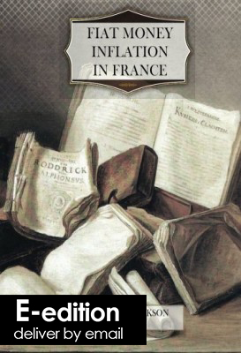
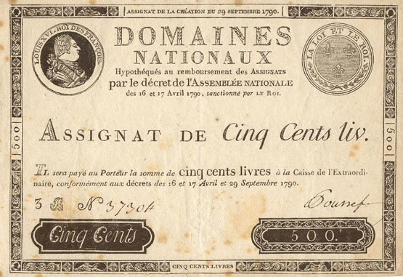
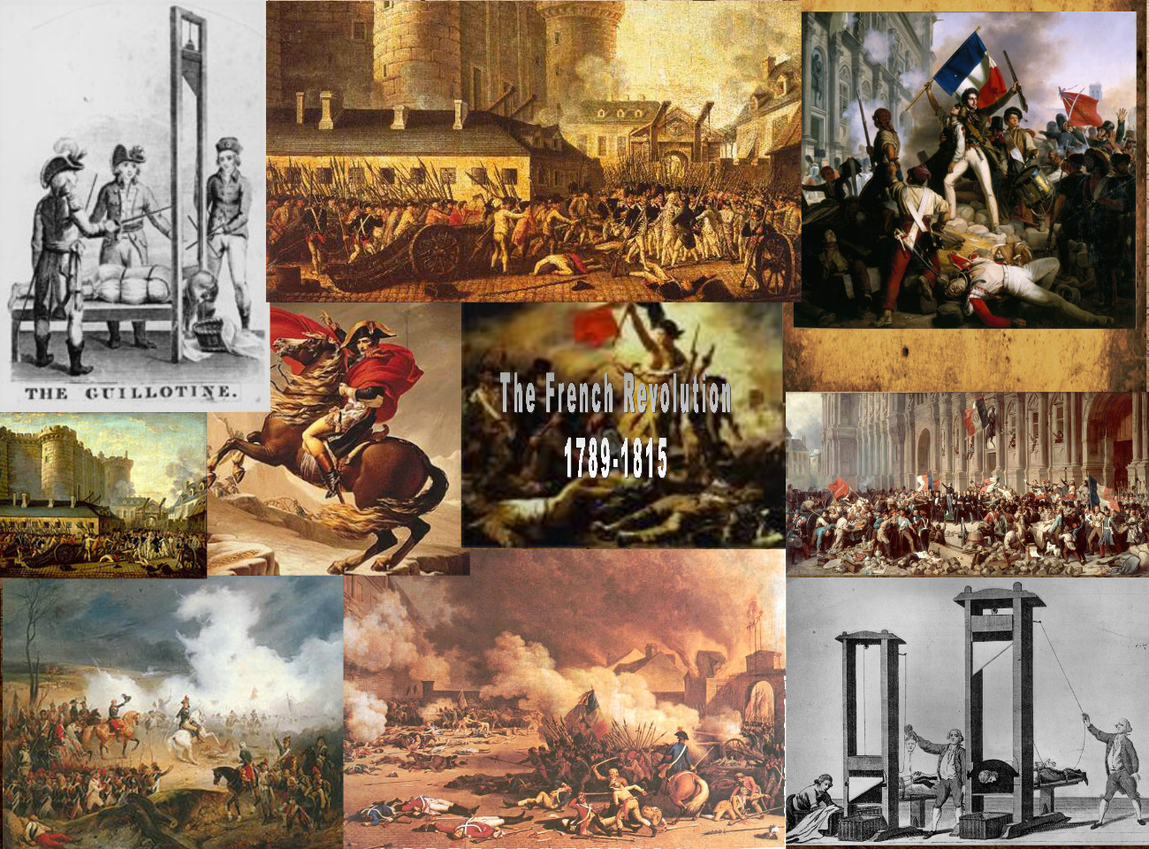
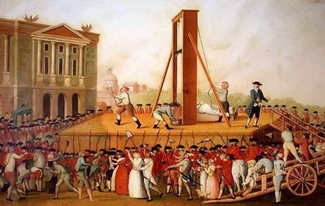
WHITE’S PURPOSE: TO ATTACK THE GREENBACK
After the American Civil War, there was a propaganda attack against the government fiat Greenback currency.
The most clever attack was from Andrew Dickson White’s Fiat Money Inflation in France, 1876.
ASSIGNAT
SCENES FROM THE FRENCH REVOLUTION
Hazlitt’s introduction presents White’s essay as objective history,
rather than with a political motive. Not mentioned is that White’s
purpose was to attack the Greenback, which a majority of voters
wanted to make a permanent feature of our money system.

Slide 40
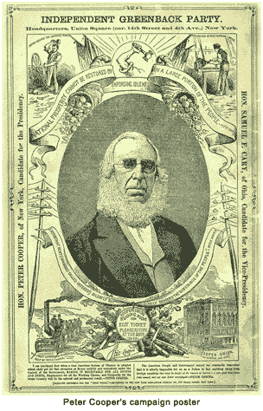
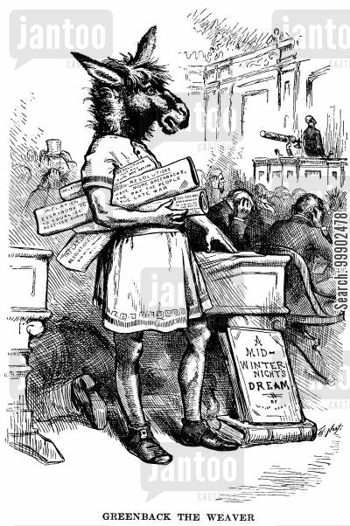
WHITE’S PURPOSE: TO ATTACK THE GREENBACK
FROM INTRODUCTION (BY THE AUTHOR, ANDREW DICKSON WHITE)
As far back as just before our Civil War I made, in France and elsewhere, a large collection of documents which had appeared during the French Revolution, including newspapers, reports, speeches, pamphlets, illustrative material of every sort, and, especially, specimens of nearly all the Revolutionary issues of paper money,--from notes of ten thousand _livres_ to those of one sou...
It certainly never entered into our minds that any such folly as that exhibited in those French documents of the eighteenth century could ever find supporters in the United States of the nineteenth…
In 1876, during the "greenback craze," General Garfield and Mr. S. B. Crittenden, both members of the House of Representatives at that time, asked me to read a paper on the same general subject before an audience of Senators and Representatives of both parties in Washington. This I did, and also gave it later before an assemblage of men of business at the Union League Club in New York…
… it is but just to acknowledge that the French proposal was vastly more sane than that made in our own country. Those French issues of paper rested not merely "on the will of a free people," but on one-third of the entire landed property of France…
1876 – NATIONAL
GREENBACK PARTY –
PETER COOPER
PETER COOPER
1880 - JB WEAVER, Prominent Member of the Greenback-Labor Party, is ignored by Speaker Randall and Congress

Slide 41
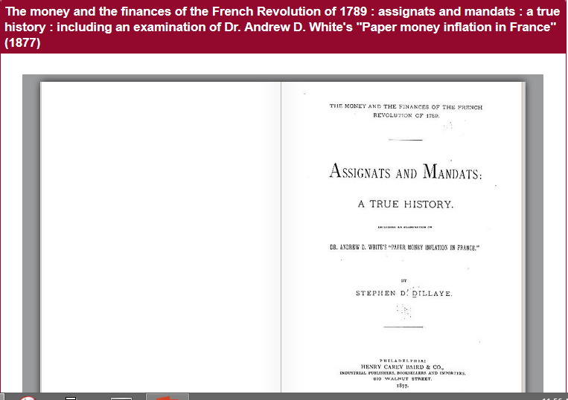
WHITE’S PURPOSE: TO ATTACK THE GREENBACK
White (Fiat Money Inflation in France, 1876) argued from analogy, asserting that what was true for France must also be true for the United States: the failure of paper money, under the chaotic conditions of the French revolution, automatically condemns government paper money everywhere.
Within the year, Stephen Dillaye (1820-1884) had demolished White’s effort, publishing Assignats and Mandats: A True History, 1877.

Slide 42


WHITE’S PURPOSE: TO ATTACK THE GREENBACK
Stephen Dillaye:
“The effort of his pamphlet [White’s Fiat Money Inflation in France] is to overthrow our paper currency; to destroy confidence in our stability as a government; to question our honor as a nation, and our honesty as a people …
to convince us that because the French revolutionists failed in establishing a paper currency worthy of confidence, we must fail …
Mr. White’s argument amounts to this or it amounts to nothing.” (emphasis added)
p. 8, Assignats and Mandats
Dillaye provided details on how English counterfeiting was a major factor in the Assignat’s decline, as it had been against our own Continental Currency.
COUNTERFEIT
CONTINENTAL
COUNTERFEIT ASSIGNATS

Slide 43
WHITE’S PURPOSE: TO ATTACK THE GREENBACK
spirit of resistance to government
May 1789 Three Estates convened:
nobility, church, people
July 1789 Bastille levelled to ground;
nobility emigrate to arm against France,
taking with them all gold and silver, leaving
Revolution without money and credit
Dec 1789 Assignat law: issued assignat currency to be
redeemed by Church lands;
saved the Revolution;
400M franc issued
June 1790 funds exhausted;
further issue of 400M francs;
clergy oppose Revolution and form
coalition with nobility
June 1790 3rd issue of Assignat (800M franc) to prepare for war;
Revolutionary Assembly declared all debts of
government should be paid in Assignats
COUNTERFEITING STARTED
COUNTERREVOLUTION ORGANIZES:
      SPECULATORS
      INTERNAL FACTIONS
      EXTERNAL ENEMIES
      NON-JURING CLERGY
Oct 1791 Middle Class takes over revolutionary legislature
Sept 1792 Conservatives in power
Jan 1793 King beheaded
“Up to this time the Assignats had furnished the entire means for the support of the Revolutionary government.
5.5B francs in circulation
15.0B value of lands of clergy & nobility
The Republic fielded:
13 armies
700,000 men under arms
greater than 1 million men in army total
“The Assignat grew into credit, won public favor, and afforded the moneyed instrument for purchase and exchange which is essential to the existence of every form of government, and to society itself.” p. 19

Slide 44
WHITE’S PURPOSE: TO ATTACK THE GREENBACK
The means adopted to destroy the value of the Assignat:
the clergy denounced to eternal pains all who sustained spoliation of church
nobility and clergy united to denounce Assignat as based on sacrilegious theft
nobility and clergy declared their lands appropriated outside law – civilized world held the titles remained with them
pledged lives, religion, honor to wage war upon Assignat, its credit, and robbery of their land
The Revolutionary Army was victorious!
“Clergy and nobility organized forgery as a business and made the passing of counterfeit assignats their occupation.” p. 32
May, 1795
government issued: 7.9B franc
value of land 15.0B franc
forged Assignats 12-15.0B franc
“…so exact in form, appearance, texture, and design to defy detection.”

Slide 45
WHITE’S PURPOSE: TO ATTACK THE GREENBACK
Culminating causes of the speedy depreciation of Assignats:
ease and extent of forgery
stock jobbing (speculation) of Assignats: the lower the price of Assignats, the cheaper to redeem the land
“…down and down went the Assignat. It was the sole means by which the government existed. As they weakened, the government weakened.” p. 36
the overthrow of Robespierre and the ascendency of the counter-revolution, which nullified the confiscation of the land
Dec 1794 regulation of prices in
Assignats repealed and a
period of reaction
Assignat began its descent to zero (0)
“… it went on depreciating and falling in value until it approached so near to worthlessness that a beggar in the streets would hardly deign to accept one.”

Slide 46
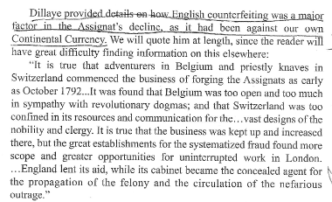

WHITE’S PURPOSE: TO ATTACK THE GREENBACK
ASSIGNATS AND MANDATS: A TRUE HISTORY

Slide 47
PART 8
THE JUDGMENT OF THE PEOPLE

Slide 48

WHITE’S PURPOSE: TO ATTACK THE GREENBACK
Zarlenga, LOST SCIENCE OF MONEY – CONCLUSION:

Slide 49
Q & A
WILL DECKER’S CONCLUSION:
THE CONTROL OF MONEY -- WITHOUT CONTROL FROM THE PUBLIC -- LEADS TO
CORRUPTION … USURPATION … SLAVERY.

