Slide 1
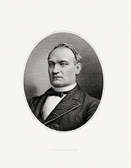
The Lost Science of Money
CHAPTER 18 – Part 1
19TH CENTURY MONETARY CRIMES – THE GREAT DE-MONETIZATIONS
“The conspiracy … formed here and in Europe to destroy … from
three-sevenths to one-half of the metallic money of the world,
is the most gigantic crime of this or any other age.”
John G. Carlisle, House of Representatives, February 21, 1878
John G. Carlisle (1834 – 1910)
Sec of Treasury 1893-1897

Slide 2
THEMES OF LOST SCIENCE OF MONEY BOOK
Primary importance of the money power (power to create money and regulate it)
Nature of money purposely kept secret and confused
How a society defines money determines who controls the society
Battle over control of money has raged for millennia: public vs private
The misuse of the monetary system causes tremendous misery and suffering for the ordinary people. Will Decker & Martin Dunn, February 2014
Whenever the public has owned a significant fraction of the money power, great public benefit has ensued: Sparta, the Roman Republic, the American Colonies in the 18th century, GREENBACKS after the Civil War, Canada after the Great Depression, British experience after World War II. Martin Dunn, July 2014.

Slide 3
PARTS OF PRESENTATION
INTERNATIONAL MONETARY DEFLATION
Introduction
Why Some Bankers Deflate
England Starts the Worldwide Demonetization of Silver 1774, 1798, 1816
The Problems of Bimetallism
The Ancient Ratio Mechanism Strikes One Last Time 1852
The Latin Monetary Union Demonetizes Silver 1865-73
The Deflation Even Reaches Japan 1882
Half the World’s Metallic Money Destroyed
NATIONAL MONETARY DEFLATION
Bankers Fear the Greenback Example
The First Attack – Remove the Greenback
a Contraction Act and Its Suspension 1866 1868
b England Sends “Experts” to Attack the Greenbacks 1869 1874
c Attacks thru Law Courts Fail 1871, 1884
d Inflation Bill Vetoed 1874
e Resumption Act: Passes Jan 1875 – Starts Jan 1879 1875 1879

Slide 4
INTERNATIONAL MONETARY DEFLATION

Slide 5
PART 1
INTRODUCTION

Slide 6
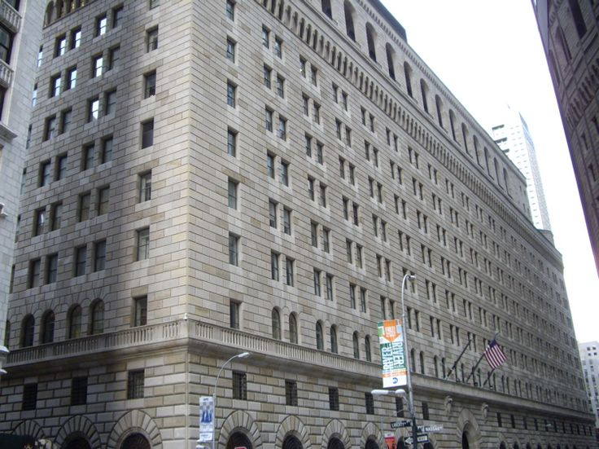
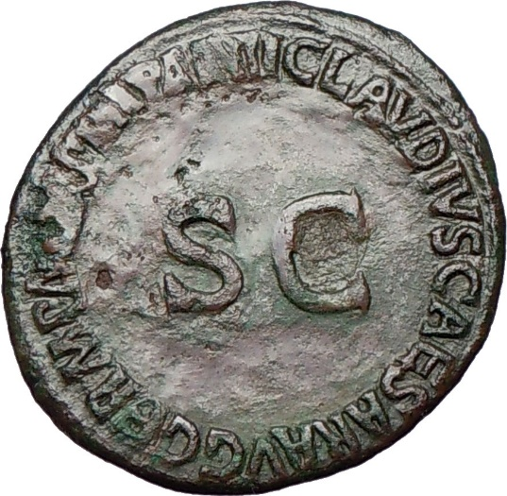
INTRODUCTION
It was recognized in Athens and Sparta, centuries before the birth of Christ, that one of the most vital prerogatives of the State was the right to issue money.
"To allow it to become a source of revenue to private issuers is to create first, a secret and illicit arm of the government and last, a rival power strong enough ultimately to overthrow all other forms of government.“ Frederick Soddy, The Role of Money, 1934
Bronze coin issued by Roman Senate (‘SC’)
from mint of Emperor Claudius 37-38 AD
PRIVATELY OWNED
N.Y. FEDERAL RESERVE BANK created 1913

Slide 7
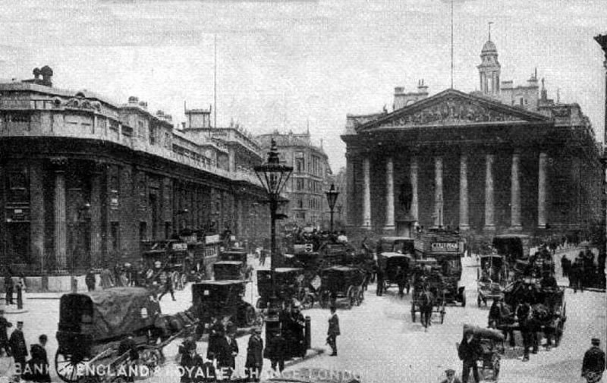
INTRODUCTION
“By 1800 the Bank of England had been operating for over a century, transferring the power and wealth of society to the People of the Bank – the bankers and associated “financiers.” Though previously subservient to government, they soon came to dominate government and society by usurping the nation’s monetary power.
“Great concentrations of wealth were accumulated through macro usury – the structural misuse of society’s monetary mechanisms.”
Zarlenga, LSM, p. 479
BANK OF ENGLAND,
founded 1694
as a private bank

Slide 8
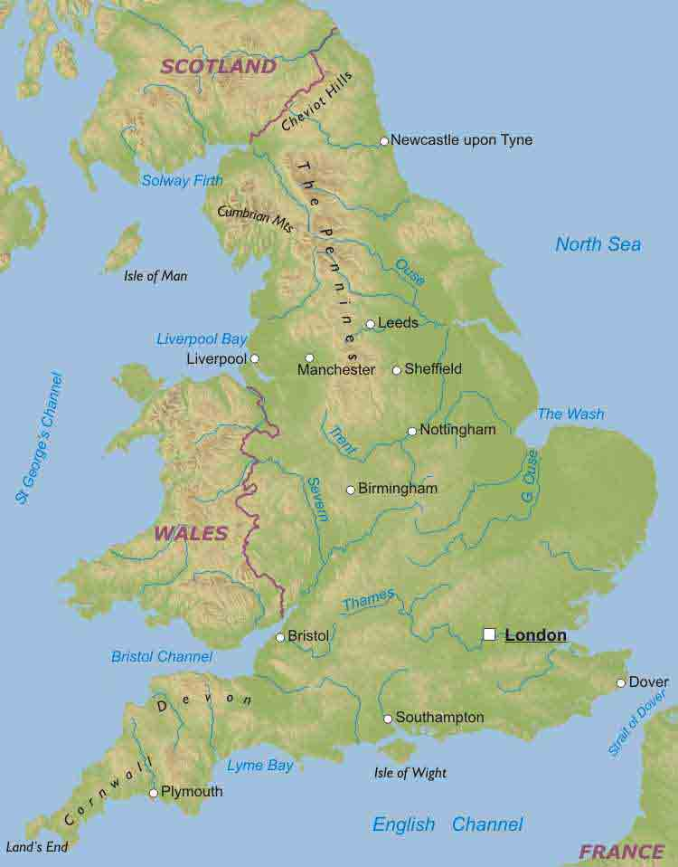
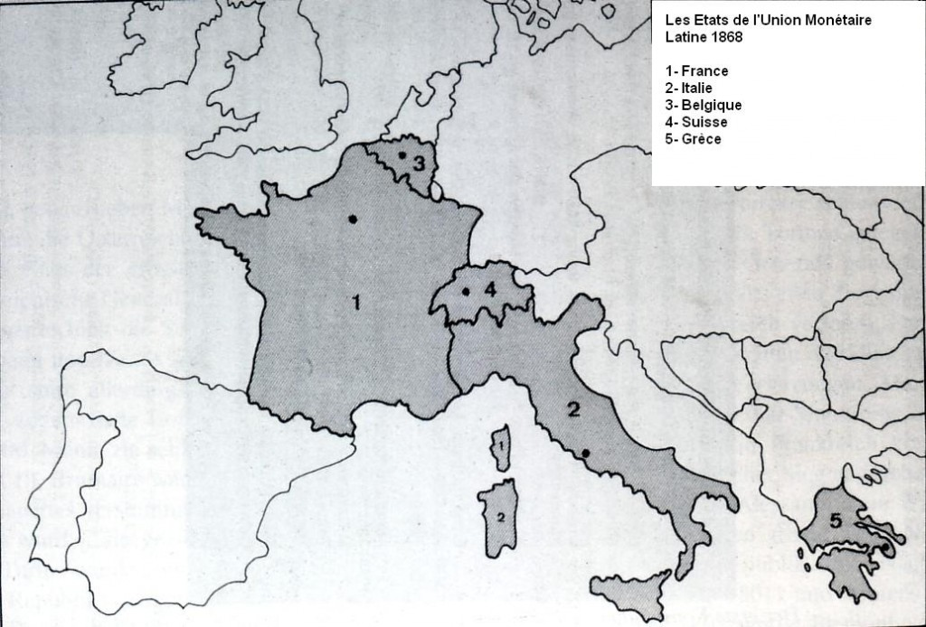
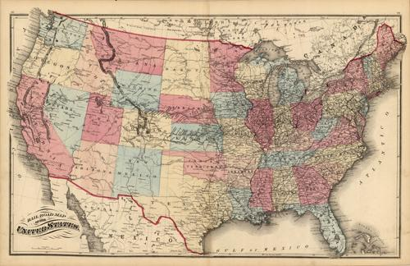
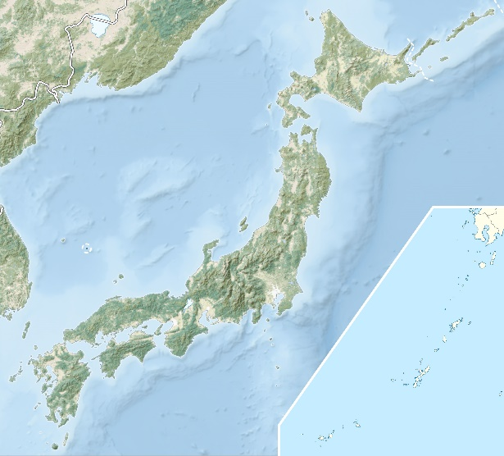
INTRODUCTION
“The world was about to witness vast, consciously executed deflations, starting in England, then Europe’s Latin Monetary Union, the U.S., and finally Japan.”
“Each country’s situation presented different opportunities for bankers to reduce the money supply and increase the value of the nation’s currency units which were owed to them.”
Zarlenga, LSM, pp. 479-480
U.S.
ENGLAND
LATIN MONETARY UNION:
France, Switzerland, Belgium, Italy, Greece
JAPAN
→ DEFLATION → → DEFLATION → → DEFLATION → → DEFLATION →

Slide 9
Part 1
Why Some Bankers Deflate

Slide 10
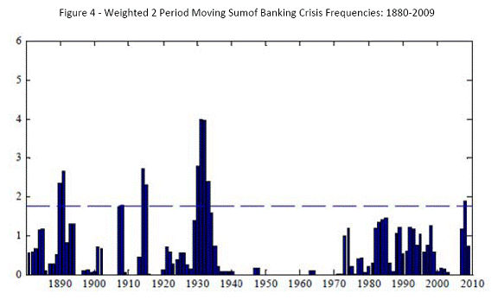

Why Some Bankers Deflate
Ideally, society should expand the money supply to keep up with population, commerce, and industry growth.
The value of the unit of currency should remain fairly stable…yes?
BANKING CRISIS FREQUENCIES, 1880-2009
QUESTION:
WHY IS OUR WORLD NOT STABLE?

Slide 11
Why Some Bankers Deflate
Privately controlled money has no motive
to give society stability and a stable value of the unit of currency.
It has two money “games”: inflation and deflation
GAME #1: INFLATION - OVER EXPANDING THE MONEY SUPPLY
MEANS HIGH PRICES AND MONEY WORTH LESS
(HURTS PERSON ON FIXED INCOME OR SAVINGS)
GAME #2: DEFLATION – CONTRACTING THE MONEY SUPPLY
MEANS UNPAYABLE DEBTS, BANKRUPTCIES, UNEMPLOYMENT
AND A MONEY THAT IS WORTH MORE (FOR THE CREDITOR)

Slide 12


Why Some Bankers Deflate
INFLATION - MEANS HIGH PRICES AND MONEY WORTH LESS (FOR THE PERSON ON FIXED INCOME AND SAVINGS)
OVERINFLATED
MONEY SUPPLY
=
OVERINFLATED
DEBT
Historically, new money
was created for war.
Today, for war, stock &
bond speculation, asset
(house) price inflation,
etc.
BANKS MAKE
PUBLIC & PRIVATE
LOANS

Slide 13



Why Some Bankers Deflate
DEFLATION - MEANS UNPAYABLE DEBTS, BANKRUPTCIES, UNEMPLOYMENT
AND A MONEY THAT IS WORTH MORE (FOR THE CREDITOR)
BANKS DENY LOANS
MONEY
SUPPLY GOES
AWAY
UNPAYABLE
DEBT IS LEFT
BANKS CALL IN LOANS – CAUSING MANY DEFAULTS
BANKRUPTCY

Slide 14

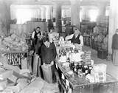


Why Some Bankers Deflate
Deflation causes unemployment and harm to the WORKING AMERICAN FAMILY.

Slide 15
Part 3
England Starts the Worldwide Demonetization of Silver

Slide 16
England Starts the Worldwide Demonetization of Silver
The primary deflationary technique was to implement a gold standard, and to demonetize silver, declaring it not a legal tender for debt payments.
TIMELINE OF BRITISH SILVER DEMONETIZATION
1774 1798 1816
_____|________ | _____________ | __________________________________
First English legal
tender law limiting
payment in silver to 25 pounds
English mint suspends coinage of silver
English law limits silver legal tender payments to 2 pounds
Gold Standard ➔
“England’s reasons for going over to the gold standard have never been fully explained.”
George Knapp, State Theory of Money, 1909, p. 275

Slide 17
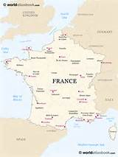
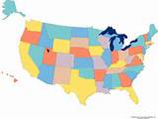
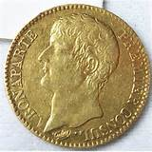
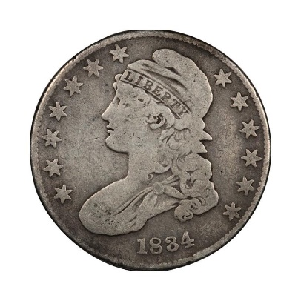
Part 4
The Problems of Bimetallism
Bimetallism was susceptible to private manipulation.
Different nations assigned slightly different gold/silver ratios to the metals. “Financiers” would export gold and silver back and forth on a large scale to take riskless advantage of these tiny differences in their official value.
16 silver: 1 gold
after 1834
15.5 silver: 1 gold
“...any overshooting of the ratio ...
establishes a differentiation...
which gives to the one metal...
purchasing power – against the other...” W.A.Shaw, The History of Currency 1252 to 1896

Slide 18
Part 4
The Problems of Bimetallism
W.A. Shaw’s The History of Currency 1252 to 1896
Shaw noted that in centuries of coinage laws:
“There is no idea of separating the two metals … there is no intention to declare a ratio; there is no conception of bullion apart from coin … The advantage which was to be derived from a trade in bullion, and from an understanding of the effects of differently prevailing ratios in different countries, was known only to the Jew and Italian. They plied their trade in secret, and the legislature was only apprised of the result by suddenly finding a slipping away and dearth of coinage …. “

Slide 19

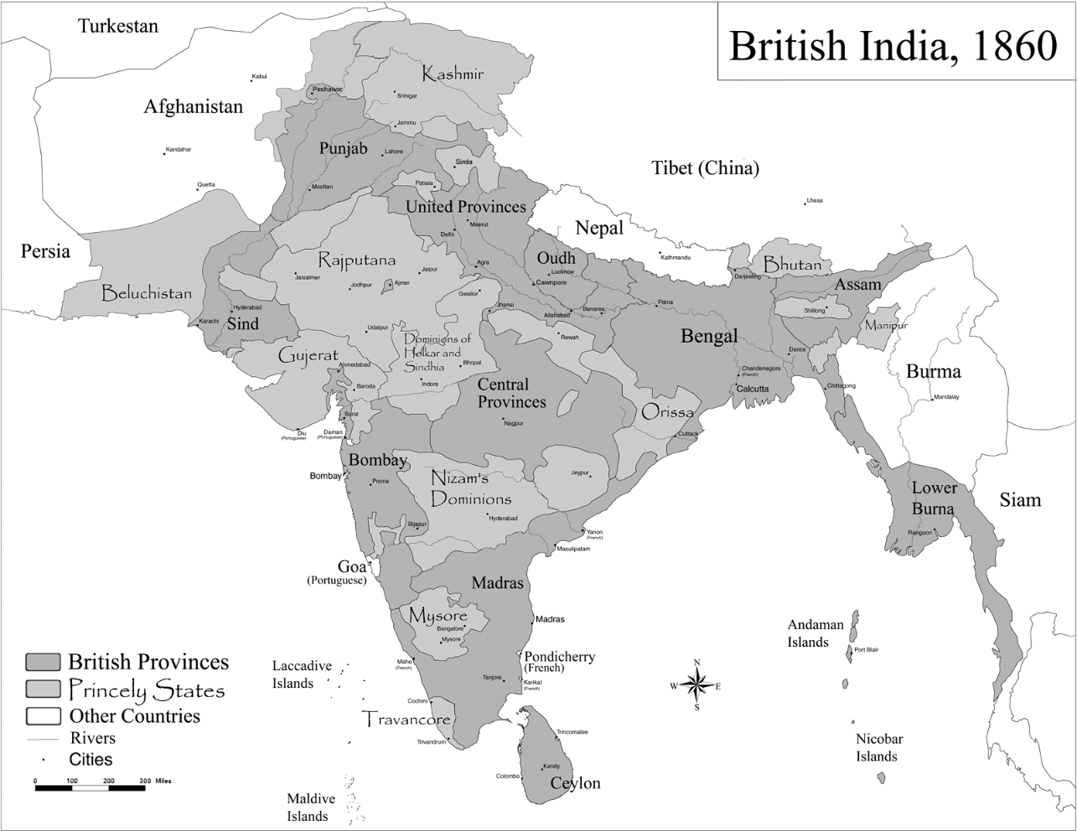
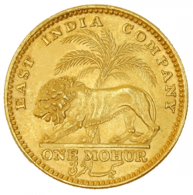
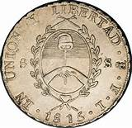
PART 5
The Ancient Ratio Mechanism Strikes
One Last Time
EUROPE 1850
1862 – 91 million Rupees
1863 – 126 million Rupees
1864 – 129 million Rupees
Starting with the last half of the 18th century, the British began to conquer the Indian states. In 1821 Britain had raised the gold/silver ratio to 15:1. However, from 1852 only silver coins were legal tender in India, and this drew silver from Europe.

Slide 20
PART 6
The Latin Monetary Union Demonetizes Silver 1865-1873
Belgium, Switzerland, Italy and France all experienced the loss of silver coin.
In 1865, these countries formed the Latin Monetary Union and agreed to change their national currencies to a common gold and silver mint ratio and make them freely interchangeable. Greece joined in 1868.
Most European countries attended the Union’s conferences.
Significantly, England never joined.

Slide 21
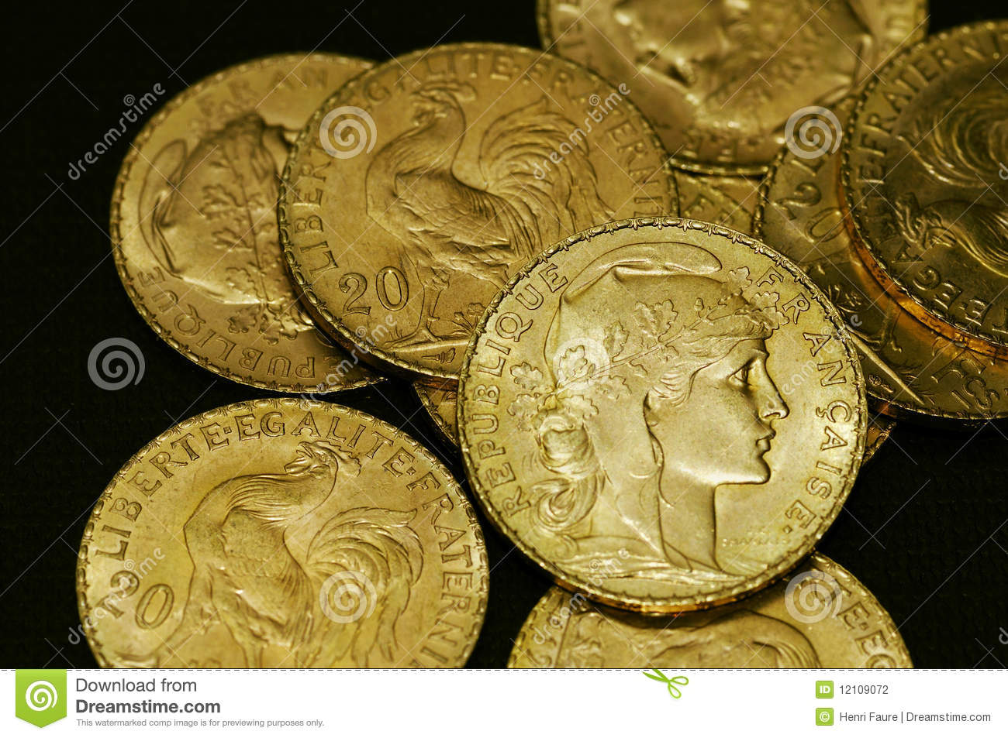
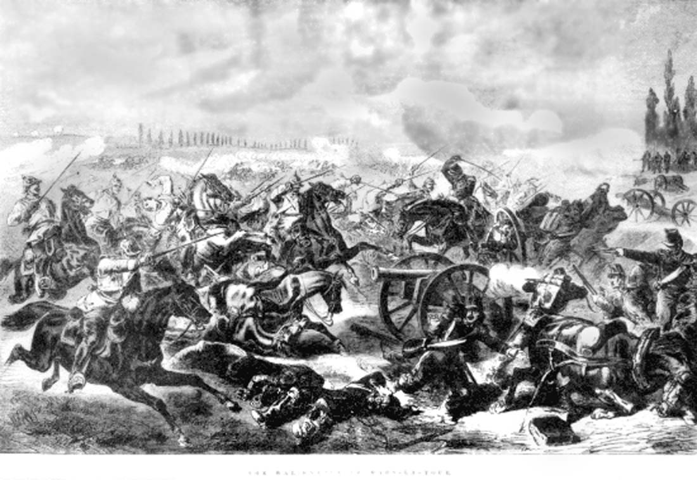
PART 6
The Latin Monetary Union Demonetizes Silver 1865-1873
Germany was the catalyst for monetary change.
Germany warred with France in 1870 and won the Franco-Prussian War.
Bismarck extracted an unprecedented war indemnity of 5 billion Francs.
Germany had demonetized gold in 1857.
However, to receive payment from France in gold (not silver),
the country went onto the gold standard in 1871.

Slide 22

PART 6
The Latin Monetary Union Demonetizes Silver 1865-1873
    FRANCE GIVES UP SILVER STANDARD
1871__________1873_____________________1876______________1878__________
France dumps silver France forced to France cancels law France agrees to redeem
to buy gold to pay limit silver coinage on free coinage of silver silver coins in gold & stop
German indemnity minting new 5 Franc silver coins
“FOR PRACTICAL PURPOSES ALL OF EUROPE WAS NOW ON A GOLD STANDARD.”
Stephen Zarlenga, LSM, p. 484

Slide 23
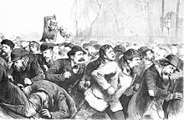
PART 6
The Latin Monetary Union Demonetizes Silver 1865-1873
“At no time in the history of the world have such enormous, such inequitable, such widespread, I may almost say cosmic disturbances of prices, such unforeseeable and undeserved changes of opportunity and fortune occurred as have occurred since the evil day – now some thirty years ago – when the coinage of silver began to be checked throughout the civilized world.” Alexander Del Mar, A History of Monetary Crimes, p. 78, speaking before the Memphis Monetary Convention 1895.
PANIC OF 1873, known as “The Great Depression” at the time:
The failure of the Jay Cooke bank set off a chain reaction of bank failures and temporarily closed the New York stock market. Factories began to lay off workers as the United States slipped into depression.
New York police violently attacking unemployed workers in Tompkins Square Park, 1874.

Slide 24
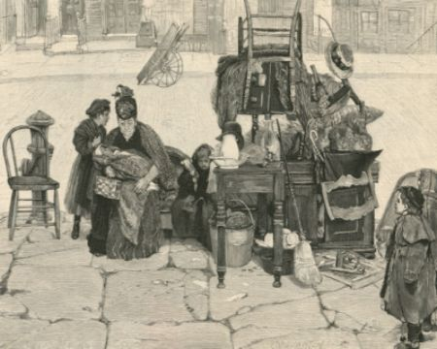
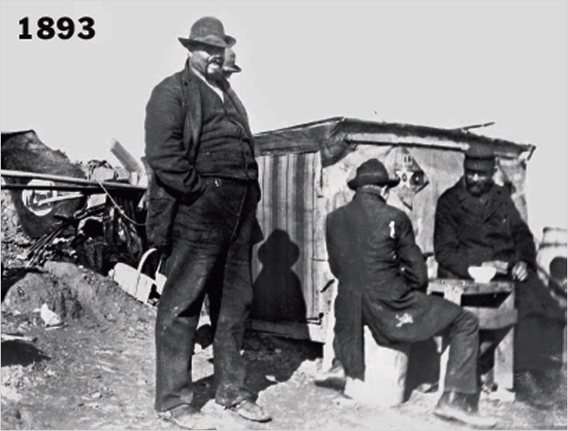
PART 6
The Latin Monetary Union Demonetizes Silver 1865-1873
“… over 95 per cent of all the exchanges of the world are transacted not with money, whether of metal or paper, but with mere orders for money, such as checks and bills of exchange … affecting to be exchangeable … on demand for coins of gold or silver. What now shall be thought of the man or the men who thirty years ago deliberately destroyed one-half of the scant support upon which the stupendous superstructure of the world’s commerce, contracts, and expectations depends?” Alexander Del Mar, A History of Monetary Crimes, p. 78-79, speaking before the Memphis Monetary Convention 1895.
PANIC OF 1893:
Speculation causing a bubble in railroad building, railroad bankruptcies, and a run on gold sparked this panic. People rushed to withdraw their money from banks, and caused bank runs.
Estimates of the unemployment rate per 100 persons during the 1890s (2 sources):
Year | Lebergott | Romer
1893 | 11.7 | 8.1
1894 | 18.4 | 12.3
1895 | 13.7 | 11.1
1896 | 14.5 | 12.0
1897 | 14.5 | 12.4
1898 | 12.4 | 11.6
1899 | 6.5 | 8.7
Dispossessed
Chicago’s Lakefront - unemployed

Slide 25


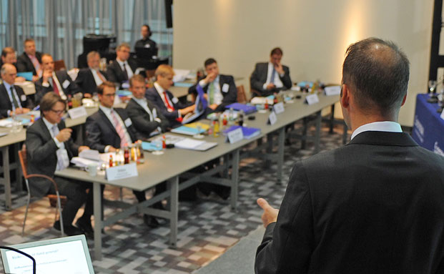
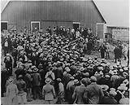
PART 6
The Latin Monetary Union Demonetizes Silver 1865-1873
Wealthy bond holders in each country gained money and power for decades,
as the value of the currency unit rose.
Creditors gained; debtors lost.
TODAY’S FAMILY OFFICES – WEALTHY CREDITORS
FARM FORECLOSURE

Slide 26
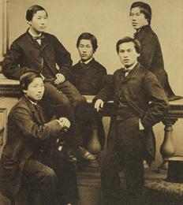
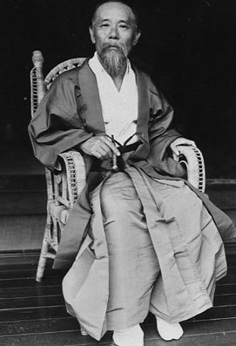
PART 7
The Deflation Even Reaches Japan
The Bank of Japan was established in October 1882 as a central bank
with the support of Finance Minister Ito Hirobumi
THE CHOSHU FIVE
In 1863, five intrepid Japanese noblemen from the Choshu clan secretly approached William Keswick, an agent from the Hong Kong based shipping company Jardine Matheson, who was keen to establish good relations with Japan with a view to future trade. Unauthorised travel was punishable by death so the utmost secrecy was required. The group cut off their chonmage (topknots) and donned western style dress in order to be smuggled out of the country onboard the Chelswick, a ship bound for Shanghai which sailed on 27th June 1863.
They studied at the University College London, whose founders were influenced by Jeremy Bentham.
One of the ‘Choshu Five’ was
Ito Hirobumi, who approved the creation of a Japanese Central Bank

Slide 27
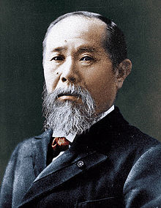
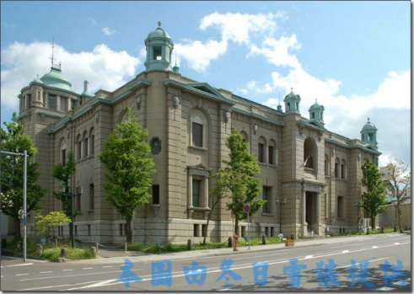
PART 7
The Deflation Even Reaches Japan
The Bank of Japan was established in October 1882 as a central bank
with the support of Finance Minister Ito Hirobumi
Ito Hirobumi visited the United States and found that “ ‘the national bank has the privilege of issuing notes and both functions of amortizing government notes and of financing,’ and he recommended adopting this system…”.
The United Nations University project on Technology Transfer, Transformation, and Development: The Japanese Experience, 1978 to 1982.
BANK OF JAPAN
ITO HIROBUMI

Slide 28
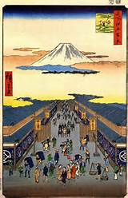
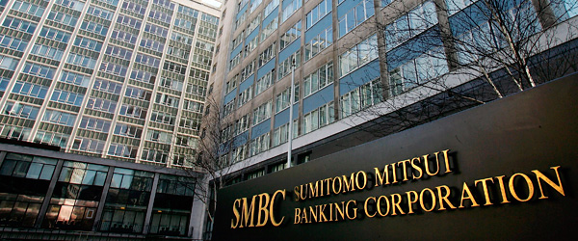
PART 7
The Deflation Even Reaches Japan
Japan’s Central Bank was privately owned, under the dominance of the Mitsui group,
the world’s oldest commercial enterprise.
MITSUI had been founded by Sokubei Takatoshi, a samurai turned merchant who opened a drapery store around 1636. Mitsui's main business in the early period were drapery, finance and trade. By 1882 the MITSUI GROUP was the most powerful organization in Japan. In 1876, Mitsui Bank, Japan's first private bank, was founded.
By 1882 the MITSUI GROUP was under the leadership of Minomura Rizeamon, known as “Man From Nowhere”. He kept Japan in line with the prevailing worldwide deflationary policy. Stephen Zarlenga, LSM, p. 484
MITSUI - TODAY
MITSUI - YESTERDAY

Slide 29
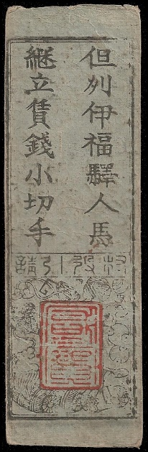
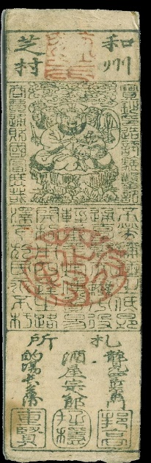
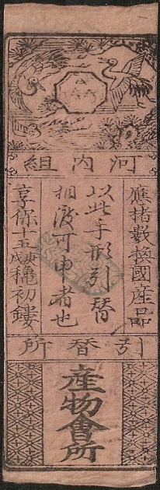
PART 7
The Deflation Even Reaches Japan
Upon its establishment in 1882, the Central Bank of Japan immediately adopted a deflationary course
HANSATSU
HAN = CLAN
SATSU = NOTE
Deflation was performed by calling in the paper money called Hansatsu – issued from 1603 to 1868 by the 250 clans. This was legal tender.
“Entering upon a policy of contraction in 1882, the government firmly persisted in its measures. At the end of 1884, the paper money was nearly at par, and by 1886 paper and silver were entirely interchangeable… But this wholesome end was not and could not be thus rapidly attained without great disturbance in all other business. ‘The prices, of course, fell as precipitately as they had risen ; with the fall in prices, distress and desolation extended over the land, and millions of people who had supposed themselves on the high road to wealth suddenly found poverty staring them in the face, while exacting creditors on all sides demanded the liquidation of debts.’ " Masayoshi Takaki, The History of Japanese Paper Currency, 1903, p. 58.

Slide 30
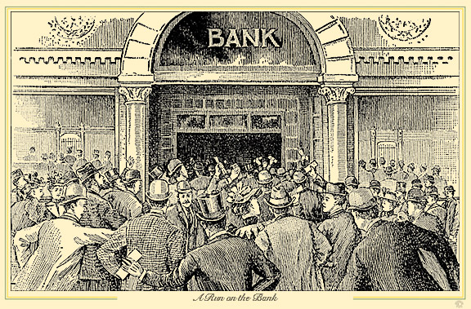
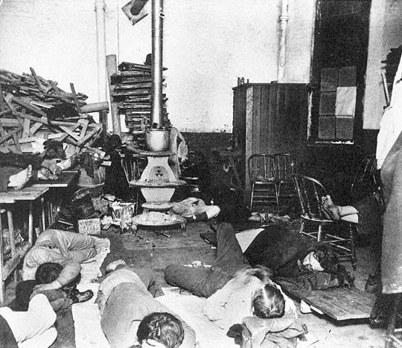
PART 8
Half the World’s Metallic Money Destroyed
“These demonetization episodes demonstrate that the financiers’ insistence . . . that the precious metals were really money . . . was in large part a ruse by which they assured the monetary power would remain in their hands.” Stephen Zarlenga, LSM, p. 485

Slide 31
NATIONAL MONETARY DEFLATION

Slide 32
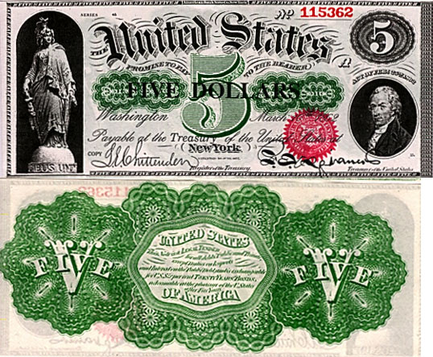
PART 9
Bankers Fear the Greenback Example:
A Well Operated Government Money System
Issuing the Greenback was based on legislative authorization (not the caprice of bankers).
Greenbacks required no debt or interest payments.
A specific number were authorized and never exceeded.

Slide 33
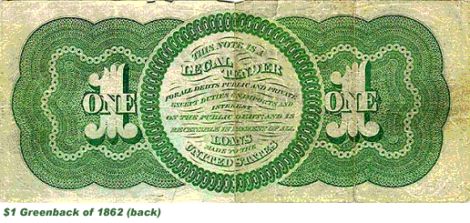
PART 9
Bankers Fear the Greenback Example:
A Well Operated Government Money System
June, 1864 – Congress enacted that the whole amount of greenbacks issued or to be issued should never exceed $450,000,000, the last $50,000,000 being a temporary issue
When the war came to an end and the army was paid off and disbanded the amount remained fixed in the law at $400,000,000
White, Money and Banking, 5th Ed.,
1911, p 118

Slide 34
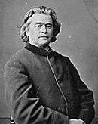
PART 9
Bankers Fear the Greenback Example:
Greenbacks were very popular
1868 – CONGRESSMAN SAMUEL FENTON (INDEPENDENT REPUBLICAN, OHIO) SPEAKING IN HOUSE OF REPRESENTATIVES
“Our Constitution gives to Congress the exclusive power to coin money and regulate the value thereof... These are attributes of sovereignty and belong exclusively to the representatives of the whole people...
The value of money has no relation to or dependence upon the material of which it is made. If it has the properties or powers of representing, measuring, and exchanging value, it is money; and these properties or powers are not inherent in any substance, but are conferred upon any chosen material by the sovereign power....
The Greenback…. helped us through one danger and will bear us triumphantly through another unless the cupidity of bankers, bondholders and shoddy contractors shall triumph over the industrial and tax-paying classes of our people...
The first step in the right direction will be to pass a law to call in and cancel the entire bank circulation and simultaneously issue an equal quantity of Treasury certificates or legal tenders.”
Samuel Fenton Cary
1814-1900

Slide 35
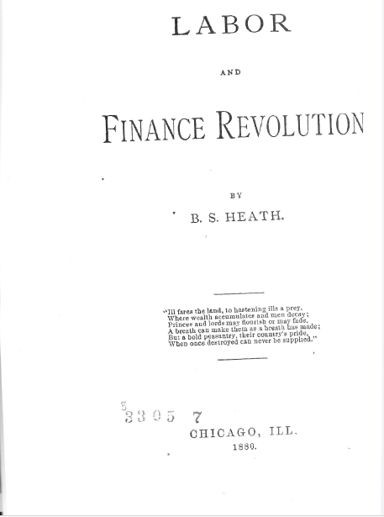

PART 9
Bankers Fear the Greenback Example:
Greenbacks were very popular
B.S. Heath, LABOR AND FINANCE REVOLUTION, 1880, p. 155-156
“There are three important considerations why the greenback should displace the bank note entirely.
It is legal tender between man and man, which the bank note is not.
When the greenback is issued, it serves the Government as money for the amount its face represents, saving the people that amount of taxation…
It costs nothing to keep the greenback in circulation… but the bank note costs an average of 5 per cent. per annum, the amount of interest the people are compelled to pay on the bonds upon which it is based. “
B.S. Heath, LABOR AND FINANCE REVOLUTION, 1880, p. 155-156

Slide 36
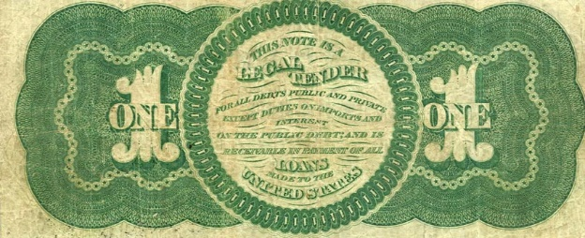
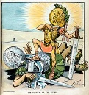

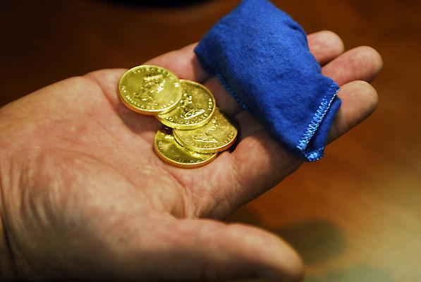
PART 9
Bankers Fear the Greenback Example --
and launch three deflationary attacks on America
REMOVE THE GREENBACKS
1865 - 1878
SECRETLY
DEMONETIZE SILVER
1873
REDEEM GREENBACK
BONDS IN GOLD
1868 - 1869

Slide 37
PART 10 The First Attack – Remove the Greenback
TIMELINE: THE FIRST 20 YEARS OF ATTACK
1866 1868 1869 1871 1873 1874 1875 1879 1884
_________________________________________________________________
Contraction Repeal Supreme Court Supreme Court
Act 1866 of 1866 Act supports Greenback supports Greenback
1871 1884
English “experts” English “experts”
attack Greenback attack Greenback
Panic of Inflation Resumption Act Resumption Act
1873 Bill Vetoed Passed 1-1875 Starts 1-1879

Slide 38
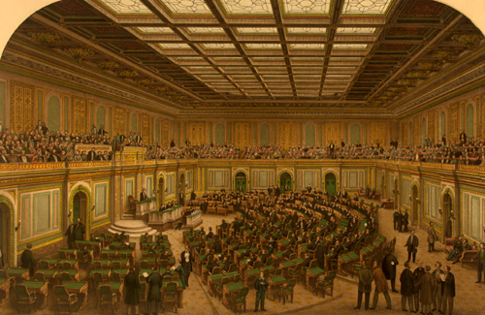
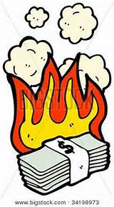
PART 10 The First Attack – Remove the Greenback
a. Contraction Act and Its Suspension 1866-1868
At the end of the Civil War, Treasury Secretary McCulloch pressed for a law to gradually retire the Greenbacks. The act was passed on April 12, 1866. It was called the Contraction Act.
The act provided that $10 million of Greenbacks, received in payment by the government,
would be destroyed over six months.
After that, up to $4 million Greenbacks per month would be destroyed.
CONGRESS, 1866

Slide 39
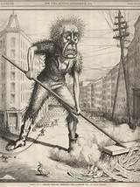
PART 10 The First Attack – Remove the Greenback
a. Contraction Act and Its Suspension 1866-1868
McCulloch retired no Greenbacks for almost six months and then retired $10 million all at once, creating great distress and causing business failures in the Northern states to skyrocket in 1867. Charles B. Spahr, The Present Distribution of Wealth in the United States, 1896, p. 37
Northern Business Failures
  1863 520
  1864 530
  1865 630
  1866 2,386

Slide 40

PART 10 The First Attack – Remove the Greenback
a. Contraction Act and Its Suspension 1866-1868
“… through 1866 direct contraction met ever-stiffening resistance from businessmen, Agrarians, and the Administration’s political opponents… culminating in February 1868 in the repeal of the 1866 Act.
By this time some $44 million of greenbacks had been retired.”
Irwin Unger, The Greenback Era, 1964, p. 43
“Leading the anti-contractionist drive was a surprisingly large section of the business community. The worsening commercial picture … drove into the anti-resumption camp many businessmen who might not otherwise have resisted McCulloch’s policy. Boot and shoe manufacturers, farm machinery producers, carriage makers, brokers, even merchants and bankers, joined the attack on the Contraction Act after April 1866 …”
Irwin Unger, The Greenback Era, 1964, p. 44

Slide 41
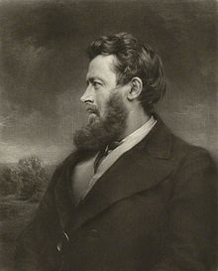
“We commonly think, I believe, that the coining of money is an economic function of Government; that the Government verifies the quality and quantity of metal in the coin out of regard to the good of its subjects, and that Government is admirably suited to this task—that it is a very reliable verifier. But in truth, if we look at the real motives of Governments, and the real action of Governments, we may come to think otherwise…
So far, then, from its being historically true that coining is an economic act, which Governments do for the benefit of their subjects, it has been a political act, which they have done for their own sake. It won them reverence and gained them money… have care for prestige and revenue… ”
A Universal Money, 1869
PART 10 The First Attack – Remove the Greenback
b. England Sends “Experts” to Attack the Greenbacks 1869 1874
Walter Bagehot was a well-known English political economist. In 1869 he wrote a short book published by the Economist which spoke about the union of American and British currencies. The book emphasized gold and the smearing of government.
Walter Bagehot
1826 – 1877)

Slide 42
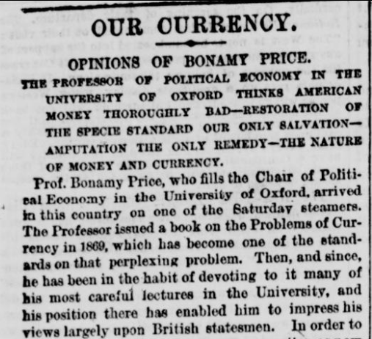


PART 10 The First Attack – Remove the Greenback
b. England Sends “Experts” to Attack the Greenbacks 1869 1874
On October 1, 1874, the Daily Tribune reporter interviewed Bonamy Price (1807–1888), professor of political economy at Oxford University, and a former mental patient who was given Thorold Roger’s professorship at that University when Rogers had proved that Englishmen were in dreadful economic shape.
Oxford University

Slide 43
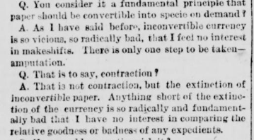
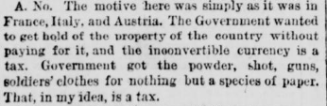

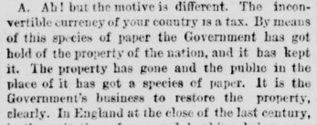
PART 10 The First Attack – Remove the Greenback

Slide 44




PART 10 The First Attack – Remove the Greenback
c. Attacks thru Law Courts Fail 1871, 1884
The issue of the constitutionality of the Legal Tender Acts came before the state courts some fifteen times between 1863 and 1869, and in almost every instance the courts held the law valid.
Charles Fairman, Mr. Justice Miller and the Supreme Court, 1862-1890, 1939, pp. 152-153

Slide 45





Knox v.
Lee
1871
PART 10 The First Attack – Remove the Greenback
Attacks thru Law Courts Fail 1871, 1884
THE SUPREME COURT OF THE U.S.
THE U.S. SUPREME COURT held that government-created fiat currency, issued during the U.S. Civil War, was legal tender and had to be accepted as payment for all debts before 1862 and after.
The court held that one could not demand payment in gold or another commodity instead of legal tender currency
THE U.S. SUPREME COURT heard the following case.
Juilliard sold and delivered 100 bales of cotton to Greenman for $5,122.90. Greenman tendered $5,100 in United States legal tender notes and the rest in coin, but Juilliard would not accept the U.S. notes.
The court supported Greenman.
Juilliard v. Greenman
1884

Slide 46


THE PANIC OF 1873
August, 1873 – large amounts of cash were withdrawn from New York banks – a collapse of banks, businesses, and the stock exchange followed.
PART 10 The First Attack – Remove the Greenback
d. Inflation Bill Vetoed 1874

Slide 47

The Panic was initially triggered in Europe due to a fall in demand for silver, which followed Germany's decision in 1871 to abandon the silver standard in the wake of the Franco-Prussian war. The first symptoms of the crisis were financial failures in the Austro-Hungarian capital, Vienna, which spread to most of Europe and North America.
Thus began the first world-wide depression. It was called The Long Depression,
beginning in 1873 and running through the spring of 1879. It was labeled the "Great Depression" at the time, and it held that designation until the Great Depression of the 1930s.
Engraving of the Panic of 1873
in Vienna that led to the
Long Depression

Slide 48

The crisis reached the United States in the fall of 1873. It touched off a series of events that encompassed the entire nation.
Jay Cooke’s banking house went under on September 18 and the U.S. markets tumbled on September 20. The New York Stock Exchange was closed for 10 days.
Credit dried up, foreclosures were common and banks failed.
Factories closed their doors, costing thousands of workers' jobs. The volume of destitute people soon overwhelmed the abilities of charities to function. Most of the major railroads failed.

Slide 49

WALL STREET, FALL, 1873

Slide 50

Banks failed.

Slide 51


… the U.S. markets tumbled on Sept 20. The New York Stock Exchange was closed for 10 days.

Slide 52

Most of the major railroads failed.

Slide 53

Foreclosures
were common.

Slide 54

The volume of destitute people soon overwhelmed
the abilities of charities to function.

Slide 55



With the hard times all around and unemployment at 25 percent, Congress passed an “Inflation Bill” that would have added $44 million of paper money from the Treasury, increasing the Greenback circulation to $400 million. It also would have increased the banknote circulation to $400 million as well (from 340 million).
PART 10 The First Attack – Remove the Greenback
d. Inflation Bill Vetoed 1874
Many farmers and working men favored the bill.

Slide 56


On April 22, 1874, President Grant unexpectedly vetoed the bill on the grounds that it would destroy the credit of the nation.
PART 10 The First Attack – Remove the Greenback
d. Inflation Bill Vetoed 1874
(President 1869–1877).
To the Senate of the United States:
Herewith I return, Senate bill No. 617, entitled "An act to fix the amount of United States notes and the circulation of national banks, and for other purposes," without my approval…
In doing so I must express my regret at not being able to give my assent to a measure which has received the sanction of a majority of the legislators chosen by the people to make laws for their guidance, and have studiously sought to find sufficient arguments to justify such assent, but unsuccessfully….
The measure has been supported on the theory that it would give increased circulation... The theory, in my belief, is a departure from true principles of finance, national interest, national obligations to creditors, Congressional promises, party pledges (on the part of both political parties), and of personal views and promises made by me in every annual message sent to Congress and in each inaugural address.
President Grant Vetos the Inflation Bill, Bottling the Genie of Butler, who supported Greenbacks

Slide 57


PART 10 The First Attack – Remove the Greenback
d. Inflation Bill Vetoed 1874
“In a word, the shift of public opinion is not great enough
to account for (the veto). Nothing in the press or surviving
political correspondence suggests a buildup of hard money
strength.” Irwin Unger, The Greenback Era, 1964, p. 213
“Grant’s veto did great damage to the Republican party. They
lost control of congress in the 1874 elections and it was this 1874
lame duck congressional session that enacted the
Resumption Act to redeem the Greenbacks in gold.”
Stephen Zarlenga, LSM, p. 493
43rd United States Congress
Duration: March 4, 1873 – March 4, 1875

Slide 58

Charles Lindbergh, Sr., REPUBLICAN US REPRESENTATIVE
AND FATHER OF THE FAMOUS AVIATOR
PART 10 The First Attack – Remove the Greenback
e. Resumption Act Passes Jan 1875 – Starts Jan 1879
"Ever since the Civil War Congress has allowed the bankers to control financial legislation. The membership of the Finance Committee in the Senate (now the Banking and Currency Committee) and the Committee on Banking and Currency in the House have been made up chiefly of bankers, their agents and their attorneys. These committees have controlled the nature of bills to be reported, the extent of them, and debates that were to be held on them when they were being considered in the Senate and the House.“ Charles Lindbergh, Sr.
U.S. SENATE

Slide 59

THE RESUMPTION ACT
PART 10 The First Attack – Remove the Greenback
e. Resumption Act Passes January 14, 1875
The U.S. Treasury would redeem Greenbacks (offered in amounts not less than $50) for gold specie beginning January 1, 1879.
$300 million of Greenbacks were to be left in circulation.
For every $80 of Greenbacks retired, $100 in bank currency was to be issued.
All "paper coins" (notes with denominations less than one dollar) were removed from circulation and replaced with silver coins.
National banks were strengthened. They could print more currency and their reserve requirements were reduced.
Senators of the 43rd United States Congress,
that passed the Resumption Bill
in January, 1875… the lame duck Congress.

Slide 60

PART 10 The First Attack – Remove the Greenback
e. Resumption Act Passes Jan 1875 – Starts Jan 1879
ANXIETY OVER SPECIE RESUMPTION AND CONTRACTION OF THE GREENBACK
PERMEATED THE BUSINESS COMMUNITY
“… dissidents of the New York Chamber of Commerce… In mid-1875, after years
of fighting contraction from within, this faction finally seceded from the Chamber…
a number of the dissenters – including Peter Cooper and others… organized the
New York Board of Trade in competition with the Chamber.”
Irwin Unger, The Greenback Era, 1964, p. 288
(1791 – 1883)

Slide 61
PART 10 The First Attack – Remove the Greenback
e. Resumption Act Passes Jan 1875 – Starts Jan 1879
POPULAR SENTIMENT FOR THE GREENBACKS WAS SO GREAT
THAT THE DEMOCRATIC-CONTROLLED CONGRESS OF DECEMBER 1877
ATTEMPTED TO REPEAL THE ACT
45th United States Congress
“…Both sides realized that committee appointments would be
crucial in the repeal fight… After consulting with Manton Marble…
the two House committees directly concerned with financial
legislation… were packed with hard money men…
Bills aimed at repeal disappeared into committee pigeonholes…”
Irwin Unger, The Greenback Era, 1964, pp. 289-290
Finally in late 1877 the House did pass a bill to repeal the
Resumption Law, but the bill was defeated in the Senate by one vote.
Duration: March 4, 1877 – March 4, 1879
For the first time since the American
Civil War, the House had a Democratic majority.

Slide 62


PART 10 The First Attack – Remove the Greenback
e. Resumption Act Passes Jan 1875 – Starts Jan 1879
On May 31, 1878, the contraction in the circulation was halted at $346,681,016,
by a law that required that all Greenbacks that were redeemed must be re-issued.
“Their good performance was one reason the leading financiers wanted them removed from circulation, as the Greenbacks gave a daily lesson in practical monetary theory.” Stephen Zarlenga, LSM, p. 495

Slide 63

PART 10 The First Attack – Remove the Greenback
e. Resumption Act Passes Jan 1875 – Starts Jan 1879
THE RESUMPTION IS A NON EVENT
“The Resumption Act had designated New York City as the place for the event. The doors of the sub treasury office opened at 10 AM. By close of the business day only $132,000 in Greenbacks were redeemed and $400,000 in gold was deposited for the more convenient bank paper! It was the same story at the banks involved in the resumption – a giant anti-climax.” Stephen Zarlenga, LSM, p. 494-495

Slide 64
PART 10 The First Attack – Remove the Greenback
e. Resumption Act Passes Jan 1875 – Starts Jan 1879
“… theoretically $346 million Greenbacks remain current U.S. money to this day”.
Stephen Zarlenga, LSM, p. 495
End of the Greenback
After the U.S. went off the domestic gold standard in 1933, circulating currency were redeemable by individuals only for silver.
When silver redemption stopped in June 1968, all U.S. currency (coins and paper) were changed to fiat currency.
The stock of Greenbacks was mostly converted into $100 bills, which spent most of their time in bank vaults. The public used Federal Reserve Notes and knew no difference between them and the Greenback.
No more Greenbacks were put into circulation after January 21, 1971.
In 1994 the Riegle Improvement Act released the Treasury from its long-standing obligation to keep the notes in circulation.
In 1996, the Treasury announced that its stock of $100 Greenbacks had been destroyed. Wikipedia

Slide 65

THE MONEY POWER VS THE U.S. CONSTITUTION
STEPHEN ZARLENGA, LOST SCIENCE OF MONEY
THE GREENBACK
“…THEY WERE PROBABLY THE BEST MONEY
SYSTEM AMERICA HAS EVER HAD…
A MORE HONEST MONEY SYSTEM, CONTROLLED
BY GOVERNMENT, INSTEAD OF BANKS.”

Slide 66
Q & A
WILL DECKER’S CONCLUSION:
THE CONTROL OF MONEY -- WITHOUT CONTROL FROM THE PUBLIC -- LEADS TO
CORRUPTION … USURPATION … SLAVERY.

