Slide 1
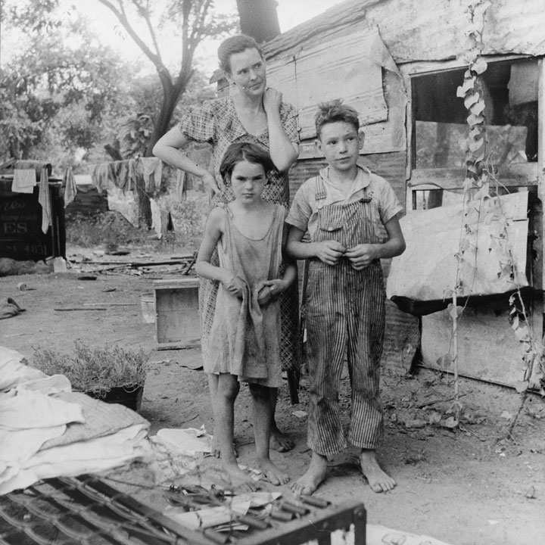
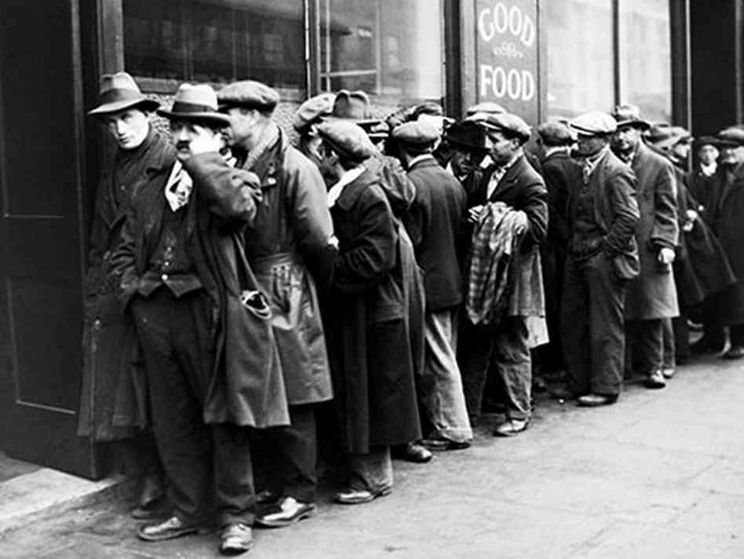
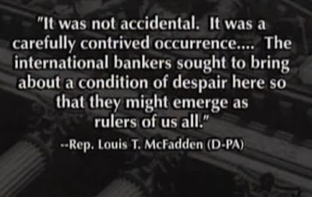
The Lost Science of Money
CHAPTER 20 – Part 1
THE FEDERAL RESERVE
WRECKS AMERICA

Slide 2
THEMES OF LOST SCIENCE OF MONEY BOOK
Primary importance of the money power (power to create money and regulate it)
Nature of money purposely kept secret and confused
How a society defines money determines who controls the society
Battle over control of money has raged for millennia: public vs private
The misuse of the monetary system causes tremendous misery and suffering for the ordinary people. Will Decker & Martin Dunn, February 2014
Whenever the public has owned a significant fraction of the money power, great public benefit has ensued: Sparta, the Roman Republic, the American Colonies in the 18th century, GREENBACKS after the Civil War, Canada after the Great Depression, British experience after World War II. Martin Dunn, July 2014.

Slide 3
PARTS OF PRESENTATION
Bankers Prefer Ambiguity
FED in the “Nick of Time” for World War One
U.S. Sells Arms to Both Sides
WW I Leaves the U.S. in Serious Debt
Bank of England Dictates American Monetary Policy in the 1920’s
The FED Destabilizes America’s Money System: 1920-21 Depression
The New York Fed Bank Directs Policy
What Made the “Roaring Twenties” Roar?
England’s Gold Standard Ideology Causes the 1920s Frenzy
The Fed Concentrates Money in Too Few Hands
The 1929 Stock Market Peak
Benjamin Strong Was Ready
The Bankers Were Warned Against “Speculation”
Warburg Warns of “The Ultimate Collapse”
The Last Straw

Slide 4


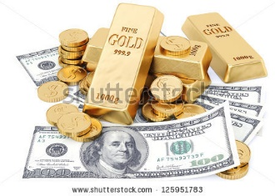

Bankers Prefer Ambiguity
The Federal Reserve Bill was poorly defined and ambiguous.
The Fed supposedly arose from Aldrich’s National Monetary Commission, which didn’t define money anywhere in its 48 reports
on banking 1909 – 1911
Publicly, the Fed touted gold-backed paper money, moving far away from the advanced Greenback concept.
Privately, the FED included credit as money, in the ‘real bills’ concept.

Slide 5
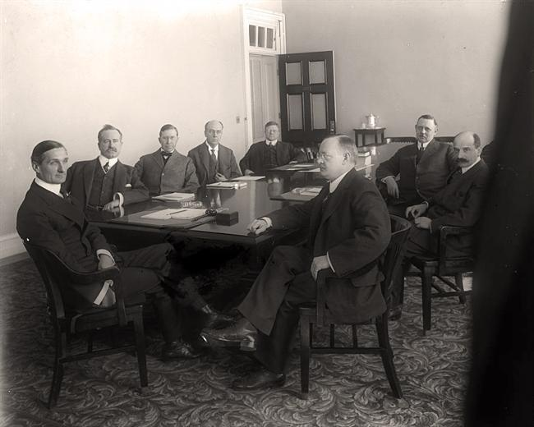
Bankers Prefer Ambiguity
The Federal Reserve Bill was poorly defined and ambiguous.
The 12 Fed Banks were there to help their member banks.
“Interestingly, the original Federal Reserve Act failed
to distribute authority within the System clearly…
Charles Hamlin, a member of the Federal Reserve Board
from the System’s inception, testifying before the U.S.
Senate Banking Committee stated, ‘As a matter of fact,
each one of those Federal Reserve banks essentially is a
central bank with autonomy of its own. It has practically
all the powers that any central bank in Europe has.’ “
Federal Reserve Bank of San Francisco
Historical Papers Series,
“Twelfth District Policymaking: The Early Years”
CHARLES HAMLIN
(1861 – 1938)
First Chairman, Fed Board
(1914-1916)

Slide 6
Bankers Prefer Ambiguity
The Federal Reserve Bill was poorly defined and ambiguous.
The 12 Fed Banks were there to help their member banks.
“The following quotation is from the Minneapolis Fed's 1921 Annual Report:
‘More than seven years have elapsed since the establishment of the Federal Reserve Banks, but there is still a surprising lack of knowledge of what they really are and of what their proper functions are, not only on the part of the public at large, but among business men and bankers as well.’ “
Federal Reserve Bank of Minneapolis,
article “Lender of More Than Last Resort”,
pub. 12/1/2002
CHARLES HAMLIN
(1861 – 1938)
First Chairman, Fed Board
(1914-1916)

Slide 7
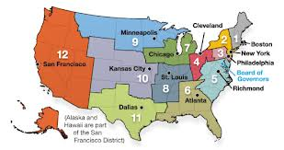
Bankers Prefer Ambiguity
The Federal Reserve Bill was poorly defined and ambiguous.
“The Reserve Banks
appointed a majority of directors from within their district,
they could set their own discount rate** and bankers’ acceptance buying rate**
(subject to the Federal Reserve Board’s approval),
and they could engage in open market operations** as they saw fit.”
[** Note to readers: all of these processes create money out of nothing] Federal Reserve Bank of San Francisco
Historical Papers Series, “Twelfth District Policymaking: The Early Years”
(References: Timberlake, The Origins of Central Banking in the United States, pub. 1978
& Wheelock, The Strategy and Consistency of Federal Reserve Monetary Policy, 1923-1933, pub. 1991)
BOSTON
NEW YORK
PHILADELPHIA
CLEVELAND
RICHMOND
ATLANTA
CHICAGO
ST. LOUIS
MINNEAPOLIS
KANSAS CITY
DALLAS
SAN FRANCISCO
These 12 Federal Reserve banks are separate corporations,
owned by their member commercial banks,
which receive 6% annual dividend on their shares.

Slide 8

Bankers Prefer Ambiguity
The Federal Reserve Bill was poorly defined and ambiguous.
From the original bill of 1913
“… any Federal reserve bank may discount** notes, drafts, and bills of exchange arising out of actual commercial transactions; that is, notes, drafts, and bills of exchange issued or drawn for agricultural, industrial, or commercial purposes…
Any Federal reserve bank may discount** acceptances which are based on the importation or exportation of goods and which have a maturity at time of discount of not more than three months…
** = make credit money out of nothing (accounting entries) and put in the account of the borrower, i.e. agricultural, industrial, or commercial business or importer or exporter.

Slide 9
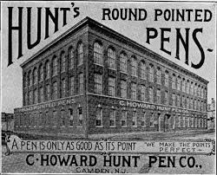
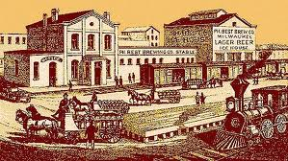

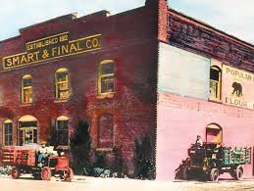
Bankers Prefer Ambiguity
The Federal Reserve Bill was poorly defined and ambiguous.
How ‘REAL BILLS’ (Short-term Business Loans) Worked
Step #1: Commercial banks make loans to commercial businesses (create money from thin air). Loans for 90 days or less. The loans were backed by business inventories (the "real“ in real bills).
Step #2: Using their commercial loans as collateral, member commercial banks could borrow from the Fed. This was called ‘access to the Fed’s Discount Window’. The Fed Bank would create reserve money out of thin air and loan it to the member bank.
This was the legalization of ‘credit’ or accounting money, created out of thin air.
This was believed to give ‘elasticity’ to the money supply.

Slide 10
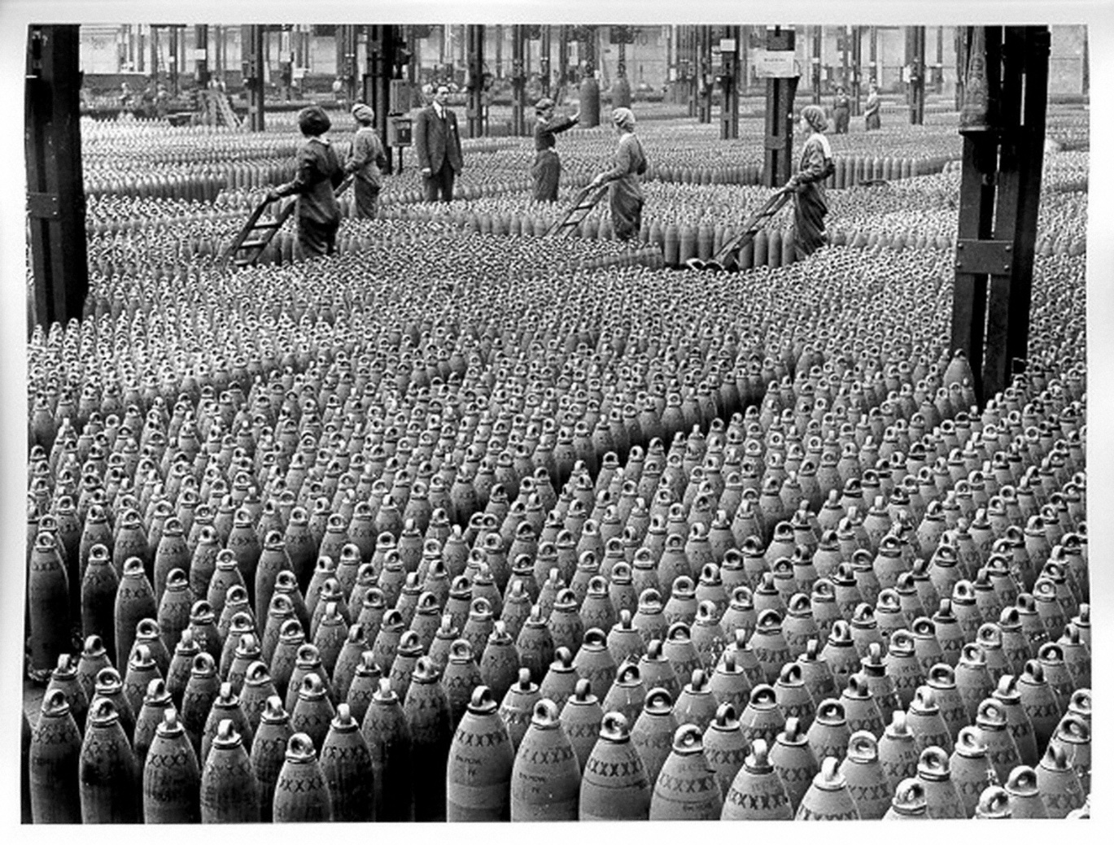
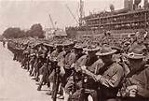
FED in the “Nick of Time” for World War One
The country could not fund World War I by the Fed Banks creating reserve money based on short-term commercial loans and gold.

Slide 11
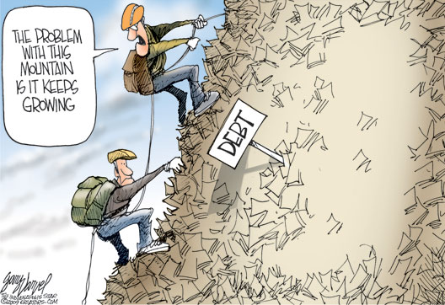
FED in the “Nick of Time” for World War One
The Federal Reserve Law was amended to dramatically increase the Fed’s ability to issue notes.
The
1916 – law amended: Fed Banks could, for the first time, make loans to member banks with government debt as collateral (in limited quantity).
April 1917: Wilson and Congress declare war.
June 1917 – law amended: Federal Reserve Notes backed with only 60% commercial loans (not 100%) and 40% gold.
1917 – law amended: government debt now substituted for commercial debt as collateral for loans from Fed Banks
The Fed now faced no constraints creating Fed Reserve notes (out of nothing) backed by federal debt.

Slide 12
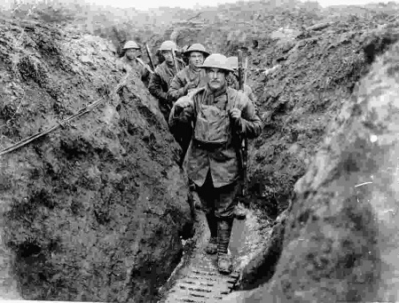
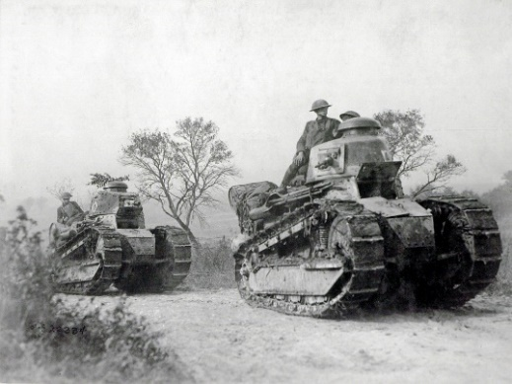
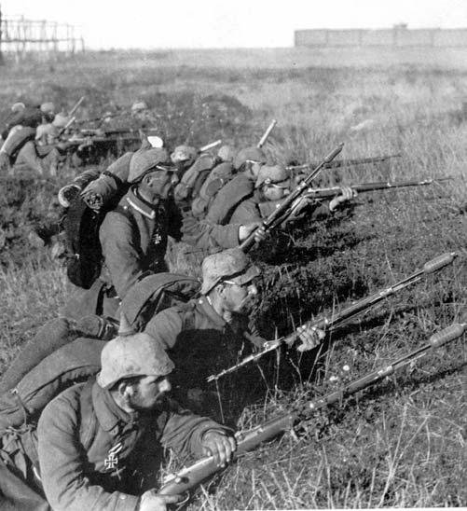
FED in the “Nick of Time” for World War One
The Federal Reserve Law amended to dramatically increase the Fed’s ability to issue notes.
Member banks could buy 3.5% Liberty bonds at government-debt auctions (with credit money they created out of nothing). The member banks would submit the bonds to the Fed as collateral for loans at the preferential rate of 3% (the Fed creating Federal Reserve notes out of nothing).
The member banks ‘pocketed’ the .5% difference in interest as profit.
“… the Reserve Banks encouraged their member banks to purchase Treasury securities by establishing preferential discount rates on loans secured by government notes and bonds (Meltzer 2003, A History of the Federal Reserve, Volume 1, 1913-1951, pp.85-86). ”

Slide 13
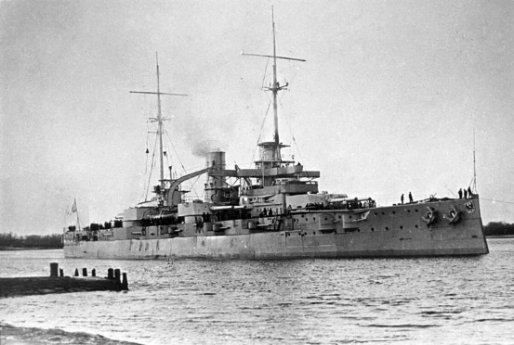
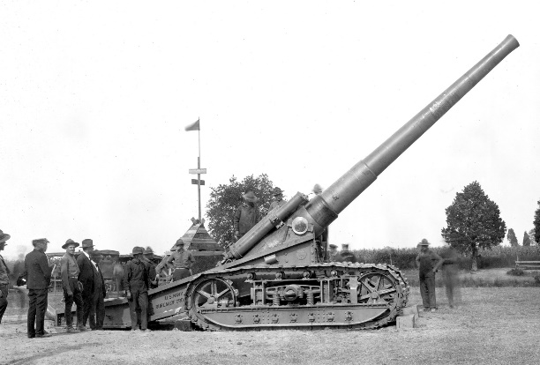
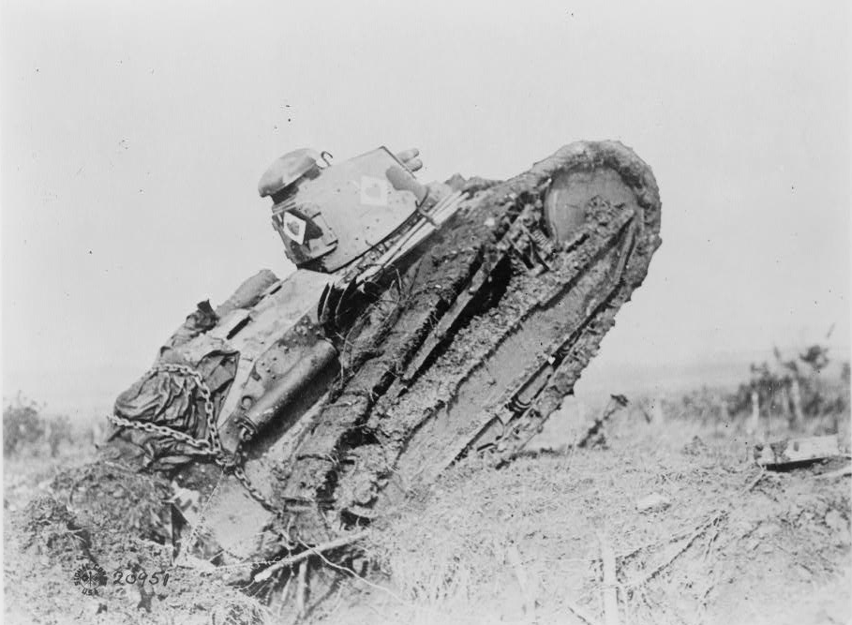
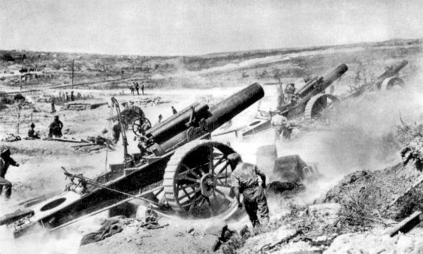
FED in the
“Nick of Time” for
World War One
Member banks make
money from ‘spread’:
3.5% earned minus
3.0% owed = 0.5% profit
TO BUY WEAPONS

Slide 14
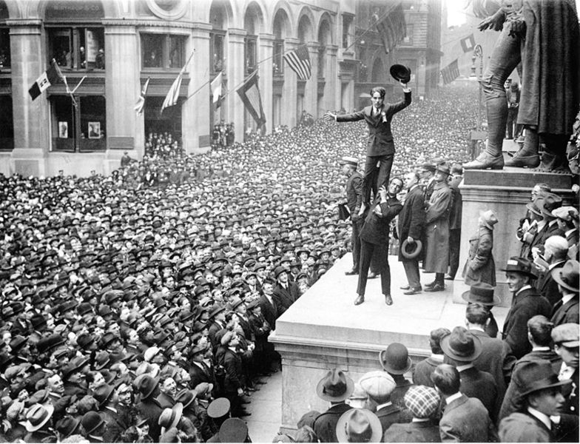
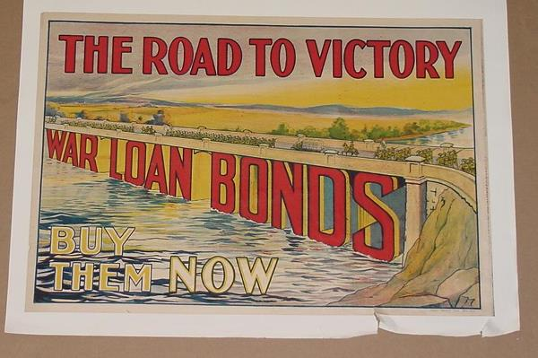
FED in the “Nick of Time” for World War One
New York Times, 1918
Charlie Chaplin stands on
Douglas Fairbanks’ shoulders
during a Liberty bonds rally, at the foot of George Washington’s statue in front of the Sub-Treasury (now Federal Hall National Memorial).

Slide 15

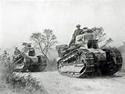
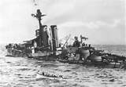
FED in the “Nick of Time” for World War One
April 1917 to the Armistice of 11/11/1918 = 19 months:
U.S. government lent the European Allied Powers the stupendous sum of
9.4 billion dollars.
All this money went to American industries, most tied to Morgan, Kuhn-Loeb, and Rockefeller, to pay for war supplies for allies.
Much of this U.S. federal debt was bought by member commercial banks of the Federal Reserve System - with credit money created out of thin air.

Slide 16
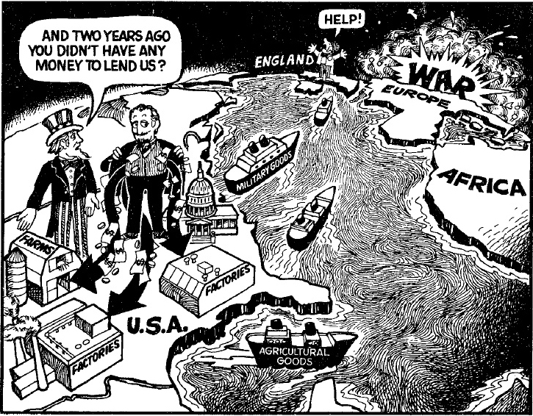
FED in the “Nick of Time” for World War One
FEDERAL RESERVE BANKS &
MEMBER/OWNER
COMMERCIAL BANKS

Slide 17
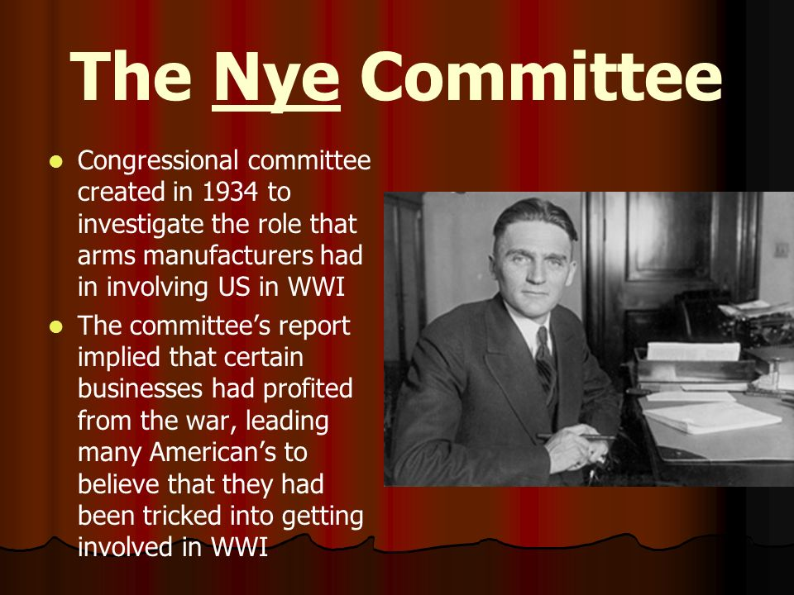
U.S. Sells Arms to Both Sides
In the 30’s, a Senate Committee called the Nye Committee, investigated banking and the munitions industries in getting America into World War I.
The committee reported that between 1915 and January 1917, the United States lent Germany 27 million dollars, and in the same period, it lent to the United Kingdom and its allies 2.3 billion dollars, almost 100 times as much.
Because of these facts Senator Nye, many war critics, and members of the American public concluded that the US entered the war for reasons of profit, not policy — because it was in American commercial interest for the United Kingdom not to lose.
Gerald Prentice Nye
(1892 – 1971)

Slide 18
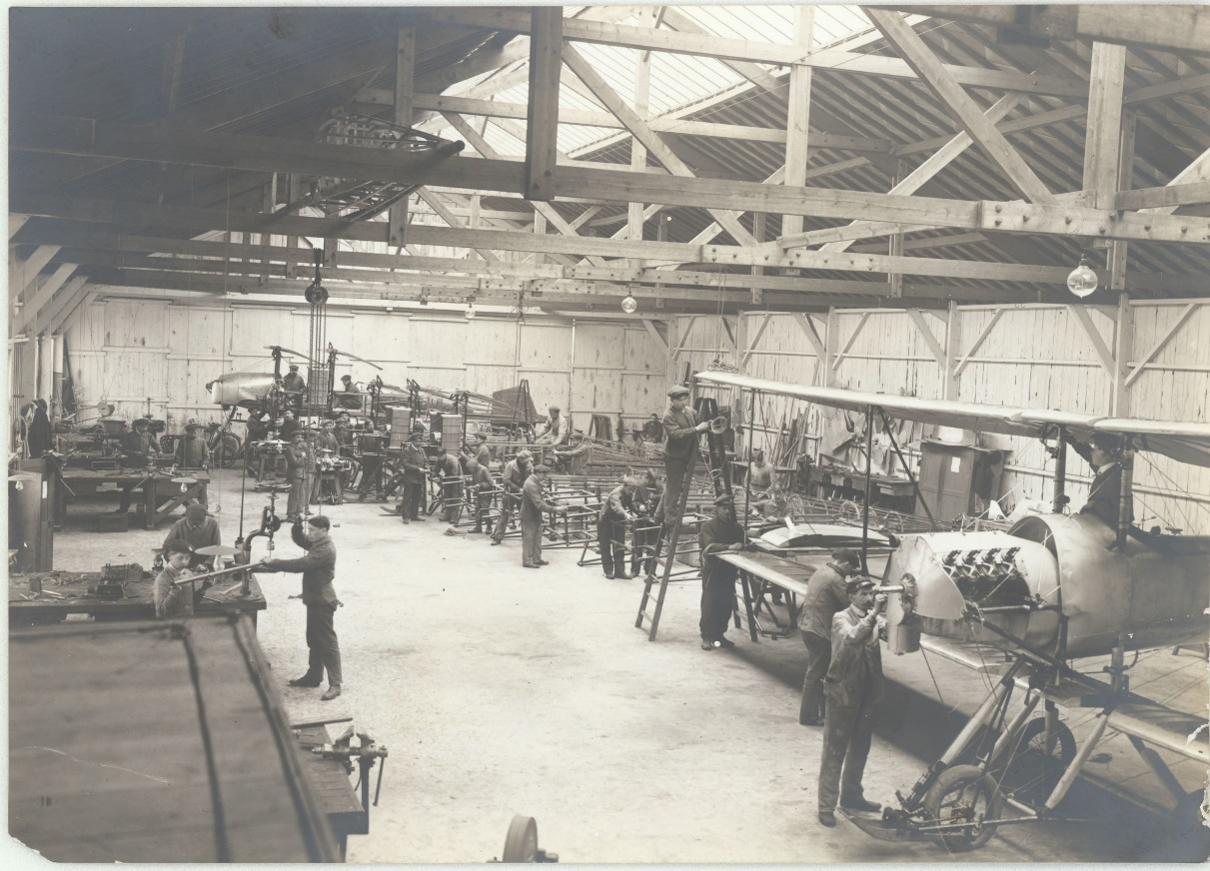
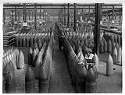
U.S. Sells Arms to Both Sides
By 1916, the private investment bank of J.P. Morgan had organized loans
to Britain and France for a staggering 1.2 billion dollars of war munitions
By the 1917 entrance into war by U.S., 5 billion dollars of war supplies and weapons have been exported from the country by Morgan syndicate

Slide 19
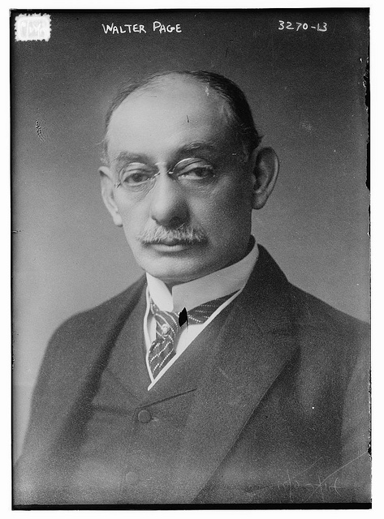
U.S. Sells Arms to Both Sides
March 5, 1917 - confidential dispatch from Walter Hines Page,
US Ambassador to London, to Wilson:
“I think that the pressure of this approaching crisis has gone beyond the
ability of the Morgan Financial Agency….If we should go to war with
Germany, the greatest help we could give the Allies would be such a credit…
Unless we go to war with Germany our Government, of course, cannot make such a direct grant of credit……”
He added that the alternative to war was domestic collapse of the US….
Walter Hines Page (1855 – 1918)
American journalist, publisher, diplomat
U.S. ambassador to U.K. during World War I

Slide 20
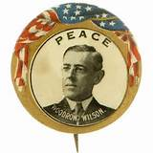
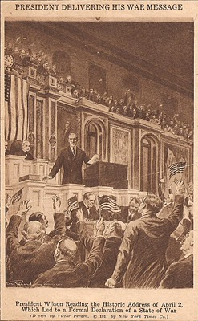
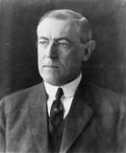
U.S. Sells Arms to Both Sides
April 1917: President Wilson, The Peace President,
asks for a declaration of war against Germany

Slide 21
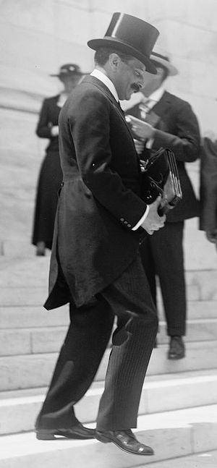
U.S. Sells Arms to Both Sides
Warburg, the Monetary Reformer
Warburg
  Governor, First Federal Reserve Board, 1914-1918
  Member, Federal Reserve’s Federal Advisory Council, 1918-1927
Paul Warburg was not only part of the secret Jekyl Island group that secretly wrote the Federal Reserve law. He later was appointed to its first board of governors from 1914 until 1918, but
resigned in 1918.
The German Warburg bank was funding the Kaiser’s war, and Max Warburg (Paul’s brother) was head of the German secret police.

Slide 22
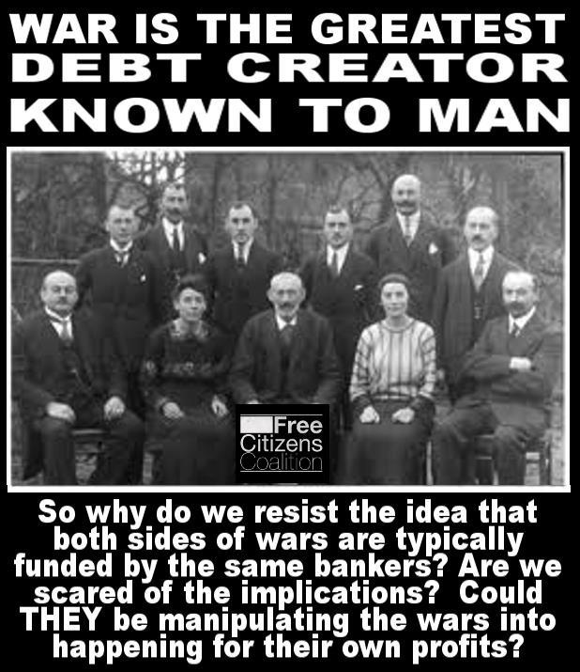
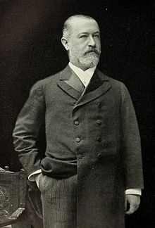
U.S. Sells Arms to Both Sides
KUHN, LOEB AND COMPANY
JACOB SCHIFF
Head, KUHN, LOEB & Co.
daughter married Felix Warburg, brother
of Paul Warburg
Paul married the daughter of the other
KUHN, LOEB owner, Solomon Loeb
SCHIFF HAD TWO BROTHERS IN
GERMANY DURING THE WAR
WHO ALSO WERE ACTIVE
AS BANKERS TO THE GERMAN
GOVERNMENT.
(1847 – 1920)
Schiff served as a director of:
Equitable Life Assurance Society
National City Bank of New York
Central Trust Co.
Western Union Telegraph Co.
Union Pacific Railroad
Bond & Mortgage Guarantee Co.
Wells Fargo & Co.

Slide 23
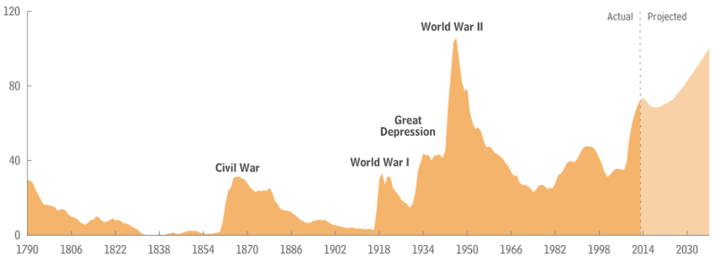

WW I Leaves the U.S. in Serious Debt
One of the primary objectives of the Money Power was achieved –
the U.S. was saddled with an unprecedented debt.
Federal Debt Held by the Public (as a percentage of gross domestic product) from 1790 to 1918
The U.S. government debt after the war was a new record high debt-to-GDP of about 33%, with more than $25 billion in debts, or about $334 billion in today's dollars.

Slide 24
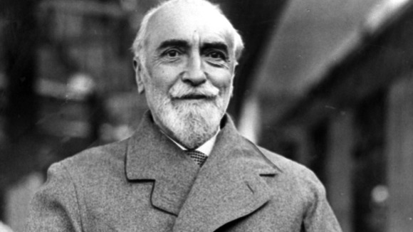
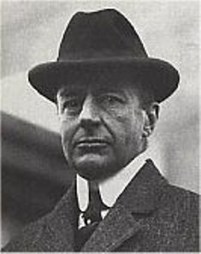
Bank of England Dictates American Monetary Policy in the 1920’s
Montagu Collet Norman,
1st Baron Norman
(1871 – 1950)
“… after W.W. I a close cooperation was established between the Bank of England and … the Federal Reserve Bank of New York … largely due to the cordial relations existing between Mr. Montagu Norman of the Bank of England and Mr. Benjamin Strong …
On several occasions, the discount rate policy of the Federal Reserve Bank of New York was guided by a desire to help the Bank of England,” wrote monetary historian Paul Einzig.
The Fight for Financial Supremacy, pub. 1931, as quoted in LSM, pp. 539-440
Benjamin Strong, Jr.
(1872 – 1928)

Slide 25
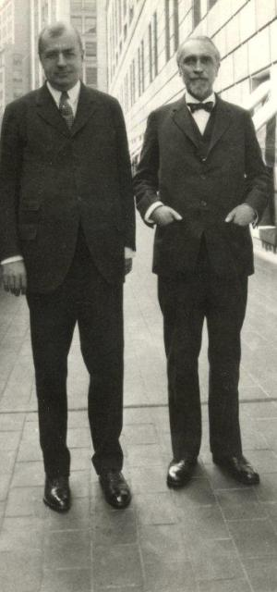
Bank of England Dictates American Monetary Policy in the 1920’s
"Strong and Norman, intimate friends, spent their holidays together at Bar Harbour and in the South of France."
"Norman therefore became Strong’s alter ego. . . . "
“Strong’s easy money policies on the New York money market from 1925-28 were the fulfillment of his agreement with Norman to keep New York interest rates below those
of London. For the sake of international cooperation, Strong withheld the steadying
hand of high interest rates from New York until it was too late. Easy money in New York had encouraged the surging American boom of the late 1920s, with its fantastic heights of speculation.“
Brian Johnson, The Politics of Money, pub. 1970, p. 63

Slide 26
Bank of England Dictates American Monetary Policy in the 1920’s
Montagu Collet Norman,
1st Baron Norman
(1871 – 1950)
“It’s pretty clear from their correspondence that Benjamin Strong and Montagu Norman were involved in more than a business relationship for years. Norman wrote to Strong on September 6, 1928, on learning that Strong was to retire due to illness:
‘Whatever is to happen to us – wherever you and I are to live – we cannot now separate and ignore these years. Somehow we must meet and sometimes we must live together… I have a feeling that in one way or another you will still be useful to those whom you have given service and made sacrifices and they are international and almost world wide. So I believe the best is yet to be.’ (Lester Chandler, Benjamin Strong, Central Banker, pub. 1958, pp. 440-60)
Exactly who were these people that Benjamin Strong had been ‘useful’ to, ‘given service’ and ‘made sacrifices’ to? These ‘international, almost world wide’ people? Montagu Norman does not say. He is certainly not referring to the American public.” Zarlenga, LSM, p. 541
Benjamin Strong, Jr.
(1872 – 1928)

Slide 27
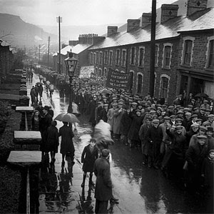
Bank of England Dictates American Monetary Policy in the 1920’s
“In January 1920, the Fed raised its discount rate by 1.25% to 6%. On June 1, 1920 it was raised again to 7%. Wholesale prices, which peaked in May 1929, fell 56% by June 1921. This was the sharpest decline in U.S. history, and led to an unnecessarily severe depression in 1920-21.”
The depression of 1920–21 was characterized by extreme deflation—the largest one-year percentage decline in around 140 years of data.
The drop in wholesale prices was even more severe … the most severe drop since the American Revolutionary War. This is worse than any year during the Great Depression.
Wikipedia, Depression of 1920-21

Slide 28
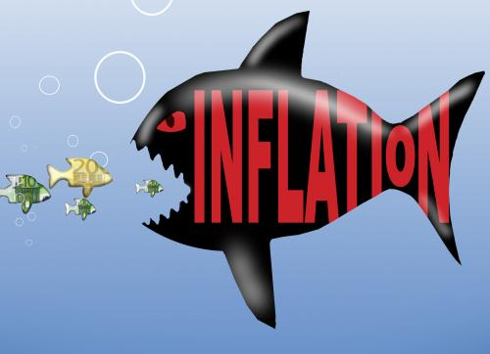
The FED Destabilizes America’s Money System:
1920-21 Depression
“The [Federal Reserve System], intended to promote monetary stability, was followed by about 30 years of relatively greater instability in the money stock than any experienced in the pre-Federal Reserve period our data cover…”
Friedman & Schwartz, A Monetary History of the United States, 1857-1960, pub. 1963
June, 1914 to April 1917 money stock up 46%
wholesale prices increase 65%
April 1917 to May 1920 money stock up another 49%
wholesale prices up another 55%
The Fed’s GOLD STANDARD was not an effective limit on inflation.

Slide 29
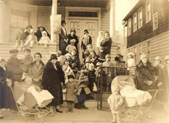
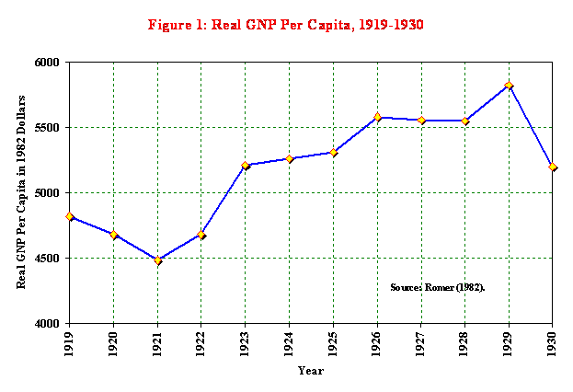
The FED Destabilizes America’s Money System:
1920-21 Depression
“… the biggest lie was that it [Federal Reserve System] would end money panics and business depressions. We were to have no more bank failures, no more farms seized by mortgage holders, no more factories closing down or unemployment…
The history of the Federal Reserve System proves that it double-crossed the farmers of America at a secret meeting on May 18, 1920, when it raised the rate to 7% on agricultural paper and precipitated the Agricultural Depression of 1920-21.”
Eustace Mullins, A Study of the Federal Reserve, 1952, p. 30
THE FORGOTTEN DEPRESSION

Slide 30
The FED Destabilizes America’s Money System:
1920-21 Depression
Senator Robert L. Owen, Chairman of the Senate Banking and Currency Committee, testified at the Senate Silver Hearings in 1939 that:
"In the early part of 1920, the farmers were exceedingly prosperous. They were paying off the mortgages and buying a lot of new land, at the instance of the Government--had borrowed money to do it--and then they were bankrupted by a sudden contraction of credit and currency which took place in 1920… Instead of liquidating the excess of credits created by the war through a period of years, the Federal Reserve Board met in a meeting which was not disclosed to the public.
They met on the 18th of May, 1920, and it was a secret meeting… They spent all day conferring; the minutes made sixty printed pages, and they appear in Senate Document 310 of February 19, 1923. The Class A Directors, the Federal Reserve Advisory Council, were present, but the Class B Directors, who represented business, commerce, and agriculture, were not present. The Class C Directors, representing the people of the United States, were not present and were not invited to be present.
Only the big bankers were there, and their work of that day resulted in a contraction of credit which had the effect the next year of reducing the national income fifteen billion dollars, throwing millions of people out of employment, and reducing the value of lands and ranches by twenty billion dollars.“
Paul Einzig, The Fight For Financial Supremacy, Macmillan, 1931

Slide 31
The FED Destabilizes America’s Money System:
1920-21 Depression
THE NEXT SERIES OF SLIDES COME FROM THE CONGRESSIONAL RECORD, REPORTING ON THE SECRET MEETING COMPOSED OF THE FEDERAL RESERVE BOARD, FEDERAL ADVISORY COUNCIL AND CLASS A DIRECTORS OF FEDERAL RESERVE BANKS -- WHICH BROUGHT ON THE DEPRESSION OF 1920 ➔

Slide 32
The FED Destabilizes America’s Money System:
1920-21 Depression
SECRET MEETING: FEDERAL RESERVE BOARD, FEDERAL ADVISORY COUNCIL, CLASS A DIRECTORS OF FEDERAL RESERVE BANKS

Slide 33
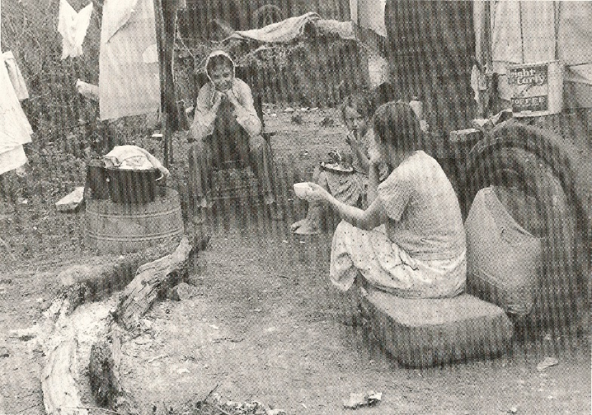
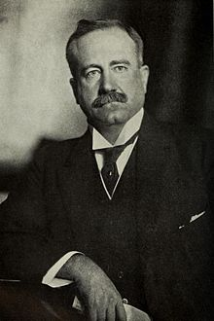
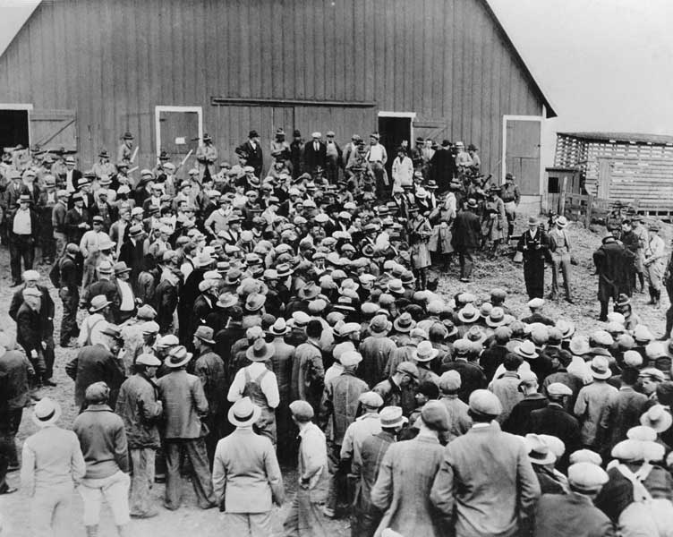
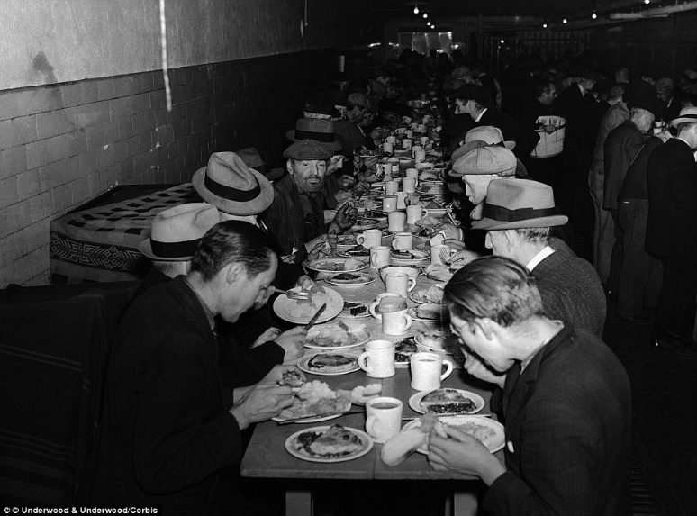
The FED Destabilizes America’s Money System:
1920-21 Depression
“In the 1920s John Skelton Williams was the Comptroller of the Currency and an ex-officio member of the Fed Board. In 1923 he wrote as follows of events in 1920: ‘When I realized the dangers of the drastic deflation which they were bringing about, I urged and implored them [bankers and their representatives] to put on the brakes before it should be too late.” William Hixson, What’s the Difference Between Bankers and Counterfeiters?, pub. 2005, p. 192
Heavily mortgaged during World War I, in expectation of continued high prices, many farms were overwhelmed by the postwar collapse of the agricultural commodities market.
John Skelton Williams
(1865 - 1926)
Controller of Currency
(1914-1921)

Slide 34
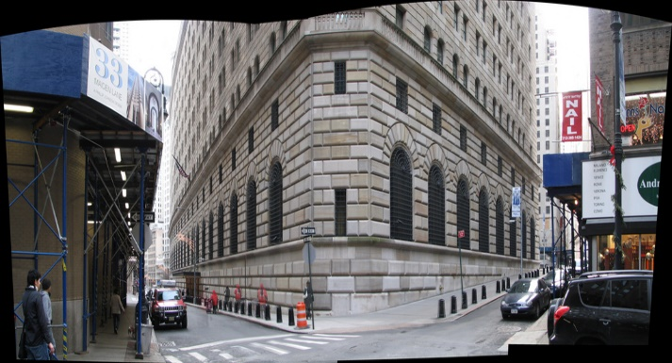



The New York Fed Bank Directs Policy
OPEN MARKET OPERATIONS:
The Buying and Selling of Government Securities by Federal Reserve Banks
“… influential Fed officials, such as the New York Fed’s Governor Strong, believed that changes in discount rates were more
effective and less disruptive if open market operations preceded them. The greater reliance on open market operations also enhanced the power of the New York Fed because open market purchases by other Reserve Banks were coordinated by the Open Market Investment Committee beginning in 1923 [with NY Fed Bank Governor Strong as head] and carried out in New York City…
New York continued to dictate much of open market policy throughout the 1920’s (Wheelock 1991, p. 72)”
The Fed's Formative Years
1913-1929
by David C. Wheelock, Federal Reserve Bank of St. Louis
FED BANK SELLS
TO COMMERCIAL BANK
OR ITS CUSTOMER
NY FED BANK
BANKS’ RESERVES REDUCED
AND THE REVERSE IS TRUE…
WHEN FED BANK BUYS GOVT
BONDS, IT CREATES NEW RESERVES TO PAY FOR THEM

Slide 35

The New York Fed Bank Directs Policy
OPEN MARKET OPERATIONS:
The Buying and Selling of Government Securities by Federal Reserve Banks
“Denoting where power rested in the Federal Reserve System of 1922, on May 25, 1922, George Harrison, second in command
at the New York Fed, wrote to the heads of the other regional Federal Reserve banks, advising them that: ‘Governor Strong has today suggested that Mr. Matteson of this bank act as the operating secretary of the [open market] committee, and has advised each of the banks by telegram that if there is no objection to that appointment the committee will commence functioning tomorrow.’ The letter further notes that ‘This whole program was reported to the Federal Reserve Board at the luncheon…’ ”
wallstreetonparade.com, Dec 9, 2013, by Pam Martens, “New Documents Show How Power Moved to Wall Street, Via the New York Fed”
2,562,973 NEW YORK in millions of $
550,427 SAN FRANCISCO
264,430 RICHMOND
254,944 ATLANTA
173,624 CHICAGO
164,166 DALLAS
128,551 CLEVELAND
125,114 PHILADELPHIA
113,425 BOSTON
69,050 KANSAS CITY
54,917 ST LOUIS
34,267 MINNEAPOLIS
Total assets of the Federal Reserve System
as of March 18, 2015
= 4,495,888 millions of dollars
DISTRIBUTED IN THE
12 FED BANKS
WHICH BANK
CALLS THE SHOTS?

Slide 36
What Made the “Roaring Twenties” Roar?
The U.S. government did not fuel the 1920’s.
1920
1929
GOVERNMENT EXPENDITURES
(as % of national income)
8%
4%
FEDERAL GOVERNMENT DEBT
24.3 Billion
16.9 Billion

Slide 37

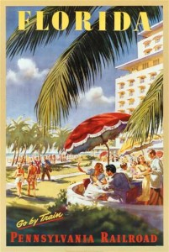

What Made the “Roaring Twenties” Roar?
The banks fueled the 1920’s:
Banks abandoned ‘real bills’ policy of commercial loans
and financed the financial bubble from 1921 to 1929
LOANS FOR SECURITIES
increased 121%
LOANS FOR REAL ESTATE
increased 178%
LOANS FOR INVESTMENTS
increased 67%

Slide 38
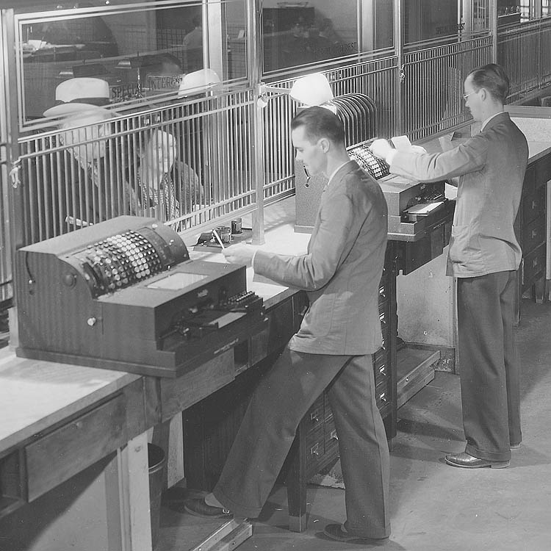
What Made the “Roaring Twenties” Roar?
The banks fueled the 1920’s
THE PECORA INVESTIGATION: Stock Exchange Practices and the Causes of the 1929 Wall Street Crash,
U.S. Senate Committee on Banking and Currency, 1934
NATIONAL CITY CO. (INVESTMENT CO. FOR NATIONAL CITY BANK)
“Commercial banks not only played a vital part in securities transactions by the extension of credit to carry on these activities, but directly engaged, in circumvention of the law, through the medium of their investment affiliates, in securities and other transactions prohibited to commercial banks… p. 156
Since the National City Bank was forbidden from owning stock in the investment company, the law was circumvented by having the officers and shareholders of the bank own all the stock of the investment company. .. p. 156
Commercial banks found a fertile field among its depositors for purchasers of security issues which their investment affiliates were sponsoring… These depositors were then sold securities in which the affiliates had a pecuniary interest [without any adequate disclosure of the interest of the investment affiliate in these securities]... p. 163
MR. PECORA: I have before me what is described as the annual report of the National City Co… for the year ended December 31, 1929… on the last page thereof appears this statement: ‘…69 district and representative offices were in operation at the year end, all served either directly or indirectly by our private-wire system of 11,386 miles. Sales facilities are also available at 26 of the bank’s Greater New York City branches, each connected with our home office by private line, telephone, or teletype service.’ “
Deposit money or
buy securities?

Slide 39
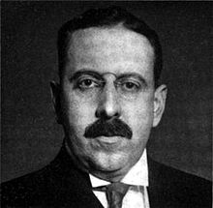
What Made the “Roaring Twenties” Roar?
The banks fueled the 1920’s
CHASE SECURITIES CO (INVESTMENT CO. FOR CHASE NATIONAL BANK)
Albert H. Wiggin, Chairman, Chase National Bank
“SENATOR ADAMS: Mr. Wiggin, is it not a rather remarkable result in these two [Chase Securities Co] syndicate operations … the stock showed a variation which ran from $483 to over $800?
MR. WIGGIN: Well, you understand, Senator, they did not buy a big amount and then wait till the end. They just traded in and out all the time.
MR. PECORA: … the transactions that were consummated by these two accounts which had the same syndicate members involved buying and selling at virtually the same time… Is that not a scheme for ‘churning the market’, and producing an activity that would stimulate the prices?
MR. WIGGIN: I think the market was a God-given market.
MR. PECORA: God-given market, did you say?
SENATOR COUZENS: That is a new one.
THE PECORA INVESTIGATION: Stock Exchange Practices and the Causes of the 1929 Wall Street Crash,
U.S. Senate Committee on Banking and Currency, 1934
Albert Henry Wiggin
(1868 – 1951)

Slide 40



England’s Gold Standard Ideology Causes the 1920s Frenzy
England returns to Gold Standard in 1925
“The British pound had been heavily inflated during WW 1, with over 5 billion pounds in new debt created. The cost of living index rose from 100 in 1914 to over 276 in 1920.
Yet in 1925 the Bank of England made the pound convertible into gold at pre-war parity levels and paid out gold for paper at the old rate, which was not realistic; in fact it was perverse.”
Zarlenga, LSM, pp. 542-543

Slide 41


England’s Gold Standard Ideology Causes the 1920s Frenzy
England returns to Gold Standard in 1925
March 16, 1926 – George Seay, Governor of the Federal Reserve Bank of Richmond, testifying before the House Banking and Currency Committee:
“A verbal understanding, confirmed by correspondence, extended Great Britain a two hundred million dollar gold loan or credit.
All negotiations were conducted between Benjamin Strong, Governor of the Federal Reserve Bank of New York, and Mr. Montagu
Norman, Governor of the Bank of England. The purpose of this loan was to help England get back on the gold standard, and the loan was to be met by investment of Federal Reserve funds in bills of exchange and foreign securities.”
Mullins, A Study of the Federal Reserve

Slide 42
England’s Gold Standard Ideology Causes the 1920s Frenzy
England returns to Gold Standard in 1925
“In 1924, with the object of creating money conditions in the international markets favorable to the efforts of Great Britain
and a number of lesser European countries to return to the gold standard, the Federal Reserve System embarked on its famous
‘easy credit’ policy, by reducing the rate at which it lent to member banks (the rediscount rate) and by forcing Reserve
Bank credit into the banking system by heavy open market operations.
As a result, between the end of 1923 and the end of 1927, $548,000,000 of Federal Reserve credit had been forced into the banking system by purchases of bills and securities. This amount must be multiplied many times to appreciate its effect on the credit power of the banking system.”
Elgin Groseclose, Money and Man, p. 220

Slide 43

England’s Gold Standard Ideology Causes the 1920s Frenzy
England returns to Gold Standard in 1925
“… the Federal Reserve System supported the Bank of England by keeping
interest rates low in America, encouraging the export of gold to Europe.
However, the U.S. money supply became progressively more leveraged,
being based on smaller reserves, and the low interest rates helped to fuel
the stock market bubble, driving prices up to unrealistic levels, from which a
collapse was likely.” Zarlenga, LSM, p. 543
“In the autumn of 1926 a group of bankers… [met] in a Washington hotel. One asked if
the low discount rates of the system were not likely to encourage speculation. ‘Yes’
replied the famous banker, ‘they will, but that cannot be helped. It is the price we
must pay for helping Europe.’ “
H. Parker Willis as quoted by Mullins, The Federal Reserve Conspiracy, p. 95

Slide 44

England’s Gold Standard Ideology Causes the 1920s Frenzy
England returns to Gold Standard in 1925
House Stabilization Hearings of 1928
From the Hearings:
GOVERNOR ADOLPH MILLER: … The Federal Reserve Board last summer, 1927, set out by a policy of open-market purchases, followed in course by reduction on the discount rate at the Reserve Banks, to ease the credit situation and to cheapen the cost of money. The official reasons for that departure in credit policy were that it would help to stabilize international exchange and stimulate the exportation of gold.
CHAIRMAN MCFADDEN: … where did the suggestions come from that caused this decision of the change of rates last summer?
GOVERNOR ADOLPH MILLER: The three largest central banks in Europe had sent representatives to this country. There were the Governor of the Bank of England, Mr. Montagu Norman, the President of the German Reichsbank, Mr. Hjalmar Schacht, and Professor Rist, Deputy Governor of the Bank of France. These gentlemen were in conference with officials of the Federal
Reserve Bank of New York… They were therefore desirous of seeing an easy money market in New York and lower rates…
MR. STEAGALL: Is it true that that action stabilized the European currencies and upset ours?
GOVERNOR ADOLPH MILLER: Yes, that is what it was intended to do.

Slide 45


England’s Gold Standard Ideology Causes the 1920s Frenzy
England returns to Gold Standard in 1925
“So the American currency was destabilized to help the Bank of England fulfill its gold obligations… The testimony reveals that the ‘automatic gold standard’ was a myth, and that back then the Federal Reserve System’s power really resided in the New York Fed. The European Bankers spent two weeks there, and not even one full day in Washington, DC.”
Zarlenga, LSM, p. 544

Slide 46


10. The Fed Concentrates Money in Too Few Hands
After World War I ended,
credit creation (new money) ended up concentrated in the hands of the wealthy.
1929
1% of the population owned 36% of the wealth

Slide 47



10. The Fed Concentrates Money in Too Few Hands
The allocation of loans by commercial banks went disproportionately to speculate on:
1) new stock issues 2) the stock market 3) office building construction
OFFICE BUILDING BONDS
1928-1931 CHRYSLER BUILDING
1930-1931 EMPIRE STATE BUILDING
NEW STOCK ISSUES
STOCK MARKET SHARE
“Between …1921 and …1929, total loans and investments of member banks increased from $24 billion
to almost $36 billion. Ordinary commercial loans, which traditionally should form the major portion of the assets
of deposit banks, fell from one-half to one-third the total. It is a remarkable fact that these loans were actually less in the boom year of 1929 than in the depression year of 1921 in spite of a rise of nearly 80 per cent in industrial production.“ Groseclose, Money and Man, p. 222

Slide 48

10. The Fed Concentrates Money in Too Few Hands
New Stock Issues Speculation
Commercial banks were key to the issue of new stock in the following ways:
1. Loaned short-term to corporations planning to expand with new stock issues
Loaned to investment bankers, against the deposit of other securities held by the investment
banker, the sum necessary to purchase the issue of stocks, and is repaid upon their sale
Loaned to investor (or his broker) the money to purchase the new issues, secured by the deposit
of the purchased securities.
NEW STOCK ISSUES
AVERAGE ANNUAL VOLUME OF NEW STOCK ISSUES* YEARS AVERAGE
1920-1924 4.3 Billion $
1925-1929 7.7 Billion $
1929 alone 10.0 Billion $
“Not only did the commercial banks assist the process of security speculation by financing the investment banker and the
pseudo-investor, but they purchased large blocks of bonds outright. ..Between 1921 and 1929, member
banks' holdings of securities, aside from United States Government securities, increased from $3,507,000,000 to
$5,921,000,000. The result was to convert many a bank from the status of a commercial credit institution to that
of an investment company.” *Elgin Groseclose, Money and Man, pub. 1934, p. 224

Slide 49


10. The Fed Concentrates Money in Too Few Hands
Stock Market Speculation
“From 1922 to 1929, the ratio of loans on securities to total loans and investments of reporting member banks advanced from 25 per cent to somewhat more than 43 per cent;
while from 1924 to 1929, the prices of industrial common stocks more than tripled, their index numbers, according to the compilations of the Standard Statistics Company, rising from 65.6 to 216.1 in September, 1929.
On September 30, 1929, New York banks and trust companies alone had over seven billion dollars loaned to New York Stock Exchange brokers to finance security speculation.”
                Groseclose, Money and Man, p. 223
STOCK MARKET

Slide 50
10. The Fed Concentrates Money in Too Few Hands
Office Building Construction Speculation
“New York and Chicago were the primary focus of the real estate run-up. More office buildings taller than 70 meters were constructed in New York between 1922 and 1931 than in any other ten-year period before or since, according to the authors’ research.
These 235 tall buildings represented more than an architectural movement; they were largely the manifestation of a widespread financial phenomenon. That is, the speculative construction meant building for the express purpose of maximizing rents in buildings with multiple tenants in order to turn a profit. Before that time, office buildings were financed and built by companies primarily for their own use. “
by Frank Byrt, www.nber.org, discussing ‘Securitization in the 1920s’
(National Bureau of Economic Research Working Paper No. 15650, Jan. 2010
by William Goetzmann and Frank Newman).
METEORIC INCREASE IN HOME PRICES
“Between January 1919 and September 1925, for example, the average nominal value of a building permit in Miami grew from $89,000 to $7,993,500, or 8,881 percent (Vanderblue 1927). “
quoted in NBER No. 15650 by Goetzmann and Newman,
Homer Vanderblue, “The Florida Land Boom”, The Journal of Land & Public Utility Economics, 1927, Vol. 3, No. 3 (August): 252- 269.

Slide 51


The 1929 Stock Market Peak
“By early 1929 the more informed bankers were getting out of the market.
Until then, they had reassured Congress and the country that all was well.”
Zarlenga, LSM, p. 545
March, 1928, Senate Committee
COMMITTEE: Do you think the brokers’ loans are too high?
ROY A. YOUNG, GOVERNOR OF THE FEDERAL RESERVE BOARD:
I am not prepared to say whether brokers’ loans are too high or too low,
but I am sure they are safely and conservatively made.
Secretary of the Treasury Mellon – assured the country that they were not too high.
President Coolidge, using material supplied him by the Federal Reserve Board, made
a plain statement to the country that they were not too high.

Slide 52

Benjamin Strong Was Ready
“Until 1928, the New York [Fed] Bank was the prime mover in Federal Reserve policy both at home and abroad, and Benjamin Strong, its governor from its inception, was the dominant figure in the Federal Reserve System. Strong represented the System in its dealings with central banks abroad in a period when each of the great central banks seemed to be personified by a single outstanding individual – the Bank of England by Montagu Norman, the Bank of France by Emile Moreau, the German Reichsbank by Hjalmar Schacht.”
Friedman & Schwartz, A Monetary History of the United States 1867-1960, p. 412
“One of the directors of the New York [Fed] Bank recalled … that he had once asked Strong, ‘why the authority for Federal reserve banks to purchase Government securities had been inserted in the Federal Reserve Act and that Governor Strong had replied that it was there to use. Governor Strong had said further that if this power were used in a big way, it would stop any panic which might confront us.’ “
Friedman & Schwartz, from Harrison, Notes, Vol. II, Apr. 4, 1932

Slide 53

Benjamin Strong Was Ready
“Irving Fisher said, ‘Governor Strong died in 1928. I thoroughly believe that if he had lived and his policies had been
continued, we might have had the stock market crash in a milder form, but after the crash there would not have been the great industrial depression.’ “
Annals of the American Academy of Political and Social Science, Philadelphia, 1934, p. 151 as quoted in Friedman & Schwartz
“In one of his last letters on System policy… he spoke of the necessity of an easy money
policy to anticipate the approach of the ‘breaking point’ … feared…:
‘Here is where I fear the consequences of hesitation or differences of opinion within the
System… If the System is unwilling to do it, then I presume the New York [Fed] Bank must do it alone, despite the tradition which we have helped to create and maintain, that no extensive open-market operations should be conducted by individual banks. An emergency presents the possible need for emergency measures.’ “
Friedman & Schwartz, referencing Chandler, Benjamin Strong, Central Banker, pub. 1958, p. 460
“Strong’s correspondence of August 1928… ‘… the very existence of the Federal Reserve System is a safeguard against anything like a calamity growing out of money rates… we [have] the power to deal with such an emergency instantly by flooding the street with money … the country is well aware of this.’ “
Zarlenga, LSM, pp. 546-547 referencing Chandler, pp. 460-462

Slide 54

Benjamin Strong Was Ready
“Unfortunately, Strong became ill on a trip to see Montagu Norman and died at age 56, before the crash. Remember that it was Strong and Warburg, among all the high officials in the system, who really understood the nature of the power they wielded.” Zarlenga, LSM, p. 547
Chandler says in Strong’s biography:
“Strong’s death left the System with no center of enterprising and acceptable leadership. The Federal Reserve Board was determined that the New York [Fed] Bank should no longer play that role. But the Board itself could not play the role in an enterprising way… most of the other Reserve Banks… were reluctant to follow the leadership of the Board, … they still thought of it as primarily a supervisory and review body.” Chandler, Benjamin Strong, Central Banker, p. 465

Slide 55

The Bankers Were Warned Against “Speculation”
1929 - The Federal Reserve Board Begins to Issue Warnings
“On February 2, 1929, the Reserve Board … issued a statement to individual Reserve banks … insisted that Federal Reserve credit not be used for speculative purposes.” wallstreetwhiz.com
“On February 6, 1929 … the Board warned the system’s member banks that their purpose was not to finance speculation in the stock market through loans on securities.” Zarlenga, LSM, p. 546

Slide 56


The Bankers Were Warned Against “Speculation”
1929 - The Federal Reserve Board Begins to Issue Warnings
“…when the Reserve authorities began to shake their fingers in warning, the head of the largest American bank [New York Fed] replied by thumbing his nose and announcing that his institution would continue to support the security markets, and had twenty-five million dollars to lend.” Elgin Groseclose, Man and Money, p. 221
George Leslie Harrison
(1887 – 1958)
President, New York FRB, 1928-1940

Slide 57

Warburg Warns of “The Ultimate Collapse”
“Paul Warburg… Writing in a March 1929 annual report to the stockholders
of his International Acceptance Bank:
‘If the orgies of unrestrained speculation are permitted to spread, the
ultimate collapse is certain not only to affect the speculators themselves
but to bring about a general depression involving the whole country.’ “
Zarlenga, LSM, p. 547
The Last Straw
“While insiders like Warburg were predicting the ‘ultimate collapse’
as early as February and March 1929, the stock market went its
merry way, reaching a peak in August…
The last straw was when the Federal Reserve Bank of New York raised
its discount rate to 6% on August 6, 1929.
Zarlenga, LSM, p. 547

Slide 58
Q & A
WILL DECKER’S CONCLUSION:
THE CONTROL OF MONEY -- WITHOUT CONTROL FROM THE PUBLIC -- LEADS TO
CORRUPTION … USURPATION … SLAVERY.

