Slide 1
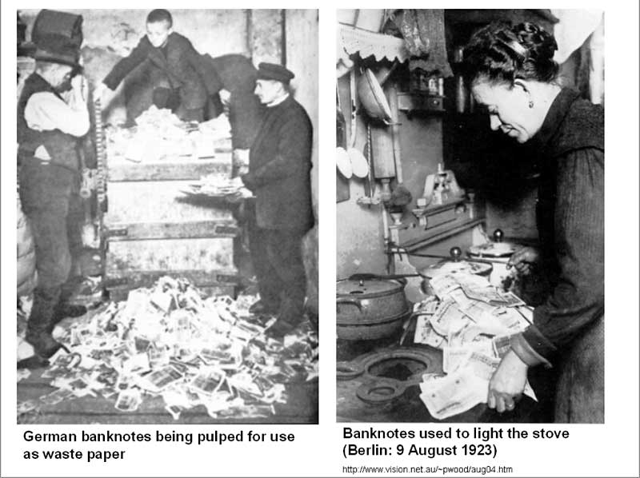
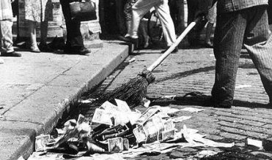
The Lost Science of Money
CHAPTER 21 – Part 1
GERMANY’S 1923 HYPER-INFLATION
UNDER A PRIVATE CENTRAL BANK

Slide 2
THEMES OF LOST SCIENCE OF MONEY BOOK
Primary importance of the money power (power to create money and regulate it)
Nature of money purposely kept secret and confused
How a society defines money determines who controls the society
Battle over control of money has raged for millennia: public vs private
The misuse of the monetary system causes tremendous misery and suffering for the ordinary people. Will Decker & Martin Dunn, February 2014
Whenever the public has owned a significant fraction of the money power, great public benefit has ensued: Sparta, the Roman Republic, the American Colonies in the 18th century, GREENBACKS after the Civil War, Canada after the Great Depression, British experience after World War II. Martin Dunn, July 2014.

Slide 3
PARTS OF PRESENTATION
INTRODUCTION
EMERGING GERMANY - BAGHDAD RAILWAY
ZIMMERN’S ‘THE ECONOMIC WEAPON’: THE ECONOMIC SIEGE
THE TREATY OF VERSAILLES, 1919
GERMANY’S 1923 HYPER-INFLATION BY A PRIVATE CENTRAL BANK
HOW IS A CURRENCY DESTROYED? - TOO MANY GERMAN MARKS ISSUED
CAUSE OF THE INFLATION: SCHACHT TELLS THE TRUTH
STABILIZING THE MONETARY SITUATION: THE RENTENMARK
SCHACHT IN CHARGE: THE GOVERNMENT STABILIZES THE CURRENCY
WHO WAS HJALMAR SCHACHT?
THE DAWES PLAN
FOREIGN LOANS USED CAREFULLY

Slide 4

1. INTRODUCTION
PRIVATE MONEY ATTACKS GOVERNMENT
“The German hyper-inflation is used to promote the idea that only private bankers can be trusted to control society’s money system… When the monetary facts are actually examined, it becomes clear that these private banking elements were deeply involved in the speculation that helped to bring down the Reichsmark… This was not stopped until the government repeatedly took decisive action against them.” Zarlenga, LSM, p. 575

Slide 5
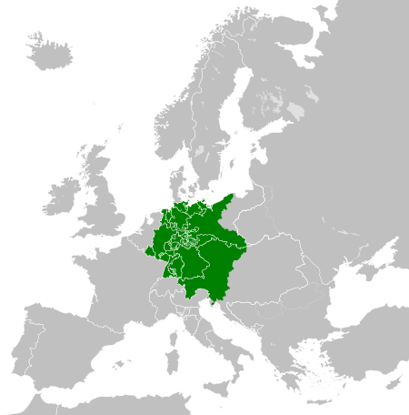
EMERGING GERMANY - BAGHDAD RAILWAY:
GERMANY CENTRALIZED LATE IN EUROPE
BY 1815 GERMANY HAD THE GERMAN FEDERATION
The German Confederation in 1815

Slide 6
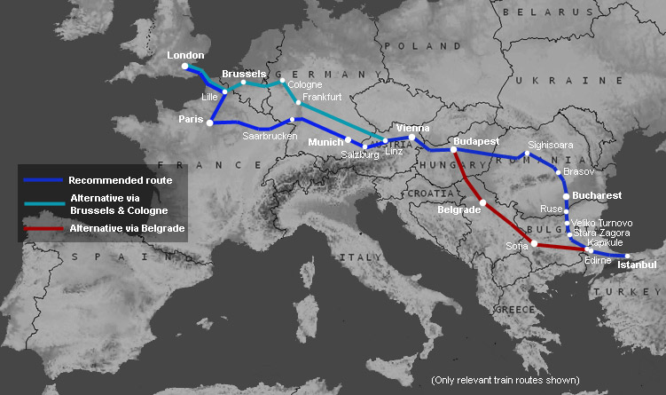
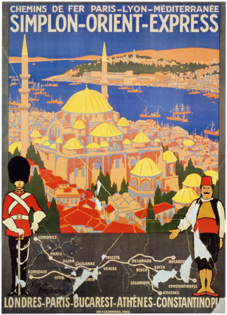
EMERGING GERMANY - BAGHDAD RAILWAY:
GERMANY BEGAN TO ECONOMICALLY COMPETE WITH BRITAIN
AND OTHER WEALTHY NATIONS IN THE 20TH CENTURY
THE ORIENT EXPRESS ALREADY CONNECTED GERMANY TO ISTANBUL, 1883+

Slide 7
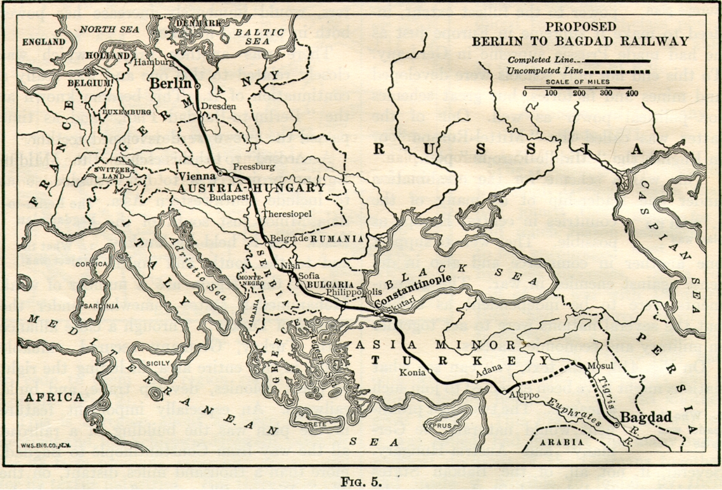
EMERGING GERMANY - BAGHDAD RAILWAY
Begun in 1903, by the outbreak of World War I, the BERLIN-BAGHDAD railway was still 600 miles away from its intended objective.
THE BERLIN-BAGHDAD RAILWAY WAS FINANCED BY DEUTSCHE BANK.

Slide 8
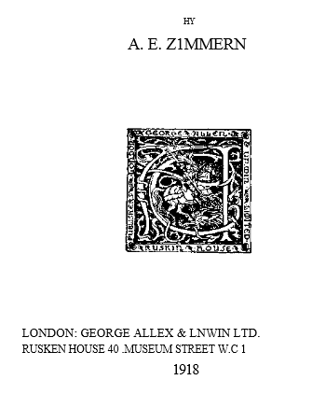
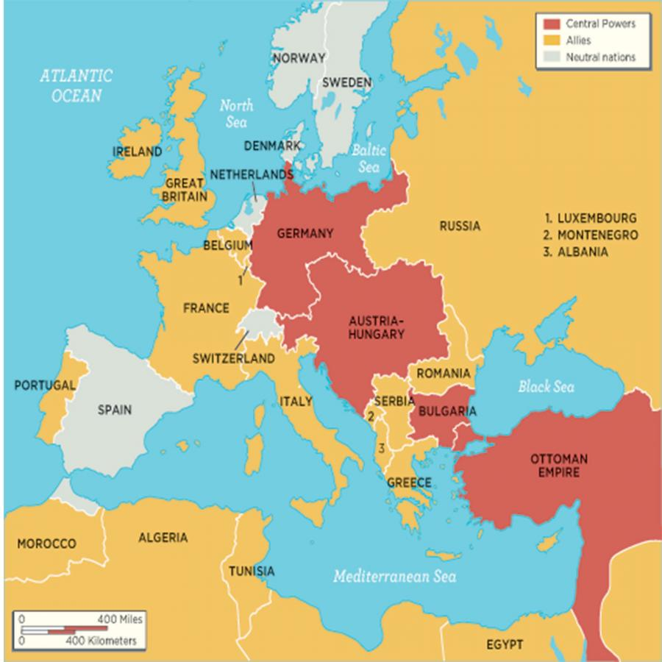
ZIMMERN’S ‘THE ECONOMIC WEAPON’: THE ECONOMIC SIEGE
A.E. Zimmern was identified by Professor Carroll Quigley, “Tragedy and Hope” as part of the Anglo-American establishment.
“What is the economic situation? It can be stated in a sentence: The Central Powers are being besieged by practically the entire world and they have no means at their
disposal for bringing the siege to an end.”
Zimmern, “The Economic Weapon”, p. 4

Slide 9
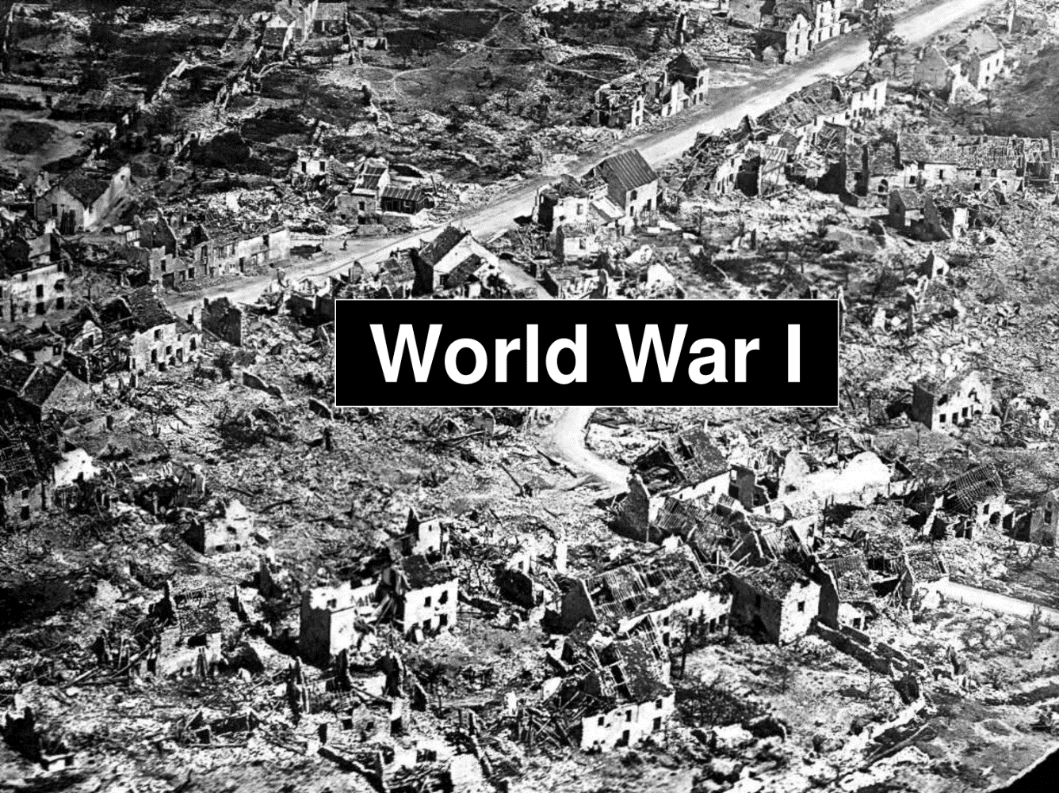
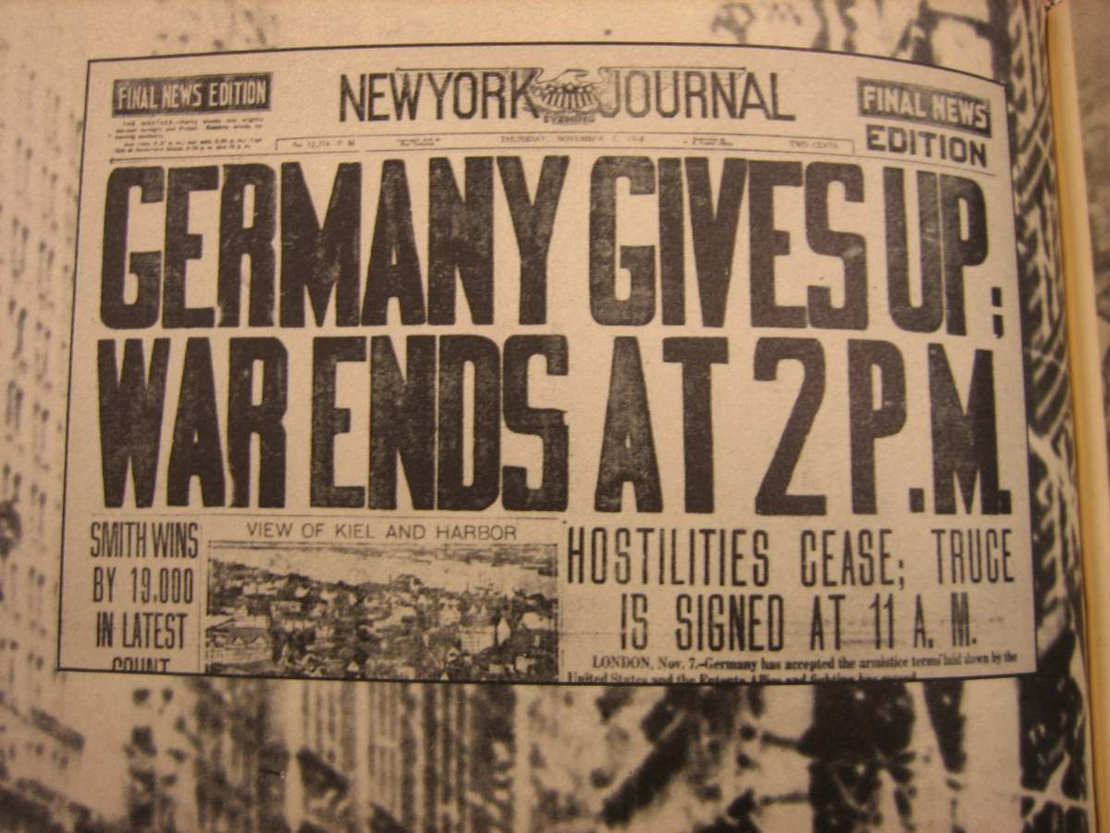
ZIMMERN’S ‘THE ECONOMIC WEAPON’: THE ECONOMIC SIEGE
Zimmern -- concerning the end of World War 1 and the ‘peace’:
“But without raw materials there can be no industrial employment; and demobilization without employment ready to hand for the disbanded soldier spells social disorder…”
“The whole civilized world will be faced… with the prospect of a shortage, if not a famine… some will have to go short. Who more naturally than Germany?... It will come about almost of itself unless special provision is made in the peace.”

Slide 10
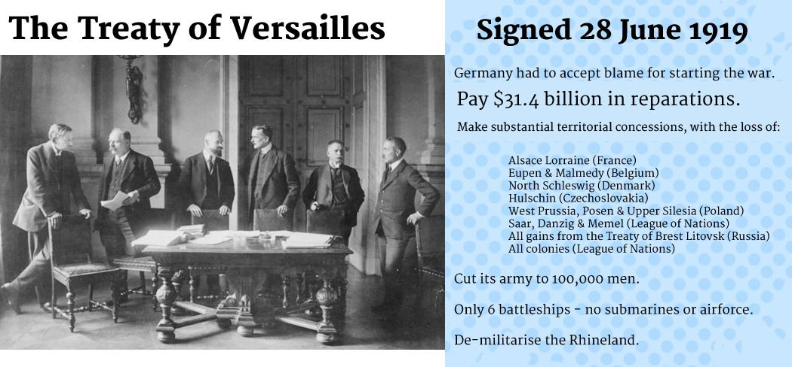
THE TREATY OF VERSAILLES, 1919
Pay 1.7 billion marks a year in foreign exchange
for 59 years, until 1933.

Slide 11
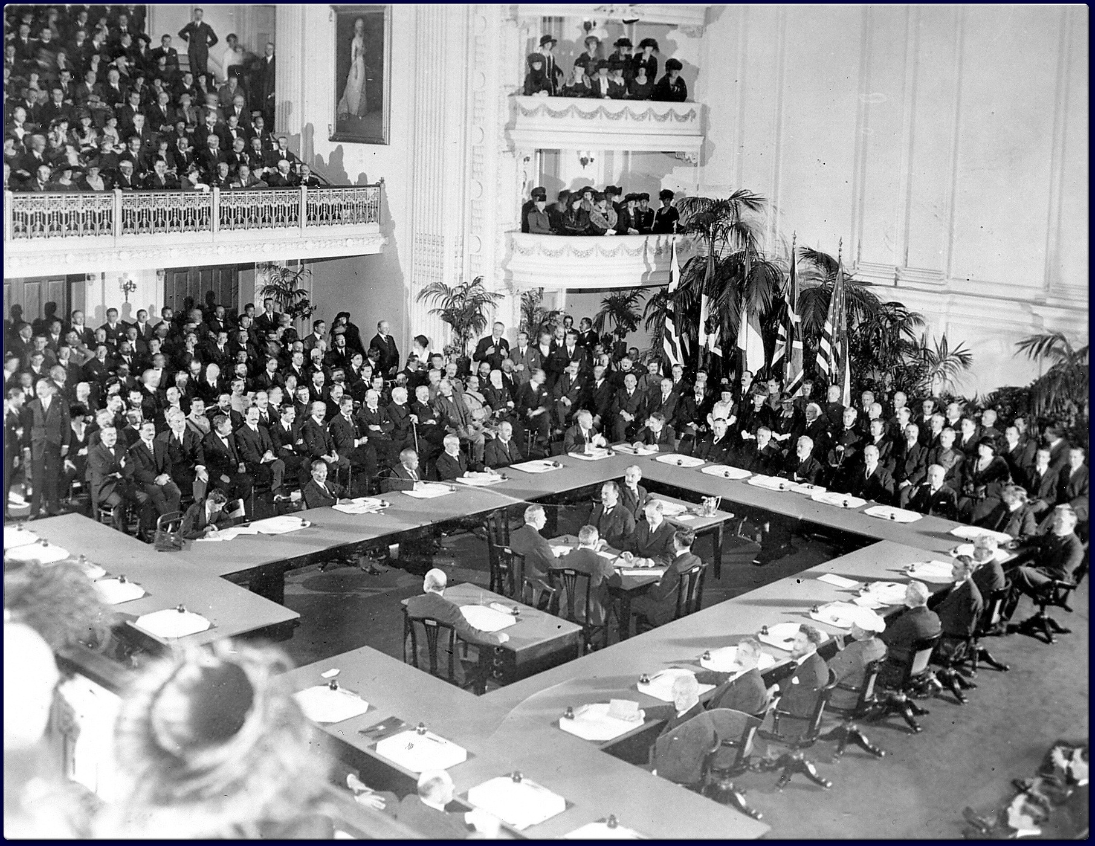
THE TREATY OF VERSAILLES, 1919
Lord Lothian (another member of the
Anglo American Establishment) was
the co-author of the Treaty of Versailles “and it would not provide for a just peace.” Zarlenga, LSM, p. 578
American experts resigned in protest to its provisions.

Slide 12
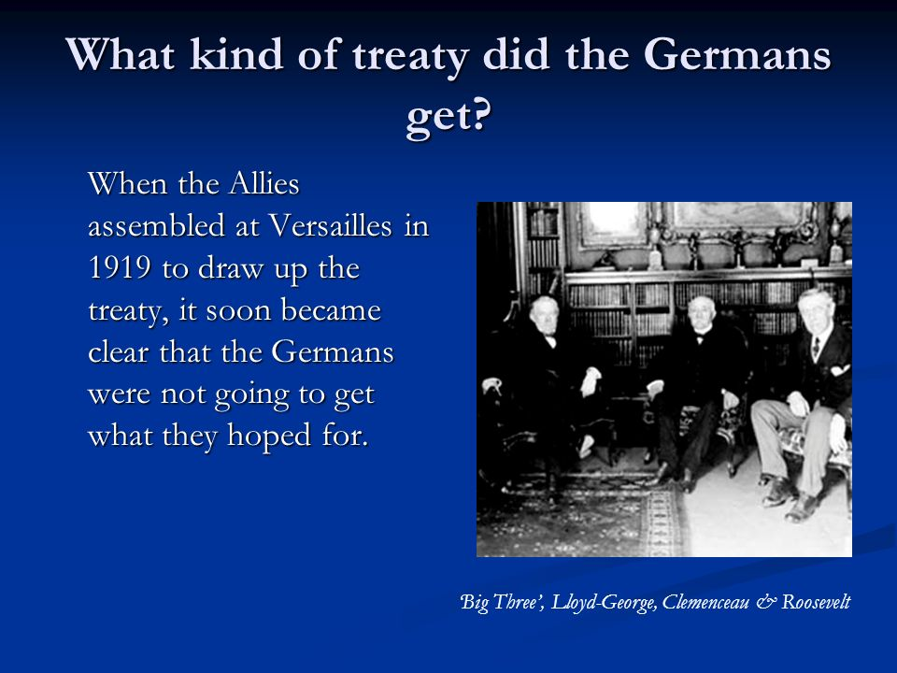
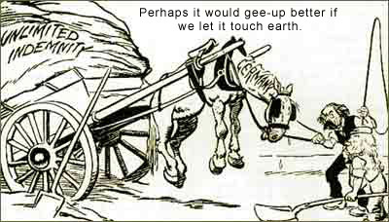
THE TREATY OF VERSAILLES, 1919
Francisco Nitti, the Prime Minister of Italy, wrote:
“…It will remain forever a terrible precedent in modern history that, against all pledges, all precedents and all traditions, the representatives of Germany were never even heard; nothing was left to them but to sign a treaty at a moment when famine and exhaustion and threat of revolution made it impossible not to sign… In the old canon law of the Church it was laid down that every one must have a hearing, even the devil… the new society of nations, did not even obey the precepts which the dark Middle Ages held sacred on behalf of the accused.”
Francisco Nitti, The Wreck of Europe, as quoted by Francis Nielsen, The Makes of War, 1950, p. 151

Slide 13
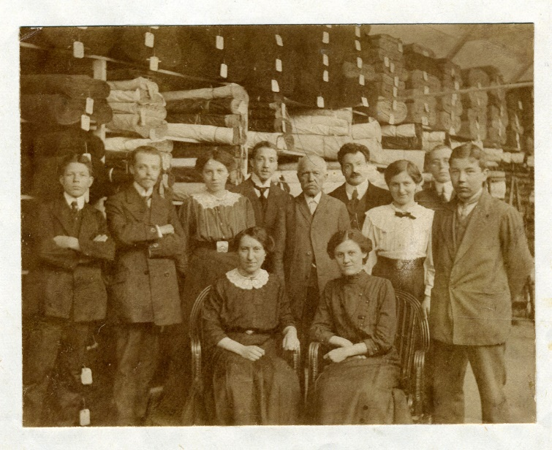
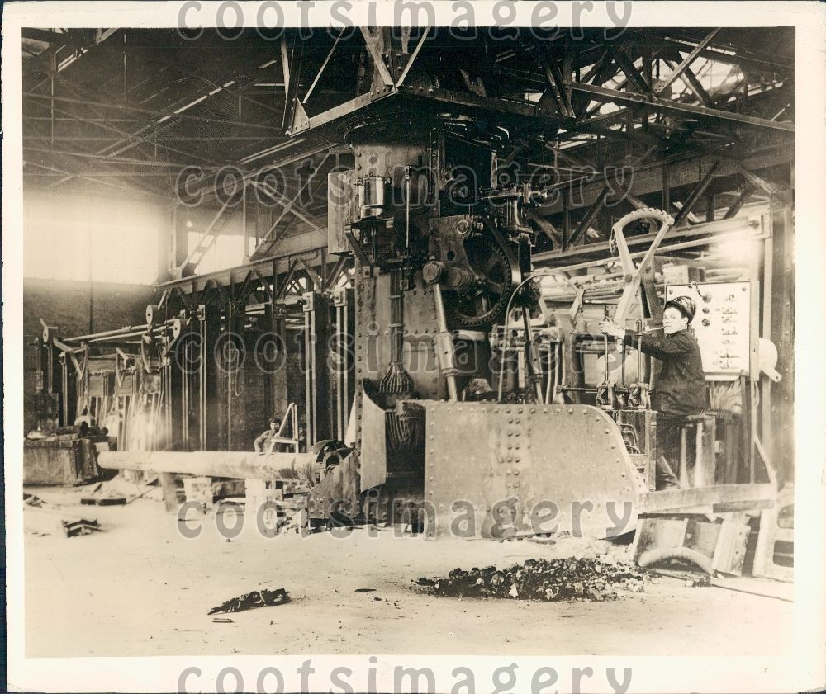
GERMANY’S 1923 HYPER-INFLATION BY A PRIVATE CENTRAL BANK
“…the 1st World War seriously damaged but didn’t destroy Germany’s money system. That came under the occupying forces.” Zarlenga, LSM, p. 579
Dec. 1914 Nov. 7, 1918
GERMANY’S 7.2 billion marks 28.4 billion marks
MONEY SUPPLY
1913 late 1918
INDEX OF 100 234
WHOLESALE PRICES
INDEX OF 100 248
WORKMEN’S WAGES
Employees of the Oppenheimer
Textile business in 1913.
GERMAN DEMOBILIZING
PROJECTILE FACTORY, 1919

Slide 14
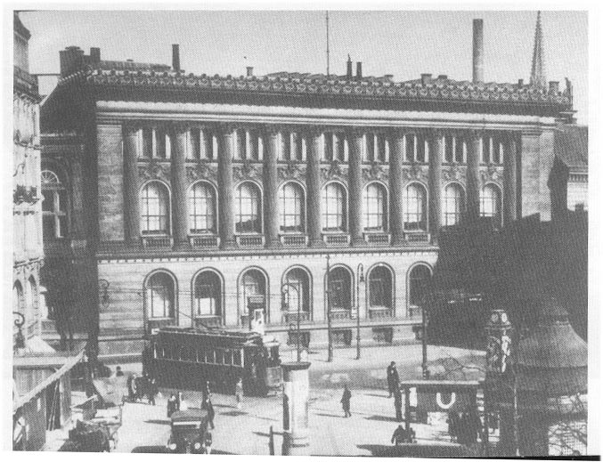
GERMANY’S 1923 HYPER-INFLATION BY A PRIVATE CENTRAL BANK
This hyperinflation is used to blame government, implying the government was responsible for the actions of the Central Bank.
But the Central Bank by 1922-23 was controlled by private bankers.
“The foreign experts delegated by the League of Nations to guide the economic recovery of Germany wanted a more free-market orientation for the German central bank.” Zarlenga, LSM, pp. 579-580
“On May 26, 1922, the law establishing the independence of the Reichsbank and withdrawing from the Chancellor of the Reich any influence on the conduct of the Bank’s business was promulgated.”
Hjalmar Schacht, Stabilization of the Mark, 1927, pp. 46-51
REICHBANK, GERMAN’S CENTRAL BANK, 1924

Slide 15
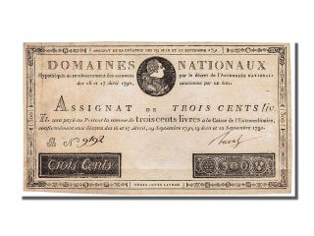
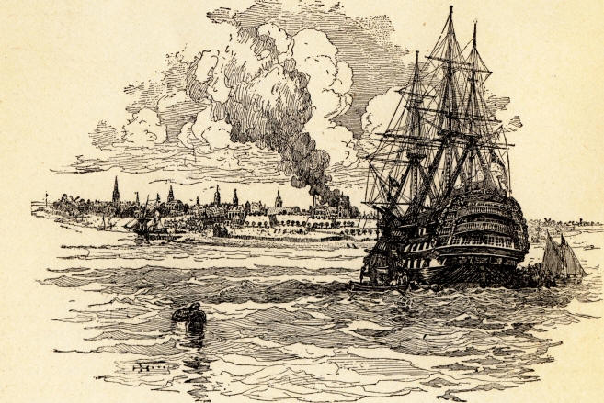
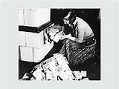
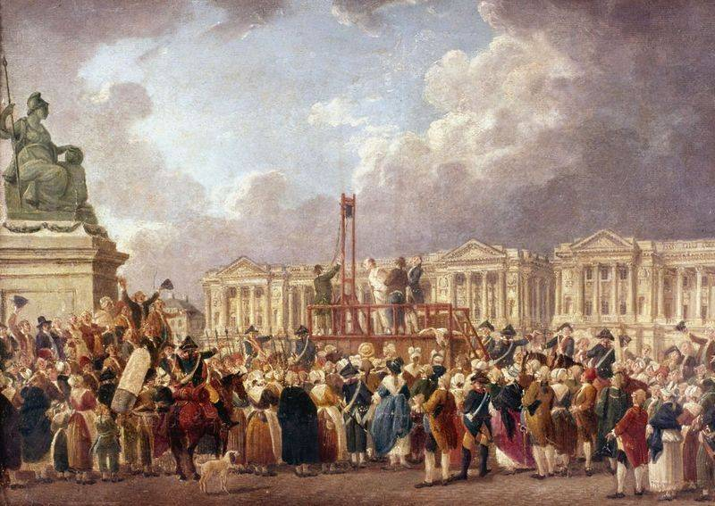
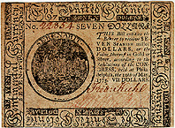
HOW IS A CURRENCY DESTROYED?
ANSWER: BY ISSUING, NOT JUST TOO MUCH,
BUT FAR TOO MUCH OF THE CURRENCY.
BRITISH SHIPS IN N.Y. HARBOR
COUNTERFEITED COLONIAL
CONTINENTAL CURRENCY –
ECONOMIC WAR
BRITISH IN LONDON COUNTERFEITED
FRENCH REVOLUTIONARY CURRENCY
CALLED ASSIGNATS – ECONOMIC WAR
What was the cause of the German
hyperinflation of 1922-23?
WOMAN LIGHTING STOVE WITH MARKS

Slide 16
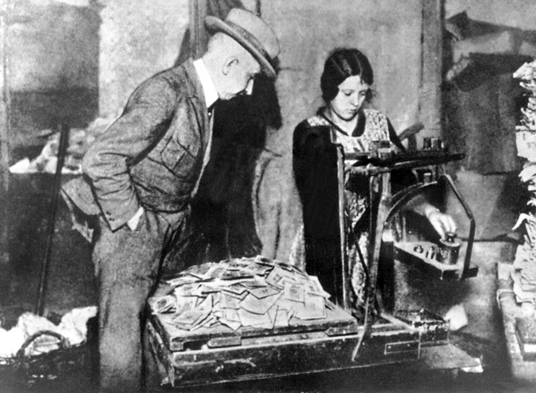
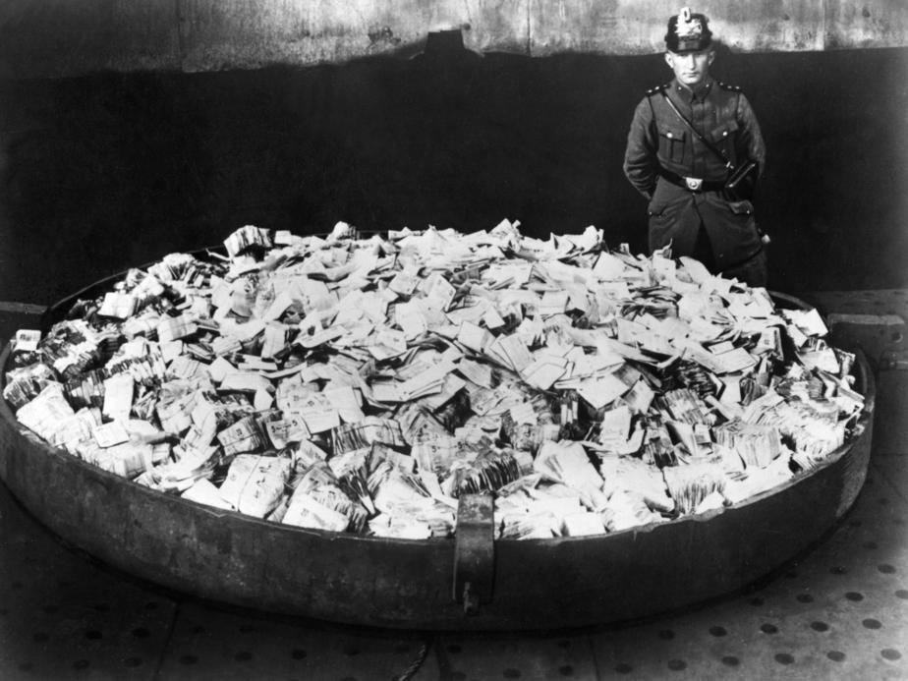
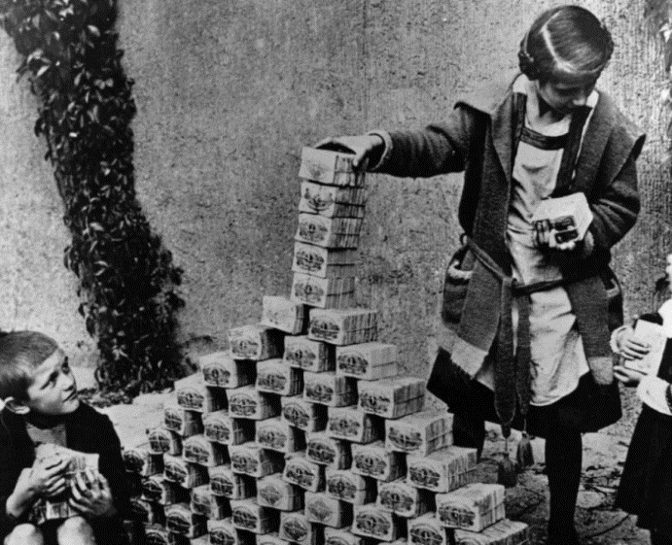
HOW IS A CURRENCY DESTROYED?
THE HYPERINFLATION
MARKS DOLLARS
JULY 1922 300 1
NOV 1922 9,000 1
JAN 1923 49,000 1
JULY 1923 1.1 MILLION 1
NOV 1923 2.5 TRILLION 1
“The private Reichsbank printing presses had been unable
to keep up and other private parties were given the authority
to issue money. Schacht estimated that about half the
money in circulation was private money from other than
Reichsbank sources.” Zarlenga, LSM, p. 581

Slide 17
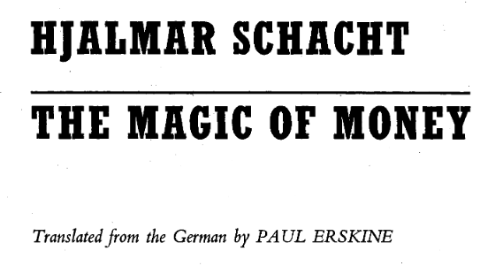
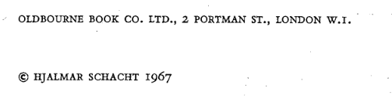
CAUSE OF THE INFLATION: SCHACHT TELLS THE TRUTH
Schacht’s first explanation was to blame the actions
of the private bank on the government, assuming
making new issues available for government
expenditures:
“…because the point at issue was the survival of
the Reich, the Reichsbank did not regard itself
justified in refusing even after the passing in 1922
of the law which gave it formal autonomy.”
Schacht, The Magic of Money, pp. 65-66

Slide 18
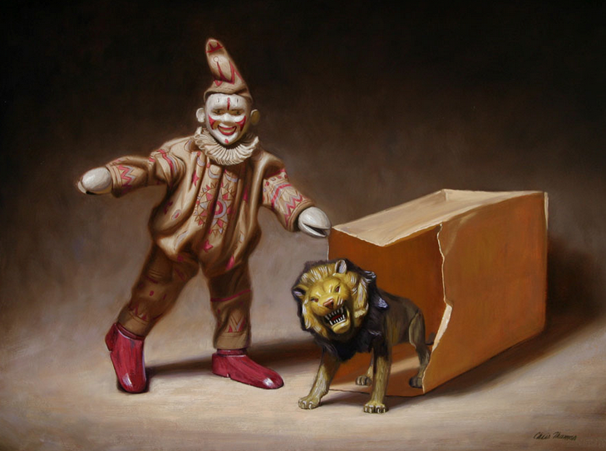
CAUSE OF THE INFLATION: SCHACHT TELLS THE TRUTH
But he proceeded to let the cat out of the bag:
the private Reichsbank had made lavish loans
to speculators selling the mark short and driving
down its value to nothing!
“In previous years such speculation had been
carried on either with loans which the Reichsbank
granted lavishly, or with emergency money which
one printed oneself, and then exchanged for
Reichsmarks…
The loans formerly easily obtained from the
Reichsbank were no longer granted…”
Schacht, The Magic of Money, p. 70
PRIVATE

Slide 19
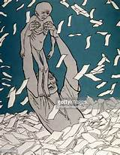
CAUSE OF THE INFLATION: SCHACHT TELLS THE TRUTH
CURRENCY SPECULATION ON A LARGE SCALE SHOULD NOT BE LEGITIMATE:
THE SPECULATOR IS ‘CREATING MARKS’ BY SELLING SHORT
(SELLING WHAT HE DOES NOT HAVE)
THIS DRIVES THE VALUE OF THE CURRENCY DOWN
THE SPECULATOR CAN THEN BUY IT BACK CHEAPER,
PAY BACK HIS MARGIN LOAN,
AND POCKET THE PROFIT
“This kind of currency speculation is at the expense of the producers and working people
whose lives and enterprises are dependent on that currency…
Currency speculation in such large amounts should be viewed as a form of aggression,
no less harmful than dropping bombs on the country in question.” Zarlenga, LSM, p. 581

Slide 20
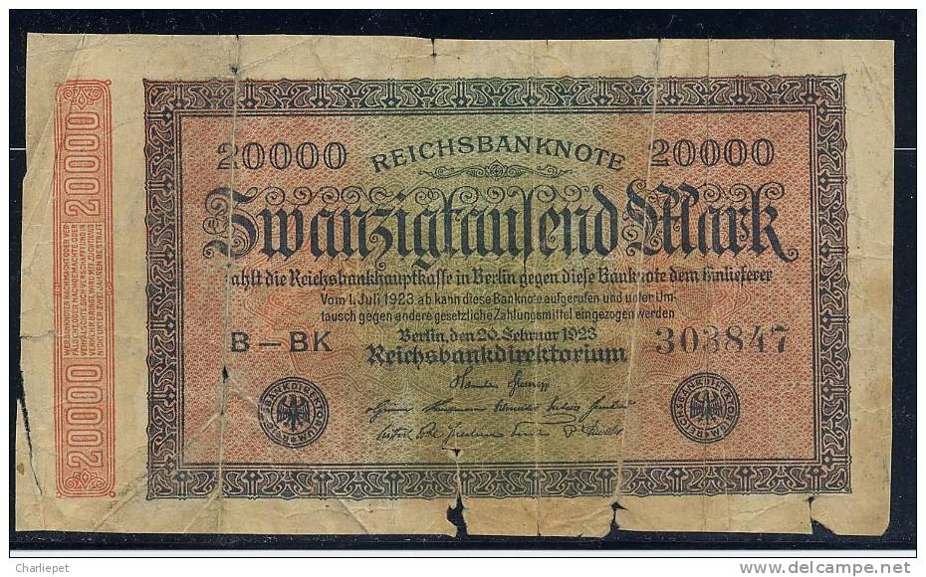
CAUSE OF THE INFLATION: SCHACHT TELLS THE TRUTH
‘Thus it was a privately owned and privately controlled central bank, that made loans to private speculators, enabling them to speculate against the nation’s currency.”
Zarlenga, LSM, p. 587

Slide 21
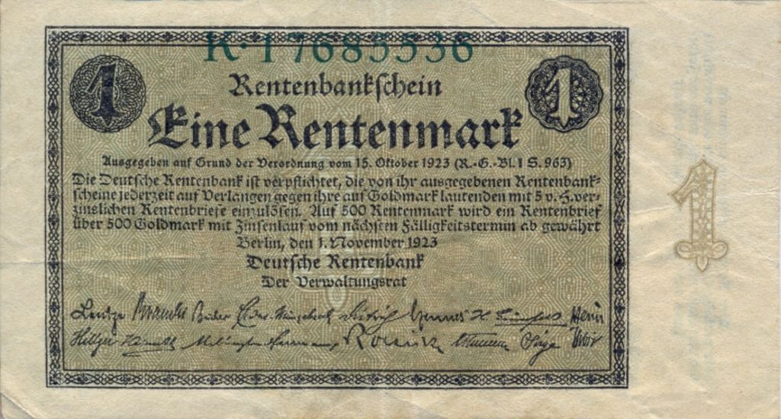
STABILIZING THE MONETARY SITUATION: THE RENTENMARK
THE RENTENMARK CURRENCY

Slide 22
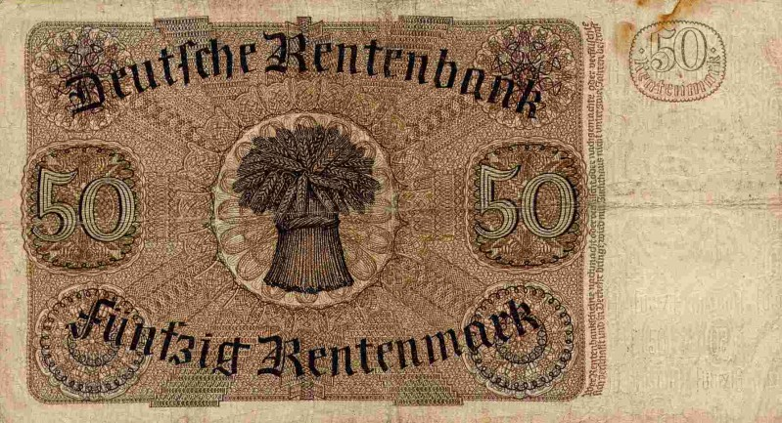
STABILIZING THE MONETARY SITUATION: THE RENTENMARK
November, 1923: Schacht became the government’s Commissioner of the Currency, a new position created to stabilize the currency. The government now actively exercised monetary control.
November 15, 1923: Schacht put into circulation a new currency, the RENTENMARK. By not over-issuing this currency, Schacht hoped to contract the legal currency and establish confidence in it:
The Rentenmark:
was not legal tender
could not be used for international payments or transferred to foreigners (this crushed currency speculation)
was not fixed in value to the fallen Reichsmark
had its value set arbitrarily at $1 = 4.2 trillion Rentenmarks
HOPEFULLY, THE PUBLIC WOULD SLOWLY GAIN
CONFIDENCE IN THE NEW CURRENCY

Slide 23
SCHACHT IN CHARGE: THE GOVERNMENT STABILIZES THE CURRENCY
Schacht, The Magic of Money, 1967, p. 68: “The invention of the Rentenmark did not stabilize the Mark; the battle for stabilization continued for a year, passing through many a difficult phase.”
ISSUE #1
THE PRIVATE ISSUERS OF EMERGENCY MONEY
“While before the war the presses of the Reichsbank had printed all banknotes, in 1923 133 additional printing firms … were needed to supply the demand…
[The Reichsbank] often had to ask the provinces, municipalities and individual large concerns to print and put into circulation their own emergency money.
…by the end of 1923 there was as much emergency money as Reichsbank money.
The result of issuing these emergency notes was that the Reichsbank lost control over the circulation of money and also stopped presiding over the credit system.”
Schacht, The Magic of Money, p. 668
November 17, 1923
A Decree
The Reichsbank would not accept any emergency money after November 22.
Holders of emergency notes had 4 days to redeem them from safe deposits of the Reichsbank.

Slide 24
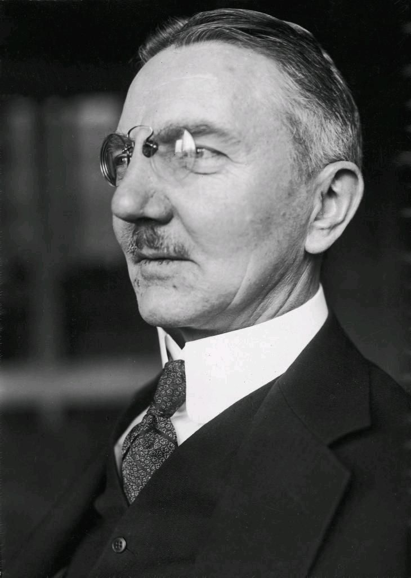
SCHACHT IN CHARGE: THE GOVERNMENT STABILIZES THE CURRENCY
December, 1923: Schacht made President of the Reichsbank
ISSUE #2
CURRENCY SPECULATORS AGAIN!
Dec 1923 – trade was accepting Rentenmarks and Reichsmarks on equal terms
Dec 1923 – April 1924 – Reichsbank granted credits to business (went from 609 million to 2 billion) – commodity prices were up and Reichbank’s foreign reserves were down
Speculators began to hoard foreign exchange – they were getting Rentenmark loans from German banks to buy foreign currencies, and these banks were ignoring the law forbidding loans of Rentenmarks to buy foreign exchange
Hjalmar Schacht
(1877 – 1970)

Slide 25
SCHACHT IN CHARGE: THE GOVERNMENT STABILIZES THE CURRENCY
March-May 1924: Schacht crushes currency speculation
March, 1924 – Schacht and Reichsbank crushes currency speculation
At first, Schacht used reminders and exhortations, but these did not stop the banks making these speculative loans. The Reichsbank then took drastic measures:
these banks were denied use of the Reichsbank’s clearing facilities
The Reichsbank refused to discount their bills of exchange until they complied (how a central bank gives loans to its banking members)
April - May, 1924
The Reichsbank decreed that there would be no new credit (suspended all new discounting of bills of exchange).
Speculators had to exchange dollars for Reichsmarks in order to pay for their dollars – foreign exchange flowed into the Reichsbank.
The wholesale price index was reduced from 124 in April to 115 in June. The credit restriction worked.
Hjalmar Schacht
(1877 – 1970)

Slide 26
SCHACHT IN CHARGE: THE GOVERNMENT STABILIZES THE CURRENCY
December, 1924: Schacht converts Rentenmarks into Reichsmarks
The Currency Contraction was brutal!
Overdraft charges rose from 40% to 80%!
By the end of 1924, merchants and others were treating the Rentenmark and old Reichsmark as equal.
Schacht converted the Rentenmarks into Reichsmarks.
Hjalmar Schacht
(1877 – 1970)

Slide 27
WHO WAS HJALMAR SCHACHT?
Why did the banker Schacht give the details of the true cause of the hyper-inflation – 44 years later?
Hjalmar Horace Greeley Schacht
Schacht was born in Tingleff, Schleswig-Holstein, Prussia, Germany Empire, now in Denmark, to William Leonhard Ludwig Maximillian Schacht and baroness Constanze Justine Sophie von Eggers, a native of Denmark.
His parents, who had spent years in the United States, originally decided on the name Horace Greeley Schacht, in honor of the American journalist Horace Greeley. His father returned to Germany as a newspaper editor.
However, they yielded to the insistence of the Schacht family grandmother, who firmly believed the child's given name should be Danish.
Schacht studied medicine, philology and political science before earning a doctorate in philosophy in 1899 – his thesis was on mercantilism, demonstrating how they were aware of the quantity aspect of money from the 1500s and 1600s.

Slide 28
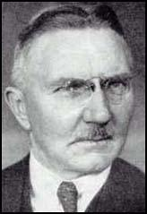
Hjalmar Schacht
Hjalmar Horace Greeley Schacht, the son of a salesman, was born in Tinglev, Germany, on 22nd January, 1877. His father had lived in the United States and named his son after the radical journalist, Horace Greeley and a prominent campaigner in America against slavery.
Schacht studied medicine in Kiel, philology in Munich and political science Berlin before taking a degree in economics in 1899.
He joined the Dresdner Bank and during the First World War was financial consultant for the German occupation government in Belgium. In 1916 he became a director of the German National Bank.
In 1923 he became Reich currency commissioner and was praised for bringing Germany's inflation under control. Schacht was rewarded by being appointed president of the Reichsbank. In 1929 he headed the German delegation that negotiated the Young Plan.
Schacht developed right-wing political ideas and in 1930 was converted to fascism after reading Mein Kampf. In January, 1931 Hermann Goering arranged a meeting with Adolf Hitler. Schacht agreed to raise funds for the Nazi Party. Schacht, who had good contacts with Germany's industrialists persuaded Albert Voegler (United Steel Works) Gustav Krupp and Alfried Krupp to join people such as Fritz Thyssen, Emile Kirdorf, Carl Bechstein and Hugo Bruckmann in providing money for the party.
In November, 1932, Schacht organized the letter signed by Germany's leading industrialists that urged Paul von Hindenburg to appoint Adolf Hitler as chancellor. This was successful and on 20th February, 1933, Schacht arranged a meeting of the Association of German Industrialists that raised 3 million marks for the Nazi Party in the forthcoming election.
After Adolf Hitler passed his Enabling Bill Schacht toured the United States where he made forty speeches, appeared on radio and wrote several articles for American newsletters where he claimed that Hitler would soon return Germany to democracy. He met Franklin D. Roosevelt but made a bad impression on the president who later described him as "extremely arrogant".
In August, 1934, Hitler appointed Schacht as his minister of economics. Deeply influenced by the economic ideas of John Maynard Keynes and Roosevelt's New Deal, Schacht encouraged Hitler to introduce a programme of public works, including the building of the Autobahnen.
Schacht also introduced the New Plan which rigorously controlled everything that was imported into Germany. This involved negotiating a series of bilateral trade agreements including one with the Soviet Union in 1935.
Like other Nazis Schacht was extremely hostile to Germany's Jewish population. In one speech he argued that "the Jews must realize that their influence in Germany has disappeared for all time." In 1934 he arranged with the World Zionist Organization, a deal where German Jews could pay 15,000 reichmarks to emigrate to Palestine. It is estimated that over the next four years over 170,000 reached Palestine under this agreement.
Schacht disagreed with what he called "unlawful activities" against Jews and in August, 1935 made a speech denouncing Julius Streicher and the articles he had been writing in Der Stuermer. He pointed out that Jews had fought bravely in the German Army in the First World War and deserved to be treated fairly.
Schacht also had doubts about the large amounts of money being spent on armaments. He warned Hitler that he was building armed forces far beyond the country's economic capacity. He found it increasingly difficult working under Hermann Goering who fully supported the government's policy on military spending. As Goering told Schacht "If the Fuehrer wishes it then two times two are five."
In November, 1937, Schacht resigned as minister of economics. However, he remained as President of the Reichsbank where he continued to oppose excessive expenditures for armaments. Hitler eventually removed Schacht from power in January, 1939.
During the Second World War he was approached by Hans Dohnanyi and Erwin von Witzleben to become involved in plots against Hitler. Schacht refused but in 1944 he was arrested and charged with being involved in the July Plot. He was sent to Dachau Concentration Camp but was still alive at the end of the war.
Arrested by the Allies he was accused of crimes against humanity at the Nuremberg War Crimes Trial. He was found not guilty but the German government had him re-arrested and charged him with other offences. He was sentenced to eight years imprisonment but he was freed on 2nd September, 1948.
On his release he formed his own bank in Dusseldorf. He also advised several foreign governments including Gamal Nasser in Egypt. Hjalmar Schacht died in Munich on 4th June, 1970.

Slide 29
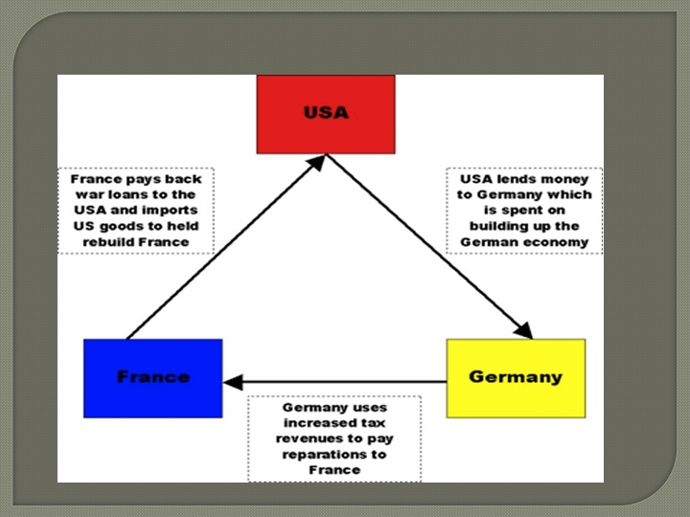
THE DAWES PLAN
“The 1924 Dawes Plan, forged in Paris by a group of economic experts under the chairmanship of American banker Charles G. Dawes, had proven a giant step towards German stability. It provided a loan of 200 million 1924 dollars to the German government for industrial recovery. It also alleviated the awful burden of Germany’s reparations payments to Allied nations. Although the total amount was not reduced, it was made payable in 2.5 billion mark annual installments over an indefinite period of time.”
Stephen Zarlenga, “Germany's 1923 Hyperinflation: A "Private" Affair”, The Barnes Review, July-Aug. 1999, pp. 61-67.
The Dawes Plan relied on capital lent to Germany by a consortium of American investment banks, led by the J.P. Morgan & Co. under supervision by the US State Dept.
The German railways, the National Bank and many industries were mortgaged as securities for the loans.

Slide 30

FOREIGN LOANS USED CAREFULLY
“After the Dawes Plan loan to the Reichsbank came through in 1924, foreign credits began to pour in… [Schacht] was against the loans and insisted that any foreign borrowings only be to finance production, not luxury or consumption. This policy, from 1924 to 1929, resulted in Germany establishing Europe’s most modern factory system of the period.” Zarlenga, LSM, p. 589
In 1930 Schacht resigned from the Presidency of the Reichsbank, in protest over some Allies economic rulings.
In 1933 Schacht was re-appointed the bank’s President, when the National Socialists came to power.
This appointment reassured German big business and foreign bankers.

Slide 31
Q & A
WILL DECKER’S CONCLUSION:
THE CONTROL OF MONEY -- WITHOUT CONTROL FROM THE PUBLIC -- LEADS TO
CORRUPTION … USURPATION … SLAVERY.

