Slide 1
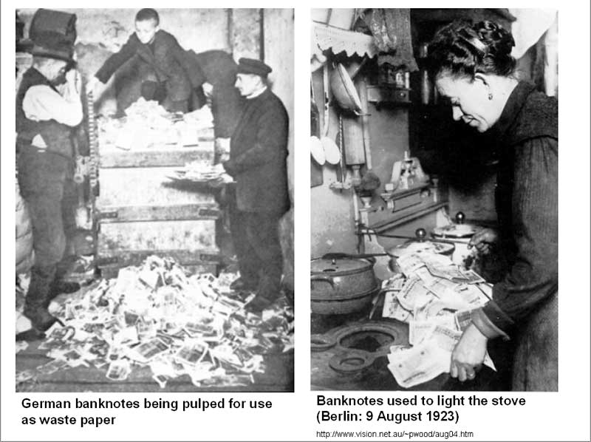
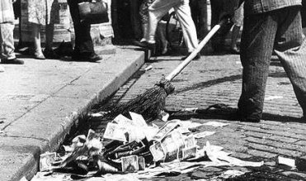
The Lost Science of Money
CHAPTER 21 – Part 2
GERMANY’S 1923 HYPER-INFLATION
UNDER A PRIVATE CENTRAL BANK

Slide 2
THEMES OF LOST SCIENCE OF MONEY BOOK
Primary importance of the money power (power to create money and regulate it)
Nature of money purposely kept secret and confused
How a society defines money determines who controls the society
Battle over control of money has raged for millennia: public vs private
The misuse of the monetary system causes tremendous misery and suffering for the ordinary people. Will Decker & Martin Dunn, February 2014
Whenever the public has owned a significant fraction of the money power, great public benefit has ensued: Sparta, the Roman Republic, the American Colonies in the 18th century, GREENBACKS after the Civil War, Canada after the Great Depression, British experience after World War II. Martin Dunn, July 2014.

Slide 3
PARTS OF PRESENTATION
Hitler Taken by Feder’s Monetary Views
H.S. Chamberlain Promotes Racism
Schacht Battles Feder
But ‘Feder Money’ Worked Well
Employment-Creation Bills Threatened “Vested Interests”
Schacht Ate Some Crow Over Feder Money
Schacht Fired
The American Professors Attack
Deutsche Bundesbank Formed as a Government Owned Bank
Much Greater Challenges under the EMU(European Monetary Union)
Schacht Finally Sees the Light

Slide 4
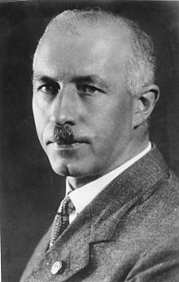
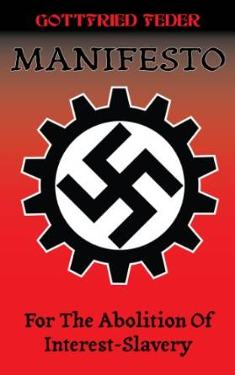
Hitler Taken by Feder’s Monetary Views
Feder met Adolf Hitler in the summer of 1919. Feder was a founding member of the German Workers’ Party, and became Hitler’s mentor on the monetary system and economics.
“The basis of Feder’s ideas was that the state should create and control its
money supply through a nationalized central bank rather than have it created
by privately owned banks, to whom interest would have to be paid. From this
view was derived the conclusion that finance had enslaved the population by
usurping the nation’s control of money.” Zarlenga, LSM, p. 590
“As Feder states throughout his manifesto, currency (or credit) is simply intended as a means of exchange, not as a profit-making commodity via usury. During the Medieval era usurers were executed; now they are regarded as the epitome of respectable business practice.”
Kerry Bolton, “Two Volumes by Gottfried Feder”
http://www.counter-currents.com/2012/11/two-volumes-by-gottfried-feder/
Pub., 1919
GOTTFRIED FEDER
(1883 – 1941)

Slide 5
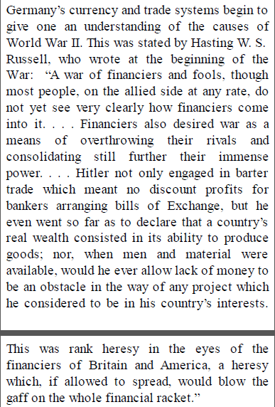
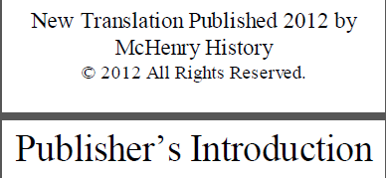
Hitler Taken by Feder’s Monetary Views

Slide 6
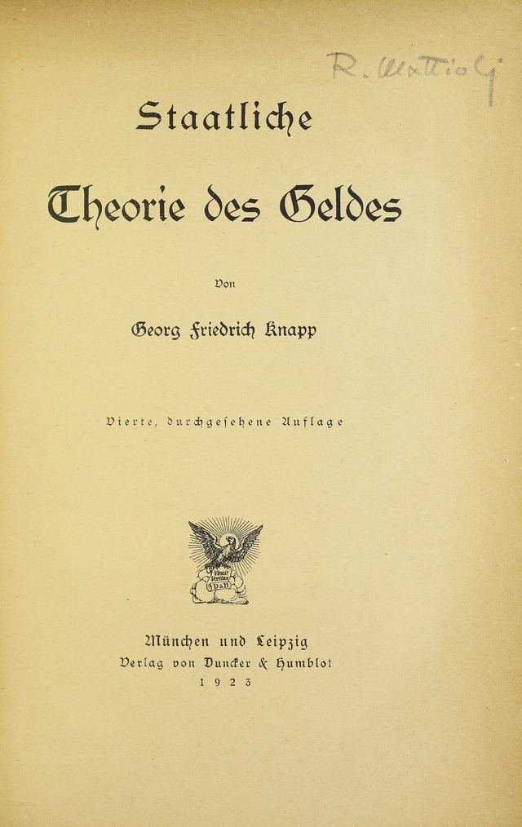
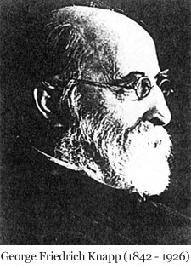
Hitler Taken by Feder’s Monetary Views
“Feder’s views could easily have originated from the work of German monetary theorists such as George Knapp, whose book The State Theory of Money (1905) is still one of the classics in the monetary area.” Zarlenga, LSM, p. 590
Knapp’s book founded the chartalist school of monetary theory:
Money has no intrinsic value, and should be a government-issued token -- public fiat money.
“Knapp casually mentions how German
monetary theorists of his day and earlier
would study and discuss American monetary
theories.” Zarlenga, LSM, p. 591

Slide 7
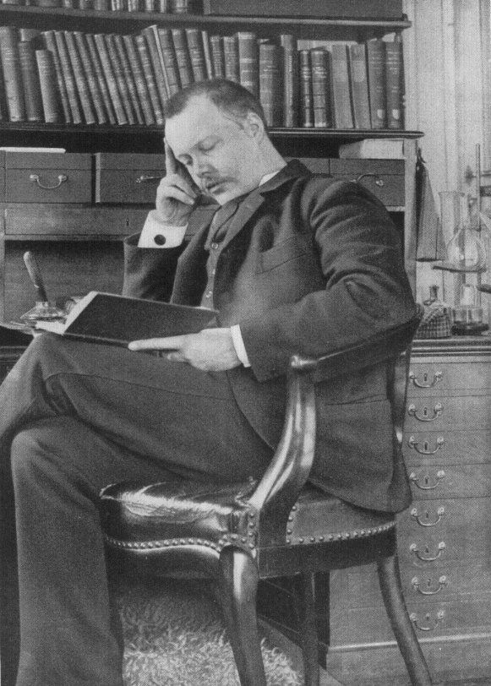
H.S. Chamberlain Promotes Racism
“Unfortunately, Feder’s monetary views were mixed up with an all-consuming anti-Semitism… some attention should be drawn to the strange personage of H. S. Chamberlain, an early 20th century figure who helped instigate racially based anti-Semitism in Germany.” Zarlenga, LSM, p. 591
Houston Stewart Chamberlain
(1855 – 1927)

Slide 8
H.S. Chamberlain Promotes Racism
Chamberlain was the son of a British admiral, and his uncle was Neville Chamberlain, once Prime Minister of England.
Chamberlain, however, was brought up in France by his grandmother, and during his teen years he had a German tutor who taught him the German language and German culture.
He studied natural science in Geneva, and then moved to Germany. “…at Dresden he plunged heart and soul into the mysterious depths of the Wagnerian music and philosophy, the metaphysical works of the master probably exercising as strong an influence upon him as the musical dramas.” (Lord Redesdale, Introduction, Foundations of the Nineteenth Century, by H.S. Chamberlain, pub 1910)
He ended up marrying the step-daughter of Richard Wagner and developing ideas of race and the supremacy of the Germanic peoples. In 1899 he published his two-volume book, The Foundations of the Nineteenth Century.
Houston Stewart Chamberlain
(1855 – 1927)

Slide 9
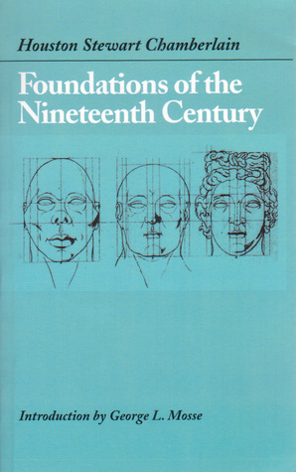
H.S. Chamberlain Promotes Racism
The Foundations sold extensively: eight editions and 60,000 copies within ten years, 100,000 copies by the outbreak of World War I and 24 editions and more than a quarter of a million copies by 1938.
The 1911 translation received positive reviews in most of the British press.
The book was important to Wilhelm II, German Emperor up to 1918, who became Chamberlain's friend.
Chamberlain's ideas on race were greatly influential to the Nazi ideology; Chamberlain himself joined the Nazi party, and both Hitler and Goebbels visited Chamberlain whilst he was on his deathbed.

Slide 10
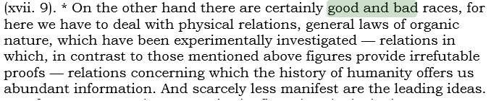
H.S. Chamberlain Promotes Racism
H.S. Chamberlain, Foundations of the Nineteenth Century
“
“

Slide 11
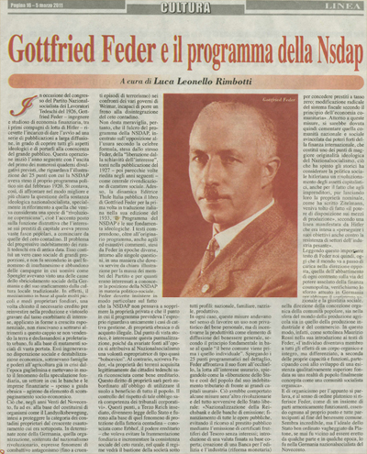
Schacht Battles Feder
Hitler and the National Socialists came to power January 30, 1933. On March 17, 1933, Schacht was re-appointed head of the Reichsbank, “partly to reassure German big business and foreign bankers.” Zarlenga, LSM, p. 592
Schacht battled against Feder’s unorthodox ideas in the party:
“National Socialist agitators led by Gottfried Feder had carried on a vicious campaign against private banking and against our entire currency system. Nationalisation of banks, abolition of bondage to interest payments, and introduction of state Giro ‘Feder’ money, these were the high-sounding phrases of a pressure group which aimed at the overthrow of our money and banking system.”
Hjalmar Schacht, The Magic of Money, p. 49, pub. 1967
Schacht won the battle and in 1934 Feder was put out to pasture as Under Secretary in the Ministry of Economic Affairs.

Slide 12
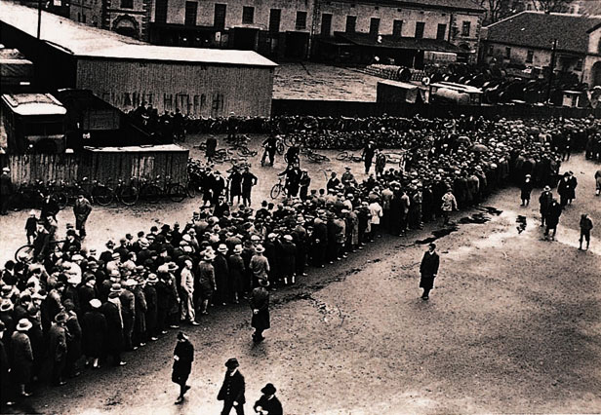
Schacht Battles Feder
Schacht as Reichsbank President
“I was persuaded to accept office as Reichsbank president not by the need to regulate the foreign debts, but by the desperate plight of the six and a half million unemployed, which, if left unsolved, would without a doubt have resulted in Germany turning to communism.
My taking up office followed upon a discussion of fundamentals with Hitler. The starting-point of this discussion was the axiom that the creation of work for the six and a half million unemployed must be the first and highest priority. This required a great deal of money.” Schacht, The Magic of Money, p. 131

Slide 13

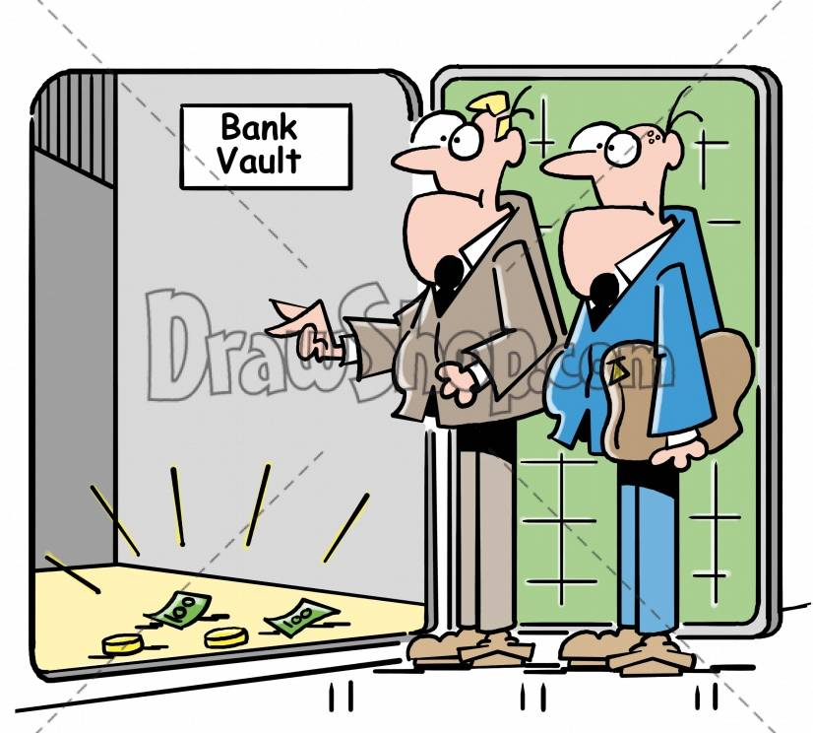
But Feder Money Worked Well
Germany’s foreign exchange and gold reserves had dropped:
late 1929 2.6 Billion marks
late 1933 409 Million marks
late 1934 83 Million marks
“According to classical economic theory, Germany was broke and would have to borrow, but Germany was to demonstrate that ‘classical’ monetary theory is not very accurate.” Zarlenga, LSM, 594

Slide 14
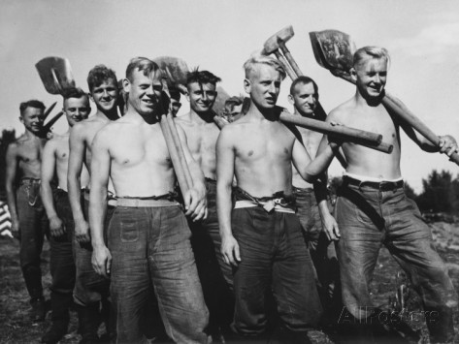
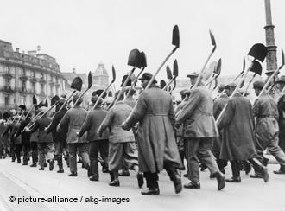
But Feder Money Worked Well
GERMANY DECIDES TO USE ALTERNATIVES TO GOLD:
THE REINHARDT PROGRAM – MAY 1, 1933
‘GERMANY’S NEW DEAL’
A 4-YEAR ALL-OUT EFFORT TO END UNEMPLOYMENT, OUTLINED BY HITLER:
    Spend 1 billion marks of “employment creation bills”
    Tax benefits for industry, agriculture, and employment of domestic help
    Marriage bonus loans up to 1,000 marks
    Government control of money and credit markets, under Schacht

Slide 15
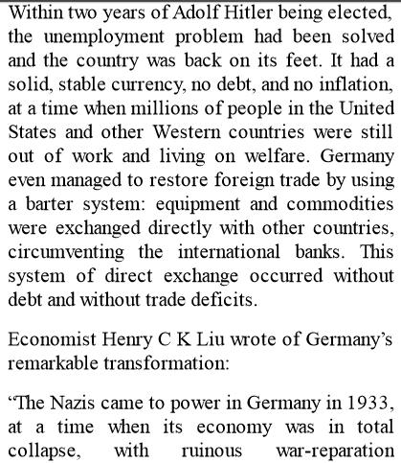
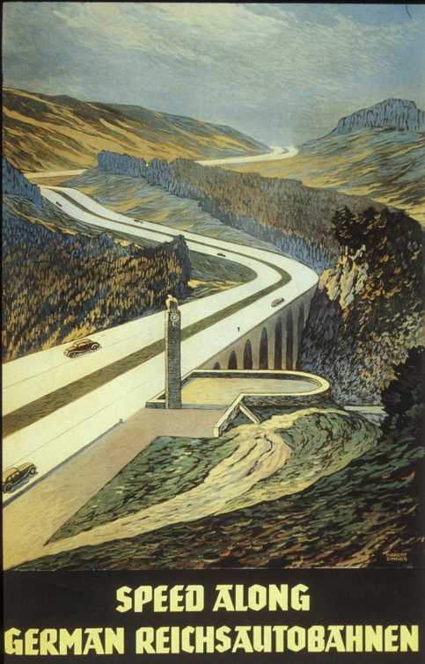
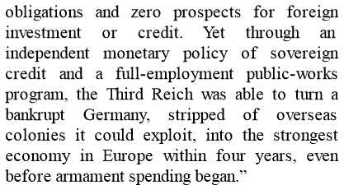
But Feder Money Worked Well

Slide 16
But Feder Money Worked Well
                Employment Creation Bills
                aka, Feder Money
                aka, Work Drafts (Arbeits-Schatzanwersungen)
                aka, MEFO bills (commodity bills)
WHAT WERE THEY?
MEFO bills of exchange were a pure bookkeeping operation and there were no actual paper certificates. They circulated between MEFO, the Reichsbank, commercial banks and manufacturers, not in the wider economy.
They were negotiable certificates, issued by government, designated to pay for specific infrastructure projects.
They were paid out to employers who equipped a factory with new machines or someone who had his house repainted, etc.
The bills paid 4½ % interest to their owners: therefore, banks and others held them.
They served as bills of exchange, convertible into Reichsmarks upon demand
They were re-discounted (exchanged from commercial banks for bank reserves) by the Reichsbank, and became part of the money supply.
The range of issued amounts range from 15 billion marks to 3 billion marks.

Slide 17
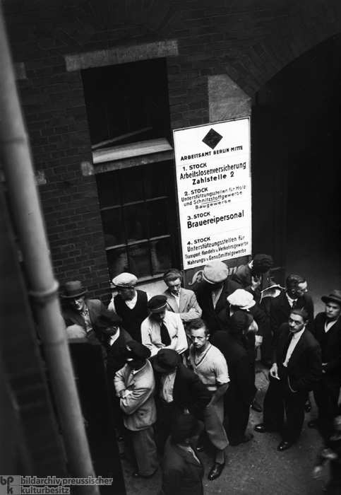
But Feder Money Worked Well
“Thus Germany did not take the full step and create a German equivalent to the American Greenback. The Greenbacks themselves were money, had no interest payments due on them and did not add to any national debt. These German infrastructure bills were a form of debt certificate, promising to pay money; they paid interest and did add to Germany’s national debt.” Zarlenga, LSM, p. 595
 | Unemployed Men Standing in Front of the Berlin Employment Office (June 22, 1933)

Slide 18
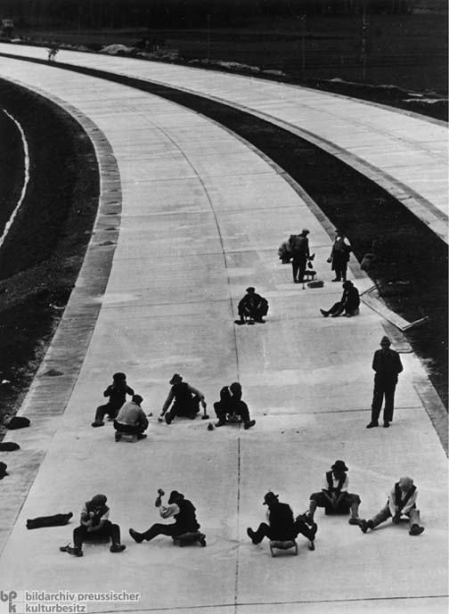
But Feder Money Worked Well
THE INFRASTRUCTURE BILLS HAD DRAMATIC EFFECTS.
#1 YEAR UNEMPLOYMENT
1933 6 MILLION
END 1936 1 MILLION
#2 SPENT, NOT ON WARFARE AND DESTRUCTION, BUT FOR PUBLIC
WORKS, ESPECIALLY CONSTRUCTION OF NEW MIDDLE CLASS HOUSING.
YEAR DWELLINGS BUILT
1932 141,265
1934 283,995
#3 THOUSANDS OF KILOMETERS OF AUTOBAHN CONSTRUCTION.

Slide 19
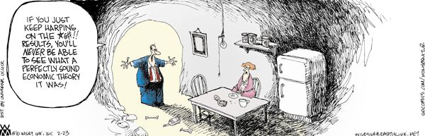
But Feder Money Worked Well
“Thus it can be argued that the cause of Hitler’s immense popularity among Germans was that he temporarily rescued German from English economic theory.” Zarlenga, LSM, p. 595
ECONOMIST
PUBLIC
Common sense tells us there is something wrong with the system and its apologists.

Slide 20
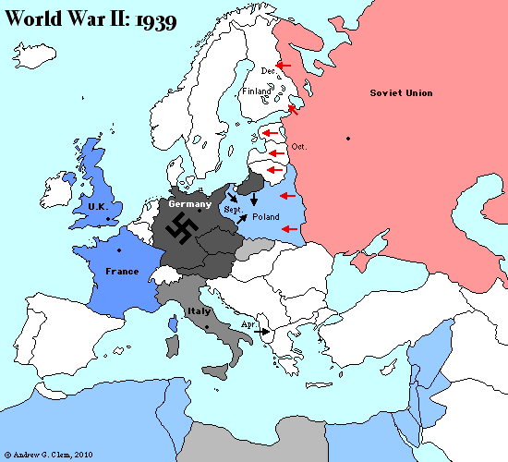
Employment-Creation Bills Threatened “Vested Interests”
“… in many other countries gold is an important asset. These countries would not look with favor upon the displacement of gold as a monetary metal; and even in the event of political changes resulting from the war, these vested interests will remain…”
Robert de Fremery, Money and Freedom, pp. 117-8, self-published
“The reader will notice that these ‘vested interest’ countries were the ones that warred with ‘goldless’ Germany. De Fremery thought this could have been one of the causes of the Second World War.” Zarlenga, LSM, p. 596

Slide 21
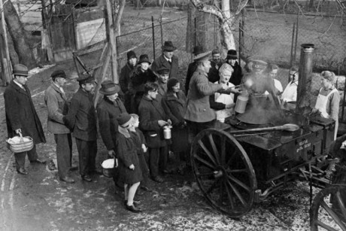
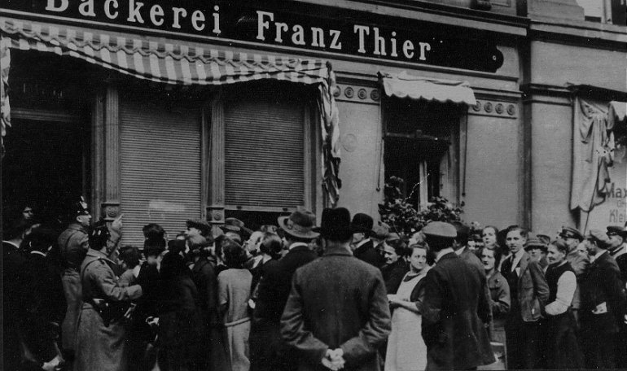
Schacht Ate Some Crow Over Feder Money
The MEFO bills were an example of substituting credit for money without inflation.
But there were two risks:
If the bulk of the MEFO bills were returned to the Reichsbank for Reichsmarks, the excessive use of the bank-note printing presses would have happened. This danger was avoided by making the bills re-discountable at any time [turned in for money to the Reichsbank], and by paying 4% interest on them.
If production had not increased both material goods and taxation revenue, the excessive use of bank-note printing presses would have happened. But conditions in Germany ensured increase in material goods and taxation revenue: there were no more stocks of raw materials, factories and warehouses lay empty, machines were idle, and six and a half million willing men were unemployed.
  Hjalmar Schacht, THE MAGIC OF MONEY, pp. 115-116
The German Army feeds the poor in Berlin in 1930.
German
unemployment
1930’s

Slide 22
Schacht Ate Some Crow Over Feder Money
Hjalmar Schacht, THE MAGIC OF MONEY, pp. 117:
“Every MEFO bill was tied to a quantity of goods. Only bills which effected a transfer of goods from one hand to another were granted. Thus the circulation of money and the circulation of goods remained in equilibrium. And that is the basic principle of currency policy.”
MONEY
MONEY
WORKERS
MARKET
GOODS
FACTORY
GOODS
CAPITAL GOODS
WAGES
MEFO BILLS
“It was their task [Reichsbank officials] to
examine all bills, to ensure that they were
issued only against deliveries of goods, and
not for any other purposes.” Schacht,
The Magic of Money, p. 114
MONEY
MEFO BILLS
COMMERCIAL
BANK
GERMAN
GOVERNMENT/
REICHSBANK
MEFO BILLS
TAXES

Slide 23
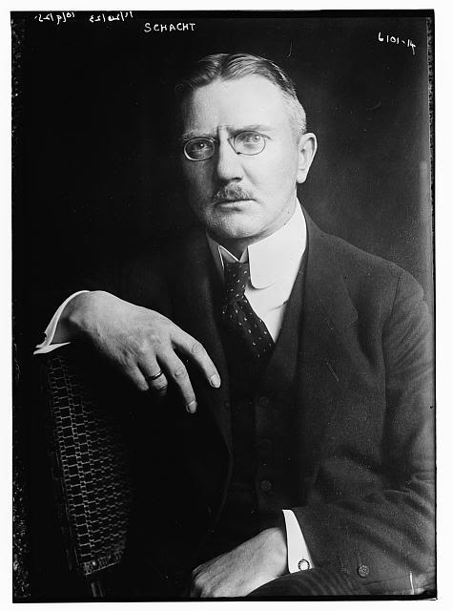
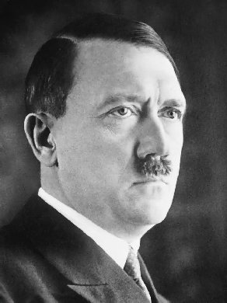
Schacht Fired Over These Matters
“As soon as full employment had been reached [1937], every further granting of credit could only lead to an excess in the circulation of money and to a rise in the price level, and thus to inflation.”
Hjalmar Schacht, The Magic of Money, p. 114
“…Hitler used these means to produce yet more
weapons of war… the MEFO bills were now
honoured when they became due, but only with
the inflated money produced by the printing presses. The second inflation had begun.”
Hjalmar Schacht, The Magic of Money, p. 117
“In the first days of January 1939, the Reichsbank handed Hitler a memorandum in which it indicated its refusal to grant the Reich any further credits. The consequences were drastic.
On 19 January I was dismissed from my office as president of the Reichsbank with immediate effect.

Slide 24
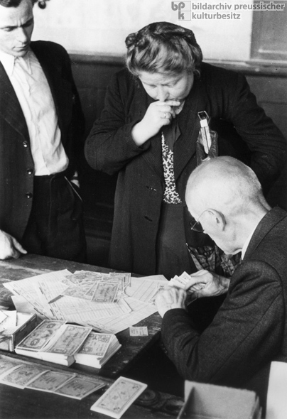
The American Professors Attack
POST-WAR INTRODUCTION OF THE DEUTSCH MARKS
“In 1948 a number of American professors were given the task of devising a so called currency reform… All old notes and coins lost their validity. Everyone received an amount of DM 40 in the new money, and employers received DM 60 for each employee… All money claims and thus also all bank deposits, savings, etc were reduced to a tenth of their nominal amount, without any regard to their economic or social significance…
It was a completely arbitrary redistribution of wealth without any social or economic foundation, the height of injustice. Against this, shares, properties, and other material assets remained undiminished in the hands of their owners. Their fortunes were left intact… they were the rich.
This transmogrification was… more diabolic in its results than the inflation of 1923.”
Hjalmar Schacht, The Magic of Money, p. 121
The initial allotment of Deutsch Marks being handed out at a disbursement site in a Carmelite school in Munich.

Slide 25

1956 Deutsche Bundesbank Formed
as a Government Owned Bank
FEDERAL CORPORATION OWNED BY THE GERMAN
GOVERNMENT
Frankfurt am Main.

Slide 26
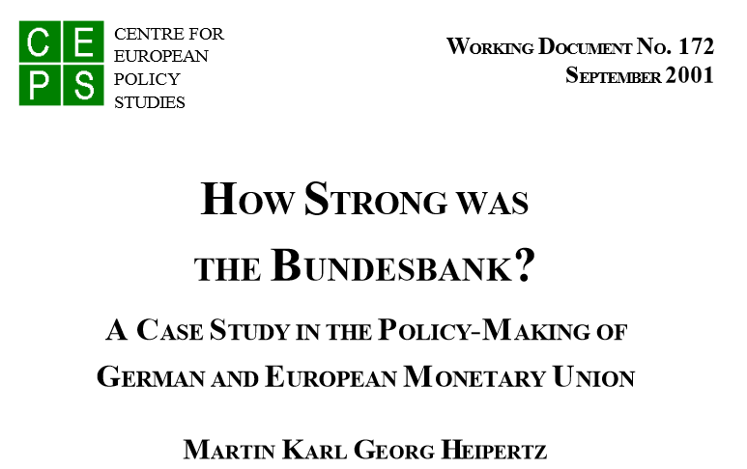
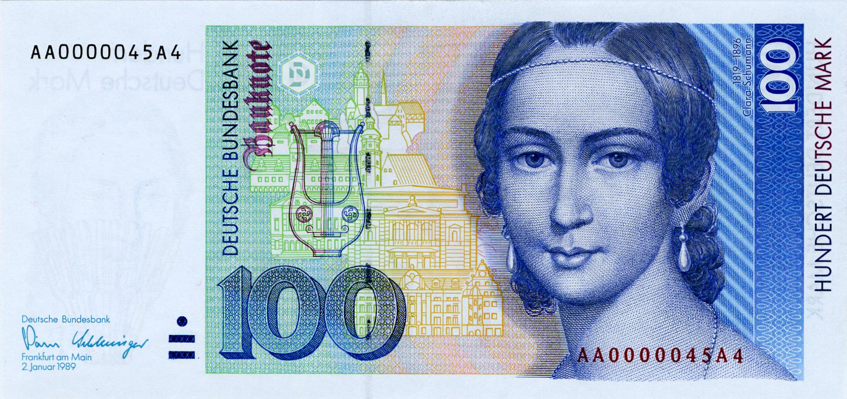
1956 Deutsche Bundesbank Formed
as a Government Owned Bank
“The Deutsche Bundesbank was founded in 1957 as West Germany’s central bank. Judged by the goal of financial stability and low inflation, it was one of the most successful central banks in the world and as such enjoyed highest esteem internationally and at home. Under its auspices, the Deutsche Mark (DM) became a symbol for stability and economic success, rose to the rank of the world’s second reserve currency and represented the benchmark for currencies in Western Europe.”

Slide 27
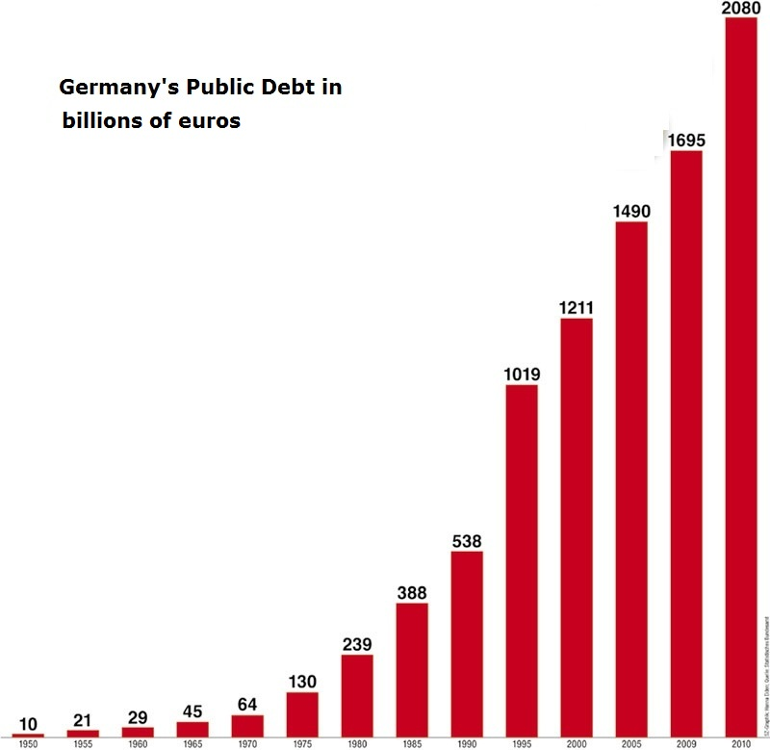
1956 Deutsche Bundesbank Formed as a Government Owned Bank
Report of the Bundesbank for the Year 1957: Bank officers and directors are nominated by the Federal Cabinet and appointed by the nation’s President.
“[The Bundesbank] has been run for the national interest, not for private profit; its management has a strong public service tradition; and the German people have worked very hard.
Up to the mid-1960s the German government ran budget surpluses, and it remained a net creditor until 1974. This saved the nation large amounts that would have gone for interest payments, had Germany financed government by borrowing, the way the U.S. has.” Zarlenga, LSM, p. 598
1950 55 60 65 70 75 80 85 90 95 2000 05 10 15

Slide 28
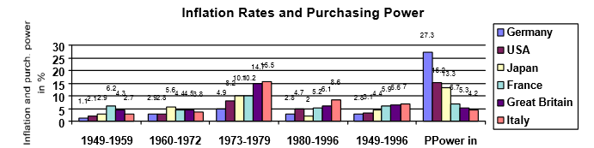
1956 Deutsche Bundesbank Formed
as a Government Owned Bank
Report of the Bundesbank for the Year 1957: “The duty to cooperate in general economic policy is limited by the responsibility, expressly laid on the Bundesbank by the Law, for safeguarding the currency.”

Slide 29
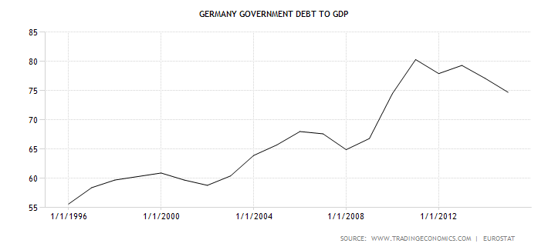
Much Greater Challenges under the EMU
(European Monetary Union)

Slide 30
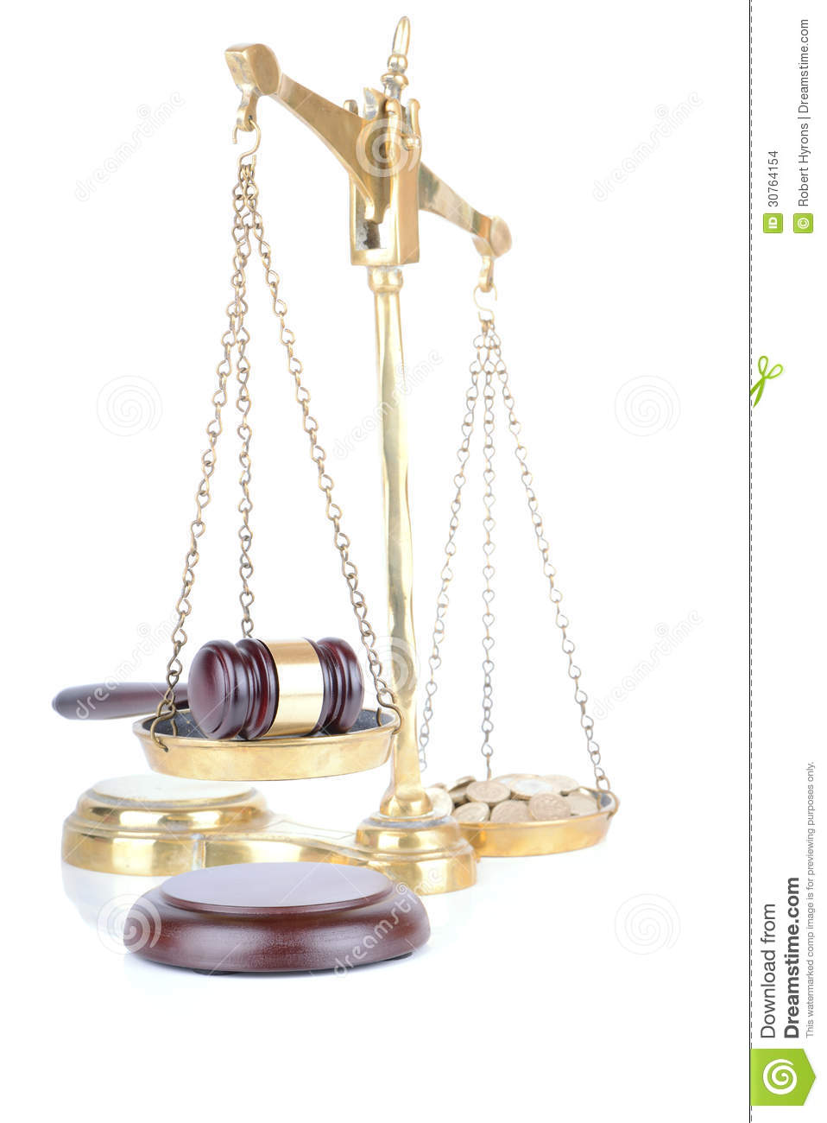

Schacht Finally Sees the Light
FROM A GOLD-BACKED CURRENCY TO A CREATION OF THE LAW
“Thus Schacht made a monetary pilgrimage similar to that of Thomas Jefferson, Alexander Del Mar, and many others, away from the primitive commodity view of money as metal, to an awareness of the ‘nominal,’ fiat nature of money as being based in law.”
Zarlenga, LSM, p. 599

Slide 31
Q & A
WILL DECKER’S CONCLUSION:
THE CONTROL OF MONEY -- WITHOUT CONTROL FROM THE PUBLIC -- LEADS TO
CORRUPTION … USURPATION … SLAVERY.

