Slide 1


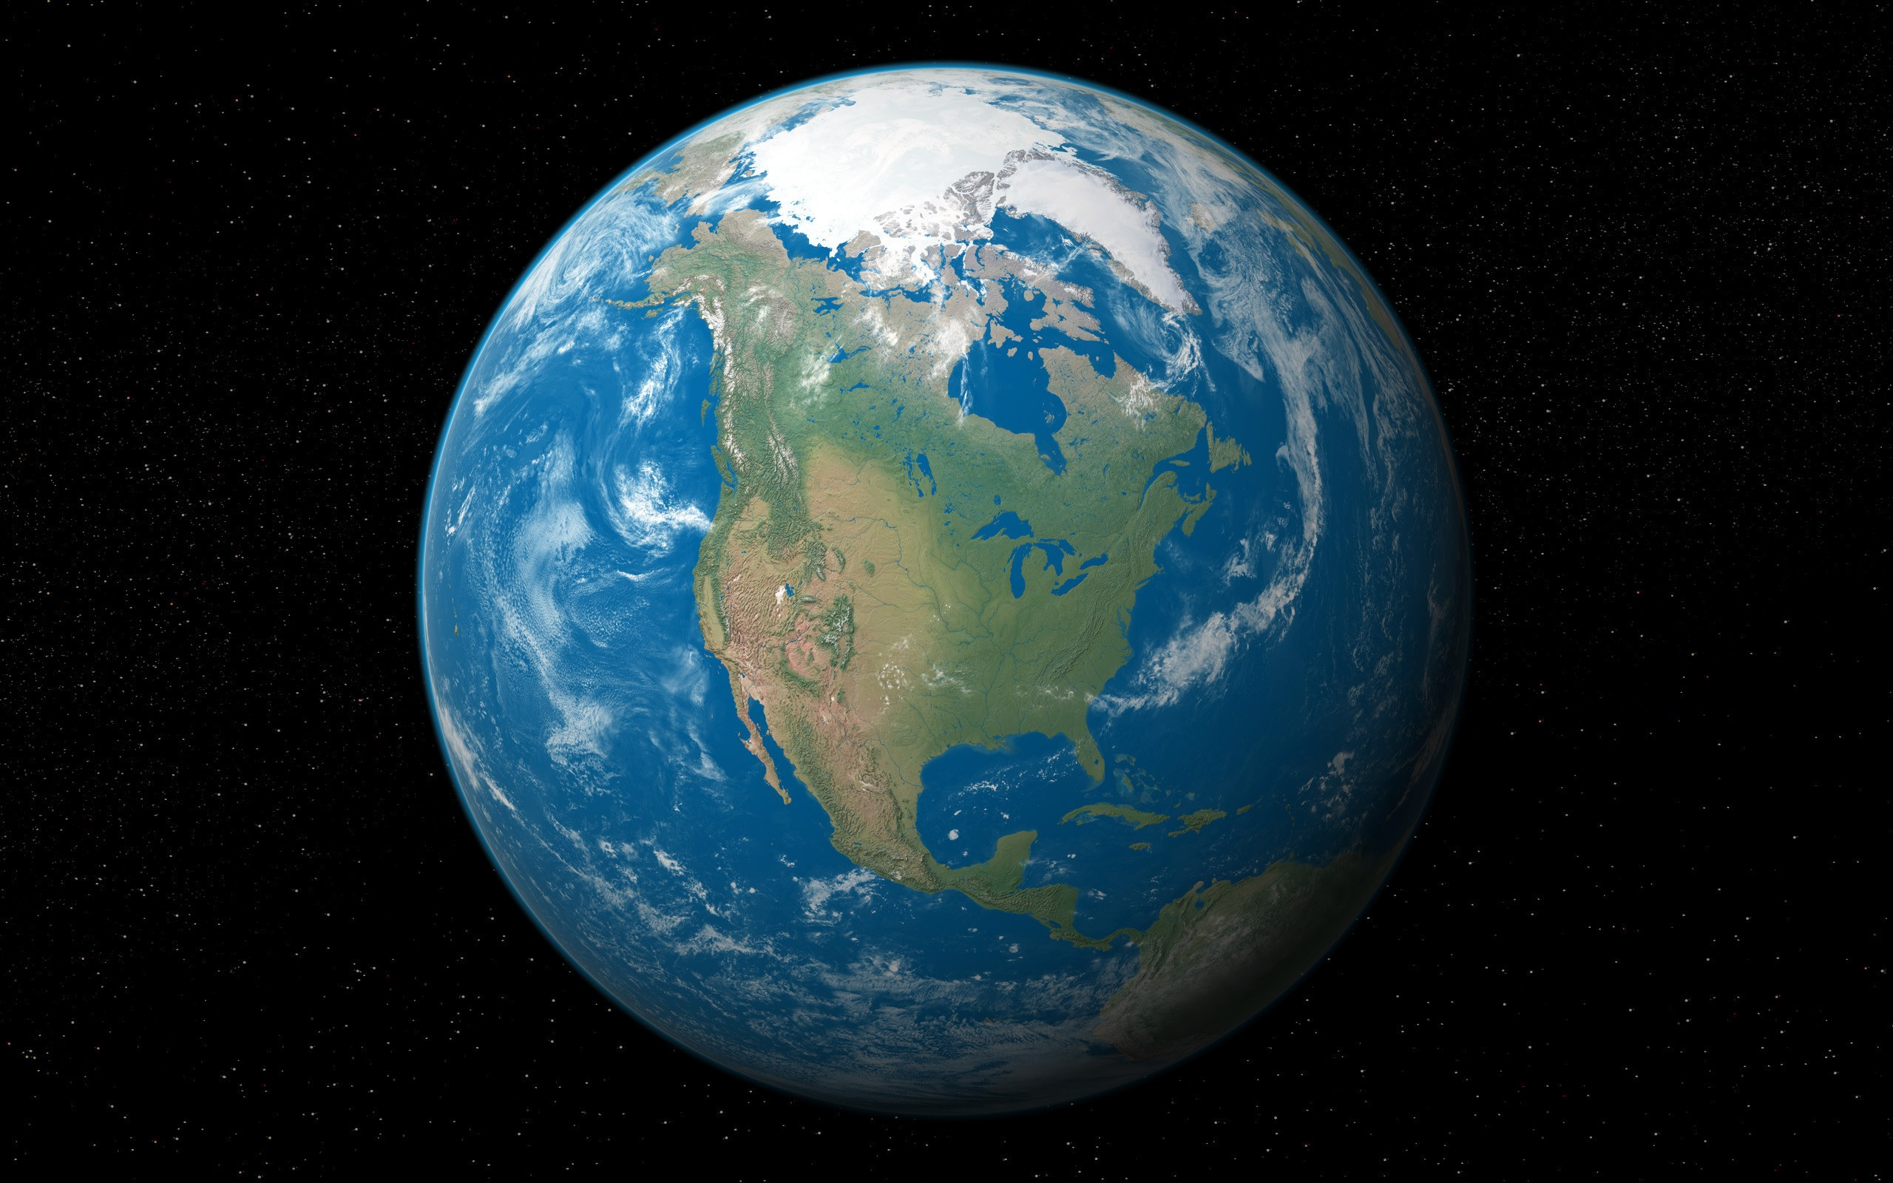

How the banking system creates what we use for money
John N. Howell, Ph.D.
September 29, 2016
Notes:
Why am I giving this talk. After I retired the 2nd time, in 2010, I became interested in the question of why we, as a rich country, aren’t doing better in maintaining our infrastructure, our educational system, our healthcare system, etc. One thing was clear, namely that our representatives in government had come to be so dependent upon their donors, that they no longer represent the people who voted for them; they represent their donors. This problem could be solved by a Constitutional amendment to specify that corporations are not persons, protected by the inalienable rights in the constitution, such as free speech, and political contributions don’t constitute speech protected by the 1st amendment.
Beyond that, however, I became aware of another fundamental feature of our system that is also inimical to real democracy. That is the monetary system. Not many folks understand how our system works. I didn’t until 4 years ago. (Henry Ford quote) So I want to share what I have learned with whoever is interested.

Slide 2
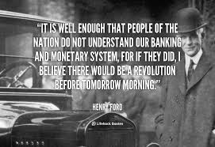

Slide 3
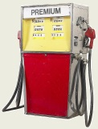


What is the economy?
goods &
services
The economy is the exchange of goods and services among people.

Slide 4

The exchange of goods and services is mediated by money.
The economy can be viewed as the circulation of money.

Slide 5
Where does the money come from?
How is money created?

Slide 6
Money comes either from banks or from the government.
Government can create money.
Banks can create credit which we use as money.

Slide 7


When governments create money…
Money created by government
Taxes – collected and spent
…money created by government is spent into circulation, producing jobs, allowing the economy to grow.

Slide 8
When government creates money…
Money created by government
Taxes – collected and spent
…the rate of money creation is tied to the growth of the real economy, eliminating boom and bust cycles.

Slide 9
When government creates money…
Money created by government
Taxes – collected and spent
… there is no debt from money creation. Money created by the government can pay down the national debt as it comes due.

Slide 10
1. In today’s world, money is created as debt, by banks, when they extend credit, i.e., when they make loans.
2. Because money is only created as debt, society only has money when it has debt.
3. People naturally think that it is better to be without debt. But in the current system, without debt, no one would have any money.
These points are made very effectively in a 3 minute pictorial video on YouTube by Positive Money, entitled, “Why Is There So Much Debt?”

Slide 11


In the current system, banks, not governments, create money
Money is created by banks as loans, which are subsequently repaid to the banks.
Loan interest
But doesn’t the government Office of Engraving and Printing produce our paper money and doesn’t the U.S. Mint produce our coins?

Slide 12

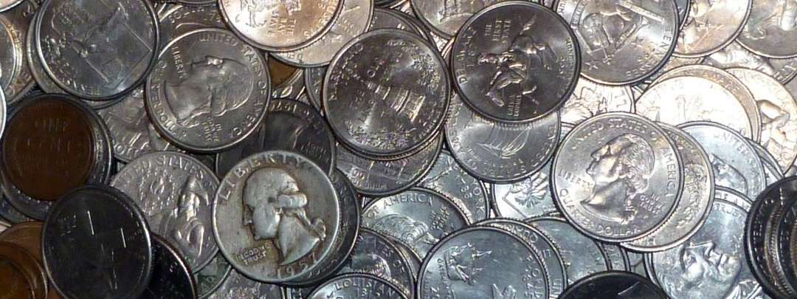
Yes, the government creates our coinage.
The government, via the U.S. mint creates the coins. It can make 4 quarters, which costs 11 cents each to make, take them to a bank and get a dollar. That is 56 cents profit for the government per dollar. (“Seigniorage”)

Slide 13
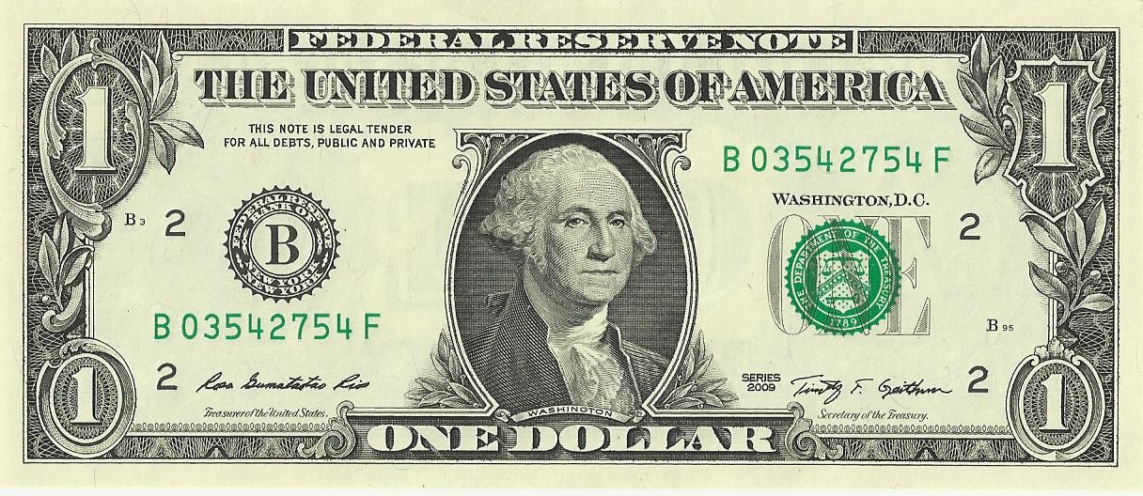
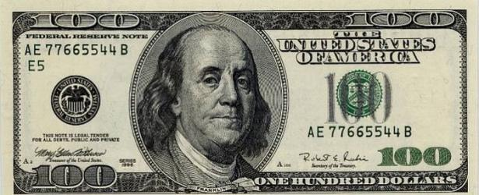
Yes, the Government Engraving and Printing Office prints our bills, but, no, the government doesn’t create our paper money
Federal Reserve banks purchase bills for the cost of their production, ~11 cents each.
The banking system gets the profit from paper money creation.
Notes:
It is different in Britain where the central bank, The Bank of England, is nationalized, i.e., owned by the government. The British government does make profit from printing their paper money, their Pound notes.

Slide 14
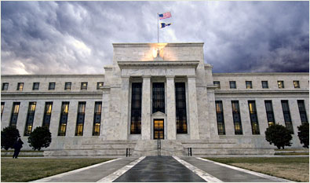
But aren’t the Federal Reserve Banks owned by the U.S. government?
No. The Federal Reserve Board of Governors –
  a government policy-making and regulatory agency.
  The Board is not a bank.
12 regional Federal Reserve Banks, owned by the private, commercial banks in the region of the country they serve.
Federal reserve bank employees are not government employees.

Slide 15
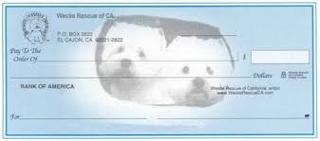
Coins and bills are trivial
About 97% of U.S. money is account money, existing only as records in computers.
All account money is created by banks when they make loans or buy securities.
Conclusion: Except for coins, money is created by banks, not by the government.
(If the government created money, why would it borrow? Why would it be in debt?)

Slide 16
Banks: loan principal, but take out principal plus interest.
Money is created by banks as loans, which are subsequently repaid to the banks.
Loan interest
Therefore they take more out than they put in. Yet they provide the money supply. How is that possible?

Slide 17
It is only possible when lending stays of ahead of repayment…
Money is created by banks as loans, which are subsequently repaid to the banks.
Loan interest
When lending stays ahead of repayment, the money supply grows; money is plentiful and times are good; but debt is growing.

Slide 18
But when lending fails to stay ahead of repayment rates…
Loans
Repayments
Loan interest
…the amount of money in the economy shrinks. Recessions/depressions occur. Jobs are lost; people suffer.

Slide 19
Which monetary system is better?
Money created by government
Money created as credit by banks
Taxes – collected and spent
Loan interest
Money as money, a public asset
Money as debt, a public liability

Slide 20
How banks create money when they make loans: a bank balance sheet
Assets
What the bank owns
What is owed to the bank
Liabilities
What the bank owes
1. Cash, central reserves, bonds (liquid assets)
2. Loans to customers
(illiquid assets)
1. Customer deposits
2. Stockholder equity
Example of a bank loan: Jack takes out a $10,000 loan. Here is what is entered on the bank balance sheet.
Assets
Liabilities
$10,000
$10,000 – Jack’s account
$10,000 of new money has been created by the bank, not transferred from somewhere or someone else.

Slide 21
Jack buys a car
Jack now writes a check to Sam for $10,000.
Sam happens to have an account at the same bank.
The bank balance sheet changes.
Assets
Liabilities
$10,000
$0 – Jack’s account
$10,000 – Sam’s account

Slide 22
What if Sam banks at a different bank?
Federal Reserve bank transfers $10,000
  from the reserves of Jack’s bank
  to the reserves of Sam’s bank.
The reserve bank would now have a liability of $10,000 to Sam’s bank instead of to Jack’s bank.
The banking system acts like one big bank.
(The clearing house function of the Federal Reserve Banks)

Slide 23
The big picture
Assets
Liabilities
$10,000
$0 – Jack’s account
$10,000 – Sam’s account
Jack takes from the economy to repay the loan
Sam spends into the economy.
The Economy
Loans stay ahead of repayment and keep the system in “money.” Loans keep the system afloat. This looks sustainable.

Slide 24
Problem #1
Assets
Liabilities
$10,000
$0 – Jack’s account
$10,000 – Sam’s account
Repayments
Loans
The Economy
When loan-making slows down as repayments continue, the money supply shrinks (recession/depression).

Slide 25
Problem #2
Interest payments
Assets
Liabilities
$10,000
$0 – Jack’s account
$10,000 – Sam’s account
Jack takes from the economy to repay the loan plus interest
Sam spends into the economy.
The Economy
The bank created the principal, but not the interest.
Where does the borrower get the money to pay the interest? Where does the economy get the money to pay the interest?

Slide 26
There is no source other than more loans.
Interest payments
Assets
Liabilities
$10,000
$0 – Jack’s account
$10,000 – Sam’s account
Repayments
Loans
The Economy
Loans
demand
more loans
demand
more loans
demand

Slide 27
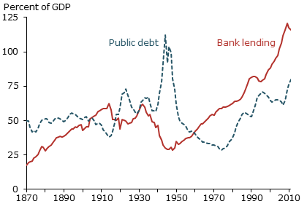
The debt money system produces rising debt – public and private
Private
Source: Jordà, Schularick, and Taylor (2013) Combined data from 17 countries.

Slide 28
But wait! Where do those interest payments go?
Interest payments
Assets
Liabilities
$10,000
$0 – Jack’s account
$10,000 – Sam’s account
Repayments
Loans
The Economy
Don’t interest payments also get fed back into the economy?

Slide 29
Some interest does filter back into the economy,
Interest payments
Financial sector grows.
Bank assets
Bank liabilities
$10,000
$0 – Jack’s account
$10,000 – Sam’s account
Jack takes from the economy to repay the loan
Sam spends into the economy.
The Economy shrinks or fails to grow.
but much of it stays in the financial sector as investments. (Note the current record levels of the stock market and the record level of inequality of wealth distribution.)
As money shifts into the financial sector;
the real economy suffers from austerity.

Slide 30
To keep a constant money supply in the economy,
the total money supply rises exponentially.
The steepness of the exponential rise is a function of interest rates.

Slide 31
Money creation by banks is a process by which wealth is transferred from the many, the borrowers, to the few, the lenders.

Slide 32

Banker argues, “We didn’t create the money when we loaned it to a customer; we took it out of ‘cash.’ We took it out of an existing asset, just like anyone does when they loan money.”
Assets Liabilities
Assets Liabilities
NL
NL – new loan
E - equity
“cash” or “reserves”
“cash” or “reserves”
deposits
money loaned
E
E

Slide 33
“But your assets haven’t decreased and yet the customer has money, which you provided to him. Doesn’t that reflect creation of new money?”
Assets Liabilities
Assets Liabilities
NL
“cash” or “reserves”
“cash” or “reserves”
deposits
money loaned
E
E

Slide 34
Banker - “Maybe so, but if you define money creation that way, any time money is loaned, by anyone, money is created. So banks aren’t the only ones doing this.”
Assets Liabilities
Assets Liabilities
NL
“cash” or “reserves”
“cash” or “reserves”
deposits
money loaned
deposits
E
E

Slide 35
What does make banks different from other lenders?

Slide 36
Lenders face constraints to lending
Assets Liabilities
Assets Liabilities
“cash” or “reserves”
loans
deposits
deposits
“cash”
E
E
As loans increase, “cash” decreases.

Slide 37
As “cash” approaches zero lending has to stop.
Assets Liabilities
Assets Liabilities
“cash” or “reserves”
loans
deposits
deposits
E
“cash”
E

Slide 38
But any lender can borrow more money to be able to continue to lend.
Assets Liabilities
Borrowed money
“cash”
This new “cash” can be lent out.
Assets Liabilities
“cash” or “reserves”
loans
deposits
deposits
E
“cash”
E

Slide 39
What limits this ability of lenders to keep borrowing so that they can continue to lend?
Assets Liabilities
“cash”
This new “cash” can be lent out.
loans
For nonbanks, it’s the market.
Can the lender find another lender willing to loan at rates that will permit further profitable lending?
deposits
“cash”
E

Slide 40
Assets Liabilities
For banks, the situation is different, because, at least in principle, they can turn to the lender of last resort, the central bank.
“cash”
This new “cash” can be lent out.
loans
deposits
“cash”
E

Slide 41



Central bank
Commercial bank
Assets Liabilities
“cash”
loans
deposits
“cash”
E
Money creation: When a central bank loans to a commercial bank, it simply raises its balance sheet, increasing both its assets and its liabilities. The commercial bank then does the same, and can use its new “cash” to continue lending.

Slide 42
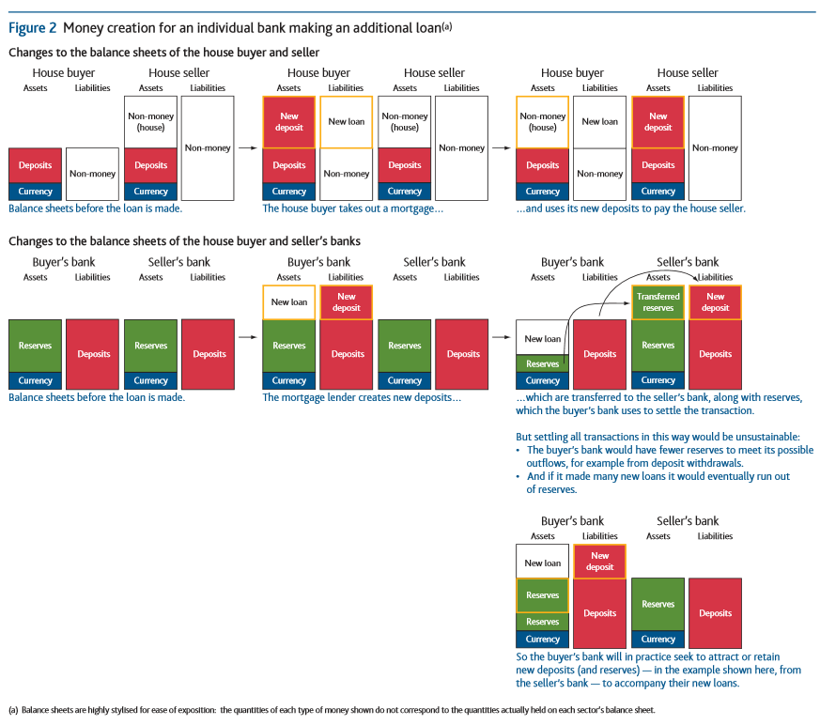
From M. McLeay, et al. Money Creation in the Modern Economy, Quarterly Bulletin (Bank of England), 2014, Q1, pp. 14-27

Slide 43
What does make banks different from other lenders?
Two advantages of banks:
  As depository institutions they have the asset of deposits to use as the basis for lending.
  As banks, they can go to the central bank for loans, when needed, at very low interests rates.

Slide 44
My tentative conclusion:
When a bank provides loan money to a customer, that money does come out of a pre-existing source, the banker’s “cash” or “reserves.”
Whenever money is loaned, by banks or non-banks, money is created.

Slide 45
What will the NEED Act do?
1. The NEED Act will prevent commercial banks from lending against deposits.
2. It will initiate money creation by government.

Slide 46
What will the NEED Act do?
3. It will still permit lending, against equity or other borrowed funds.
4. It will not prevent credit extension, i.e., debt money creation, in the private sector, but, through indirect means, it will decrease it greatly.

Slide 47
What will the NEED Act do?
5. It will free the economy from its dependence on debt money for growth.
6. It will make a just society and a stable and sustainable economy possible.
7. It provides, at least, the hope of achieving environmental sustainability.

Slide 48
Thanks to Stephen Zarlenga, and fellow monetary reformers.

