Slide 1

Monetary Reform
www.cpe.us.com

Slide 2
Our elected political leaders are not in charge of the economy! The commercial banking system is in charge by controlling the amount of money in circulation!

Slide 3
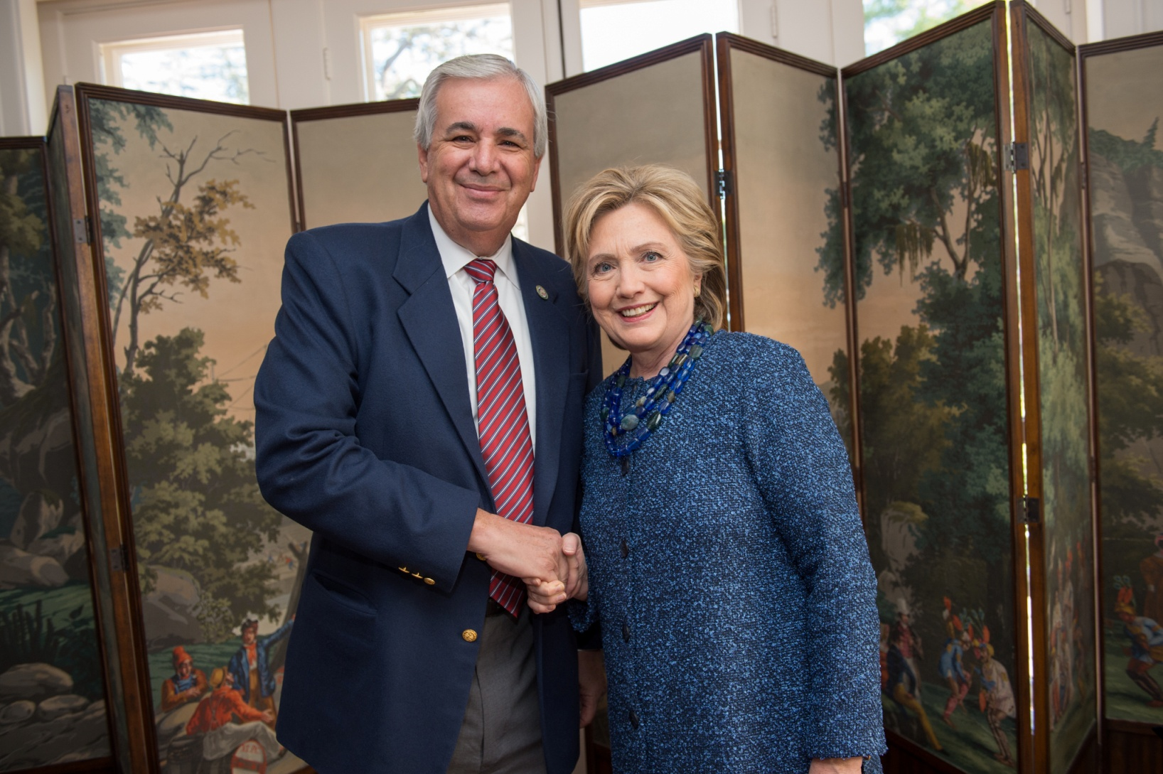

Slide 4
A Monetary System has two separate processes:
CREATION
&
DISTRIUBITION

Slide 5
CREATION PROCESS
Money is NOT scarce
Cost is ZERO (except for excess inflation)
Based on the volume of money issued and determined by inflation statistics including asset prices
Checks & Balances
Secure Computer

Slide 6
It is not “Who” is running the monetary system, but “What” is the system.

Slide 7
CREATION PROCESS
PROCESS
LEGISLATIVE BRANCH
EXECUTIVE BRANCH
INDEPENDENT BRANCH

Slide 8
Federal Government Structure
Spending Into Circulation (NEED Act)
Diversified System
No return – fiscal spending
With return – monetary investment
Monetary System
Only spending
Increasing taxes

Slide 9
Distribution – 3 Ways (Vehicles)
Direct Currency Issue
Using Debt
Using Equity
(Cost is small)

Slide 10
INCREASE THE DISTRIBUTION OUTLETS
NOT THE CREATION
(30 REASONS WHY AT www.cpe.us.com)

Slide 11
30 Reasons for Monetary Reform
Commercial Banking system has monopolistic power over money creation
System of interest rates is hard for small businesses
Controlling the monetary supply based on interest punishes the economy
Diversification reduces criminal activity
Diversifying will reduce boom/bust scenarios
Reduces Inequality
Expands investment of new money

Slide 12
Reasons Continued
Reduces the effects during economic expansion
Defaults will not hurt entire economic system
More control of new money will lower chance of over expansion
More capital to areas with high need
An error in one system will not affect the whole system
Fiscal systems should be as diversified as other government bodies
Credit Risk Formulas are inherently flawed

Slide 13
Reasons Continued
More transparency will aid in coping with change
Transparency will help combat excessive greed
Self-interest and other human factors can not be offset by one delivery system
One system is less willing to share risk
Banking crisis will not be detrimental to entire economy
Diversification reduces “herd” behavior
Diversity will reduce risk to the entire banking system

Slide 14
Reasons Continued
Monetary System will support the real economy instead of the financial sector
Reduction of the tax burden on a majority of the population
Spending programs will reduce political fiscal pressure
Current system is set up to be a bubble economy
Borrowing money leads to tax expense
Financial systems only stop expanding credit during a crisis

Slide 15
Reasons Continued
Banks should not have power to create money because they are profit seeking, risk taking institutions
Reduction of the financialization of the American economic system will allow the money to serve the economy and not to master it
Bankruptcy or Write Downs should not be the only way for the economy to have permanent money

Slide 16
Distribution Systems - Banks
Environmental Bank
Primary Housing Bank
Venture Capital Bank
Land and Infrastructure Bank
Student Loan Bank
Microfinance Bank
Non Profit and Culture Bank

Slide 17
Distribution Systems - Banks
Agriculture Bank
Pension Assistance Bank
Commercial Banking Assistance
Food Stamp Bank
Local Government and Public Banks
Federal Deficit
Community and SBA Bank

Slide 18
OVERCOMING THE INFLATION OBJECTION
Diversity of monetary delivery systems.
Production and Productivity.
Reduction of the high interest rate charges.
Encouraging savings and investing.
Encouraging spending on services rather than goods
Having the Commerce Dept. create and publish numerous inflation formulas and statistics
Checks & Balances

Slide 19
Voters will be able to cast their votes based on inflationary mgmt of the country
Currency and commodity markets should be monitored in the long term, including gold.
Increasing taxation removes money from circulation.
Competition keeps pressure on prices.
Substantially encourage reusing, renewables and recycling to reduce the demand pressures on raw materials – commodities.
Elimination of “fractional reserve banking”

Slide 20
Trade Deficits can be very detrimental to the value of a country’s currency
Selling Treasury Bonds will decrease the money supply

Slide 21
There is no such thing as a business cycle for an entire economy
Business cycles are for businesses and industries
It should be called a “Monetary Cycle”

Slide 22
There is no such thing as the “National Debt”
We have not paid it off since 1835
A debt is something you have to pay back!
It is the National Monetization Account or the National Money Creation Debt

Slide 23
Taxes and Spending (Fiscal Policy) WAS 100% NOT THE CAUSE OF THE “GREAT RECCESSION” Therefore it is NOT the Solution!

Slide 24
When Money Flows We Grow and When Money Stops we Flop!

Slide 25
Politics of Monetary Reform

Slide 26
Goal – “Start the Debate”

Slide 27
$$$$$$ - www.caclean.org
Clean Money Movement

Slide 28
Find
Congressional Members or Candidates

Slide 29
Find
Sponsors for HR-2990 or similar bill

Slide 30
Tie Reform to Fundraising

Slide 31
BUNDLERS

Slide 32
PAC – 503c4

Slide 33
TO FAR TO THE LEFT BRING IN THE RIGHT

Slide 34
WE NEED TO CREATE A QUALITY WIN-WIN 21ST CENTURY ECONOMY

