Slide 1
2-1 to 2-21-2018
TRIP TO EUROPE
FOR MONETARY REFORM
Week 1: Zurich, Bologna
Thurs 2-1 to Wed 2-7
AMI:
Sue Peters, Bob Poteat, Jamie Walton

Slide 2
LEAVING NEW YORK
… FOR ZURICH, SWITZERLAND
2-1-2018

Slide 3
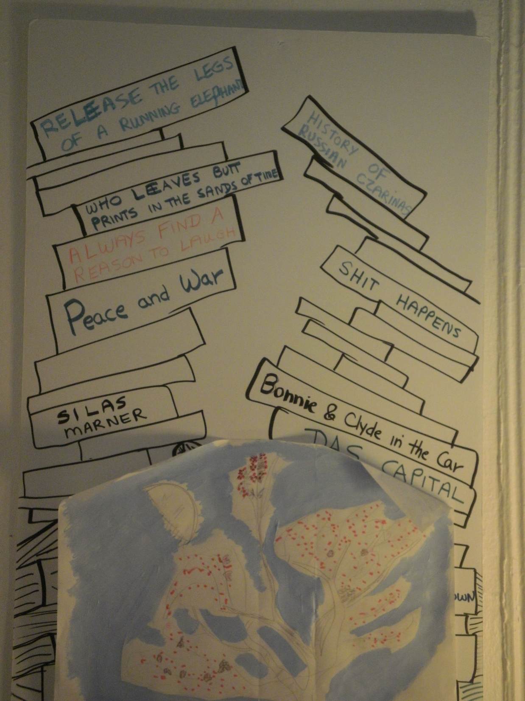
A wall from Sue’s bedroom….
“…release the legs of a running elephant…” etc.

Slide 4
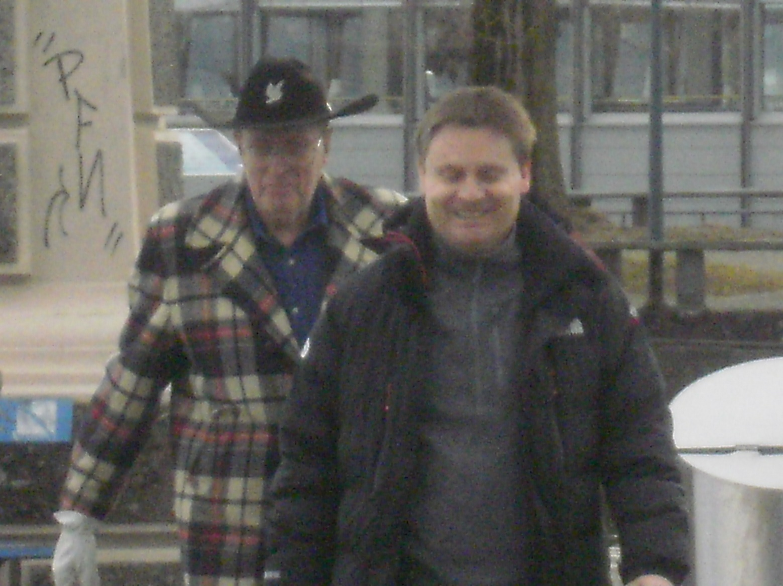
Fly with Bob from Newark Intl Airport & arrive Zurich,
to meet Jamie
2-2-2018
I never lost Bob and Jamie…
I just followed the cowboy hat and plaid jacket
all over Europe

Slide 5
ARRIVING
…. ZURICH, SWITZERLAND
Fri. 2-2-2018 10:30am

Slide 6
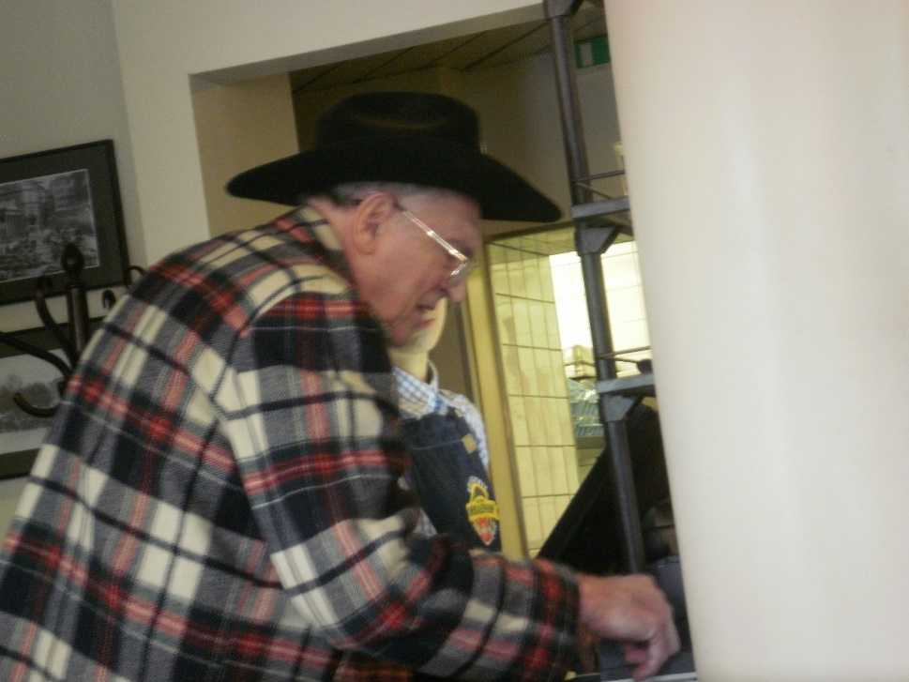
Zurich Airport – be careful of foreign exchange manipulators
US Dollars (USD) to Swiss Francs (CHF)
2-2-2018
This man in the Zurich airport said his debit card was not working.
He said he would give me 50 USD for my using my debit card and withdrawing 50 CHFs for him.
But I said….”wait, the exchange rate is less than 100%...” so he gave me 52 USD. But I figured it out later, he should have given me 54 USD!
If you find this man, force him to give me 2 USD more, thanks. FX manipulators get big bucks out of doing lots of penny stealing.

Slide 7
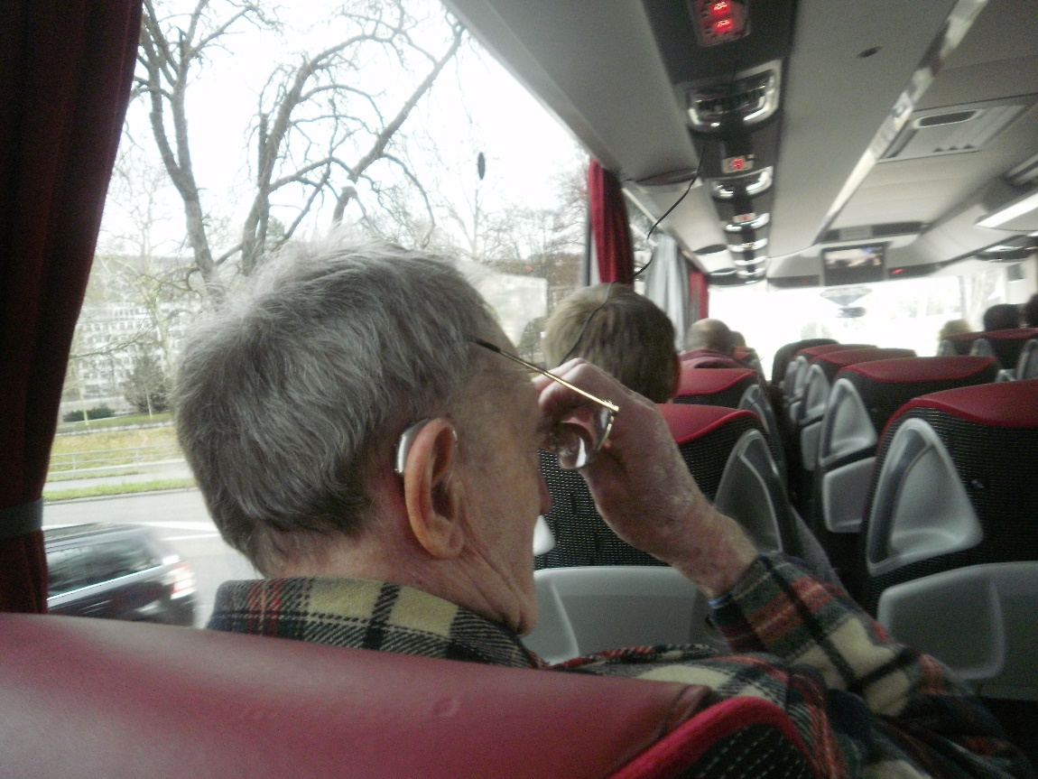
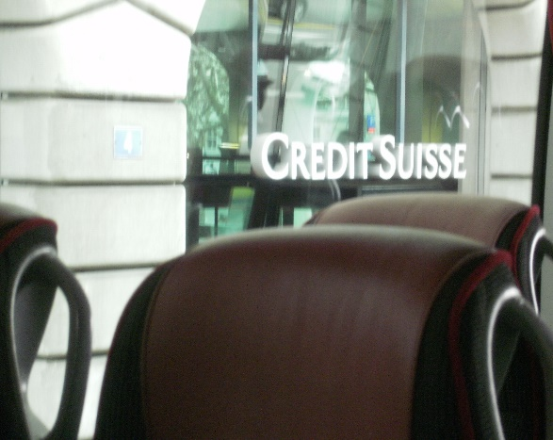
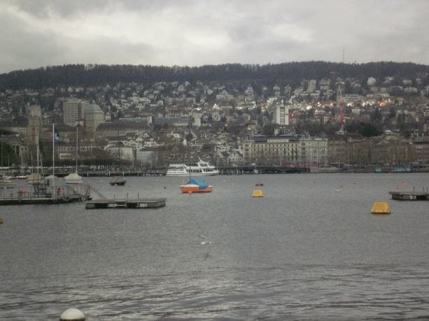
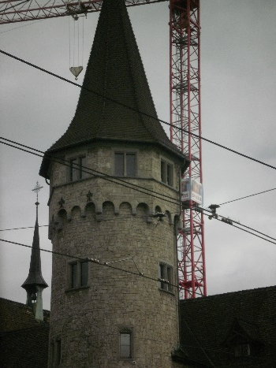
Zurich Bus Tour (34 CHFs)
SAT 2-3-2018
On the bus tour, we found out Zurich is at the top of a beautiful lake with a northern river flowing into the European river system to the North Sea (see map next slide).
We also found that there was a Swiss businessman, Alfred Escher, who started the first bank in Switzerland in 1856 – CREDIT SWISS – because he needed ‘capital’ (i.e., bankmoney) to continue his nation-wide railroad building. (Sound like U.S. financiers in the 19th century?)
<=JAMIE
BOB=>
SUE (taking picture)
Anyone want to write a research
paper on Alfred Escher (1819 – 1882)?
Wikipedia euphemistically calls him
a ‘railways pioneer’.

Slide 8
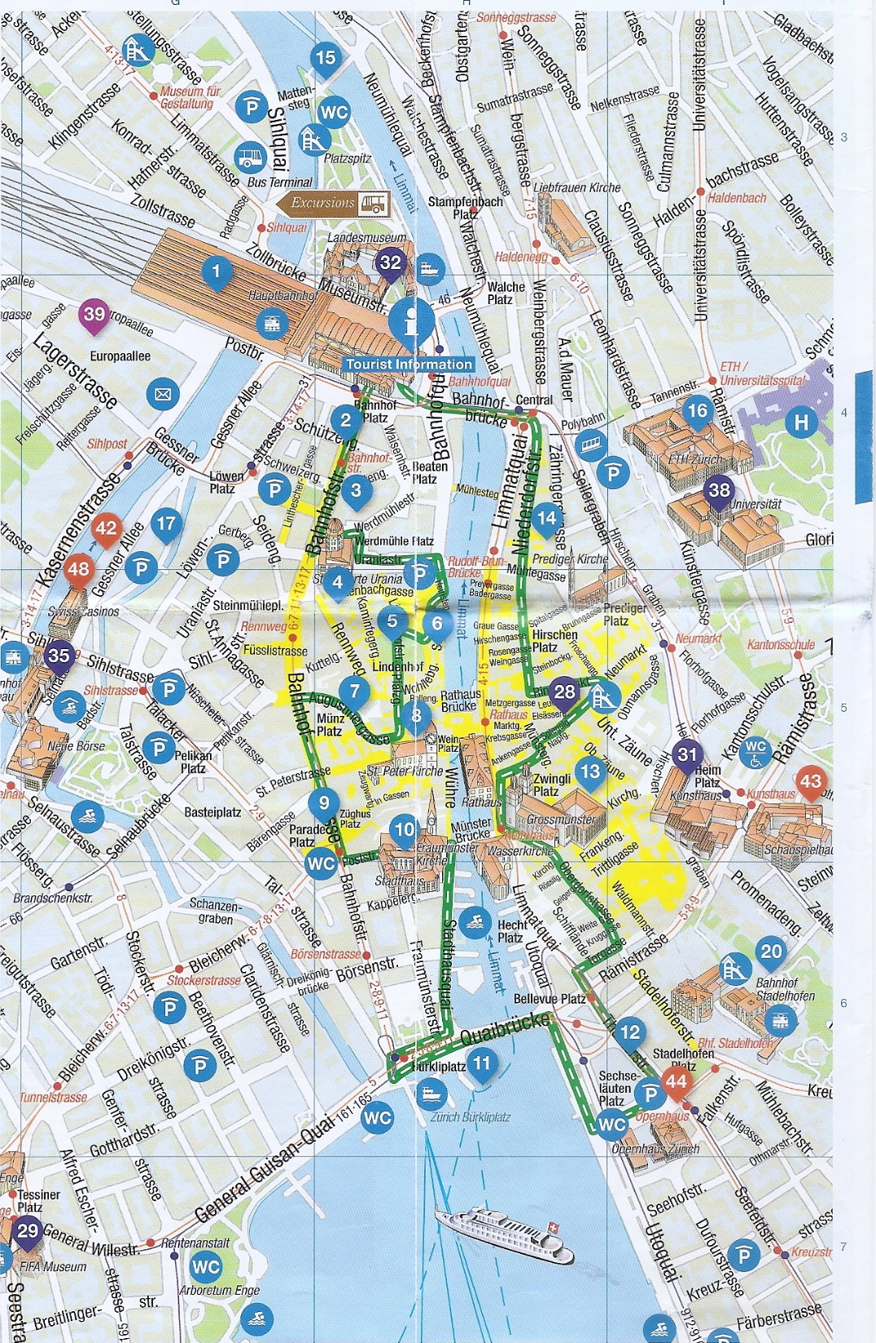
Tour Bus Trip around Zurich,
2-3-2018
TRAIN STATION
TO ALL EUROPE=>
⬅to Rhine River
OLD CITY WITHIN
GREEN LINE➔
The Rhine is a European river that begins in the southeastern Swiss alps, forms part of the Swiss border with Liechtenstein, Austria, Germany and Franco-German border; then flows through Germany and Netherlands into the North Sea.
I wonder if this has anything to do with the fact
that Switzerland is the banking center of Europe?
TO OUR HOSTEL ➔
⬅TAKE TRAM #7
INTO OLD CITY
LAKE ZURICH-
LARGE!

Slide 9
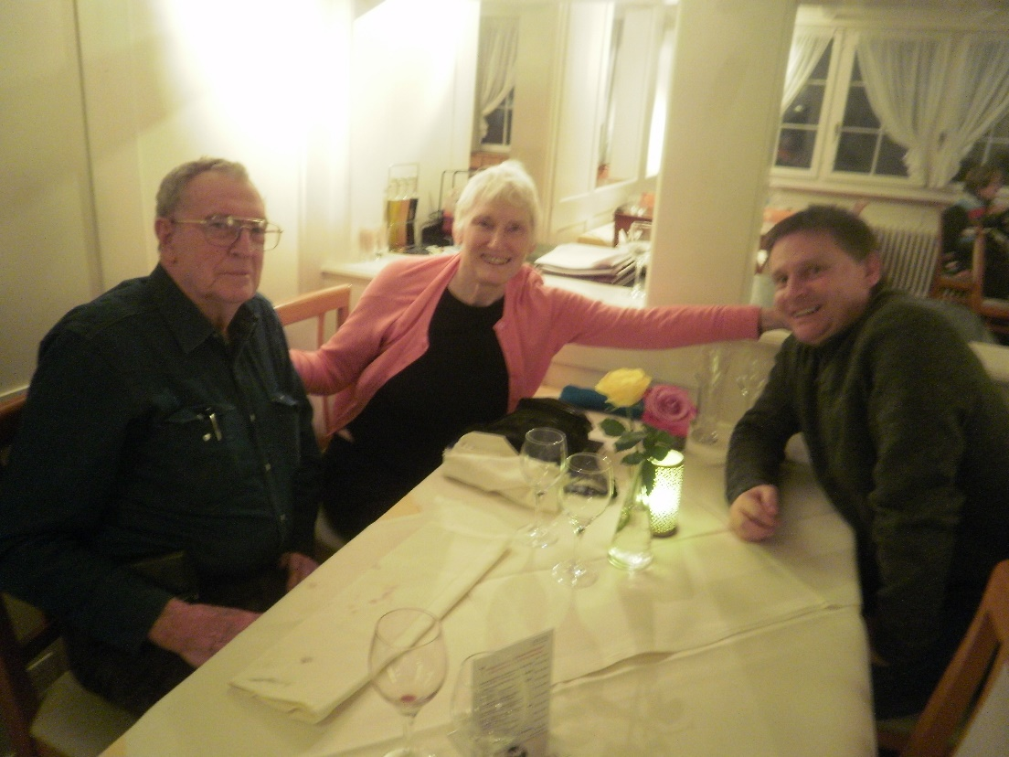
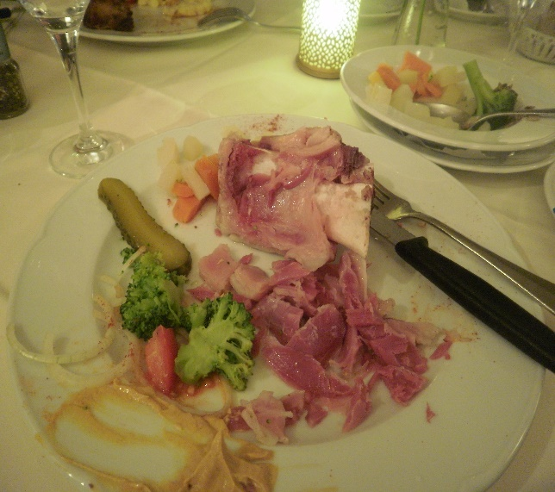
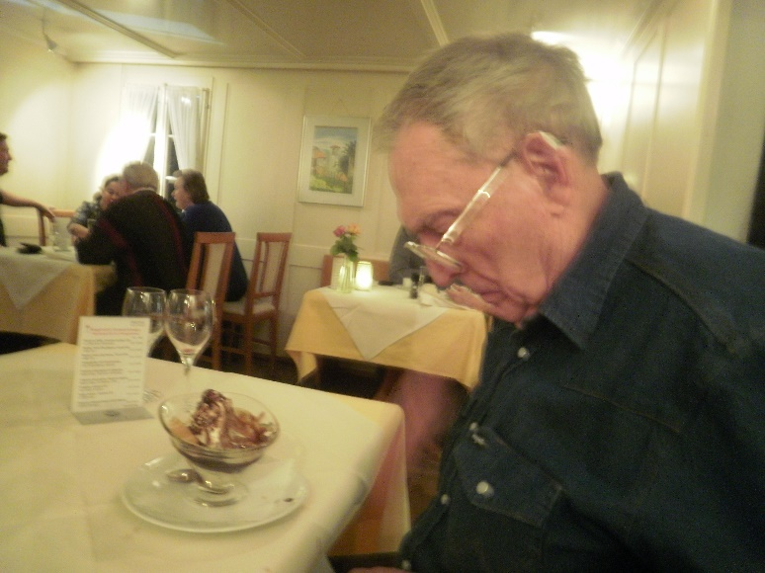
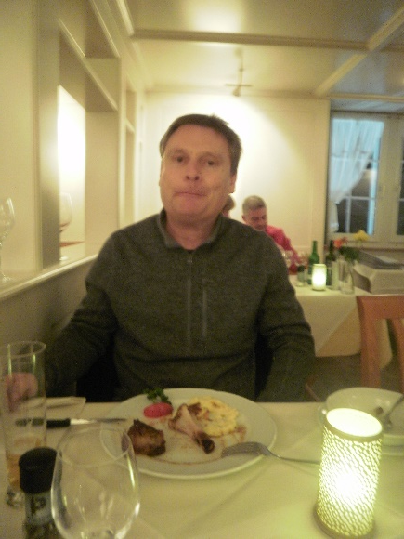
Zurich food:
The chef at our hostel was very good so we ate breakfast (free)
and dinners mostly there (12 CHFs entrée); but we celebrated being in the banking capital of Europe by going to a fancy restaurant down the road one night.
I ate pig’s knuckle, but couldn’t finish all the meat. I took the rest home but never ended up eating it, so it went into recycling.
PIG’S KNUCKLE

Slide 10
8:00 am – 17:30 pm Monday, 2-5-2018
MONETARY REFORM CONFERENCE, ZURICH, SWITZERLAND
Our Money, Our Banks, Our Country:
MONEY CREATION IN THE MODERN ECONOMY

Slide 11
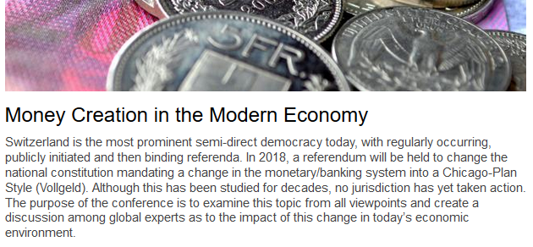
MONETARY REFORM CONFERENCE
Conference Description by Swiss GDI Think Tank,
Conference Host
My note: The Swiss Monetary Reform Initiative is not proposing the
Chicago Plan, but a direct sovereign money system.

Slide 12
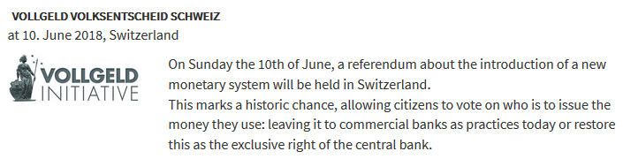
MONETARY REFORM CONFERENCE
The Swiss Sovereign Money Reform: The Vollgeld Initiative
Monetäre Modernisierung (MoMo) is the NGO that has organized the Swiss people’s initiative. The members collected over 110,000 signatures of Swiss citizens to put this question to a national vote.

Slide 13
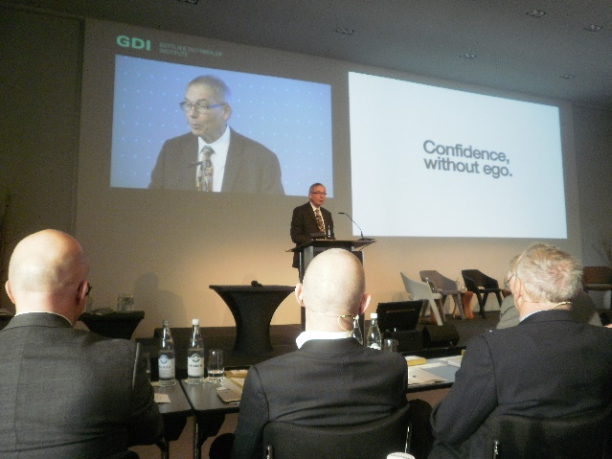
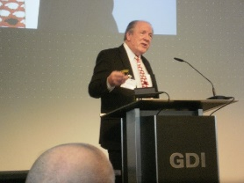
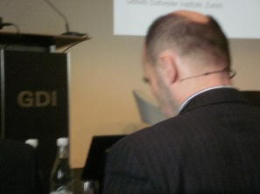
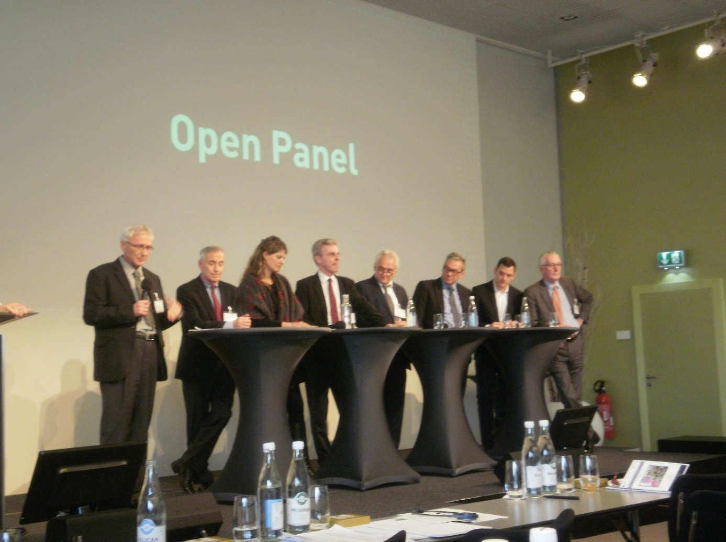
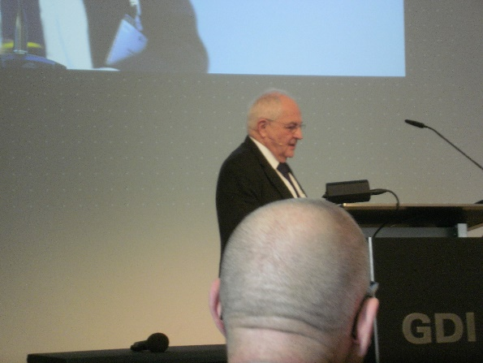
Conference participants
PANEL: “THE CURRENT MONETARY SYSTEM”
William Dunkleberg
Richard Werner
Larry Kotlikoff
William White
PANEL: VOLLGELD - ‘YES’
Joseph Huber, Katharina Serafirmova, Sergio Rossi
ULI KORTSCH, moderator
Aleksander Berentsen, Ruedi Noser, Jurg Muller
PANEL: VOLLGELD - ‘NO’
Martin Wolf,
Keynote speaker

Slide 14

The conference presented a 1996 Interview of Michael Ende,
author of MOMO
This 1973 book has been translated into 49 languages.
The NGO responsible for the Vollgeld Initiative is named MOMO
In the ruins of an amphitheatre just outside an unnamed city lives Momo, a little girl of mysterious origin. She is remarkable in the neighbourhood because she has the extraordinary ability to listen—really listen.
This pleasant atmosphere is spoiled by the arrival of the Men in Grey, eventually revealed as a species of paranormal parasites stealing the time of humans. Appearing in the form of grey-clad, grey-skinned, bald men, these strange individuals present themselves as representing the Timesavings Bank and promote the idea of "timesaving" among the population: supposedly, time can be deposited in the Bank and returned to the client later with interest. After encountering the Men in Grey, people are made to forget all about them, but not about the resolution to save as much time as possible for later use. Gradually, the sinister influence of the Men in Grey affects the whole city: life becomes sterile, devoid of all things considered time-wasting, like social activities, recreation, art, imagination, or sleeping.

Slide 15
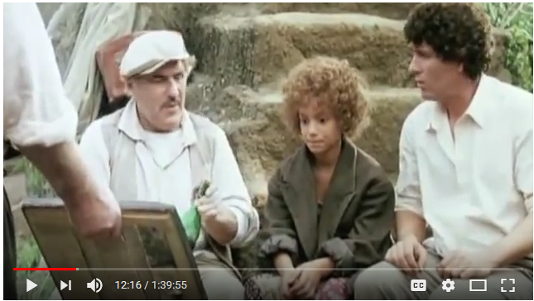
1996 Interview: author Michael Ende, MOMO
WATCH THE MOVIE, MOMO in English:
https://www.youtube.com/watch?v=8Q_JYYcBP2Q

Slide 16
Meeting with Monetary Reformers
in Zurich

Slide 17
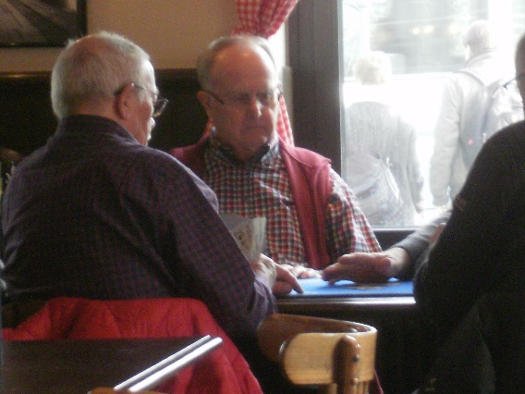
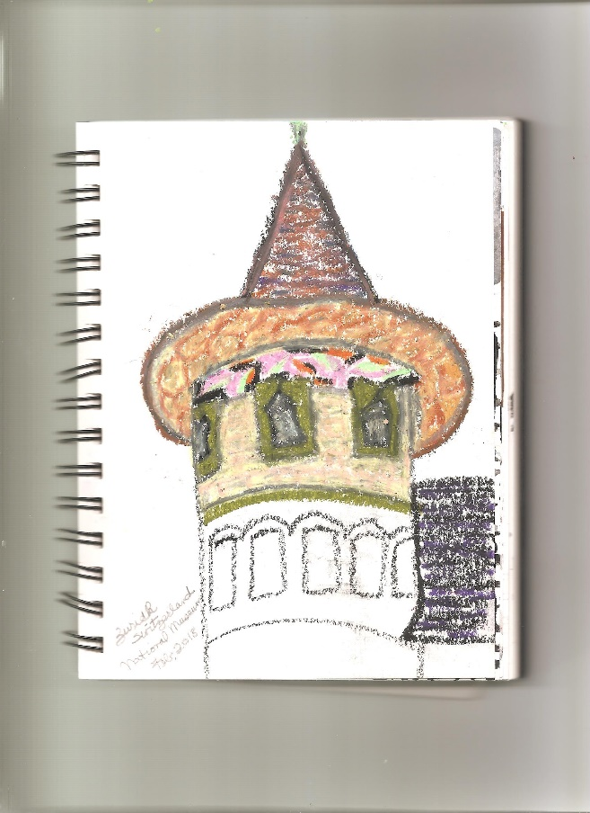
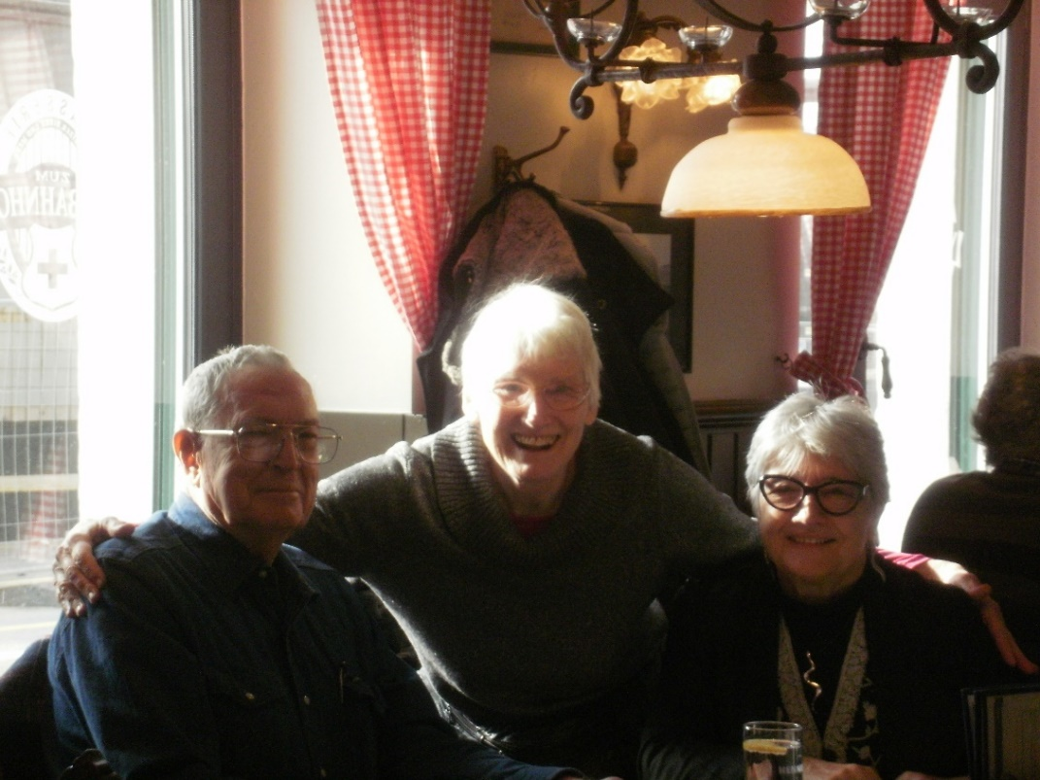
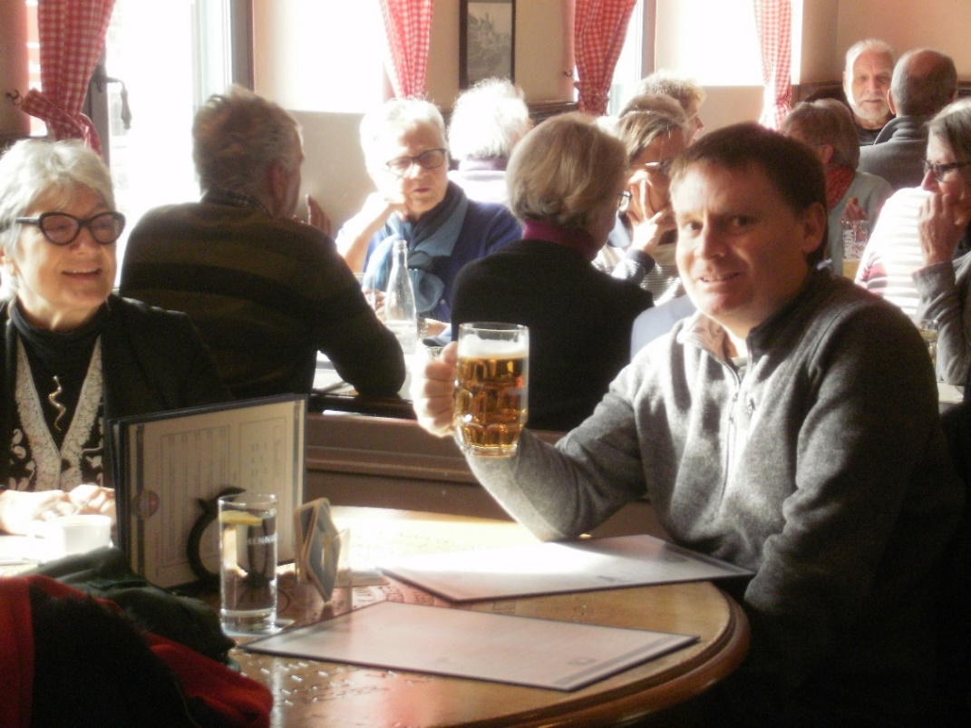
Meeting with Monetary Reformers in Zurich
Lucienne came for the conference, so the next day all us AMI-ers had lunch (and drink!)
in a restaurant near the train station, where locals hung out to talk and play cards.
While there we met with Matt Lyons of Positive Money. He is young and smart, curious and open.
He was interested in Raw Materials Economics, which related to his school thesis, and I promised
to send him some information about this.
I managed to take some time to paint a turret from the National Museum down the road.
SOME LOCALS
TURRET OF
NATIONAL MUSEUM

Slide 18
Learning from my dorm mates
in Zurich

Slide 19
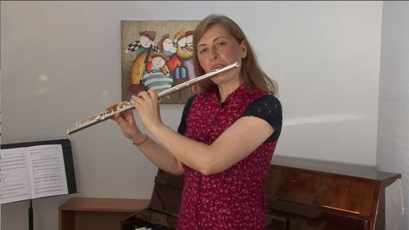

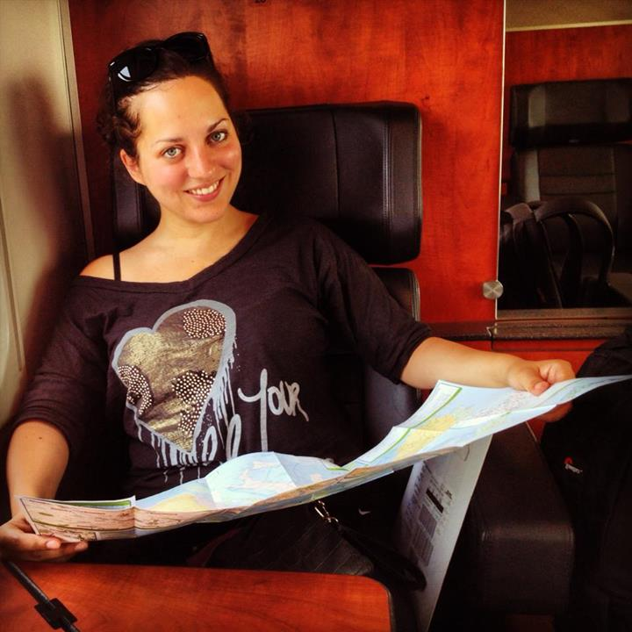
Learning from my dorm mates in Zurich
In Zurich, we stayed at the HI Hostel. I slept for 6 days in a 4-bed dorm with other women.
While there, I meet some friendly women and learned a lot from them.
Anna, Flute Teacher, Switzerland:
Amelia, Australia:
Diana, Germany:
Anna and I stayed up one night until 2am
talking. She grew up in Zurich and went
to University here. But, she studied flute
and arts and can’t find a job in her field
to support herself or afford Zurich prices.
So she lives with a friend in Berlin and
travels to Zurich to give flute lessons to
her long-time students and her major
income source.
Amelia has been travelling for about five months. She graduated with a degree in international relations. She
had dinner with us all and went with us to the Irish Pub for ‘Game Night’.
She had suggestions for funny shows on TV/youtube that could be used as monetary reform comedies. (See next slide.)
Diana had just come from
Iceland for the first time.
She spent 6 days in a rented
car traveling by herself around
the island. I found out later this is
extremely dangerous in Iceland.
She said it’s expensive so bring
cheese and other food with you.

Slide 20
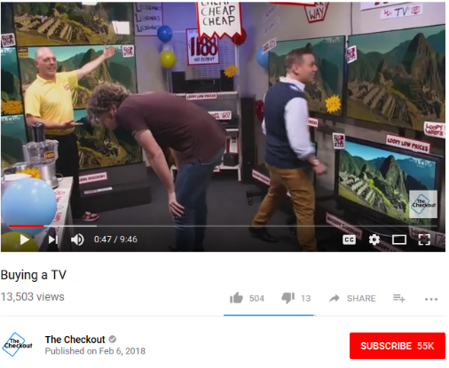
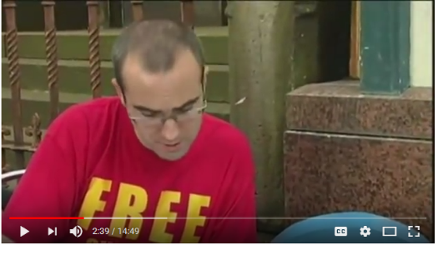
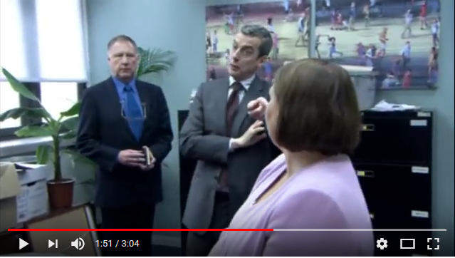
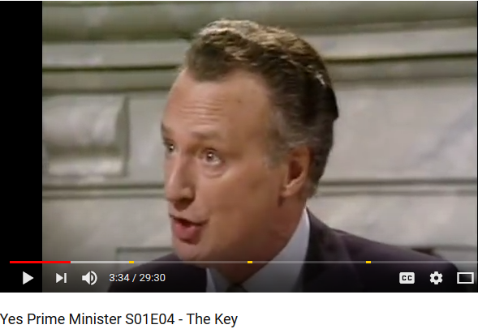
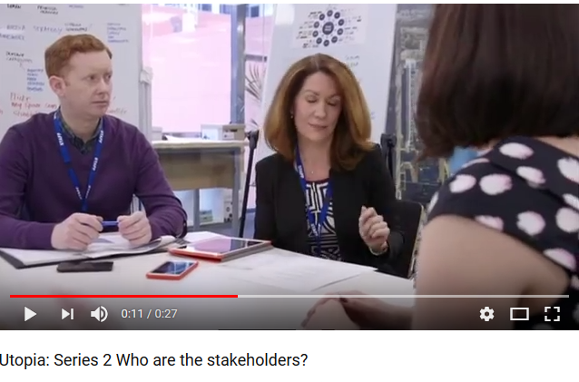
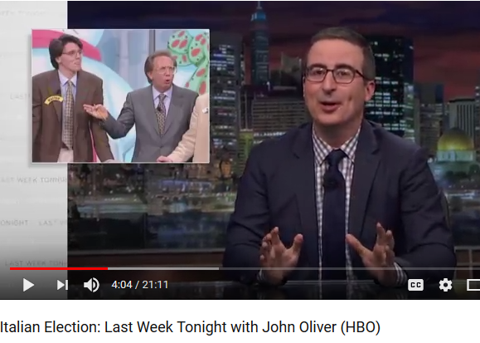

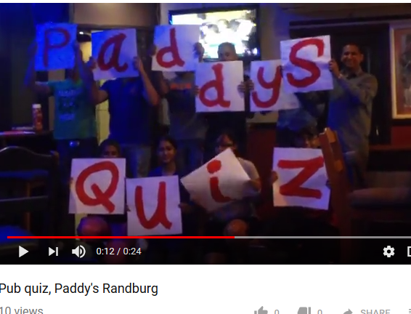
Comedy Ideas for Monetary Reform
With Amilia’s help, we made a list of funny shows, that could be models for monetary reform comedies.
Monetary Reform needs HUMOR!
THE CHECKOUT
AUSTRALIA
“Buying a TV”
THE CHASER
AUSTRALIA
“Free Gullibility Test”
THE THICK OF IT
BRITISH BBC
“Massive Data Loss”
YES, PRIME MINISTER
BRITISH BBC
“The Key”
UTOPIA
AUSTRALIA
“Who are the
Stakeholders?”
LAST WEEK TONIGHT
with JOHN OLIVER
HBO
“Italian Elections”
Music Videos
“Who Let the Dogs Out?”
by Baha Men
Irish Pub Quiz Night

Slide 21
Comedy Ideas for Monetary Reform
WHAT ARE YOUR IDEAS?
THE CHECKOUT
AUSTRALIA
“GOING TO THE BANK”
THE CHASER
AUSTRALIA
“Free Money”
THE THICK OF IT
BRITISH BBC
“Massive Money Loss”
YES, CENTRAL BANKER
BRITISH BBC
“The Key”
BANKTOPIA
AUSTRALIA
“Who are the
Shareholders?”
LAST WEEK TONIGHT
with JOHN OLIVER
HBO
“Where has the Lira Gone?”
Music Videos
“Who Let the Bankers In?”
by Baha Men
Irish Pub
Bank Quiz Night

Slide 22
On a high-speed train from Zurich to Bologna, Italy
Wed. 2-14-2018 (afternoon)

Slide 23
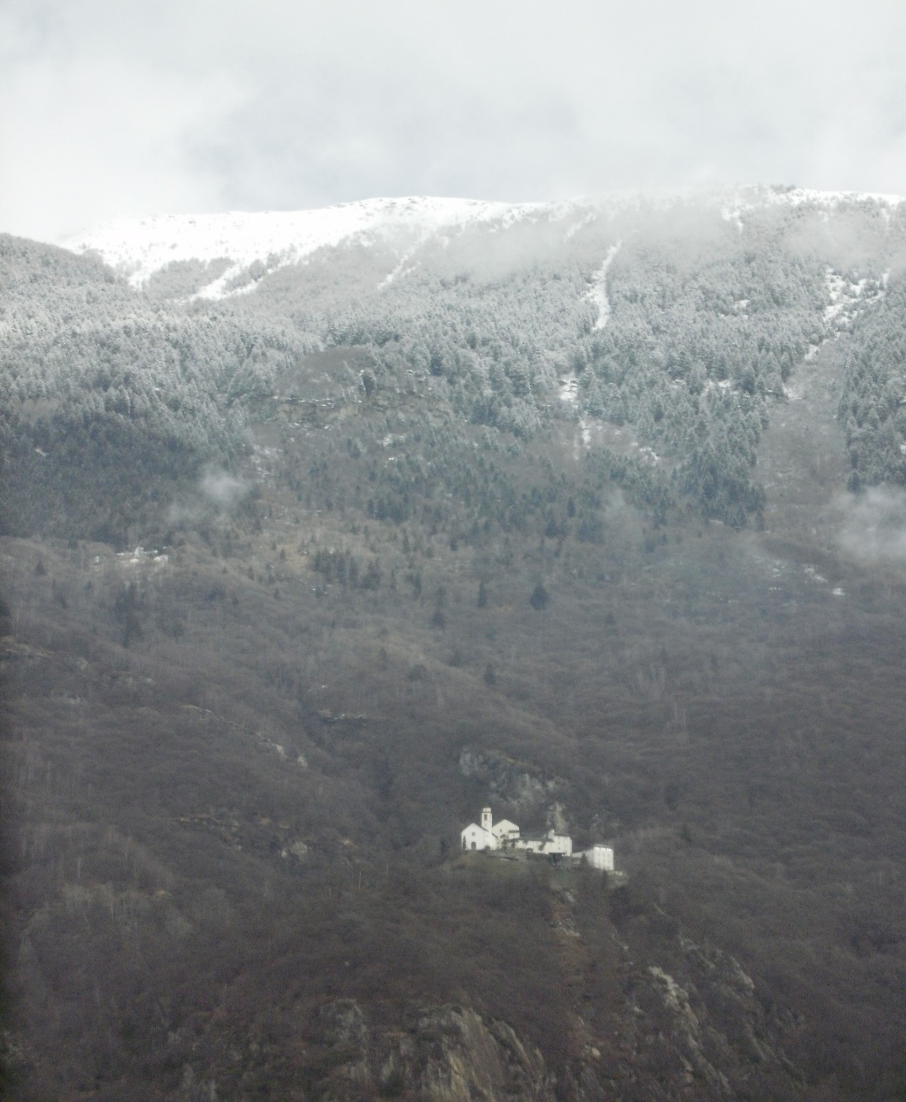
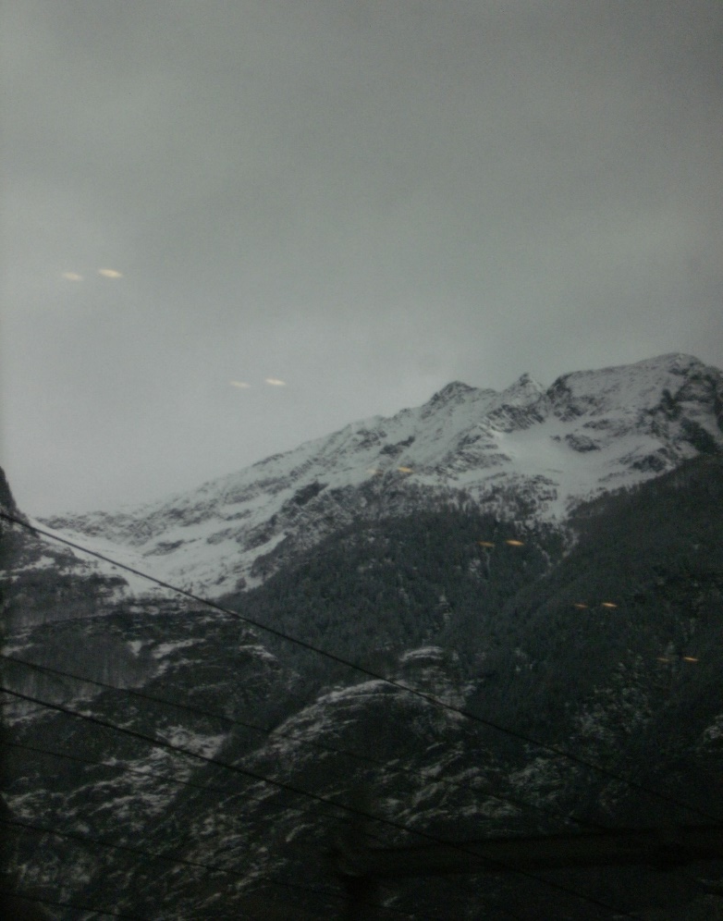
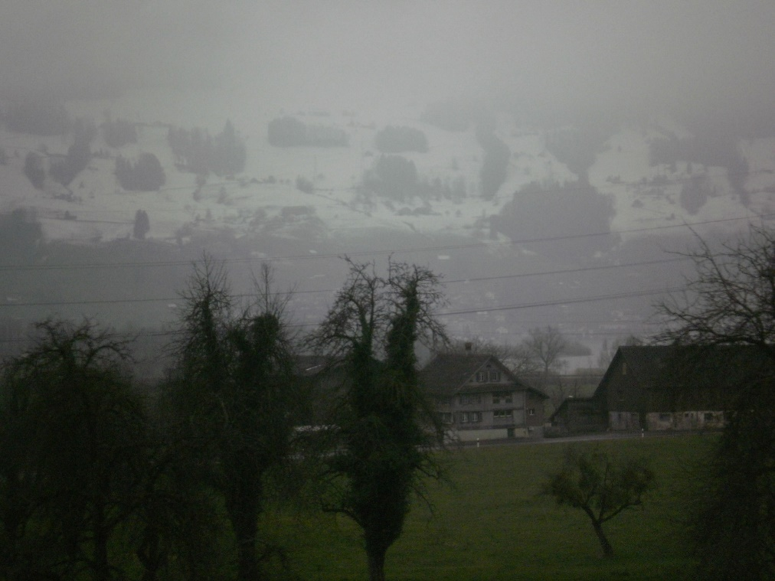
SWITZERLAND

Slide 24
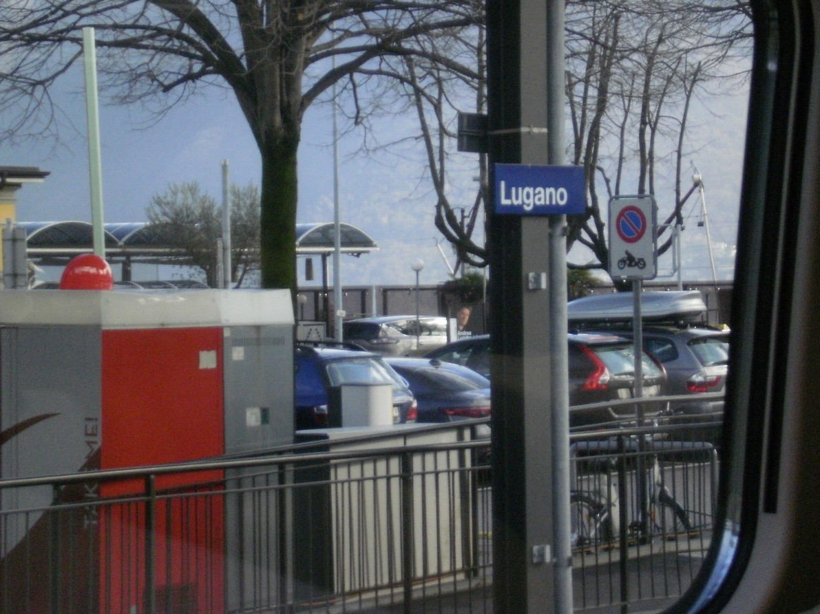
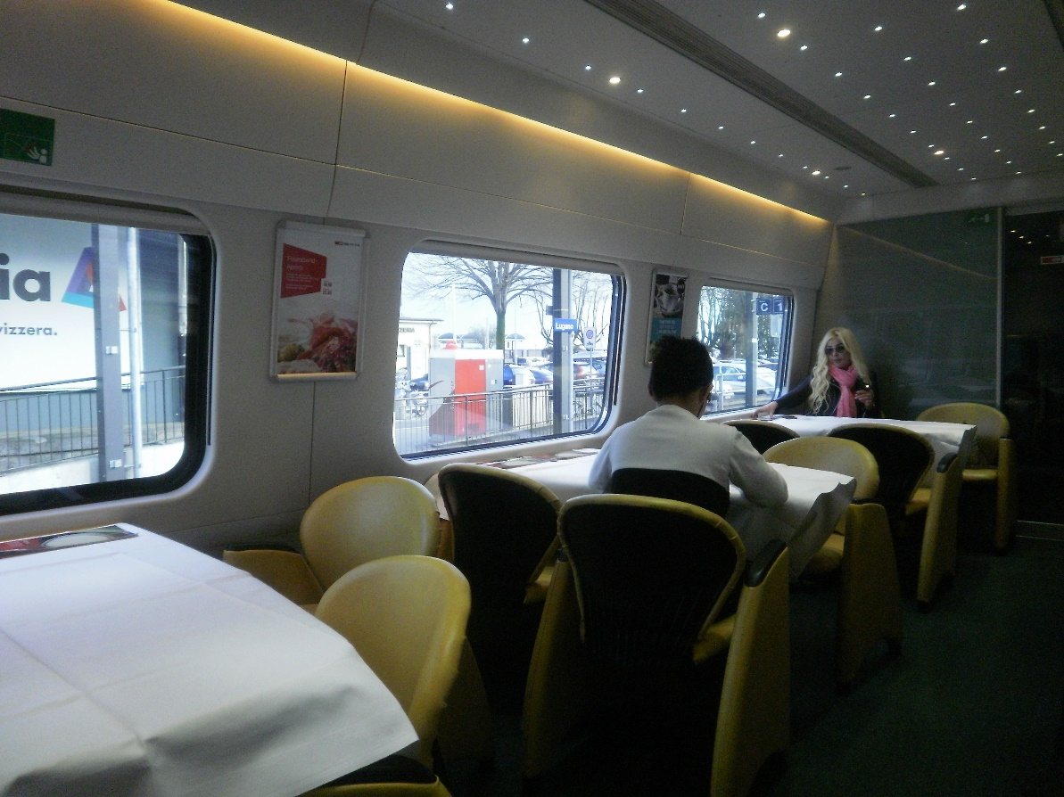
SWITZERLAND
We passed thru Lugano, Switzerland – Lugano is found in southern Switzerland, the residents speak Italian, and the city is close to the Italian border..

Slide 25
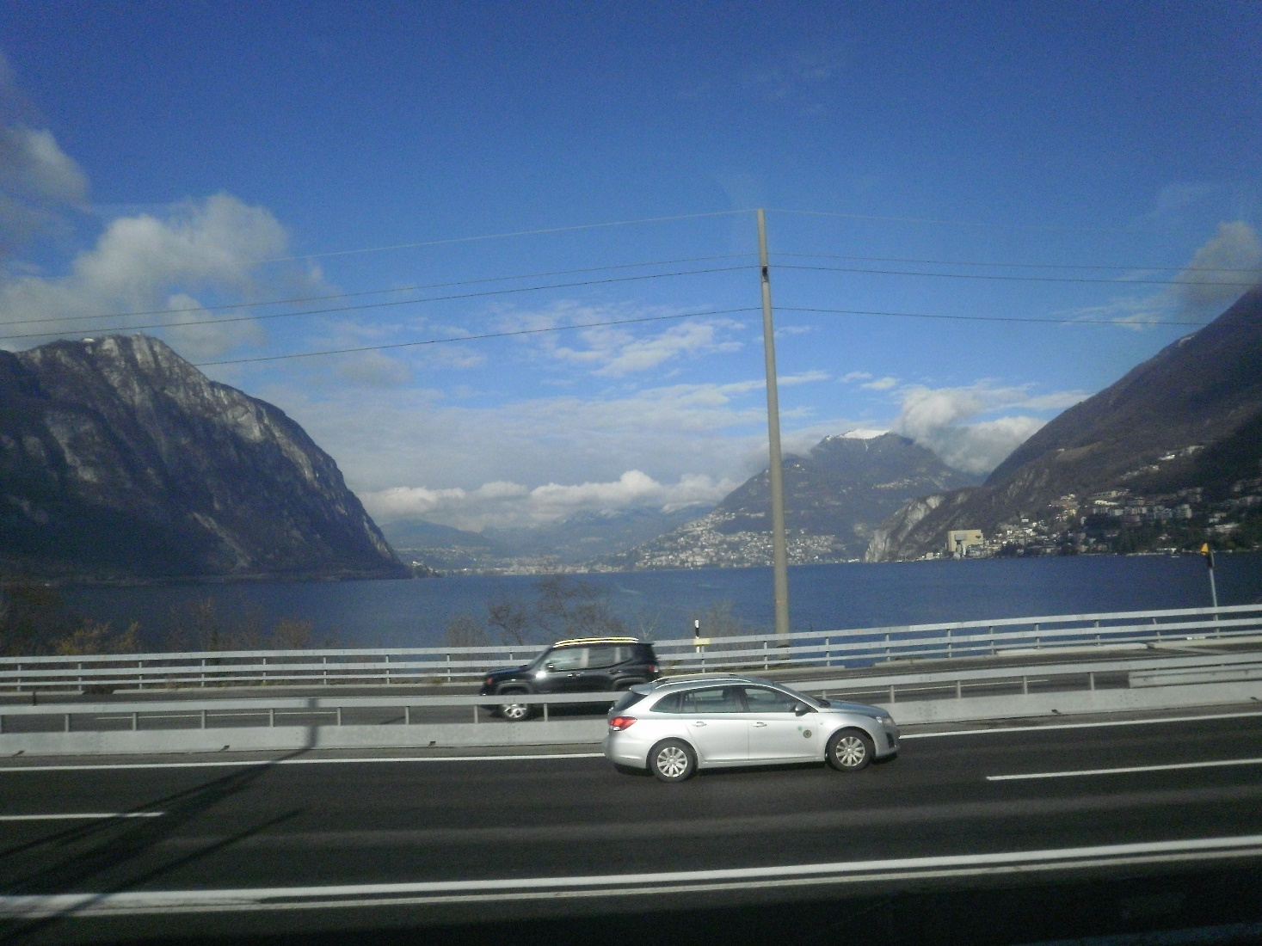
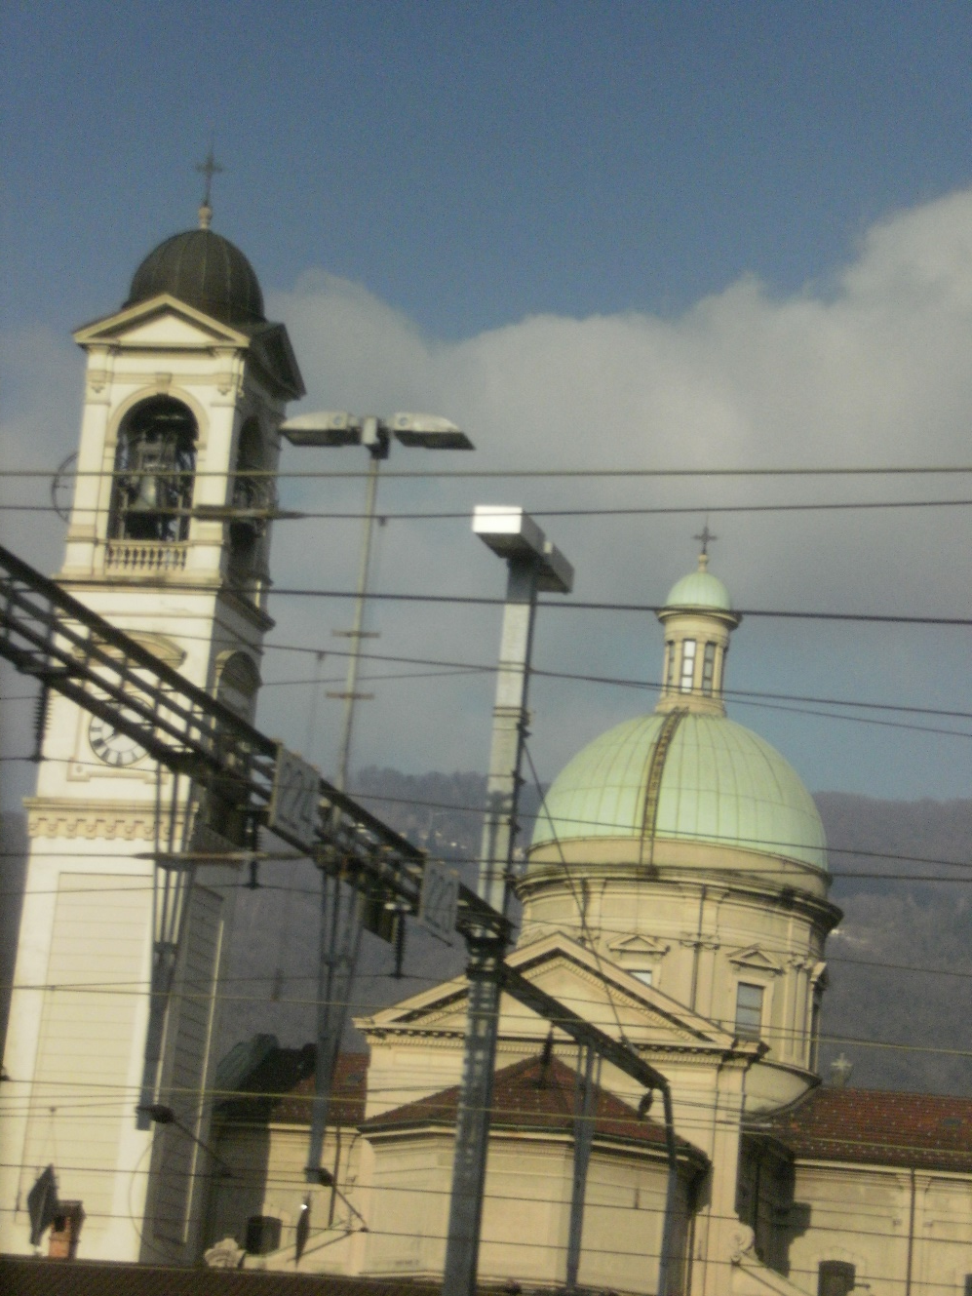
SWITZERLAND
Lugano is on Lake Lugano
surrounded by mountains

Slide 26
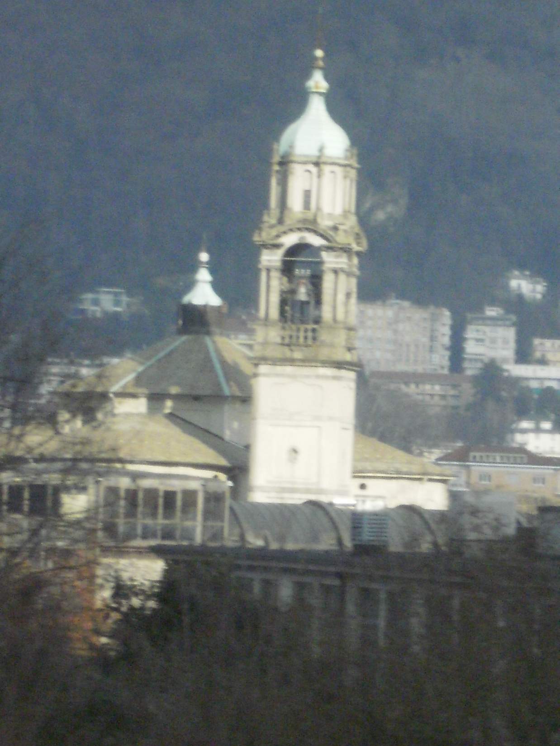
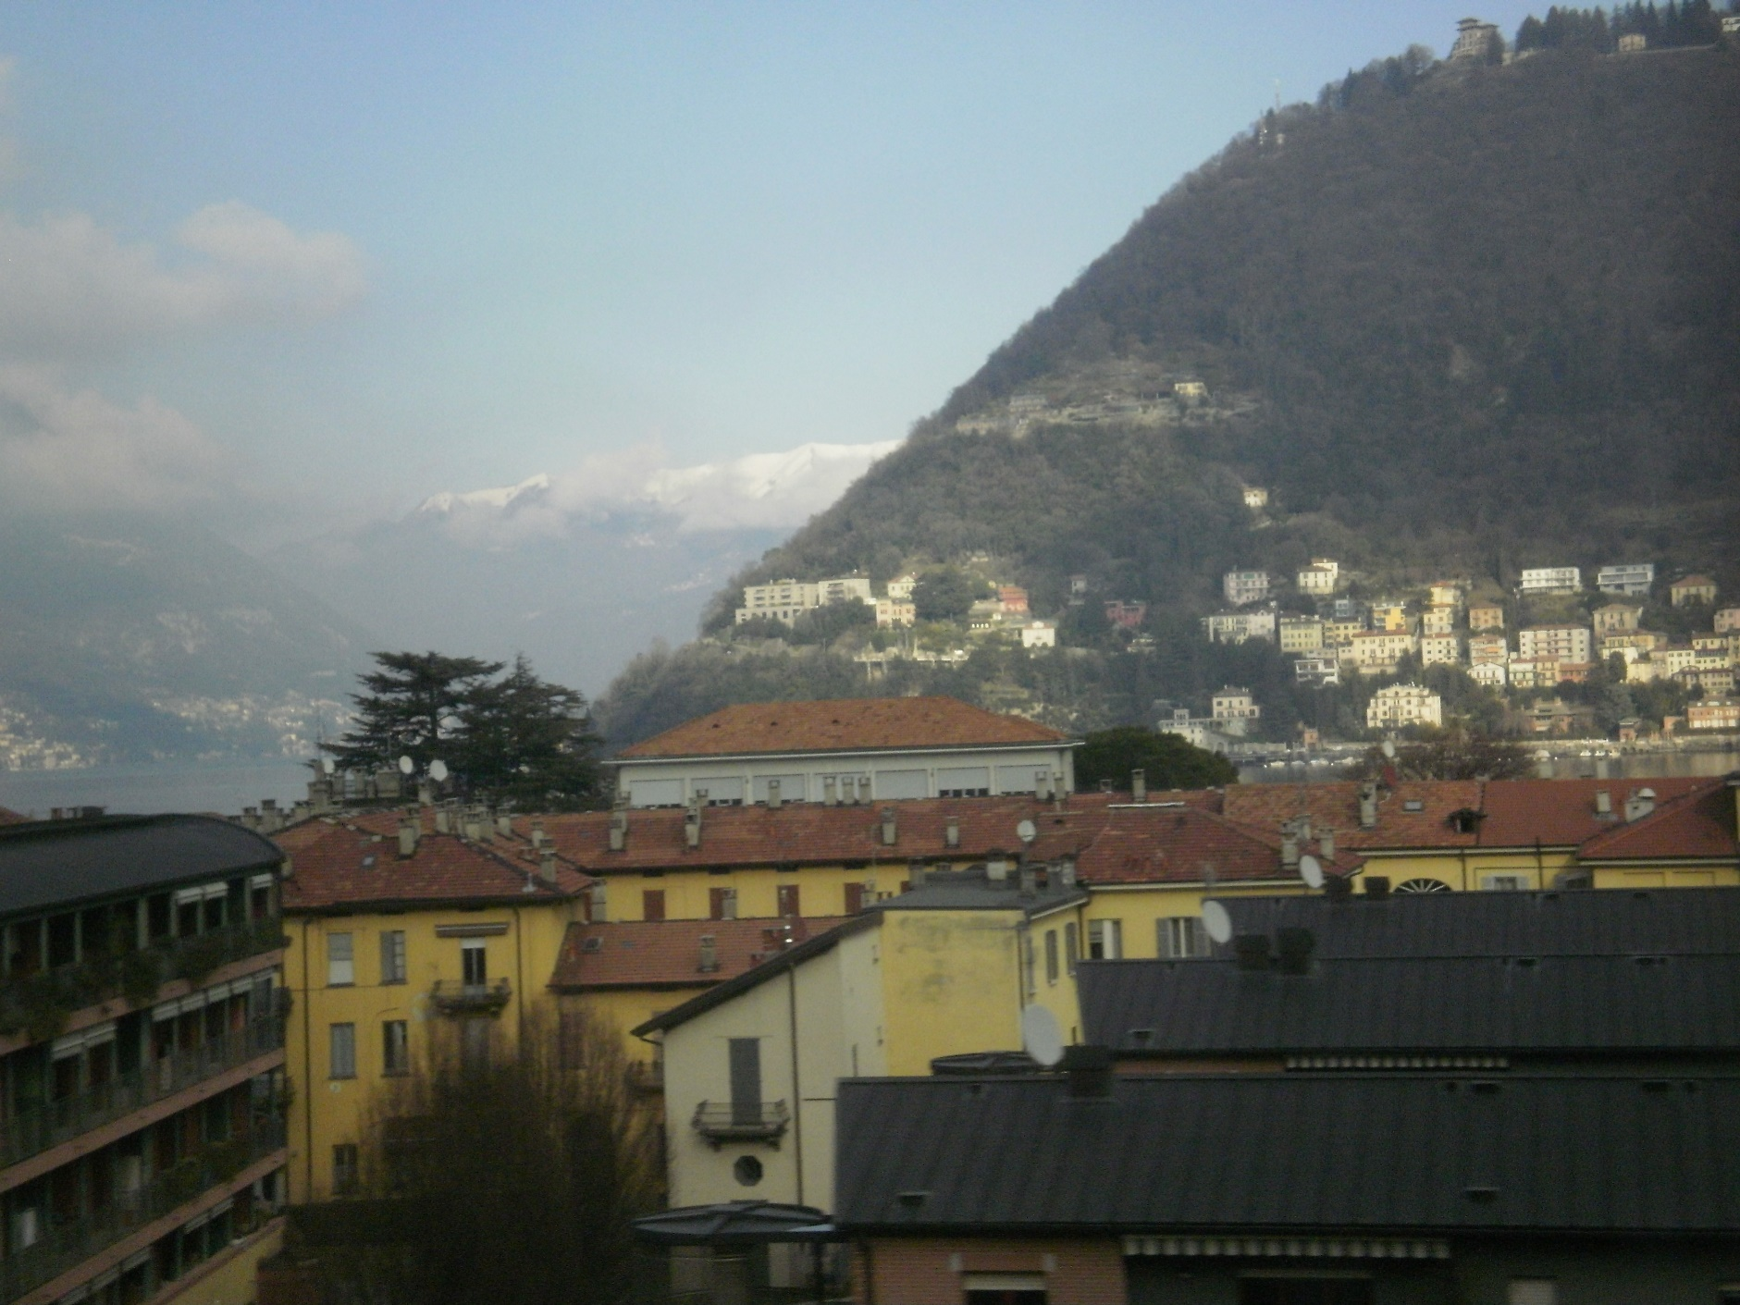
NORTHERN ITALY

Slide 27
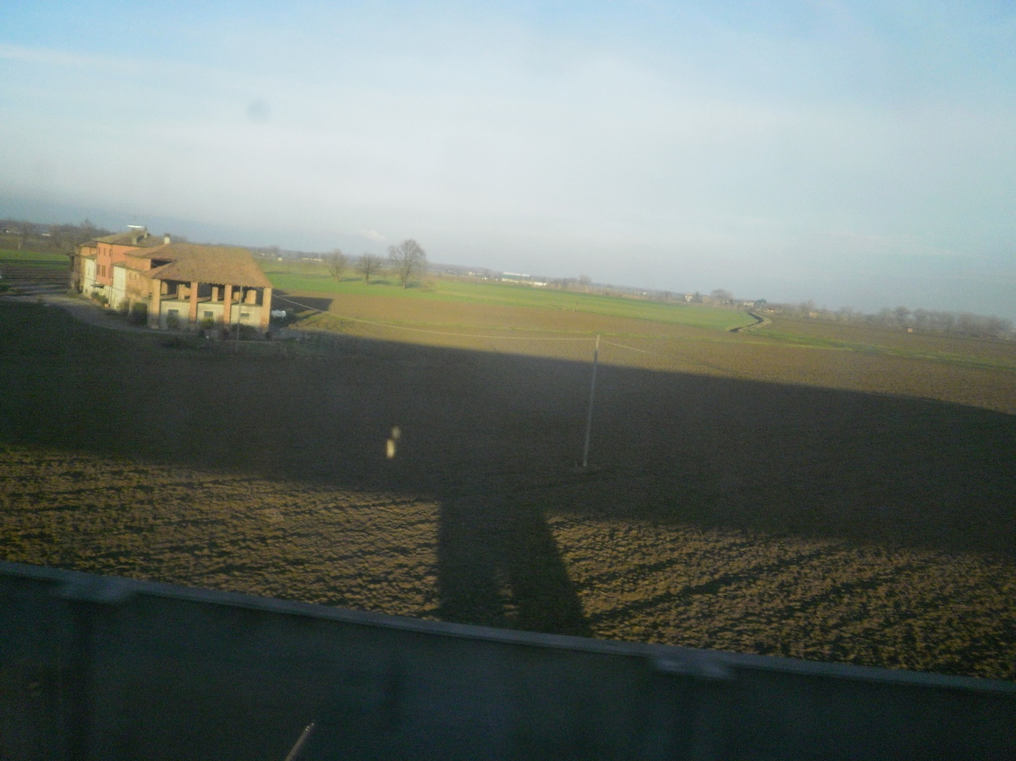
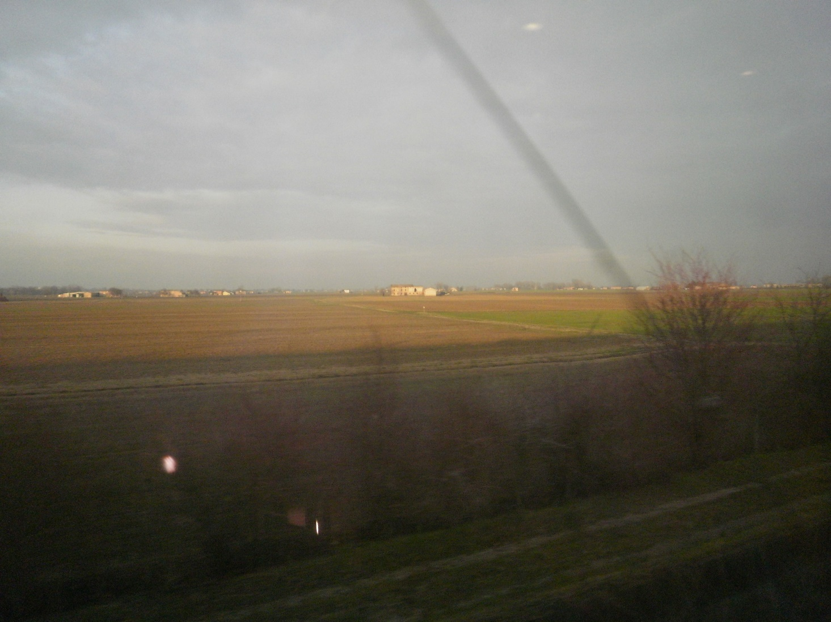
NORTHERN ITALY: CLOSER TO BOLOGNA – IT IS FLAT FARM LAND ALL OVER

Slide 28
Bologna, Italy
Wed. 2-14-2018 (late afternoon)
to
Thurs. 2-15-2018 (late morning)

Slide 29
Meeting Monetary Reformers
in Bologna

Slide 30
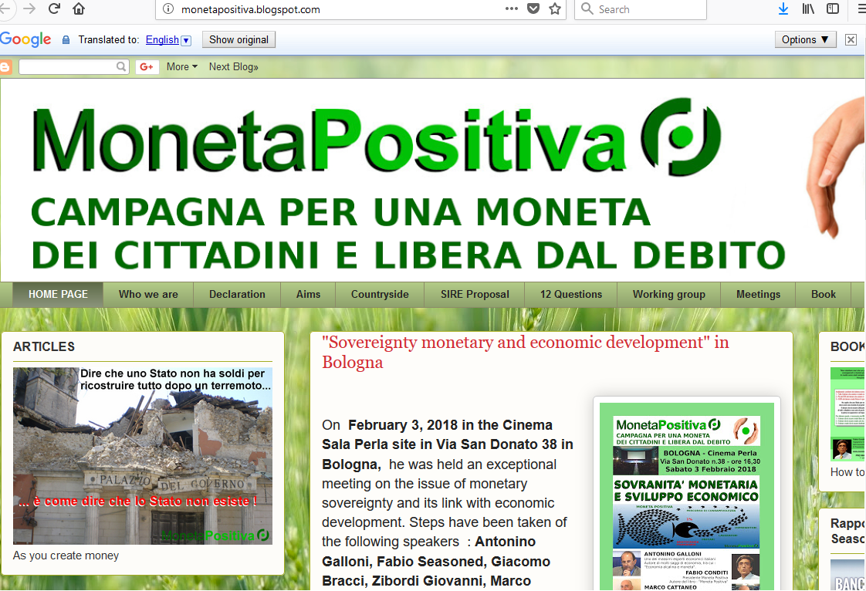
Monetary Reform - BOLOGNA, ITALY
Two Italian monetary reformers – Giovanni and Fabio of the organization, Moneta Positiva –
met us at the train station and drove us to our hostel.
Giovanni and Fabio –
Moneta Positiva
Both give many public talks and gets many people to come
monetapositiva.blogspot.com
look them up on YOUTUBE
(in Italian)

Slide 31
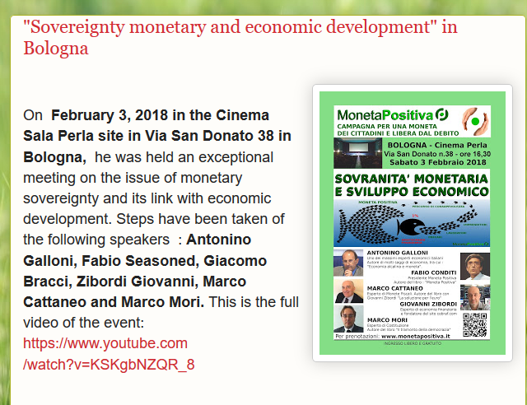
Monetary Reform - BOLOGNA, ITALY
⬅FABIO
⬅GIOVANNI

Slide 32
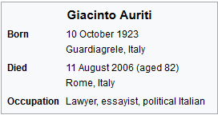
Monetary Reform - BOLOGNA, ITALY
Giovanni and Fabio shared some of the history of Monetary Reform in Italy.
Their mentor was Professor Auriti.
https://en.wikipedia.org/wiki/Giacinto_Auriti
In the 90's, Giacinto Auriti conducted a series of initiatives as Secretary General of the "Union of Anti-wear" (saus) and as legal representative of the cultural association "Alternative social property of people.“
He bought a suit against the privately owned Bank of Italy in the Court of Rome. The Bank of Italy opposed the request. The request is rejected and the Court of Rome condemns Auriti to pay the legal costs.
Would someone like to research
this history for our archives?
Can you read Italian?
Let’s keep our monetary reform
history alive.

Slide 33

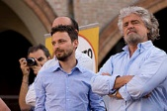
Monetary Reform - BOLOGNA, ITALY
Giovanni and Fabio spoke of Beppe Grillo and the Five Star Movement in Italy.
Beppe Grillo was a famous standup comedian known throughout Italy in the 1980’s.
In 2005 he began to build the largest political party in Italy today, M5S – The Five Star Movement.
It has 200 people in Parliament today.
In the 1990’s, Grillo spoke about monetary reform and how the banks
created our money. Listen to: https://www.youtube.com/watch?v=U6XeBY-d2gM
BUT IN 1998, HE STOPPED TALKING ABOUT MONEY.
He is not considered supportive to monetary reform today.
⬅Beppe Grillo, 2011
Would someone like to research
this history for our archives?
Let’s keep our monetary reform
history alive.

Slide 34
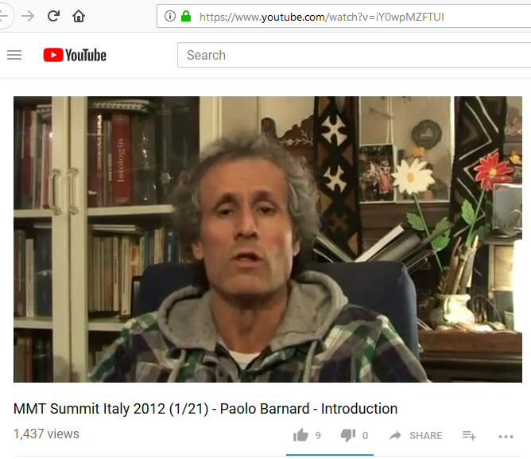
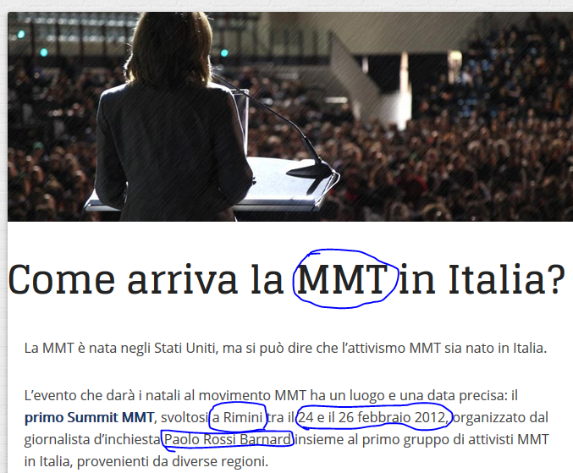

Monetary Reform - BOLOGNA, ITALY
Giovanni and Fabio spoke of Warren Mosler and MMT in Italy. MMT has been promoted by the Italian journalist Barnard, who organized the first MMT summit 2-24 to 2-26-2012 in Rimini
with Hudson, Kelton, Bill Black, etc.

Slide 35


Monetary Reform - BOLOGNA, ITALY
Barnard has organized more MMT conferences –Treviso, Italy
& Mosler in Venice, Italy

Slide 36

Monetary Reform - BOLOGNA, ITALY
Sovereign Money in the Italian News:
Several months ago, the Italian newspaper,
MICROMEGA, had an article on the
Swiss monetary reform Vollgeld Initiative

Slide 37
Dining Out in Bologna

Slide 38

Dining Out in BOLOGNA, ITALY
This young lady was from Eastern
Europe. The economy is very
bad there.
There were many young people from
Eastern Europe who were working
throughout the cities of our trip
as guides, waitresses, and other
service workers.
They all said they have a better
paying job here than back home.
Back home, prices are too high and
incomes very very low.
P.S. I think Bob took her name and
number if you want to reach her.

Slide 39


Walking in BOLOGNA, ITALY
The city is old and full of marble sidewalks, arches all over,
columns, and brown, orange, cream buildings.

Slide 40

Walking in BOLOGNA, ITALY
There’s the cowboy hat…..➔ ➔

Slide 41

Our hostel in BOLOGNA, ITALY
Quite a modern room
with black and white decor!

Slide 42



Our hostel in BOLOGNA, ITALY
The guys fell asleep…
…and I had fun painting them!

Slide 43


Our hostel in BOLOGNA, ITALY
BOB
JAMIE

Slide 44
Taking High Speed Train to Rome
Thurs. 2-15-2018

Slide 45

High Speed Train to Rome
My camera battery was dead, so I took no pictures, but I drew quick sketches….

Slide 46
High Speed Train to Rome
12:25 pm leave Bologna (for Rome)
mostly tunnel @ 300 klm/hour
glimpses of leaving mountains
old old buildings amidst newer
near Firenze – 8 story or more modern apartment buildings
in train station see lots of graffiti on buildings
palm trees on patios of apartment buildings!
buildings with shutters around windows all around
hanging laundry on patios
Leaving Florence rail station (for Rome)
rolling green hills on way to Rome – lots of pine trees
cows in shed outside train tunnel
sheep in fields
big river winding on small steep hills
private estates of very old buildings
lots of fields with rows up and down hills – for growing grapes?
greenhouses
some industry in certain areas, then horses
and wrote short descriptive phrases all the way – it was so so beautiful

Slide 47
End
Week 1: Zurich, Bologna

