Slide 1
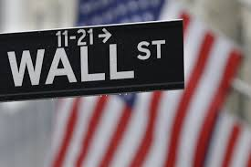


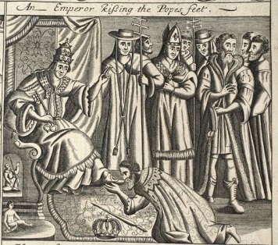

Vote ‘NO’ to Proposal #922…..
Keep ‘Greening the Dollar’
in the platform
Give our nation debt-free money
BANKING SYSTEM
CORPORATIONS
PRIVATE BANKS CREATE MONEY WHEN THEY MAKE LOANS…
AND EMPOWER THE CORPORATIONS

