Slide 1


Sue Peters
Thursday 10-25-2018
AMI Conference, Chicago, Ill.
“Recent History of MMT in Green Party US”

Slide 2
TABLE OF CONTENTS
  2000-2010 History of ‘Greening the Dollar’ platform plank
  2017 MMT into GPUS
    March David Cobb (Green News Network): interviews MMT, AMI, PBI
    July MMT Panel: GPUS Annual Meeting, Newark, N.J.
    Dec. Nebraska GP: approves resolution for MMT national platform changes
  2018 MMT defeated (for now)
    April NB and TN request “advisors”
    May GPUS Platform Committee accepts Nebraska platform changes
    June-July GPUS National Committee discusses/votes
  Future Organizing
    Nov. 2018 State Parties: will request GPUS to create new standing committee:
    Committee on Banking and Monetary Reform
PART
1
2
3
4

Slide 3
PART 1
2000-2010
History of ‘Greening the Dollar’

Slide 4
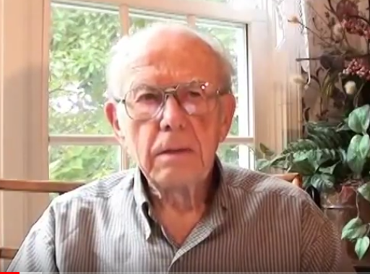
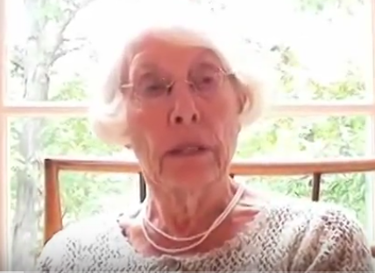
2000 & 2007
Missouri Greens Ben Kjelshus and Dee Berry met and heard Stephen Zarlenga
give a talk on Monetary Reform in Kansas City, Missouri
Ben Kjelshus
Dee Berry
Dee Berry: “I was impressed with what I heard and saw the fit with the Green Party.”

Slide 5

Summer 2007
Steve Zarlenga gave talk on monetary reform
at GPUS Annual Meeting in Reading, PA.
Dee Berry:
“Well received, but we realized it required considerable
educational process for GP.”
Title:
Greening the Dollar:
How Monetary Reform Could Restore
and Solidify Our Democracy
Presenter:
Stephen Zarlenga

Slide 6
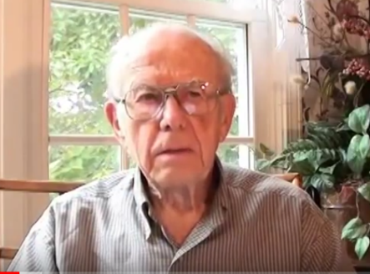
2008 - 2010
Dee Berry and Steven Zarlenga worked together
to educate Greens and add ‘Greening the Dollar’ to the National Platform
Dee: “The monetary system is an invisible system. People are made to think
they can’t understand it.”
Ben: “The Greens have a systems approach for serious problem change.
The AMI message can contribute tremendously.”

Slide 7

AMI message
became part of
2010 GPUS National Platform
2010
The crisis in our financial system makes it imperative that we
restructure our monetary system.
It is both possible and necessary for our government to take back its special
money creation privilege …
end the privilege banks now have to create money..

Slide 8
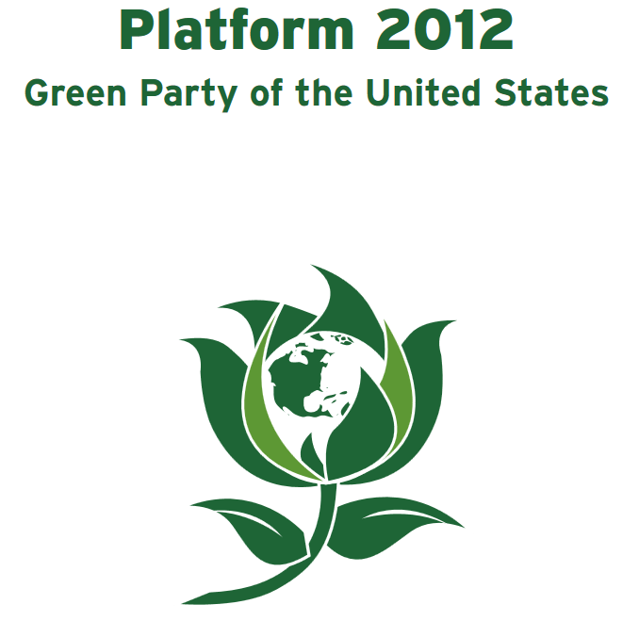
“Greening the Dollar”
becomes part of
2012 GPUS National Platform
Monetary Reform (Greening the Dollar)
The crisis in our financial system makes it imperative that we restructure our monetary system.
.....
15 Nationalize the 12 Federal Reserve Banks, …..
end the privilege banks now have to create money
The new money that must be regularly added….
assure a fair distribution of such expenditures
across the United States, creating good jobs…

Slide 9
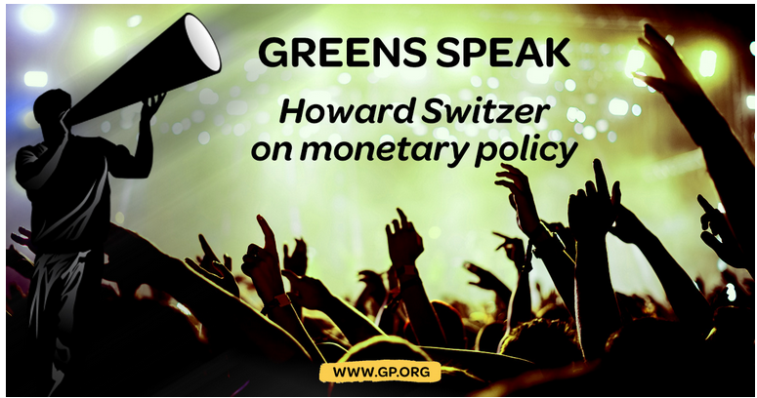
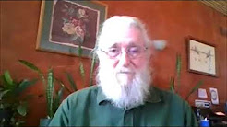
HOWARD SWITZER
GP Voice for
True Monetary Reform:
“To have control of public policy, the public must control the monetary system.”
AMI’s Howard Switzer is a 2001 founding member of the Tennessee Green Party.
In 2007 he heard Stephen Zarlenga talk at the Reading, PA, Green National Meeting.
In 2013 Stephen called him up and invited Howard to the AMI conference. At the conference, Howard bought LOST SCIENCE OF MONEY. Since reading the book, he has been a constant presence on the GP National Committee listserv, connecting issues caused by the bank-run monetary system to solutions in “Greening the Dollar” .

Slide 10
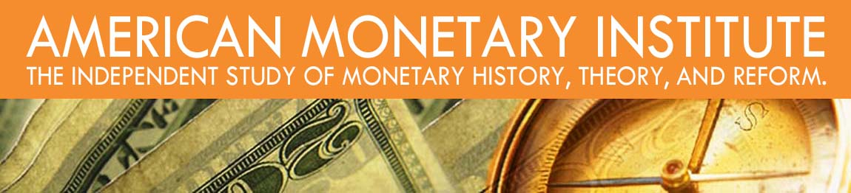
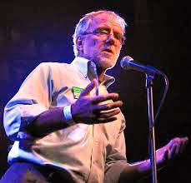
AMI 2015 Conference
Greens offered discount
Howie Hawkins keynote speaker
Howie Hawkins, a well-known Green, gave the keynote speech, on the history of third parties in U.S. history, including the Greenback Party.
Howie knows the history of money very well.

Slide 11
The AMI Conference of 2015
invited Green Party members to participate
After Howie’s talk,
during the Q&A, we asked him:
“Howie, what should we do next?”
His answer: “Create a website to teach people about money, and about the NEED ACT in the Green Party National Platform. But one thing … KEEP IT SIMPLE!

Slide 12
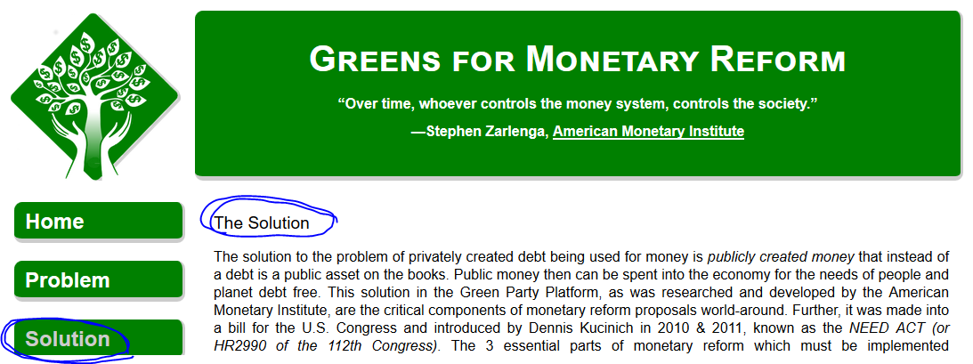
Today, we have the website…. GreensForMonetaryReform.org
Nationalize the 12 Federal Reserve Banks
End bank creation of money
The federal government creates and spends money into the economy,
for the needs of the nation and its people.

Slide 13
PART 2
2017
MMT into Green Party

Slide 14
March, 2017
DAVID COBB’s Internet Show

Slide 15
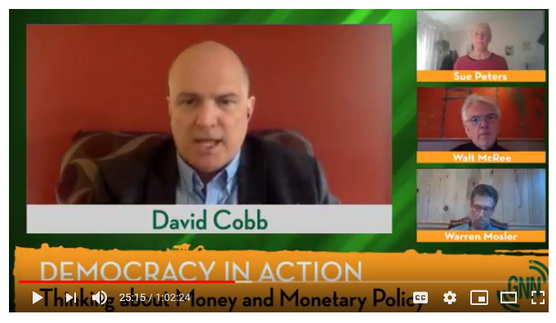
“Thinking About Money and Monetary Policy”
GREEN NEWS NETWORK
Warren Mosler MMT
Sue Peters AMI
Walt McRee PBI

Slide 16
July 2017
Green Party US ANNUAL MEETING
Newark, N.J.

Slide 17
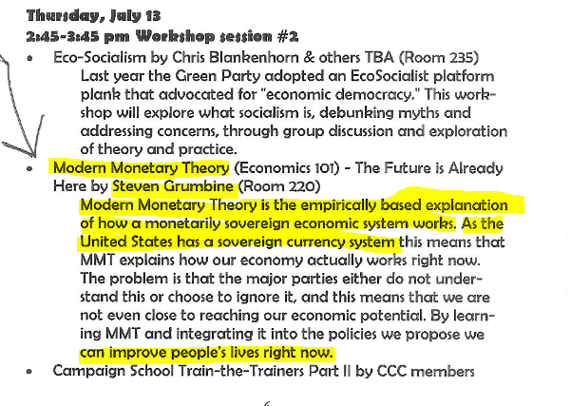
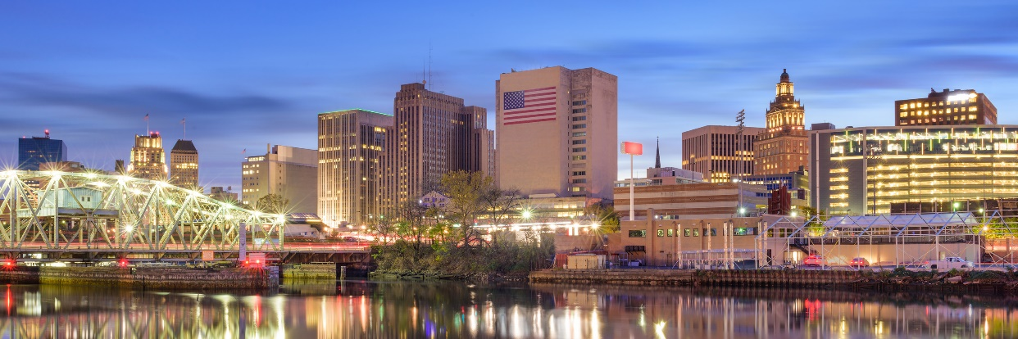
MMT Workshop on “Enabling a Green New Deal”
NEWARK, NJ -- JULY, 2017

Slide 18
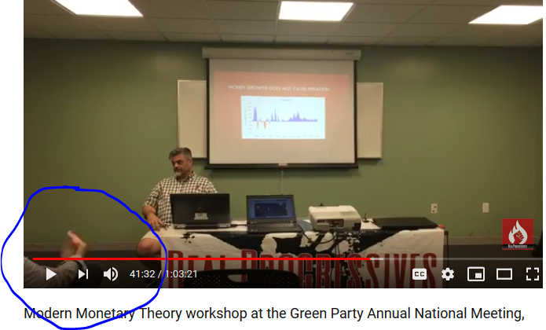
“MMT 101 – The Future Is Already Here” with Stephen Grumbine
THEMES OF THE MMT TALK:
The U.S. has a sovereign monetary system and
is the sole issuer of the currency.
Politicians are to blame because they do
not know or chose to ignore the government’s
power to create money.

Slide 19
“MMT 101 – The Future Is Already Here” with Stephen Grumbine
Steven Grumbine:
“QE is nothing more than rearranging the
chairs on the deck.”
Sue:
“No, when the Fed Reserve Banks create reserves
and buy bad debt off the multinational banks,
this QE is making the banks stronger.”
Steven Grunbine:
“QE does not add new net financial assets.
It is just shifting debt around. Nothing more.”
At this point, “one of the audience” in the front ➔
row indicated to Steven Grumbine with his hand
to just go on and don’t answer me any more.

Slide 20
PART 3
2018
MMT submits multiple amendments to GPUS National Platform

Slide 21
April, 2018
“Advisors to national committee”
approved to post on National Committee Listserv
In the GPUS, a state party can submit changes to the national platform;
requirements include:
format approval by Platform Committee
approval by Steering Committee
discussion and vote by 130+ members of National Committee

Slide 22
April 8, 2018 – GPUS Steering Committee
Approves 2 Advisors for Nebraska
Fadhel Kaboub
Dr. Joseph Firestone
Passed by consensus of the Steering Committee.
April 22, 2018 – GPUS Steering Committee
Approves 2 Advisors for Tennessee
Sue Peters
Joe Bongiovanni
Consensus could not be found. Passed by vote.

Slide 23
June/July, 2018
Discussion/Vote on NB MMT Platform Amendments

Slide 24

BEFORE WE BEGIN….
HERE WAS THE OUTCOME FOR THE 5 NB MMT PLATFORM CHANGES:
AMI
ALL 5 NB MMT PLATFORM CHANGES WERE
VOTED DOWN
BY THE NATIONAL COMMITTEE!

Slide 25
APPROXIMATELY 80+ PEOPLE VOTED.
THE VAST MAJORITY VOTED ‘NO’ TO THE MMT AMENDMENTS.
1
2
3
FAIR TAXATION
Yes: 35
No: 70
Abstain: 12
LIVABLE INCOME
Yes: 11
No: 70
Abstain: 3
GREENING THE DOLLAR
Yes: 9
No: 71
Abstain: 3
4
5
NATIONAL DEBT
Yes: 15
No: 63
Abstain: 3
PREAMBLE
Yes: 12
No: 66
Abstain: 4

Slide 26
BEFORE WE LOOK AT THE MMT PROPOSED CHANGES,
THIS IS WHAT I NOTICED IN THIS CHALLENGE FROM MMT
MMT IGNORES:
1 Bankmoney (credit creation)
2 Debt levels in the U.S.
3 Corporate power
4 Multinational corporations
5 Monopolies
6 Globalization
7 History
MMT FOCUSES ON:
Blaming government
Deficit Spending = net financial asset
Federal Taxes do not fund spending
Fed creates Reserves for Treasury
Money = debt
Government is to blame
Government is to blame
Government is to blame

Slide 27
BEFORE WE LOOK AT THE MMT PROPOSED CHANGES…
PROF. JOSEPH HUBER’S DEFINITION OF
A STATE SOVEREIGN MONEY
Currency prerogative determining the national unit of account
Legal tender prerogative issuing the money
Seigniorage benefitting from first-user advantage of new money
“There is no reason why modern money should not be spent into circulation
debt-free by a monetary authority, rather than being loaned into circulation
as debt money.” Prof. Joseph Huber

Slide 28
1
FAIR TAXATION

Slide 29
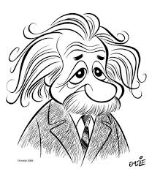
WHAT DID MMT PROPOSE?: Fair Taxation
MMT REMOVES
MMT ADDS
Taxes are the means whereby we fund our public services.
The Green Party knows that at the federal level,
taxes do not fund spending.
Congress, through its appropriations and the rules it sets for the Federal Reserve and the Treasury, does that.
Apply the Federal Insurance Contributions Act (Social
Security and Medicare) taxes to investment income and
to all levels of income, not merely the first $106,800 earned
Repeal Federal Insurance Contributions Act
(Social Security and Medicare) taxes.
Oh Dear!
ALBERT EINSTEIN

Slide 30
2
LIVABLE INCOME

Slide 31

WHAT DID MMT PROPOSE?: Livable Income
MMT REMOVES
MMT ADDS
We call for a universal basic income
Greens support the Government providing a full time or part-time job at a living wage with standard government fringe benefits to every person wanting either …
As the issuer of the currency, it is the role of the federal government to maintain a deficit large enough to meet the savings and spending needs of those in the economy whose needs are not being met by the private sector.
ALBERT EINSTEIN

Slide 32
3
GREENING THE DOLLAR

Slide 33
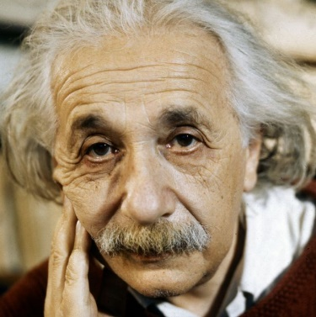
WHAT DID MMT PROPOSE?: Greening the Dollar
MMT REMOVES
MMT ADDS
…government has been reluctant to use its fiscal powers
Our Government retains its sole ability to create high-powered government money (government reserves, currency, and coins) and to deficit spend this money into circulation through fiscal policy …
The private creation of money or credit which substitutes for money, will cease…..
17. The new high-powered government money/net financial assets, that must be regularly added to an improving economic system … will be created and spent into circulation by the U. S. Government using fiscal policy
It is both possible and necessary for our government to take back its special money creation privilege and spend this money into circulation
16. The Monetary Authority….will redefine bank lending rules and procedures to end the privilege banks now have to create money when they extend their credit
… acknowledge while banks do create money, they do not have the capacity to create net financial assets at will like the federal government.
I have a toothache!
ALBERT EINSTEIN

Slide 34
4
NATIONAL DEBT

Slide 35
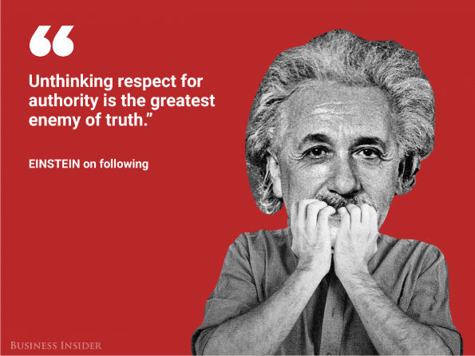
WHAT DID MMT PROPOSE?: National Debt
MMT REMOVES
MMT ADDS
Greens will reduce our national debt.
The idea that the National Debt is a cumulative debt that all Americans together have to “pay” is not just untrue, but it is highly misleading, dangerous...
We cannot ignore the consequences of our nation’s past deficits and the related costs of debt service.
1. Reduce our national debt by increasing taxes on large corporations, the super-rich and pollution; and decreasing expenditures in some areas, especially for war, armaments and corporate welfare.
Any American who has bought Treasury Securities and Bonds is holding that liability which is an investment for them, a private surplus, though we may call it Public Debt.
The Federal Government is the Issuer of the Currency, and issues and spends into the economy for Public Purpose.
Presidents George W. Bush and Barack Obama have irresponsibly expanded our national debt by trillions of dollars to finance tax cuts for America’s wealthiest citizens, war, corporate welfare and bailouts of Wall Street and the automotive industry.
ALBERT EINSTEIN

Slide 36
5
PREAMBLE

Slide 37
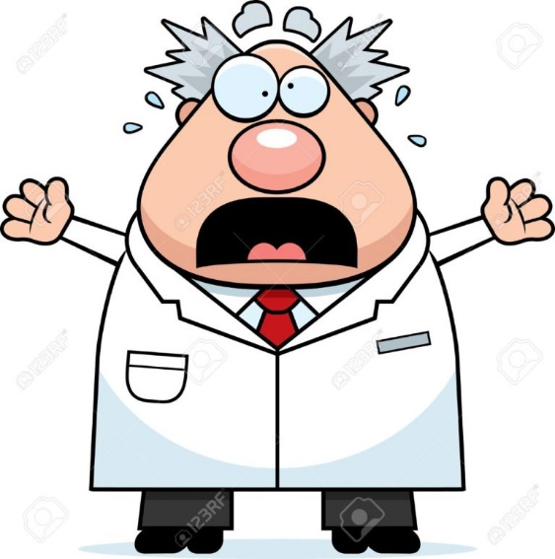
WHAT DID MMT PROPOSE?: Preamble
MMT REMOVES
MMT ADDS
Levels of federal revenue are the lowest they have been since 1950 because of tax cuts and breaks for the very rich and for corporations.
Amend the following statements from the Preamble to reflect the sovereign economics as they are, and to acknowledge again that these problems mostly stem from people in our government who are not willing to do what is needed to take care of the problems faced by the American People.
…because Congress refuses to use its sovereign power to spend what is necessary to meet the challenges that face us.
ALBERT EINSTEIN

Slide 38

Some thoughts about all this ….
Americans are not taught
how the monetary system works.
We need to keep speaking
the truth of debt-free
money and its history.
MMT says monetary reform is not that
hard. No structural changes are
necessary. People are attracted to this.

Slide 39
THINK ABOUT THIS:
How does MMT compare to….

Slide 40
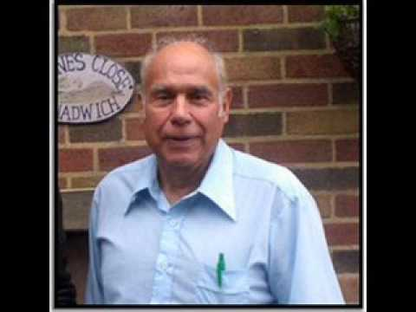
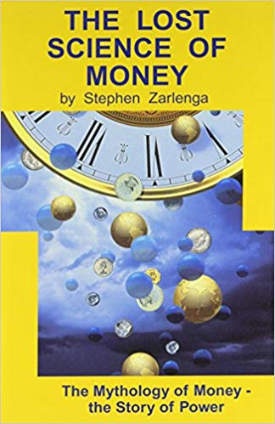
THEMES OF LOST SCIENCE OF MONEY BOOK
Primary importance of the money power (power to create money and regulate it)
Nature of money purposely kept secret and confused
How a society defines money determines who controls the society
Battle over control of money has raged for millennia: public vs private

Slide 41
PART 4
NOVEMBER, 2018
Future Organizing

Slide 42

    MI, TX, TN, NY State Parties
    to request GPUS to create new standing committee:
    Committee on Banking and Monetary Reform
    to educate Greens on meaning of current platform ‘Greening the Dollar’
All these Greens are members of GreensForMonetaryReform.org
and organizers for the new Committee.
MI Rita Jacobs
TN Howard Switzer
TX Kevin McCormick
NY Sue Peters
Special thanks to Rita for coming up with the idea and spearheading it!

Slide 43
THE END
“The nature of money purposely kept
secret and confused.”

