Slide 1
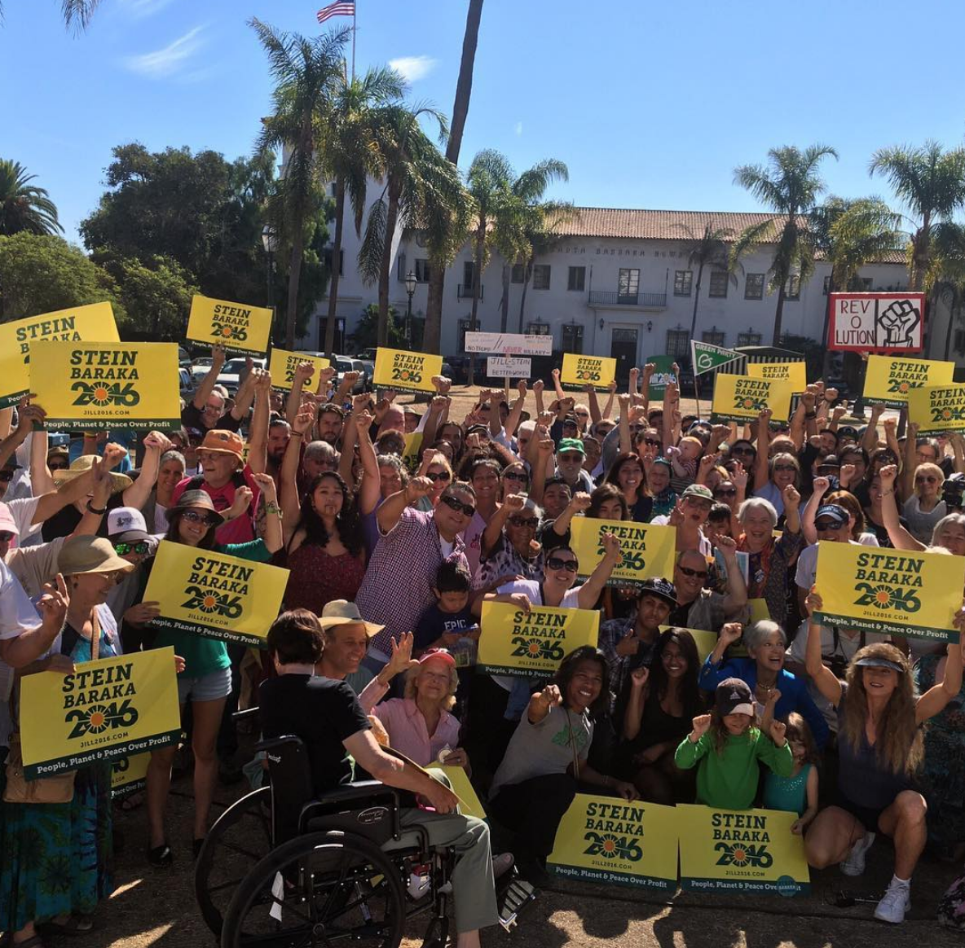
Presidential Politics Workshop
Presidential Campaign Support Committee (PCSC)
John Andrews, Justin Beth
pcsc@gp.org
Green Party Annual National Meeting
Salem, MA July 27, 2019
180604
Notes:
1
1

Slide 2
Outline of Workshop
• Why do we run for president?
• Previous results (ballot access, votes, fundraising)
• Nature of the 2020 presidential campaign
• Challenges in 2020
• How you can help
>>> Give us your email to get a copy of all slides presented.

Slide 3
Why do we run for President?

Slide 4
What We Accomplished in 2016
• GP won 3.1 times more votes than in 2012.
• GP received more than 21 times more votes than any other progressive alternative party.
• Jill won federal matching funds 2 months earlier than in 2012.
• Jill’s campaign raised over $3.4m total – triple the 2012 total (not counting money for the recounts)
• A high point in ballot access: 45 states comprising 89% of voters.
• Campaign contributed to surge in GP registration, donor lists, volunteer lists, local candidates.
• Campaign revitalized state parties and local chapters.
Notes:
7.2x more votes than Constitution party, next highest third party
http://www.uvm.edu/~dguber/POLS125/articles/nader.htm

Slide 5

Green Party Presidential Vote
How do we keep growing?
Ref: http://ballotpedia.org/List_of_political_parties_in_the_United_States
Notes:
http://www.fec.gov/pubrec/fe2012/2012presgeresults.pdf
Part of growth is due to increased ballot access.
In 2000, Nader brought his own organization into the campaign with staff and donors.
Note: In 1996, Ralph Nader was not officially nominated by the Green Party, but was endorsed by a number of state Green Parties. He was on the ballot in 22 states. Winona LaDuke was his running mate in most states.

Slide 6
Why do we run for President?
Practical Reasons
It is one of the most effective ways to grow the Party.
We can achieve a surge of
• Volunteers
• Donors
• State/local party activity
• Green Voters
• Coalition partners
• Visibility
- Conventional Media
• Social media
• Voter registration
• Trained staff
• Candidate recruitment
It wins ballot access.
It supports state/local candidates.
Notes:
We can’t expect to win the office. We will be outspent 200:1. The corporate media will be heavily biased against us. So why do we run? We CAN succeed on many fronts even if we don’t win the office.

Slide 7
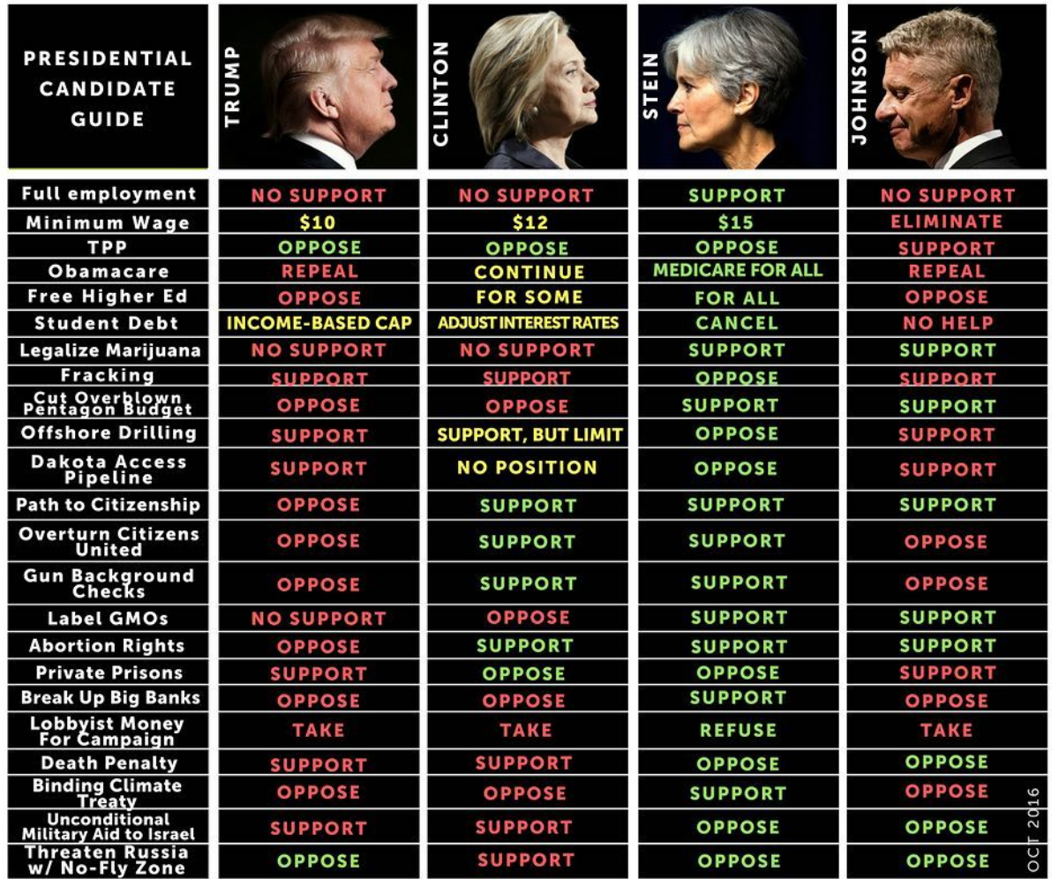
Offering Voters a Progressive Choice
Some 2020 Dem candidates support.
Few 2020 Dem candidates support.
Notes:
If a voter could only choose Hillary, look what they would be voting for . . . .
It there are only two choices, it brainwashes the American people into accepting their answers as the only reasonable answer.
Likely Dem is Joe Biden who will look largely similar to Hillary.
Pentagon budger: Huge (Clinton) or even huger (Trump).

Slide 8
Greens increase voter turnout
• In exit polls, about 60% of Stein voters said they would not have bothered to vote if their choices were only a Democrat and a Republican.

Slide 9
Green Party Ballot Access
51
45
38
89% of voters
32
No. of States
25
2004
2008
2012
2016
Note: 3 additional states allow write-in votes for the Green Party candidate.
Notes:
We have states with larger populations, so over 89% of voters see the GP on the ballot. Counting write—in states, 97.6% of all voters were able to cast a vote for the GP candidate.
Missing states in 2016: Georgia†, Indiana†, Oklahoma, Nevada, North Carolina†,.South Dakota.
In 2016 Stein spent ~$645k on ballot access. The GPUS spent ~18k.

Slide 10
2016 Total Fundraising
$0.0
$1.0m
$2.0m
$3.0m
Stein/Baraka Revenue 2016
$3.45m
Spent on ballot access
Ballot
$645k
Green Party Revenue 2016
$196k
Spent on ballot access
$18k
Sources: https://www.opensecrets.org/pres16/candidate?id=N00033776
http://gpus.org/wp-content/uploads/2015/12/2016-Budget-Proposal-revised12-6-15.pdf
Notes:
Something to ponder:
• It’s obvious why Stein/Baraka took the lead in so many things.
• It’s obvious that the Green Party is an underachiever when it comes to fundraising.

Slide 11
Stein Fundraising By Month - 2016
$800k
Nomination
clinched
PNC
700k
600k
500k
400k
Qualify for Matching
300k
200k
100k
0k
M
J
J
A
S
O
N
D
J
F
M
A
M
J
J
A
S
O
N
2015
2016
FEC matching funds
Sources: Reports filed with FEC
Notes:
Some gaps in FEC data were filled in with estimates. Need November receipts to complete.

Slide 12
How 2020 is shaping up
OPINION
• Republican nominee Trump will do outrageous things to focus attention on himself and to fan social and racial divisions.
• Likely Democrat nominee Joe Biden will be similar to Hillary Clinton. Uninspiring but on some points contrasts favorably with Trump.
• If not Biden, the Dem nominee will be a moderate progressive acceptable to Wall Street who will move right as soon as the primary is over.
• The message of the Democrats and much of the progressive-leaning community will be “Nothing is as important as defeating Trump and only the Democrat can do that. Anyone who doesn’t get behind the Democrat is helping reelect Trump.”
• The establishment media and Dem-friendly journalists will blacklist the Green candidate.
In 2020 there will be major obstacles to the GP ticket going mainstream.

Slide 13
Can we win the presidency in 2020?
A GP win isn’t yet within reach – it would require a historically unprecedented collapse of both major parties.
Green
Dem
Voter Base
1%
40%
Funding
$2m
$1000m
Natl. TV Debate Appearances
0
5
500
Also reflects amount of coverage and positive/negative slant.
Newspaper Endorsements
0
Internet Staff
3
250
But we can still achieve many important goals of party growth and changing the dialogue.
Notes:
This is just to inject a little reality into our thinking. Candidates that start out way behind and are massively outspent do NOT win races in the United States. Voter dissatisfaction with major party candidates does not lead to massive defections to third parties – it is more likely to result in votes against the major party candidate they detest the most or lower turnout. We aren’t as mismatched on the internet, but Dems will have 100 times more internet-savvy staffers.
We CAN succeed in achieving many critical objectives in 2020, but the goal of winning the presidency will probably remain beyond our reach. If this isn’t irrefutably clear now, it will be by July 2020.
https://en.wikipedia.org/wiki/Newspaper_endorsements_in_the_2016_United_States_presidential_election

Slide 14
Possible Elements of GP 2020 Strategy
• Keep the Party united. We need everyone.
• Run against the establishment. People don’t trust them.
• Continue to lead on policy: Green New Deal, peace, universal health care, rejecting capitalism.
• Have big presence on the Internet and social media - bypass conventional media.
• Go after young people, people of color, and alienated Democrats
• Rebut spoiler accusations.
• Build strength at the state and local levels.
Notes:
Keep Party united: We can’t afford to backslide by shedding key supporters in order to advance one faction. A nominee who is running against other Greens is likely to be a disaster for the Party.
The presidential ticket can boost campaigns at the state and local levels.
If you’re not thinking numbers, you’re not thinking.
•

Slide 15
What do we need for a successful campaign?
• A candidate who
- Embodies Green Party principles and policies
- Is dedicated to uniting and building the Green Party
- Is articulate and compelling
- Has good managerial skills
- Is a good fundraiser
- Inspires volunteers and staff
- Has stamina and courage
• Party engagement to provide
- Advice, guidance, corporate memory
- A well-run primary process
- Ballot access
- State/local party engagement
• Post-election follow-through
Notes:
Embodies GP principles: Not 100% parrots the platform. But when people hear the candidate and then go to a meeting of a Green Party chapter, there shouldn’t be a disconnect.
Uniting and building: If you want to drive away people who don’t pledge allegiance to your favorite policy, you’re going to wind up with a smaller party.
Managerial skills: The candidate is the CEO. They will make the final decision on key managerial matters, such as hiring and firing, picking a vice-presidential running mate, major policy decisions, etc. We often attract some bad candidates – who are running for self-centered reasons and simply don’t have the required skills. A bad nominee could really hurt the party – not only through missed opportunities, but through creating a bad public image. Hopefully bad candidates will not make it through the primary process.
Candidates self-assessment: If you know you’re weak on some point, work on it. Get help.

Slide 16
How GP is Organized

Slide 17
Relationships
National Committee
Steering Committee
Media Committee
PCSC Committee
Ballot Access Committee
Media
State Agencies
Primaries
Presidential Nominating Convention
President/ VP Ticket
FEC
State Parties
Caucuses
Notes:
• The presidential ticket must be prepared to interact with a number of GP entities and external entities.

Slide 18
The Presidential Campaign Support Committee (PCSC)
• Recruits candidates
• Advises candidates on processes.
• Serves as point of contact with GPUS.
• Helps GPUS members learn about candidates (e.g. PCSC questionnaire, forums)
• Manages the official recognition process
• Encourages healthy primary processes in the states
• Promotes debate inclusion
PCSC welcomes new members! Write to jandrews166@gmail.com to learn more.
Notes:
Please contact your state party or caucus if you are interested in joining the PCSC. We have monthly telecons.
We do not encourage people to join if they are currently working on behalf of a particular candidate (This could violate our conflict-of-interest rules.)

Slide 19
Federal Matching Funds
• FEC will match first $250 of each donation in the primary phase of the election.
• To qualify: Raise $5000 in each of 20 states.
• In 2016 Jill Stein received $456k in matches – 12% of her total fundraising.
• All matching funds have to be spent in the primary phase or else returned to FEC.
Warning: Democrats in house passed bill (H.R. 1) that would effectively block Greens from qualifying. This legislation has stalled in the Senate.
Notes:
H.R. 1 would raise qualify threshold to $50,000 from each of 20 states – ten times higher than currently. Even Jill Stein did not raise over about $19,000 from any one state.

Slide 20
Field of Candidates
Active
Candidate
List
Self-
Declared
Officially
Recognized
Nominated

Slide 21
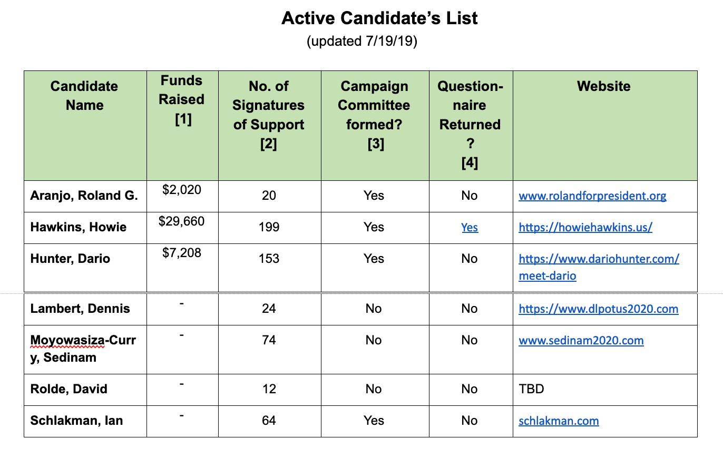
The Active Candidates List
• A guide to candidates who are running for the GP nomination.
• Maintained by the PCSC.
• Persons listed here are not endorsed or approved by the GPUS.
See the current list at https://docs.google.com/document/d/1lsfRXRZTMYsHRp7SMrjdPo3SZiE9NX8ThSkdxzmxL3A/edit
Notes:
Appearance on this list does not constitute an endorsement or approval.

Slide 22
Official Recognition
• Under Article 10 of GPUS bylaws, official Recognition is granted to candidates that have taken preliminary steps toward running a serious campaign.
• Some requirements for official recognition are:
• Set up a campaign committee with the FEC.
• Collect 100 signatures of support
• Raise $5000 or collect donations from 100 people.
• If a candidate receives official recognition they can be given special attention in GP media work and are more likely to be placed on primary election ballots.
• See Article 10 of the GPUS Rules to find the detailed requirements for official recognition.
• See the Active Candidates page to find out who has achieved official recognition.
Notes:
Currently Steering is in process of documenting what party resources will be available to candidates at each level.

Slide 23
Primary Processes
• State parties use a democratic process to select delegates to send to the Presidential Nominating Convention (PNC)
• Possible types of processes: state-run primary, statewide party convention, local party caucuses, online voting, etc.
• Certain state election laws may apply to the process, e.g. state party may be asked to submit the candidate names to go on their primary ballot.
• Delegates may be pledged to vote for their assigned candidate on first ballot (or later ballots) depending on state party rules. Uncommitted delegates may also be appointed.
• State party must complete the PNC credentialing process in order for their delegates to be seated at the PNC.
Notes:
Each state is different. Very complicated task to figure it all out.
Can have uncommitted delegates if state law permits.

Slide 24
State Level Action
• Work to ensure ballot access (if you don’t have it already).
• Recruit state and local candidates that work as a team with the national ticket.
• Project the GP brand in all races.
• Set up a local media team.
• Set up a visit by the national ticket (tour, rallies, fundraisers)
• Do outreach to local groups.
• Grow your volunteer list and your donor list.
• Post-campaign, draw campaign workers into your permanent organization.
Notes:
• Without ballot access, the local media will ignore you. Write-in campaigns are not taken seriously.
• You can speak to any voter in your state about the presidential race.

Slide 25
Additional State Level Strategic Planning
Know Your Goals...
  Grow Green Membership, Statewide.
  Get Greens Elected at all Levels
  Pass legislation for the People.
Come up with a Plan...
  Start Wednesday (or better yet...Today!).
  Check in with the Plan.
Activate Every County...
  Connect on Issues and Develop Green Points of Contact.
  Identify People interested in Elections/Running for Office.
  Empower new Greens with the Tools and Training.
Do your Research...
  Pay attention to election results, not just in your races with Greens, but every other similar race.
  Look for Opportunities. Identify Blindspots. Be Aware of Weaknesses.
Notes:
These are Justin Beth slides.

Slide 26
2020 Strategy in Maine
151 State Rep Strategy...
  Don’t run in every district, but know the situation in each district.
  After finding/vetting a candidate: develop their own candidate strategy, provide them tools and training, empower them to develop their own campaign.
Signature Collection...
  Have a plan.
Flagship Race...
  Focusing on one Statewide Race... US Senate Race (against Susan Collins).
  For success, it requires engagement in all counties.
How it all connects...
  Synergy!
Notes:
Justin Beth slide.

Slide 27
General Election Process
• Secretary of State must be notified of PNC official results with names of president and vice-president nominees.
• A set of verified electors must be recruited to cast votes in the Electoral College if the GP candidate wins.

Slide 28
Post-Election Tasks
• Media work to get out GPUS viewpoint.
• Pass donors and volunteer lists to GPUS.
• Prepare for FEC audit.
• Conduct review and document lessons learned.
• Integrate volunteers into state party.
• Get presidential ticket to help GPUS fundraising.
• Support any recounts or lawsuits.
Notes:
Don’t let what you have achieved fade away after Election Day!

Slide 29
How You Can Contribute
• Organize through your state party for primary, candidate visits, local media work, ballot access, etc.
• Volunteer for a candidate’s campaign
• Donate to a candidate or to ballot access fund.
• Support other GPUS committees (Media, PCSC, Ballot Access, etc.)
• Help with outreach to your contacts.
Notes:
http://www.uvm.edu/~dguber/POLS125/articles/nader.htm

Slide 30
Thank You!
• To contact the PCSC, write to pcsc@gp.org
• For an overview of the GP race, go to https://gpus.org/how-to-seek-2020-green-nomination-2/
Notes:
Announce upcoming workshops and events if relevant to presidential politics.

Slide 31
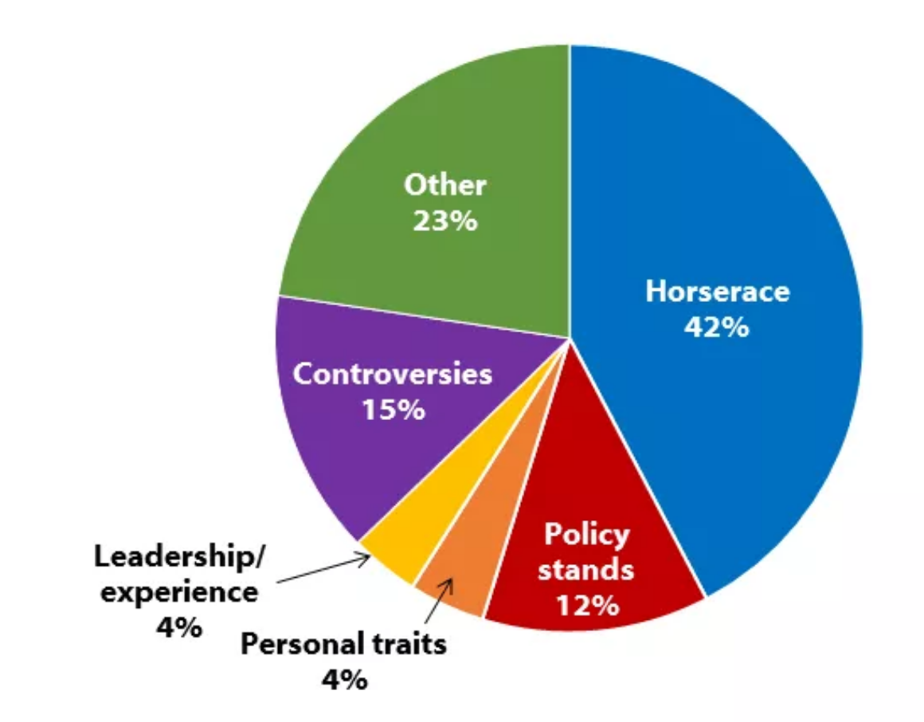
Topics of Media Coverage
(2016 Presidential Race)
Media coverage is overwhelmingly focused on the two frontrunners.
”Other” includes upcoming events, staffing changes, family, etc.
Notes:
Source: https://shorensteincenter.org/news-coverage-2016-general-election/

Slide 32
Presidential Results 2016
CANDIDATE | PARTY | VOTE | RANK | PERCENT
Hillary Clinton | Democratic | 65,734,379 | 1 | 48.23%
Donald Trump | Republican | 63,065,730 | 2 | 46.27%
Gary Johnson | Libertarian | 4,442,131 | 3 | 3.26%
Jill Stein | Green | 1,444,059 | 4 | 1.06%
Evan McMullin |  | 691,997 | 5 | 0.51%
Darrell Castle | Constitution | 198,237 | 6 | 0.15%
Bernie Sanders |  | 105,549 | 7 | 0.08%
Gloria La Riva | Peace and Freedom | 73,636 | 8 | 0.05%
Rocky De La Fuente | Reform | 33,085 | 9 | 0.02%
Other (incl. undisclosed write-ins) |  | 503,342 |  | 0.37%
Source: https://en.wikipedia.org/wiki/United_States_third-party_and_independent_presidential_candidates,_2016
Notes:
https://en.wikipedia.org/wiki/United_States_third-party_and_independent_presidential_candidates,_2016
http://www.fec.gov/pubrec/fe2012/2012presgeresults.pdf

Slide 33
What We Accomplished in 2012
• Jill Stein became the most successful female presidential candidate in US history, winning 469,501 votes, 2.9 times more than the GP received in 2008.
• GP received more than 11 times more votes than any other national progressive party.
• For the first time, a GP member won federal matching funds.
• Jill’s campaign raised over $1m total.
• GP hit high point in ballot access: 38 states comprising 82% of voters.
• Campaign contributed to surge in GP registration, donor lists, volunteer lists, local candidates
• Campaign revitalized state parties and local chapters
• Campaign spun off the Green Shadow Cabinet and Global Climate Convergence.
Notes:
See other slide on what we accomplished in 2016.

Slide 34
Presidential Fundraising 2016
Candidate | Funds Raised |  | Total Spent
 | By Campaign | By Outside Groups
Hillary Clinton | $497,808,791 | $205,909,959 | $639,635,565
Donald Trump | $247,541,449 | $74,905,285 | $302,488,918
Gary Johnson | $11,410,313 | $1,386,554 | $11,619,451
Rocky De La Fuente | $7,351,270 | $0 | $7,354,663
Jill Stein | $3,509,477 | $0 | $3,451,174
Evan McMullin | $1,644,102 | $0 | $1,642,165
Darrell Castle | $52,234 | $0 | $51,365
Gloria La Riva | $29,243 | $0 | $24,207
Monica Moorehead | $11,547 | $0 | $9,127
Peter Skewes | $7,966 | $0 | $4,238
Source: https://en.wikipedia.org/wiki/United_States_presidential_election,_2016
Notes:
Clinton groups spent 188 times what Stein spent. Stein totals includes federal matching funds for the primary phase.
Figures do not include post—election spending on recount. This was separate fundraising and was sequestered to be spent only on the recounts.
A Green candidate needs about $3m to run a serious campaign. This pays for basic staff, travel, materials, online resources, ballot access, and legal counsel. It doesn’t allow for television ads. (15 staff x 12 months x $5k/mo = $900k).

