Slide 1


Inspired by
National Organization for Raw Materials
normeconomics.org
WITH AMI PARITY GROUP
2021 IMMR CONFERENCE
Sun., 2021-03-19
MONEY & PRICE PARITY:
MONEY IN THE REAL ECONOMY

Slide 2
WITH AMI PARITY GROUP
PRICE PARITY =
AN ECONOMY THAT WORKS FOR EVERYONE

Slide 3

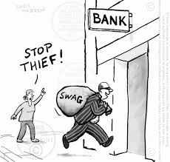

THERE ARE TWO ECONOMIES
THE REAL ECONOMY
where we all live and work
to produce wealth and earn income
THE FINANCIAL ECONOMY
that converts wealth into debt,
to bring in perennial unearned income
and steal all the resources of the world
“Unlike wealth, which is subject to the laws of thermodynamics,
debts do not rot with old age and are not consumed in the process of living.
On the contrary, they grow at so much per cent per annum, by the well-known
mathematical laws of simple and compound interest.”
Frederick Soddy
Wealth, Virtual Wealth and Debt, 1926

Slide 4
All wealth comes from the earth…
“Is any study simpler than economics? A child could grasp it.”
“…the first lesson in economics. The human being lives, but depends for nourishment upon the rest of creation…”
“We were made to be interdependent; to play our part in reliance on others.”
“The balance between what we give and receive is disturbed when one of us takes without giving.”
Leon Maclaren, “The Function of Economics”, 1952

Slide 5
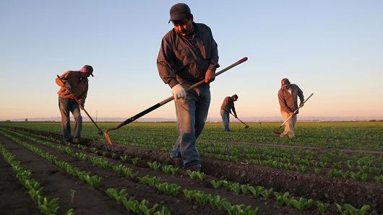
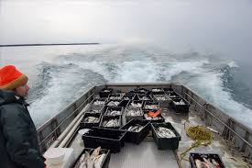
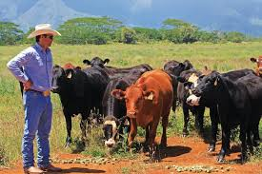
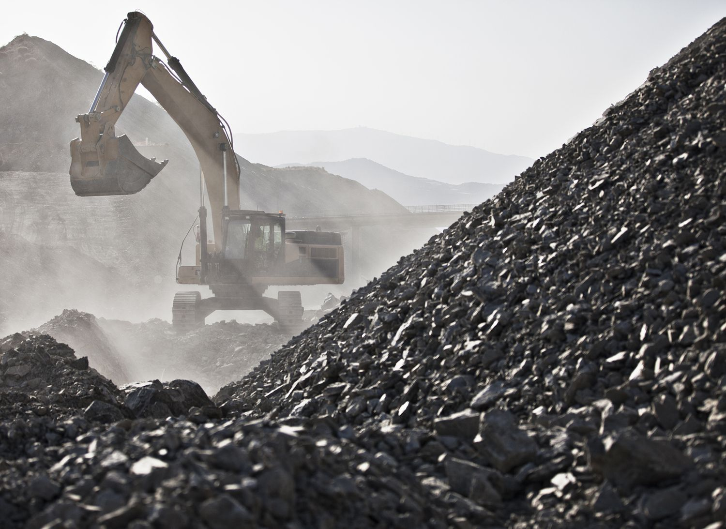
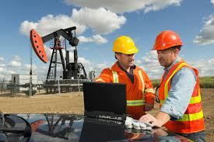
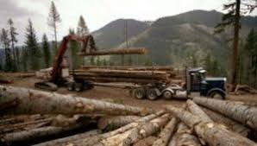
All wealth comes from the earth…
AGRICULTURE
FISH
CATTLE RANCHING
METALS
OIL
LUMBER

Slide 6
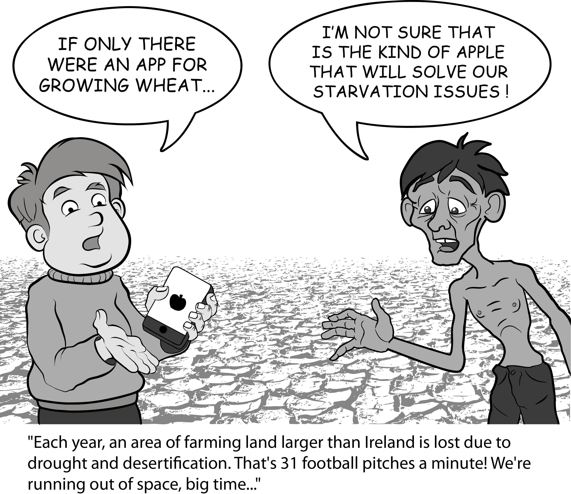
All wealth comes from the earth…
“Cut off from the earth….our industries would stop, our works crumble,
and we ourselves starve.” Leon Maclaren, “The Function of Economics”, 1952

Slide 7
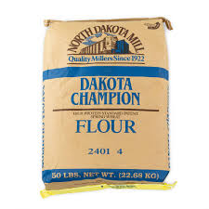
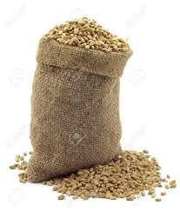
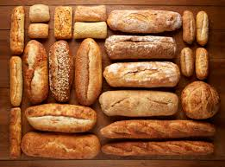
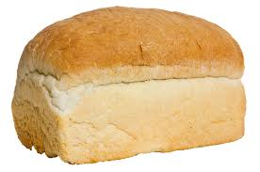

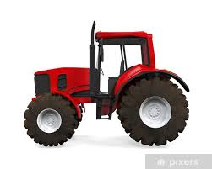
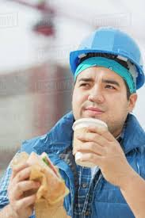
All wealth comes from the earth…
An economy starts with the production of raw materials,
which find their way to the consumer.
Mill
FLOUR
Bakery
BREAD
WHEAT
Farm
Store
BREAD
TRACTOR
Consumer
(worker)
TRACTOR
STORE
LABOR
TRACTOR
TRACTOR FACTORY

Slide 8

All wealth comes from the earth…
Money, involved in sales/purchases passes from hand to hand.
Mill
FLOUR
Bakery
BREAD
WHEAT
Store
Farm
MILLER
BAKER
STORE KEEPER
FARMER
BREAD
TRACTOR
WORKER
TRACTOR
DEALER
TRACTOR
MANUFACTURER
Consumer
(worker)
TRACTOR
STORE
LABOR
TRACTOR
TRACTOR FACTORY

Slide 9
All wealth comes from the earth…
The INCOME of a business is used to pay its COSTS.
INCOME
MILLER
BAKER
STORE KEEPER
FARMER
WORKER
COSTS
TRACTOR
DEALER
TRACTOR
MANUFACTURER

Slide 10
All wealth comes from the earth…
The INCOME of a business is used to pay its COSTS.
MILLER
BAKER
STORE KEEPER
FARMER
WORKER
INCOME
TRACTOR
MANUFACTURER
TRACTOR
DEALER
COST

Slide 11
All wealth comes from the earth…
The INCOME of a business is used to pay its COSTS.
MILLER
BAKER
STORE KEEPER
FARMER
WORKER
TRACTOR
DEALER
TRACTOR
MANUFACTURER
COST
INCOME

Slide 12
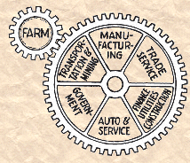
All wealth comes from the earth…
and operates according to the natural law of economics
RAW
MAT’L
If raw materials production is priced in balance with the costs of labor and capital (parity prices), prosperity is possible.

Slide 13
All wealth comes from the earth…
and operates according to the natural law of economics
RAW
MAT’L
Parity ensures EARNED INCOME
will be DISTRIBUTED
throughout the economy
as widely and as fairly as possible.

Slide 14
All wealth comes from the earth…
and operates according to the natural law of economics
RAW
MAT’L
Parity prices for raw materials, at the first point of sale, helps guarantee an adequate national income, without debt.

Slide 15
What is the proof of this
natural law of economics?

Slide 16
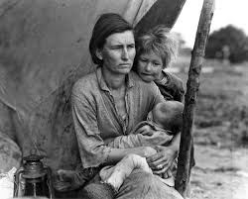
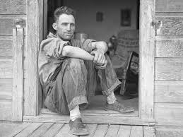
What is the proof of this natural law of economics?
Using the U.S. economy between 1910 and 1940, this natural law was proven by a small group of men, who founded the Raw Materials National Council in 1936 in Sioux City, Iowa. They were looking for a satisfactory explanation of the current U.S. economic depression. The basic question was this: if a bushel of corn sold for $.50 on one day, why did it sell for $.20 one week later?
The research took 3 years (without computers) looking through reams of statistics from government agencies. The proof was there: the relationship between raw
material income at the first point of sale and the resulting national income.

Slide 17
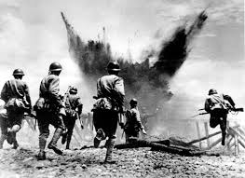
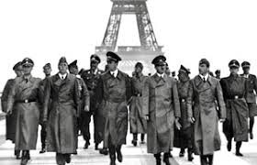
What is the proof of this natural law of economics?
When the U.S. was attacked by Japan at Pearl Harbor in December, 1941, it took Congress very little time to pass a parity price bill for many farm products,
to ensure sufficient national income here at home to wage the war overseas.
The parity prices were in effect from 1942 to 1952. This experience proved the theory in action. It enabled the U.S. to fight and win a world war and kept us out of depression following the war.

Slide 18


TODAY, however, the ‘money power’, using their control of international prices,
ruins farmers and causes them to substitute debt for earnings.
Speculators and bankers grow richer with the ups and downs of trade.
Farmer
Secretary,
‘Miss Smith’
Today U.S. farmers are forced to sell commodities to the international market, taking the price offered by international traders. Way below a parity price.
The price in one year could be $2/bushel,
but the next year $1/bushel, etc. But the farmers’ costs do not go down with the international price.
How would you like your yearly income to vary
according to the international market?
“Miss Smith, you’ve worked for us this year and we will be paying you $20,000. I know we paid you $30,000 last year, but the international market price for secretaries has gone down.”

Slide 19


Both AMI and NORM want a just world and therefore fight the money power.
Both want to get sovereign U.S. money into the hands of our citizens.
Congress creates and distributes new sovereign
U.S. money for raw materials parity prices,
infrastructure, education, health care.
Teach the truth about money and credit.
Parity prices distribute sovereign U.S. money as earned income to producers, laborers, owners.
Teach the truth about economics and prices.

Slide 20
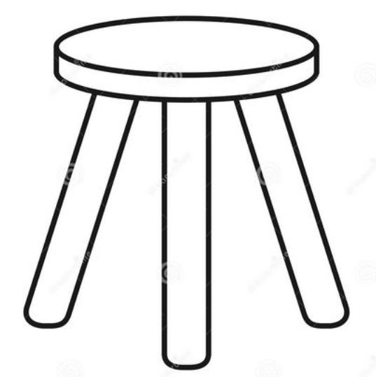
THREE LEGS OF A PROSPEROUS NATIONAL ECONOMY
1
3
2
PARITY PRICES
FOR RAW MATERIAL PRODUCERS
to produce adequate national income
PARITY TARIFFS
to protect national purchasing power
PARITY WAGES FOR LABOR
to distribute wealth
A FLOOR OF HONEST SOVEREIGN MONEY

Slide 21
Inspired by
National Organization for Raw Materials
normeconomics.org
WITH AMI PARITY GROUP
THE END
LET AMI KNOW YOU WISH TO LEARN MORE ABOUT PARITY

