Slide 1
H.R. 2990
INTRODUCED BY DENNIS KUCINICH
HOW THIS REFORM WOULD WORK

Slide 2
BANK CREDIT = DEBT-MONEY
PRIVATE BANK MONEY
CREATED BY BANK LOANS

Slide 3
CURRENT BALANCE SHEET
COMMERCIAL BANK
ASSETS =
WHAT BANK OWNS
LIABILITIES =
WHAT BANK OWES

Slide 4
CURRENT BALANCE SHEET: COMMERCIAL BANK
ASSETS =
WHAT BANK OWNS
LIABILITIES =
WHAT BANK OWES
BANK
LOANS
CASH TO
DEPOSITORS
CHECKING
ACCOUNTS
TIME DEPOSITS
(CD’S, ETC.)
BOUGHT
SECURITIES
CASH MONEY
DIGITAL MONEY

Slide 5
CONVERSION PROCESS – HR2990

Slide 6
U.S. MONEY = DEBT-FREE MONEY
PUBLIC MONEY:
Created by U.S. Treasury
On authority of US Congress

Slide 7
CHANGES TO –
BANK’S LIABILITIES

Slide 8
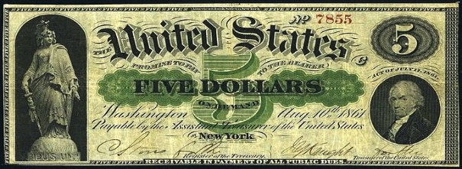
CONVERTED BALANCE SHEET: COMMERCIAL BANK
LIABILITIES = WHAT BANK OWES
MONETARY AUTHORITY (U.S. TREASURY)
*** NEW ACCOUNTING RULES ***
CHECKING
ACCOUNTS
TIME DEPOSITS
(CD’S, ETC.)
CASH MONEY
DIGITAL MONEY
Provides banks
with U.S. Money
to replace
Fed Reserve Bills
ALL DEPOSITS TREATED AS U.S. MONEY
TIME DEPOSITS EARN INTEREST,
ARE NOT FDIC INSURED, ARE ASSETS OF BANK
CHECKING DEPOSITS DO NOT EARN INTEREST,
ARE FDIC INSURED, NOT ASSETS OF BANK (IN TRUST)

Slide 9
CHANGES TO –
BANK’S ASSETS

Slide 10
CURRENT BALANCE SHEET: COMMERCIAL BANK
ASSETS = WHAT BANK OWNS
MONETARY AUTHORITY (U.S. TREASURY)
*** NEW ACCOUNTING RULES ***
BOUGHT
SECURITIES
PRE-CONVERSION
LOANS
BANK
LOANS
POST-CONVERSION
LOANS
NO CHANGE
AS PAID OFF TO BANK:
BANK KEEPS INTEREST
PRINCIPAL GIVEN TO
REVOLVING LOAN FUND (U.S. TREASURY)
FOR FUTURE LOANS TO BANKS
BY GOVERNMENT
PRINCIPAL IS U.S. MONEY AND
INDISTRUCTIBLE MONEY
BANK IS TRUE INTERMEDIARY
ALL NEW LOANS ARE U.S. MONEY
FROM TIME DEPOSIT ACCOUNTS,
LOANED FROM REVOLVING LOAN FUNDR,
OR FROM CAPITAL OF BANK

