Slide 1
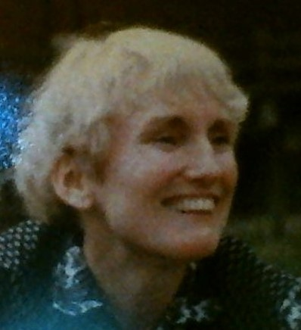
AMI CONFERENCE – Chicago, 2017
Sue Peters, Speaker
peters.s@startmail.com
HOW I BUILT MONETARY REFORM:
Learning by Teaching

Slide 2
TABLE OF CONTENTS
who am I?
how did I discover monetary reform?
what did I do next?
what have I been doing?

Slide 3
1 who am I?

Slide 4
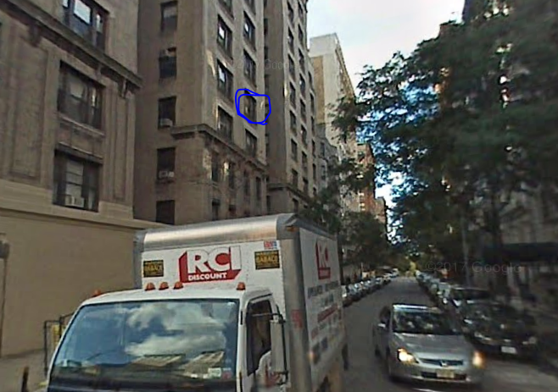
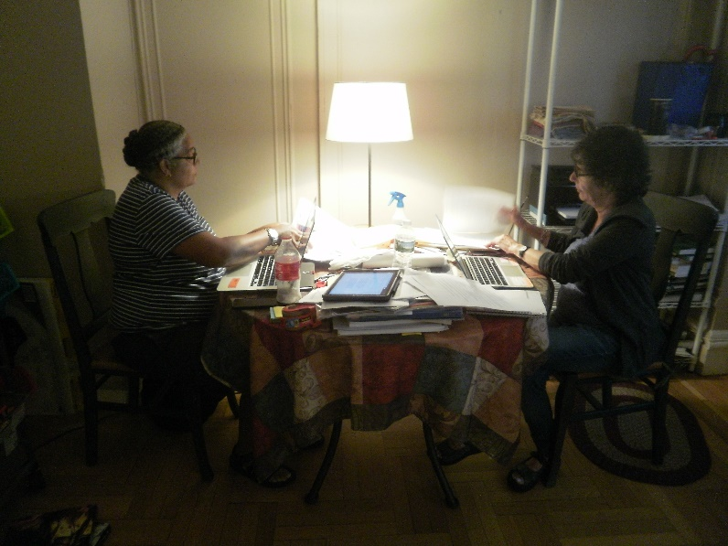
I am a New Yorker.
I live with two roommates on the Upper West Side of Manhattan.
For many years, I worked on Wall Street as a computer programmer/analyst. I designed business systems using computer programs.
In 2000, I got a job working for my FIRST BANK.

Slide 5
2 how did I discover monetary reform?

Slide 6


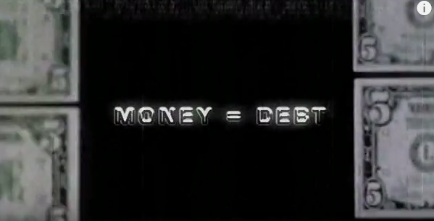
In 2010, while watching a documentary movie, I learned that all private commercial banks CREATE our money, when they give a ‘loan’! I was shocked!
MONEY = DEBT

Slide 7
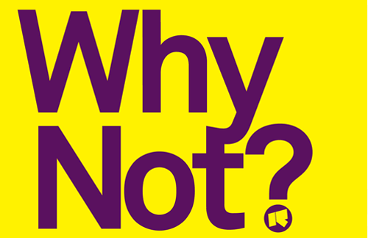
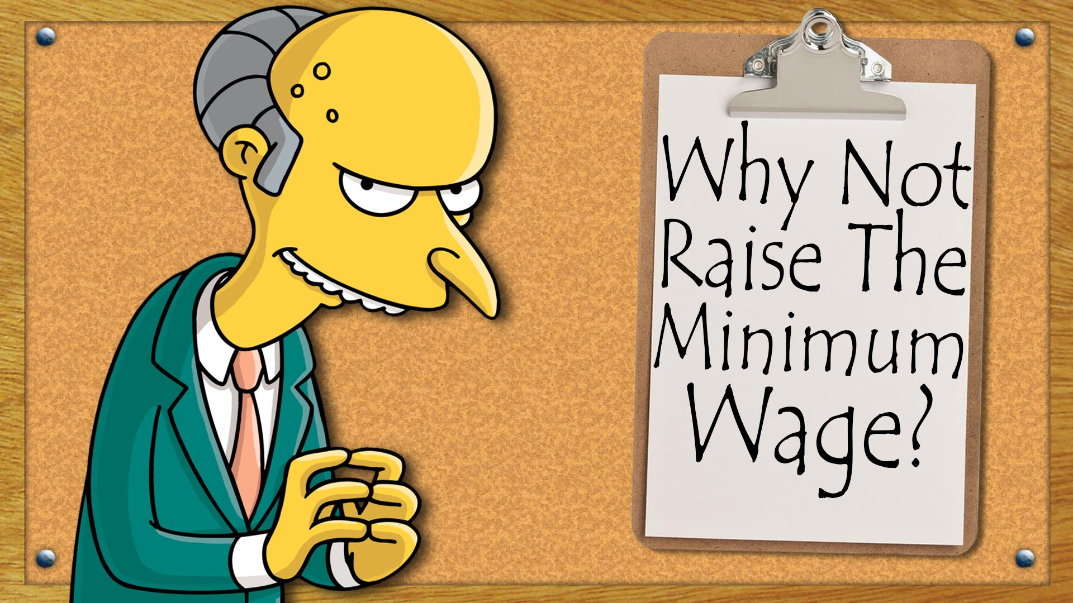
I asked myself:
WHY DIDN’T I LEARN THIS IN MY EDUCATION?

Slide 8
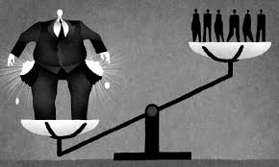
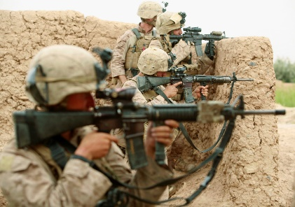

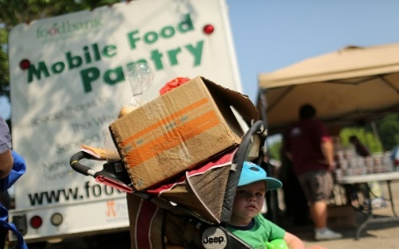
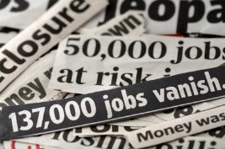


I looked around me and said:
“PRIVATE MONEY -- EXPLAINS WHAT I SEE IN MY COUNTRY…”
DEBT
CONCENTRATION OF WEALTH
WAR
POVERTY
UNEMPLOYMENT

Slide 9
3 what did I do next?

Slide 10

I went into work, looked in the computer programs, and found that……
THE BANK WAS CREATING MONEY!

Slide 11
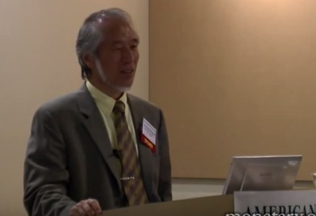
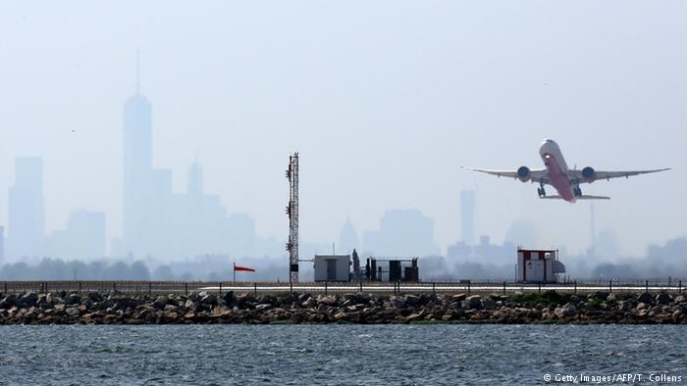
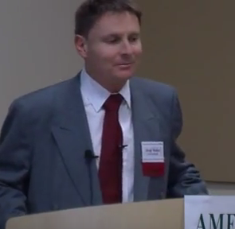
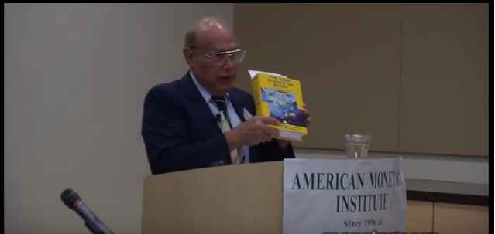
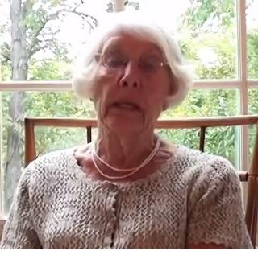
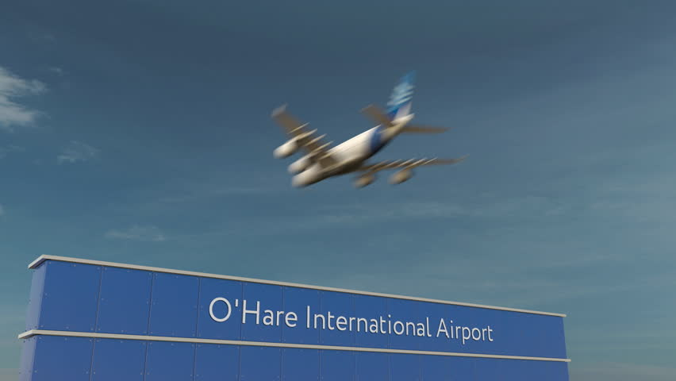
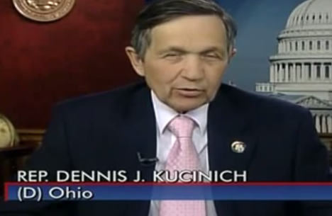
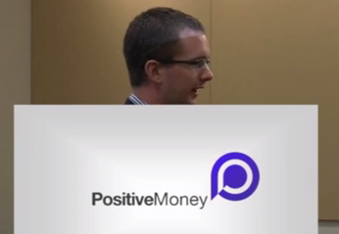
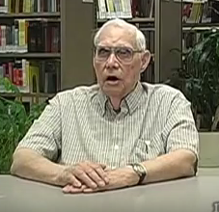
Then… I tried to find out as much as I could about the banks creating MONEY!
Somewhere along the line, I found out about the AMI.
I read about their 2010 Conference in Chicago. I needed to go.
AMI Conference
Kaoru
Yamaguchi
Leaving New York City
Jamie Walton
STEVEN ZARLENGA
DEE BERRY GP
Dick
Distelhorst
Arriving Chicago
REP DENNIS KUCINICH
Positive Money
Ben Dyson

Slide 12
I have been going to annual AMI Conferences every since….
and more ….

Slide 13
4 WHAT HAVE I BEEN DOING?
A my local community group
B public talks
C teach an ‘intro to monetary reform’ course
D teach THE LOST SCIENCE OF MONEY book
E collaborate to build a website
F reach out to other reform groups - NORM

Slide 14
    MY LOCAL COMMUNITY GROUP
WE CALL OURSELVES – “The FED GROUP”

Slide 15
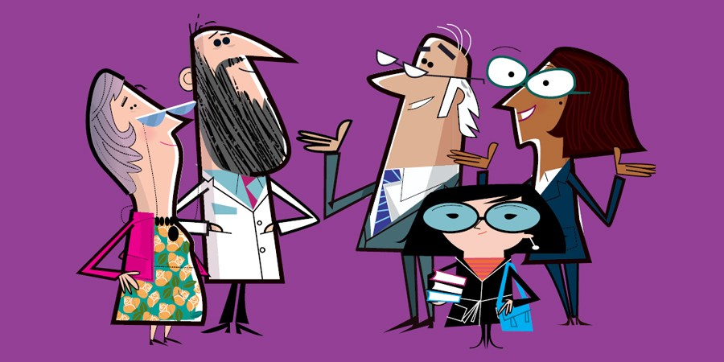
THE FED GROUP
It’s important to meet in a group to share ideas
that may not be understood by the wider culture.
You need support to challenge the assumptions of your society.

Slide 16
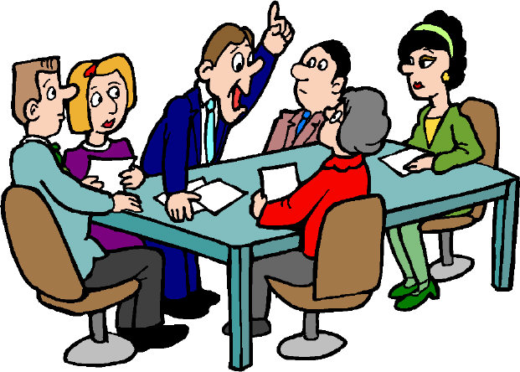
THE FED GROUP
A reformer needs the support of a group to express ideas, opinions, and generally FEEL LIKE A GROUP!
Always have a topic to discuss. One person brings information to share
with others for their thoughts and feelings. This will sustain the group.

Slide 17
B. PUBLIC TALKS

Slide 18
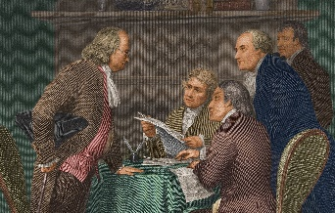
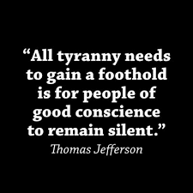
PUBLIC TALKS
I learned as I prepared my talks. It was fun!
My motivation was the importance of the ordinary
citizen knowing about this private money system.

Slide 19

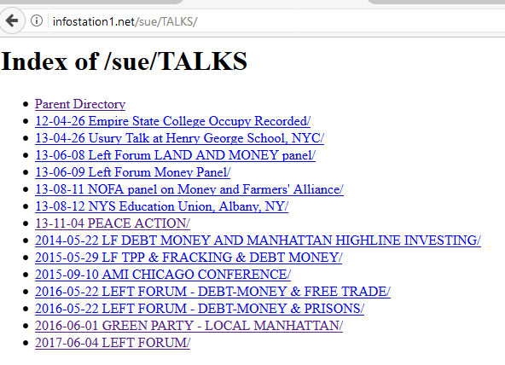

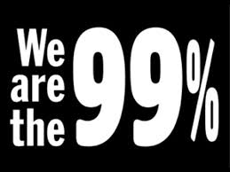
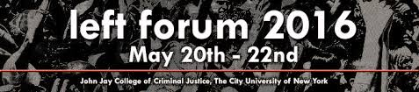


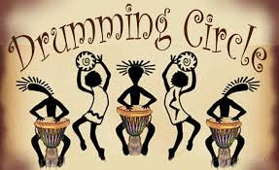
infostation1.net/sue/TALKS
MY FIRST TALK: Manhattan Green Party Local: Jan., 2011
OCCUPY WALL STREET
LEFT FORUM, NYC
ENGLAND, 2013: Reaching out to Positive Money Reformers
NORTHEAST ORGANIC FARMERS
PEACE ACTION ORG.
MY DRUMMING GROUP

Slide 20



But remember … it has to be FUN!

Slide 21
C.
TEACH AN ‘INTRO TO MONETARY REFORM’ COURSE

Slide 22
Syllabus THE SCIENCE OF MONEY: Understanding and Empowerment
10-Week Course Spring, 2013
Sue Peters
WEEKLY TOPICS:
1. Today’s monetary system:
definition of money and credit
2. Debt-money, aka interest-bearing money
3. Debt-free money, aka interest-free money:
colonial money, Lincoln’s Greenback,
1938-1974 Bank of Canada, England’s tally stick & Bradbury
4. Let’s summarize:
U.S. history of private vs. public control of money
5. Today’s Federal Reserve System:
debt-money and private banks
6. Overview of today’s economic system:
investment banks, commercial banks, Wall Street, markets,
how the economics profession talks about all this
7. History of monetary reform:
Farmer’s Alliance, Chicago Plan, etc.
8. 1929 – 1939 Great Depression and money
9. 2008-2009 Credit Crisis and money
10. The American Monetary Institute:
a solution based on the science of money
I designed a course.
I found people in my neighborhood
and community to join.
I LEARNED AS I CREATED THE
LESSONS AND TAUGHT THEM
IN THE CLASS……

Slide 23
D.
TEACH THE LOST SCIENCE OF MONEY
BY STEPHEN ZARLENGA

Slide 24
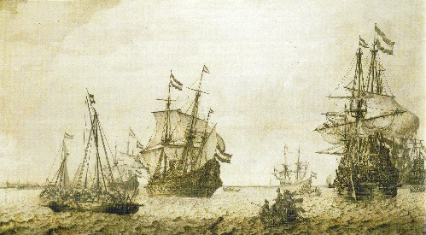
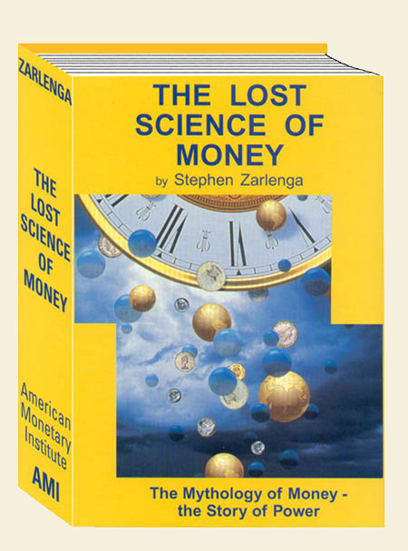
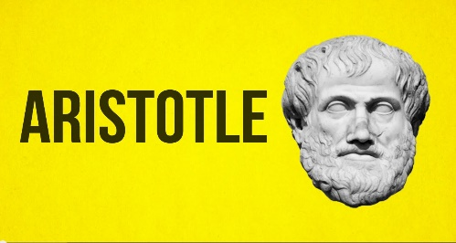
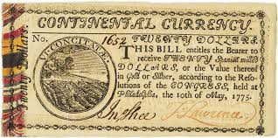
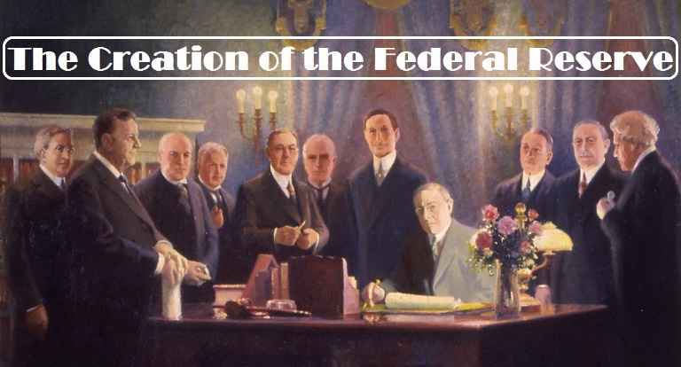
After my fourth AMI Chicago conference in 2013, I decided I had to teach
Stephen Zarlenga’s history – his book, LOST SCIENCE OF MONEY.
I had been a history major in college. But my studies did not talk about
who controlled the money!
PUBLIC CONTROL VERSUS PRIVATE CONTROL
DUTCH EAST INDIA CO.
COLONIAL CURRENCY
FEDERAL RESERVE SYSTEM

Slide 25

THIS WAS EXCITING….
AND I WOULD LEARN BY TEACHING THE BOOK….

Slide 26
THEMES
When I teach I always start with the
themes of the LOST SCIENCE OF MONEY book.
Primary importance of the money power
Nature of money purposely kept secret and confused
How a society defines money determines who controls the society
Battle over control of money has raged for millennia: public vs private

Slide 27
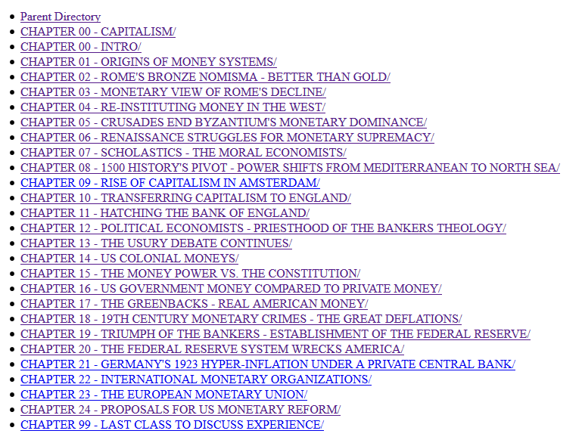
infostation1.net/books/Zarlenga, LOST SCIENCE OF MONEY
My website with all
the class materials
Stephen Zarlenga’s book has
24 chapters.
Each chapter has incredible
research and Stephen’s
critical thinking.

Slide 28
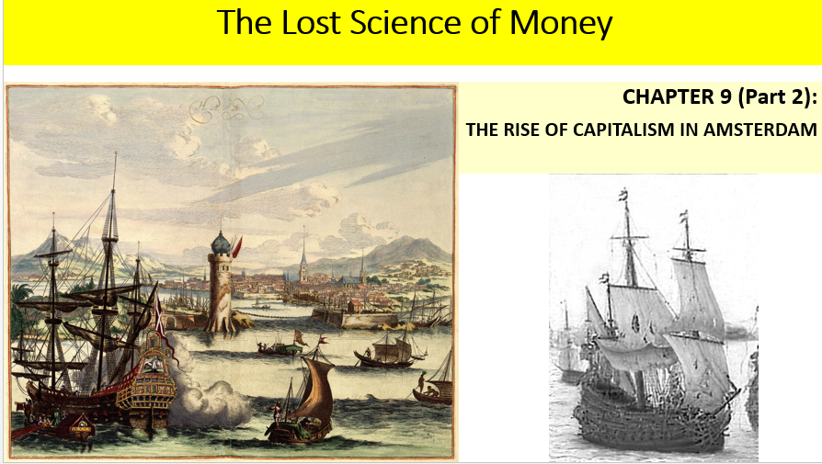
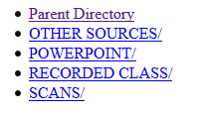

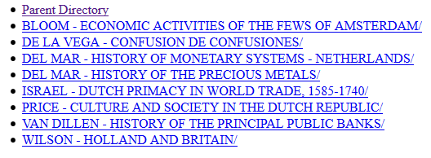
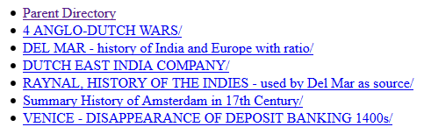
EACH CHAPTER HAS A POWERPOINT PRESENTATION,
RECORDING OF THE CLASS, AND SOURCE MATERIALS.
POWERPOINT
RECORDING
SCANS
OTHER SOURCES

Slide 29

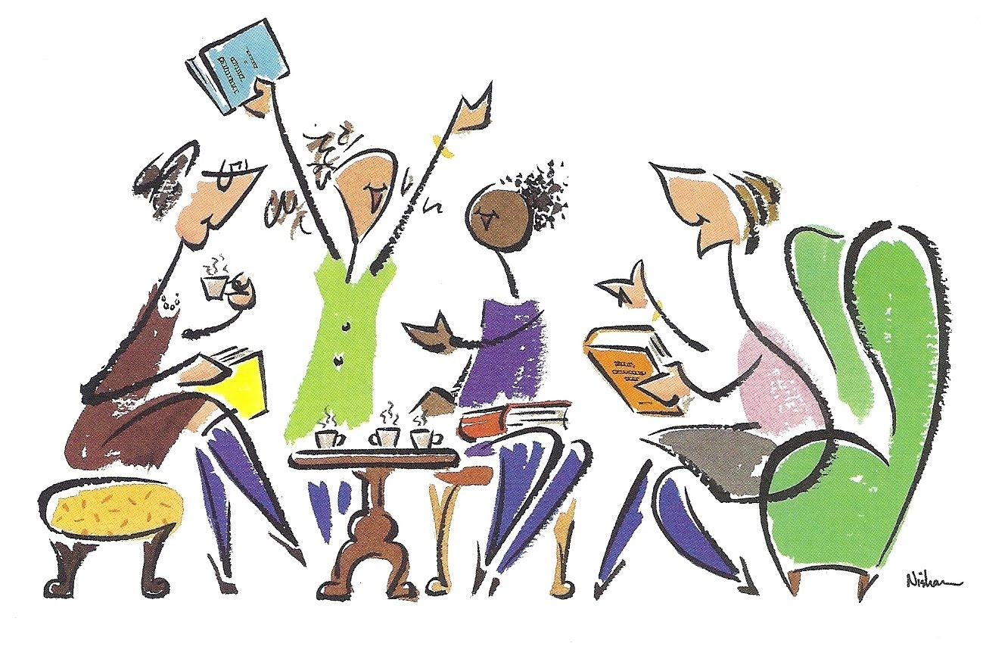
All of these materials are available to anyone to use
to teach
teach
teach
teach
teach…..
However you decide is best for your group to learn.

Slide 30

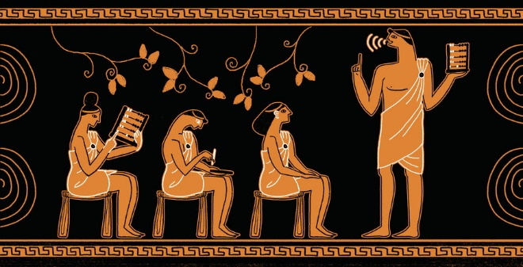
I am available to facilitate any learning you and your friends
might want…. as you learn about the history of MONEY and POWER.
I just need a regular time and day, and a skype connection.
Or your group can learn it by just reading, discussing, using the powerpoints, or however is best for you.

Slide 31

My reasons for teaching the LOST SCIENCE OF MONEY were several:
Learning the history of money
Hear the thoughts and feelings of others doing the same
Help myself and others understand how the world worked.
Spread the HIDDEN TRUTH!

Slide 32
E.
CREATE A WEBSITE

Slide 33
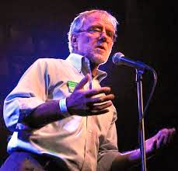
The AMI Conference of 2015
invited Green Party members to participate
Howie Hawkins, a well-known Green, gave the keynote speech, on the history of third parties in U.S. history. This included parties like the Greenback Party.
Howie knows the history of money very very well.

Slide 34
After Howie’s talk,
during the Q&A, we asked him:
“Howie, what should we do next?”
His answer: “Create a website to teach people about money, and about the NEED ACT in the Green Party National Platform. But one thing … KEEP IT SIMPLE!

Slide 35

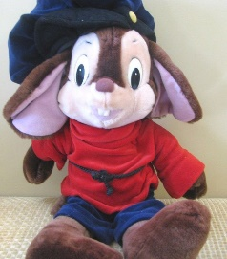
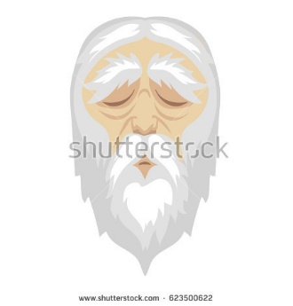
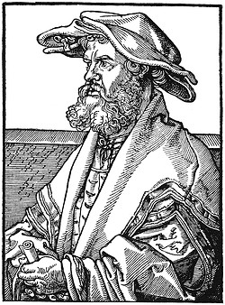
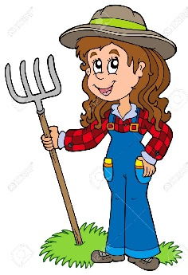
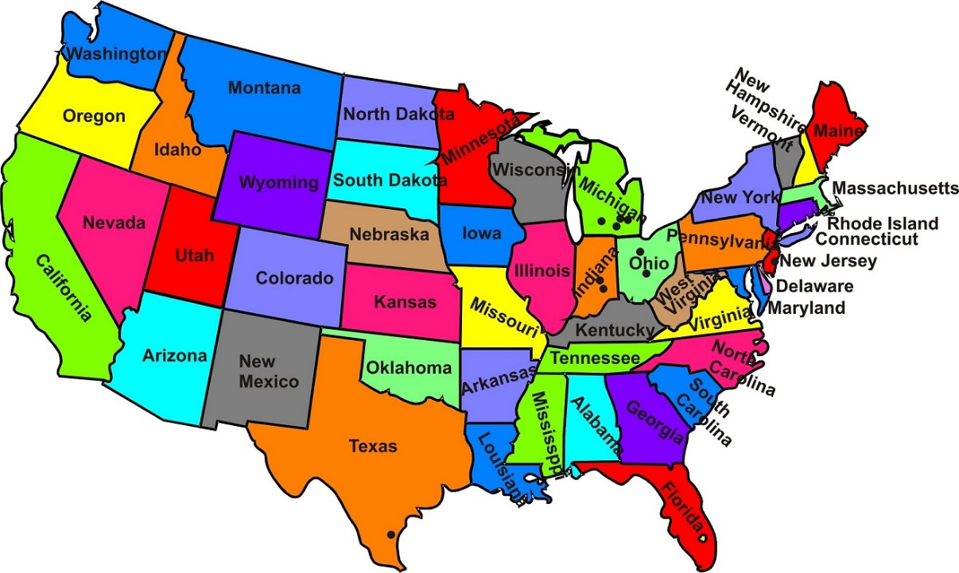


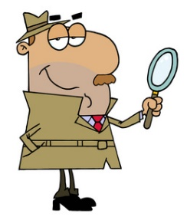
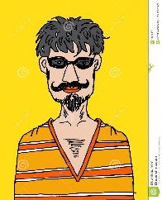
Over the next several months,
a small group began to work on the website,
for two hours… one day a week.
WEBMASTER
ALLEN
Along the way,
these people helped us:
HOWARD, TENN.
PROF. HUBER, GERMANY
Upstate New York State
JEAN
HOWARD
PROF. HUBER
New York City
SUE
San Antonio, Texas
Miami, Florida
Norman, Oklahoma
CATHY & STEVE
KEVIN
WILL

Slide 36
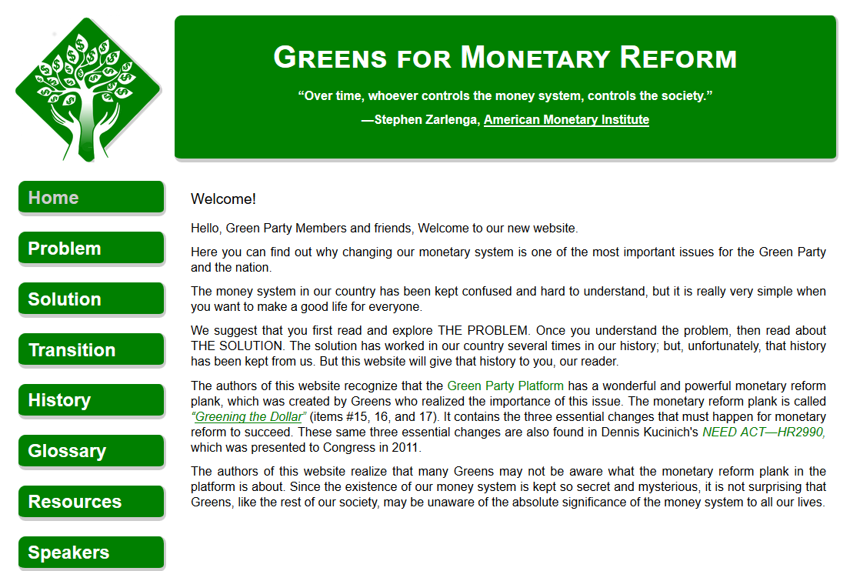
Today, we have the website…. GreensForMonetaryReform.org

Slide 37
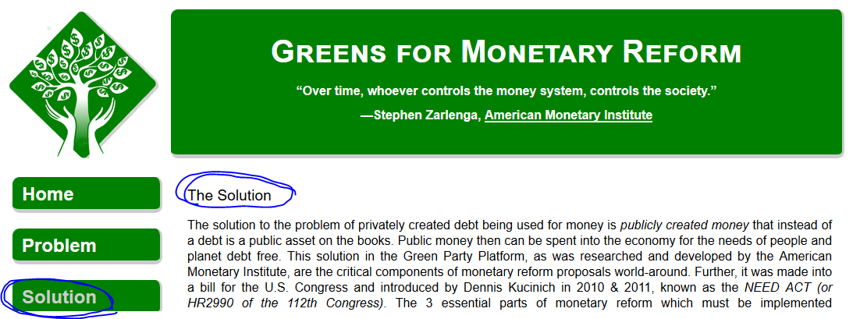
The website explains the 3 reforms that are necessary
to be implemented together.
Nationalize the 12 Federal Reserve Banks
End bank creation of money
The federal government creates and spends money into the economy,
for the needs of the nation and its people.

Slide 38

We have begun to use it to spread the word….
GP Local Groups
GP State members
Put monetary reform into state platforms
GP National members
P.S. -- even if you’re not a Green Party member,
the website is great!
GP Local Candidates
Put monetary reform into local election campaigns

Slide 39
F.
CONNECT AMI TO OTHER GROUPS
NORM

Slide 40
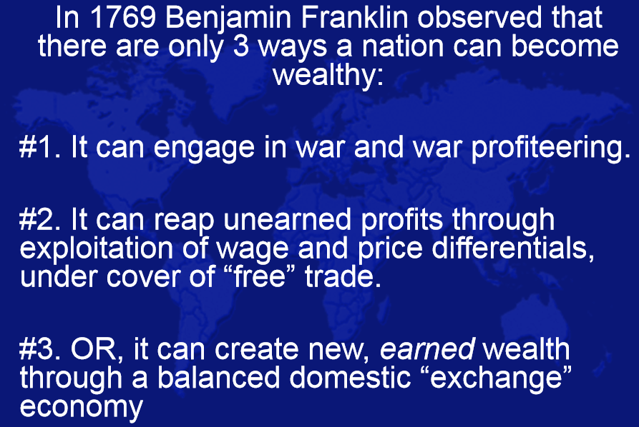
About a year ago, my friend Geri Perry
shared a Left Forum panel with me.
Geri included in her slides, the following:
#1 Make war -- take the wealth by force
#2 Trade – to be profitable requires cheating
#3 Or… it can profit through agriculture,
whereby planting a seed creates
new wealth as if by a miracle

Slide 41
When I asked my website group, what they thought about Ben Franklin’s choices of how a country can become wealthy, Will said:
Will: “Well, we all know about the wars we’re in. And about #2 Trade?
Look at the World Trade Center in New York. It’s all about cheating.
The world’s traders have built a showcase – a theater - to make us
think this is where wealth comes from.“
“It’s the guy who is working down here on the farm that’s created
our wealth. Just hard work.”
Norman, Oklahoma
WILL

Slide 42

So I talked to Geri, and started reading about NORM –
The National Organization for Raw Materials
normeconomics.org
I discovered NORM is very much like the AMI:
  they have knowledge that is PROVABLE (not theory)
  about how an economy works and how money can be distributed
  as widely as possible to the owners and workers of
  private enterprise
  their knowledge has been suppressed by the MONEY POWER!

Slide 43
Again, I asked myself the question:
WHY HAVEN’T I BEEN TAUGHT THIS IN MY EDUCATION?

Slide 44



Agriculture must be considered the foundation of the economy of the United States:
  it is the nation’s largest industry
  it creates the biggest share of the raw material input of new wealth in any accounting period

Slide 45



Wild berries feed no one until someone picks them. New wealth is created by the application of human labor to natural resources.

Slide 46




Our cities, industries, and small businesses would not exist without the work of the farmers.

Slide 47

A PARITY PRICE FOR RAW MATERIALS
PARITY PRICES keep agriculture in balance with the costs of labor and capital in the rest of the economy.
Parity ensures that EARNED INCOME will be DISTRIBUTED throughout the economy as widely and as fairly as possible.

Slide 48







Gross farm income generates earned national income.
If earned national income is too low to avoid deficits (debts),
ag prices are below parity.

Slide 49
With parity, gross farm income will multiply as it is spent through the domestic economy at least 7 times.

Slide 50




With parity, earned income will be fairly distributed to owners and workers throughout our private enterprise economy = PROSPERITY. With no debt creation!
PARITY PRICES
BUY FROM RURAL STORES
PURCHASE TRACTORS & MORE
PAY WORKERS GOOD WAGES

Slide 51

Both the AMI and NORM want a just world, where all citizens have the opportunity for a decent life.
Both are fighting the money power. And both want to get public U.S. money into the hands of our citizens.
Congress will create and distribute new public U.S. money
into the economy for infrastructure, education, health care.
A parity price will fairly distribute public U.S. money
as earned income to owners and workers
throughout our private enterprise economy.

Slide 52

NORM’S EQUITABLE TRADE
In addition, NORM has proposed Equitable Trade. Not the current ‘free, cheating’ trade!
With Equitable Trade, the standard of living of the poorer countries will be encouraged
to come up to our standard.
Middlemen, international traders, and bankers cannot make a profit off of this trade.
Equitable trade takes place between importers/exporters in each country.

Slide 53



THAT WAS ALL I NEEDED!
I READ….
      I ASKED QUESTIONS…..
I JOINED NORM AS A MEMBER…. http://normeconomics.org/
I PARTICIPATE EVERY WEEK IN THEIR MEMBER CONFERENCE CALLS.
CHARLES WALTERS
economist, eco-farmer, author

Slide 54

THE END
… I hope my experience will help you ask…
“what do I want to do?”
  You will help your family, community, country.
And you will have fun!

