Slide 1
MONEY AND WAR:
To end war, we must change the monetary system.
Peace Action
11/4/13

Slide 2

My Lightbulb Moments
My Job
Watching a Documentary Film
My Dizziness

Slide 3
  PART 1 Nature of Money Purposely Kept Secret and Confused:
  PRIVATIZED MONEY
  PART 2 The Primary Importance of the Money Power:
  GENERATING WAR
  PART 3 How a Society Defines Money Determines Who Controls It:
  THE SOLUTION

Slide 4
PART 1
Nature of Money Purposely Kept Secret and Confused
BECAUSE…
OUR NATIONAL MONEY HAS BEEN
PRIVATIZED

Slide 5
1 What is money?
2 What do we use as money?
3 What are the effects of this money system?
PART 1
NATURE OF MONEY PURPOSELY KEPT SECRET AND CONFUSED

Slide 6
TOPICS
1 WHAT IS MONEY?

Slide 7
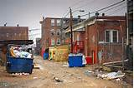

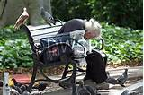
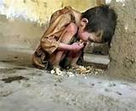
MONEY IS UNIQUE – IT HAS THE POWER OF LIFE AND DEATH
Without money, people die.

Slide 8




MONEY IS UNIQUE
ESSENTIAL FOR SOCIETY TO EXIST AND FUNCTION
A HUMAN INVENTION
EXISTS IN LAW

Slide 9






MONEY CAN BE DEFINED BY ITS FUNCTIONS
A Means of exchange – a ticket to buy what we need.
A Means of payment – legal power to pay debts

Slide 10


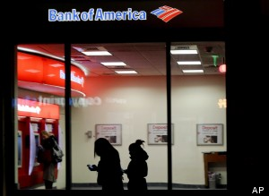
WHAT MONEY IS NOT
MONEY IS NOT WEALTH ---
IT IS USED TO BUY WEALTH.
MONEY IS NOT DEBT:
DEBT IS PAID WITH MONEY.

Slide 11
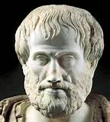
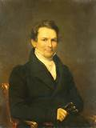
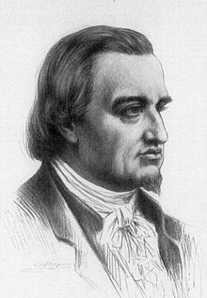
A SOCIETY DEFINES ITS MONEY IN THE LAW
Aristotle (384 BC – 322 BC):
"Money exists not by nature but by law."
Edward Kellogg, 1861, A New Monetary System:
“The most important fundamental law in any nation
is that which institutes money…”
Meyer Rothschild- private banker:
“Give me control of a nation’s money supply,
and I care not who makes its laws.”

Slide 12
TOPICS
WHAT DO WE USE FOR MONEY?

Slide 13



WE HAVE
PRIVATELY ISSUED BANK CREDIT

Slide 14

PRIVATE commercial banks
create bank credit…..
which functions as money
but is DEBT.

Slide 15


PRIVATE COMMERCIAL BANKS –
Do not lend your deposits to borrowers
NO
DEPOSITS
LOANS

Slide 16
IT IS THE EXACT OPPOSITE !!!

Slide 17
A borrower signs a loan contract,
and the BANK CREATES A DEPOSIT
in the borrower’s account
LOANS
CREATE
DEPOSITS

Slide 18


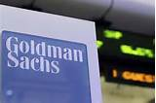
I’VE NEVER HEARD OUR MONEY SUPPLY
COMES FROM PRIVATE BANK LOANS !!!
WHERE DID THIS
DEBT-MONEY SYSTEM COME FROM ???

Slide 19
1913 FEDERAL RESERVE LAW
CORPORATIONS
NEW YORK FEDERAL RESERVE BANK:
COMMERCIAL BANKS:
OWNERS OF NY FED BANK
NEW YORK FEDERAL RESERVE BANK
CORPORATIONS
GOLDMAN SACHS
BANK OF
AMERICA
CITIGROUP
J.P.MORGAN
CHASE
DEUTSCHE BANK
HSBC
UBS
MIZUHO
CORPORATE BANK
ETC.

Slide 20
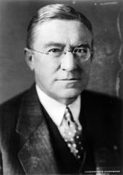
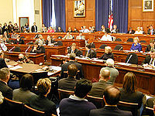
Who knew about this private takeover of our money?
How do I know it is true?
Louis McFadden (R-PA), Chairman of the
US House Banking and Currency Committee 1920–1931:
"Some people think the Federal Reserve Banks are U.S. government institutions. They are private credit monopolies… money lenders which prey upon the people the United States for the benefit of themselves and their foreign. customers…"

Slide 21
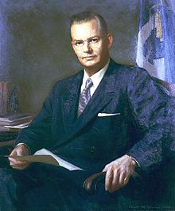
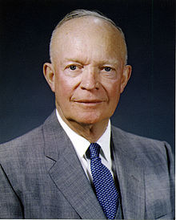
Who knew about this private takeover of our money?
How do I know it is true?
Robert B. Anderson, Secretary of the Treasury under President Eisenhower:
"When a bank makes a loan it simply adds to the borrowers’ deposit account in the bank by the amount of the loan. The money is not taken from anyone else's deposit; it was not previously paid in to the bank by anyone. It's new money, created by the bank for the use of the borrower.“

Slide 22
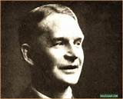
Who knew about this private takeover of our money?
How do I know it is true?
Dr. Frederick Soddy, THE ROLE OF MONEY
“The “money-power” … is … nothing more nor less than a new technique designed to create and destroy money by adding and withdrawing figures in bank ledgers, without the slightest concern for the interests of the community….”

Slide 23
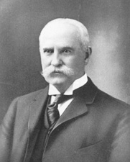
Who knew about this private takeover of our money?
How do I know it is true?
1913 – Nelson Aldrich, Rhode Island Senator and Chairman, Senate Finance Committee
Speaking before The Academy of Political Science:
“… it will be the first and most important step toward changing our form of government from a democracy to an autocracy.”
MEMBER, JEKYL ISLAND CLUB

Slide 24
TOPICS
WHAT ARE THE PURPOSES OF THE
PRIVATE MONETARY SYSTEM?

Slide 25
PURPOSE #1:
CONCENTRATION OF WEALTH

Slide 26

The INTEREST on the loan is never created by the bank.

Slide 27




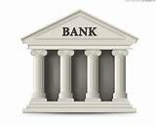
IT IS BUILT INTO THE SYSTEM –
There will always be people who cannot pay off their debts.
The banks get the collateral.

Slide 28
IT IS BUILT INTO THE SYSTEM –
The private banks get interest on all of our money
HOUSEHOLDS
SMALL
BUSINESS
RETAILERS
MORTGAGE, CC, STUDENT, ETC. INTEREST
SMALL BUSINESS LOAN INTEREST
PRIVATE
BANKS
FEDERAL DEBT
INTEREST
CORPORATE LOAN INTEREST
LABOR
CORPORATE
PRODUCTION &
DISTRIBUTION

Slide 29
PURPOSE #2
TO WAGE WAR,
THE MOST PROFITABLE ACTIVITY

Slide 30
OUR FEDERAL GOVERNMENT
BORROWS MONEY
WHY ?

Slide 31
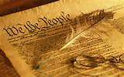
OUR CONSTITUTION GIVES THE POWER TO ISSUE MONEY
TO OUR CONGRESS ….. DEBT-FREE ….. INTEREST-FREE …..
ARTICLE I
Section. 8. The Congress shall have Power …..
To coin Money, regulate the Value …..

Slide 32
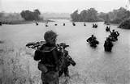

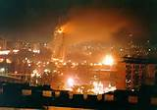
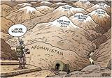
BUT…WAR CAN ONLY BE FUNDED BY DEBT
Borrowing for war requires the people
to only pay the interest from their taxes.
People could not and would not fund
the entire cost of the wars.

Slide 33
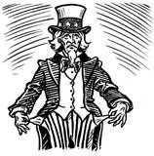

IT IS BUILT INTO THE SYSTEM –
According to the 1913 Federal Reserve Law,
the NY Fed Bank can create money to buy government bonds (debt).
INTEREST EXPENSE
Available Historical Data Fiscal Year End
2013……. $415,688,781,248.40
2012……. $359,796,008,919.49
2011……. $454,393,280,417.03
2010……. $413,954,825,362.17
2009……. $383,071,060,815.42
17.2 TRILLION $ DEBT
10/31/2013
2 TRILLION $ INTEREST
2009 THRU 2013

Slide 34

Financial historian William F. Hixson wrote:
“For the government to permit banks to issue money, borrow that money, and pay interest on it is idiotic!

Slide 35
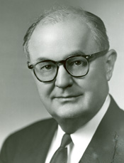
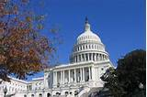
Wright Patman, TX Democrat,
Chair, US House Committee on Banking and Currency (1965-75):
"I have never yet had anyone who could, through the use of logic and reason, justify the Federal Government borrowing the use of its own money. "

Slide 36
PURPOSE #3
PRIVATE MONEY CREATION CONTROLS OUR GOVERNMENT

Slide 37
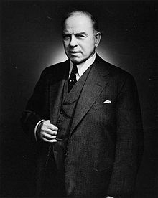
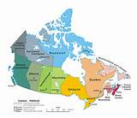
William Lyon Mackenzie King, 10th Prime Minister of Canada 1935-48:
"Until the control of the issue of currency and credit is restored to government and recognized as its most sacred responsibility, all talk of the sovereignty of parliament and of democracy is idle and futile....”

Slide 38
IT IS BUILT INTO THE SYSTEM –
The power of money creation buys any government.
LOBBYISTS
GIVE LOANS &
CONTRIBUTIONS TO
NEW YORK FED
BANKS
PACS
ELECTIONS

Slide 39
PURPOSE #4:
PRIVATE MONEY CREATION DECIDES
THE DIRECTION OF THE SOCIETY

Slide 40
IT IS BUILT INTO THE SYSTEM –
The power of money creation funds the Financial – Military – Industrial Empire
HEDGE FUNDS, ASSET MANAGERS
STOCKS, BONDS, DERIVATIVES
GOLDMAN, CITIBANK, MORGAN CHASE, BOA, ETC.
LOANS & INVESTMENT
WEAPONS

Slide 41
PURPOSE #5
PRIVATE CONTROL OVER EDUCATION
AND THE PEOPLE

Slide 42
The fraud of the Money System must not be known.
MEDIA CORPORATIONS
to confuse the public
HISTORY DEPARTMENTS
to erase
monetary history
GIVE LOANS AND INVESTMENTS TO….
FED RESERVE
MEMBER BANKS
ECONOMICS DEPARTMENTS
To erase money
UNIVERSITIES FOR
MILITARY RESEARCH

Slide 43
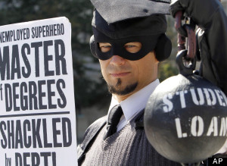
PRIVATELY-ISSUED
DEBT-MONEY
KEEPS EVERYONE IN DEBT
INDIVIDUAL DEBT
STUDENT DEBT | $ 1 TRILLION
CREDIT CARD DEBT | $ .8 TRILLION
MORTGAGE DEBT | $ 13 TRILLION
CORPORATE DEBT
NON-FINANCIAL CORP DEBT | $ 9 TRILLION
FINANCIAL CORP DEBT | $ 14 TRILLION
GOVERNMENT DEBT
STATE, LOCAL GOVT DEBT | $ 3 TRILLION
FEDERAL GOVT DEBT | $ 17 TRILLION
TOTAL PRIVATE, CORP, GOVERNMENT DEBT | $ 57.8 TRILLION

Slide 44
END
PART 1

Slide 45

PART 2
The Primary Importance of the Money Power
IN GENERATING
WAR

Slide 46
TOPICS
#1 EXAMPLE: Banks and World War I
#2 EXAMPLE: Banks and Nuclear Weapons
Notes:
3 what is our current monetary system???

Slide 47
#1 EXAMPLE:
FUNDING WORLD WAR 1

Slide 48
1900: AMERICAN BANKING ELITES
CONTROL INDUSTRIAL CARTELS

Slide 49
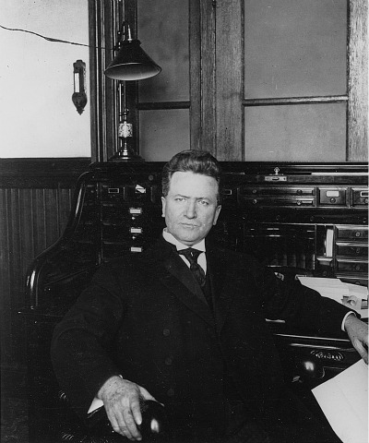
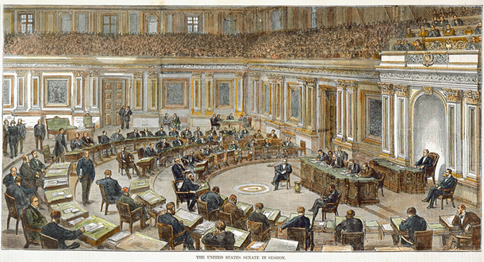
1900: AMERICAN BANKING ELITES CONTROL INDUSTRIAL CARTELS
Congressional Record — Senate
1908 March 17
SENATOR ROBERT LA FOLETTE

Slide 50
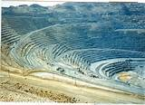
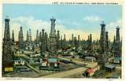
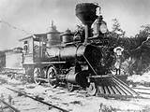
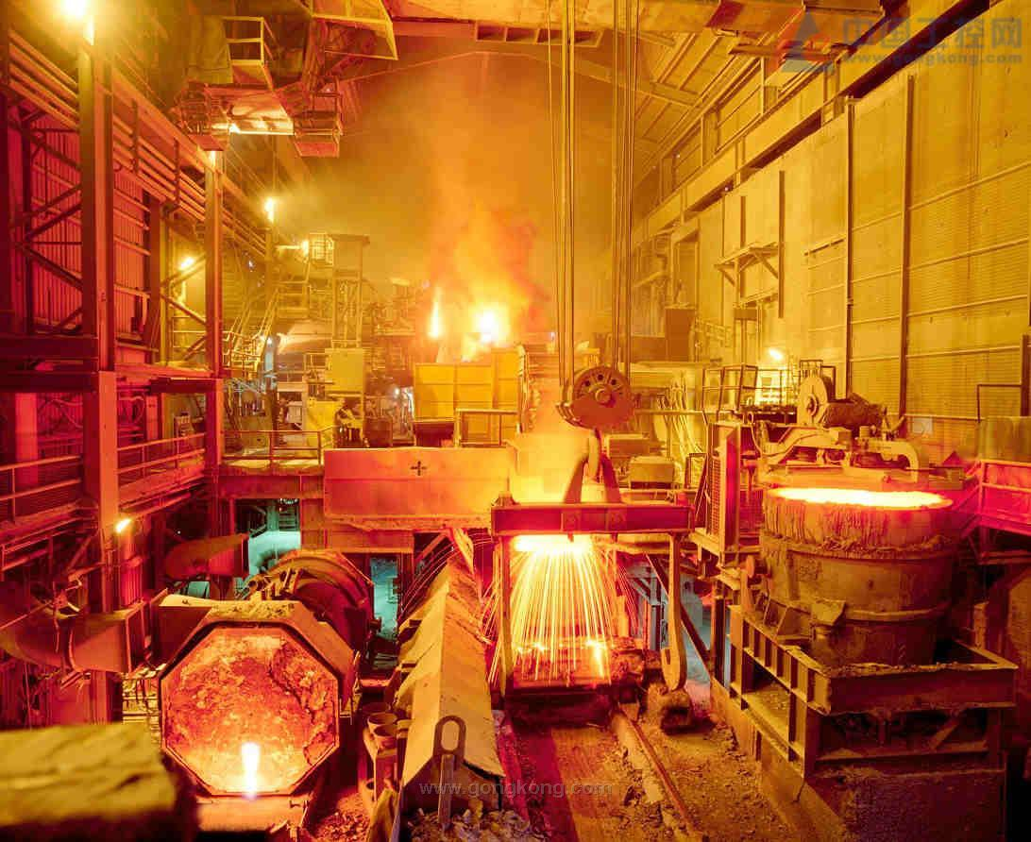
1900: AMERICAN BANKING ELITES CONTROL INDUSTRIAL CARTELS
SENATOR ROBERT LA FOLETTE:
“I shall ask, Mr. President, to have incorporated in the RECORD
this list of about 100 men with their directorships….
transportation… industrial… commercial …
a small group of men hold in their hands the business of this country.“

Slide 51
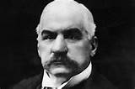
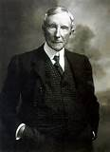
1900: AMERICAN BANKING ELITES CONTROL INDUSTRIAL CARTELS
SENATOR ROBERT LA FOLETTE - continuing:
“But the country seems not to understand how completely great banking
institutions in the principal money centers have become bound up with the
control of industrial institutions…
these sixty-two men, who are directors of the (Morgan and
Rockefeller) banks, are not additional to the … 100 men
to whom I have referred … but a most important part of it.“
Rockefeller’s
National City Bank
(today’s Citibank)
J.P. Morgan’s
National Bank of Commerce

Slide 52
1914: WAR BREAKS OUT IN EUROPE
The U.S. is neutral…?

Slide 53
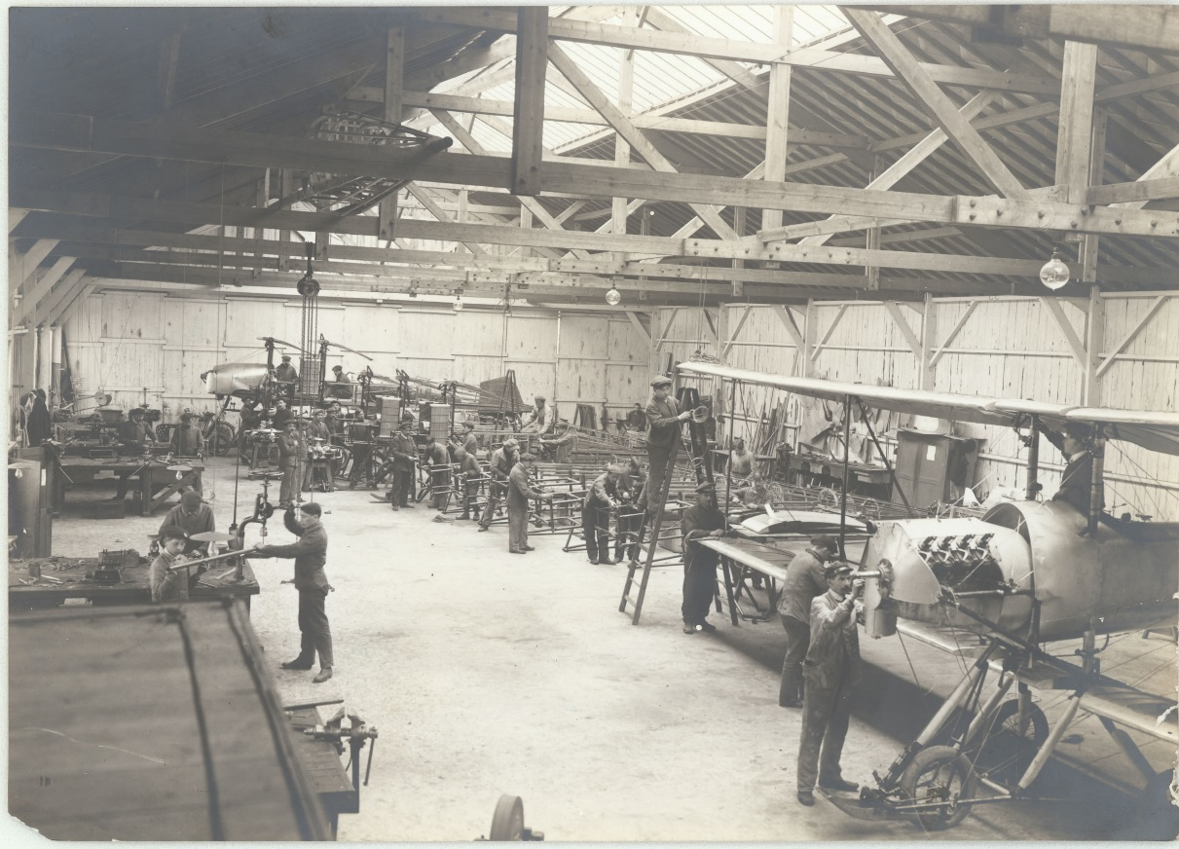
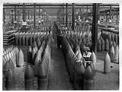
1914, J.P. Morgan & Co., Private Investment Bank
By 1916, organizes loans to Britain and France for staggering 1.2 billion dollars of war munitions
By the 1917 entrance into war by U.S., 5 billion dollars of war supplies and weapons have been exported from the country by Morgan syndicate

Slide 54
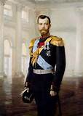
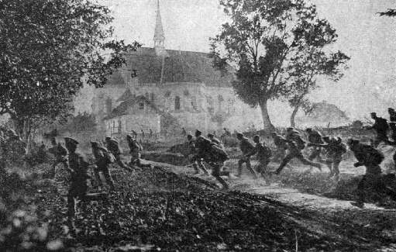
Early March 1917: Russian Czar Nicholas II abdicates --
Russian front against Germany collapses
COULD GERMANY WIN THE WAR?
J.P.MORGAN AND OTHER BANKING ELITES WOULD BE RUINED

Slide 55
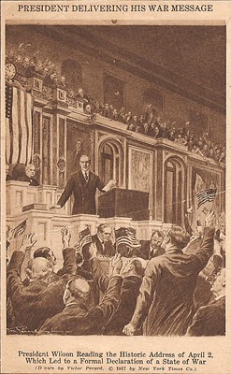
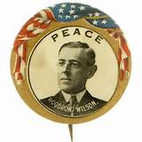
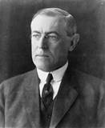
April 1917: President Wilson, The Peace President,
asks for a declaration of war against Germany

Slide 56
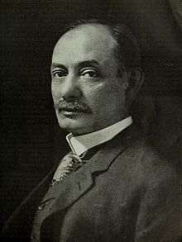
April 1917: President Wilson, The Peace President,
asks for a declaration of war against Germany
March 5, 1917 - confidential dispatch from Walter Hines Page,
US Ambassador to London, to Wilson:
“I think that the pressure of this approaching crisis has gone beyond the
Ability of the Morgan Financial Agency….If we should go to war with
Germany, the greatest help we could give the Allies would be such a credit…
Unless we go to war with Germany our Government, of course, cannot make
such a direct grant of credit……
He added that the alternative to war was domestic collapse of the US….

Slide 57

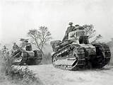
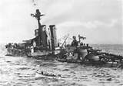
April 1917: President Wilson, The Peace President,
asks for a declaration of war against Germany
April 1917 to the Armistice of 11/11/1918:
U.S. government lent the European Allied Powers the stupendous sum of 9.4 billion dollars.
All this money went to American industries, most tied to Morgan, Kuhn-Loeb, and Rockefeller, to pay for war supplies for allies.

Slide 58
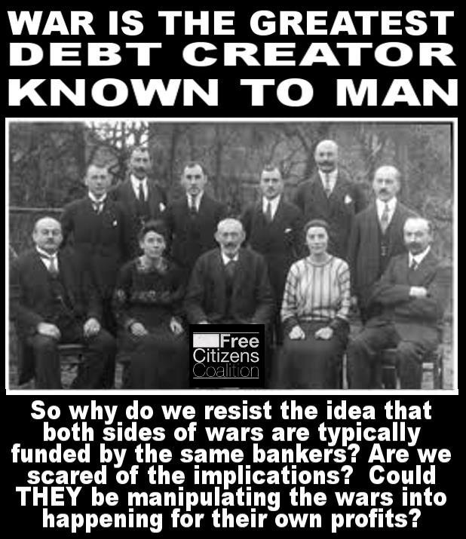
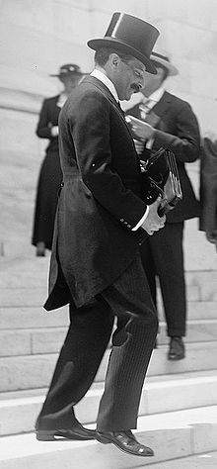
THE WARBURGS
PAUL WARBURG WAS
PART OF THE SECRET
JEKYL ISLAND GROUP THAT
SECRETLY WROTE FEDERAL
RESERVE LAW. HE LATER
WAS APPOINTED TO ITS
FIRST BOARD OF GOVERNORS
FROM 1914 UNTIL 1918,
AND…..
THE GERMAN WARBURG BANK WAS
FUNDING THE KAISER’S WAR.
MAX WARBURG (PAUL’S BROTHER)
WAS HEAD OF THE GERMAN
SECRET POLICE.

Slide 59
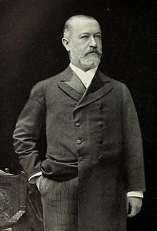
KUHN, LOEB AND COMPANY
JACOB SCHIFF, Head, KUHN, LOEB & Co.,
PRIVATE NEW YORK INVESTMENT
BANK ALLIED WITH MORGAN, whose
daughter married Felix Warburg, brother
of Paul Warburg. Paul married the daughter
of the other KUHN, LOEB owner, Solomon Loeb –
SCHIFF HAD TWO BROTHERS IN
GERMANY DURING THE WAR
WHO ALSO WERE ACTIVE
AS BANKERS TO THE GERMAN
GOVERNMENT.
Schiff served as a director of
Equitable Life Assurance Society,
National City Bank of New York,
Central Trust Co.,
Western Union Telegraph Co.,
Union Pacific Railroad,
Bond & Mortgage Guarantee Co.,
and Wells Fargo & Co.

Slide 60
#2 EXAMPLE:
FUNDING NUCLEAR WEAPONS

Slide 61
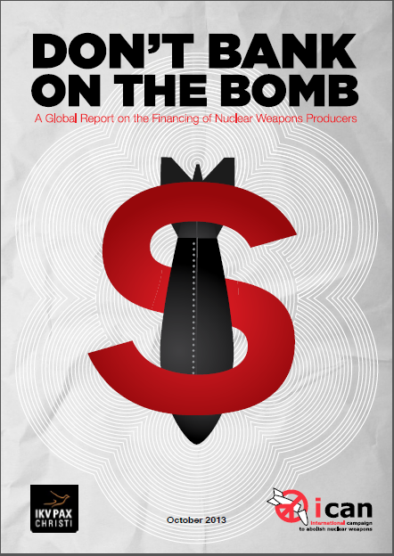
BY PAX CHRISTI,
DUTCH PEACE ORGANIZATION,
THE NETHERLANDS
2013

Slide 62
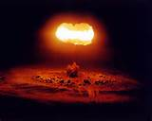
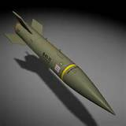
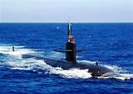
THE BANKS FINANCING AND INVESTING
IN NUCLEAR WEAPONS
ARE TIED TO THE FEDERAL RESERVE SYSTEM

Slide 63
Financial Institutions most heavily invested in nuclear weapon producers
North America
State Street invests USD 20,441.16 millions
2. Capital Group of Companies invests USD 19,490.53 millions
3. Blackrock invests USD 19,239.67 millions
Europe
Royal Bank of Scotland (United Kingdom) invests USD 5,635.70 millions
2. BNP Paribas (France) invests USD 5,366.37 millions
3. Deutsche Bank (Germany) invests USD 4,764.43 millions
Asia
Mitsubishi UFJ Financial (Japan) invests USD 4,033.90 millions
2. Life Insurance Corporation of India (India) invests USD 2.697.34 millions
3. Sumitomo Mitsui Banking (Japan) invests USD 1,462.80 millions
MEMBER – N.Y. FEDERAL RESERVE
MEMBER – N.Y. FEDERAL RESERVE
MEMBER – KANSAS CITY FED
MEMBER – N.Y. FEDERAL RESERVE
MEMBER – S.F. FEDERAL RESERVE

Slide 64



NOTICE THE POWER SUPPLY TO THE CORPORATIONS ---
N.Y. FED RESERVE
MEMBER BANKS
RAYTHEON CORPORATION
DEBT-MONEY LOANS
DO YOU NOTICE THAT CORD?
LOCKHEED MARTIN
EVERY CORPORATION REQUIRES
BANK LOANS TO EXIST.
BOEING
GENERAL DYNAMICS

Slide 65
THE FOLLOWING 3 BANKS
HAVE ALL GIVEN LOANS TO
AND INVESTED IN
NUCLEAR WEAPONS PRODUCERS

Slide 66
THE FOLLOWING 3 BANKS
ARE ALL OWNERS OF THE
NEW YORK FEDERAL RESERVE BANK

Slide 67
THE FOLLOWING 3 BANKS
ARE THE LARGEST OWNERS
OF FINANCIAL DERIVATIVES
IN THE WORLD

Slide 68
THE FOLLOWING 3 BANKS
WERE BAILED OUT BY THE
U.S. TAXPAYERS IN 2008

Slide 69
THE FOLLOWING 3 BANKS
ARE ALL CONSIDERED
TBTF – TOO BIG TO FAIL

Slide 70
J.P. MORGAN CHASE
MEMBER AND OWNER, NEW YORK FEDERAL RESERVE BANK

Slide 71
JP Morgan Chase
JP Morgan Chase currently has an estimated USD 11,880.22 million invested or available for the nuclear weapon producers identified in this report.
Loans
In October 2012, Boeing entered into a USD 4,600 million revolving credit facility.
The proceeds were used for refinancing bank debt and general corporate purposes.
JP Morgan Chase was one of … syndicate of four banks, providing an estimated amount of USD 1,380 million.553
In September 2011, Northrop Grumman secured a revolving credit facility with a value of USD 2,000 million
The proceeds were used for general corporate purposes.
JP Morgan Chase participated in the 11 bank syndicate, committing an estimated amount of USD 200 million.565
Investment banking
In November 2012, General Dynamics issued bonds with a total value of USD 2,400 million.
The proceeds were used for reduce indebtedness and general corporate purposes.
JP Morgan Chase participated in the 18 bank syndicate, underwriting an amount of USD 336 million.578

Slide 72
CITIBANK
MEMBER AND OWNER, NEW YORK FEDERAL RESERVE BANK

Slide 73
Citi
Citi currently has an estimated USD 8,145.40 million
invested or available for the nuclear weapon producers
identified in this report.
Loans
In December 2010, BAE Systems secured a five-year revolving credit facility with a value of £ 2,000 million (USD 3,161 million).
The proceeds were used for refinancing and general corporate purposes.
Citi was part of the 24 bank syndicate,
committing an estimated amount of USD 132 million.265
In June 2013, Bechtel signed a five-year revolving credit facility with a value of USD 3,000 million.
The proceeds would be used for refinancing and general corporate purposes.
Citi was one of … syndicate of eight banks, and committed an estimated amount of USD 300 million.268
In November 2011, Boeing entered into a USD 4,600 million revolving credit facility.
The proceeds were used for refinancing bank debt and general corporate purposes.
Citi was one of … syndicate of 35 banks, providing an estimated amount of
USD 920 million.270

Slide 74
GOLDMAN SACHS
MEMBER AND OWNER, NEW YORK FEDERAL RESERVE BANK

Slide 75
GOLDMAN SACHS
Goldman Sachs currently has an estimated USD 6,570.93 million
invested or available for the nuclear weapon producers
identified in this report.
Loans
In December 2010, BAE Systems secured a five-year revolving credit facility with a value of £ 2,000 million (USD 3,161 million).
The proceeds were used for refinancing and general corporate purposes.
Goldman Sachs was part of the 24 bank syndicate, committing an estimated amount of USD 132 million.438
In November 2011, Boeing entered into a USD 4,600 million revolving credit facility.
The proceeds were used for refinancing bank debt and general corporate purposes.
Goldman Sachs participated in the syndicate of 35 banks, providing an estimated amount of USD
83.6 million.441
Investment banking
In April 2013, EADS issued new shares, raising € 2,261.2 million (USD 2,946.9 million).
Goldman Sachs participated in the syndicate of two banks,
underwriting an estimated amount of USD 1,473.5 million.453

Slide 76
END
PART 2

Slide 77
PART 3
How a society defines money determines who controls it:
THE SOLUTION

Slide 78
WE DO NOT HAVE TO HAVE THIS MONEY SYSTEM!
TAKE BACK OUR GOVERNMENT…
TAKE BACK OUR MONEY SYSTEM…
FOR A MORE PEACEFUL WORLD

Slide 79
THE SOLUTION
GOVERNMENT-ISSUED,
INTEREST-FREE,
DEBT-FREE
MONEY

Slide 80
THE SOLUTION
Democracy requires public debt-free money.

Slide 81
The solution
has 3 parts.

Slide 82

#1: FED RESERVE BANKS will be owned
by the Government
Federal government buys all the shares of the 12 Federal Reserve Banks from member commercial banks.

Slide 83

#2 POWER TO CREATE MONEY will be taken
away from PRIVATE BANKS
Accounting rules will be changed.
Banks can only lend existing deposits.

Slide 84




#3 U.S. MONEY SPENT FOR THE BENEFIT OF ALL CITIZENS
Congress spends to CREATE JOBS and REAL WEALTH
for all people in the country, not the few.
  Build infrastructure -- trains, dams, bridges, levees
  Education
  Health Care

Slide 85
HR2990
This bill contains all
3 parts of the solution.

Slide 86

USA
American Monetary Institute, USA,
www.monetary.org,
drafted HR2990 with Congressman Kucinich

Slide 87
THE END

