Slide 1

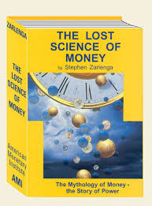
“Over time, whoever controls the money system, controls the nation.” Stephen Zarlenga (1941 – 2017)
With the founding of the American Monetary Institution (AMI) (1996) and
the publication of his book, THE LOST SCIENCE OF MONEY (pub. 2002),
Stephen Zarlenga began the new American Monetary Reform Movement for sovereign money.
Thank you, Stephen!
The LOST SCIENCE OF MONEY tells the missing history of money.

Slide 2

PART 1 THE SYSTEM PART 2 ITS CONSEQUENCES
HI! I’m going to talk about two things:

Slide 3
PART 1 THE SYSTEM
Listen up!

Slide 4
Private banks create the money we need…
Meet the system!

Slide 5


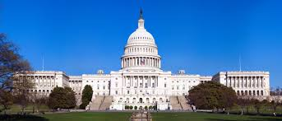

Private banks create our money! Not our government?
I don’t believe it… It’s too hard to believe…
You don’t have to believe me. Here… listen to others ➔ ➔ ➔ ➔

Slide 6
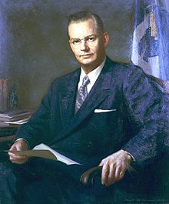
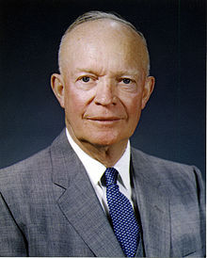
Robert B. Anderson, Secretary of the Treasury under President Eisenhower:
"When a bank makes a loan it simply adds to the borrowers’ deposit account in the bank by the amount of the loan.
The money is not taken from anyone else's deposit…
It's new money, created by the bank for the use of the borrower.“
Robert B. Anderson
Secretary of the Treasury, 1957-1961
President Dwight D. Eisenhower
1953-1961

Slide 7
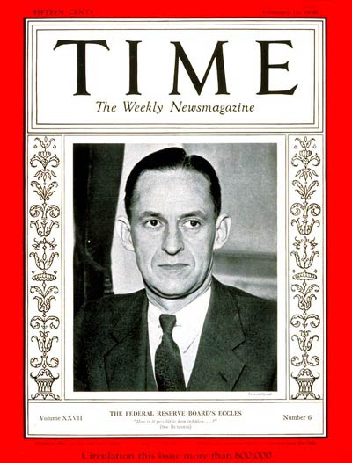
“That is what our money system is.
If there were no debts in our money system,
there wouldn’t be any money.”
Mariner S. Eccles
Chairman, Federal Reserve
under President Franklin D. Roosevelt

Slide 8
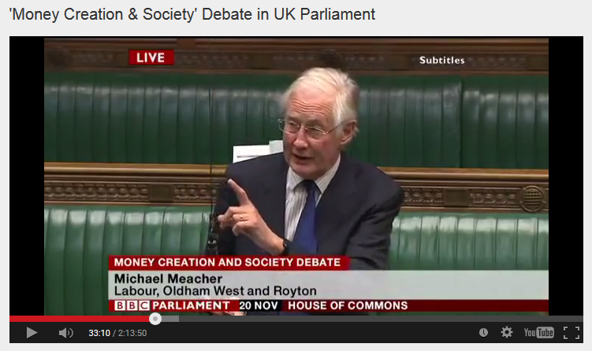
House of Commons, Nov. 20, 2014, Mr. Michael Meacher, MP:
“It is unfortunate… that it is so little understood by the public that money is created every time by the banks when they make loans.”
“And it is the banks – the banks – which determine how money is allocated across the economy.”

Slide 9
Let’s look at the money system.
How does it work?

Slide 10



#1
When a private commercial bank makes a loan, it CREATES MONEY.
(The money supply grows.)
When the loan is repaid, the MONEY DISAPPEARS.
(The money supply shrinks.)
What! This can't be! We all need that money! It mustn’t go away!

Slide 11
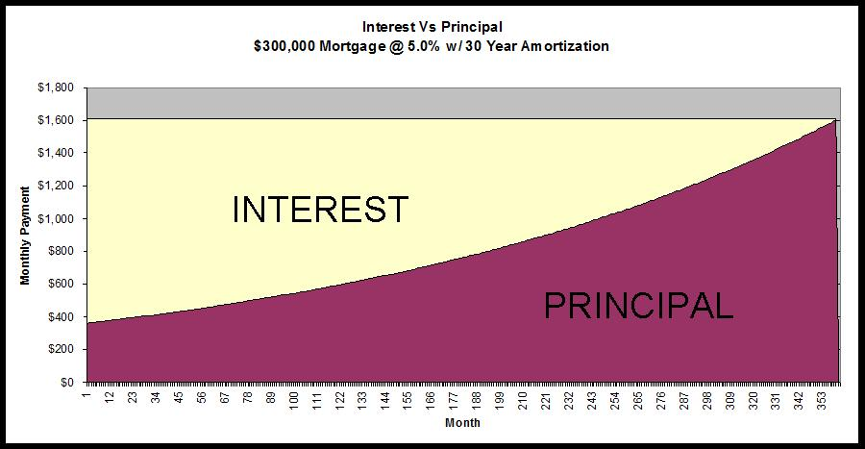
#2
Of course, we know that every borrower must pay interest.
The problem is that banks NEVER CREATE THE MONEY FOR THE INTEREST. Only for the principal of the loan.
Oh, my goodness.
This is getting really confusing. Why not create the INTEREST?
NEVER CREATED➔

Slide 12
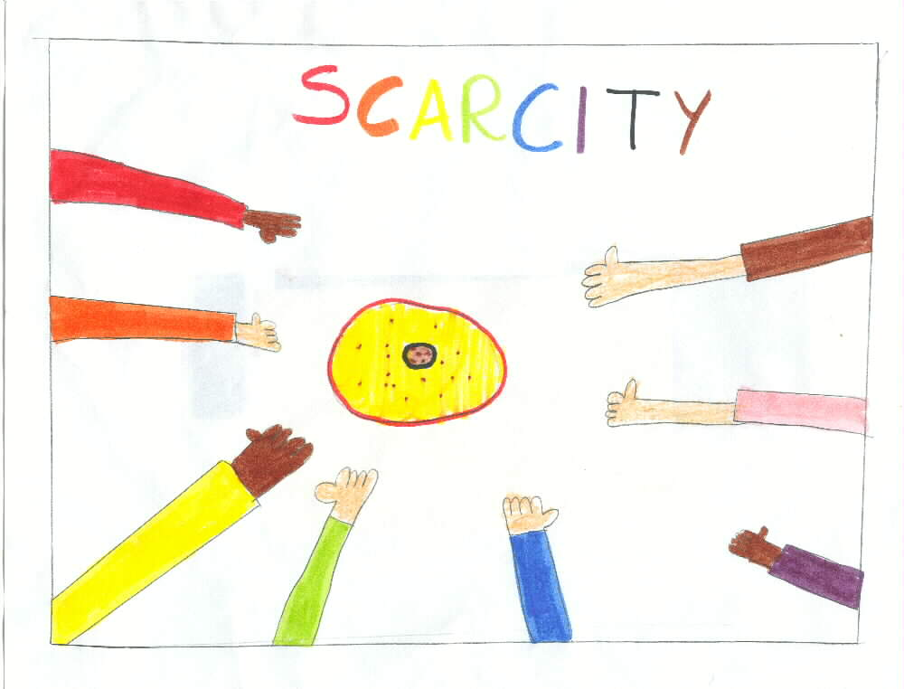


Since the money for interest is never created, money is always SCARCE.
Where will I get the money to pay the interest !!!
PRINCIPAL ONLY
LOOK HERE ➔ ➔

Slide 13






With more loans!!!
CREDIT CARD DEBT
CAR LOAN DEBT
STUDENT DEBT
HOME MORTGAGE DEBT

Slide 14
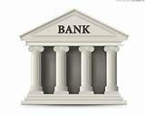
Or the bank gets the wealth -- ah -- excuse, me –
I meant ‘collateral’
DEBT SLAVE

Slide 15

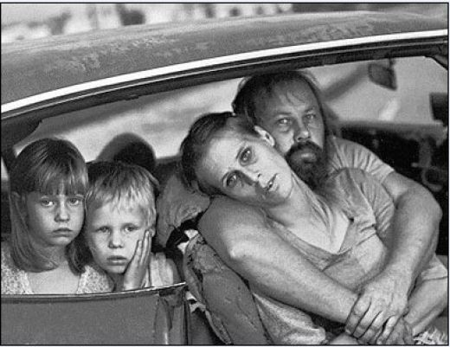

The SYSTEM DEMANDS that more loans be created,
OR ELSE the money supply will shrink and there will be defaults, foreclosures, bankruptcies, unemployment, recessions, depressions…

Slide 16


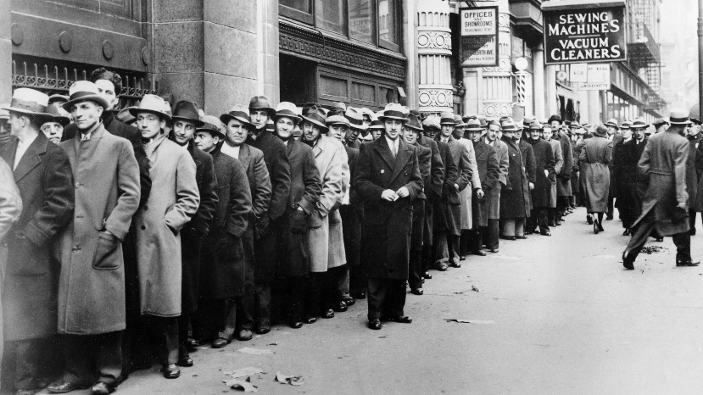
TRUTH: A private bank corporation is a
unique and abnormal corporation.
If the banks give loans,
our economy has LIFE.
If they decide to stop making loans or call in loans, our economy DIES.

Slide 17

PART 2 More CONSEQUENCES OF THIS entrenched and ruthless SYSTEM

Slide 18
THE SYSTEM CONCENTRATES WEALTH
The private banks get interest on our money supply
HOUSEHOLDS:
MORTGAGE LOANS,
STUDENT LOANS,
CAR LOANS, ETC.
SMALL
BUSINESS
LOANS
INTEREST
INTEREST
PRIVATE
BANKS
INTEREST
INTEREST
GOVERNMENT LOANS:
FEDERAL,
STATE, LOCAL
CORPORATE
LOANS

Slide 19


The bankers decide… Who gets money… How much…
Umm. I don’t like the sound
of this….

Slide 20
THE SYSTEM EMPOWERS FINANCIAL SPECULATION
HEDGE FUNDS
STOCKS & BONDS
PRIVATE COMMERCIAL BANKS:
GOLDMAN, CITI, MORGAN CHASE, BOA, ETC.
CREATE MONEY FOR
DERIVATIVES
MARKETS
CURRENCY
MARKET
TREASURY
MARKET

Slide 21
THE SYSTEM EMPOWERS THE Military-Industrial COMPLEX:
PRIVATE
MILITARY COMPANIES
WEAPONS
MANUFACTURERS
PRIVATE COMMERCIAL BANKS:
GOLDMAN, CITI, MORGAN CHASE, BOA, ETC.
CREATE MONEY FOR
UNIVERSITIES FOR
MILITARY RESEARCH

Slide 22
THE SYSTEM CORRUPTS OUR GOVERNMENTS
LOBBYISTS
CREATE MONEY FOR
PRIVATE COMMERCIAL BANKS:
GOLDMAN, CITI, MORGAN CHASE, BOA, ETC.
SUPER
PACS
DARK MONEY IN ELECTIONS

Slide 23
THE SYSTEM HIDES ITSELF FROM THE PUBLIC:
MEDIA CORPORATIONS
to confuse the public
PRIVATE COMMERCIAL BANKS:
GOLDMAN, CITI, MORGAN CHASE, BOA, ETC.
CREATE MONEY FOR
HISTORY DEPARTMENTS
to ignore
monetary history
ECONOMICS DEPARTMENTS
to erase the nature of money

Slide 24
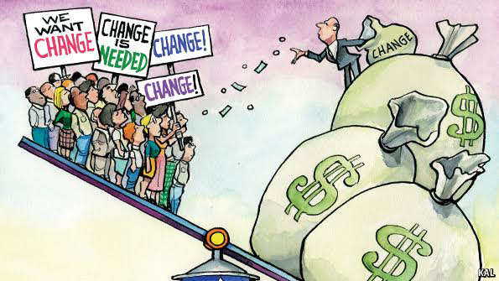

The private bankmoney system is the
ROOT CAUSE and DRIVER of …
CORPORATE CAPITALISM
The essential feature of CAPITALISM is
the misuse of the money system.
This is capitalism’s most essential feature and completely missing from the study and definition of capitalism.

Slide 25

MORE
CONSEQUENCES ?!?

Slide 26

THE SYSTEM WAS DESIGNED TO MAKE US ALL DEBT SLAVES
INDIVIDUAL DEBT
STUDENT DEBT | $ 1.5 TRILLION
CREDIT CARD DEBT | $ .8 TRILLION
MORTGAGE DEBT | $ 14.8 TRILLION
CORPORATE DEBT
NON-FINANCIAL CORP DEBT | $ 6.1 TRILLION
FINANCIAL CORP DEBT | $ 13.7 TRILLION
GOVERNMENT DEBT
STATE, LOCAL GOVT DEBT | $ 4 TRILLION
FEDERAL GOVT DEBT | $ 20.5 TRILLION
TOTAL PRIVATE, CORP, GOVERNMENT DEBT | $ 61.4 TRILLION as of March 2018
SOURCE: Federal Reserve Bank of St. Louis

Slide 27


CAUSES INFLATION
PRODUCERS ARE IN DEBT.
To pay business debts, producers are forced to raise PRICES of goods and services.
PRICES UP
It’s estimated that 30% of the price of goods
and services goes to pay debts of producers.

Slide 28



MAJOR CAUSE OF POVERTY
CONSUMERS ARE IN DEBT.
After paying debts, consumers have less disposable income to BUY goods and services.
DISPOSABLE
INCOME DOWN

Slide 29





EMPOWERS Multinationals -
over small business

Slide 30

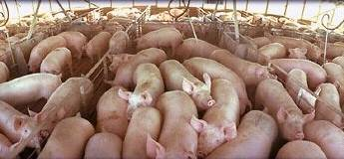
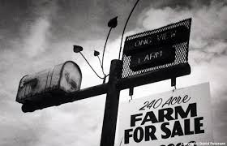



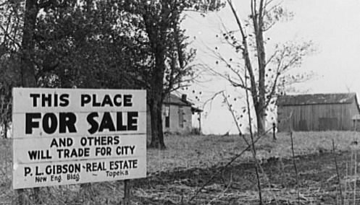
EMPOWERS factory farming –
over small farmers

Slide 31

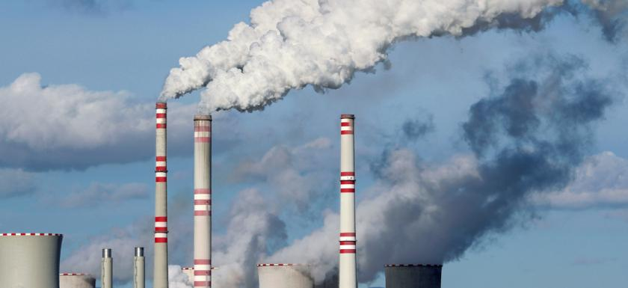

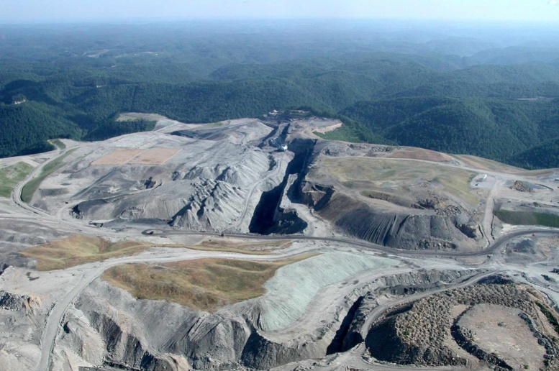
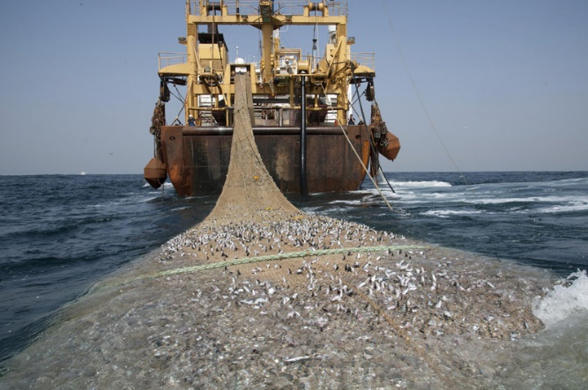
EMPOWERS MULTINATIONALS –
WHO DESTROY THE ENVIRONMENT
POLLUTING OUR AIR
DESTROYING THE RAIN FORESTS
DESTROYING THE LAND
PRIVATE BANKS CREATE MONEY
FOR MULTINATIONALS.
PROFIT IS FIRST (TO PAY DEBTS TO BANK)….
NATURE COMES LAST.
OVERFISHING THE OCEANS

Slide 32

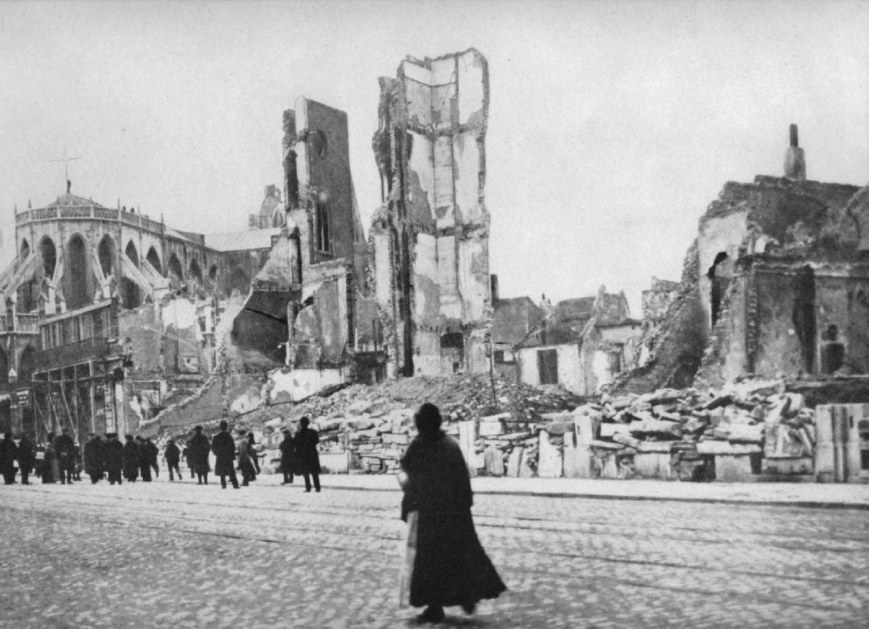

THE SYSTEM FUNDS WARS
In 1917 …
the Federal Reserve Law was changed:
member banks were allowed to create bankmoney and buy Liberty bonds at government-debt auctions.
America could afford World War 1.

Slide 33
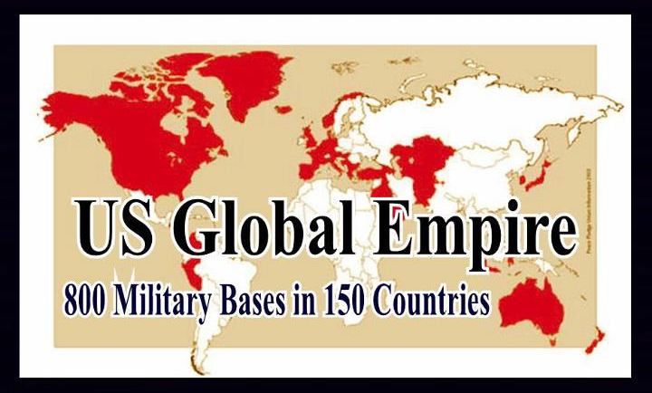
THE SYSTEM FUNDS WARS
In 2018 …
The U.S. maintains the largest military in the ENTIRE HISTORY OF THE WORLD ...
which Fed member banks support by creating bankmoney and giving loans of billions and billions of dollars to the arms industry.
And the Fed and its member banks are the
single largest owner of U.S. Bonds.

Slide 34
THIS SYSTEM CAN BE CHANGED!
Remember that!

