Slide 1
TOPIC
THE CURRENT MONETARY SYSTEM:
PRIVATELY ISSUED MONEY

Slide 2

THE CURRENT MONETARY SYSTEM is PRIVATE

Slide 3

PRIVATE commercial banks
create bank credit…..
which functions as money
but is DEBT.

Slide 4


PRIVATE COMMERCIAL BANKS –
Do not lend your deposits to borrowers
NO
DEPOSITS
LOANS

Slide 5
IT IS THE EXACT OPPOSITE !!!

Slide 6
A borrower signs a loan contract,
and the BANK CREATES A DEPOSIT
in the borrower’s account
LOANS
CREATE
DEPOSITS

Slide 7
OUR MONEY IS CREATED
WHEN WE GO INTO DEBT…
TO PRIVATE BANKS….

Slide 8
TOPIC
THE PRIVATE FEDERAL RESERVE SYSTEM
AND
THE BOOM AND BUST CYCLE

Slide 9
THE FEDERAL RESERVE BANKING BILL
- PASSED BY CONGRESS IN 1913
-SECRETLY WRITTEN BY BANKERS IN 1910
PRIVATE Federal Reserve Bank:
NEW YORK FEDERAL RESERVE BANK
PRIVATE member commercial banks:
GOLDMAN SACHS
BANK OF
AMERICA
CITIGROUP
J.P.MORGAN
CHASE
DEUTSCHE BANK
HSBC
UBS
ETC.

Slide 10


#1 Commercial banks create our MONEY SUPPLY from LOANS
BANK GETS
CUSTOMER GETS
BORROWER will find $20,000 added to his account …..
LOAN CONTRACT
for $20,000
+ $20,000
DEPOSIT

Slide 11
#2 INTEREST ?
BANK’S ASSET
CUSTOMER’S
ACCOUNT
LOAN CONTRACT
for $20,000
+ $20,000
DEPOSIT

Slide 12
INTEREST -- COMES FROM EXISTING MONEY SUPPLY…
DEBTS TO BE PAID
Principal + Interest
MONEY SUPPLY
Principal
DEMAND
SUPPLY

Slide 13

#3 WHEN A LOAN IS PAID OFF…..
BANK’S ASSET
LOAN ACCOUNT
PRINCIPAL disappears
LOAN CONTRACT
EXPIRES
$0.00
30,000.00
INTEREST
INCOME
INTEREST remains with bank

Slide 14
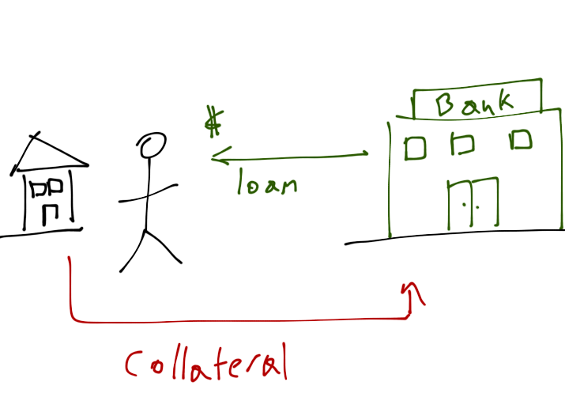

#4 WHEN A BORROWER DEFAULTS…..
BANK’S ASSET
LOAN ACCOUNT
PRINCIPAL disappears
LOAN CONTRACT
EXPIRES
$0.00
Bank gets
COLLATERAL
to sell

Slide 15
MONEY SUPPLY BALLOONS….
WHEN BANK LOANS (DEBT) INCREASES
MONEY SUPPLY
MONEY SUPPLY
STOCK MARKET BUBBLE - 1920+
MORTGAGE BUBBLE – 2004+

Slide 16
MONEY SUPPLY SHRINKS….
WHEN LOANS ARE PAID OFF OR DEFAULT
MONEY SUPPLY
MONEY SUPPLY
GREAT DEPRESSION 1930+
GREAT RECESSION 2008+

Slide 17

THE BOOM AND BUST MONETARY CYCLE
EXPANDING MONEY SUPPLY
COLLAPSING MONEY SUPPLY
BUY, BUY, BUY
Prices UP
More bank loans
SELL, SELL, SELL
Prices FALLING
Bankruptcy, foreclosure, unemployment
Buy assets cheap

Slide 18
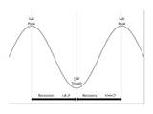
THE ‘BUSINESS CYCLE’…….
IS A BANK CREDIT CREATION CYCLE,
      creating instability for all citizens
      benefiting the few

Slide 19


WE ARE AT THE MERCY OF PRIVATE BANKS
OUR COUNTRY DOES NOT HAVE
A STABLE MONEY SUPPLY

Slide 20
TOPIC
INJUSTICE:
PRIVATELY ISSUED
CREDIT MONEY
“whoever controls the money system, over time will control the nation”

Slide 21

GOVERNMENT DEBT
$16.7 TRILLION DEBT

Slide 22
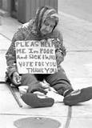



BOOM & BUST CONCENTRATES WEALTH
HOMELESSNESS
UNEMPLOYMENT
    BUSINESS BANKRUPTCIES
ASSET CONFISCATION

Slide 23
INTEREST CONCENTRATES WEALTH
HOUSEHOLDS
RETAILERS
INTEREST
PRIVATE
BANKS
INTEREST
INTEREST
INTEREST
LABOR
INTEREST
PRODUCTION
DISTRIBUTION
GOVERNMENT
DEBT

Slide 24
THE POWER OF PRIVATE BANKS TO DECIDE WHO GETS LOANS…..
CONCENTRATES WEALTH IN THE FINANCIAL SECTOR –
NOT WHERE THE JOBS ARE
HEDGE FUNDS
DERIVATIVES
TRADING
1980+
GOLDMAN, CITIBANK, MORGAN CHASE, BOA, ETC.
LOANS
CURRENCY
TRADERS
STOCK, BOND MARKETS
SECURITIZATION
CMO, MBS, ABS, etc.
1990+

Slide 25
CONCENTRATION OF CONTROL:
EDUCATION, WAR, MEDIA, ELECTIONS, GOVERNMENT
PRIVATELY-
ISSUED
MONEY
UNIVERSITIES
WAR,
SECURITY STATE
FUNDS
MEDIA OWNERSHIP
PACS
WRITING LAWS
LOBBYISTS
ELECTIONS
COURTS
(CITIZENS’ UNITED)

Slide 26

PRIVATELY-ISSUED MONEY KEEPS EVERYONE IN DEBT
STUDENT DEBT | $ 1.0 TRILLION
CREDIT CARD DEBT | $ .8 TRILLION
MORTGAGE DEBT | $ 13.0 TRILLION
CORPORATE DEBT | $ 8.7 TRILLION
STATE, LOCAL GOVT DEBT | $ 3.0 TRILLION
FEDERAL GOVT DEBT | $ 16.4 TRILLION
TOTAL PRIVATE, CORP, GOVERNMENT DEBT | $ 42.9 TRILLION

Slide 27
SOLUTION: Government-issued money
INTEREST-FREE
INDESTRUCTIBLE
SPENT FOR THE MANY
PROVEN TO WORK
FROM OUR NATION’S HISTORY

Slide 28
THE END

