Slide 1
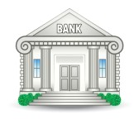
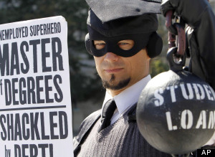
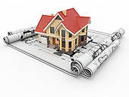

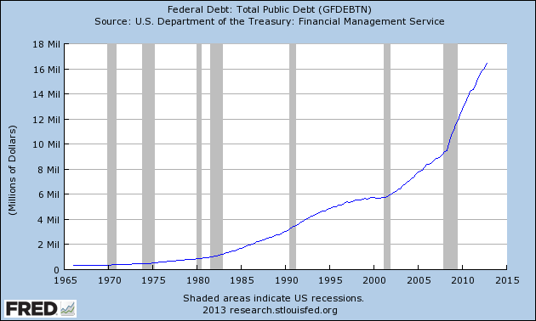
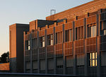
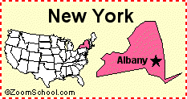
LENDING FOR PROFIT: IS LOAN INTEREST DEFENSIBLE? HOW DID OUR WORLD END UP IN SO MUCH DEBT? ANSWER: USURY
CREDIT CARD DEBT
$ .8 TRILLION
MORTGAGE DEBT
$ 13 TRILLION
STUDENT DEBT
$ 1 TRILLION +
CORPORATE DEBT
$ 8.7 TRILLION
FEDERAL DEBT
$ 16.4 TRILLION
STATE & LOCAL DEBT
$ 3 TRILLION

Slide 2
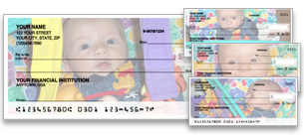

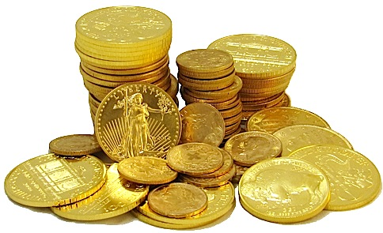
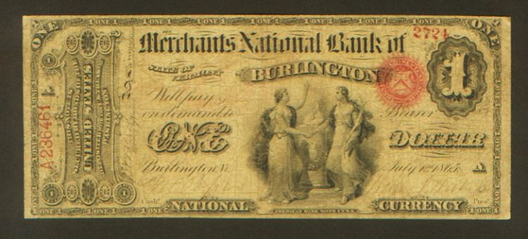
LENDING FOR PROFIT: IS LOAN INTEREST DEFENSIBLE? Does interest concentrate wealth? Steal the labor of others? Compromise the dignity of the full reward of labor? Cause economic instability? Affect negatively future generations? Destruct nature?

Slide 3
INTEREST: FEE FROM BORROWER TO LENDER FOR USE OF MONEY FIRST -- WHAT IS MONEY?

Slide 4

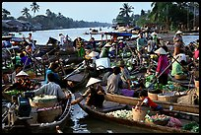


MONEY IS UNIQUE – It has the power of life and death over each and every person
It is indispensable for society to function. It is essential to the existence of society.
It is an invention of humans --A ticket system for the distribution of goods and services.
It is absolutely necessary: humans demand a means of exchange and valuation – to meet everyone’s needs for life and progress.

Slide 5




FUNCTIONS OF MONEY
Means of exchange – a ticket. Not wealth.
Store of value – an important quality - its steadiness in value. Therefore, it is useless unless its quantity is limited and controlled.
Measure of value – defined in law &
marked with stamp of sovereign authority
Means of payment: legal power to pay debts -- public and private

Slide 6
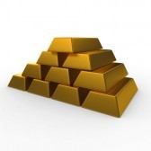
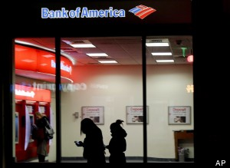
WHAT MONEY IS NOT
MONEY IS NOT WEALTH, NOT A COMMODITY.
MONEY IS A MEDIUM OF EXCHANGE,
SERVING HUMAN NEEDS.
MONEY IS NOT CREDIT (DEBT).
WE PAY OUR DEBTS WITH MONEY.

Slide 7
A SOCIETY DEFINES ITS MONEY IN THE LAW
Aristotle
“it exists not by nature, but by law”
Edward Kellogg, 1861, A New Monetary System:
“The most important fundamental law in any nation is that which institutes money; for money governs the distribution of property, and thus affects in a thousand ways the relations of man to man.”

Slide 8
FOR MOST OF HISTORY, USURY = LENDING WITH INTEREST

Slide 9
WHEN DID USURY START?

Slide 10
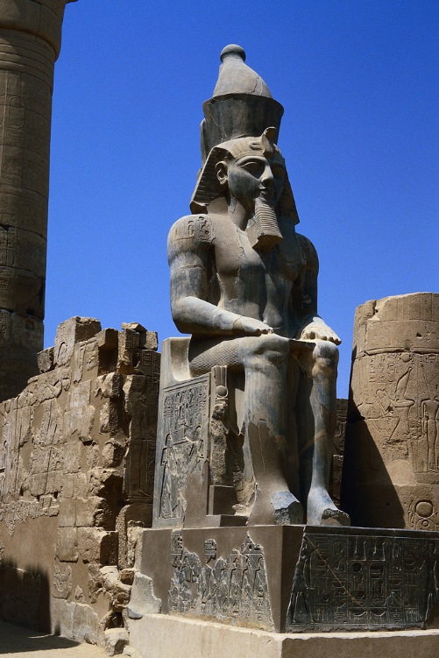
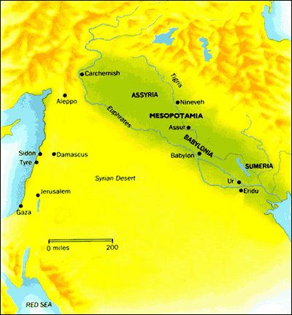
USURY IN THE FIRST CIVILIZATION: lending with interest
2500 BC Early Urban States:
EGYPT, ASSYRIA, SUMERIA, BABYLONIA
The early money was debt-money:
loans from palace and temple
using farm commodities and
silver by weight
The loan of seeds generated more seeds, but the loan of silver metal did not generate more silver.
Result: interest charged on ‘barren’ metals caused debt slavery and
loss of land to creditors.

Slide 11
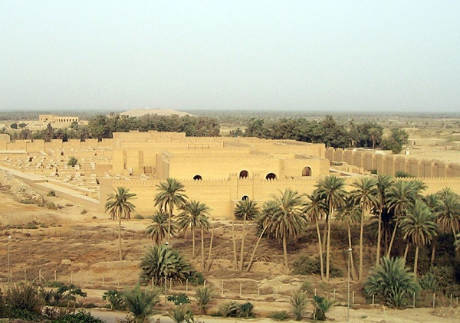
SOLUTION?
Kings issued Debt Jubilees – debt slaves were set free and land returned to them.
Thus, the King restored economic balance.

Slide 12
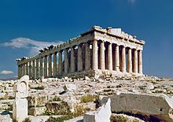
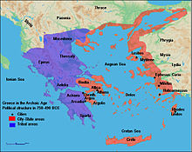
USURY IN THE GREEK CITY STATES: lending with interest
800+ BC Greek Cities: ATHENS, SPARTA, CORINTH, MEGARA, ARGOS, ETC.
The money was gold and silver coins,
loaned with interest in metals.
Result: concentration of wealth
due to interest on coined metals.
Small farmers were enslaved.
Land concentrated in the hands of few.
In Athens (594 B.C.) the bulk of the population, who had originally been small proprietors became gradually indebted to the rich to such an extent that they were practically slaves. Those who still kept their property nominally owed more than they could pay, and stone pillars erected on their land showed the amount of the debts and the names of the lenders. Usury had given all the power of the state to a small plutocracy.

Slide 13
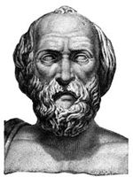
A SOLUTION IN SPARTA
As part of massive reforms to the Spartan society, LYCURGUS reformed the money system.
LYCURGUS’ REFORM
Removed gold coins
Money was iron disks
treated to be valueless
First fiat money: state law regulated
volume and thus value
Lasted for 3 ½ centuries!
820–730 BC?

Slide 14
The PRACTICE OF USURY has repeatedly been condemned prohibited scorned restricted ……………

Slide 15
BASED ON THE NATURE OF MONEY Where does the borrower get the interest? Does interest concentrate money’s power in a few hands?

Slide 16
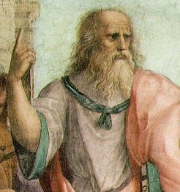
ANCIENT WESTERN PHILOSOPHERS: PLATO
“…and no one shall deposit money with another whom he does not trust as a friend, nor shall he lend money upon interest” - Laws, by Plato, Book V, 360 BCE
428/7 - 347 B.C.

Slide 17
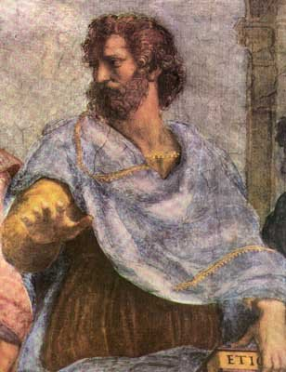
ANCIENT WESTERN PHILOSOPHERS: ARISTOTLE
“…The most hated sort, and with the greatest reason, is usury, which makes a gain out of money itself, and not from the natural object of it. For money was intended to be used in exchange, but not to increase at interest….
…And this term interest,
which means the birth of money from money…
this is the most unnatural.” - Politics, by Aristotle, Book 1
384 BC – 322 BC

Slide 18
BASED ON RELIGION AND MORALITY How do you treat your brother? Practically all important ethical teachers -- Moses, Aristotle, Jesus, Mohammed, and Saint Thomas Aquinas, for instance -- have denounced lending at interest as usury and as morally wrong.

Slide 19

JEWISH RELIGION: OLD TESTAMENT
Deuteronomy 23:19
Thou shalt not lend upon interest to thy brother.
Leviticus 25:36-37
Take thou no interest from him or increase; but fear thy God, that thy brother may live with thee. Thou shalt not give him thy money upon interest, nor lend him thy victuals for increase.

Slide 20
CHRISTIANITY
JESUS – ALL MEN ARE BROTHERS
Luke 6:34-35
But love ye your enemies, and do good, and lend, hoping for nothing again; and your reward shall be great, and ye shall be the children of the Highest: for he is kind unto the unthankful and to the evil.

Slide 21
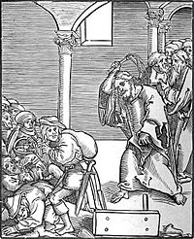
CATHOLIC CHURCH
4TH century AD – First Council of Nicaea (325) – church prohibited taking of usury by clergy under pain of expulsion from clergy
5th century AD – church prohibited taking of usury by laity
8th century AD – church declared usury to be a general criminal offence
850 – Synod of Paris – excommunicated all usurers
1179 – Third Lateran Council - excommunicated those who engage in usury – “notorious usurers should not be admitted to communion of the altar or receive Christian burial if they die in this sin.”
1311 – ban on usury absolute – Pope Clement V declared all secular legislation in its favor null and void
1515 – Lateran Council – “gain is sought from use of a thing not itself fruitful (=‘barren’) without labour, expense, risk on part of lender”
1586 - Pope Sixtus V would call the practice of usury, "most detestable to God and man, damned by the sacred canons and contrary to Christian charity."
Christ drives the Usurers out of the Temple,
a woodcut by Lucas Cranach the Elder

Slide 22
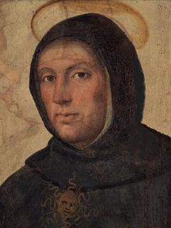
Catholic Scholastics (1100-1500 AD) Church scholars – first moral economists
“Money is medium in exchange, and not terminus.” Money is not an end in itself.
A loan has no risk to the lender; therefore usury is unearned income.
The lender cannot gain from the advantage accruing to the borrower.
Is the contract between lender and borrower equal? Is money the same as merchandise or is the borrower a slave to the lender?
But the Scholastics allowed 2 types of loans.
‘SOCIETAS’
The lender could earn interest if actually taking some risk,
without a guaranteed gain. Partnerships could be formed if
profitable investment opportunities existed. There was no objection to
seeking profit. One partner could supply labor and the other money.
Venice, the ‘first capitalistic city’ used partnerships in this category for their
banking activities.
‘CENSUS’
The obligation to pay an annual return based on some ‘fruitful’ property.
The lender took a risk, since if the crop was destroyed by weather, the
borrower had no obligation that year.
THOMAS AQUINAS
1225 - 1274

Slide 23
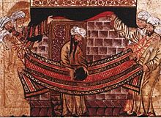
ISLAM
MOHAMMAD – ALL MEN ARE BROTHERS
Mohammed forbade… the acceptance of interest on loans…’RIBA’. This is unearned income.
‘God has permitted trade but forbidden usury. Profit is the result of initiative, enterprise and efficiency – value creation. Not so with usury… interest is fixed, profit fluctuates’
570-632 AD

Slide 24
ISLAMIC BANKING TODAY
The basic principle of Islamic banking is based on risk-sharing which is a component of trade rather than risk-transfer which is seen in conventional banking.
EXAMPLE: In an Islamic mortgage transaction, instead of lending the buyer money to purchase the item, a bank might buy the item itself from the seller, and re-sell it to the buyer at a profit, while allowing the buyer to pay the bank in installments. However, the bank's profit cannot be made explicit and therefore there are no additional penalties for late payment.

Slide 25
IN SUMMARY, CODES THROUGHOUT HISTORY HAVE RESTRICTED USURY
2130-2088 BC CODE OF HAMMURABI LIMIT TO 33%
2000-1400 BC VEDIC TEXTS OF ANCIENT INDIA - HINDU LAW BANNED USURY
600- 400 BC BUDDHIST JATAKAS: ‘USURERS..FOUL-TOOTHED…’ CONTEMPT FOR USURY
342 BC REPUBLICAN ROME BANNED USURY
49-44 BC rule of JULIUS CAESAR, ROMAN EMPIRE LIMIT TO 12 ½ %
306–337 AD rule of CONSTANTINE, THE GREAT LIMIT FROM 4-8%,
interest could not be
greater than principal
7th century AD Muslim Koran BANNED USURY
806 AD Charlemagne BANNED USURY
1981 AD United States Individual state usury laws
were sidestepped.

Slide 26
BANKING, TRADE AND CAPITALISM: Weakening of the Usury Laws
GROWTH OF TRADE AND FINANCE (BANKING) forced change upon a society. This push came first from the city of Venice (1100-1600) and other Italian cities with their banking companies. The profits of trade finance brought rapid wealth accumulation.
The ecclesiastical doctrine of interest was the greatest obstacle to modern banking, but now the pro-usury counter-movement began to grow. The new demands for goods from all across the globe created an environment that was simply too rich for the practice of usury not to flourish.
The 16th century Protestant Reformation, initiated by Martin Luther, John Calvin, and other early Protestants, allowed the split between secular society (the laws of the Princes) and the religious society (the law of the church), weakening the usury laws.

Slide 27
BANKING – MONEY OF ACCOUNT: BANKING’S SECRET
Early banking had developed a money of account, based on handwritten entries.
The Knights Templars brought back to Europe from the Crusades the knowledge of double-entry bookkeeping. This method was implemented by the banks.
“It must have soon become apparent to the Templars, the Italian merchant bankers and the great German lending houses that they possessed the power to CREATE MONEY in the form of bookkeeping credits on their books.” Stephen Zarlenga, THE LOST SCIENCE OF MONEY

Slide 28
BANKING – MONEY OF ACCOUNT: BANKING’S SECRET
Loans would not have to be made in coinage.
Loans could be made by WRITING IN CREDITS TO THE BORROWER’S ACCOUNT. The borrower would have the ability to write checks on that account.
Once the borrowers got in the habit of using checks (back then, called bills of exchange), the banker could increase the money supply with these credits. The credits would be used as a means of exchange, as money. But the new accounting money came with usury – these were loans. The Church scholars, the Scholastics, had not known about this sleight of hand – and thus could not shine the sin of usury on it!
Today it is legal and the basis of our banking system. But it is a well-kept secret.

Slide 29
BANKING – MONEY OF ACCOUNT: HOW IT WORKS TODAY

Slide 30
HOW THE PRIVATE FEDERAL RESERVE BANKS & PRIVATE COMMERCIAL BANKS CREATE ‘MONEY’
NEW YORK FEDERAL RESERVE BANK:
OWNED BY ITS MEMBER BANKS
COMMERCIAL BANKS:
OWNERS OF NY FED BANK
NEW YORK FEDERAL RESERVE BANK
GOLDMAN SACHS
BANK OF
AMERICA
CITIGROUP
J.P.MORGAN
CHASE
DEUTSCHE BANK
HSBC
UBS
ETC.

Slide 31


PRIVATE COMMERCIAL BANKS CREATE BANK CREDIT -- USED AS ‘MONEY’ BY NEGOTIATING LOANS
BALANCE SHEET OF COMMERCIAL BANK: ITS FINANCIAL WORTH
OWNS, OWED
OWES
$20,000
STUDENT LOAN CONTRACT
(ASSET)
$20,000
DEPOSIT INTO
BORROWER’S
ACCOUNT
(LIABILITY)
These accounting entries came into existence only when the loan document was signed by the borrowers.

Slide 32
Today, according to the 1913 Federal Reserve Act and subsequent laws, the following is the working of our monetary system – * The U.S. Government must borrow to have money. It does not issue money for the American people. The U.S. Government mints coins and prints money, but does not spend them to pay expenses. It sells them at cost to the private Federal Reserve Banks, who spend them. * Our entire money supply is created when private commercial banks makes loans and create the credits in the borrower’s account. This has been described as creating money ‘out of thin air’. It is creating money ‘out of loans’ – all with interest to the banks!

Slide 33
THIS IS USURY OVER THE ENTIRE ECONOMY
CREDIT CARD DEBT
$ .8 TRILLION
MORTGAGE DEBT
$ 13 TRILLION
STUDENT DEBT
$ 1 TRILLION +
CORPORATE DEBT
$ 8.7 TRILLION
FEDERAL DEBT
$ 16.4 TRILLION
STATE & LOCAL DEBT
$ 3 TRILLION

