Slide 1

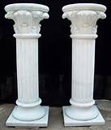
LAND
THE SECRET PILLARS OF CAPITALISM
Land Control and Debt-Money: Two systems that enslave us and how we can change them …
MONEY
The private collection of land rent usurps value created by nature and society. The issuance of debt-money by private commercial banks and private federal reserve banks creates a system of control over government, corporations, and citizens alike.
These are the two main structural flaws in our economic system, causing unemployment, poverty, and other social ills. Come and hear common-sense solutions.
Economic Rent
Money Creation
Notes:
Get a better labor image

Slide 2
The Problem
At the root of today’s economic problems lies the fact that we have never been true to Thomas Jefferson’s Principle:
Equal rights for all; special privileges to none.
As a result, instead of economic justice we have a privileged class who threaten to destroy everything we have worked so hard to achieve
LAND
MONEY
Economic Rent
Money Creation
Notes:
Current conditions illustrate a disproportionate distribution of wealth and ordinary citizens are being faced with many burdens such as heavy taxation environmental depravation, massive unemployment, lack of housing and homelessness, and various aspects of poverty …

Slide 3

Land
Economic Rent
The master key to unlocking the solution to our current economic predicament is an understanding of
“Economic Rent.”
Notes:
In order to explain economic rent we need to define the basic terms in economics- so let us begin by asking the question
Note-before defining economic rent let us take a step back and look at the discipline of economics to define some key words and concepts.

Slide 4
What is Economics?

Slide 5
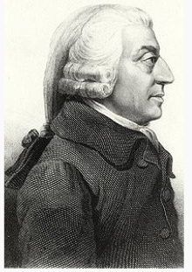
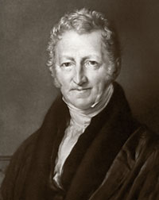
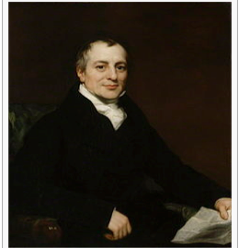
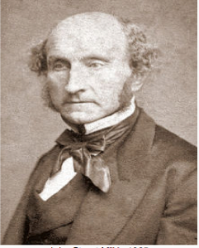
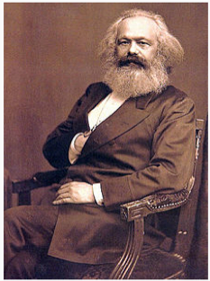
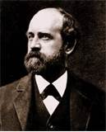
Classical Economists
Adam Smith
Thomas Malthus
David Ricardo
John Stuart Mill
Karl Marx
Henry George
Notes:
The Modern discipline begins with the beginning of the industrial civilization coming out the medieval times…economists such as the classical economic were trying to analyze these events

Slide 6
ECONOMICS
A social science,
that examines the nature of WEALTH and the natural and man-made laws, governing its PRODUCTION and DISTRIBUTION.
Notes:
Now that we have defined economics let’s now look at some key words wealth , production , distribution

Slide 7
Wealth
The product of LAND transformed by LABOR and CAPITAL to satisfy human desires …
Notes:
So now we expand on what land and labor is …

Slide 8
How is wealth produced?
Factors of Production
            LAND
            LABOR
            CAPITAL
Notes:
Look at these three factors in relationship to wealth … lets define wealth
This a summary ( see next slides)

Slide 9

Land
The entire material universe, excluding people and their products.
Notes:
This includes the oceans, skies, fish, and all natural resources ie another way to think of land is the commons( not man-made) a common heritage of humanity
“all that we share” or “ everything that belongs to all of us” … we then look at how we transform land using labor
Note land is the platform from which labor launches all of its productive activities. It is also the storehouse form which labor acquires all the natural resources from al its productive activities …

Slide 10
The Commons
Land is the most fundamental example of the Commons. We can describe the Commons as: Everything that belongs to all of us .
Notes:
Some of these things seem obvious but we need to take some time to define these concepts and keep them clear in mind

Slide 11
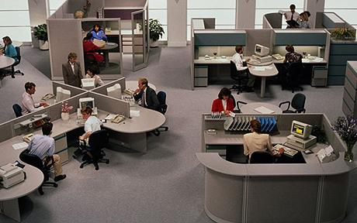
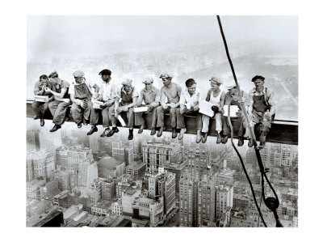
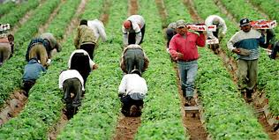
Labor
All human exertion, mental and physical,
in the production of wealth.
Teacher images
Notes:
Make the point: these things are very basic – you can’t miss the point everything labor is done on the land
Note; one can think of labor as the active factor and land as the passive factor. They are the two primary factors in the production of wealth. A third factor which arises from the primary factors is capital.

Slide 12


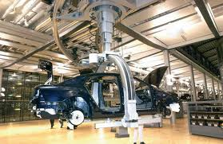

Capital
Wealth that
is used to
produce more wealth
Notes:
Land and labor are primary and capital is subset ie secondary

Slide 13
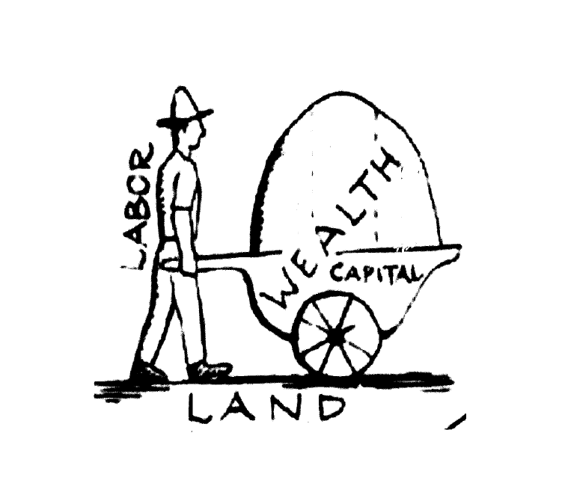
Factors of Production
Notes:
So there is the EASY part – we have PRODUCED all the WEALTH – this Is a natural law that happened throughout all of human history and civilizations to satisfy their needs … now we get into the interesting part DISTRIBUTING THE WEALTH –this is where the FUN starts

Slide 14

How is wealth distributed?
WEALTH
Notes:
Now we talk about the contentious part how is wealth distributed

Slide 15

Production of Wealth
Land
Labor
Capital
Notes:
These are the three factors that produced it ( inputs) so logically/reasonable/moral that will be the factors that it will go back to –this is the way the classical economists saw it –they had certain terms they use for it …

Slide 16
Distribution of Wealth
Economic
Rent
(Land)
Wages
(Labor)
Economic Rent
Wages
Economic Rent
Return to Capital Goods
(Capital)
Return to capital goods
Notes:
Classical economists call the outputs of the avenues of distribution… Ron ‘s section begins here focusing on economic RENT
Another way to look at labor capital is saved up labor – we FOCUS on the economic rent because such a HUGE percentage of it goes to a small group of people and as such is HIDDEN …

Slide 17
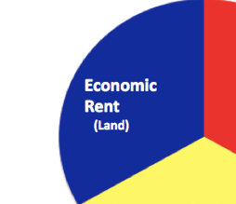
Economic Rent
The master key to unlocking the solution to our current economic predicament
Notes:
To illustration how we can determine the economic rent let us at the example of the island of manhattan
Note

Slide 18
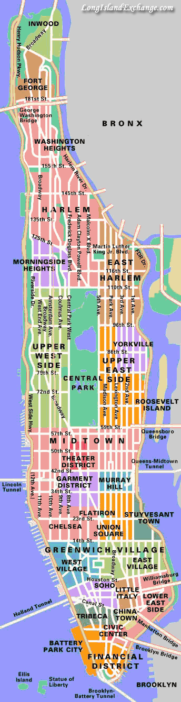
Manhattan Island
Notes:
The productive value of land will closely correspond to its market price- so let us look at some typical market prices of land in Manhattan

Slide 19
Average Land Prices Per Square Foot
⬅
$150 Inwood
$250 Washington Heights
$500 HARLEM
$1,500 Morningside Heights
Columbia University
$3,500 UPPER EAST SIDE
$2,000 UPPER West SIDE
$2,500 59th COLUMBUS CIRCLE
$2,000 42ND ST – TIMES SQUARE
$1,800 Chelsea
$2,000 Pace University
$1,400 Lower East Side
$2,700 Wall Street
⬅
⬅
⬅
⬅
⬅
⬅
⬅
⬅
⬅
⬅
Notes:
Lets translate this to a bar graph

Slide 20
Land Prices in Manhattan Per Square Foot

Slide 21
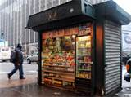
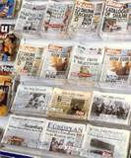

Economic Model
Ceteris Parebis:
“holding all else constant”
Capital
Labor
Notes:
What we are interested in Is the economic rent so we are going to hold the other two factors constant – the latin term for this is Ceteris Parebis – for illustrative purpose we are going use a typical manhattan news stand and attendant – if we super impose this on our previous diagram this is what we get …

Slide 22
Ceteris Parebis

Slide 23
The Margin
The least productive site under equal market conditions
Economic Rent
Return to capital
wages

Slide 24
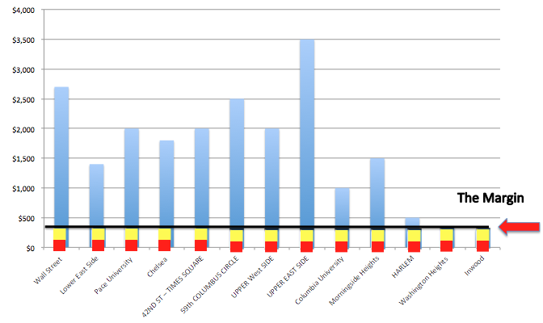
Economic Rent
That portion of the wealth yielded on a piece of land in excess of that yielded at the margin under equal market conditions.

Slide 25
The first demand of the Communist Manifesto.
Abolition of property in land and application of all rents of land to public purposes .
Karl Marx

Slide 26
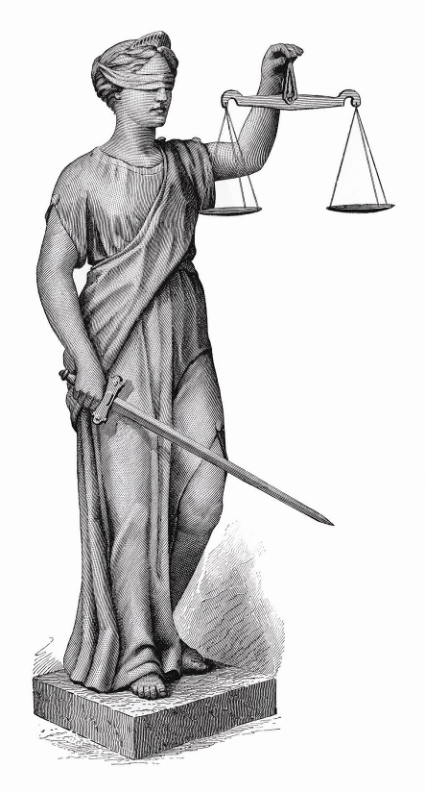
                Solution
                A. The economic rent which is due to the land i.e. the commons should be distributed to the community for the common good.
B. ALL taxes on labor and capital can then be abolished.
Equal opportunities for all; special privileges to none.
Notes:
This is will be possible when the economic rent which belongs to all of us is shared by all of us and not taken away by a privileged few …

Slide 27
Public money

Slide 28
What is money?
Public vs Private control of money issuance
Our present debt-based money

Slide 29
What is money?

Slide 30
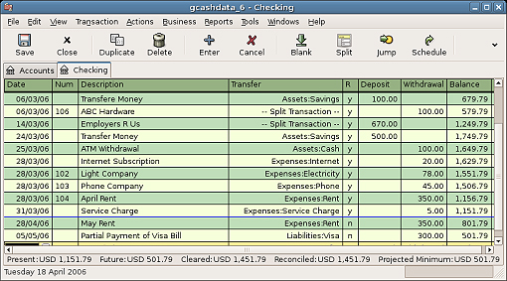
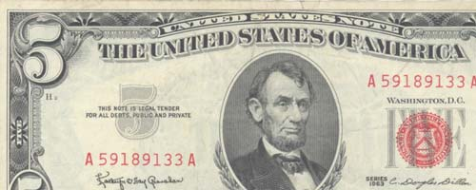
90% or more of our money is account money
10% or less of our money is coins and bills

Slide 31
Account money is nothing new
Ancient Mesopotamia, 3500 BC, clay tablets with Cuneiform records of debts “payable to the bearer.”
“Some of the very first written documents that have come down to us are Mesopotamian tablets recording credits and debits” – Graeber, Debt: The First 5,000 Years

Slide 32
Some examples of money
Account balances
Cattle
Cowry shells
Leather money
Beads
Tool money
Clay tablets recording debt payable to the bearer
Sacks of grain
Metals by weight
Shekel
Coins
Bills of exchange
Assignable promissory notes (goldsmiths)
Tally sticks
Tobacco
Beaver skins
Banknotes
Paper money
New account money created as loans
New account money created debt-free by government

Slide 33
Money has taken many forms.
What makes them all be money, i.e.
What is the nature of money?

Slide 34
Different forms of money all function as a
Medium of exchange
Unit of measure
Store of value

Slide 35
Why do people accept money in return for their labor and goods?

Slide 36
Is a society's money system a public matter?

Slide 37
The money supply
Overall quantity of money
Does the overall quantity of money affect price levels?

Slide 38
Review so far
Money is whatever functions as medium of exchange for a community or society
The overall quantity of money is a crucial variable for maintaining stable wage and price levels

Slide 39
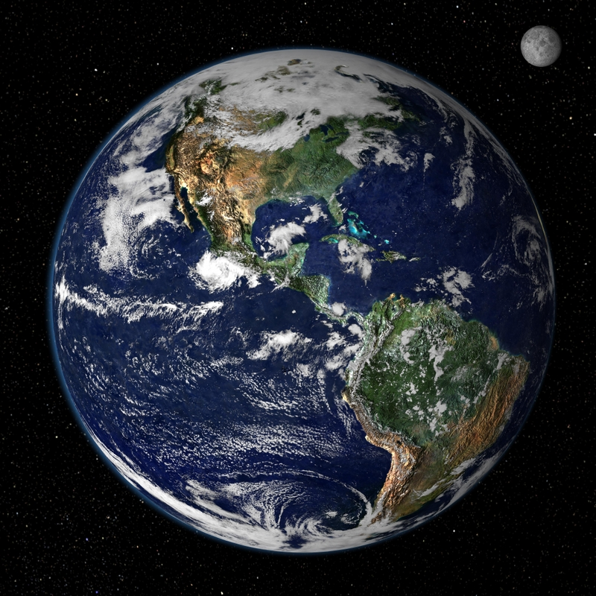

Slide 40
The Commons
Earth or Nature
(ground, water, air, frequencies, ...)
Cultural heritage
(money, language, art, knowledge, customs, ...)
What IF :
Money
(shared medium of exchange)

Slide 41
Some examples of money
Account balances
Cattle
Cowry shells
Leather money
Beads
Tool money
Clay tablets recording debt payable to the bearer
Sacks of grain
Metals by weight
Shekel
Coins
Bills of exchange
Assignable promissory notes (goldsmiths)
Tally sticks
Tobacco
Beaver skins
Banknotes
Paper money
New account money created as loans
New account money created debt-free by government

Slide 42
We can classify forms of money into these types:
COMMODITY | FIAT
 | Credit Debt-free

Slide 43
Public vs Private control of money issuance

Slide 44
U.S. MONETARY HISTORY
PUBLIC
Colonial scrip
Continentals
US Mint (coinage)
United States Notes (1862-1971)
VS
PRIVATE
Commodity monies
Bank credit money has dominated
Central banks
  First Bank of the US
  Second Bank of the US
  Federal Reserve System

Slide 45
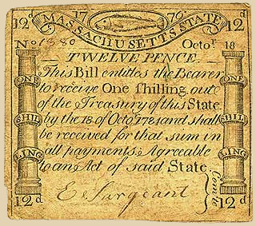
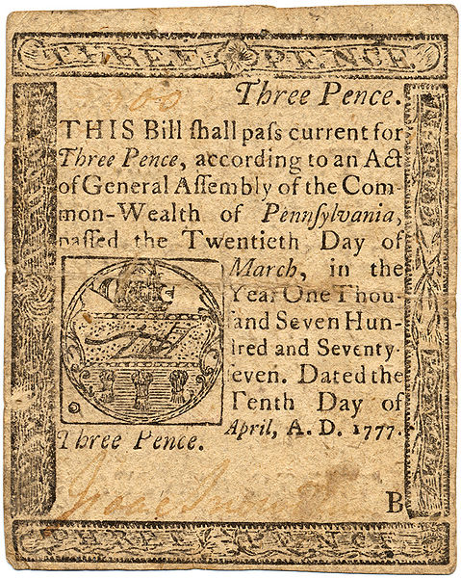
Colonial currencies

Slide 46
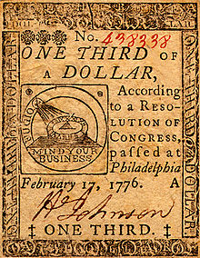
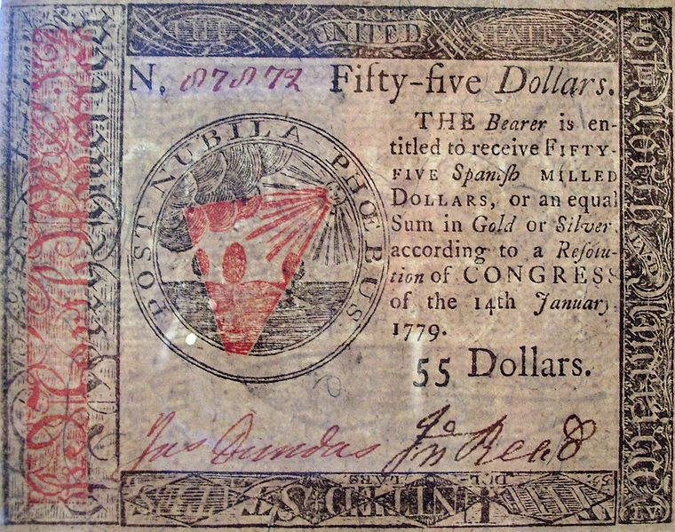
Continental currency

Slide 47
United States Mint
Created with the Coinage Act of 1792

Slide 48
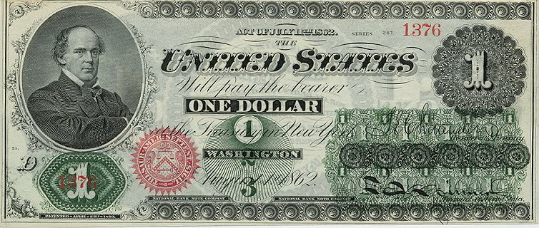
Legal Tender Acts (1862-3)
US Notes 1862 - 1971

Slide 49
Article I, Section 8 of the United States Constitution
The Congress shall have power
Clause 1: To lay and collect Taxes
Clause 2: To borrow Money
Clause 5: To coin Money, regulate the Value thereof

Slide 50
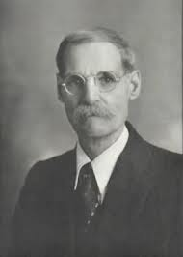
“The mistake … lies in fearing money and trusting debt.”
– Professor Henry Simons

Slide 51
Banks have been given license to create money
When a loan is approved, a bookkeeping entry is made.
The entry in the borrower's account is new money.
Debt-money is extinguished when loan principals are repaid.
Same story before and after 1913 (Federal Reserve Act): >90% of our circulating medium is created by bank loans.

Slide 52
The Federal Reserve System
did not change the above fact
Privately owned, by its shareholders.
Its shareholders are the member banks.
The US President appoints the 7 members of the Federal Reserve Board of Governors.
Who do you think controls the System?
52
Notes:
52

Slide 53
An unjust privilege
As long as banks create money that didn't exist before the loan,
we have a recipe for transfer of money from the many to the few.

Slide 54
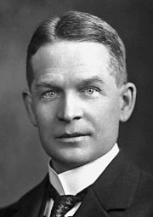
Frederick Soddy
1877-1956, English chemist
In four books written from 1921 to 1934, Soddy carried on a "campaign for a radical restructuring of global monetary relationships", offering a perspective on economics rooted in physics … Soddy wrote that financial debts grew exponentially at compound interest but the real economy was based on exhaustible stocks of fossil fuels. Energy obtained from the fossil fuels could not be used again. This criticism of economic growth is echoed by his intellectual heirs in the now emergent field of ecological economics.
http://archive.org/stream/roleofmoney032861mbp#page/n11/mode/2up Soddy, The Role of Money (1934)

Slide 55
Frederick Soddy
The Role of Money (1934)
PREFACE
This book attempts to clear up the mystery of money in its social aspect.
...
The “money-power” … to create and destroy money by adding and withdrawing figures in bank ledgers, without the slightest concern for the interests of the community or the real role that money ought to perform therein.
[a few] have realized the enormous significance of this money power … its key position in shaping the course of world events through the ages. … To allow it [monetary system] to become a source of revenue to private issuers is to create, first, a secret and illicit arm of the government and, last, a rival power strong enough ultimately to overthrow all other forms of government.

Slide 56
What type we accept as our money has far-reaching consequences
Medium of exchange
Shall money be
some valuable commodity? (intrinsic value)
credit? (abstract)
publicly issued, debt-free? (abstract)
Who shall control our money system?

Slide 57
“Nationalize Money, Not Banks”
Herman Daly, ecological economist
”If our present banking system … seems “screwy” to you, it should. Why should money, a public utility (serving the public as medium of exchange, store of value, and unit of account), be largely the by-product of private lending and borrowing? Is that really an improvement over being a by-product of private gold mining, as it was under the gold standard? The best way to sabotage a system is hobble it by tying together two of its separate parts, creating an unnecessary and obstructive connection. Why should the public pay interest to the private banking sector to provide a medium of exchange that the government can provide at little or no cost?”

Slide 58
Public money
Separation of
money issuance (public)
from
money lending (private)

Slide 59
“Nationalize Money, Not Banks”
Herman Daly
“Is there not a better away? Yes, there is. We need not go back to the gold standard. Keep fiat money, but move from fractional reserve banking to a system of 100% reserve requirements.”

Slide 60
TOPIC
THE CURRENT MONETARY SYSTEM:
PRIVATELY ISSUED MONEY

Slide 61

THE CURRENT MONETARY SYSTEM is PRIVATE

Slide 62

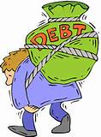
PRIVATE commercial banks
create bank credit…..
which functions as money
but is DEBT.

Slide 63



PRIVATE COMMERCIAL BANKS –
DO NOT TAKE YOUR DEPOSITS -- AND LEND THEM TO BORROWERS
NO

Slide 64
IT IS THE EXACT OPPOSITE !!!

Slide 65
A borrower signs a loan contract,
and the BANK CREATES A DEPOSIT
in the borrower’s account
LOANS
CREATE
DEPOSITS

Slide 66
OUR MONEY IS CREATED
OUT OF DEBT TO PRIVATE BANKS….
for the benefit of the few

Slide 67
TOPIC
THE PRIVATE FEDERAL RESERVE SYSTEM
AND
THE BOOM AND BUST CYCLE

Slide 68
THE FEDERAL RESERVE BANKING BILL
WAS PASSED BY CONGRESS IN 1913
(BUT SECRETLY WRITTEN BY BANKERS IN 1910)
ALL SHARES of the Federal Reserves
Banks are owned by its member banks
PRIVATE member commercial banks:
NEW YORK FEDERAL RESERVE BANK
GOLDMAN SACHS
BANK OF
AMERICA
CITIGROUP
J.P.MORGAN
CHASE
HSBC
UBS
ETC.
DEUTSCHE BANK

Slide 69

All you need is a bookkeeper to open a bank.

Slide 70


#1 Commercial banks create our MONEY SUPPLY from LOANS
BANK GETS
CUSTOMER GETS
BORROWER will find $20,000 added to his account …..
LOAN CONTRACT
for $20,000
+ $20,000
DEPOSIT

Slide 71
#2 THE BANK NEVER CREATES THE MONEY FOR THE INTEREST.
BANK’S ASSET
CUSTOMER’S
ACCOUNT
LOAN CONTRACT
for $20,000
+ $20,000
DEPOSIT

Slide 72
INTEREST MUST COME FROM THE EXISTING MONEY SUPPLY…
DEBTS TO BE PAID
Principal + Interest
MONEY SUPPLY
PRINCIPAL ONLY
DEMAND > SUPPLY

Slide 73

#3 WHEN A LOAN IS PAID OFF…..
BANK’S ASSET
LOAN ACCOUNT
PRINCIPAL disappears
LOAN CONTRACT
EXPIRES
$0.00
30,000.00
INTEREST
INCOME
INTEREST remains with bank

Slide 74
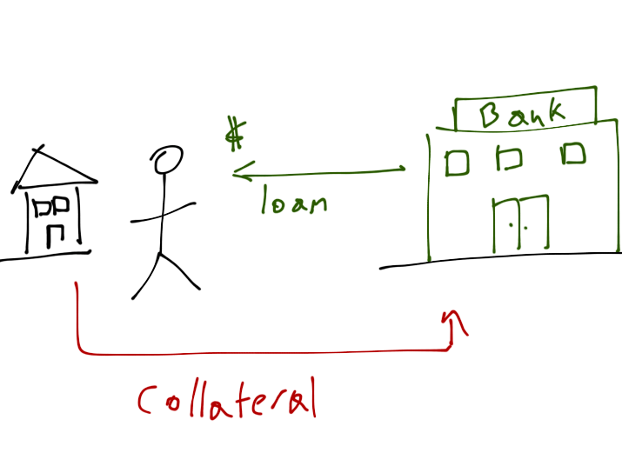
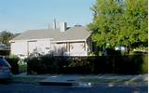
#4 WHEN A BORROWER DEFAULTS…..
BANK’S ASSET
LOAN ACCOUNT
PRINCIPAL disappears
LOAN CONTRACT
EXPIRES
$0.00
Bank gets
COLLATERAL
to sell

Slide 75
MONEY SUPPLY SHRINKS….
WHEN LOANS ARE PAID OFF OR DEFAULT
MONEY SUPPLY
MONEY SUPPLY

Slide 76
MONEY SUPPLY BALLOONS….
WHEN BANKS GIVE LOTS OF LOANS
MONEY SUPPLY
MONEY SUPPLY

Slide 77

THE BOOM AND BUST MONETARY CYCLE
WHEN ANYONE CAN GET A LOAN –
EXPANDING MONEY SUPPLY
WHEN BANKS REFUSE LOANS -
COLLAPSING MONEY SUPPLY
“Economy in great” BUY, BUY, BUY
HOUSE PRICES UP!
STOCK PRICES UP!
BORROW to buy that stock or house!
More and more debt……
“Market is shaky!” SELL, SELL, SELL…..
FALLING PRICES……
UNEMPLOYMENT…
BANKRUPTCIES…..
1% buys up assets cheap……

Slide 78
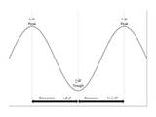
THE ‘BUSINESS CYCLE’…….
IS A BANK CREDIT CREATION CYCLE,
      creating instability for all citizens
      benefiting the few

Slide 79

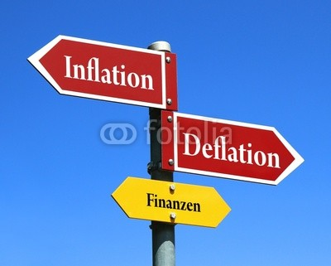
WE ARE AT THE MERCY OF PRIVATE BANKS ISSUING OUR MONEY
OUR COUNTRY DOES NOT HAVE
A STABLE MONEY SUPPLY

Slide 80
TOPIC
EFFECTS OF
PRIVATELY ISSUED MONEY
“whoever controls the money system, over time will control the nation”

Slide 81
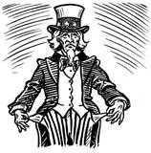

GOVERNMENT DEBT (mostly owned by 1%)
= CONCENTRATES WEALTH
INTEREST PAID ON DEBT
(BILLIONS)
2012 | $360
2011 | $454
2010 | $414
2009 | $383
2008 | $451
16.7 TRILLION $ DEBT

Slide 82
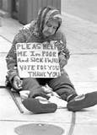



BOOM & BUST CYCLE
CONCENTRATES WEALTH
HOMELESSNESS
UNEMPLOYMENT
    BUSINESS BANKRUPTCIES
HOUSES – PUBLIC UTILITIES – MINES – LAND….

Slide 83
INTEREST CONCENTRATES WEALTH………..
HOUSEHOLDS
SMALL BUSINESS LOAN INTEREST
RETAILERS
MORTGAGE INTEREST
PRIVATE
BANKS
CORPORATE LOAN INTEREST
FEDERAL DEBT
INTEREST
LABOR
PRODUCTION
DISTRIBUTION

Slide 84
THE BANKS’ DECIDING WHO GETS MONEY (LOANS)…..
CONCENTRATES POWER
DERIVATIVES
TRADERS
HEDGE FUNDS
GOLDMAN, CITIBANK, MORGAN CHASE, BOA, ETC.
LOANS
BOND MARKET
CURRENCY
TRADERS

Slide 85
CONCENTRATION OF WEALTH…..
LEADS TO CONCENTRATION OF POWER
ECONOMICS
TEACHING
HISTORY
TEACHING
TOO BIG
TO FAIL BANKS
FUND
CONCENTRATION OF MEDIA
WRITING LAWS
PACS
LOBBYISTS
ELECTIONS
COURTS
(CITIZENS’ UNITED)

Slide 86

PRIVATELY-ISSUED MONEY KEEPS EVERYONE IN DEBT
STUDENT DEBT | $ 1.0 TRILLION
CREDIT CARD DEBT | $ .8 TRILLION
MORTGAGE DEBT | $ 13.0 TRILLION
CORPORATE DEBT | $ 8.7 TRILLION
STATE, LOCAL GOVT DEBT | $ 3.0 TRILLION
FEDERAL GOVT DEBT | $ 16.4 TRILLION
TOTAL PRIVATE, CORP, GOVERNMENT DEBT | $ 42.9 TRILLION

Slide 87
TOPIC: SOLUTION
GOVERNMENT-ISSUED, INTEREST-FREE MONEY
“Credit will collapse during a crisis.
Money does not collapse.”

Slide 88
SOLUTION: Government-issued money
The solution
has 3 parts.

Slide 89
SOLUTION: Government-issued money
#1
FED RESERVE BANKS
will be owned
by the Government

Slide 90
SOLUTION: Government-issued money
Federal government buys all the shares of the 12 Federal Reserve Banks from member commercial banks.

Slide 91
SOLUTION: Government-issued money
#2
POWER TO ISSUE MONEY
will be taken away from
PRIVATE BANKS

Slide 92
SOLUTION: Government-issued money
LENDING BY BANKS:
Banks can only lend existing deposits.

Slide 93
SOLUTION: Government-issued money
#3
U.S. MONEY SPENT FOR
THE BENEFIT OF ALL CITIZENS

Slide 94
SOLUTION: Government-issued money
Congressional spending to CREATE JOBS and CREATE REAL WEALTH
for all people in the country,
not the few.
  Repair/building of infrastructure, like trains, dams, bridges, levees
  Education
  Health Care

Slide 95
A NEW BILL: HR2990
This bill contains all
3 parts of the solution.

Slide 96
A NEW BILL: HR2990
GOVERNMENT-ISSUED INTEREST-FREE INDESTRUCTIBLE MONEY:
All new money will be issued and spent into circulation by the federal
government. The money is called ‘U.S. Money’ and is publicly issued,
interest- free, circulating in the economy until recalled by taxes.
PRICE LEVEL: kept stable by a Monetary Authority in the US Treasury, with regular PUBLIC REPORTING of money supply and prices.
GOOD JOBS: the government will spend for infrastructure repair, education, health care, etc. to benefit all citizens and CREATE JOBS.

Slide 97
JOIN THE FIGHT for
PUBLICLY ISSUED,
INTEREST-FREE
U.S. MONEY

Slide 98
JOIN THE FIGHT for
DECENT JOBS
FOR ALL AMERICANS

Slide 99
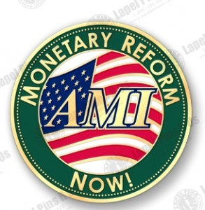
USA
American Monetary Institute, USA,
www.monetary.org,
drafted HR2990 with Congressman Kucinich

Slide 100
THE END

