Slide 1
Questioning Money & Debt:
The Farmer’s Alliance 1880-1894
NOFA, Sunday, August 11, 2013
Notes:
My intro: WHY SUPPORT NOFA - studied permaculture and have friends very involved in growing food sustainably, eaten organically all my life, Silent Spring by Rachel Carlson in high school – why put any chemicals in one’s body, now buy from Amish organic farmer who brings food to city every two weeks – raw dairy, grassfed meats.
My intro: WHY TALKING ABOUT MONEY AND BANKING? – worked for Citibank from year 2000 to 2012 when I was laid off. First bank I worked for. I write application systems for large corporations. Always want to know business, not just immediate task. Learned about the private debt-money system.

Slide 2
TOPICS
I WHAT IS MONEY?
WHERE DOES OUR MONEY COME FROM?
WHAT ARE THE EFFECTS OF THE CURRENT MONETARY SYSTEM?
Q & A
WHAT WAS THE MONETARY SYSTEM WHEN THE FARMERS’
ALLIANCE ORGANIZED?
5 WHAT WAS THE FARMERS’ ALLIANCE?
WHAT NEEDS TO BE DONE TODAY FOR A MORE JUST MONEY SYSTEM
FOR ALL?
Q & A
Notes:
3 what is our current monetary system???

Slide 3
TOPICS
I WHAT IS MONEY?
Notes:
We need to define our terms so we all know what we are talking about. People have a lot of different ideas of what money is. This is the way we will define it.

Slide 4
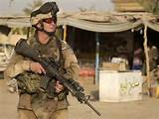
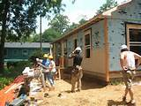


MONEY IS UNIQUE –
It has the power of life and death over each and every person
ESSENTIAL FOR SOCIETY TO EXIST
INDISPENSABLE FOR SOCIETY TO FUNCTION
IS A HUMAN INVENTION, EXISTING IN LAW
Notes:
Essential for society to exist --- any history of a society must first identify what is the money and who controls it – controls the society
Indispensable for society to function – cannot have war without money…..community…..economy
Over history, humans have decided what is the money – example: silver and gold by weight in Babylonia 2500 BC, Homeric Greece 800 BC; fiat currency decided by state – Sparta iron disks, Greece silver coins

Slide 5



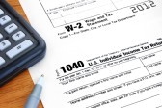

MONEY CAN BE DEFINED BY ITS FUNCTIONS
#1 A means of exchange –
a ticket. Not wealth.
#2 A store of stable value –
RULE: QUANTITY MUST BE CONTROLLED.
#3 A measure of value –
denominated by law & stamped by sovereign authority
#4 A means of payment –
legal power to pay debts -- public and private
Notes:
SHOW $10 AND $1 BILL

Slide 6

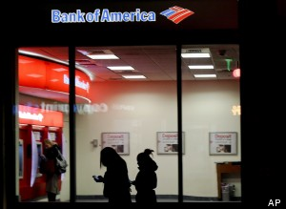
WHAT MONEY IS NOT
MONEY IS NOT WEALTH, NOT A COMMODITY.
MONEY IS NOT DEBT.
WE PAY OUR DEBTS WITH MONEY.

Slide 7
A SOCIETY DEFINES ITS MONEY IN THE LAW
Edward Kellogg, 1861, A New Monetary System:
“The most important fundamental law in any nation is that which institutes money; for money governs the distribution of property, and thus affects in a thousand ways the relations of man to man.”

Slide 8
TOPICS
WHERE DOES MONEY COME FROM?

Slide 9
WE HAVE
PRIVATELY ISSUED MONEY

Slide 10
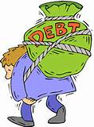
PRIVATE commercial banks
create bank credit…..
which functions as money
but is DEBT.

Slide 11


PRIVATE COMMERCIAL BANKS –
Do not lend your deposits to borrowers
NO
DEPOSITS
LOANS

Slide 12
IT IS THE EXACT OPPOSITE !!!

Slide 13
A borrower signs a loan contract,
and the BANK CREATES A DEPOSIT
in the borrower’s account
LOANS
CREATE
DEPOSITS

Slide 14

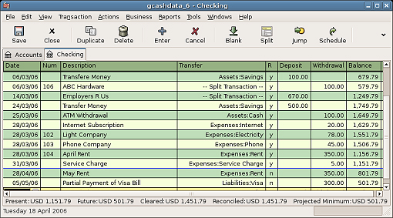
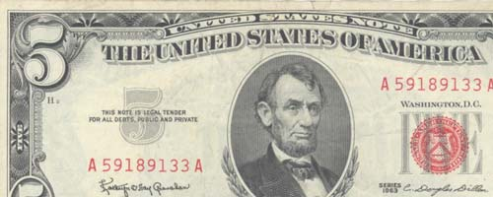
OUR MONEY SUPPLY
97% CHECKING DEPOSITS --
BOOKKEEPING ENTRIES ONLY
3% COIN AND BILLS
MINTED &
SPENT BY U.S. TREASURY
(‘ISSUED BY GOVERNMENT
DEBT-FREE’)
PRINTED BY U.S. TREASURY –
BUT SOLD AT COST TO PRIVATE FEDERAL RESERVE BANKS, WHO SELL IT TO THEIR PRIVATE MEMBER BANKS AT FACE VALUE

Slide 15
THIS BANK CREDIT (DEBT-MONEY) SYSTEM
WAS IMPLMENTED BY THE 1913 FEDERAL RESERVE LAW
NEW YORK FEDERAL RESERVE BANK:
OWNED BY ITS MEMBER BANKS
COMMERCIAL BANKS:
OWNERS OF NY FED BANK
NEW YORK FEDERAL RESERVE BANK
GOLDMAN SACHS
BANK OF
AMERICA
CITIGROUP
J.P.MORGAN
CHASE
DEUTSCHE BANK
HSBC
UBS
ETC.

Slide 16
TOPICS
WHAT ARE THE EFFECTS OF THE
CURRENT MONETARY SYSTEM?
“whoever controls the money system, over time will control the nation”

Slide 17

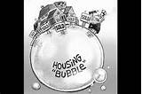
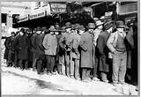
LET’S THINK ABOUT THIS
OUR MONEY SUPPLY: 97% BANK CREDIT
Bank creates a deposit to a borrower’s account,
for the principal of the loan
MONEY SUPPLY IS INCREASED
if done systemically, creates ‘BUBBLE’
commodity prices RISE, called INFLATION
Deposits circulate from person to person as a check
When the borrower repays the loan, the principal is erased from the accounting ledger
MONEY SUPPLY IS DECREASED
if done systemically, creates ‘BUST’
prices FALL, unemployment, homelessness

Slide 18
THERE IS NO STABILITY
TO OUR ECONOMY
CAUSES GRIEF, FEAR, POVERTY, DEATH

Slide 19
INTEREST concentrates wealth.
Has done so since the first civilization in the Near East.
Interest creates debt slaves.

Slide 20
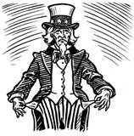
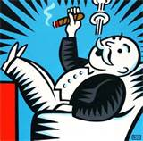
OUR GOVERNMENT BORROWS MONEY,
AND GOES INTO DEBT,
WHEN IT CAN CONSTITUTIONALLY CREATE IT
BANKERS, 1%
INTEREST PAID ON DEBT
(BILLIONS)
2012 | $360
2011 | $454
2010 | $414
2009 | $383
2008 | $451
16.7 TRILLION $ DEBT
Notes:
ANY MONEY THE GOVERNMENT NEEDS MORE THAN TAX REVENUE IS BORROWED

Slide 21
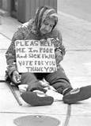
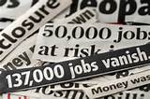
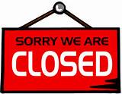

BOOM & BUST CYCLE CONCENTRATES WEALTH
“THE BUST”
HOMELESSNESS
UNEMPLOYMENT
    BUSINESS BANKRUPTCIES
    FORECLOSURES

Slide 22
INTEREST CONCENTRATES WEALTH………..
HOUSEHOLDS
RETAILERS
MORTGAGE, CC, STUDENT, ETC. INTEREST
SMALL BUSINESS LOAN INTEREST
PRIVATE
BANKS
FEDERAL DEBT
INTEREST
CORPORATE LOAN INTEREST
LABOR
PRODUCTION
DISTRIBUTION

Slide 23
THE BANKS’ DECIDE WHO GETS MONEY (LOANS)…..
CONCENTRATES POWER
DERIVATIVES
TRADERS
HEDGE FUNDS
GOLDMAN, CITIBANK, MORGAN CHASE, BOA, ETC.
LOANS
BOND MARKET
CURRENCY
TRADERS

Slide 24
CONCENTRATION OF WEALTH…..
LEADS TO CONCENTRATION OF POWER
ECONOMICS
TEACHING
HISTORY
TEACHING
TOO BIG
TO FAIL BANKS
GIVE LOANS TO
MEDIA
CONCENTRATION
BIG
PHARMA
WRITING LAWS
PACS
LOBBYISTS
ELECTIONS
COURTS
(CITIZENS’ UNITED)

Slide 25
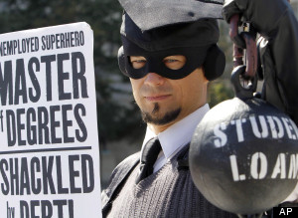
PRIVATELY-ISSUED MONEY KEEPS EVERYONE IN DEBT
STUDENT DEBT | $ 1.0 TRILLION
CREDIT CARD DEBT | $ .8 TRILLION
MORTGAGE DEBT | $ 13.0 TRILLION
CORPORATE DEBT | $ 8.7 TRILLION
STATE, LOCAL GOVT DEBT | $ 3.0 TRILLION
FEDERAL GOVT DEBT | $ 16.4 TRILLION
TOTAL PRIVATE, CORP, GOVERNMENT DEBT | $ 42.9 TRILLION

Slide 26
TOPICS
Q & A

Slide 27
TOPICS
WHAT WAS THE MONETARY SYSTEM
WHEN THE FARMERS’ ALLIANCE ORGANIZED?

Slide 28
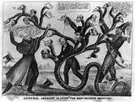
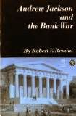
U.S. HISTORY OF MONEY –
Struggle between public vs private control of money issuance
At the time of the Farmers’ Alliance,
the American people were aware of the power given to the issuer of money.
Money struggles were part of the public discourse throughout the 18th and 19th centuries:

Slide 29
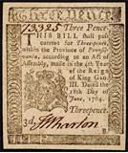
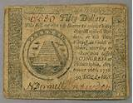

There was a long history of U.S. Government-Issued
Debt-Free Paper Money
1690 - 1789 Colonial governments issued Bills of Credit
1776 - 1781 Continental Congress-Revolutionary War issued Continentals
1789 - 2013 U.S. Constitution, Article 1, Section 8 Congressional power
To coin Money, regulate the Value thereof,
1812 – 1815 President James Madison – War of 1812 U.S. Notes
1862 – 1971 President Abraham Lincoln –Civil War Greenbacks
1874 – 1889 Greenback Party - supported Greenbacks
1877 – 1892 Farmer's Alliance - supported Greenbacks
Notes:
Need for money In colonies – people were returning because there was not enough money
Continentals were counterfeit money and make worthless

Slide 30
At the time of the Farmers’ Alliance, the country’s money was a combination of coin, paper (public and private), and deposits
U.S. Mint issued gold and silver coins – government-issued & debt-free
U.S. Treasury issued Greenbacks – government-issued & debt-free
National Bank notes (private banks) – privately-issued –
loaned with interest
4. Private bank deposits – bank credit

Slide 31
THE GENERAL PUBLIC WAS NOT AWARE OF CREATION OF PRIVATE BANK CREDITS, like today!
…..BUT THE BANKERS WERE
Alexander Hamilton, who supported the private control of the monetary system, recognized the creation of bank credit as money quite clearly. He writes in a Congressional report in 1791:
“Every loan which a bank makes is, in the first shape, a credit given to the borrower on its books, the amount of which it stands ready to pay, either in its own notes, or in gold or silver, at his option But, in a great number of cases, no actual payment is made in either. The borrower, frequently, by a check or order, transfers his credit to some other person, to whom he has a payment to make; who, in his turn, is as often content with a similar credit… and in this manner the credit keeps circulating, performing in every stage the office of money…”

Slide 32
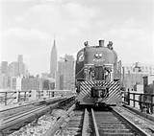
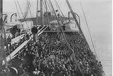
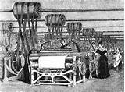
THE FARMERS WANTED MORE MONEY TO BE CREATED.
1865-1895: DEFLATION OF MONEY SUPPLY –
compared to growth in population
and productivity

Slide 33
THE LONG DEPRESSION: 1873 – 1896
Cause: the unstable money system
Panic of 1873 – economic contraction following the panic lasted 65 months, eclipsing the Great Depression's 43 months of contraction. 18,000 businesses went bankrupt, including hundreds of banks, and ten states went bankrupt, while unemployment peaked in 1878, long after the panic ended. The collapse of cotton prices devastated the already war-ravaged economy of the southern U.S. Although farm prices fell dramatically, American agriculture continued to expand production.
Panic of 1884 (during the recession of 1882-85) – financial panic destroyed eleven New York banks, more than a hundred state banks, and led to defaults on at least $32 million worth of debt. Unemployment, which had stood at 2.5% between recessions, surged to 7.5% in 1884-1885, and 13% in the northeastern U.S. This second recession led to further deterioration of farm prices. Kansas farmers burned their own corn in 1885 because it was worth less than other fuels such as coal or wood.
Panic of 1993 - profits, investment and income all fell, leading to political instability, the height of the populist movement, and the Free Silver movement
Panic of 1996 - production shrank and deflation reigned

Slide 34
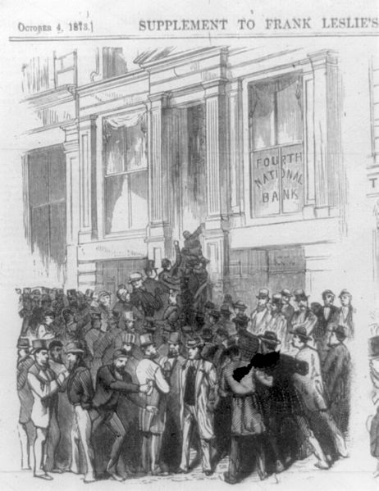
Run on
Fourth National Bank,
No. 20 Nassau Street,
New York City, 1873

Slide 35
TOPICS
5 WHAT WAS THE FARMERS’ ALLIANCE?

Slide 36
THE FARMERS’ ALLIANCE:
1877-1896
THE LAST DEMOCRATIC MASS MOVEMENT –
CAN WE HAVE ANOTHER?

Slide 37
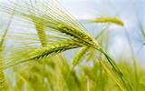
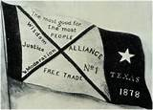
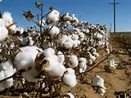
WHAT WAS THIS MOVEMENT?
WESTERN PLAINS FARMERS & SOUTHERN FARMERS
JOINED TOGETHER TO FORM AN ORGANIZATION CALLED
NATIONAL FARMERS’ ALLIANCE AND INDUSTRIAL UNION

Slide 38
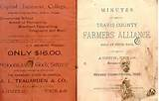
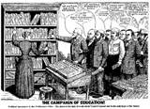
WHAT WAS ITS PURPOSE?
“…more speedily educate ourselves” in preparation for the day “when all the balance of labor’s products become concentrated into the hands of a few, there to constitute a power that would enslave posterity”

Slide 39
WHAT WAS ITS PURPOSE?
“…more speedily educate ourselves” in preparation for the day “when all the balance of labor’s products become concentrated into the hands of a few, there to constitute a power that would enslave posterity”

Slide 40
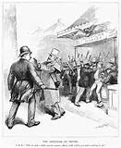
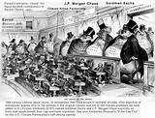
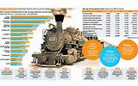
THE FARMERS’ ALLIANCE DENOUNCED:
Credit Merchants
Railroad monopolies
Trusts
Money Power
Capitalists
2-price Credit System

Slide 41
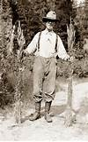
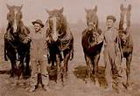
WHO CREATED THIS ORGANIZATION?
MEN AND WOMEN WITH POLITICAL SELF-RESPECT
AND SELF-POSSESSION

Slide 42
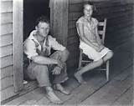
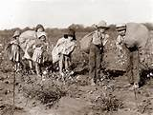
WHAT WAS THE CONDITION OF THE
SOUTHERN FARMER?
SOUTHERN FARMERS WERE IN DEBT TO THE TOWN PLANTER/MERCHANT
THE CROP LIEN SYSTEM PREDOMINATED

Slide 43
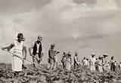
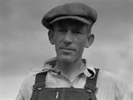
THE CROP LIEN SYSTEM
The ‘furnishing merchant, able to get most of their goods on consignment from competing Northern mercantile houses, bought supplies and “furnished” them on credit to farmers, taking a lien on the farmer’s crop for security. Farmers learned that the interest they were paying on everything they consumed limited their lives in a new and terrible way; the rates imposed were frequently well in excess of 100% annually, sometimes over 200%. At the heart of the process was a simple two-price system for all items – one price for cash customers and a second and higher price for credit customers. P. 22, THE POPULIST MOMENT, by Lawrence Goodwyn

Slide 44
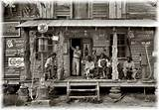
THE CROP LIEN SYSTEM
“acted out at a thousand merchant counters in the South after the Civil War…farmer, his eyes downcast, and his hat sometimes literally in his hand, approached the merchant with a list of his needs. The man behind the counter consulted a ledger, and after a mumbled exchange, moved to his shelves to select the goods that would satify at least a part of his customer’s wants….no money changed hands; the merchant merely made brief notations in his ledger.”
“At ‘settlin’-up’ time, the farmer and the merchant would meet at the local cotton gin….at that moment, the farmer
would learn what his cotton had brought…the merchant…then consulted his ledger for a final time.
The accumulated debt for the year, he informed the farmer, exceeded the income received from the cotton crop.
The “furnishing merchant” would then announce his intention to carry the farmer through the winter on a new
account, the latter merely having to sign a note mortgaging to the merchant the next year’s crop…..
Farmer, empty-handed, climbed in his wagon and drove home, knowing that for the second or fifth
or fifteenth year he had not paid out. P. 21, THE POPULIST MOMENT, by Lawrence Goodwyn

Slide 45
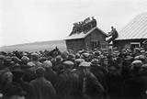
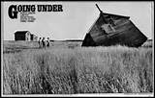
WHAT WAS THE CONDITION OF THE
WESTERN FARMER?
WESTERN FARMERS WERE IN DEBT
TO THE BANKS & MORTGAGE COMPANIES –
FOR HOMES AND PERSONAL PROPERTY
Notes:
The organic nofa farmers need to understand the struggle with the money system like the alliance.
Its demise kept the 2 party system.

Slide 46
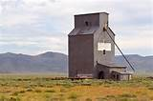
WHAT WAS THE CONDITION OF THE
WESTERN FARMER?
A farmer with only a few dollars in his pocket comes out here and takes a claim…..then he goes in debt for the farm for sufficient money to prove up and buy a horse or two….then he goes in debt for the necessary machinery to harvest his crop, and by the time his grain is ready to sell he is pretty well buried under a pile of debts. He takes his wheat to market, of course firmly believing that it is nothing less than No. 1 hard, but the elevator man’s eagle eye promptly discovers that it has been ‘frosted’ or is ‘damp’ and instead of getting 80 cents a bushel, as he expected, he is forced, from his necessities, to sell for what he can get. …the sun is now obscured by two or three blanket mortgages; and he sits down in his lonely cabin on the bleak prairies and imagines that he is being ground down by the despotic heel of monopoly. P. 82, THE POPULIST REVOLT, by John D. Hicks
Notes:
The organic nofa farmers need to understand the struggle with the money system like the alliance.
Its demise kept the 2 party system.

Slide 47

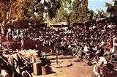
HOW DID THE ALLIANCE GROW?
ITS BUILDING BLOCKS WERE:
1. INDIVIDUAL SELF-RESPECT
2. COLLECTIVE SELF-CONFIDENCE
3. DEMOCRATIC SELF-DIRECTION
4. CREATION OF A MOVEMENT CULTURE
5. MASS ORGANIZATIONAL EDUCATION IN FINANCIAL SYSTEM AND FARMING
Notes:
The organic nofa farmers need to understand the struggle with the money system like the alliance.
Its demise kept the 2 party system.

Slide 48
HOW DID THE ALLIANCE GROW?
#1 ORGANIZATIONAL BASE: created an institution called the National Farmers Alliance and Industrial Union - experimented with self-help
#2 MASS RECRUITMENT: became the world’s first large-scale working class cooperative which attracted farmers in droves – attempted to pool products for market sale and transport. This experience educated the alliance members about the prevailing forms of economic power and privilege.
#3 MASS EDUCATION: each sub-alliance in a town had its own lecturer, to educate about the financial system and farming. At its height, the movement had 40,000 lecturers! This education was supported by hundreds of Alliance newspapers initiated throughout the movement.
#4 POLITICS: turned to independent political action by creating its own institution, a third party called The People’s Party
Notes:
The organic nofa farmers need to understand the struggle with the money system like the alliance.
Its demise kept the 2 party system.

Slide 49
WHAT LESSONS DID THE ALLIANCE LEARN?
#1 immediate political action will not work – too many of the poor are tied to traditional modes of thinking
#2 personal self-respect must be instilled in membership – the movement had to support members educating each other (lecturer system)
#3 the cooperative idea spurred the organizational work
#4 the democratic instinct would be released with education and a new political language shared in mutually supportive groups
Notes:
The organic nofa farmers need to understand the struggle with the money system like the alliance.
Its demise kept the 2 party system.

Slide 50
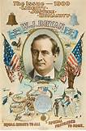
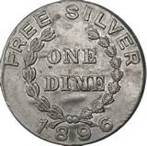
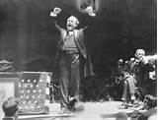
WHY WAS THE ALLIANCE NOT SUCCESSFUL?
The People’s Party leadership ultimately decided to merge with the Democratic Party in the Presidential elections of 1892 and 1896. This was called ‘fusion’.
The Democrats incorporated some of the platform of the People’s Party, but were not for serious monetary reform. The plank of ‘Free Silver’ became the rallying cry, but the revolutionary goal to put the power to issue money back into the hands of the public was lost.
Notes:
The organic nofa farmers need to understand the struggle with the money system like the alliance.
Its demise kept the 2 party system.

Slide 51
TOPICS
WHAT NEEDS TO BE DONE TODAY FOR A MORE JUST MONEY SYSTEM FOR ALL?

Slide 52
MONETARY REFORM TODAY
THE TRUTH OF THE STRUGGLE
OVER THE CONTROL OF MONEY
MUST BE TOLD

Slide 53
SOLUTION
WE CAN JOIN WITH OTHERS TO ---
TAKE ACTION….
ORGANIZE….
EDUCATE….

Slide 54
SOLUTION
Change the money system
by changing the law!
Money is defined in law

Slide 55
A BILL: HR2990
In 2011 and 2012,
Rep Dennis Kucinich of Ohio introduced a bill to change the monetary system, H.R. 2990.

Slide 56
A BILL: HR2990
It has 3 parts.

Slide 57
A BILL: HR2990
#1
FED RESERVE BANKS will be owned by the Government
The federal government will buy all the shares of the 12 Federal Reserve Banks from the member commercial banks.

Slide 58
A BILL: HR2990
#2
PRIVILEGE TO CREATE MONEY will be taken away from
PRIVATE COMMERCIAL BANKS
Using a change of accounting rules, private commercial banks will be allowed to lend only existing deposits.

Slide 59
A BILL: HR2990
#3
U.S. MONEY SPENT FOR THE BENEFIT OF ALL CITIZENS
GOOD JOBS: the government will spend for infrastructure repair, education, health care, etc. to benefit all citizens and create jobs.

Slide 60
RESULTS: HR2990
GOVERNMENT-ISSUED INTEREST-FREE MONEY: ‘U.S. Money’
All new money will be issued by the federal government.
It is interest- free and circulates until recalled by taxes.
PRICE LEVEL: kept stable. A new authority in the U.S. Treasury will be responsible for monitoring the volume of the money supply and keep the price level inflating or deflating. Reports will be public.
GOOD JOBS: government spends on infrastructure repair, education, health care, green economy, to benefit all citizens and create jobs.

Slide 61
JOIN THE FIGHT for
DECENT JOBS
FOR ALL AMERICANS

Slide 62
TOPICS
Q & A

