Slide 1
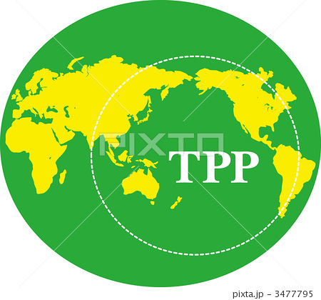
Corporate Dominance: Our Debt-Money System and the Trans Pacific Partnership (TPP) Session 3: Sat 03:15pm - 05:00pm in Room 1.101

Slide 2

WHAT IS THE TPP?

Slide 3
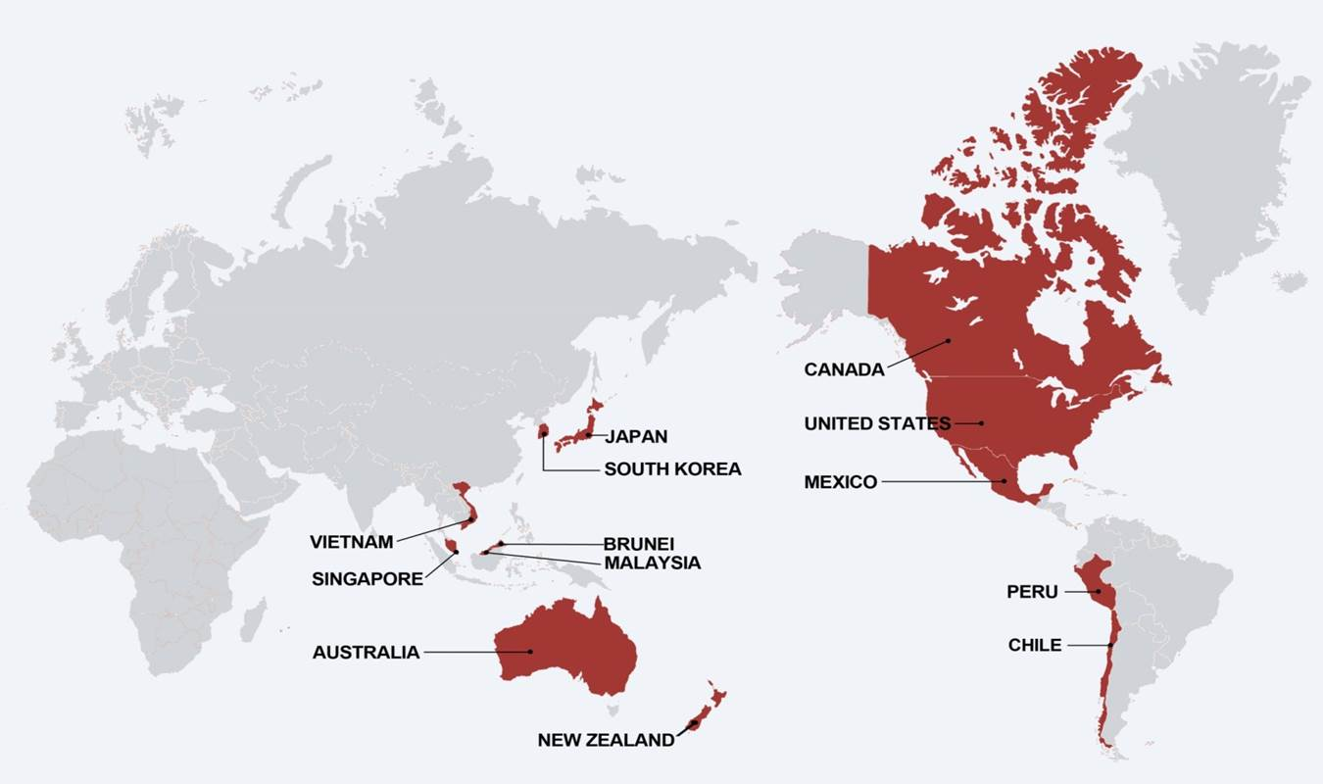
The Trans Pacific Partnership is called a “Free Trade” Agreement, purportedly to regulate trade relations among the US and 11 other Pacific Rim Countries:
Mexico
Canada
Japan
Singapore
Vietnam
Australia
New Zealand
Chile
Peru
Malaysia
Brunei
This agreement covers more than
40% of the global economy.

Slide 4
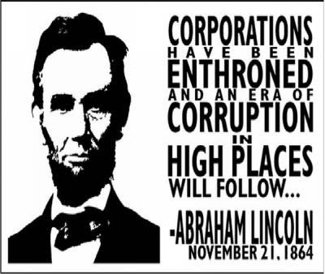
They say it is a trade agreement, but it is WAY MORE!!!!
THERE ARE 29 CHAPTERS AND ONLY 5 OF THEM ARE ON TRADE…
IT IS AN AGREEMENT TO PROMOTE CORPORATE POWER…
SOME OF THE AREAS COVERED:
INTELLECTUAL PROPERTY (COPYRIGHT
AND PATENTS)
ENVIRONMENTAL POLICY
FINANCIAL SERVICES
PROCUREMENT
INVESTMENT – ‘ISDS’
INTERNET ACCESS
MEDICATIONS
LABOR RIGHTS
BANKING REGULATIONS
FARM POLICY

Slide 5
TRADE NEGOTIATIONS
THE TPP IS BEING NEGOTIATED IN SECRET BY U.S. TRADE REPRESENTATIVES (Part of the Executive Office of the President).
2. THERE ARE 500, MOSTLY CORPORATE LOBBYISTS, ACTING AS “ADVISORS,” WITH SECURITY CLEARANCE, ALLOWED TO SEE THE TEXT OF THE AGREEMENT.
3. SOME MEMBERS OF CONGRESS HAVE VIEWED THE TEXT.

Slide 6
HISTORY
BEFORE CONGRESS PASSED NAFTA (NORTH ATLANTIC FREE TRADE AGREEMENT) IN 1994, TRADE AGREEMENTS COVERED ONLY QUOTAS AND TARIFFS.
STARTING WITH NAFTA, THE SO-CALLED “FREE TRADE” AGREEMENTS HAVE EXPANDED THE AREAS COVERED – LIKE INTERNET ACCESS, INTELLECTUAL PROPERTY, ENVIRONMENT, ETC.
SINCE 1994, THERE HAVE BEEN MULTIPLE FREE TRADE AGREEMENTS… MOST HAVE INCLUDED A CLAUSE CALLED: ISDS -- INVESTOR STATE DISPUTE SETTLEMENT.

Slide 7
ISDS INVESTOR STATE DISPUTE
SETTLEMENT CLAUSE
THIS CLAUSE ELEVATES CORPORATIONS TO THE STATUS OF A STATE…
IT ALLOWS FOREIGN CORPORATIONS TO SUE SOVEREIGN GOVERNMENTS…
AND WIN HUGE MONETARY AWARDS, BASED ON THE LOSS OF EXPECTED FUTURE PROFITS DUE TO DOMESTIC LAWS, SUCH AS LAWS PROTECTING THE ENVIRONMENT, WORKERS, HEALTH AND SAFETY…
ALL OF OUR PROTECTIVE LEGISLATION IS IN JEOPARDY.
THE NUMBER OF ISDS CASES HAS DRAMATICALLY INCREASED SINCE 1994.

Slide 8
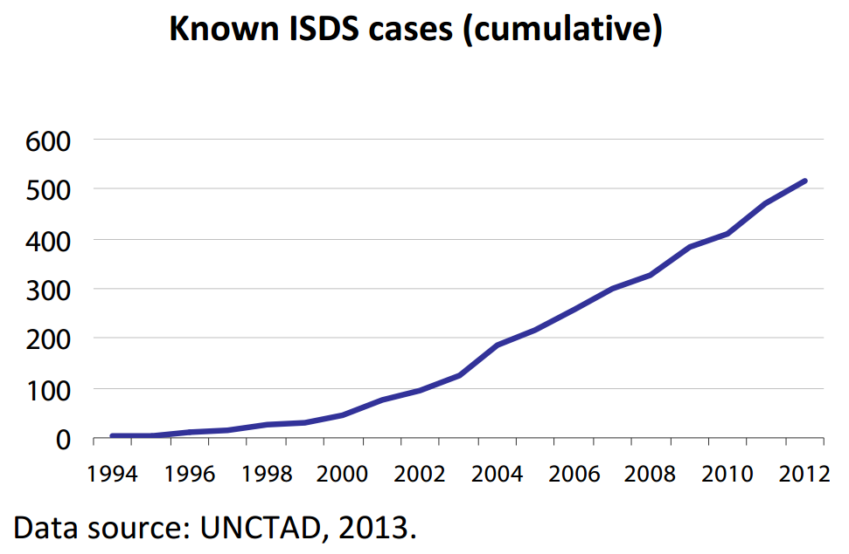

Slide 9
ISDS EXAMPLES

Slide 10
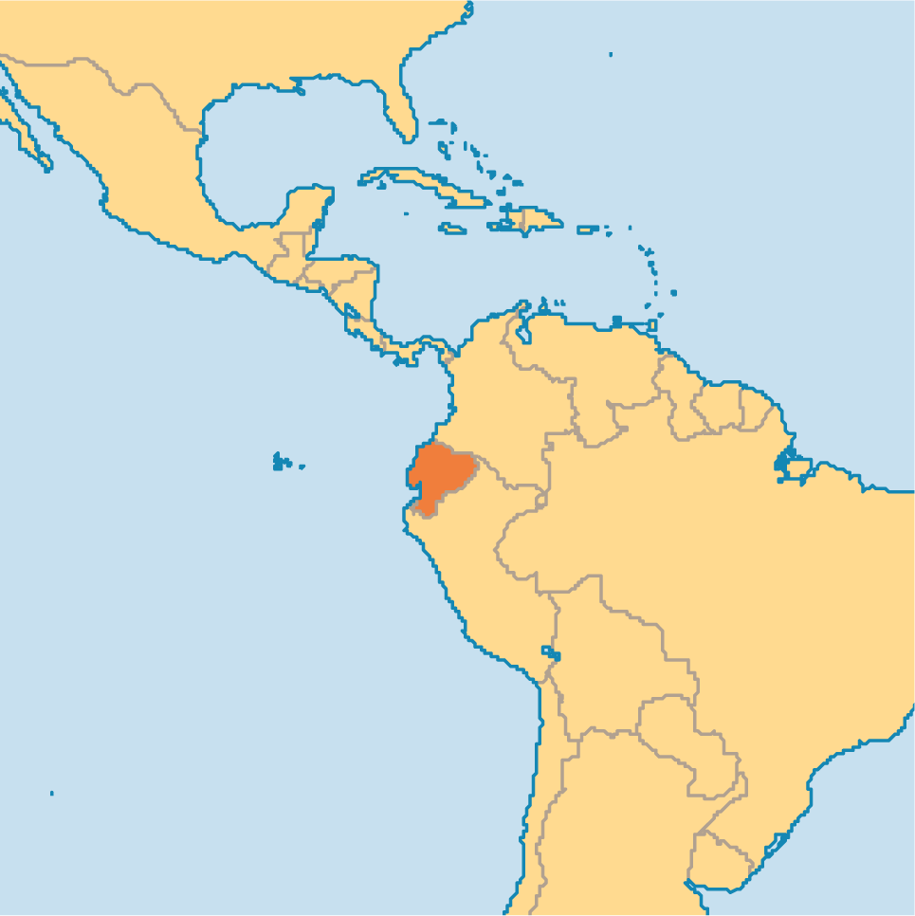

ISDS EXAMPLE #1:
THE HIGHEST REWARD SO FAR IS 3.2 BILLION $
GIVEN TO OCCIDENTAL OIL CO.
OCCIDENTAL SUED EQUADOR OVER EQUADOR’S TERMINATION OF AN OIL CONCESSION CONTRACT, EVEN THOUGH THE TERMINATION WAS APPARENTLY LEGAL.

Slide 11
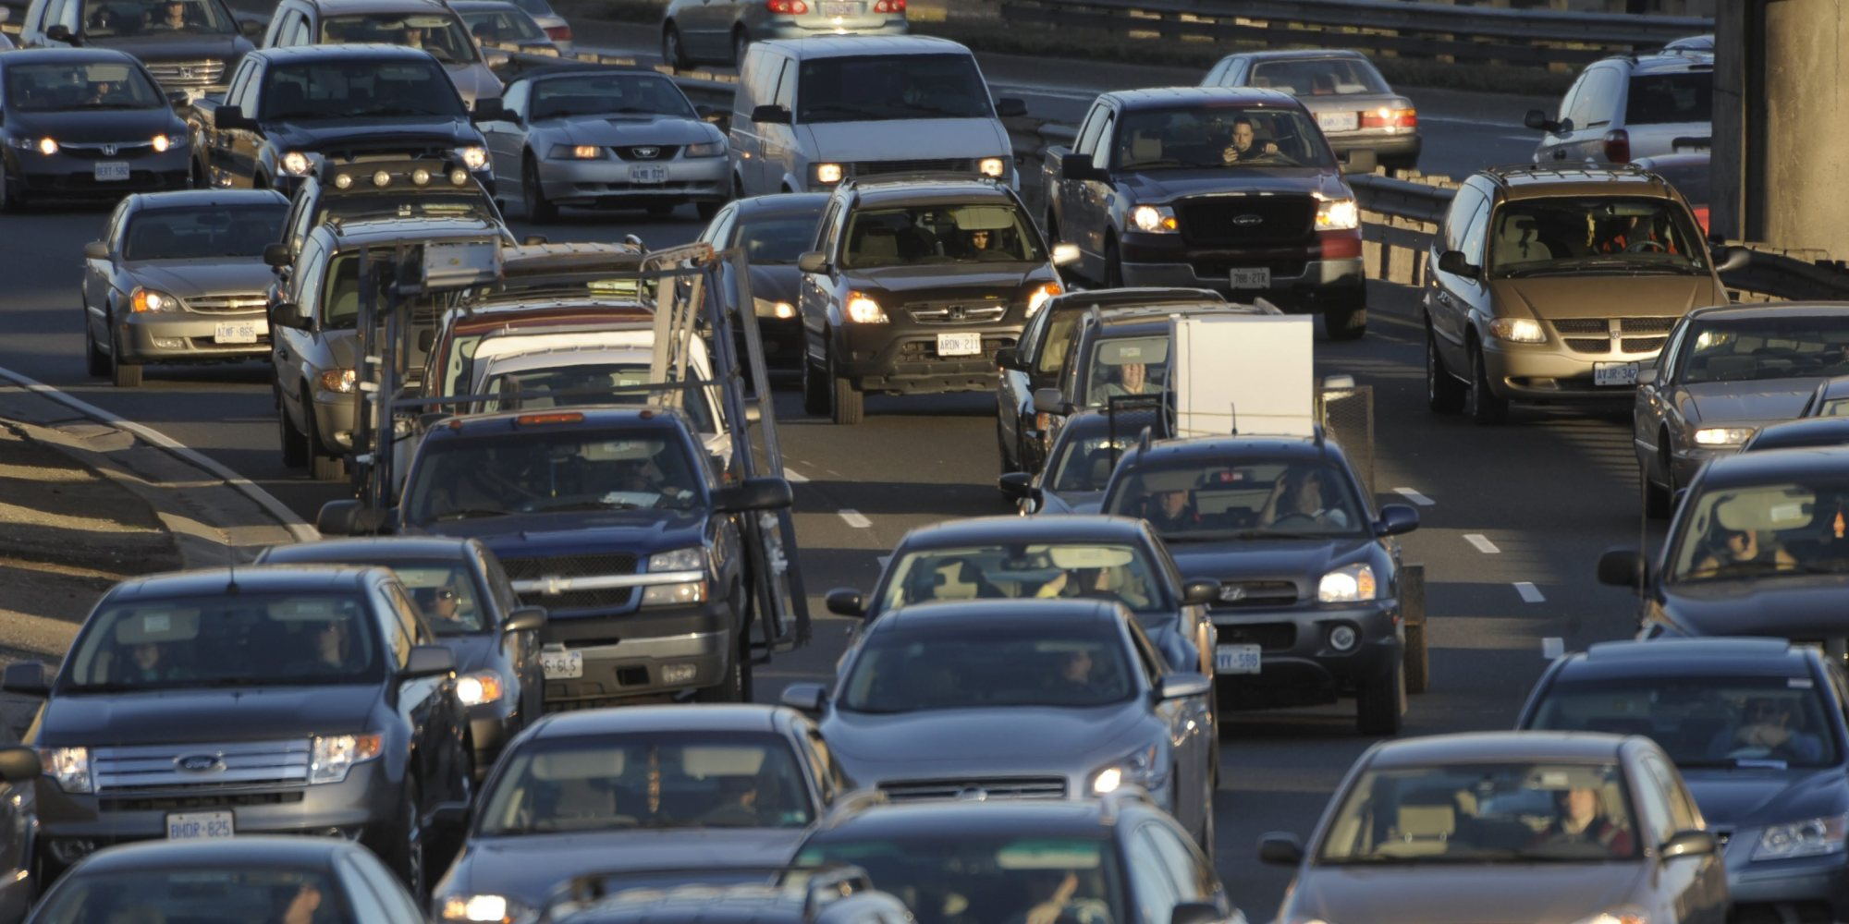
ISDS: EXAMPLE #2 ENVIRONMENT
Under NAFTA, Ethyl Corporation sought $251 million from Canada because Canada implemented a ban on the import and transport of a toxic gasoline additive, MMT.
Canada settled with Ethyl.
The terms required the Canadian government to pay Ethyl $13 million in damages and legal fees, to revoke the ban and to post advertising saying that MMT was safe.

Slide 12
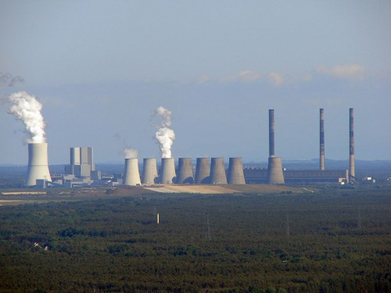
ISDS #3: NUCLEAR
IN 2012, VATTENFALL, A SWEDISH UTILITY OPERATING 2 NUCLEAR PLANTS IN GERMANY, SUED THE GERMAN FEDERAL GOVERNMENT, AFTER GERMANY DECIDED TO SHUT DOWN THEIR NUCLEAR POWER INDUSTRY, FOLLOWING FUKUSHIMA.
THIS IS STILL IN ARBITRATION.
VATTENFALL

Slide 13
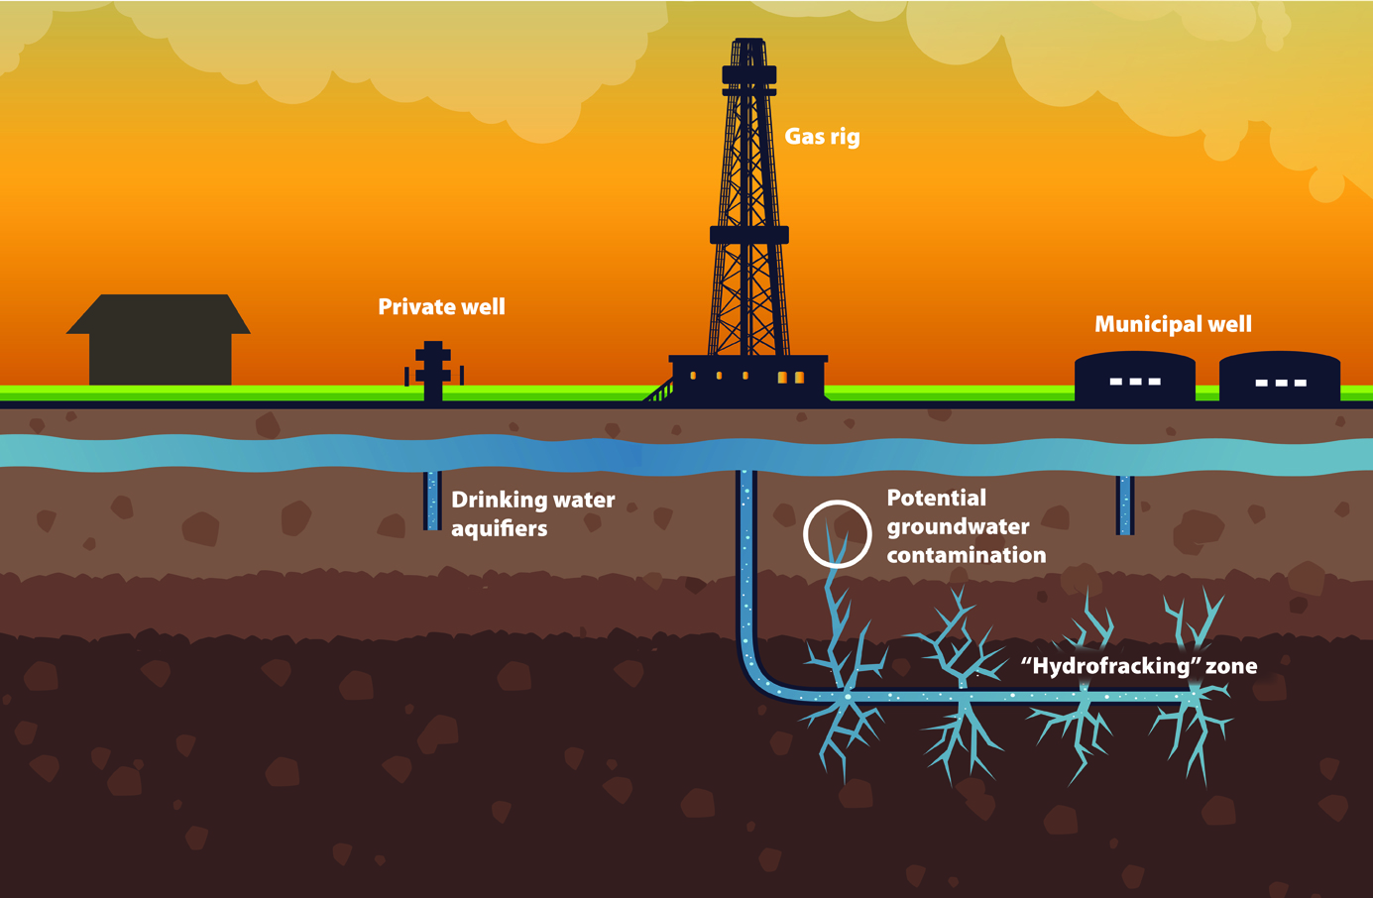
ISDS #4 FRACKING
IN 2013, U.S. MINING COMPANY, LONEPINE RESOURCES INC. SUED CANADA BECAUSE THE PROVINCE OF QUEBEC PUT A MORATORIUM ON FRACKING, DUE TO ENVIRONMENTAL CONCERNS.

Slide 14
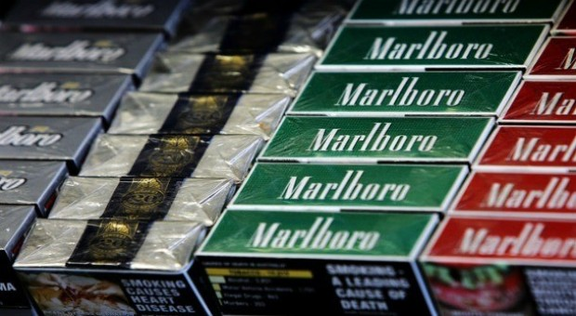
ISDS #5 HEALTH AND SAFETY REGULATIONS
PHILIP MORRIS IS SUING AUSTRALIA AND URUGUAY FOR THEIR ANTI-SMOKING LAWS, REQUIRING HEALTH WARNINGS ON CIGARETTE PACKAGING.

Slide 15
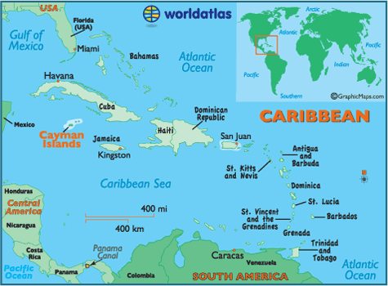
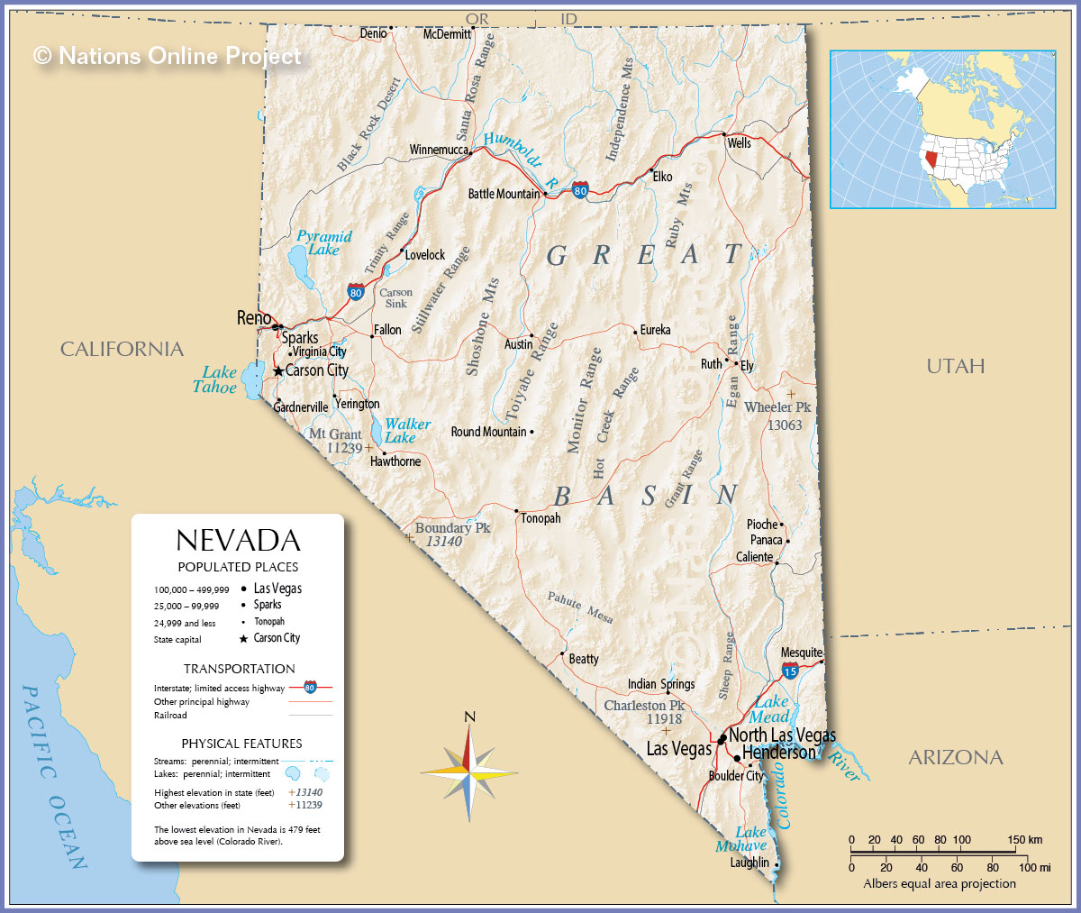
ISDS #6 ENVIRONMENT
PACIFIC RIM MINING CORPORATION, A CANADIAN CO., SUED EL SALVADOR UNDER CENTRAL AMERICA FREE TRADE AGREEMENT (CAFTA). PACIFIC RIM WANTED TO ESTABLISH A GOLD MINE IN THE BASIN OF EL SALVADOR’S LARGEST RIVER. EL SALVADOR SAID ‘NO’ FOR ENVIRONMENTAL REASONS.
SINCE CANADA IS NOT A PARTY TO CAFTA, THIS CANADIAN CO. MOVED ITS SUBSIDIARY FROM THE CAYMAN ISLANDS TO NEVADA, U.S., AND REINCORORATED IN ORDER TO SUE UNDER CAFTA.

Slide 16
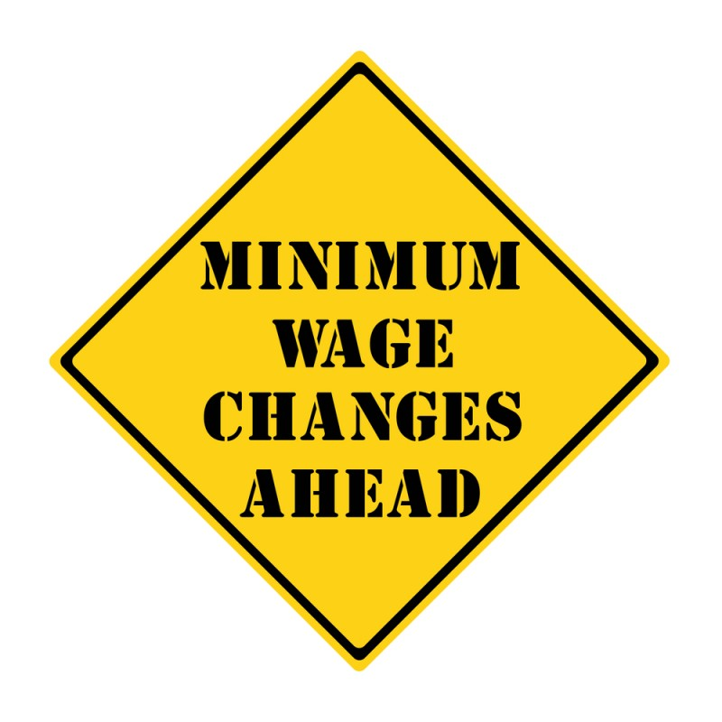
#7 ISDS EXAMPLE: MINIMUM WAGE
A FRENCH MULTI-NATIONAL, VEOLIA GROUP, IS SUING EGYPT, CONTESTING INCREASES IN EGYPT’S MINIMUM WAGE.

Slide 17
HOW DOES THE ISDS OPERATE?

Slide 18

A PANEL OF THREE JUDGES
THE JUDGES ARE CORPORATE ATTORNEYS.
PROCEEDINGS ARE SECRET.
THERE IS NO APPEAL.
THE JUDGES ONLY CONSIDER THE LOSS OF “EXPECTED FUTURE PROFITS”,
BUT NOT THE RIGHT TO
A CLEAN ENVIRONMENT,
FAIR LABOR STANDARDS,
HEALTH AND SAFETY OF POPULATION,
GENERAL WELFARE

Slide 19

“THE PROMISE”
THE PROMISE OF CLINTON-BUSH-OBAMA HAVE BEEN THAT THESE TRADE AGREEMENTS WILL LEAD TO NEW JOBS.
PROMISE: CLINTON PROMISED 200,000 NEW JOBS UNDER NAFTA, THOUGH INCREASED
EXPORTS TO MEXICO.
RESULT: BY 2010, THE TRADE DEFICIT WITH MEXICO ELIMINATED 700,000 JOBS.
PROMISE: OBAMA PROMISED AN INCREASE OF 70,000 JOBS WITH THE KOREAN AGREEMENT
OF 2012.
RESULT: ONE YEAR LATER, THE TRADE DEFICIT COST 40,000 JOBS IN MANUFACTURING.

Slide 20
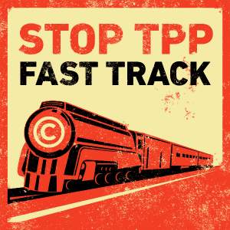
“FAST TRACK”
CONCEPT FIRST PROPOSED UNDER NIXON.
GIVES AUTHORITY TO THE PRESIDENT FOR 6 YEARS TO TO NEGOTIATE AND SIGN TRADE DEAL.
PRESIDENT PRESENTS SIGNED AGREEMENT TO CONGRESS FOR AN UP OR DOWN VOTE WITH ONLY 60 DAYS TO REVIEW.
ONCE CONGRESS AUTHORIZES ‘FAST TRACK’: CONGRESS CANNOT CHANGE OR AMEND THE NEGOTIATED TREATY.
5. PRESIDENTS AFTER OBAMA WILL HAVE FAST TRACK AUTHORITY FOR FUTURE TRADE DEALS.
FOR 6 YEARS

Slide 21
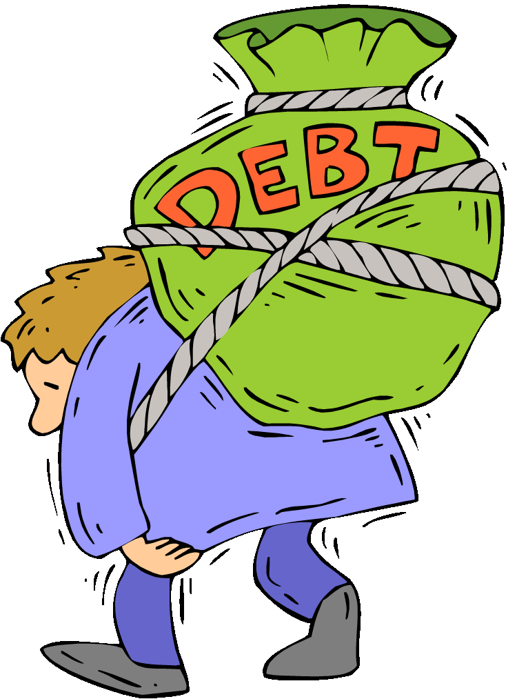
FOSSIL FUELS & OUR DEBT-BASED FINANCIAL SYSTEM
TO WHOM IS EVERYONE IN DEBT?

Slide 22
PUBLIC DEBT

Slide 23
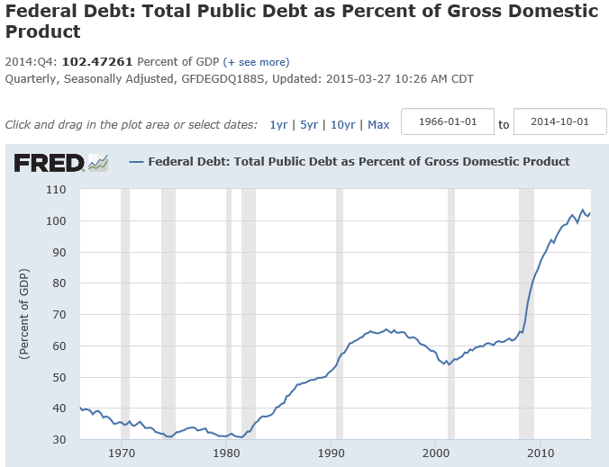
PUBLIC DEBT
U.S.A. is now up to
102% of GDP
WHAT CHANGED AROUND
1980 ???

Slide 24
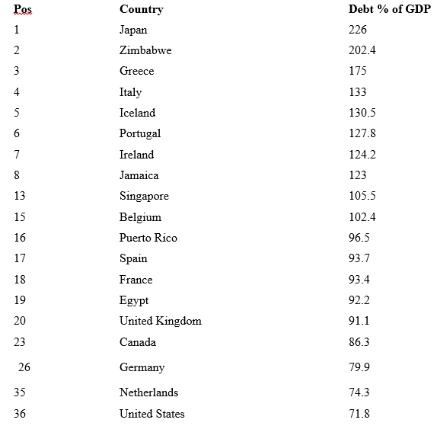
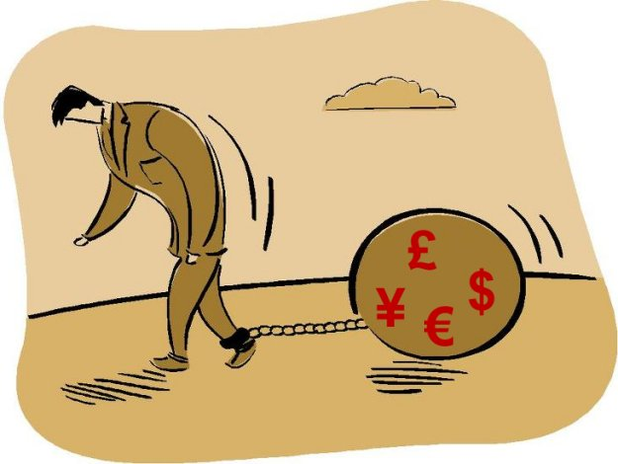
EVERY COUNTRY IN THE WORLD
SUFFERS FROM A MASSIVE,
CONSTANTLY INCREASING
NATIONAL DEBT
PUBLIC DEBT
as % of GDP,
as of 2010
⬅ TODAY, U.S. IS 102% OF GDP!

Slide 25
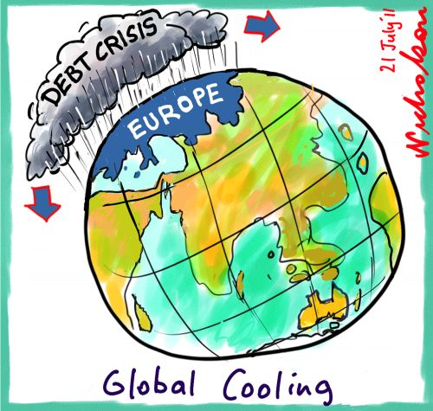
PUBLIC DEBT

Slide 26


IF ALL THE NATIONS OF THE WORLD ARE IN DEBT, WHO ARE THEY IN DEBT TO?
PUBLIC DEBT

Slide 27
PRIVATE DEBT

Slide 28
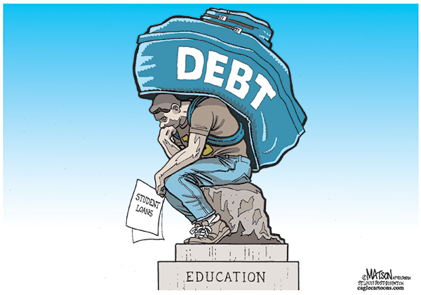

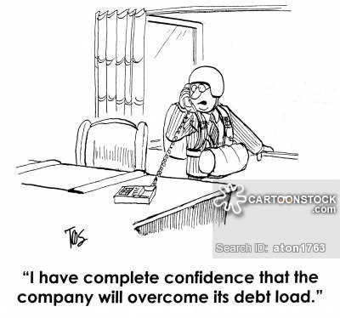
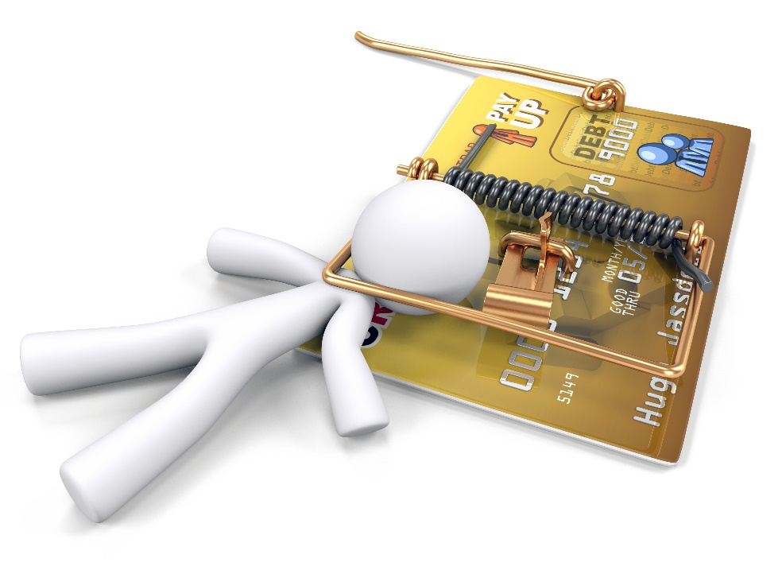
IN ADDITION TO MOUNTING NATIONAL DEBTS, THERE IS
ESCALATING
PRIVATE DEBT
STUDENTS
HOME
BORROWERS
BUSINESS
PEOPLE
CREDIT CARD USERS

Slide 29
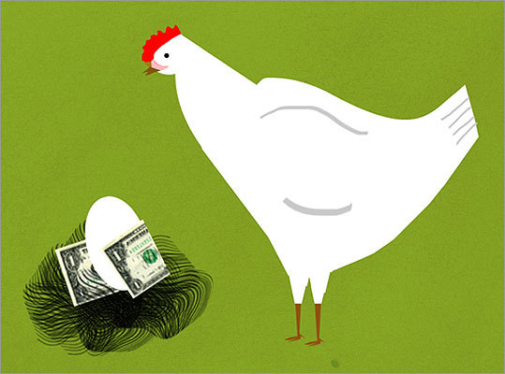
CHICKEN DEBT

Slide 30
IF SO MANY INDIVIDUALS, STUDENTS, MORTGAGORS, BUSINESSES ARE IN DEBT,
WHO ARE THEY IN DEBT TO?
PRIVATE DEBT

Slide 31
HOW BIG ARE OUR DEBTS?

Slide 32
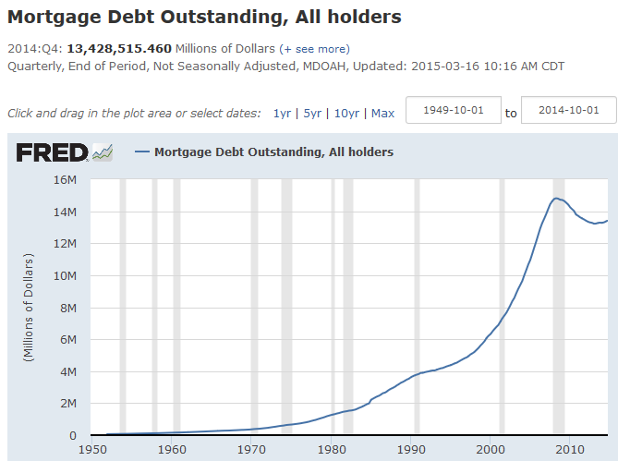
OUR MORTGAGE DEBT IS NOW > 13.4 TRILLION $
PRIVATE DEBT

Slide 33
WHY? HOW?
WHO HAS THE WEALTH?
THE OWNERS OF THE PRIVATE BANKING SYSTEM ARE
FAR WEALTHIER THAN ANYONE ELSE…

Slide 34
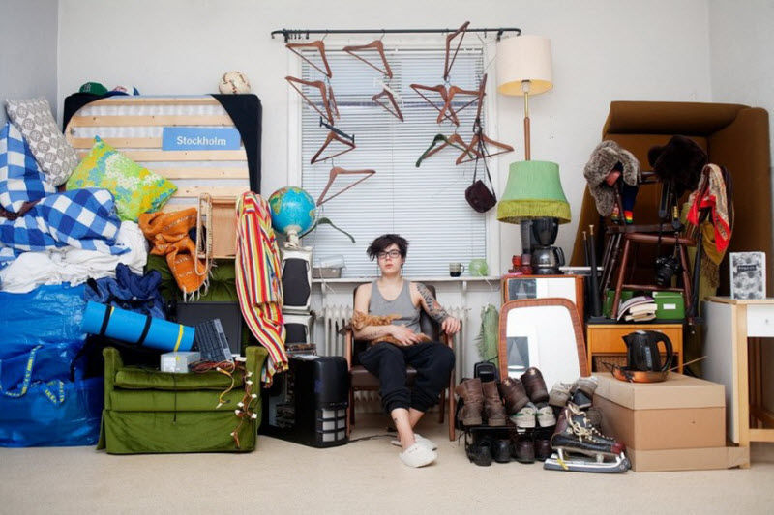
WHAT THEY OWN

Slide 35
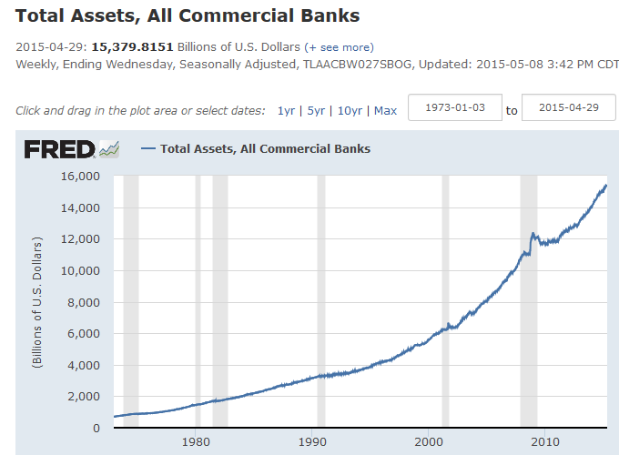
WHAT THEY OWN –
15.4 TRILLION
BANK’S ASSETS ARE:
CASH 2.8 T
LOANS 8.2 T
SECURITIES 3.0 T
OTHER 1.4 T
TOTAL 15.4 T

Slide 36
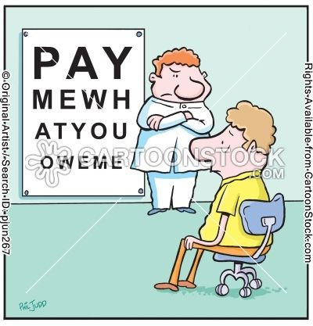
WHAT THEY OWE
O W E M E

Slide 37
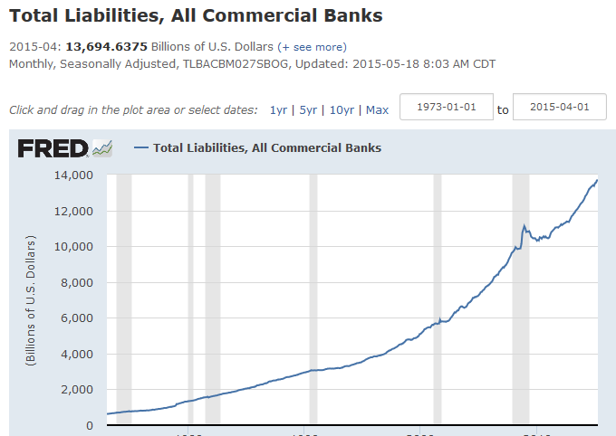
WHAT THEY OWE –
13.7 TRILLION
BANK’S LIABILITIES ARE:
DEPOSITS 10.7 T
BORROWINGS 1.7 T
OTHER .6 T
TOTAL 13.7 T

Slide 38

WHY IS THE PRIVATE BANKING SYSTEM SO WEALTHY?

Slide 39

YOU WILL BE SURPRISED !!!

Slide 40
LIES WE HAVE BEEN TAUGHT
AND ARE TOLD EVERY DAY

Slide 41
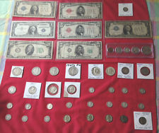
#1 LIE: Government creates our money.
TRUTH: Government only creates 3% of our money –
coins and paper notes.
ONLY 3% OF OUR MONEY SUPPLY!

Slide 42
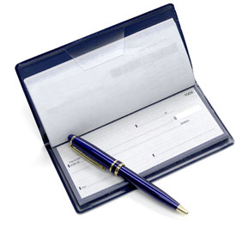
#2 LIE: Banks lend money they have in the bank.
TRUTH: Banks create brand-new money when they make a loan &
type accounting numbers in the borrower’s account.
97% OF OUR MONEY SUPPLY
ALL CHECKING ACCOUNT
MONEY STARTED AS A
PRIVATE BANK LOAN

Slide 43

LIE #3: Private commercial banks (like Bank of America)
are just like any other corporation.
TRUTH: A private bank corporation is a unique
and abnormal corporation.
If the banking corporations decide to give loans, our economy has life.
If the banking corporations decide to stop making loans and call in loans, our economy dies.

Slide 44
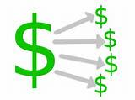
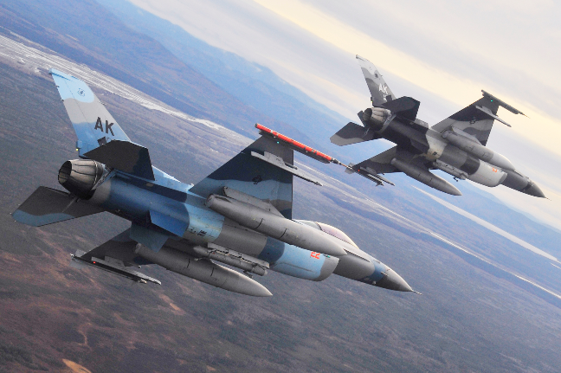

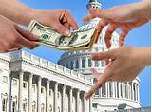


#4 LIE: The government decides who gets money.
TRUTH: Banking corporations decide who gets money
because they decide to whom to give loans [debt].
weapons manufacturers
stock speculators
Congressional lobbyists
agribusiness
fossil fuel companies
mortgagors
multi-national corporations

Slide 45
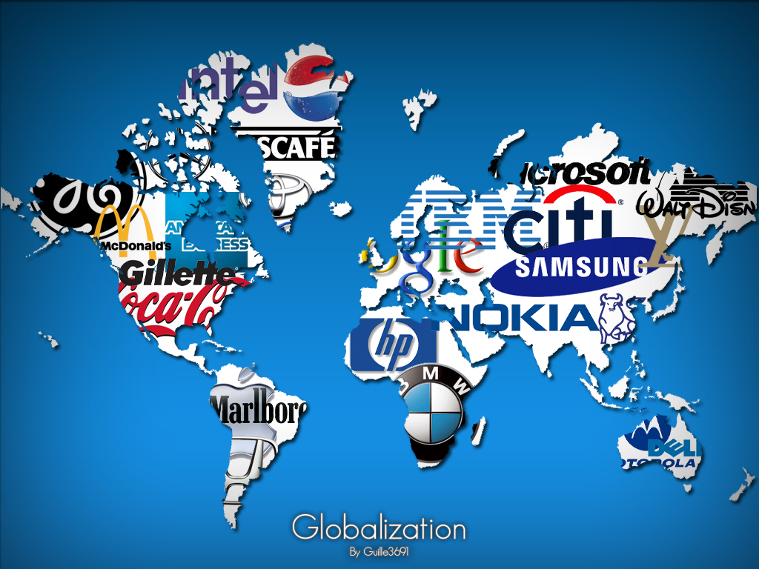
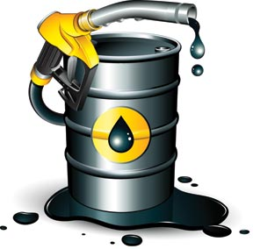
#5 LIE: The problem is multi-national corporations.
TRUTH: The problem is the
PRIVATE DEBT-MONEY banking system.
DEBT
DEBT
DEBT
DEBT
The OWNERS of the private debt-money system also OWN multi-national corporations, and FUEL them with their debt.

Slide 46

YOU ARE PROBABLY THINKING I AM NOT AN EXPERT
AND DON’T KNOW WHAT I AM TALKING ABOUT….
THAT WHAT I AM SAYING IS NONSENSE OR WORSE!
DON’T TAKE MY WORD FOR IT ====➔

Slide 47
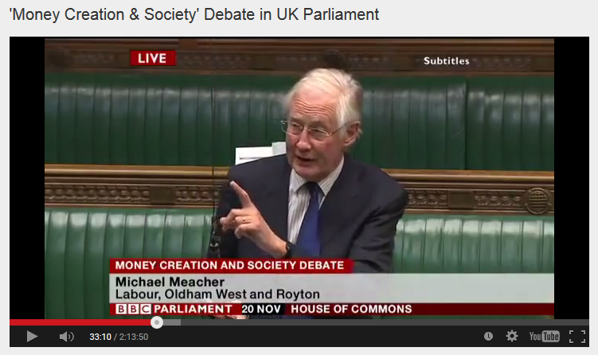

House of Commons, Nov. 20, 2014, Mr. Michael Meacher, MP:
“It is unfortunate… that it is so little understood by the public that money is created every time by the banks when they make loans.”
“And it is the banks – the banks – which determine how money is allocated across the economy.”

Slide 48
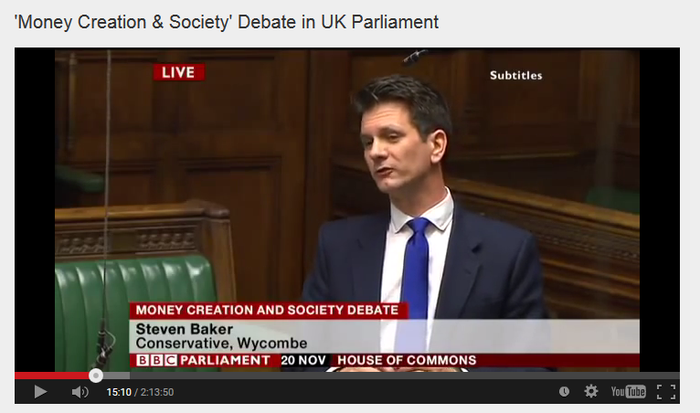
House of Commons, Nov. 20, 2014, Mr. Steven Baker, MP:
“Whenever a bank makes a loan it simultaneously makes a matching deposit in the borrower’s bank account, thereby creating new money.”

Slide 49
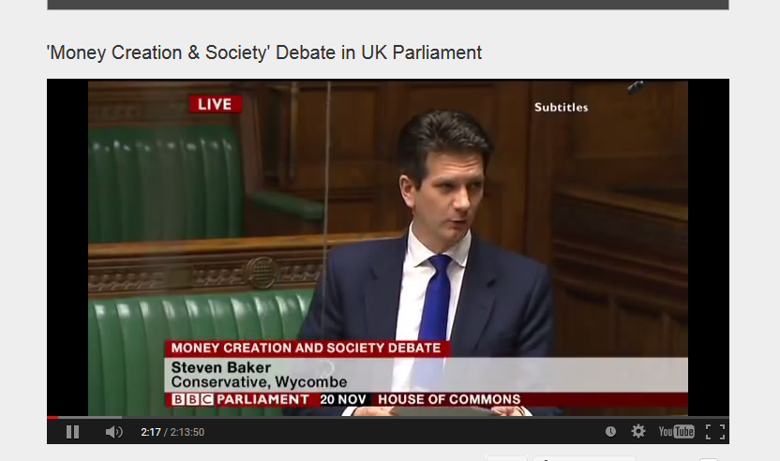
House of Commons, Nov. 20, 2014, Mr. Steven Baker, MP:
“The explanation is actually taken from the Bank of England article ‘Money Creation in the Modern Economy’. It seems to me rather hard to dismiss.”

Slide 50
WHAT ARE THE EFFECTS
OF THE DEBT-MONEY SYSTEM?
ON OUR NATION?

Slide 51
SINCE ALL MONEY IS DEBT….
MONEY IS CONSTANTLY DISAPPEARING, AS DEBT IS PAID OFF
BANKS
1
ECONOMY
LOANS ARE CREATED…
ECONOMY
2
“
m
1
2
m
‘MONEY’
DESTROYED
IN THE BANK
‘MONEY’
CREATED
‘MONEY’
SHRINKS
2
MONEY IS CONSTANTLY REMOVED
FROM CIRCULATION AS PAST LOANS
ARE PAID DOWN.
3
EVERYONE IS COMPETING
FOR THE REMAINING MONEY
4
THE RESULT: CONSUMERS BORROW TO BUY,
BUSINESS BORROWS TO INVEST,
GOVERNMENT BORROWS TO GOVERN

Slide 52



SINCE ALL MONEY IS DEBT….
THEREFORE, MONEY IS PULLED IN TWO DIRECTIONS
REPAY DEBTS
PAY FOR GOODS & SERVICES

Slide 53
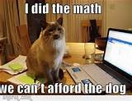
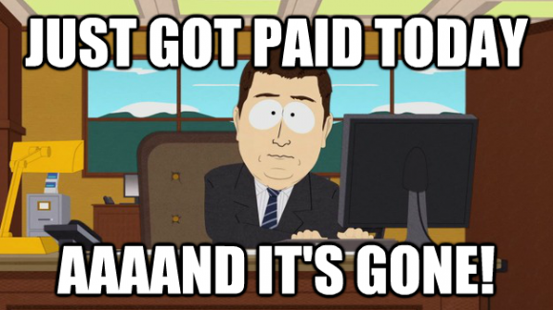
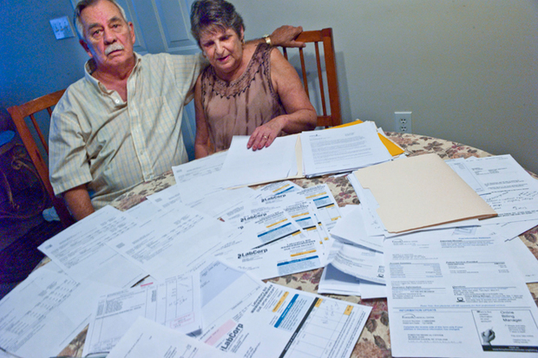
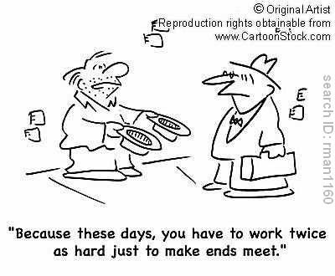
THEREFORE, THIS ‘DOUBLE DEMAND’ ON MONEY
CREATES A CHRONIC LACK OF PURCHASING POWER
CONSUMER: HAS LESS MONEY TO BUY GOODS & SERVICES
DISPOSABLE INCOME

Slide 54
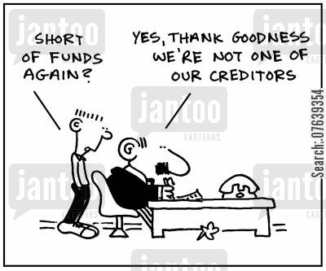
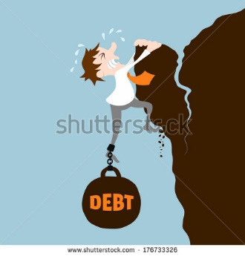
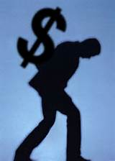
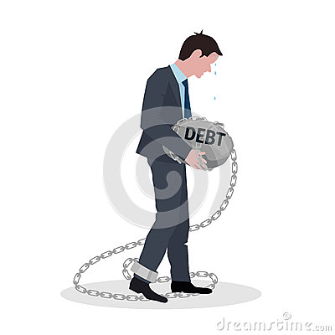
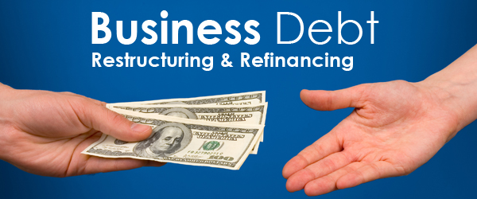
THEREFORE, THE CHRONIC LACK OF PURCHASING POWER
AFFECTS BUSINESSES TRYING TO SELL THEIR GOODS & SERVICES
BUSINESS: ADDS THE COST OF LOANS TO THE PRICE OF GOODS & SERVICES
PRICES

Slide 55
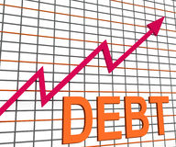
THEREFORE, THE DEBT-MONEY SYSTEM IS A DRIVING FORCE ---
FOR MORE DEBT…..
CONSUMERS:
MUST BORROW-TO-BUY
BUSINESS:
MUST BORROW TO INVEST
GOVERNMENT:
MUST BORROW TO GOVERN

Slide 56
WHAT ARE THE EFFECTS
OF THE DEBT-MONEY SYSTEM…
ON THE INTERNATIONAL ECONOMY?

Slide 57
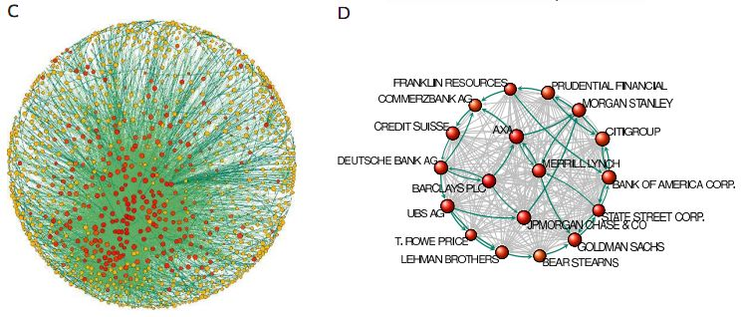
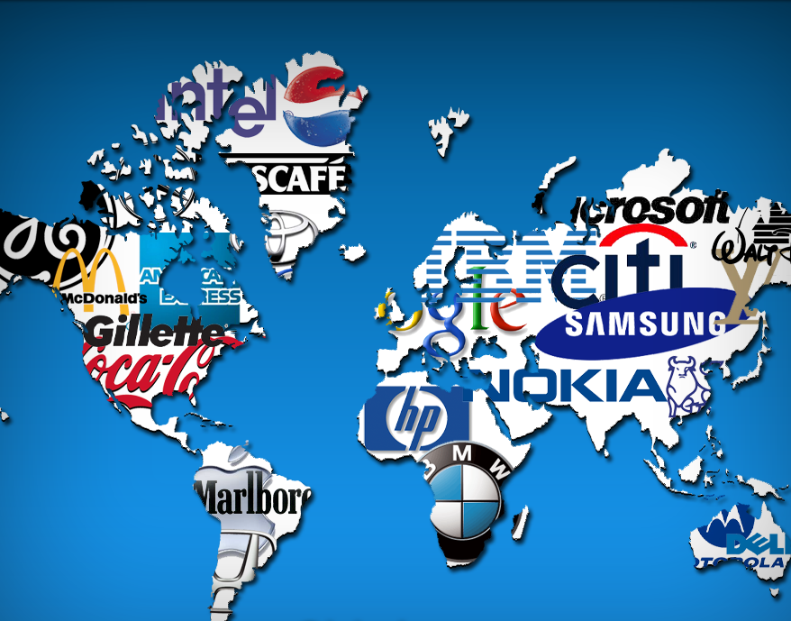
THE DEBT-MONEY SYSTEM
FUELS THE GROWTH OF
MULTI-NATIONAL CORPORATIONS

Slide 58
THE DEBT-MONEY SYSTEM FUELS THE GROWTH
OF MULTI-NATIONAL CORPORATIONS
All nation states, wealthy and third world, are exposed by debt and driven to compete for exports.
If a firm cannot obtain sufficient sales from within its national market, it will seek a foreign market.

Slide 59
THE DEBT-MONEY SYSTEM FUELS THE GROWTH
OF MULTI-NATIONAL CORPORATIONS
In an economy riddled by debt, and with people lacking disposable income, low-price goods win over costlier good-quality products that last longer.
This spells success for mass production and big business.

Slide 60
THE DEBT-MONEY SYSTEM FUELS THE GROWTH
OF MULTI-NATIONAL CORPORATIONS
Multi-nationals are also in debt.
But they generally are able to obtain credit more easily and at lower rates of interest.

Slide 61
THE DEBT-MONEY SYSTEM FUELS THE GROWTH
OF MULTI-NATIONAL CORPORATIONS
Multinationals are the ultimate creations of debt-money: the culmination of the unfair advantage given to big business in a debt economy.
mass production
cost cutting
employment shedding, outsourcing
bulk transport
extensive marketing
constant change
poor product quality and durability

Slide 62
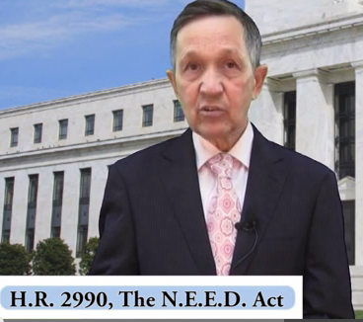
THE SOLUTION: DEBT-FREE MONEY
THE GOVERNMENT BUYS ALL THE SHARES IN THE FEDERAL RESERVE BANKS
THE BANKS CANNOT CREATE DEBT-MONEY. THEY MUST LEND ALREADY EXISTING DEPOSITS.
CONGRESS SPENDS THE DEBT-FREE GOVERNMENT MONEY ON PHYSICAL INFRASTRUCTURE, EDUCATION, HEALTH CARE. IN THE PROCESS, JOBS ARE CREATED.
DENNIS KUCINICH
THE NEED ACT 2011-2012

Slide 63
Free trade vs Rigged trade
Multinational Corporations
Against Third World Countries

Slide 64

Political Economist DAVID RICARDO Supported Free Trade His Four Conditions Make Free Trade Work
WHAT FREE TRADE WAS SUPPOSED TO BE
In 1817 David Ricardo, advancing the theory of comparative advantage, set forth 4 conditions:
Do not move capital over borders from a high wage
to a low wage country.
2. Balance trade between participating countries.
3. Trade only between countries with full
employment.
4. Open competition: no monopolies or oligopolies.

Slide 65
FREE TRADE VS RIGGED TRADE
“It is the elites who are in favour of global free trade.
It is they who will be enriched.”
James Goldsmith
ECONOMISTS BELIEVE IN ‘FREE TRADE’
REGARDLESS OF THE FACTS
According to free trade advocates, both countries will
benefit. BUT THIS IS NOT TRUE!!
WHY?
#1 Capital does cross borders from high wage to low wage country.
#2 Trade between the two countries is unbalanced.
#3 Each country does not have full employment.
#4 Monopolies unbalance trade, gaining advantage

Slide 66



THE DEBT-MONEY SYSTEM DRIVES
RIGGED TRADE WORLD WIDE
1
Debt-money
is loaned to
poor nations
3
World Bank
sells bonds
Banks create
debt-money &
buy bonds
2
DEBT
Private Commercial Banks
in Rich Nations
Third World Nations

Slide 67



THE DEBT-MONEY SYSTEM DRIVES
RIGGED TRADE WORLD WIDE
WHAT DOES
THE IMF LOAN?
SDR = Special Drawing Rights
are an IMF world currency that it
creates when it makes loans to
poor countries – it is ‘debt-money’
DEBT
DEBT IS A
WEAPON

Slide 68




THE DEBT-MONEY SYSTEM DRIVES
RIGGED TRADE WORLD WIDE
To repay their international debts, poor nations must earn dollars.
They compete against other poor countries, all who export similar products, glut the market, and drive down prices
They compete against the wealthy nations, who strive to maximize exports and minimize imports, because they too have massive public and private debts
ALL NATIONS
ARE IN DEBT !!!!

Slide 69

THE DEBT-MONEY SYSTEM DRIVES
RIGGED TRADE WORLD WIDE
Poor nations are not earning enough money to repay their loans, and so the private banks seize the assets – land, minerals, buildings, and food – of the poor nations.
“YUM, YUM”
says the
international
banker

Slide 70

Today’s Situation None of the necessary conditions for free trade, to produce mutual benefits, apply anywhere in today’s world
Instead, all nations try to pursue an imbalance of trade, where they profit the most.
Multinational corps. rig trade to their profit at the expense of third world nations, while calling it “free” trade.
This Free Trade sham has been accepted and promoted by powerful financial and legal world agencies: World Bank, IMF, GATT, WTO, OECD, the UN and governments of the strongest nations.

Slide 71

Vision Statement
We must organize a system that functions efficiently for the mutual benefit of all parties involved.

Slide 72

Objective
Remove the pressure of ubiquitous debt distorting all our activities.
A small girl, sold into slavery to pay debts, labors under the hot sun forming bricks in South Asia.

Slide 73

Strategies for a fairer ‘free’ trade….
Find a solution to our debt based financial system.
Find a solution to aggressive exporting from our own developed economy.
End illegitimate debts of developing nations.
Give each nation power to set priorities for and monitor its economy, using Ricardo’s conditions.
Set a code of conduct for multinationals to counterbalance their aggressive actions

Slide 74

RECOMMENDATIONS
Reform the U.S. monetary system by passing the NEED Act in
Congress
Open up the TPP for public scrutiny and discourse
Have a public referendum on the TPP at the national level
Have a debt jubilee for the developing nations
Refuse international trade agreements that contain ISDS
tribunals
Modify the legal relationship between the corporation and its
charter issuer to ensure
the corporation does no
injury to society – and this
includes international
organizations too like the
World Bank, IMF, WTO,
etc.

Slide 75

THE END

