Slide 1

Private Prisons as Profit Factories
Left Forum 2016 Panel Presentation
Responsible Endowments Coalition

Slide 2





















National Private Prison Divestment Campaign
Notes:
Nina - what is the prison divestment campaign? (10 mins)
The National Private Prison Divestment Campaign is an effort by more than 150 advocacy groups, community organizations, student groups and unions in the U.S. calling on institutions to divest their stock in the private prison industry. Campaign bridges movements to address how PIC has worked to decimate and profit off Black, brown, immigrant, low-income communities.
These organizations are part of the steering committee and the national campaign efforts are convened by Enlace International. Give a shout out to Columbia Prison Divest for being the first university campaign to win in the country.
The campaign started in 2011 because CCA lobbied for SB1070 to criminalize immigrants. Organizers at Enlace recognized that private prison companies were writing the laws and bankrolling the politicians who have been filling their facilities with poor people of color and recent immigrants.

Slide 3

What is the Prison Divestment Campaign & Coalition?
We aim to stop the lobbying power of the private prison industry so that humane and common sense reforms are possible in criminal and immigration policy.The National Private Prison Divestment Campaign targets the investors of Corrections Corporation of America (CCA) and GEO Group (GEO), the two largest private prison companies in the United States. Profiting from the separations of families, violations of human rights, and general pain caused by these prisons is inhumane and unacceptable.
Notes:
(CONT’D) Nina - what is the prison divestment campaign? (10 mins)
Someone read the slide. This is the mission of the Private Prison Divestment campaign.
The objective of the campaign is to Break the lobbying power of the private prison industry at all levels of government to make it possible to halt unjust incarcerations of immigrants and people of color. The campaign is a multi-racial alliance of criminal justice and immigrant rights groups working nationally and locally to cut the corporate and political ties that allow incarceration and detention to continue.
Mass incarceration is an enormous machine with many moving parts that impact one another.
In order for us to realize the goal of ending mass incarceration, a variety of concurrent, complementary, and diverse strategies will have to be employed. Our organizations’ strategies focus on prison profiteers because we recognize the powerful role that these companies play in the mass incarceration machinery. If we closed every private prison in the U.S. tomorrow, we will not have solved the problem of mass incarceration. However, when the industry that has played such a forceful role in expansionist prison policy-making is starved to death, then we will have made great strides in thwarting the growth of the entire Prison Industrial Complex. Putting prison profiteers out of business is a means to a greater end, not an end in and of itself.

Slide 4
Million Shares Club
x Jennison Associates, LLC
x Lazard Asset Management LLC
x London Co. Of Virginia
x Managed Account Advisors LLC
x New South Capital Management INC
x Northern Trust Corp
x Nuance Investments, LLC
x Principal Financial Group Inc
x Prudential Financial Inc
x Raymond James & Associates
x Reinhart Partners, Inc.
x River Road Asset Management, LLC
x State Street Corp
x Vanguard Group INC
x Waddell & Reed Financial Inc
x Wells Fargo & Company​
x American Century Companies Inc.
x Ameriprise Financial Inc.
x Anchor Capital Advisors LLC
x Bank of America
x Bank Of New York Mellon Corp.
x Blackrock Fund Advisors
x Cramer Rosenthal McGlynn LLC
x Diamond Hill Capital Management
x Eagle Asset Management Inc.
x Epoch Investment Partners, Inc.
x First Trust Advisors LP
x FMR LLC
x Geode Capital Management, LLC
x Hodges Capital Management, LLC
x Hotchkis & Wiley Capital Management LLC
x Invesco LTD.
Notes:
(32) Without the financial support of major investors like Vanguard and Wells Fargo, CCA and GEO alone would not be strong enough to successfully lobby for policies that increase government demand for private prisons. With these powerful allies, however, they have been able to sway public policy in favor of more severe “tough on crime” laws and the increasing criminalization of immigrants.
I researched the million share club list and there are 5 commercial banks on the list who are members of the Federal Reserve System:
Northern Trust Corp.
State Street Corp.
Wells Fargo & Co.
Bank of America
Bank of New York Mellon Corp.
Can you highlight them in color in your powerpoint presentation to indicate they are different from the other financial firms. Only the commercial banks have the legal power to create what we all use as money when they make a 'loan', by creating an accounting entry for the loan principal in the borrower's account.

Slide 5

Legislation - How it works
Immigrants for Sale
Notes:
Natalie:
CCA (83’)
Nashville, TN
70 Facilities/80,000 beds
Profit: $1.79 Billion (‘15)
Political Contribution: $3.87 Million (9 years)
Lobbying: $17.4 Million (11 years)
GEO (84’)
Boca Raton, FL
104 facilities/87,000 beds
Profit: $1.69 Billion (13’)
Political Contribution: $8 Million (9 years)
Lobbying: $4.16 Million (11 years)
Approximately 250 facilities in contract with ICE
Over 60% of these facilities are privatized
34,000 people detained at all times (contractual agreement between Government and ICE)
Explain: Bed Quota’s
Ex. Ohio has 20 year deal with Lake Erie Correctional Institution with 90% bed quota
Mass-incarceration of POC lead to disproportionate representation in facilities
Mass-incarceration also leads to mass-profits (ex. facility in Texas garnered over 73$ mill of profit alone - residential home really a detention center)
Nina & Natalie
Approximately 250 facilities in contract with ICE
Over 60% of these facilities are privatized
34,000 people detained at all times (contractual agreement between Government and ICE)

Slide 6
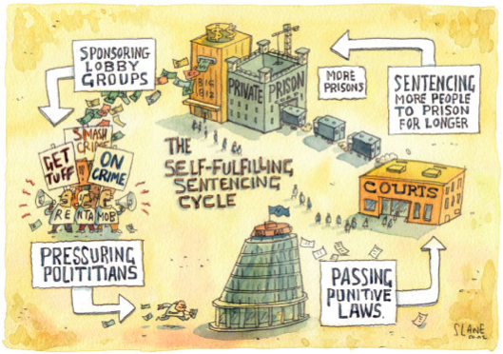
Notes:
How Private Prisons Make Their Money – (3 mins)
Spend millions of dollars every year lobbying the government for policies that people into jail
Depend on institutional investors to lobby the government to pass laws that criminalize communities
Most of these institutional investors are big financial institutions like the big banks
Some cases, biggest investors deploy lobbyists. For ex, CCA and JPMorgan&Chase shared the same lobbying firm McBee Strategic Consulting
PERKS: Federal contracts, req 90% of beds full, REIT, Geo & CCA together control 73% of the private prisons

Slide 7
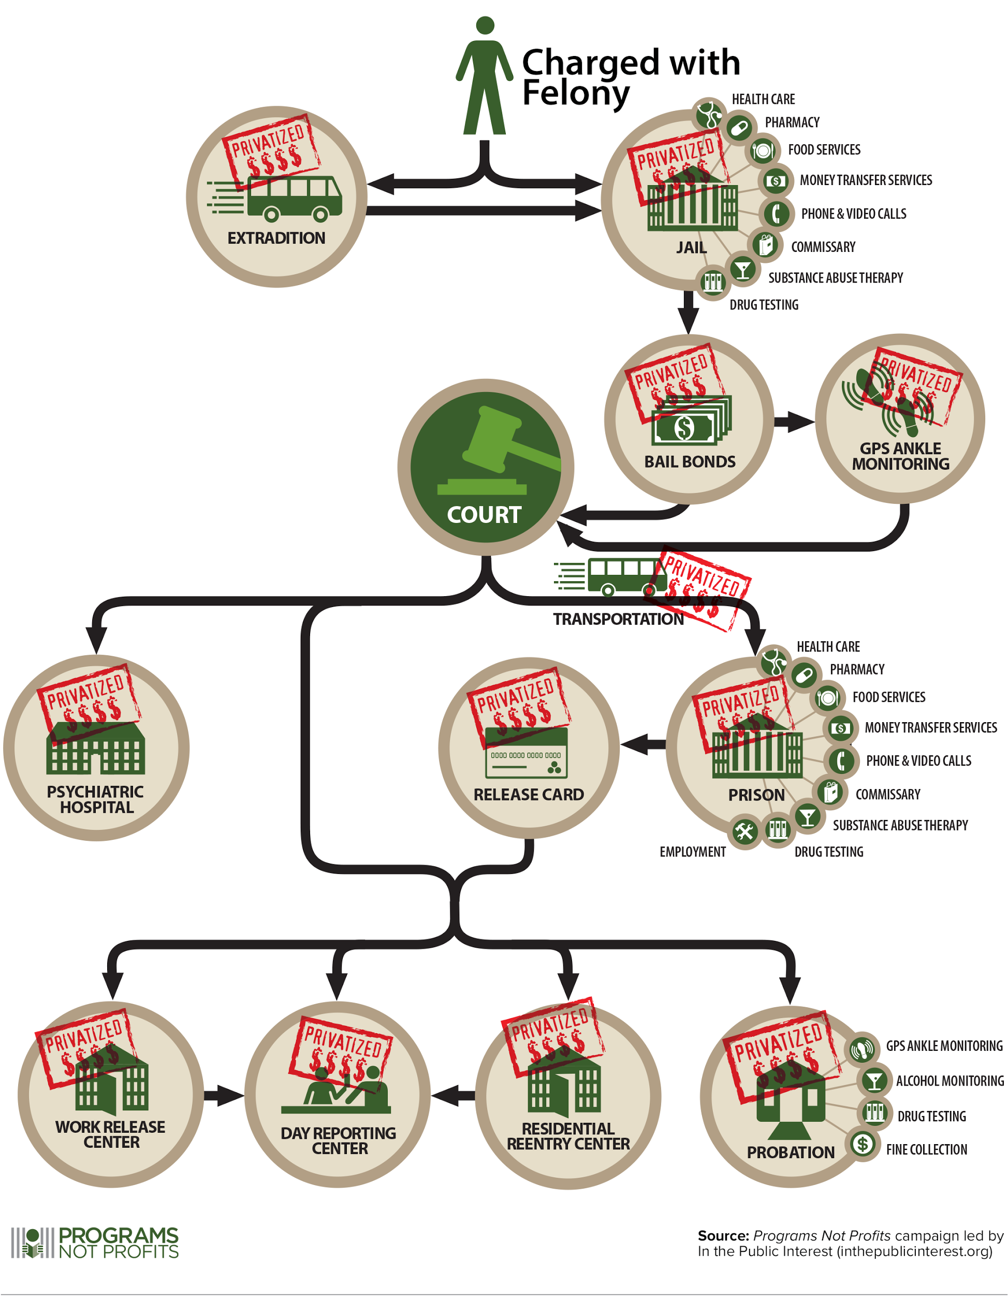
Notes:
Natalie

Slide 8
Notes:
Natalie

Slide 9
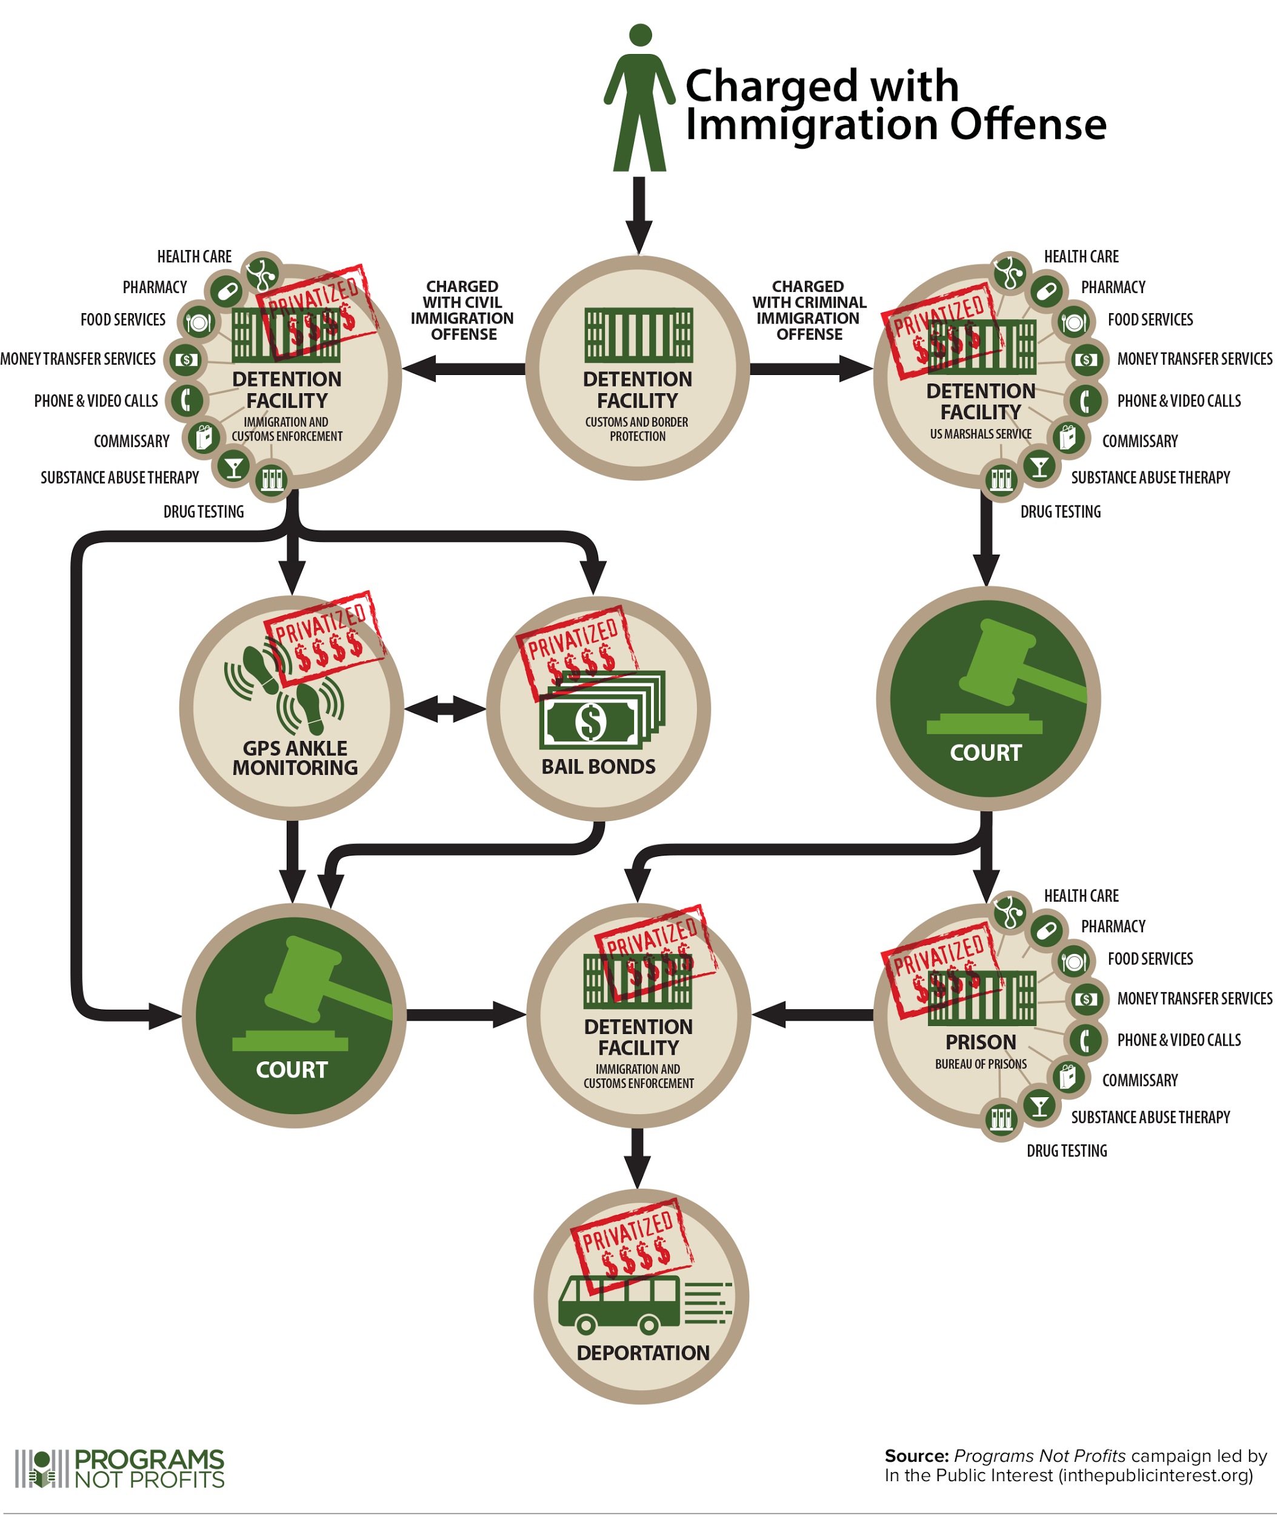
Notes:
Natalie

Slide 10
Notes:
Natalie
Q: What are some things that people notice about these two processes??
Focus on the fact that there is a lot of privatization
Prisons have privatized a lot of the process (healthcare, food, communications, security and surveillance, halfway houses and rehabilitation programs etc.)
Also: these processes are essentially the same, even if we are taught to think of them as differently

Slide 11
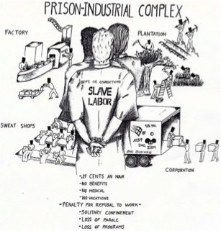
Prison Industrial Complex (PIC) is a term we use to describe the overlapping interests of government and industry that use surveillance, policing, and imprisonment as solutions to economic, social, and political problems (from Critical Resistance, www.criticalresistance.org)
Notes:
Nina:
Explain that when we think of detention and deportation of immigrants we need to be thinking larger. Mass incarceration of both immigrants and American citizens, especially Black Americans is an extension and expansion of slavery - a system that created a pool of cheap labor to ensure and maximize profit for the ruling class. Today, that ruling class is made up of politicians and corporations.
Mention the 13th Amendment here: "Neither slavery nor involuntary servitude, except as a punishment for crime whereof the party shall have been duly convicted, shall exist within the United States, or any place subject to their jurisdiction."
Labor:
23 cents to 1 dollar in prisons
At least 60,000 immigrants worked in federal detention centers — more than any other single employer in the country, according to United States Immigration and Customs Enforcement (ICE)
The cheap labor, 13 cents an hour, saves the government and the private companies $40 million or more a year by allowing them to avoid paying outside contractors the $7.25 federal minimum wage.
Some immigrants held at county jails work for free, or are paid with sodas or candy bars, while also providing services like meal preparation for other government institutions.
On any given day, about 5,500 detainees out of the 30,000-plus average daily population work for $1, in 55 of the roughly 250 detention facilities used by ICE.

Slide 12
Privatization
1817 - First Model Prison built in US (NY)
1890s - First Detention Center built in US (NY)
1951 - Boggs Act first created - first mandatory minimum law for marijuana
1954 - Four former FBI agents found Wacknut Corporation's -- renamed GEO
1973 - NY passes Rockefeller Drug Laws, first statewide “tough on crime law”
1983 - First Private Prison company founded (CCA)
  GEO Group founded in 84’
1980s - Shift in Immigration Policy
  Privatization begins -> INS signs with CCA in 83’
1986 - Reagan signs Anti-Drug Abuse Act - funding new prisons and creating nationwide mandatory minimums
1990s - Shift in immigration policy - detention centers become primary form of enforcement
1996 - Illegal Immigration Reform and Immigrant Responsibility Act expand criminalization & mandatory detention of undocumented migrants
2005 - Operation Streamline moves prosecution of undocumented immigrants to federal criminal justice system
2010 - SB 1070
2013 - GEO and CCA apply for REIT tax status
2015 - House Appropriation committee proposes $2.9 billion for ICE detentions
Notes:
Natalie
1951: Boggs Act is first mandatory minimum for marijuana
1954: Wacknut Corporation a private investigation firm specializing in surveilling “radicals” including SNCC, MLK & Angela Davis
1973: Rockefeller Drug laws - statute dealing with sale and possession of narcotic drugs in NY
1980s: INS - Immigration and Naturalization Services - DHS in 2003
1986: The number of people behind bars for nonviolent drug law offenses increased from 50,000 in 1980 to nearly 500,000 by 2000
2010 - SB 1070 inspired several copycat bills throughout the south

Slide 13
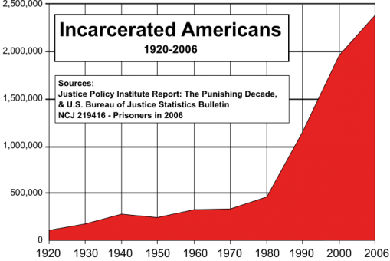
Notes:
Natalie

Slide 14
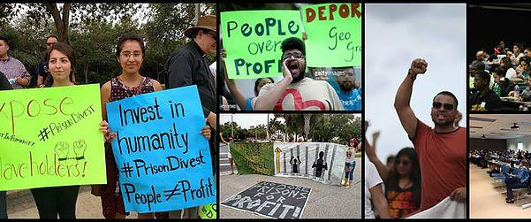
GET INVOLVED!
National Prison Divestment Coalition
National Prison Divestment Youth Retreat
  August 12th - 14th
  3-day retreat to learn more about PIC and Prison Divestment from youth activists around the USA
STAY IN TOUCH! www.endowmentethics.org
Nina Macapinlac
nina@endwomentethics.org
Notes:
Get involved!
Darrell: Assata Quote

