Slide 1
NYC SCHOOLS AND NYC DEBT
Phyllis Kreuttner
New York Society for Ethical Culture
Fed Group of Upper West Side

Slide 2


THE MONEY POWER:
THE LEGAL POWER OF (ONLY) COMMERCIAL BANKS TO CREATE AND ISSUE MONEY
TO CREATE – to bring into existence
TO ISSUE – to add to the money supply

Slide 3
THE MONEY POWER:
THE LEGAL POWER OF (ONLY) COMMERCIAL BANKS TO CREATE AND ISSUE MONEY
FEDERAL GOVERNMENT – only has the legal power to create and issue coins.
STATE GOVERNMENT – no legal power to create and issue
money.
CITY GOVERNMENT – no legal power to create and issue
money.

Slide 4
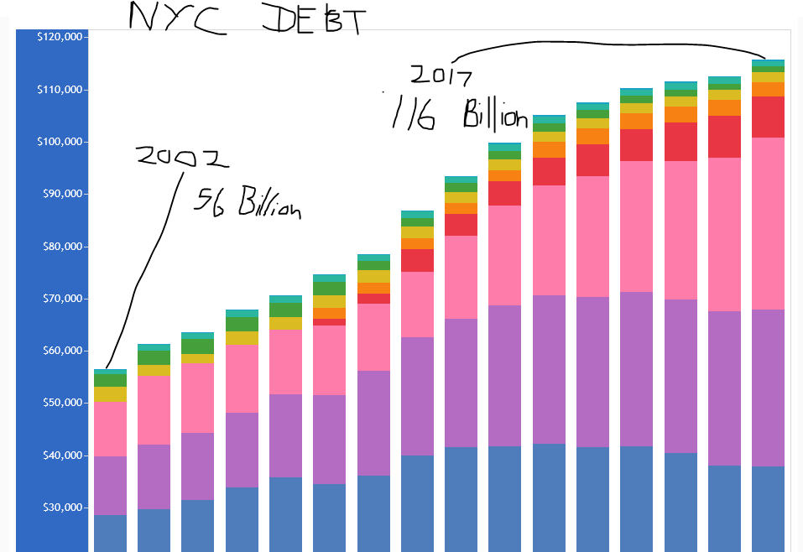

Slide 5
FUNDING HUDSON YARDS
WHO BUYS THE CITY’S DEBT?
(Funds the City’s debt?)
UNDERWRITERS (banks, brokers)
WHO ARE THESE BANKS AND BROKERS?
Underwriters (banks and brokers) make profits from the difference
between the ‘buy’ and ‘sell’ price (THE SPREAD),
plus FEES.

Slide 6
BANKS BUYING CITY DEBT – WITH THEIR MONEY POWER
FEDERAL RESERVE MEMBER BANKS & UNDERWRITERS
of New York City General Obligation Bonds
(all banks are members of the NY Federal Reserve Bank, unless noted otherwise)
Senior Managers
Morgan Stanley
Bank of America (Richmond FED)
Merrill Lynch
J.P. Morgan Securities
Citigroup Global Markets Inc
Senior Co-Managers
Barclays Capital
Goldman, Sachs & Co.
PNC Capital Markets LLC (Cleveland FED)
RBC Capital Markets, LLC
(Royal Bank of Canada; not FED member)
Wells Fargo Securities, LLC (San Francisco FED)
When these banks buy the NYC bonds, they use money
they create and issue.
Co-Managers
TD Securities (USA), LLC
Selling Group
BNY Mellon Capital Markets, LLC
Deutsche Bank Securities Inc.
HSBC Securities (USA) Inc.
U.S. Bancorp (Minneapolis Fed)

Slide 7
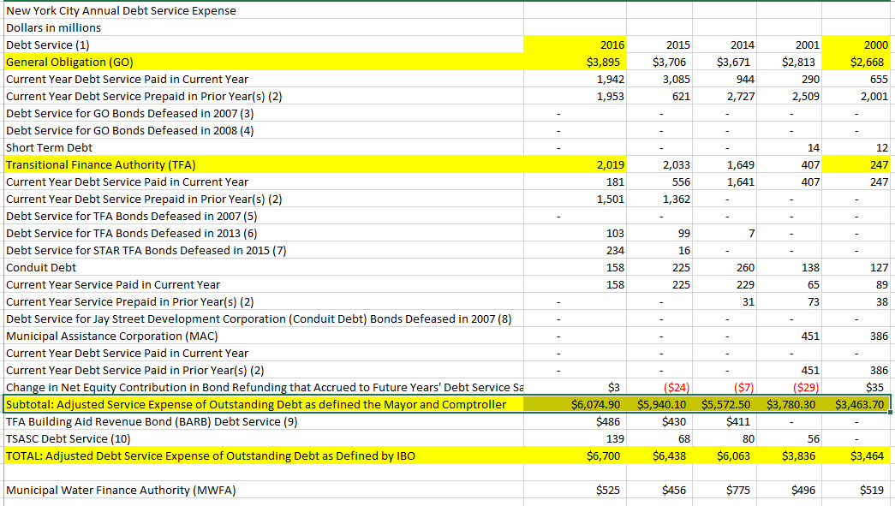

Slide 8
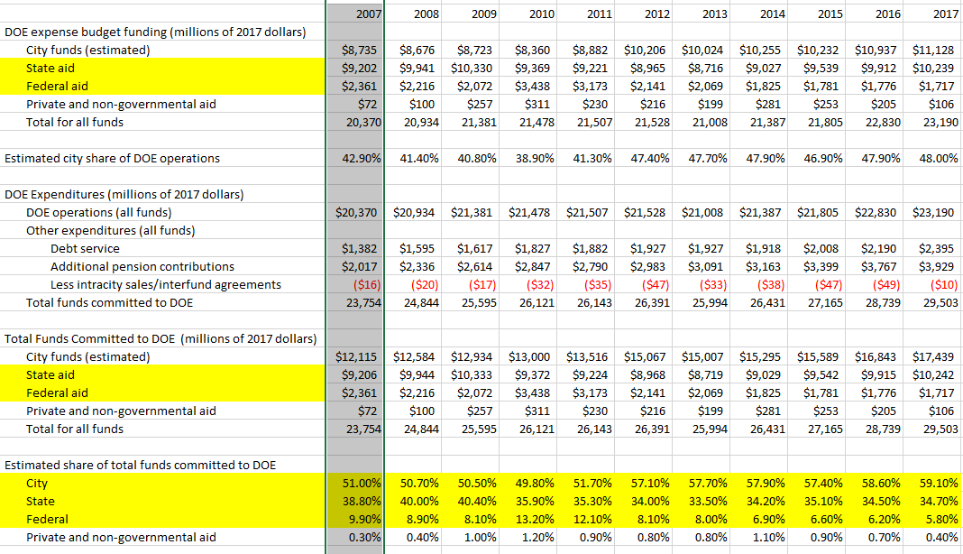

Slide 9
PART 4
THE FEDERAL NEED ACT:
ALTERNATIVE
INTEREST-FREE
FINANCING

Slide 10
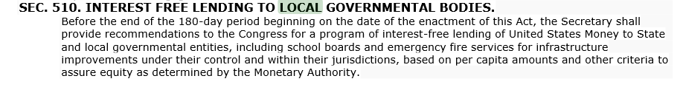
FUNDING HUDSON YARDS
NEED ACT
INTEREST FREE LENDING

Slide 11

FUNDING HUDSON YARDS
NEED ACT
PRIVATE BANKS CANNOT CREATE MONEY –
Banks can only use investor’s money or bank fees
to loan to borrowers
With a simple accounting change, the private commercial banks
will no longer be able to CREATE and ISSUE money.
They will have to loan already existing money.

Slide 12
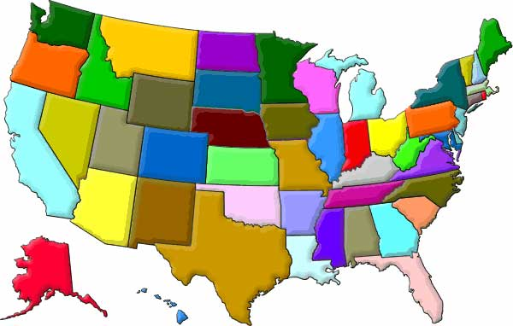
NEED ACT
25% OF NEW FEDERAL MONEY WILL BE
GIVEN TO STATE GOVERNMENTS AS GRANTS
TO BE USED AS THE STATE SEES FIT

