Slide 1

OUR NEW MONETARY AUTHORITY
MONETARY AUTHORITY
Or … how much new money
does our economy need this year?

Slide 2



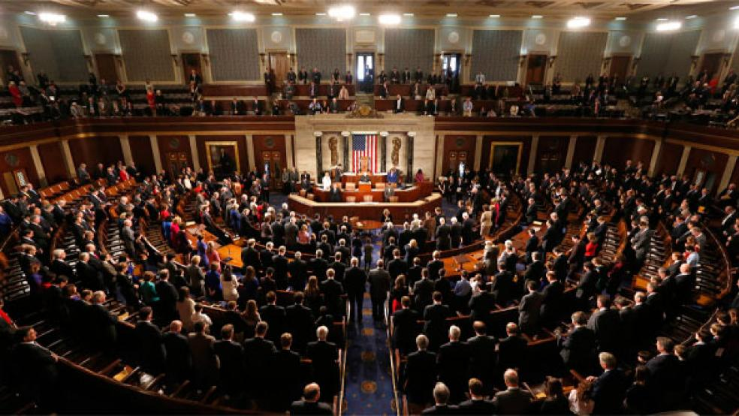

The new MONETARY AUTHORITY in the Treasury will:
Establish how much new money is needed each year.
Congress decides how much money will be spent and for what.
The Treasury Secretary pays out the money authorized by Congress. If there is no money left, the Secretary will issue money, BUT ONLY UP TO THE LIMITATION SET BY THE MONETARY AUTHORITY.
MONETARY AUTHORITY
U.S. CONGRESS
TREASURY

Slide 3
MONETARY AUTHORITY
How can we trust the people appointed to the Monetary Authority
(by the President with consent of Senate)?

Slide 4

MONETARY AUTHORITY
The NEED ACT says:
The Secretary of the Treasury may not delay, prevent, or intervene in:
The Monetary Authority.
The Authority’s decision of the amounts of money to be created.
The Authority’s decision of the most efficient method of disbursement consistent with the appropriations of Congress.

Slide 5


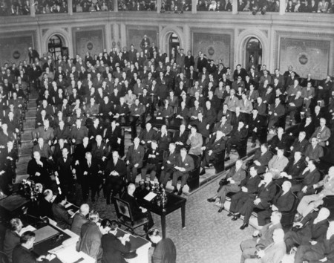
MONETARY AUTHORITY
How will the citizens know what is going on?
There will be public reports every quarter of the year.
Whenever the target set by the Monetary Authority differs by 0.5% from the actual money supply, the Secretary of the Treasury will report this to Congress every quarter of the year.
0.5% means a difference of $5,000 for every million dollars
in the money supply.

Slide 6
But the most important change in our money system is .....

Slide 7


The NEED ACT removes the most powerful privilege of all – the privilege of banks to manufacture money by issuing loans!
….

Slide 8
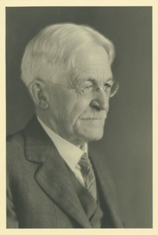
Here is a respected American.....
DAVIS RICH DEWEY, AMERICAN ECONOMIST AND STATISTICIAN
(1858 – 1942)
“The underlying idea in the greenback philosophy…is that the issue of currency is a function of government, a sovereign right which ought not to be delegated to corporations.”

Slide 9
The Monetary Authority will be protecting our common welfare!
MONETARY AUTHORITY

